Slide 1

Time-Series Forecasting
LSTM MODEL

Slide 2

Long Short-Term Memory
Type of Recurrent Neural Network (RNN)
Uses sequential data or time series data
Predict the next value in sequence or classify it
Retain information for a longer period of time

Slide 3
Datasets
Dataset from previous assignment
J17 Well
Comal Spring
San Marcos
Imputed Data after Kalman Filtering

Slide 4
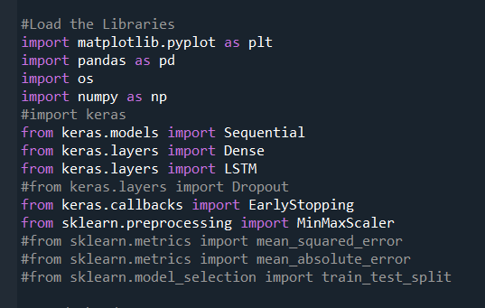
Loading the required Libraries

Slide 5
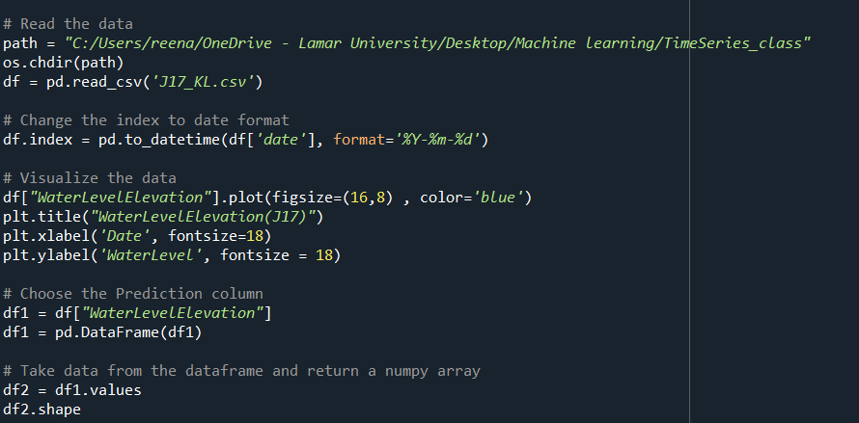
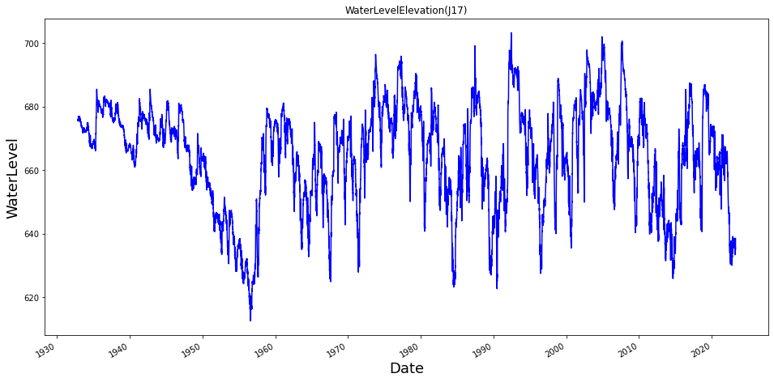
Reading the dataset

Slide 6
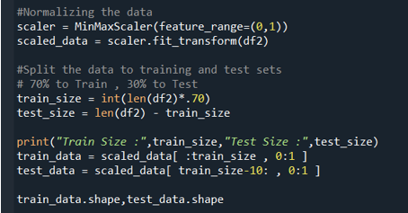

Normalize and Slipt the dataset
MinMaxScaler transfer each feature to given range
Avoid large difference in Magnitude
Improves accuracy of the model
70% data to training set and 30% to test set

Slide 7
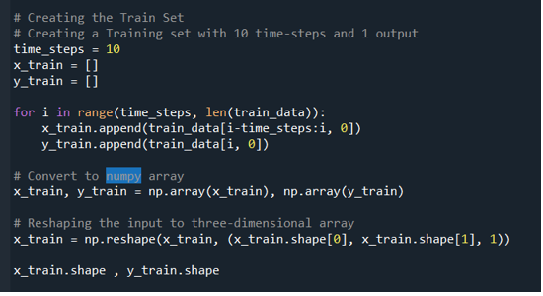

Training the model
Past time steps data points as input and next data as output
Use past 10-time steps to predict the next value

Slide 8
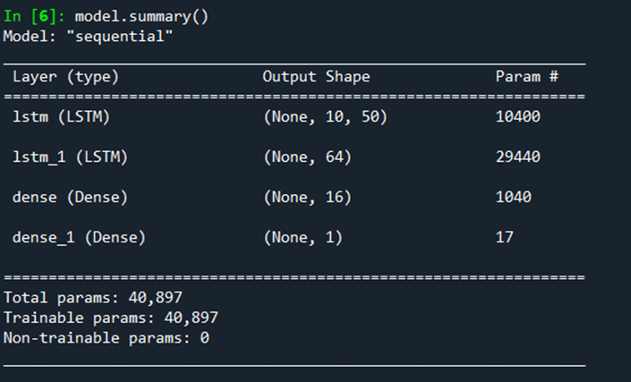
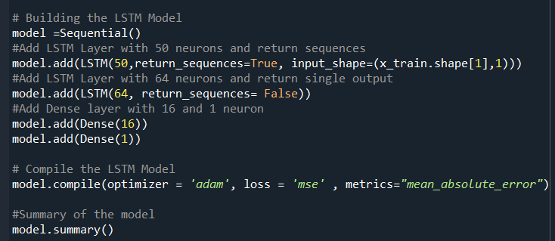
Model Architecture
Two LSTM and two Dense layer used
Adam used as optimizer
Summary gives overview of architecture of the model

Slide 9
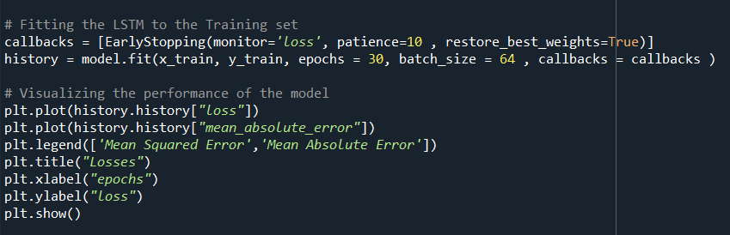
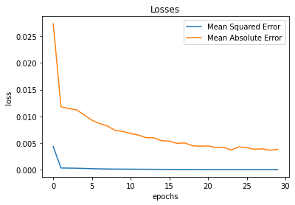
Fitting the model and visualizing
EarlyStopping is callback used to stop training once the model performance stops improving
Epoch specifies no. of times the dataset will pass through the model
Batch size specifies the no. of samples to be processed each batch

Slide 10
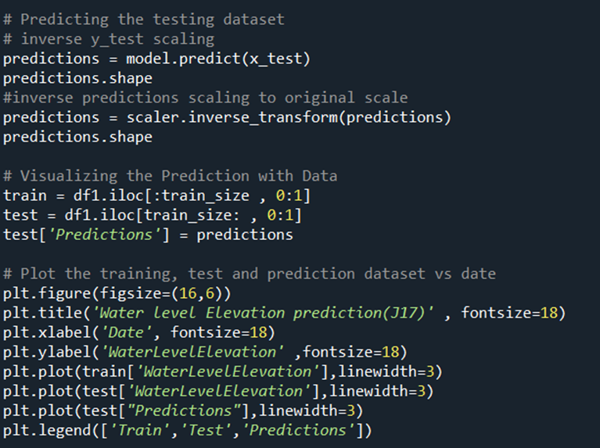
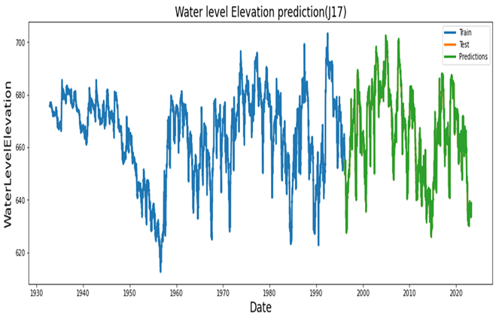
Prediction and Visualization
Make prediction on test dataset
Scaler.inverse_transform converts scaled prediction to original scale

Slide 11
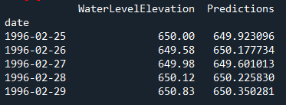
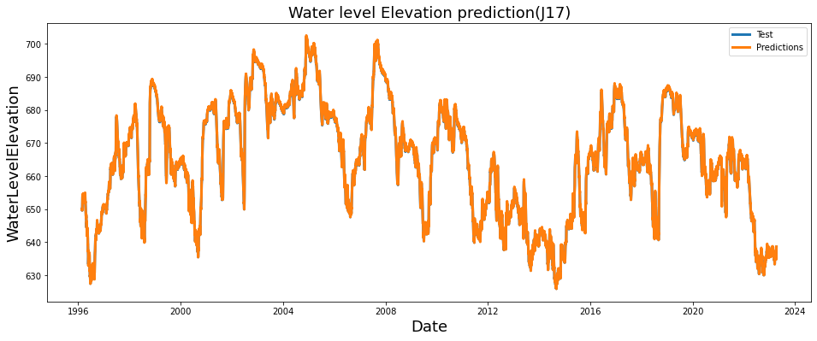
Comparing Test and Prediction dataset

Slide 12
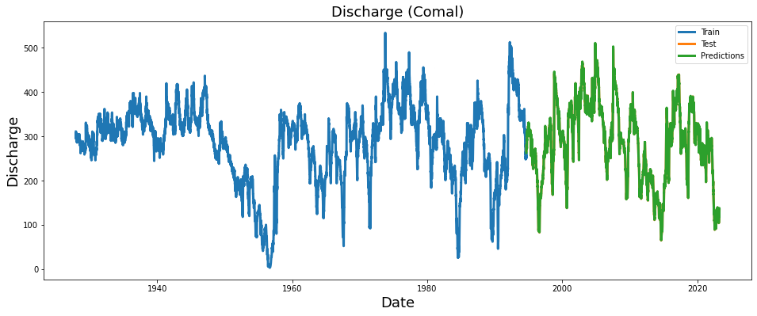
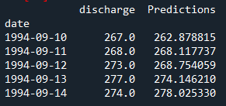
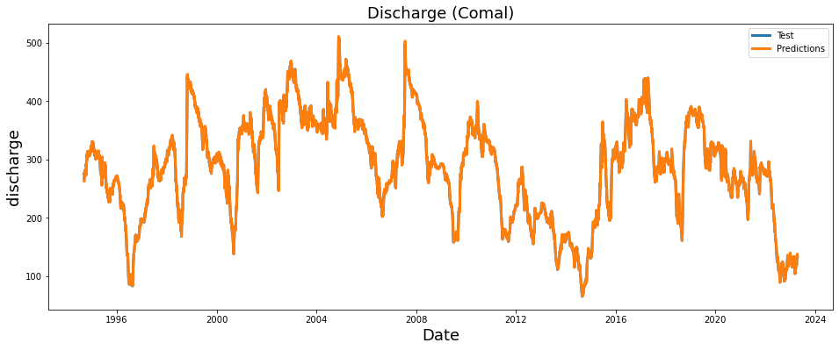
Comal Spring

Slide 13
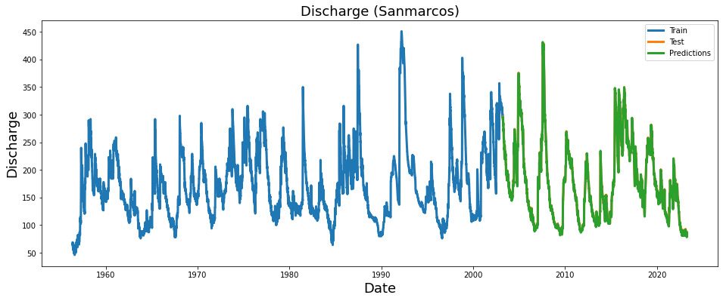
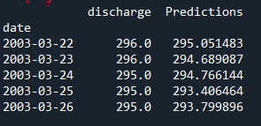
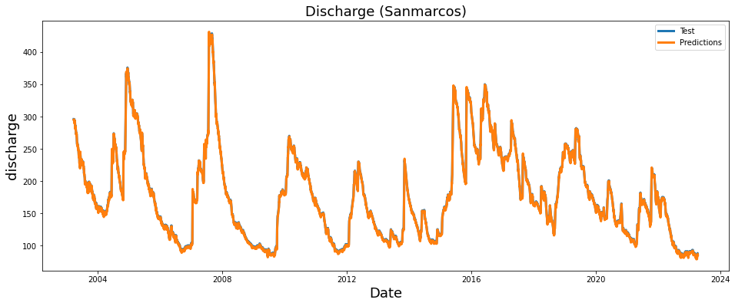
San marcos

Slide 14

Summary
Normalize the dataset
Split the dataset
Train the model
Building the model
Fitting the model
Predicting on the dataset
Visualization of the model

Slide 15
References
https://www.youtube.com/watch?v=c0k-YLQGKjY
https://www.kaggle.com/code/abduulrahmankhalid/tesla-stock-price-prediction-with-lstm

