Slide 1
Cosmos db backups
with the help of azure data factory

Slide 2

ABOUT ME
Vasyl Magometa
About 8 years of experience in software development
Have experience with full software development life cycle, including coding standards, code reviews, build processes, testing and operations
Co-founder at NovaXSoft
https://www.linkedin.com/in/vasyl-magometa-032bab45/

Slide 3
Agenda
Project architecture
CI/cd process
ARM templates
Cosmos DB
Azure Data factory
Backup solution
Q & a

Slide 4

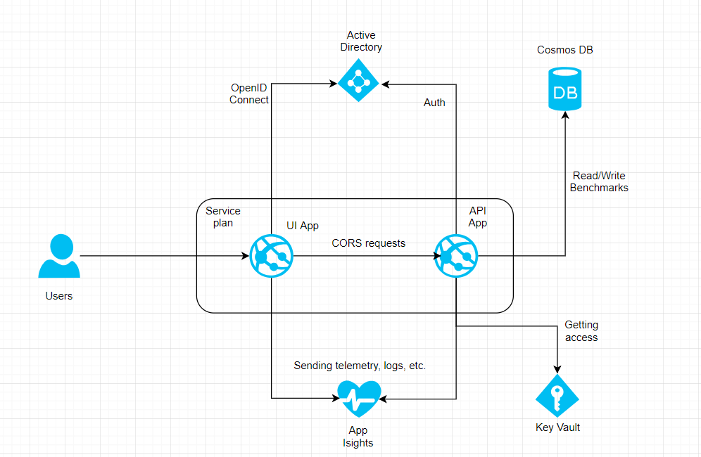
Project architecture

Slide 5
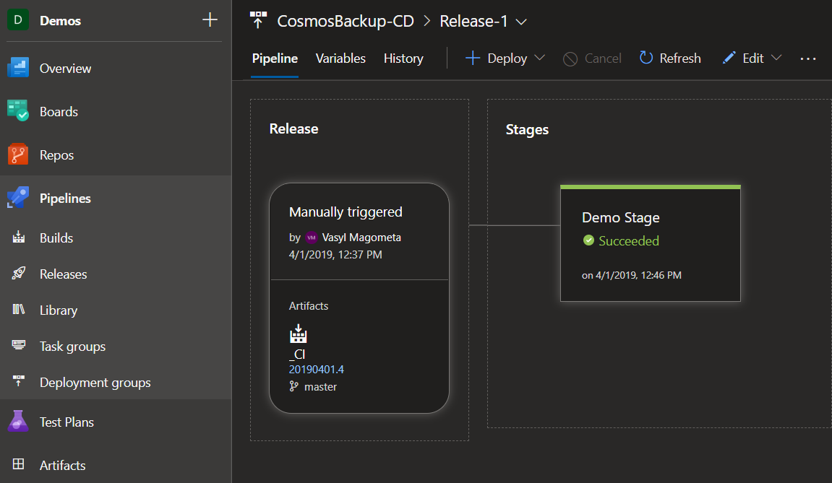
CI/cd process
Build pipeline to produce Artifacts
Release pipeline for continuous deployment

Slide 6
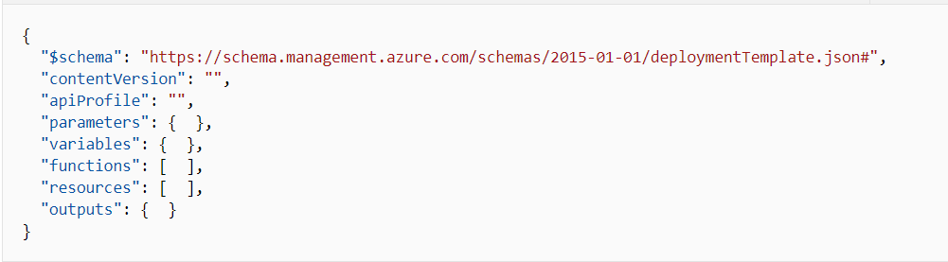
ARM template

Slide 7
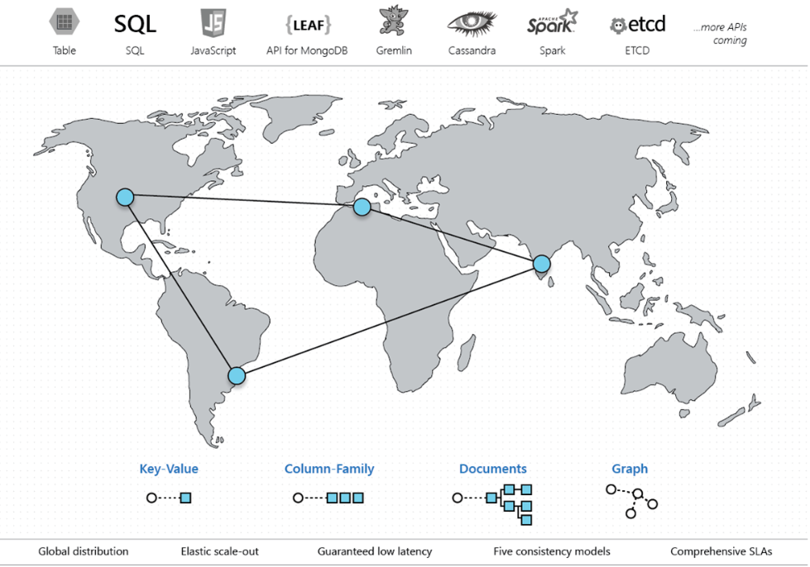
Azure cosmos database

Slide 8
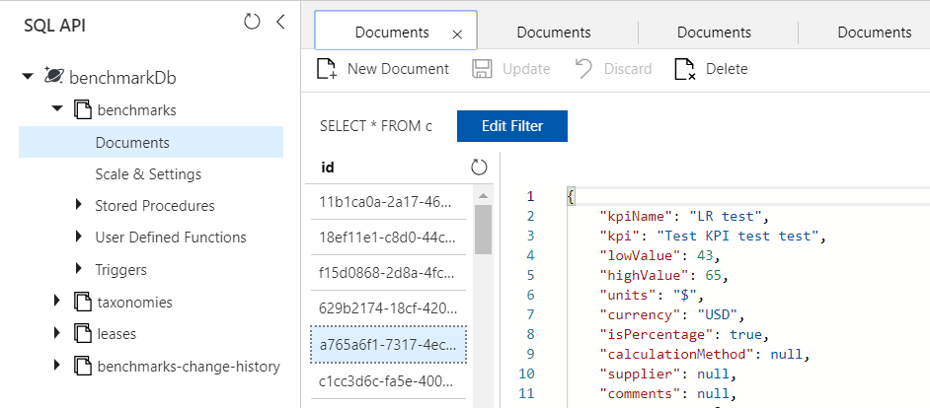
Documents

Slide 9
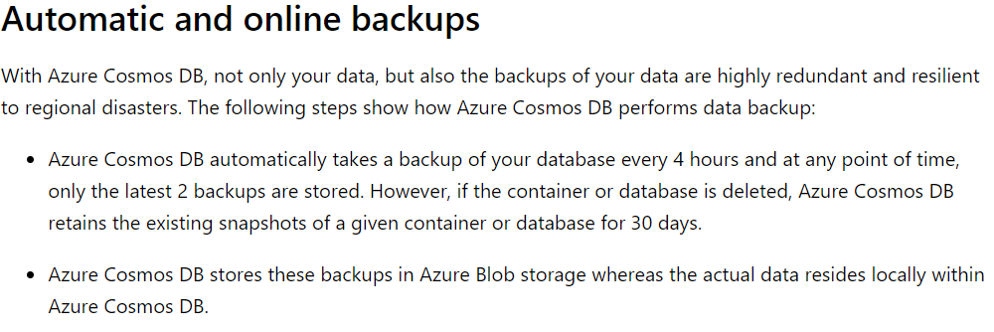
Cosmos DB automatic backups

Slide 10
alternative Options for backup
Cosmos db change feed
Azure data factory

Slide 11
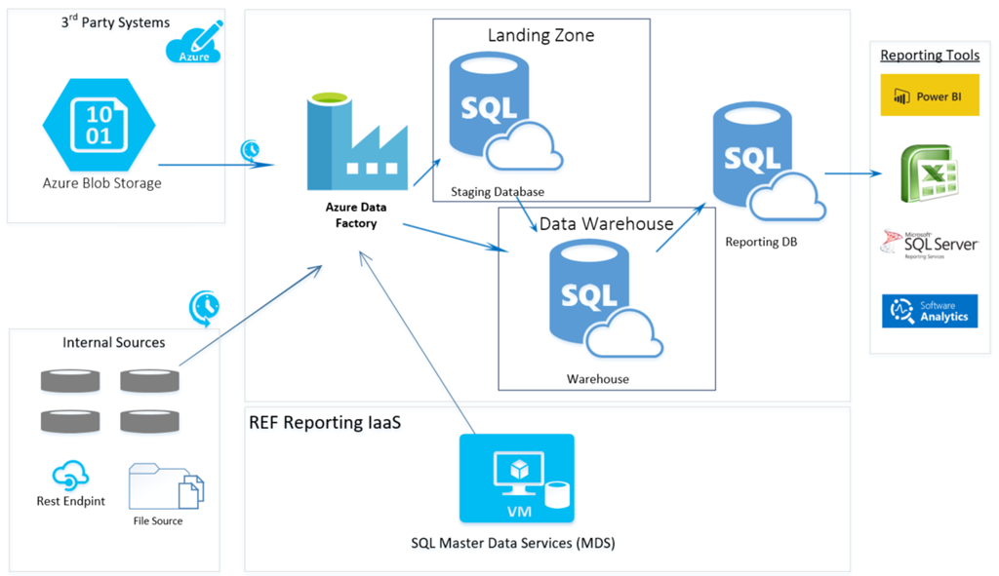
Azure data factory

Slide 12
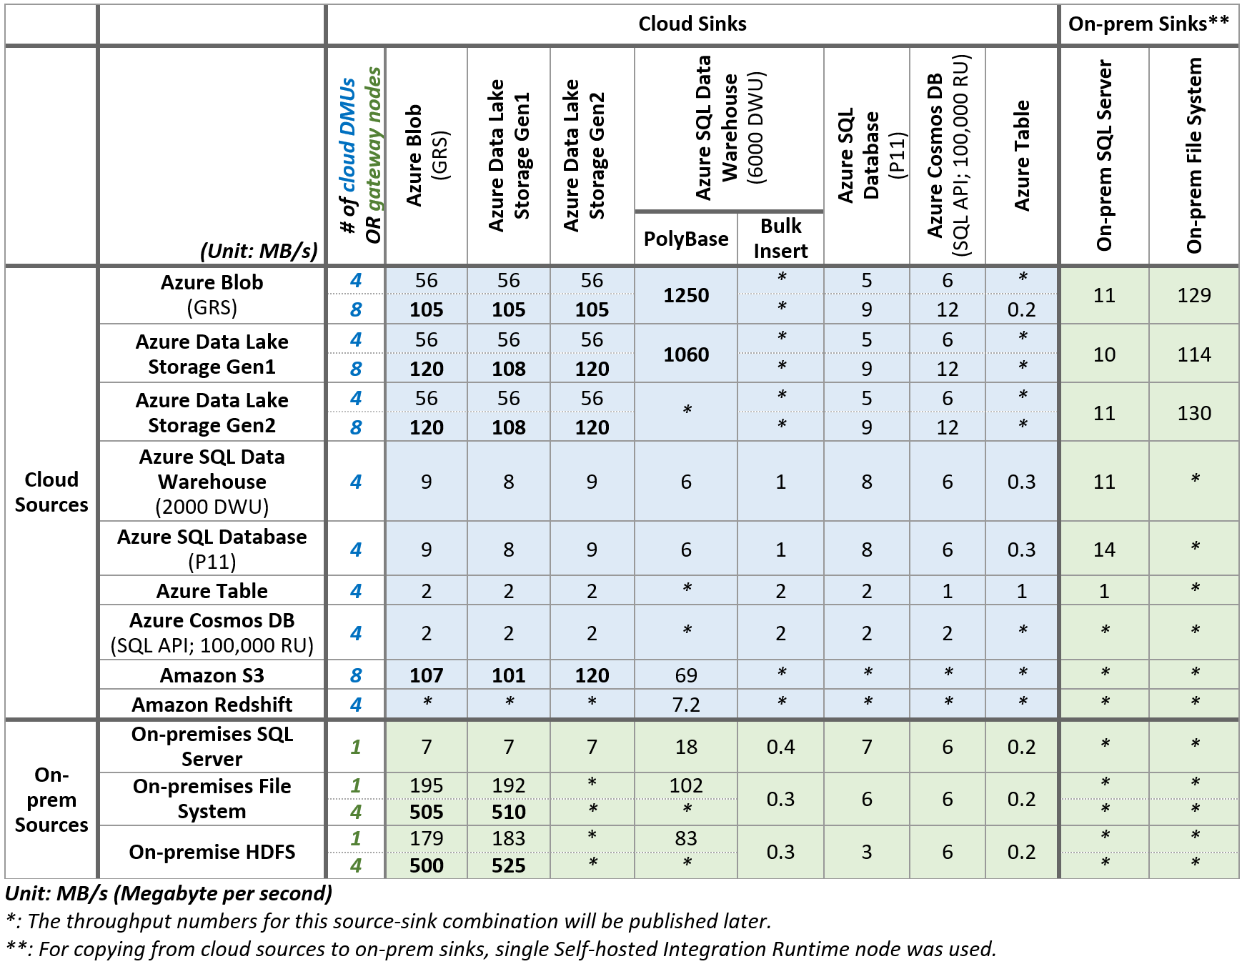
Performance Benchmarks

Slide 13
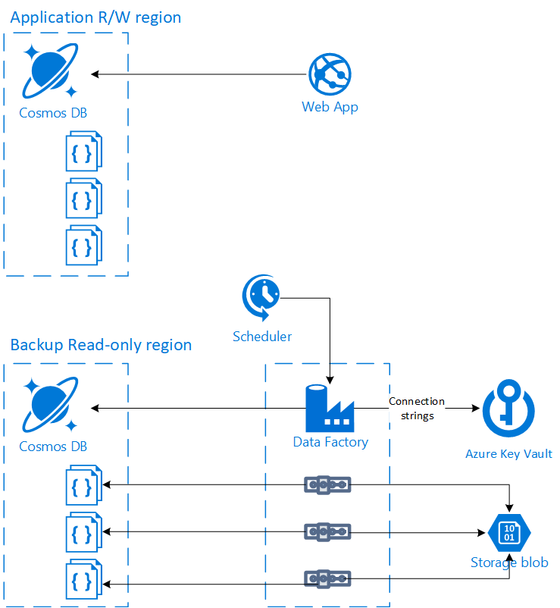
Backup solution

Slide 14
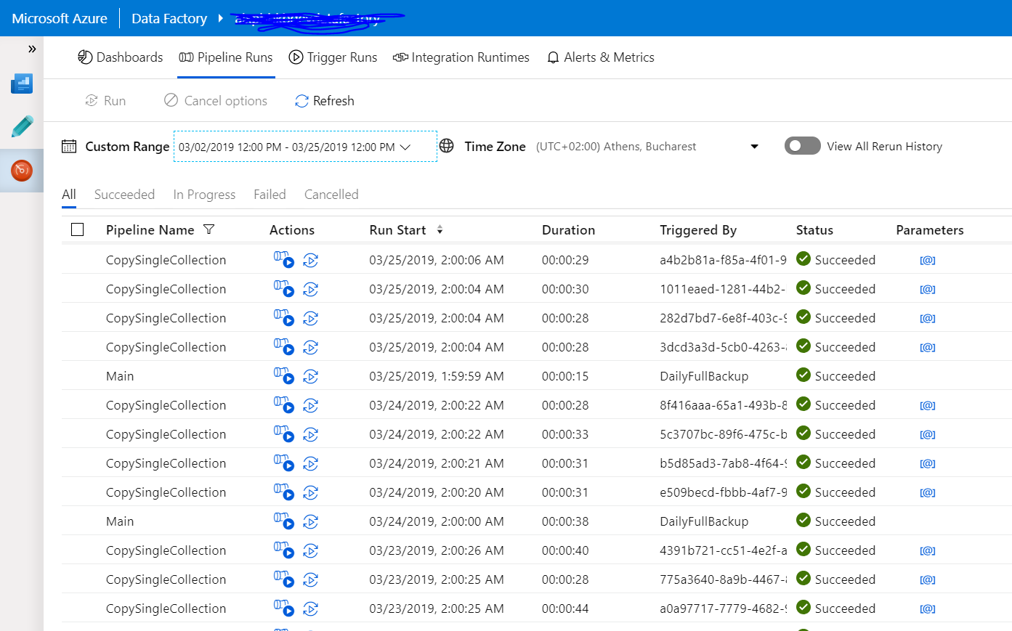
Monitoring

Slide 15
DEMO

Slide 16
Links
https://cosmosdb.github.io/labs/
https://docs.microsoft.com/en-us/azure/azure-resource-manager/resource-group-authoring-templates
https://channel9.msdn.com/Shows/Azure-Friday/Code-free-data-transformation-at-scale-using-Azure-Data-Factory
https://docs.microsoft.com/en-us/azure/data-factory/copy-activity-performance

Slide 17


