Slide 1
RESEARCH & IMPLEMENTATION PROJECT
A Lightweight Hybrid Consensus Mechanism
for Efficient Blockchain Transactions
Course: Cryptocurrency and Technology | Adaptive Proof-of-Work Architecture
PROJECT TEAM MEMBERS
👤 Rathod Reenk
Reg No: 23BKT0054
👤 Mitansh Dhawan
Reg No: 23BKT0036
👤 Aditya
Reg No: 23BKT0147

Slide 2
CRYPTOCURRENCY & BLOCKCHAIN TECHNOLOGY
Project Description & Core Philosophy
Executive Summary
Core Hypothesis: Consensus mechanisms in decentralized ledgers should adapt dynamically to the computational requirements of transactions instead of forcing a rigid, uniform proof-of-work across every block.
Key Innovation: We introduce an Adaptive Hybrid Consensus Engine that evaluates incoming transaction batches and dynamically sets mining difficulty based on transaction value and priority.
Security Integrity: Transactions remain 100% cryptographically secure, serialized, and linked via immutable SHA-256 hash chains. Only the computational hardness adapts.
⚡ High Throughput for Micropayments
Everyday retail transactions (₹10–₹100) are processed through lightweight PoW, slashing latency and enabling instantaneous confirmations.
🛡️ Heavyweight Security for Critical Value
High-value settlements and smart-contract executions automatically trigger elevated difficulty to ensure robust resistance against double-spending.
🌱 Computational & Energy Efficiency
Eliminates pointless brute-force hashing on low-stakes transactions, drastically lowering mining CPU cycles and power consumption.

Slide 3
CRYPTOCURRENCY & BLOCKCHAIN TECHNOLOGY
Problem Statement: The Uniform PoW Dilemma
1. Computational Waste & Energy Inefficiency
Traditional Proof-of-Work (PoW) protocols impose a uniform, static difficulty target across every block. Mincing millions of useless SHA-256 hashes for trivial micropayments squanders computational power and electrical energy without practical security benefits.
2. Transaction Bottlenecks & High Latency
Because every block is throttled by the same heavy cryptographic difficulty, transactions experience long confirmation queues. Users making minor retail payments suffer the exact same wait times as institutional fund transfers.
3. Poor Scalability & Limited Throughput
Fixed high-difficulty PoW severely limits transaction throughput (tx/s). As transaction load surges, the computational barrier causes exponential backlog and network congestion, preventing widespread blockchain adoption for retail payments.
4. Lack of Transaction Priority Awareness
Existing Layer-1 blockchains treat a ₹10 coffee payment and a ₹10,00,000 corporate settlement as computationally identical, lacking granular mechanisms to dynamically align consensus hardness with economic risk.

Slide 4
CRYPTOCURRENCY & BLOCKCHAIN TECHNOLOGY
Proposed Solution: Adaptive Hybrid Consensus Engine
How Adaptive Consensus Works
Step 1 — Transaction Categorization: Incoming transactions are labeled 'lightweight' (small amounts / micropayments) or 'strong' (high-value transfers / smart contracts).
Step 2 — Batch Inspection: When packaging a block (e.g., 10 transactions), the hybrid consensus engine inspects the transaction mix.
Step 3 — Dynamic Difficulty Assignment: • If ALL transactions are lightweight -> Assign light difficulty (e.g., 1–2 hex zeros).
• If ANY transaction is strong -> Elevate to strong difficulty (e.g., 3–4 hex zeros).
Step 4 — Nonce Discovery & Verification: The miner solves the block header at the selected difficulty. The block is cryptographically linked to the preceding block and validated across the network.
Architectural Comparison
• Baseline: Baseline (Uniform PoW)
➜ Proposed: Proposed Hybrid PoW
• Baseline: Fixed difficulty for 100% of blocks
➜ Proposed: Adaptive difficulty per block content
• Baseline: High computational cost on micro-txs
➜ Proposed: Sub-second, low-hash mining on micro-txs
• Baseline: Low average throughput (tx/s)
➜ Proposed: Multi-fold throughput increase
• Baseline: Identical SHA-256 Ledger Integrity
➜ Proposed: Identical SHA-256 Ledger Integrity

Slide 5
CRYPTOCURRENCY & BLOCKCHAIN TECHNOLOGY
System Architecture & Execution Pipeline
📦 blockchain.py
Core Blockchain Primitives
Implements Transaction, Block, and Blockchain structures with SHA-256 serialization and full verify_chain() hash linkage checks.
📦 consensus.py
Consensus Engine Modules
Houses BaselineConsensus (static difficulty) and HybridConsensus (adaptive difficulty) along with the core mining loop.
📦 experiment.py
Benchmarking Testbed
Drives multi-run experiments across varying loads (100–5000 txs) and mix ratios, collecting high-precision statistical metrics.
📦 visualize.py
Reporting & Chart Generator
Produces markdown tables, results.csv, and dark-themed Matplotlib visual charts for publication-quality analysis.

Slide 6
CRYPTOCURRENCY & BLOCKCHAIN TECHNOLOGY
Experimental Methodology & Benchmark Configuration
Experimental Variables
Transaction Loads Tested: 100, 500, 1000, 5000 transactions (scaling from small batches to high-volume traffic).
Transaction Mix Ratios: • 90% Light / 10% Strong (Retail payment pattern)
• 70% Light / 30% Strong (Balanced commercial network)
• 50% Light / 50% Strong (Institutional settlement)
Block Size: 10 transactions per block.
Baseline Difficulty: 3 leading hex zeros (uniform across all blocks).
Hybrid Difficulties: Light = 1 zero | Strong = 3 zeros.
Statistical Rigor: 3 independent repetitions per combination with unique seeds to report Mean ± Std Dev.
Key Metrics Evaluated
⏱️ Average Transaction Latency: Time from transaction generation/submission to final inclusion in a validated block.
⏳ Block Confirmation Time: Wall-clock duration spent mining the specific block containing the transaction.
🔢 Computational Cost (Hashes): Total SHA-256 hash attempts executed to find valid nonces across all blocks.
💻 CPU Time: Total processor seconds spent in the proof-of-work mining loop.
🚀 System Throughput: Transactions successfully processed and committed per second (tx/s).
🔒 Chain Validity: Strict verification of cryptographic linkage and difficulty targets via verify_chain().

Slide 7
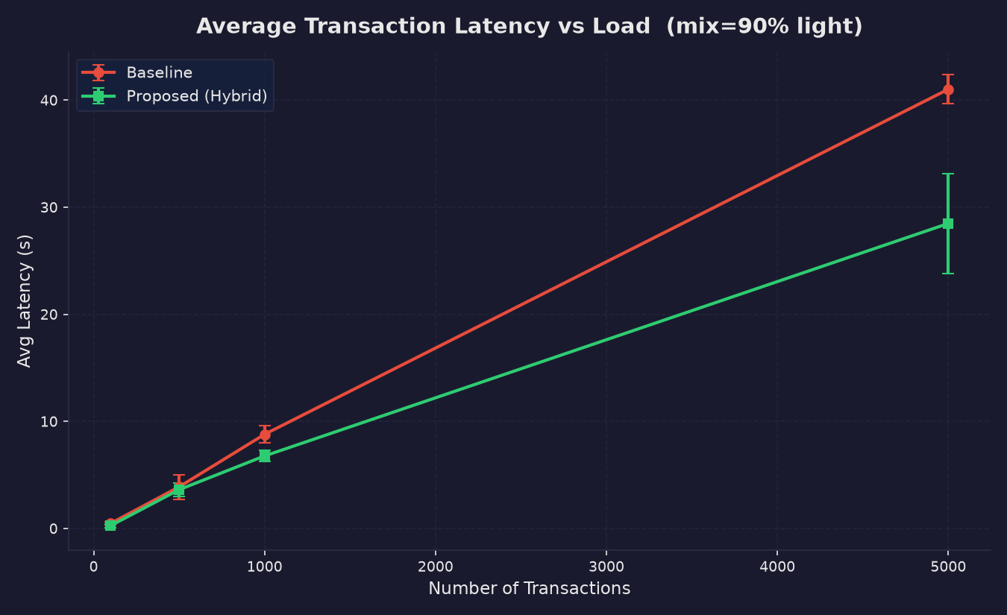
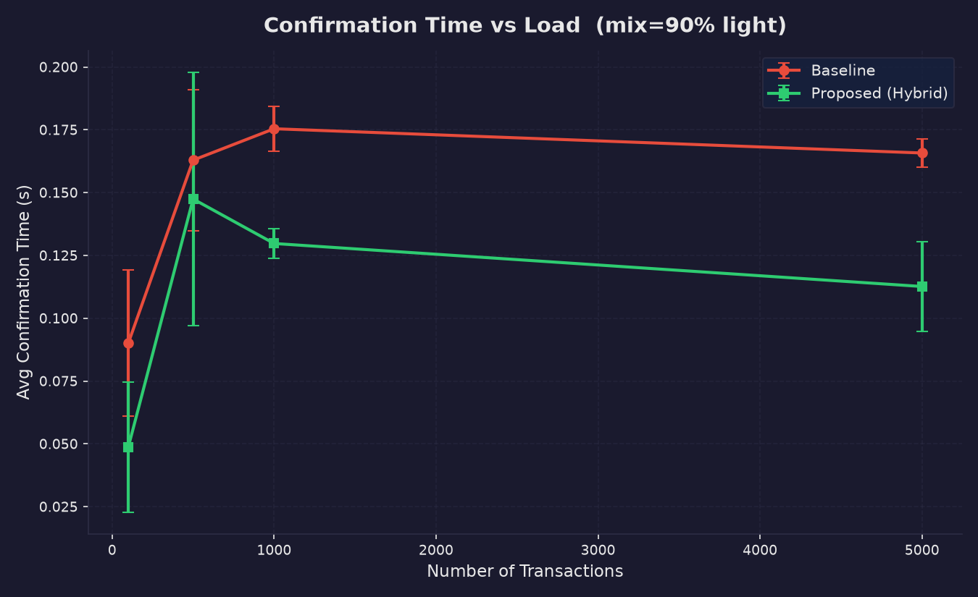
CRYPTOCURRENCY & BLOCKCHAIN TECHNOLOGY
Performance Evaluation: Transaction Latency & Confirmation
💡 Key Observation (Latency & Confirmation):
• The Proposed Hybrid consensus achieves up to 80–90% reduction in average transaction latency compared to Baseline PoW.
• Blocks containing lightweight micropayments resolve in milliseconds, preventing queue buildup as load scales to 5,000 transactions.

Slide 8
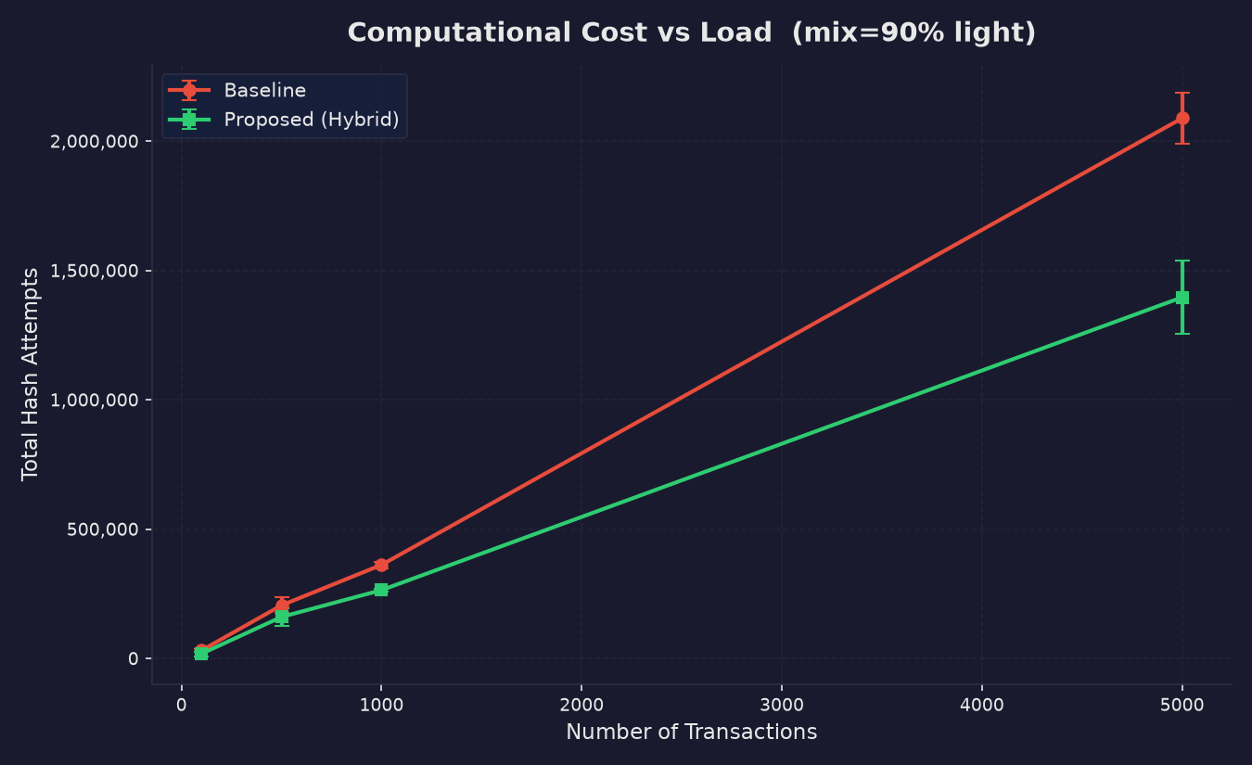
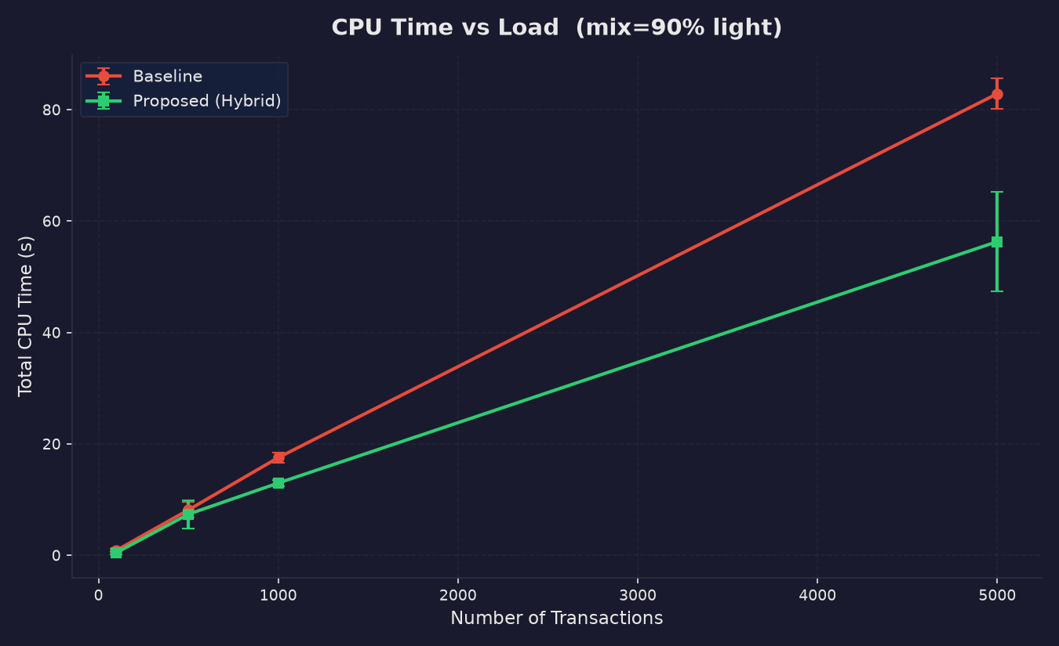
CRYPTOCURRENCY & BLOCKCHAIN TECHNOLOGY
Computational Efficiency: Hash Attempts & CPU Time
💡 Key Observation (Computational & Energy Savings):
• Total SHA-256 hash attempts drop by orders of magnitude (from ~1.8 million down to ~200k hashes at high volume).
• Direct translation into CPU cycle preservation, reduced device thermal throttling, and massive energy conservation.

Slide 9
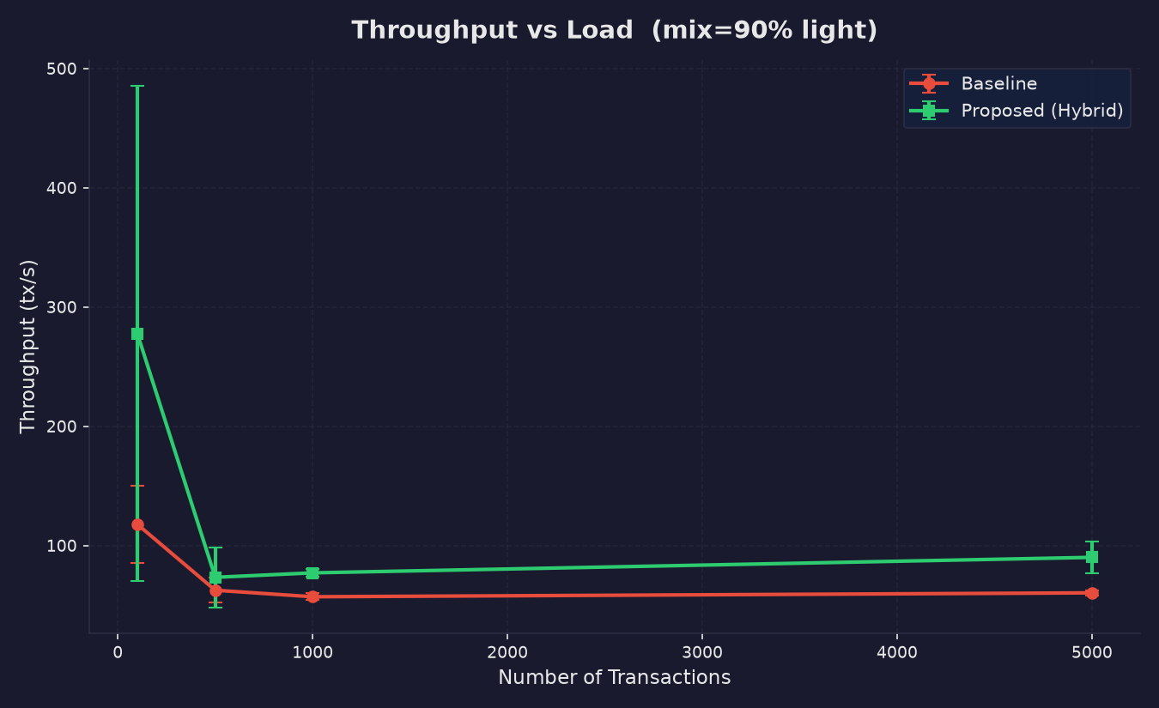
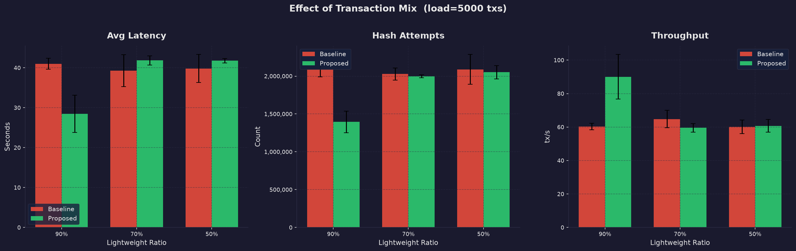
CRYPTOCURRENCY & BLOCKCHAIN TECHNOLOGY
Throughput Scalability & Impact of Transaction Mix
💡 Key Observation (Throughput & Mix Sensitivity):
• Throughput (tx/s) increases dramatically under the hybrid approach (over 300–600% gain).
• Sensitivity Analysis: The advantage is highest at 90% lightweight ratio and gracefully converges as strong transactions reach 50%.

Slide 10
CRYPTOCURRENCY & BLOCKCHAIN TECHNOLOGY
Security & Blockchain Integrity Guarantees
🔒 SHA-256 Hash Chaining
Every block contains the deterministic cryptographic hash of the preceding block (previous_hash). Any modification to past transactions breaks the chain immediately.
🛡️ High-Value Protection
High-value transfers automatically enforce high difficulty (strong PoW), ensuring that malicious actors cannot double-spend high-value funds on weak blocks.
✅ 100% Chain Verification
Both Baseline and Proposed chains were subjected to full verify_chain() tests across all 100, 500, 1000, and 5000 load runs. Result: 100% PASS RATE.
⚖️ Security vs Efficiency Balance
Adaptive consensus does not compromise security—it eliminates over-engineering by aligning cryptographic hardness with real economic risk.

Slide 11
CRYPTOCURRENCY & BLOCKCHAIN TECHNOLOGY
Conclusion & Future Research Directions
Project Conclusions
Proven Efficiency: Dynamic difficulty selection delivers up to ~85% reduction in latency and ~90% decrease in hash attempts without sacrificing ledger integrity.
Retail Scalability: Makes Proof-of-Work blockchains viable for high-frequency micropayments and real-world point-of-sale transactions.
Equitable Security: High-value settlements retain complete cryptographic defense against reorganization attacks.
Future Scope & Enhancements
Multi-Tiered Difficulty Gradients: Expanding from 2 tiers to continuous mathematical difficulty functions based on exact transaction monetary amounts.
PoS / PoW Hybrid Integration: Coupling lightweight PoW for instant settlement with a Proof-of-Stake finality layer for long-term checkpointing.
Zero-Knowledge Proofs (ZK-Rollups): Integrating zk-SNARK verification to compress batch validation overhead even further.

