Slide 1
Discrete Probability Distributions
Flight Delay Analysis & Journal Article Review
STAT 562 Project 1

Slide 2
Introduction
Data: 3,000,000 flight-level records with FL_DATE and DEP_DELAY. Cleaning retained 2,922,356 flights with nonmissing date and departure delay.
Observed calendar: 1,704 daily intervals from 2019-01-01 to 2023-08-31.
Delayed flight: DEP_DELAY > 0 minutes.
Mean departure delay: 10.123 minutes. Empirical SD: 49.252 minutes.
Delayed flights: 992,843, or 33.974%.

Slide 3
Binomial Distribution
Use: high-delay days in a fixed 10-day period.
Own-data success: daily delayed-flight rate > 40%.
Estimated p = 0.275235; E[X] = 2.752; Var(X) = 1.995.
Simulation, 10,000 draws: mean = 2.756; variance = 1.989.
MGF: M_X(t) = (1-p+p e^t)^n, t in R.
Theory: Blitzstein and Hwang (2019).

Slide 4
Poisson Distribution
Own-data outcome: delayed flights per observed day.
lambda = 582.654; empirical variance = 73,845.030; empirical SD = 271.744.
Poisson theoretical variance = 582.654; variance-to-mean ratio = 126.739.
Simulation mean = 582.747; simulation variance = 583.783.
MGF: M_X(t) = exp{lambda(e^t-1)}, t in R.
Theory: Blitzstein and Hwang (2019).

Slide 5
Geometric Distribution
Own-data success: at least 10% of a day’s flights have DEP_DELAY > 30 minutes.
p = 0.487676; E[X] = 2.051 days; Var(X) = 2.154.
Simulation mean = 2.061; simulation variance = 2.165.
MGF: M_X(t) = p e^t / [1-(1-p)e^t], t < -log(1-p).
Theory: Blitzstein and Hwang (2019).

Slide 6
Negative Binomial Distribution
Own-data success: a delayed flight, DEP_DELAY > 0.
r = 5; p = 0.339741; E[X] = 14.717 flights; Var(X) = 28.602.
Simulation mean = 14.748; simulation variance = 28.426.
MGF: [p e^t / {1-(1-p)e^t}]^r, t < -log(1-p).
Theory: Blitzstein and Hwang (2019).

Slide 7
Hypergeometric Distribution
Own-data population: N = 2,922,356; delayed flights K = 992,843; sample n = 100.
E[X] = 33.974; Var(X) = 22.431.
Simulation mean = 33.932; simulation variance = 22.539.
MGF: sum over support of e^(tx) P(X=x), t in R.
Theory: Blitzstein and Hwang (2019).

Slide 8
Journal Article: Aircraft Delay Analysis
Peer-reviewed journal article: Mitsokapas, Schäfer, Harris, and Beck (2021), Scientific Reports.
The study statistically characterized arrival delays at UK airports during 2018–2020 and reported broad delay behavior.
Connection: the project’s daily count variance greatly exceeds its Poisson mean, so a simple Poisson model is a benchmark rather than a fitted conclusion.
Mueller and Chatterji (2002) remains background: it is an AIAA technical-forum paper, not the journal article used here.

Slide 9
Conclusion
The flight-level results support five distinct probability experiments.
Poisson provides a count benchmark but overdispersion is substantial.
Revised daily-rate thresholds avoid the earlier degenerate Binomial and Geometric results.
All five 10,000-draw simulations closely match their theoretical moments.
Interpret results as describing this sample, not every scheduled U.S. flight.

Slide 10
References
Blitzstein, J. K., & Hwang, J. (2019). Introduction to Probability (2nd ed.). Chapman and Hall/CRC.
Mitsokapas, E., Schäfer, B., Harris, R. J., & Beck, C. (2021). Statistical characterization of airplane delays. Scientific Reports, 11, 7855. https://doi.org/10.1038/s41598-021-87279-8
Mueller, E. R., & Chatterji, G. B. (2002). Analysis of aircraft arrival and departure delay characteristics. AIAA ATIO Technical Forum, AIAA 2002-5866. https://doi.org/10.2514/6.2002-5866
Flight-level data: flights_sample_3m.csv, source citation to be completed from original download.

Slide 11
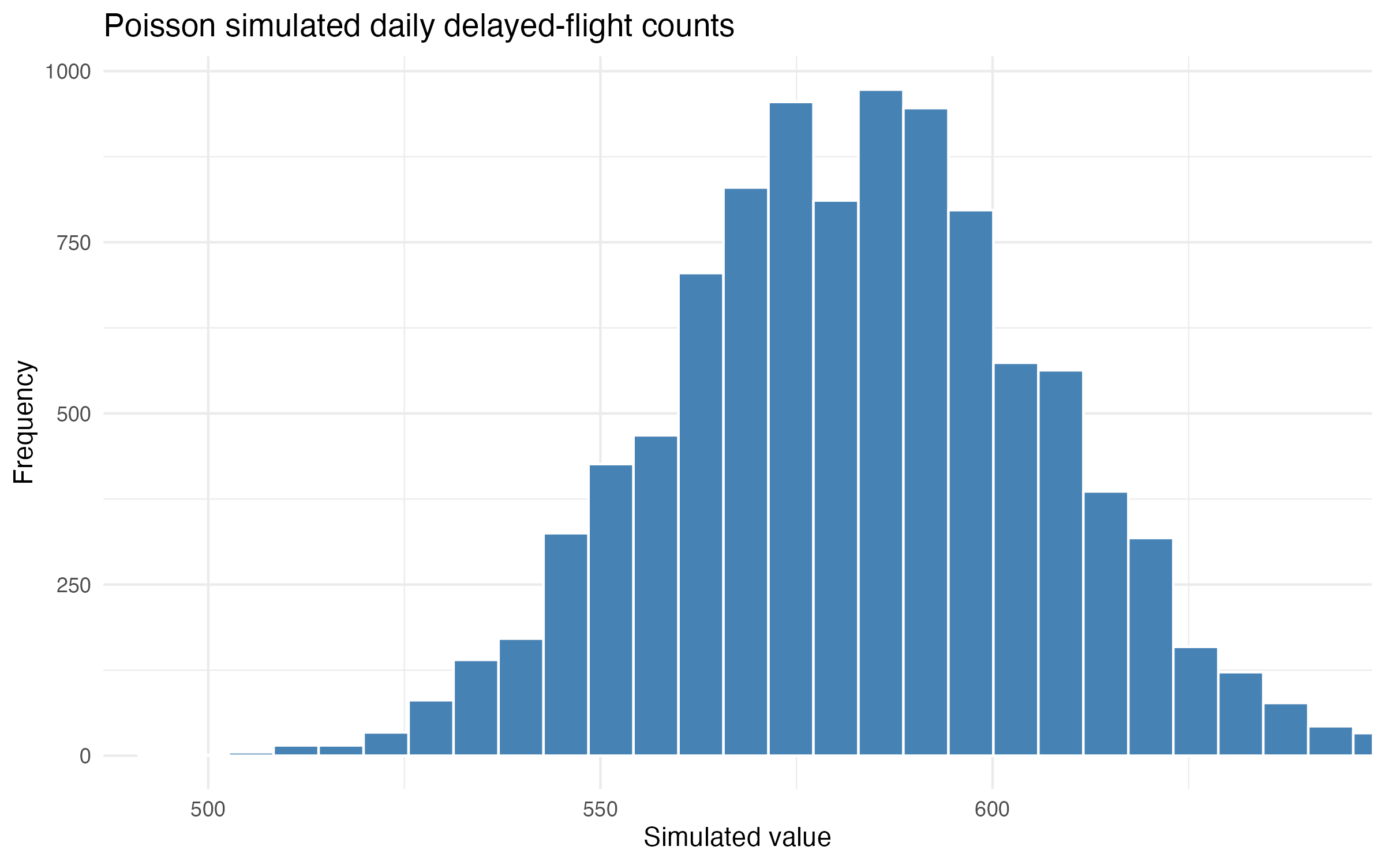
Poisson simulation
Notes:
Simulation uses 10,000 draws and random seed 562. Source: project output/results/simulation_summary.csv.

Slide 12
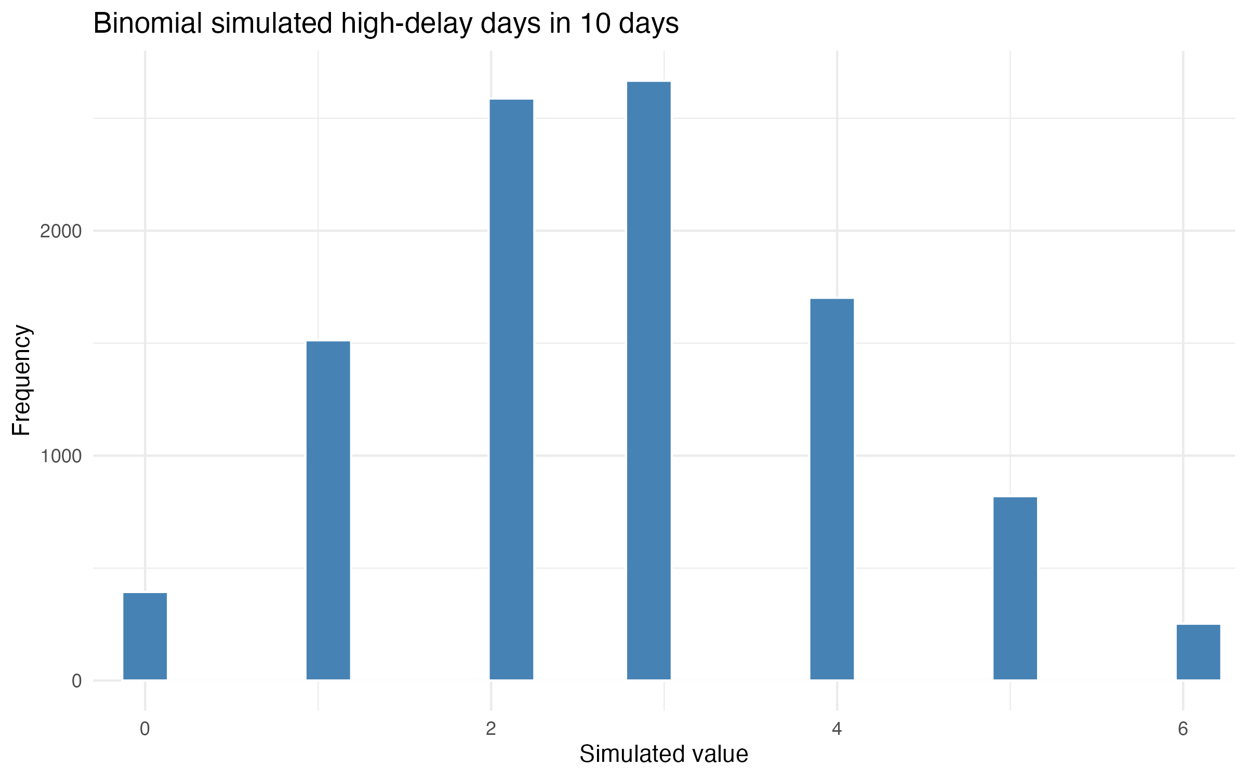
Binomial simulation
Notes:
Simulation uses 10,000 draws and random seed 562. Source: project output/results/simulation_summary.csv.

Slide 13
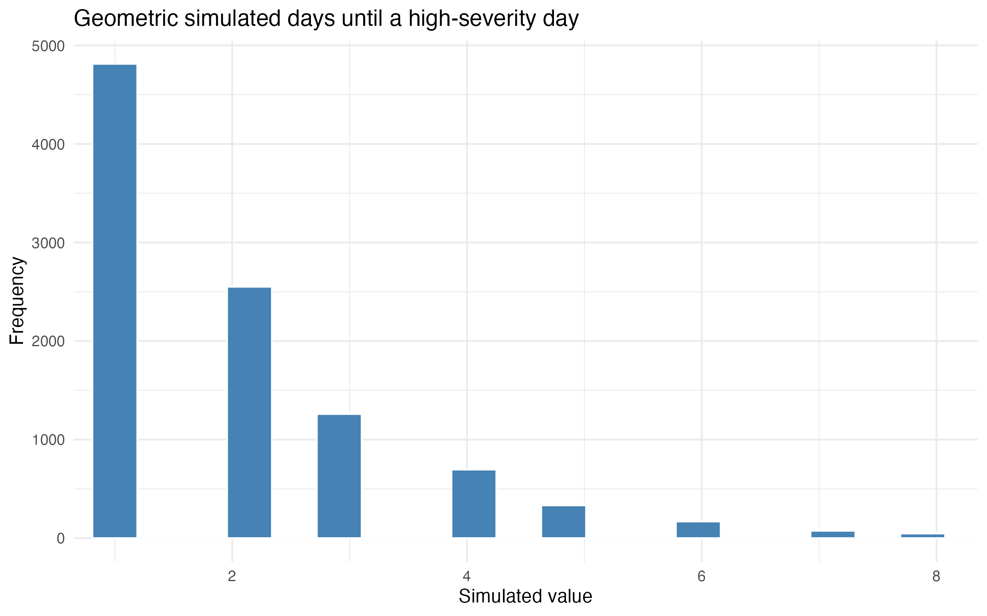
Geometric simulation
Notes:
Simulation uses 10,000 draws and random seed 562. Source: project output/results/simulation_summary.csv.

Slide 14
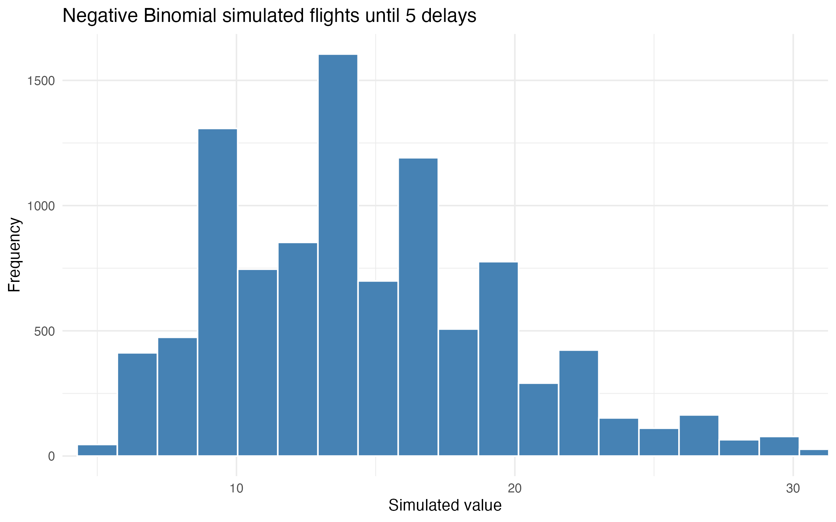
Negative Binomial simulation
Notes:
Simulation uses 10,000 draws and random seed 562. Source: project output/results/simulation_summary.csv.

Slide 15
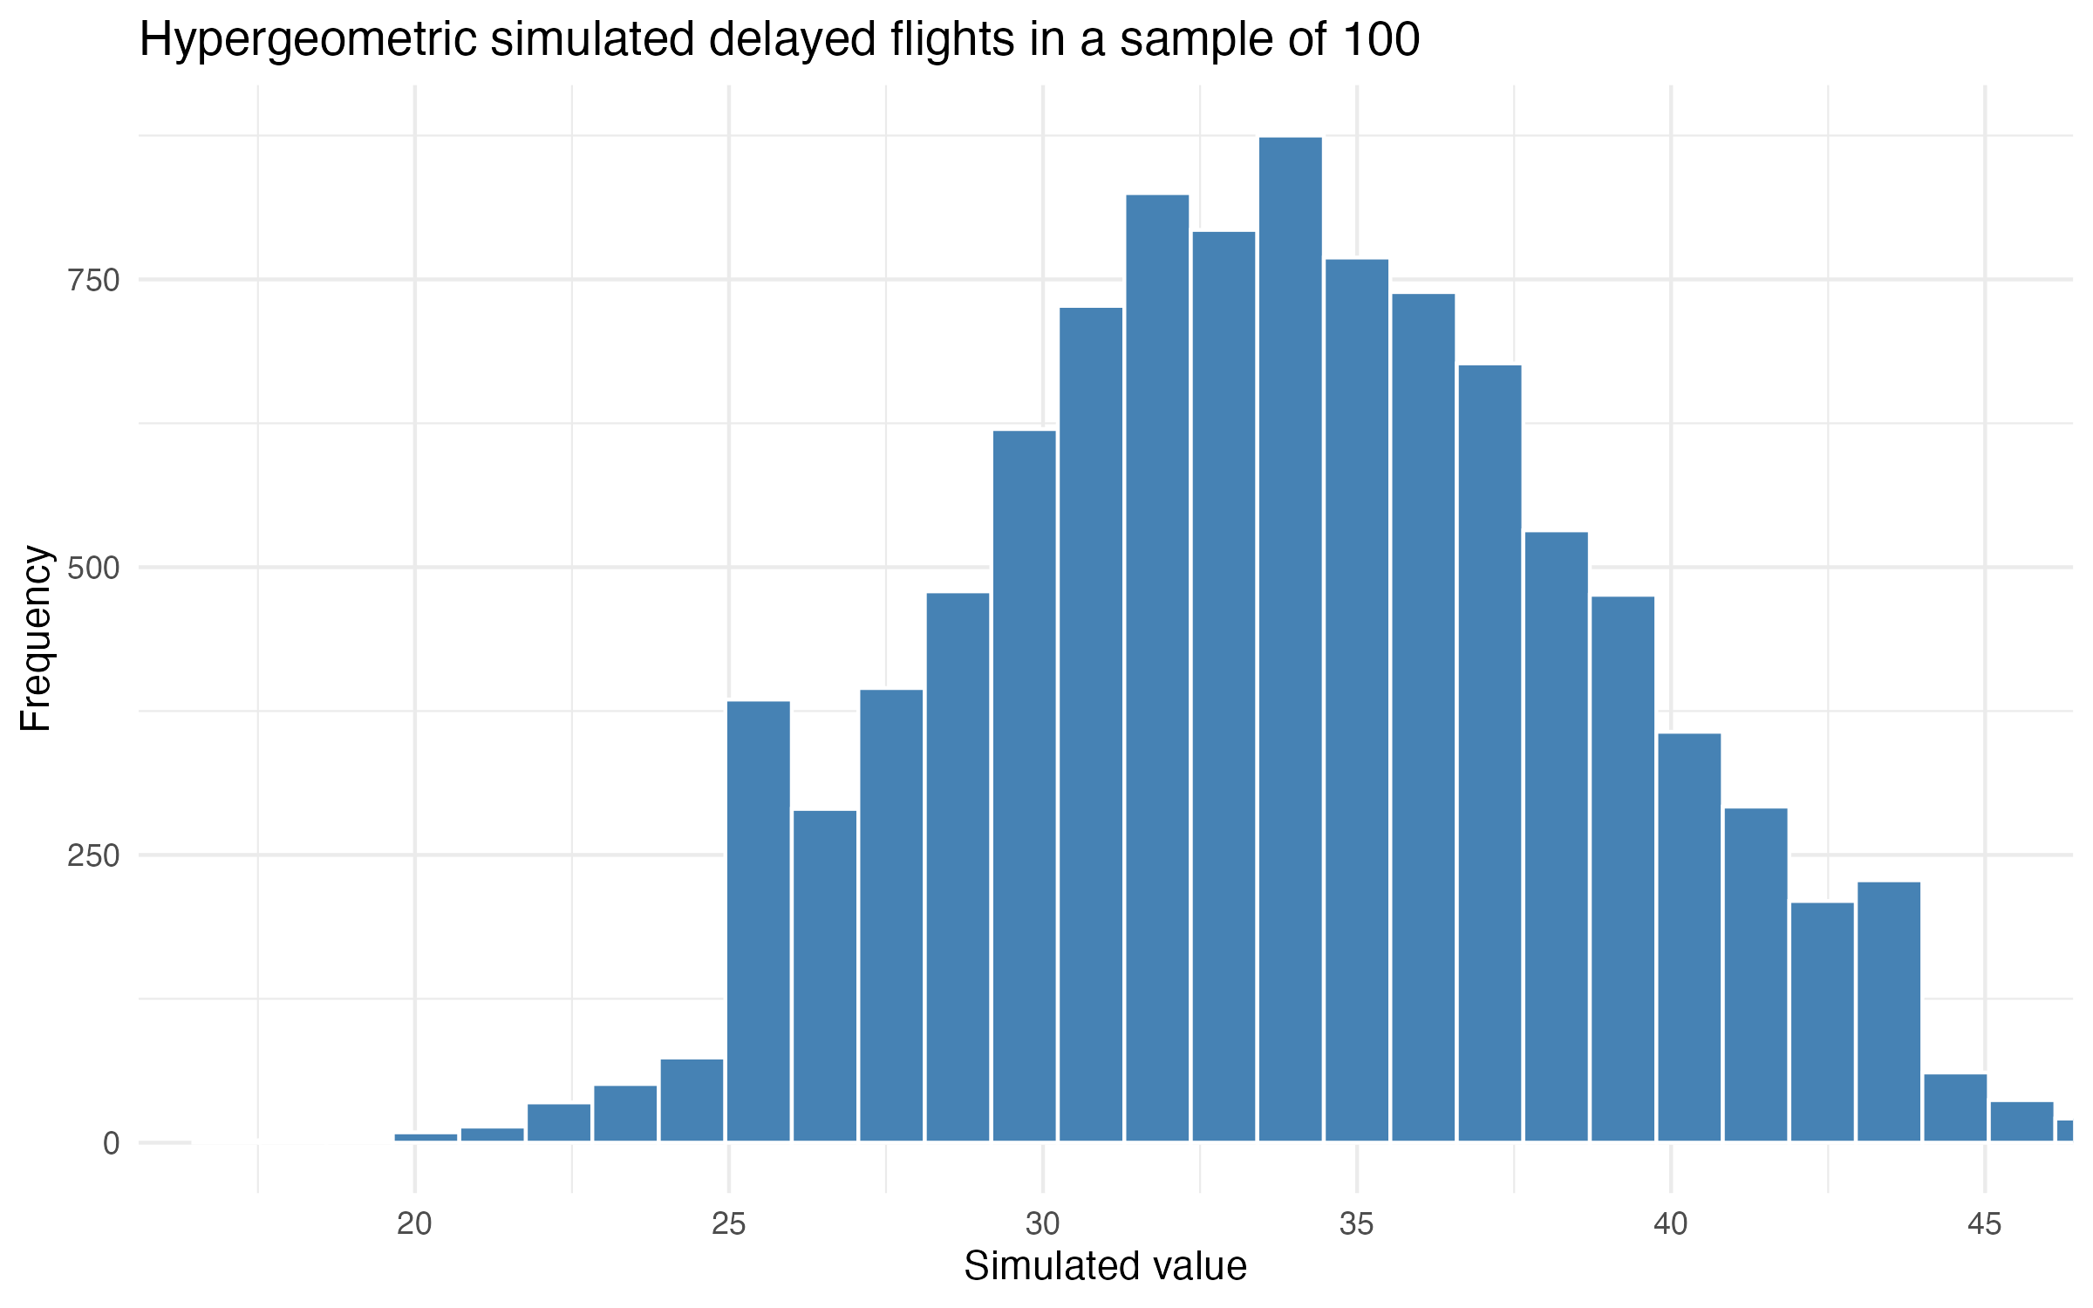
Hypergeometric simulation
Notes:
Simulation uses 10,000 draws and random seed 562. Source: project output/results/simulation_summary.csv.

