Slide 1

Team Kalanchoe
PineMap
Shepard Garrett, Matthew Quesnell, Nicholas Pontius, Reese Hatfield

Slide 2

The Problem
Lack of Unified Information
Limited customization
Overcomplicated

Slide 3

Solution
Section
12
Modular Mapping System
Dynamic, configurable information
Accessible and User Friendly

Slide 4

Demonstration

Slide 5

Technology and Security
Section
12
Post-quantum Encryption Algorithm
Assured User Security
Industry Standard Framework

Slide 6

Further Improvements
More Concurrent Users
Increased Mapping Features
Dynamically Styled Interface

Slide 7

Why Kalanchoe?
Section
12
Best use-case for your business
Increased productivity
Team Efficiency

Slide 8
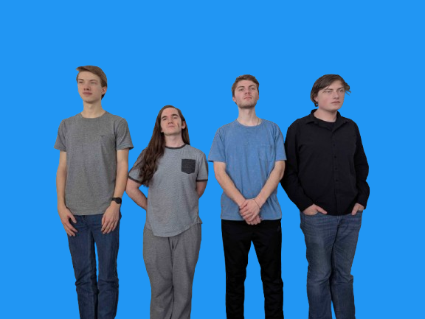
Thank you!
Questions?

