Slide 1

Python Errors
Reese Bottorff

Slide 2
Types of errors
Syntax Error
This type of error occurs when the code is containing/missing a piece of code
Runtime Error
These types of errors occur when the code can’t run because of an unexpected condition that prevents it from continuing
There are multiple types of runtime errors
Logical Error
This error occurs when the code runs without any error, but produces incorrect results
These errors are usually more difficult to find

Slide 3
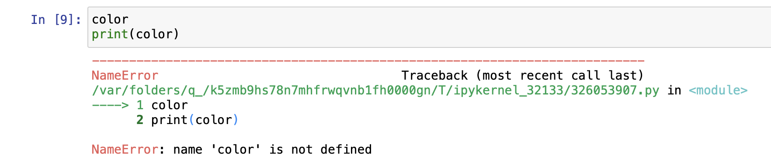
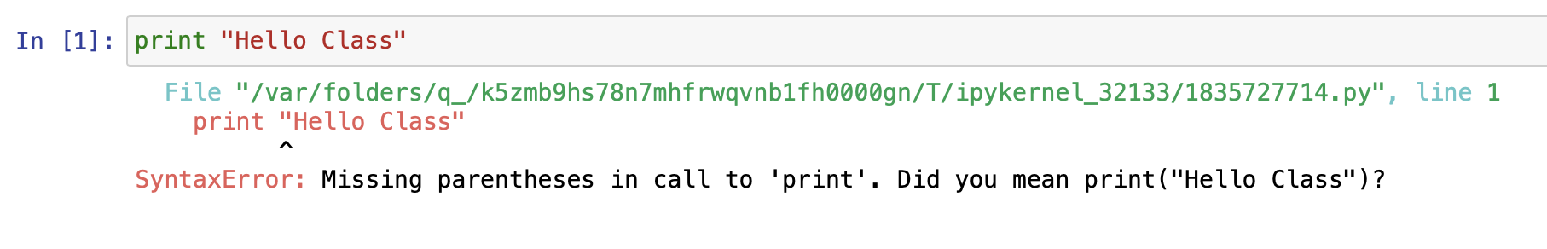
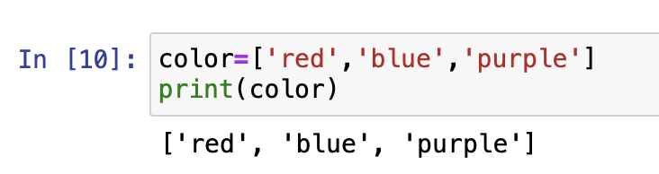
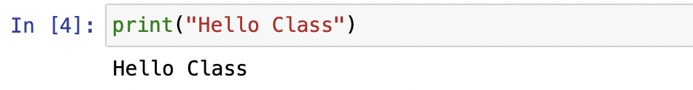
Name Error
Syntax Error
This error occurs when there is an invalid syntax in code
In this example, the parentheses were forgotten when trying to print this message
This error occurs when a variable or function doesn’t exist or invalid
In this example, the variable color is written but not defined

Slide 4
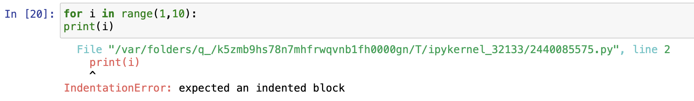
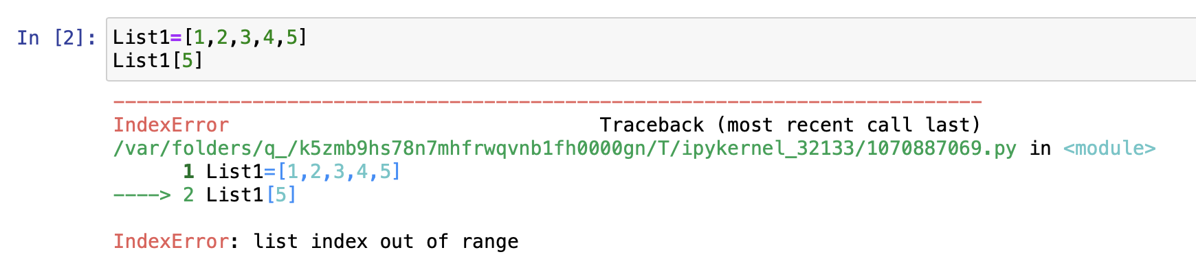
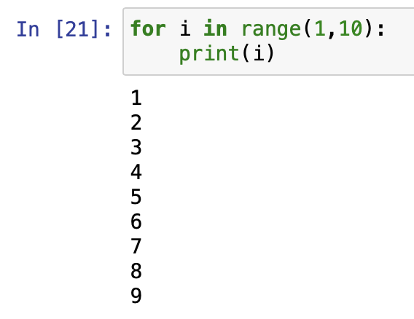
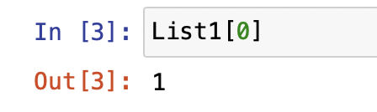
Index Error
Indentation Error
This error occurs when an attempt is made to access an item in a list when the index is out of bounds
In this example, the list only goes up to 4, but 5 is being called
This error occurs when an indention is missed in a code
In this example, the print line should be indented

Slide 5
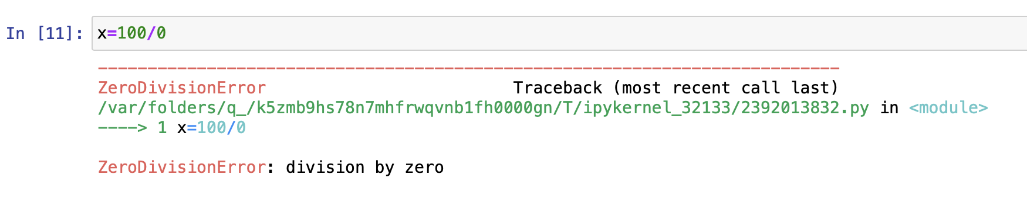
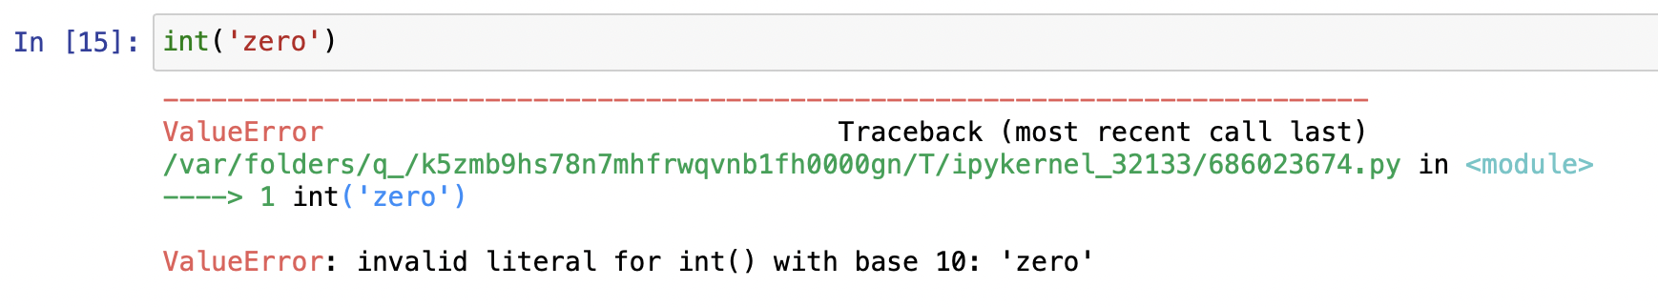
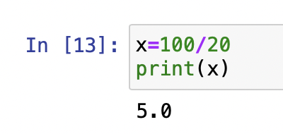
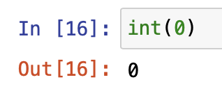
ZeroDivision Error
Value Error
This error occurs when a number is being divided by 0
In this example, 100 is attempting to divide by 0
This error occurs when there is the proper argument type but incorrect value
In this example, zero is being called as an int instead of a string

Slide 6
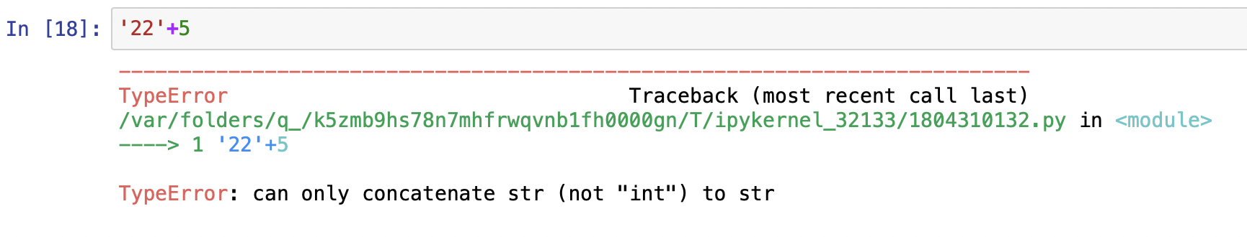
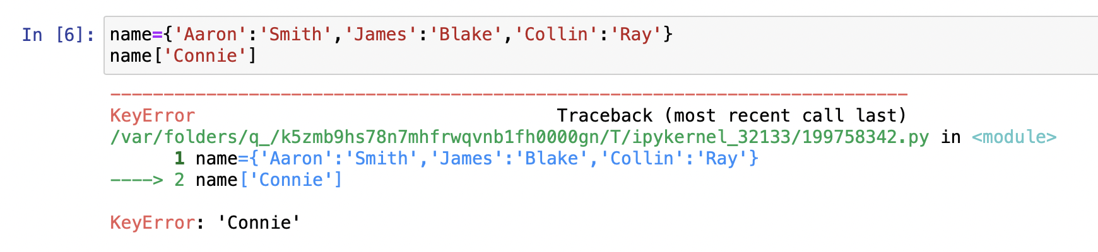
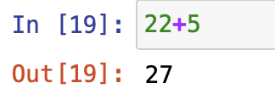
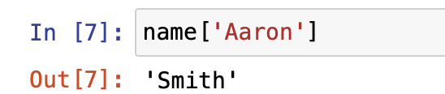
Type Error
Key Error
This error occurs when the data type of an object in an operation is incorrect (similar to value error)
In this example, 22 is written as a string instead of an int
This error occurs when the key that is being called doesn’t exist
In this example, the name that is trying to be found doesn’t exist

Slide 7
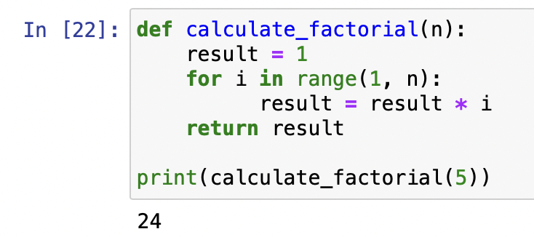
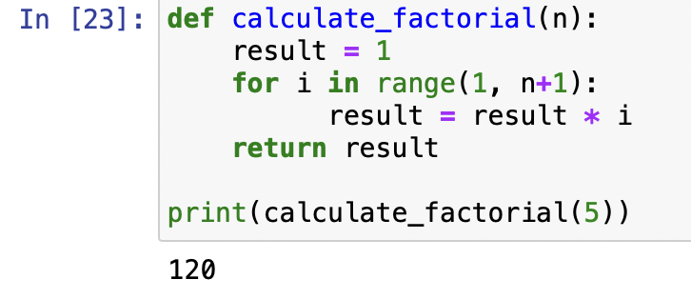
Logical Error
This error occurs when the code runs without any error, but produces incorrect results
In this example, this code should run 5 times. Instead of going from 1 to n, it is actually going from 1 to n-1, causing the output to be 24
The right answer would be n+1 for the code to run correctly, creating the output of 120

