Slide 1
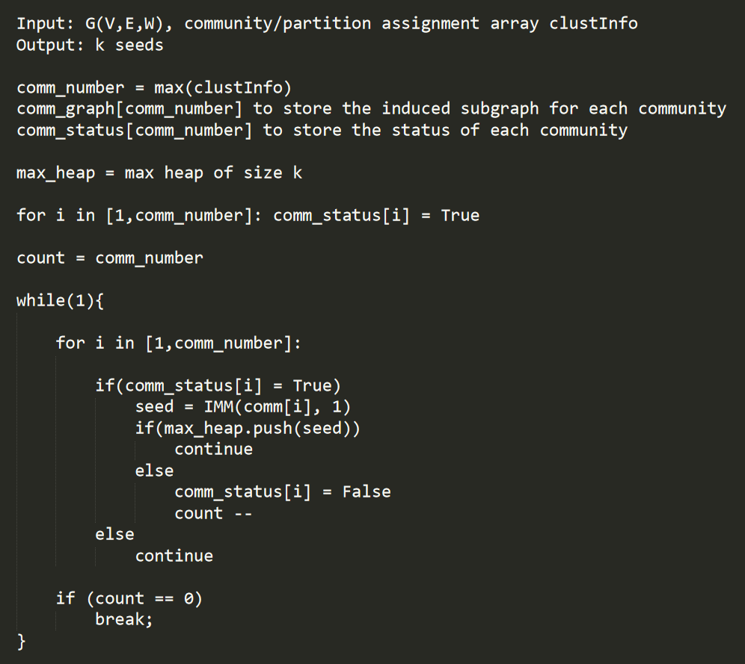
Louvain-IMM : Rough Pseudocode

Slide 2
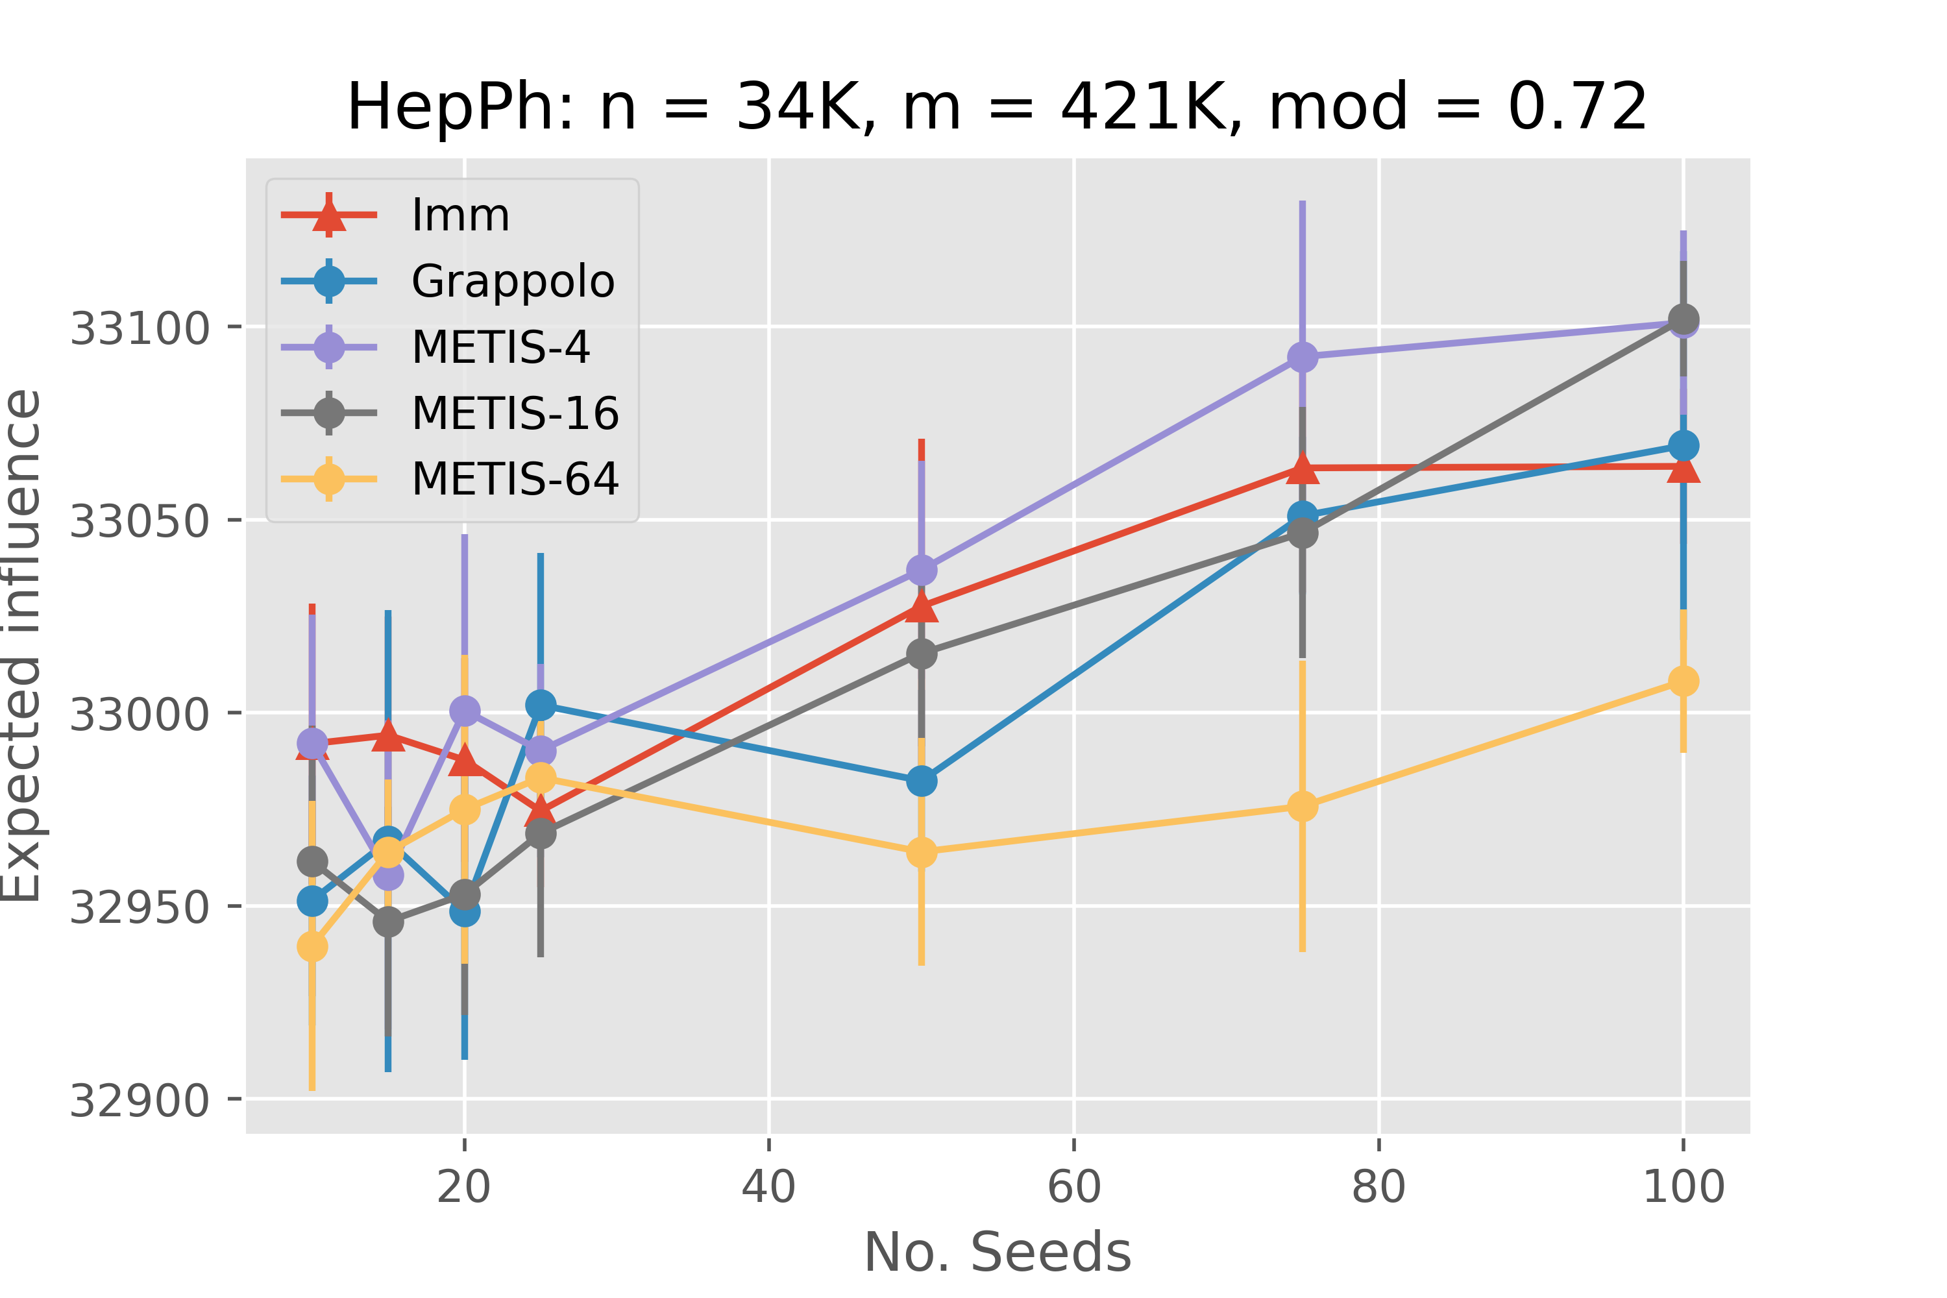
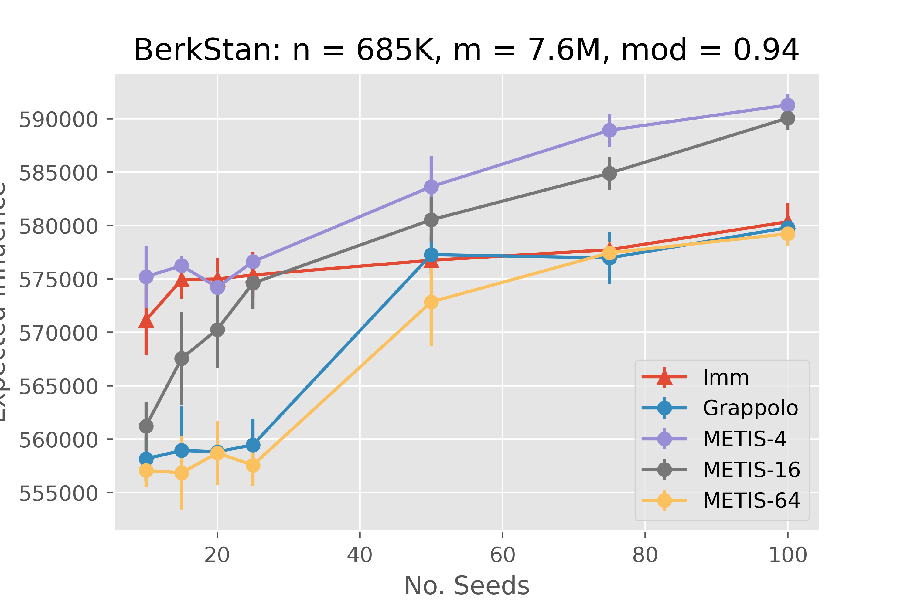
Expected Spread

Slide 3
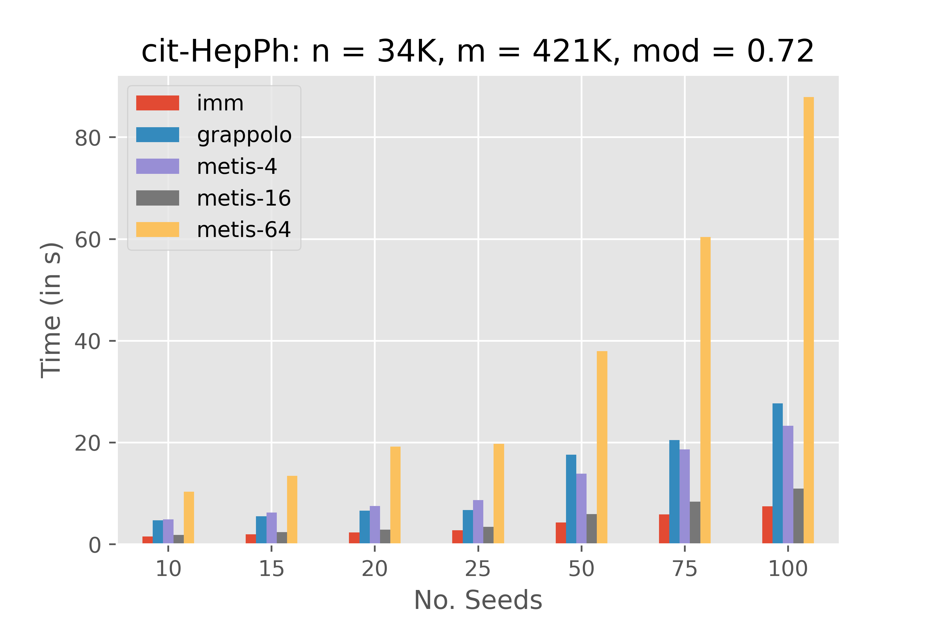
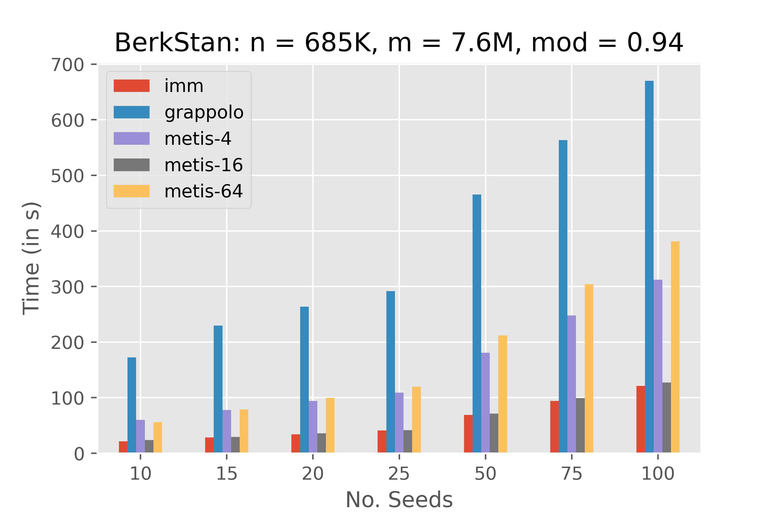
Execution Time (Preprocessing not considered)

Slide 4
Inputs
Graph | Nodes | Edges | Avg. Deg | Max Deg | Modularity | #Communities
HepPh | 34K | 421K | 24.41 | 846 | 0.727573 | 81
SlashDot | 77K | 905K | 23.41 | 5048 | 0.391440 | 853
Epinions | 75K | 508K | 13.41 | 3079 | 0.462041 | 870
DBLP | 317K | 1.05M | 6.62 | 343 | 0.821085 | 190
CNR | 325K | 2.7M | 16.826 | 18236 | 0.927244 | 217
Google | 875K | 5.1M | 11.66 | 6353 | 0.979539 | 3157
BerkStan | 685K | 7.6M | 22.18 | 84290 | 0.941496 | 1127
Europe | 50M | 54M | 2.123 | 13 | 0.998945 | 3053

Slide 5
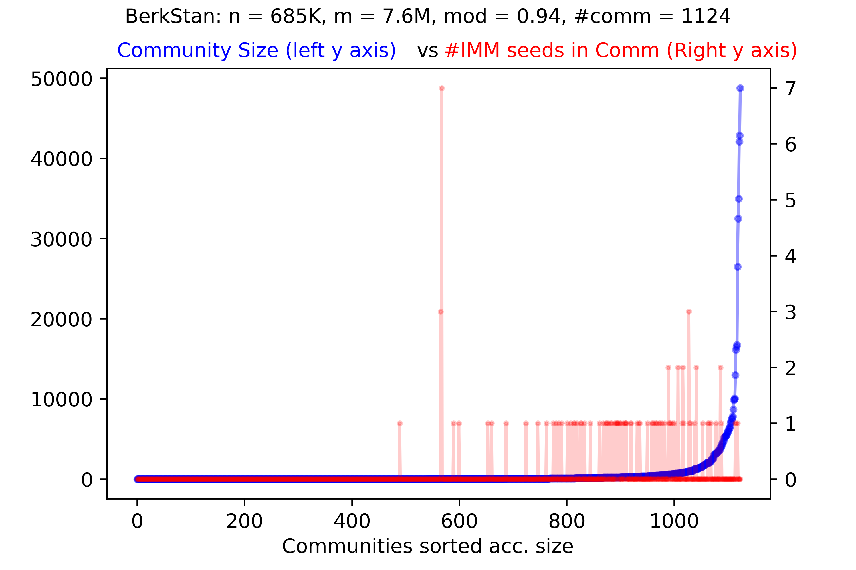
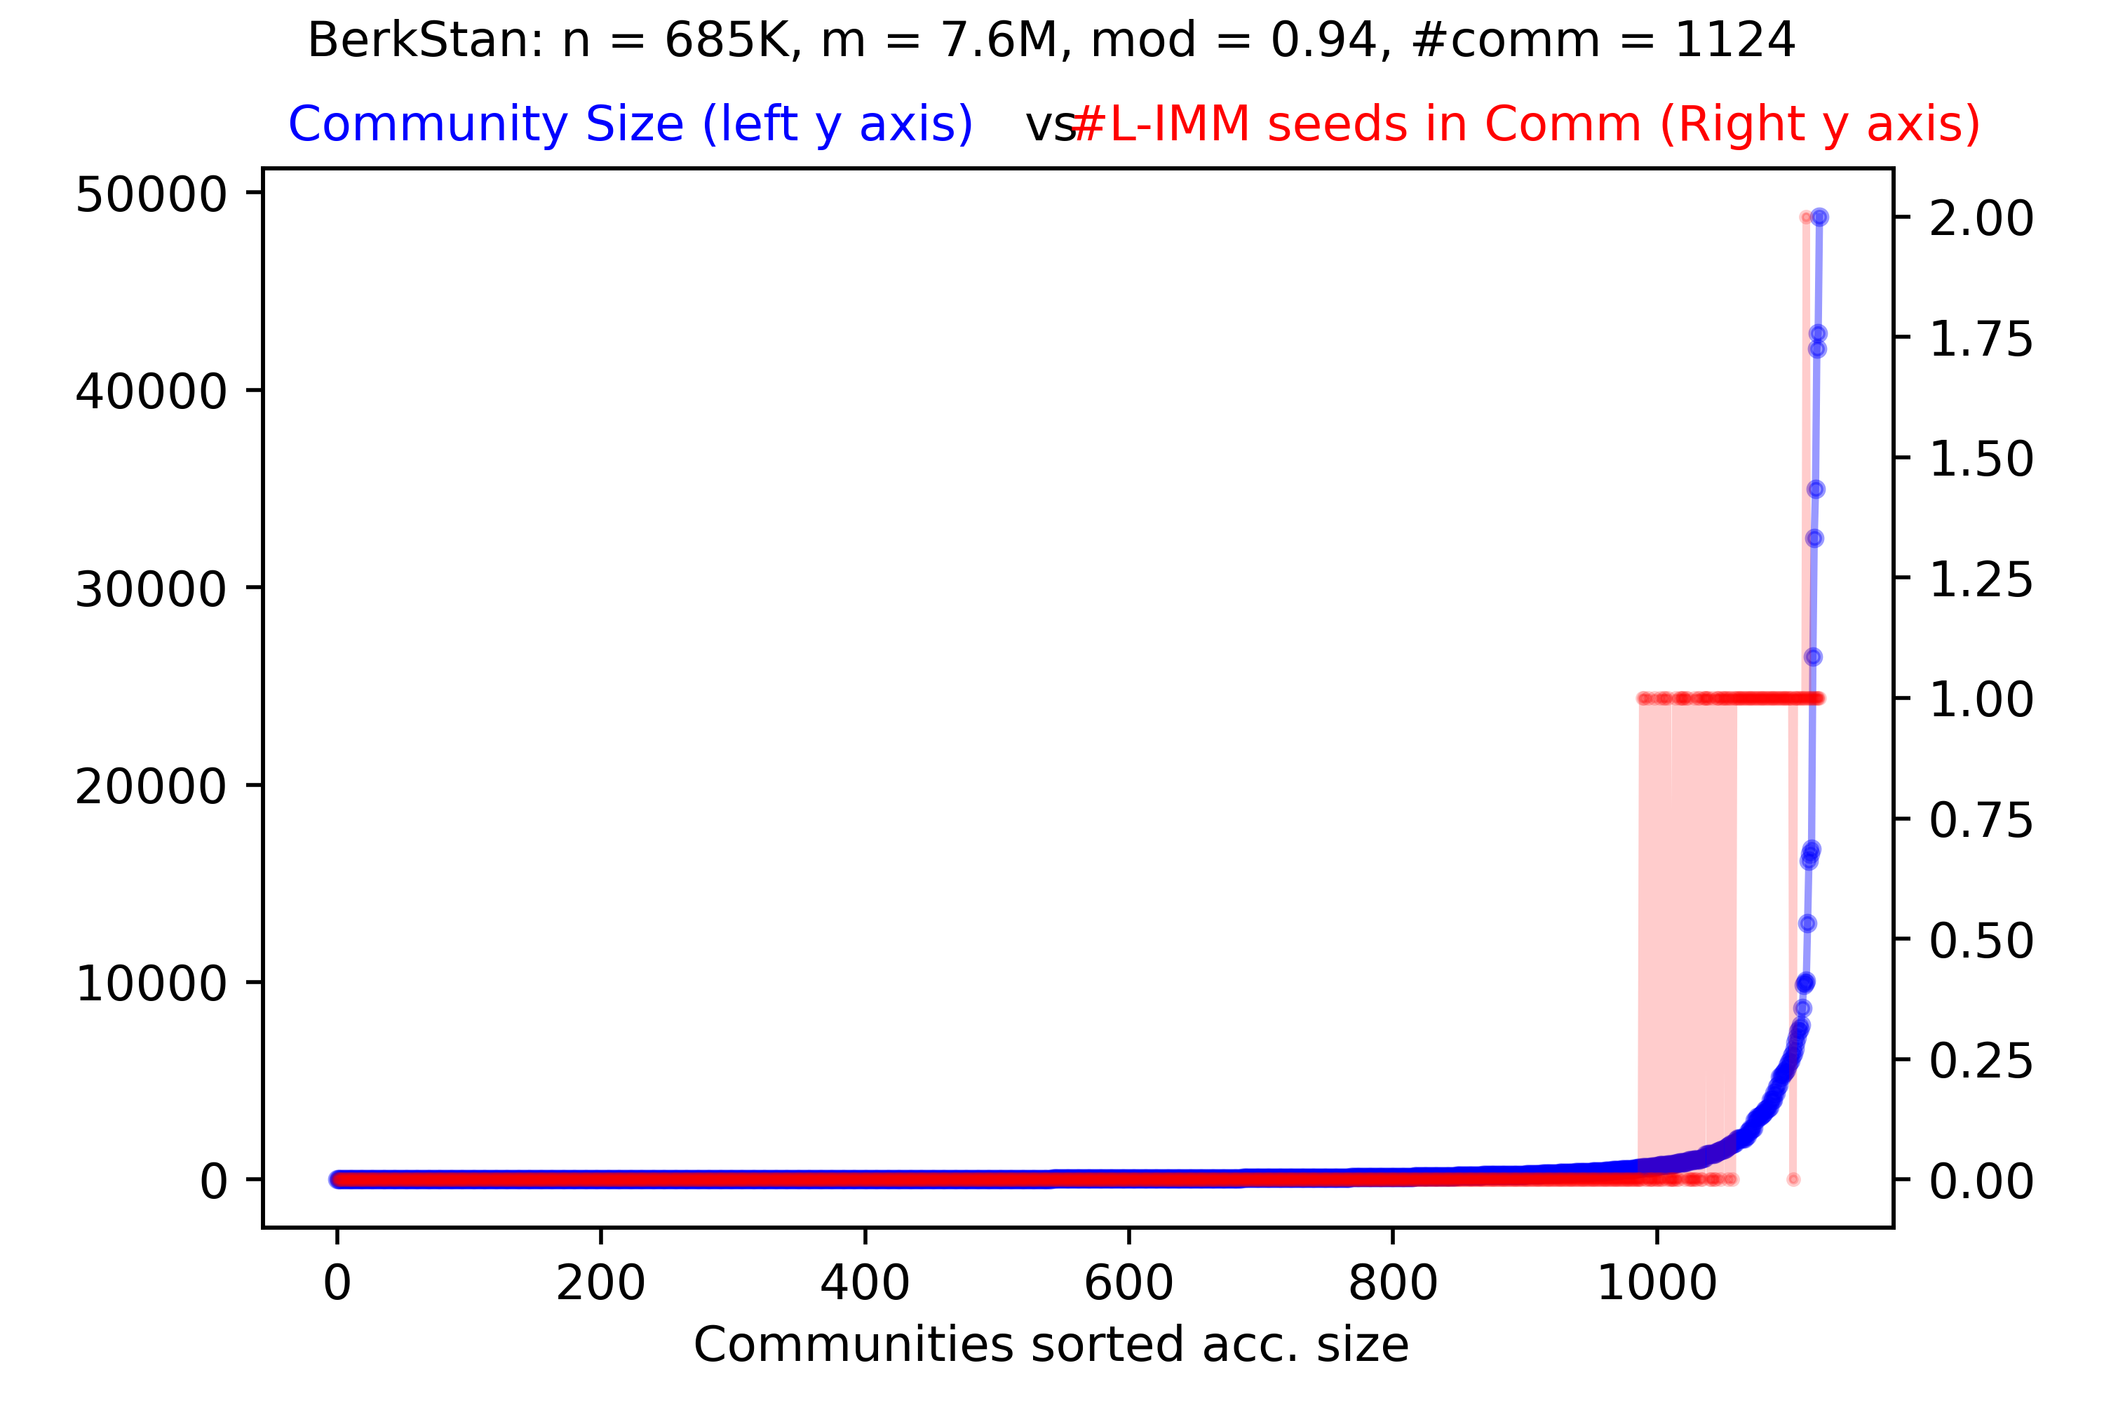
Seed Distribution Across Communities: IMM vs Louvain-IMM

Slide 6
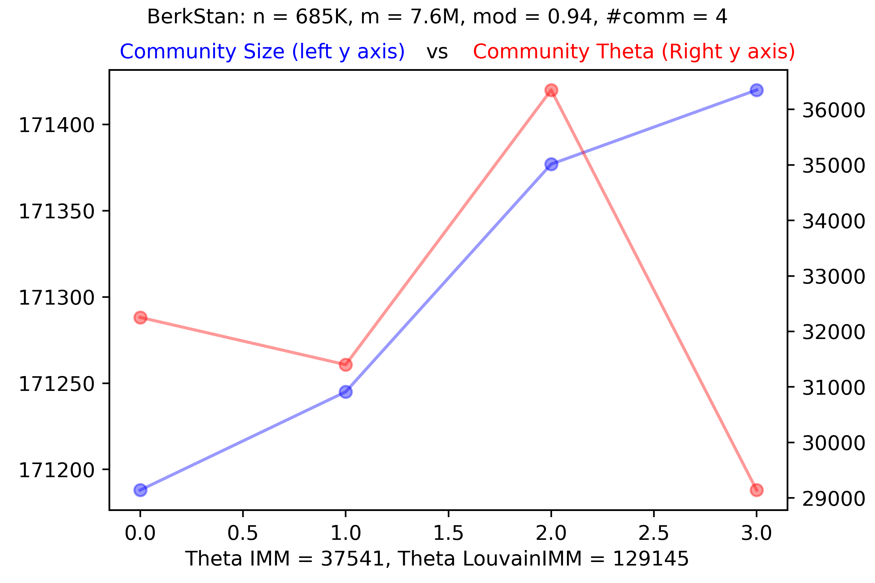
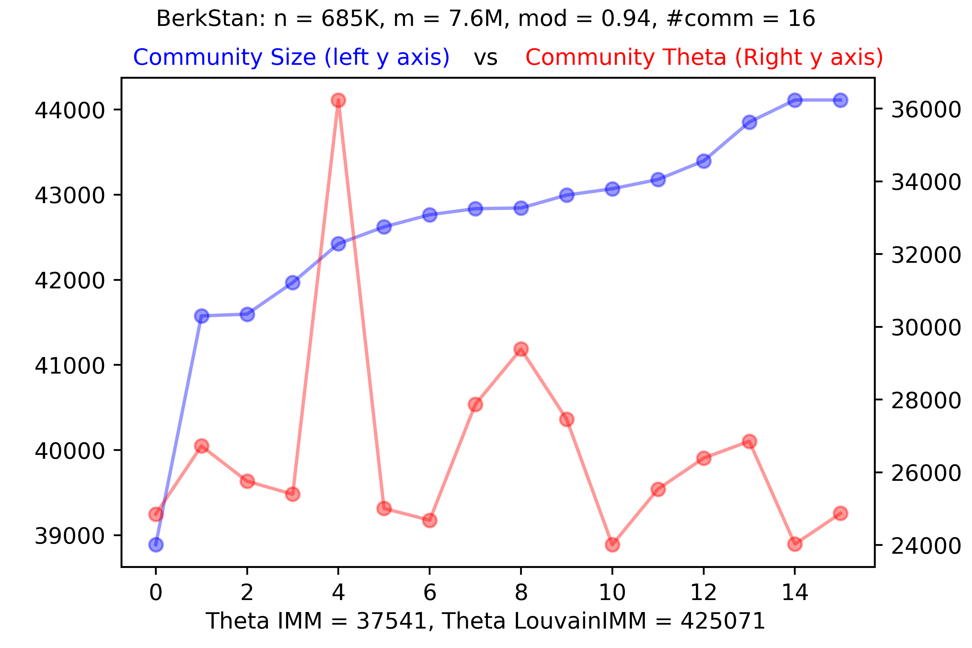
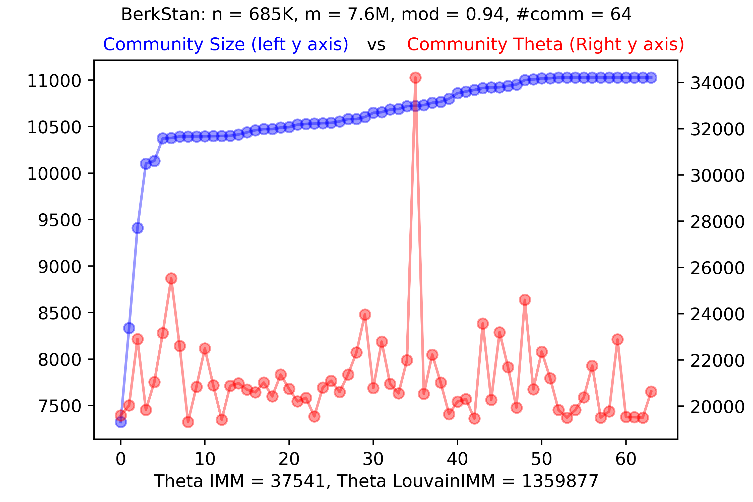
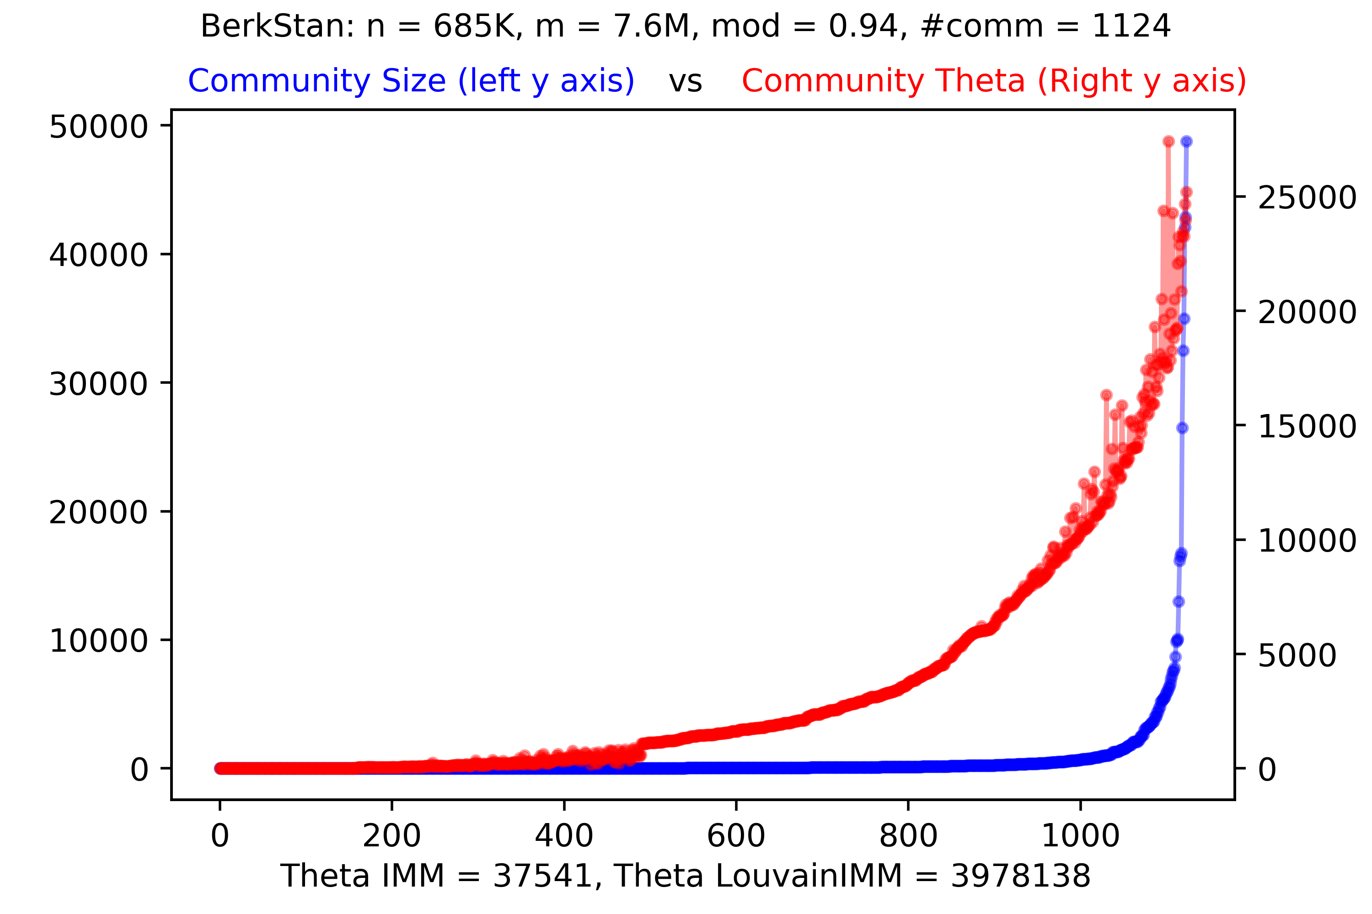
Sampling Effort vs Comm/Partition Size

Slide 7
To Do:
Investigate the bottleneck
Make sure that the sum of sampling effort across all communities < sampling on the whole graph by IMM
Parallelize the heap update across communities
Redo the experiments after doing 1-3
Go for distributed approach if everything fails
To Do:
Same weighted graph as i/p to Grappolo and Louvain-IMM/IMM
Investigate Community graph to check which community is most connected to other
Budget K according to some rule:
Use Grappolo to partition into communities (edge weights are normalized fractions of inter community edges)
Use IMM (ask for n/2 seeds) to generate an order and ask 1 seed for the last half.
For metis: K divided by #partitions as parameter to Sampling for each partition

Slide 8
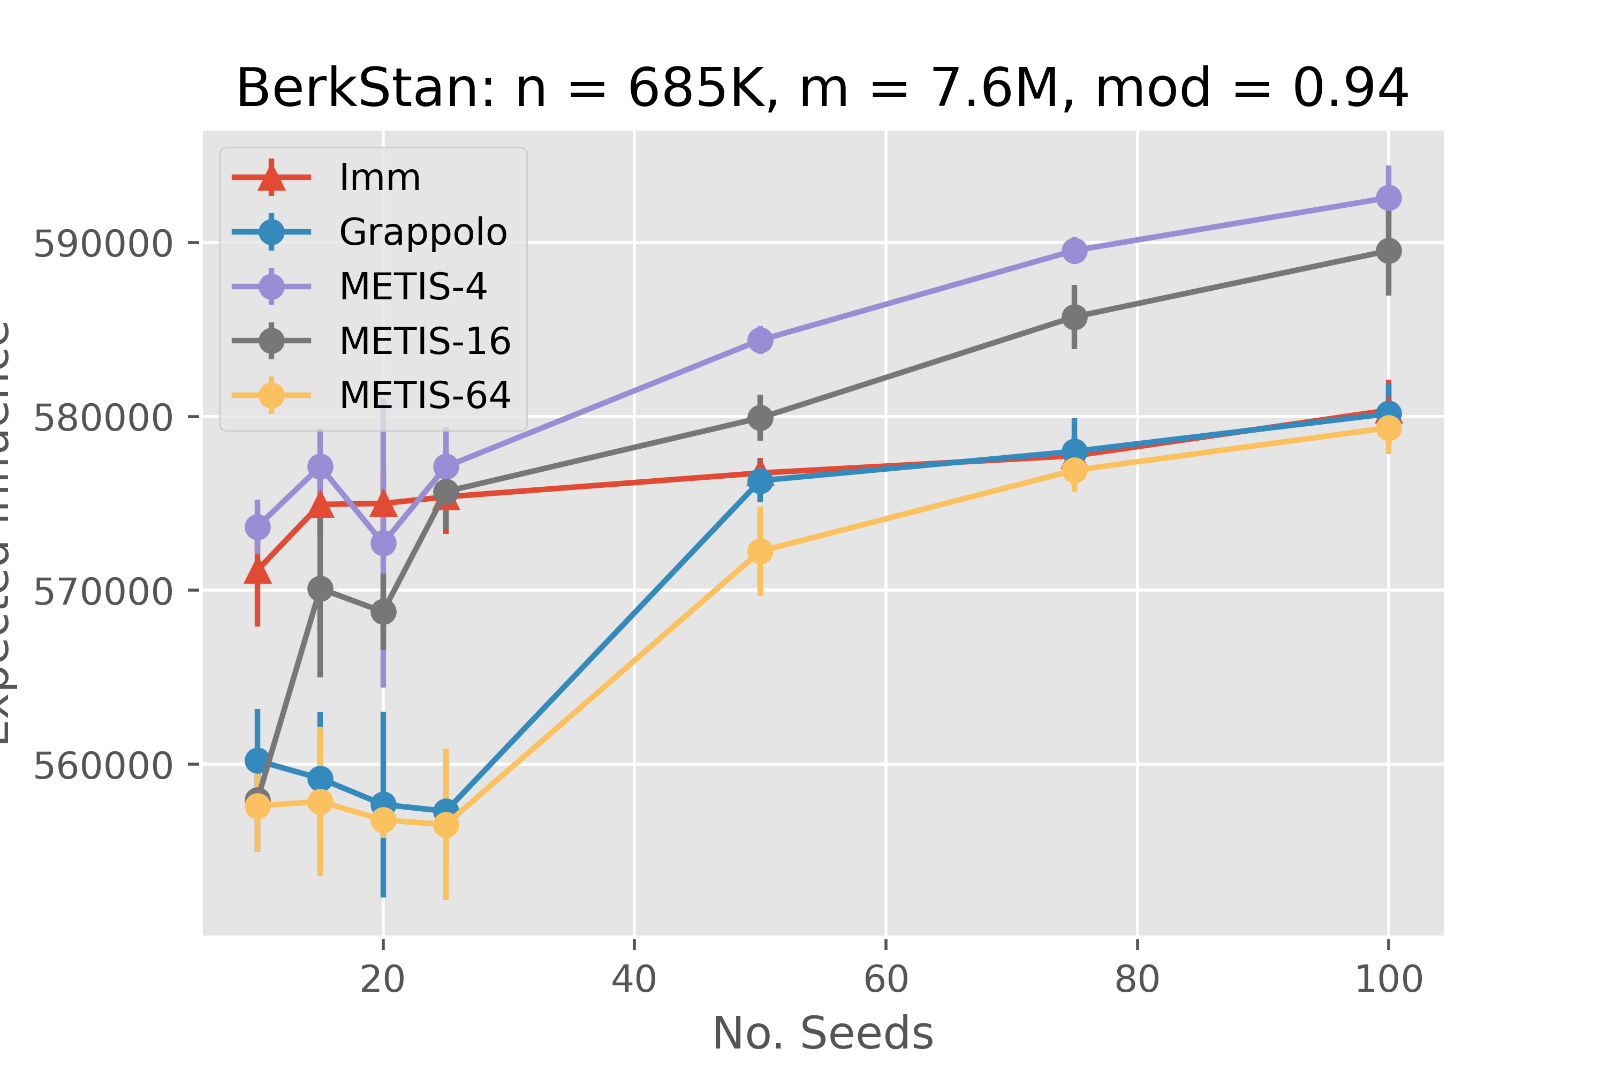
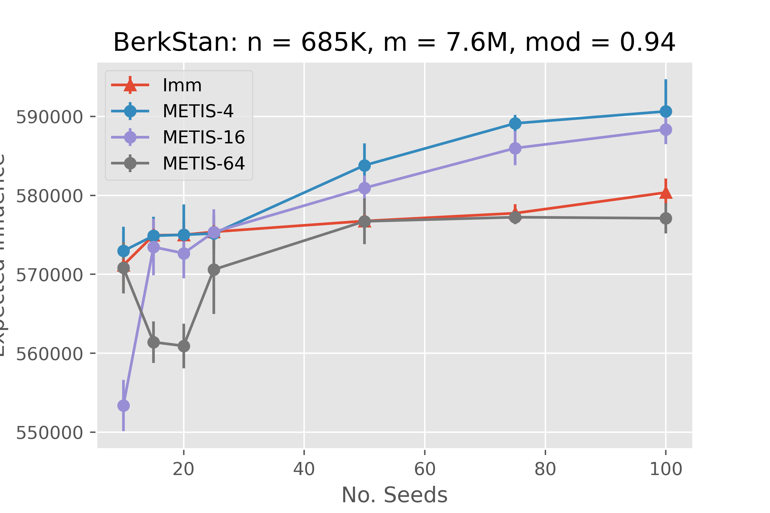
Expected Influence
Before (left) and After (right) Sampling Adjustment

Slide 9
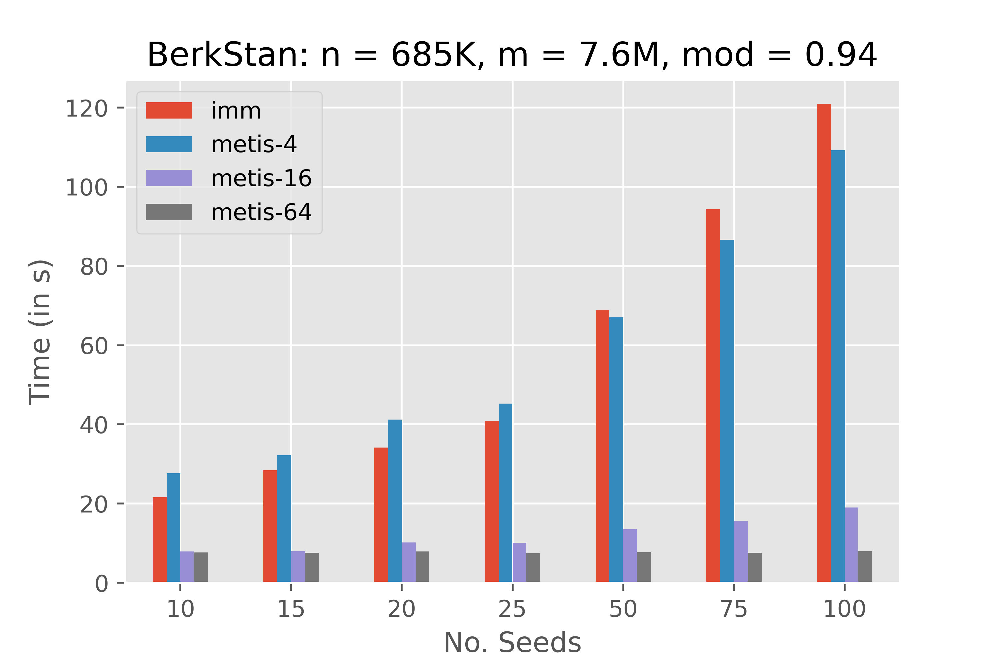
Execution Time
Before (left) and After (right) Sampling Adjustment

