Slide 1
OMIS 652: Data Base Management Systems
Group: D
Bharath Matlapudi (Z1974327)
Reethika Bollaboyana (Z1973175)
Gowtham Krishna Gutta (Z19736665)
Sandeesh Reddy Gayam (Z1970581)
Abhiram Reddy Nevuri (Z1975839)

Slide 2
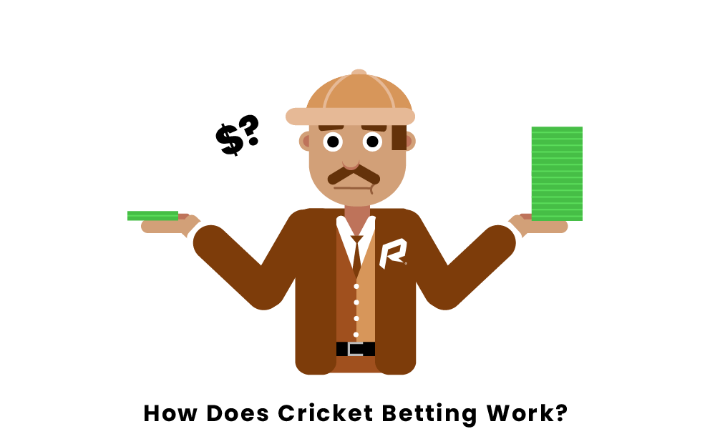
BETLIVE

Slide 3

AGENDA
Description
ER diagram
Database Diagram
SQL queries

Slide 4
Description
Betlive is a online cricket betting app.
The customer will create an account and will add certain amount in the wallet to place the bets.
Betlive provides only one type of betting , that is, the result of the match.
The winner will receive double the amount he spend on betting.

Slide 5
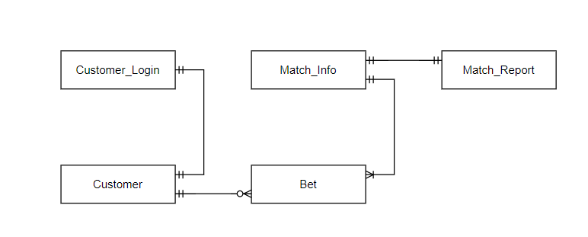
ER Diagram
Customer and bet relation

Slide 6
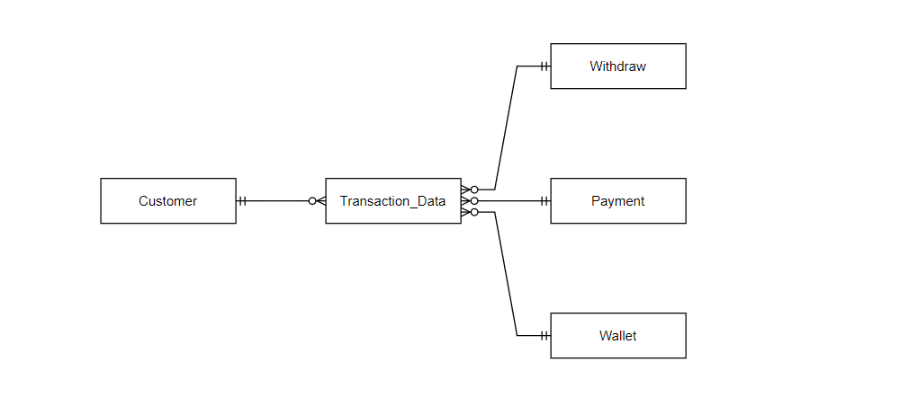
Transaction and customer relation

Slide 7
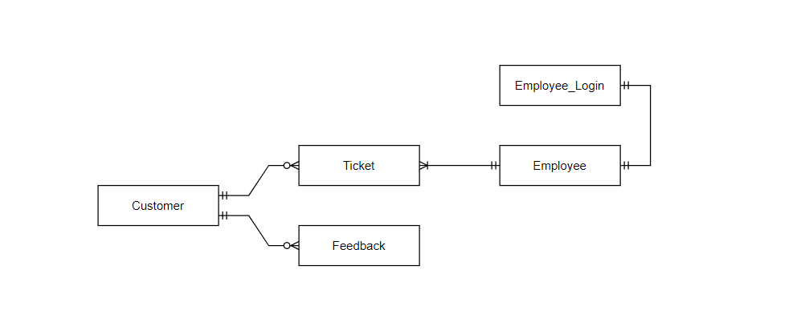
Customer, employee and ticket relation

Slide 8
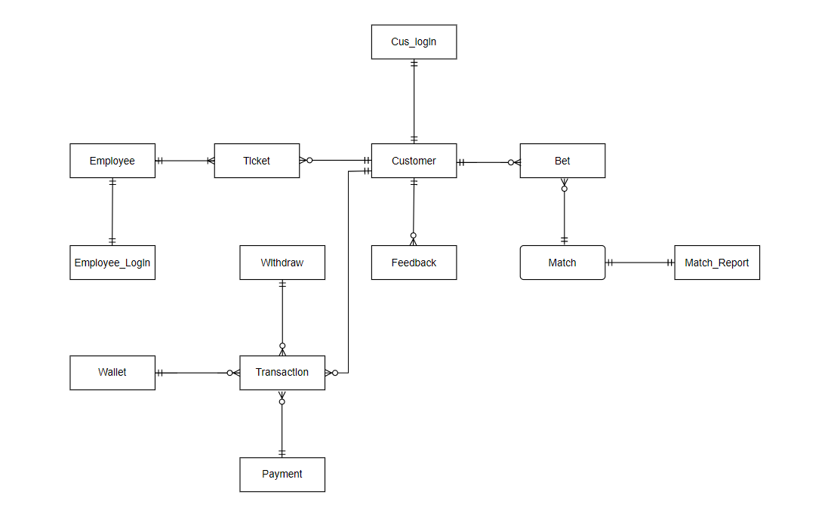

Slide 9
Assumptions
We can have multiple bets in each match and advance betting of the match.
Customers can place bets only by loading the wallet first.
If the customer guesses the winning team, they receive double the amount.
Team1 list is ‘home team’ and Team2 list is ‘away team’
Each customer can place a bet only by loading the amount in the wallet.

Slide 10
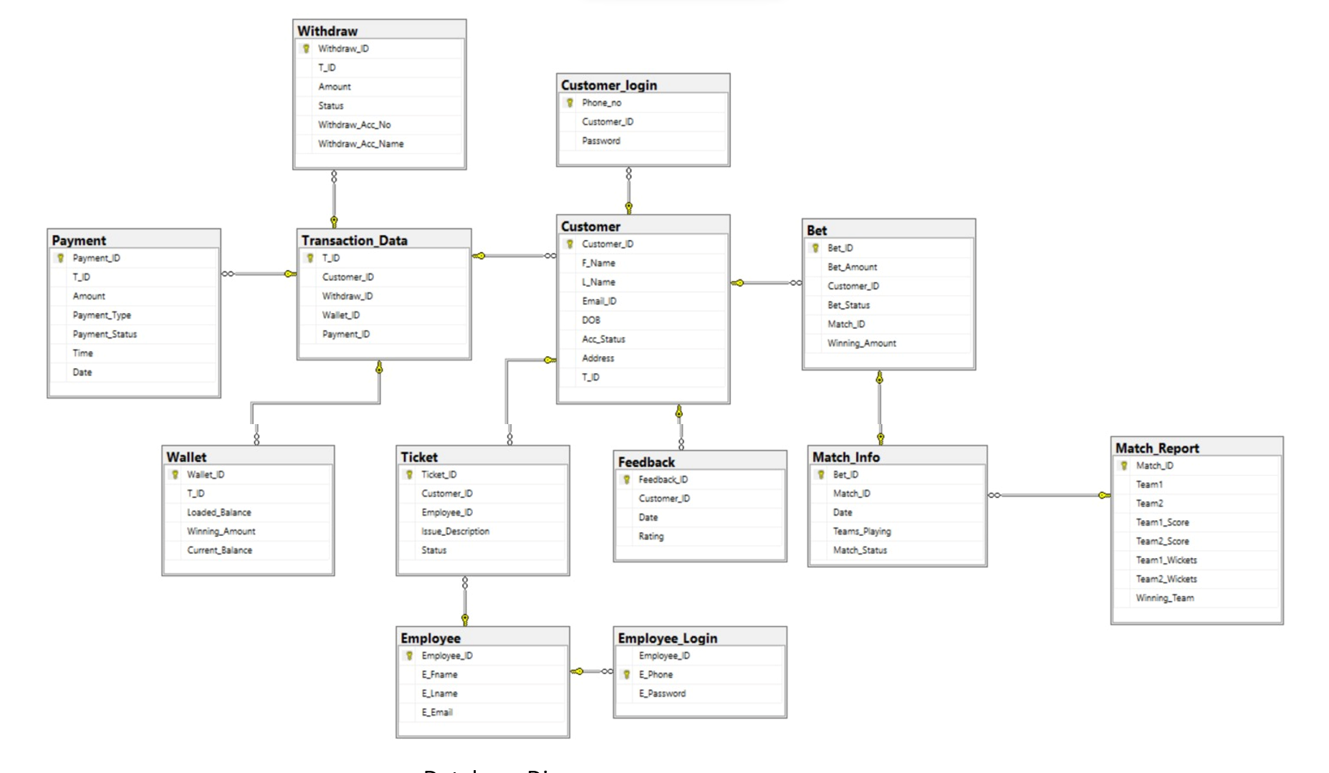
Database Diagram

Slide 11
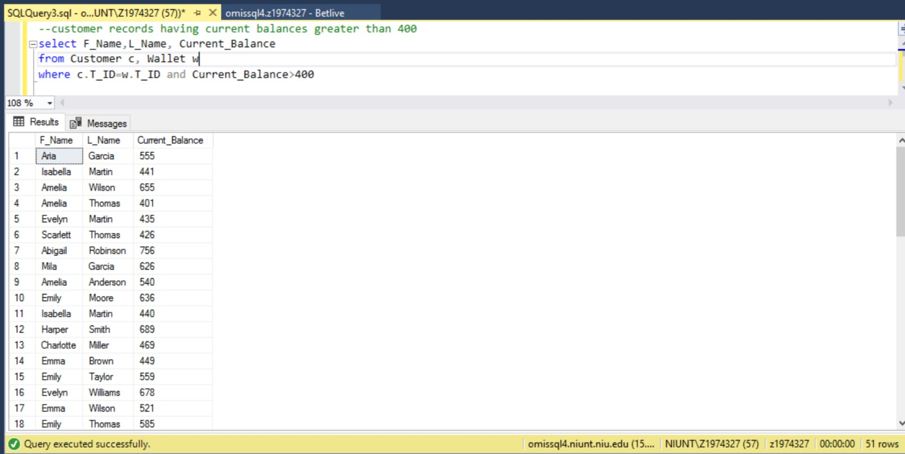
Queries

Slide 12
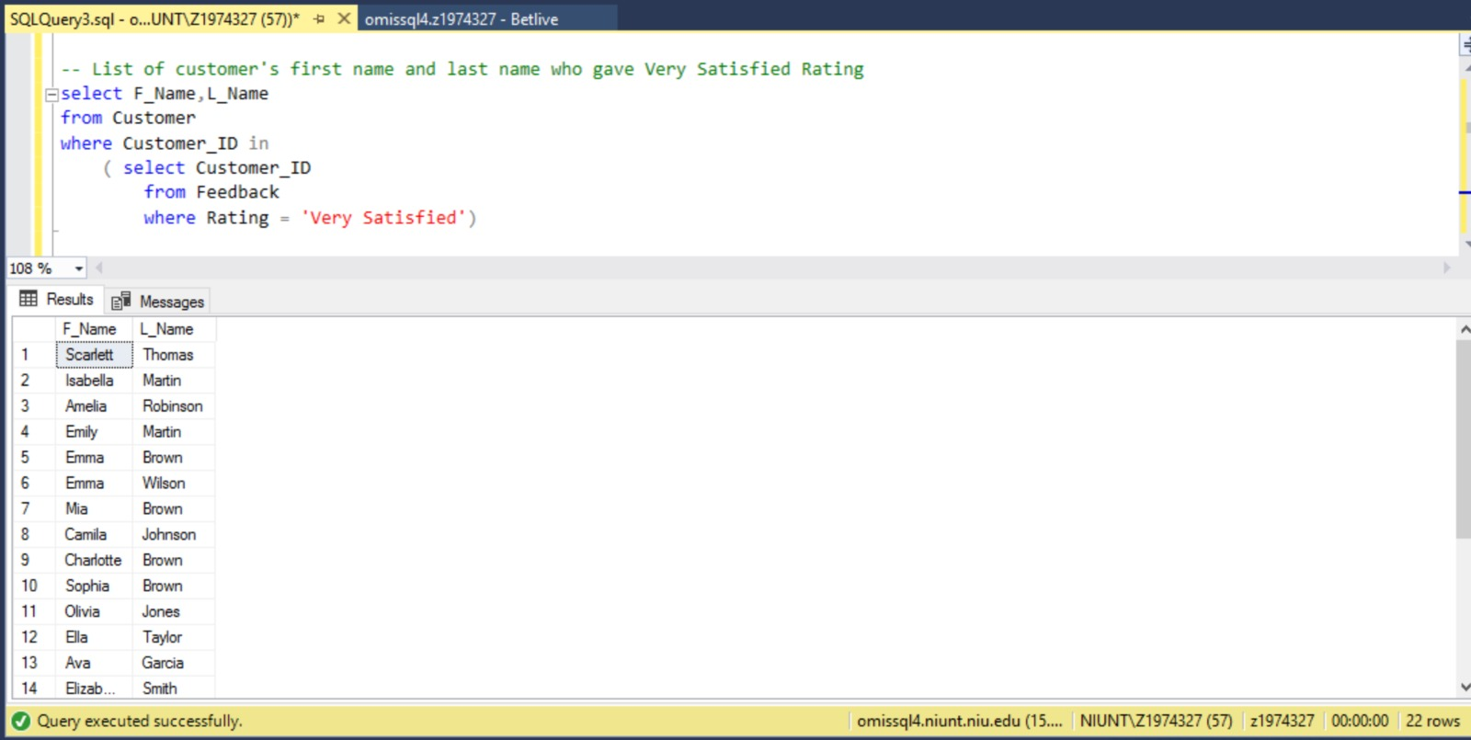

Slide 13
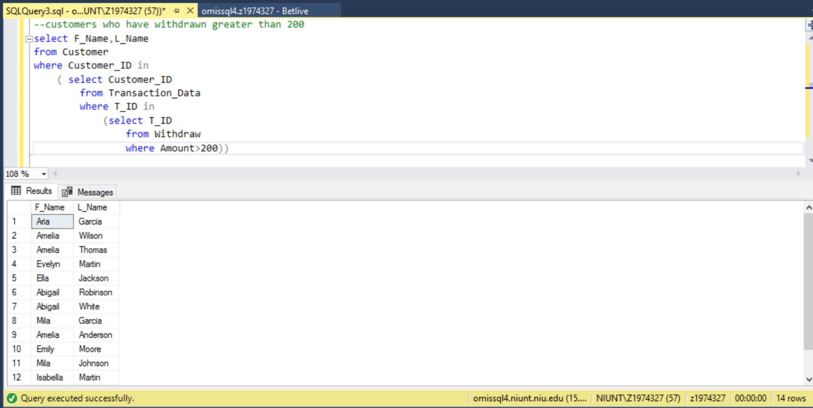

Slide 14
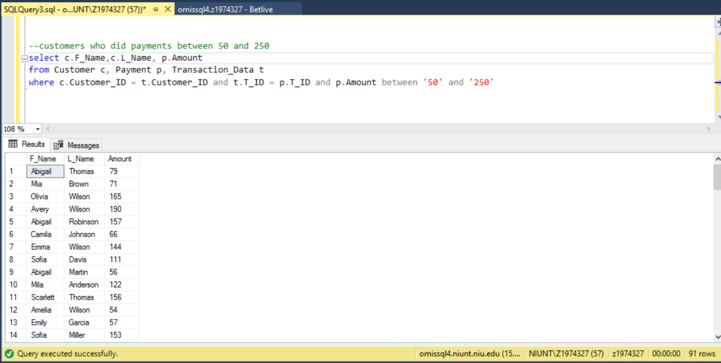

Slide 15
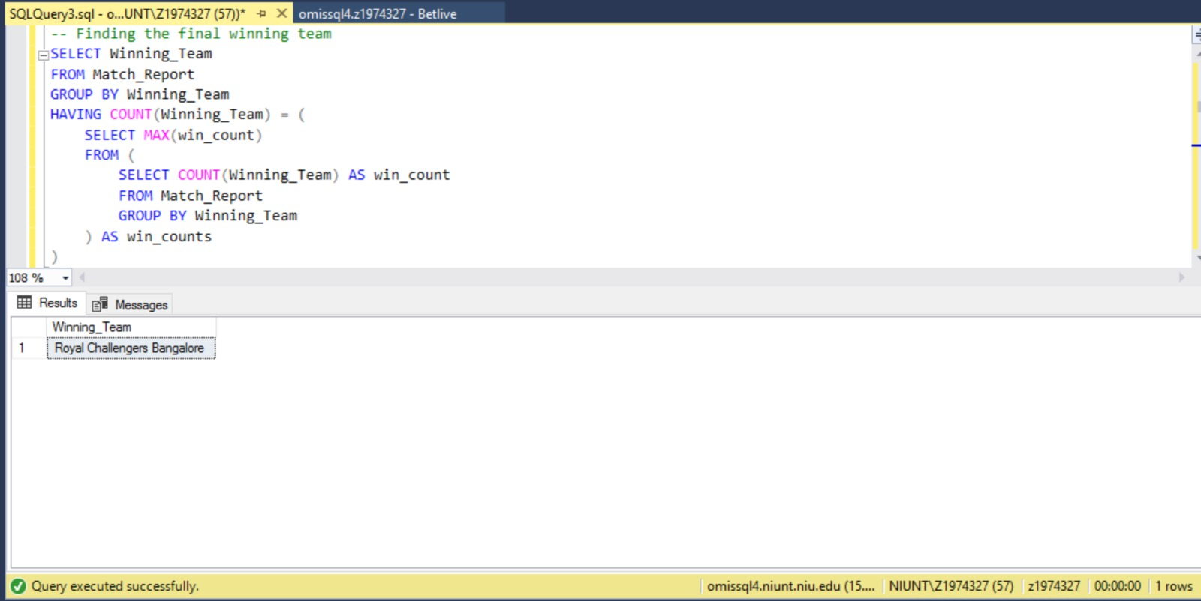

Slide 16


Slide 17
Any Questions?

Slide 18

Thank YOU.

