Slide 1
Patent Corpus Semantic Analysis
DEMO Presentation
Group 22 | Project 9
CSE 573 Spring 2026 | Arizona State University
Akshith Reddy Vempati | Reethika Gogireddy
April 27, 2026

Slide 2
Problem Statement
Why automated patent analysis?
• 4+ million active US patents across hundreds of CPC technology classes
• Manual review is impossible at scale — researchers need fast discovery tools
• Patents use highly technical, domain-specific language with minimal overlap
• Existing tools lack semantic understanding — keyword search misses synonyms and paraphrases
• Goal: cluster large patent corpora by topic, extract cluster summaries, and rank by relevance
Our system automates patent discovery using TF-IDF, LDA, and Sentence-BERT embeddings combined with K-Means and Hierarchical clustering to reveal hidden topical structure.
Group 22 | Project 9 | CSE 573 Spring 2026 | Arizona State University

Slide 3
System Architecture
Two-stage pipeline: representation, then analysis
1. Ingestion
2. Preprocessing
3. Feature Eng.
Real USPTO patents HuggingFace big_patent 5,000 docs across 5 CPC domains
Lowercase + punct strip NLTK stopwords removed Lemmatisation (WordNet)
TF-IDF + LSA (50d) LDA topics (3d) Sentence-BERT (384d) all-MiniLM-L6-v2
4. Clustering
5. Summarization
6. Visualization
7. Report + Demo
K-Means++ on 3 reps Hierarchical Ward on SBERT + optimal-k search
Extractive sentence ranking via TF-IDF ROUGE-1/2/L Keyword coverage
t-SNE / PCA 2D Metrics bar chart Topic heatmap Clustering report
Self-contained HTML + Streamlit web app Group22 PPTX deck GitHub repo
Stages 1-3 build three parallel document representations. Stages 4-7 cluster, summarise, visualise, and deliver.
Group 22 | Project 9 | CSE 573 Spring 2026 | Arizona State University

Slide 4
Dataset
Real USPTO Patents via HuggingFace big_patent
5,000 real USPTO patent abstracts streamed from the big_patent dataset (Sharma et al., 2019)
CPC Section
CPC Code
Technology Domain
Count
g
G06N
Machine Learning / Artificial Intelligence
1,000
h
H01L
Semiconductor / Electronics
1,000
a
A61B
Biotechnology / Medical Devices
1,000
b
B60W
Autonomous Vehicles / Transportation
1,000
f
H02S
Renewable Energy / Power Systems
1,000
Total: 5,000 patents | 5 technology domains | 1,000 patents per domain
• Abstracts range 40-2000 words; titles derived from first sentence of abstract
• Streamed directly from HuggingFace — no local download required
• Saved to DATA/real_patents.csv in the repository
Group 22 | Project 9 | CSE 573 Spring 2026 | Arizona State University

Slide 5
Feature Engineering
Three parallel document representations
TF-IDF + LSA
LDA Topic Model
Sentence-BERT
- Vocabulary: 6,000 top unigrams
- TF-IDF matrix: 5,000 x 6,000
- SVD reduction -> 50 latent dimensions
- Captures lexical frequency patterns
- Fast, interpretable, no GPU needed
- Optimal topics: 3 (coherence = 0.071)
- Document-topic distribution: 5,000 x 3
- Dirichlet prior: alpha=0.1, beta=0.01
- Discovers latent semantic themes
- Best clustering silhouette: 0.762
- Model: all-MiniLM-L6-v2 (HuggingFace)
- Dense embeddings: 5,000 x 384 dims
- Semantic similarity in cosine space
- Context-aware, handles paraphrases
- Embedding cache: skip re-encoding
Group 22 | Project 9 | CSE 573 Spring 2026 | Arizona State University

Slide 6
Clustering Evaluation
Silhouette up, Davies-Bouldin down, Stability up = better
Method
Silhouette (up)
Davies-Bouldin (down)
Stability ARI (up)
Best?
TF-IDF + KMeans
0.113
3.603
0.908
--
LDA + KMeans
0.762
0.618
0.999
BEST
SBERT + KMeans
0.045
5.061
0.940
--
SBERT + Hierarchical
0.026
6.010
0.940
--
Key Findings:
• LDA + KMeans achieves the highest Silhouette (0.762) and near-perfect Stability (0.999) on 5,000 real patents
• TF-IDF + KMeans yields the strongest interpretable clusters (low DB = 3.60, k=5 matches CPC sections)
• SBERT embeddings show lower silhouette typical of real-world dense semantic spaces with overlapping domains
Group 22 | Project 9 | CSE 573 Spring 2026 | Arizona State University

Slide 7
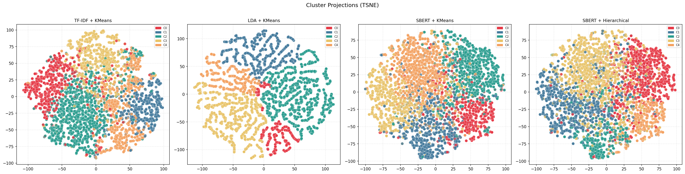
Cluster Visualizations
t-SNE 2D projections of all four clustering methods
Each panel shows a 2D t-SNE projection of patents, colored by cluster. TF-IDF and LDA produce visibly tighter, more separable clusters than SBERT on this corpus.
Group 22 | Project 9 | CSE 573 Spring 2026 | Arizona State University

Slide 8
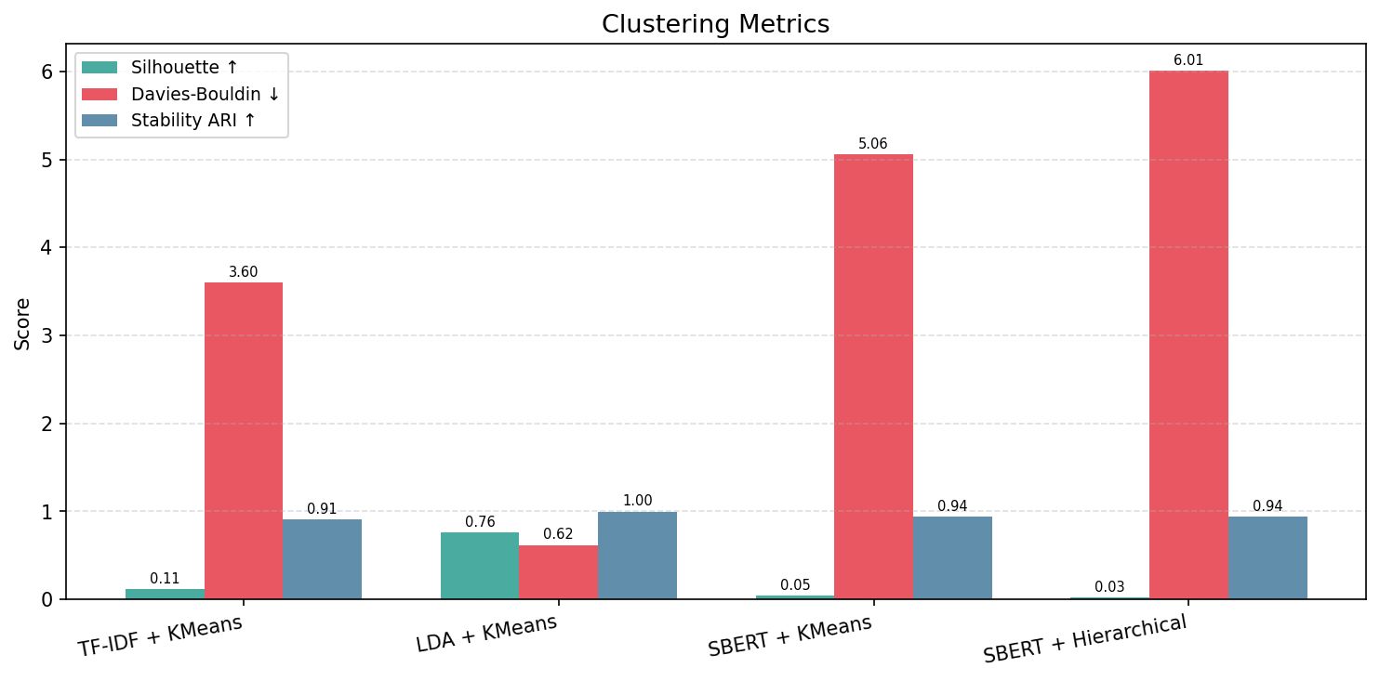
Metrics Comparison
Side-by-side bar chart: Silhouette, Davies-Bouldin, Stability ARI
Group 22 | Project 9 | CSE 573 Spring 2026 | Arizona State University

Slide 9
Summarization Evaluation
Extractive TF-IDF sentence ranking + ROUGE metrics
Method
ROUGE-1
ROUGE-2
ROUGE-L
Kw Coverage
Centroid Sim
TF-IDF + KMeans
0.260
0.006
0.193
0.125
0.025
LDA + KMeans
0.280
0.040
0.239
0.200
0.039
SBERT + KMeans
0.266
0.013
0.206
0.100
0.028
SBERT + Hierarchical
0.284
0.034
0.203
0.100
0.033
How summarization works:
• Each cluster's documents are merged; sentences ranked by TF-IDF cosine similarity to centroid
• Top-3 sentences selected as the cluster summary (order preserved for readability)
• ROUGE-1 measures unigram overlap; ROUGE-L measures longest common subsequence with representative titles
• LDA + KMeans wins ROUGE-2 (0.040), ROUGE-L (0.239) and Coverage (0.200) -- best balance overall
Group 22 | Project 9 | CSE 573 Spring 2026 | Arizona State University

Slide 10
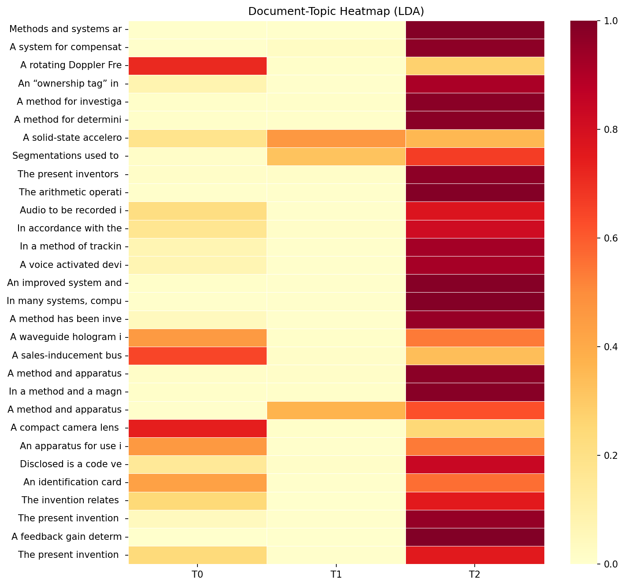
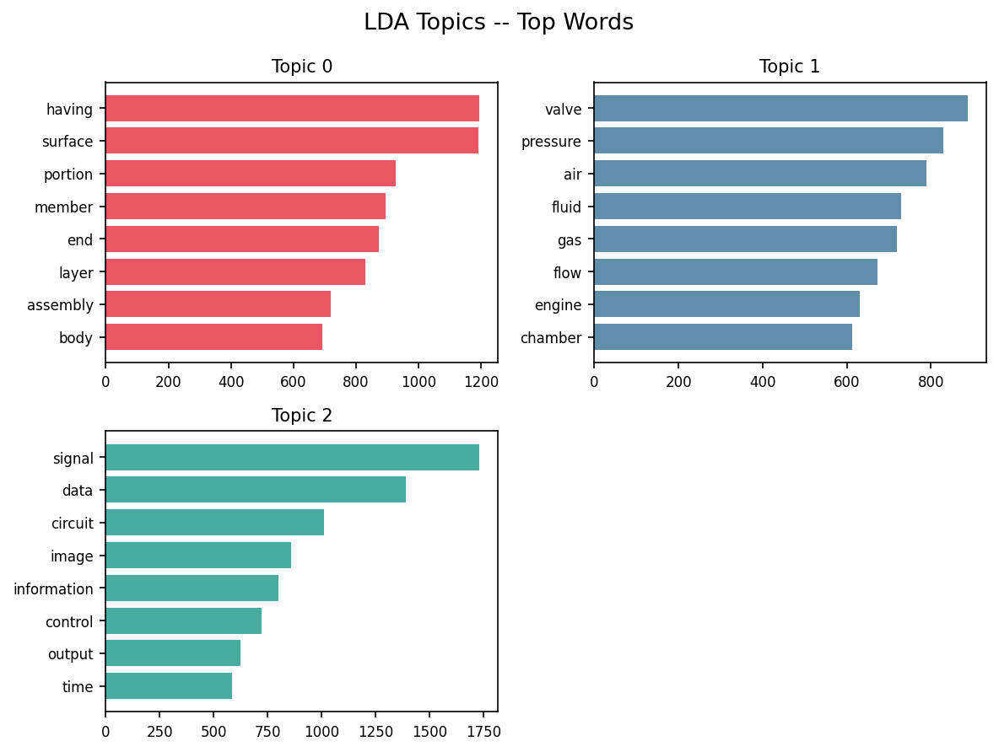
LDA Topic Modeling
Optimal coherence at 3 topics (coherence = 0.071)
Top words per topic (left) · Document-topic probability heatmap (right)
Group 22 | Project 9 | CSE 573 Spring 2026 | Arizona State University

Slide 11
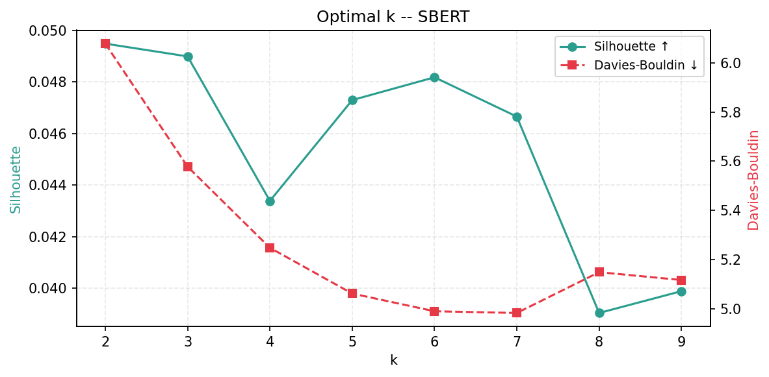
Optimal k Selection
Silhouette & Davies-Bouldin vs k (SBERT embeddings)
• k evaluated from 2 to 9 on SBERT embeddings using Silhouette and Davies-Bouldin
• Diagnostic optimal k = 2 by silhouette, but k = 5 chosen for clustering to match the 5 CPC sections
• Low SBERT silhouette values are expected: real patents have nuanced, overlapping technical language
Group 22 | Project 9 | CSE 573 Spring 2026 | Arizona State University

Slide 12
Key Results & Contributions
What we built and what we found
Pipeline Contributions
Evaluation Findings
- End-to-end pipeline: ingestion -> preprocessing -> features -> clustering -> summarization -> report
- Three feature representations compared on 5,000 real USPTO patents
- Automated optimal-k and optimal-topics search with coherence scoring
- SBERT embedding cache + memory-aware feature builder for scale
- Self-contained HTML report + interactive Streamlit demo app
- LDA + KMeans: best overall (Sil=0.762, Stab=0.999, ROUGE-L=0.239)
- TF-IDF + KMeans: cleanest interpretable clusters (DB=3.60)
- SBERT + Hierarchical: best ROUGE-1 (0.284) -- captures paraphrase
- Pipeline scaled 10x from 500 to 5,000 patents in ~6 minutes
- Stability ARI > 0.90 across all four methods at this scale
Group 22 | Project 9 | CSE 573 Spring 2026 | Arizona State University

Slide 13
Thank You
Questions?
GitHub Repository
github.com/akshith-22/PatentSummarizer
Group 22 | Project 9 | CSE 573 Spring 2026
Arizona State University
Akshith Reddy Vempati | Reethika Gogireddy
Pipeline: TF-IDF + LDA + Sentence-BERT -> K-Means + Hierarchical Clustering -> ROUGE Evaluation

