Slide 1
TASK-2

Slide 2
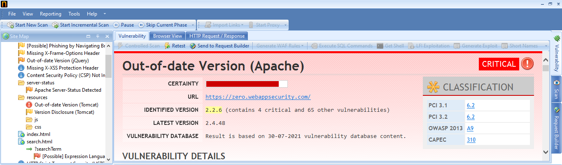

Slide 3
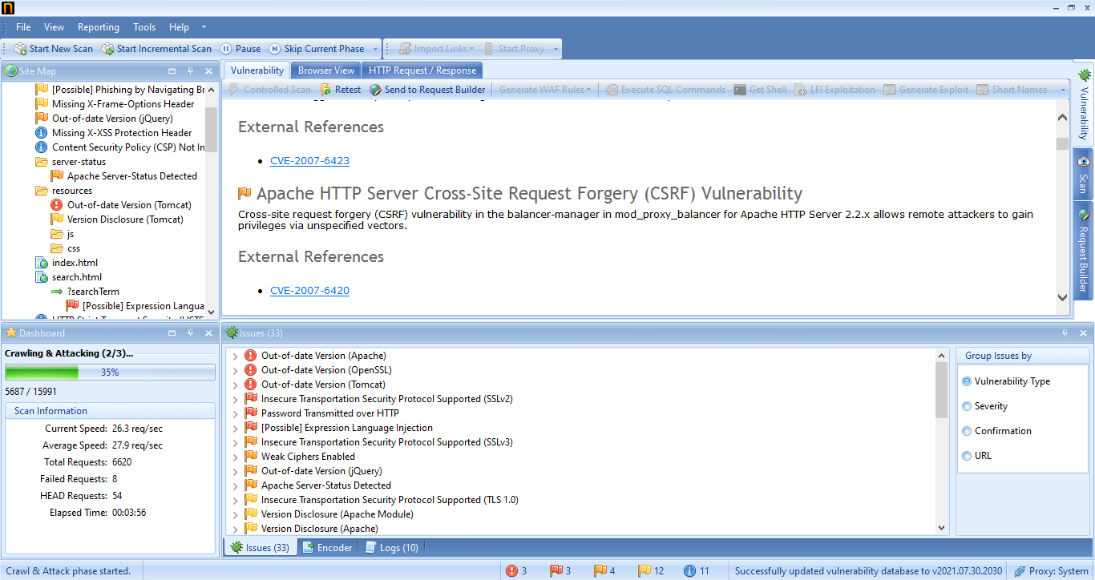

Slide 4
REPORT
TITLE: CROSS-SITE SCRIPTING
DOMAIN: http://zero.webappsecurity.com/
LINUX 2021.2
DESCRIPTION: I found cross-site scripting vulnerability on our website which creates impact in stealing the login credentials and sensitive data of users.
STEPS FOLLOWED:
I used Netsparker to find this vulnerability.
Added http://zero.webappsecurity.com/ this URL in the dialog box and clicked start scan.
I defined customization option as default and it automatically scanned the website.
I found three critical vulnerabilities.

Slide 5
IMPACT: XSS can have tremendous impact on web application and its clients. Client records can be commandeered, qualifications could be taken, touchy information could be exfiltrated, and finally, admittance to your customer PCs can be acquired.
MITIGATION: Cross-site scripting can be prevented by Filter input on arrival. And Encode data on output. And we can also use appropriate response headers and Content Security Policy to keep our website safe and secure.

