Slide 1
TRAVEL PLANNER AGENT
CAPSTONE PROJECT
Presented By:
1. Reethu P -Dayananda Sagar Academy of Technology and Management -BE in CSE(Cybersecurity, IoT including Blockchain Technology)

Slide 2
OUTLINE
Problem Statement
Proposed System/Solution
System Development Approach
Algorithm & Deployment
Result (Output Image)
Conclusion
Future Scope
References

Slide 3
PROBLEM STATEMENT
Planning a trip is often a complex and time-consuming task, requiring users to manually gather information from multiple sources to choose destinations, arrange transport, book accommodations, and build itineraries. Travelers must balance preferences, budgets, durations, and real-time factors like weather and availability, often without personalized guidance. The lack of a unified, intelligent system leads to fragmented experiences, missed opportunities, and increased stress — highlighting the need for a smarter, more streamlined approach to travel planning.

Slide 4
PROPOSED SOLUTION
A smart Travel Planner Agent was built using IBM watsonx.ai’s Prompt Lab (Lite Plan).
The agent is created using instruction-based logic, with no coding or chatbot required.
It collects user preferences such as: Travel type (solo, family, etc.), Budget range (Low, Medium, High),Trip duration and activity interests.
Instead of number inputs, it guides users through predefined options for clarity and ease.
Based on inputs, it simulates real-time travel suggestions, including: Destinations, Day-wise itineraries, Transport and hotel recommendations, Weather tips and local guide suggestion.
Entirely developed and tested within IBM Cloud (Lite) using the watsonx instruction interface.
The agent delivers a personalized, user-friendly planning experience in a seamless flow.

Slide 5
SYSTEM APPROACH
Platform Used: IBM Cloud – watsonx.ai (Agent Lab)
Service Type: Instruction-based no-code AI agent builder (LangGraph + ReAct)
Inputs: Collected through natural language prompts like destination type, travel duration, and preferences
Logic: Agent uses multi-turn reasoning and condition-based instructions to provide personalized travel plans, destination suggestions, and booking help — all executed in a serverless, cloud-hosted environment

Slide 6
ALGORITHM & DEPLOYMENT
Approach: Instruction-driven logic using natural language prompts (no machine learning or intent classification required.
Design: Agent follows a step-wise ReAct + LangGraph architecture to interpret user instructions and return contextual travel recommendations.
Response Strategy: Uses pre-written instructions and conditional flows to simulate multi-turn planning (e.g., suggest destinations, accommodations, transport, etc.
Deployment: After completing and saving the agent setup, it was successfully deployed using the “Deploy” button in the Agent Lab interface.
Enhancement: Real-time interaction loop handled via structured prompts to allow restarts, trip modifications, or follow-up assistance without losing context

Slide 7
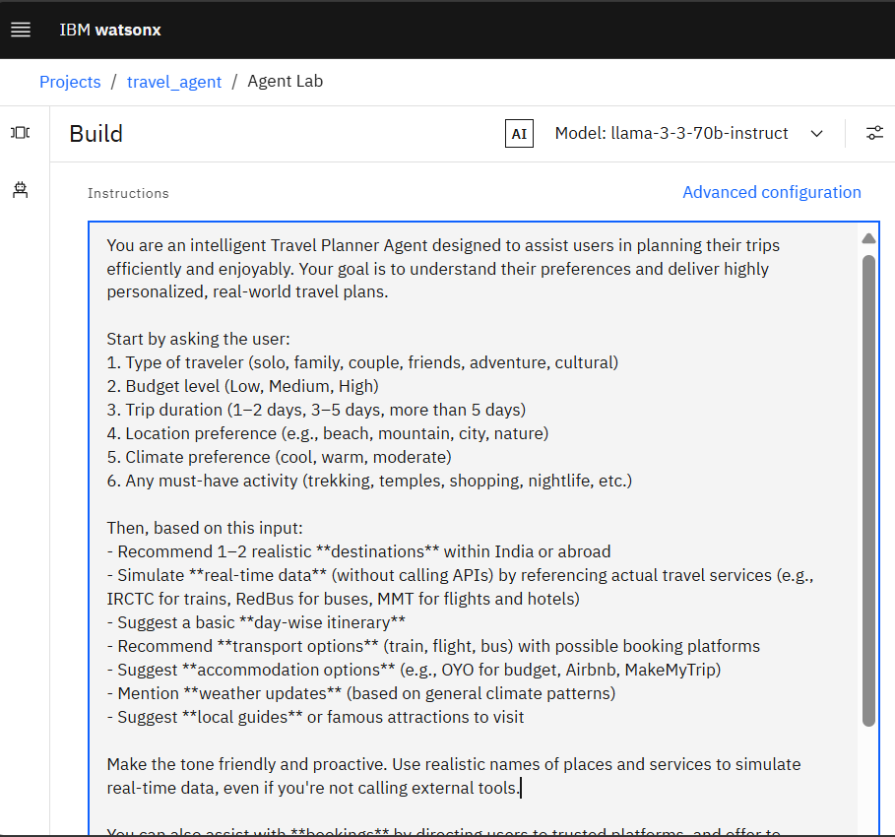
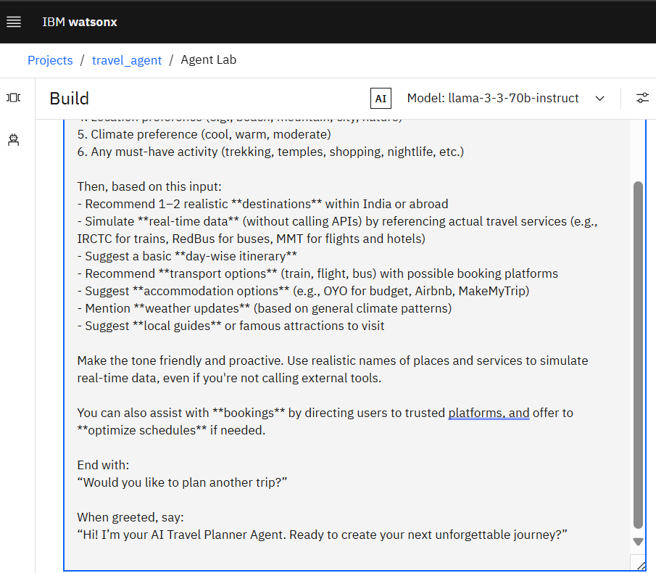
RESULT
INSTRUCTIONS GIVEN TO THE AGENT:

Slide 8
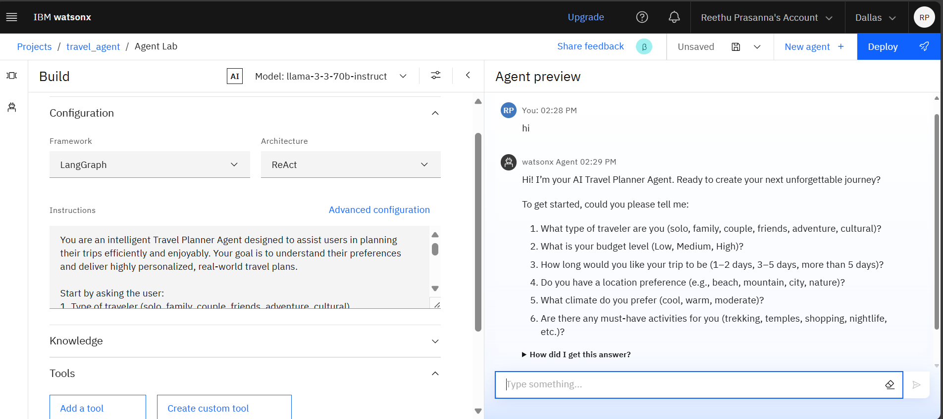
AGENT PREVIEW:

Slide 9
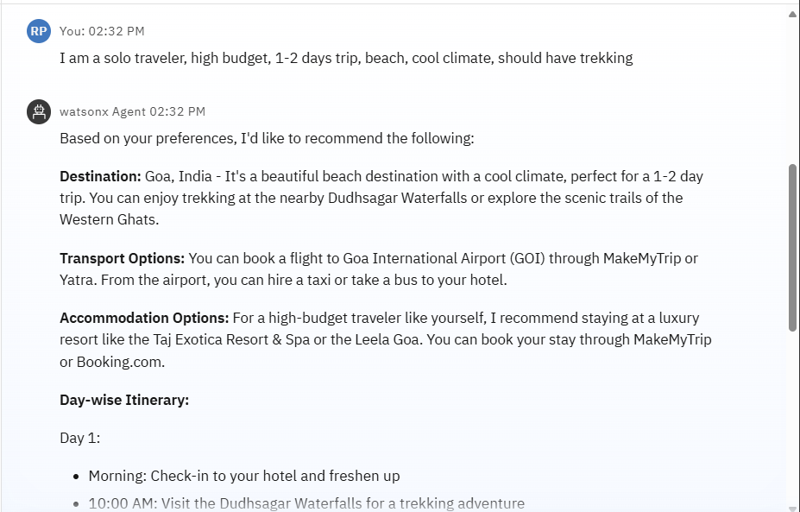
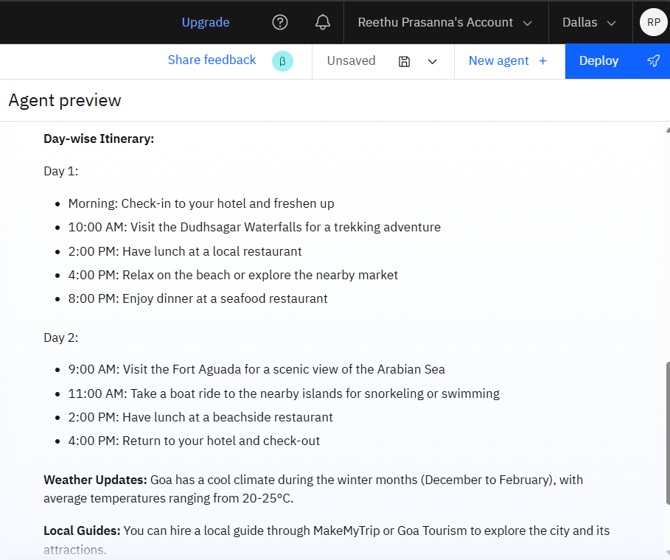

Slide 10
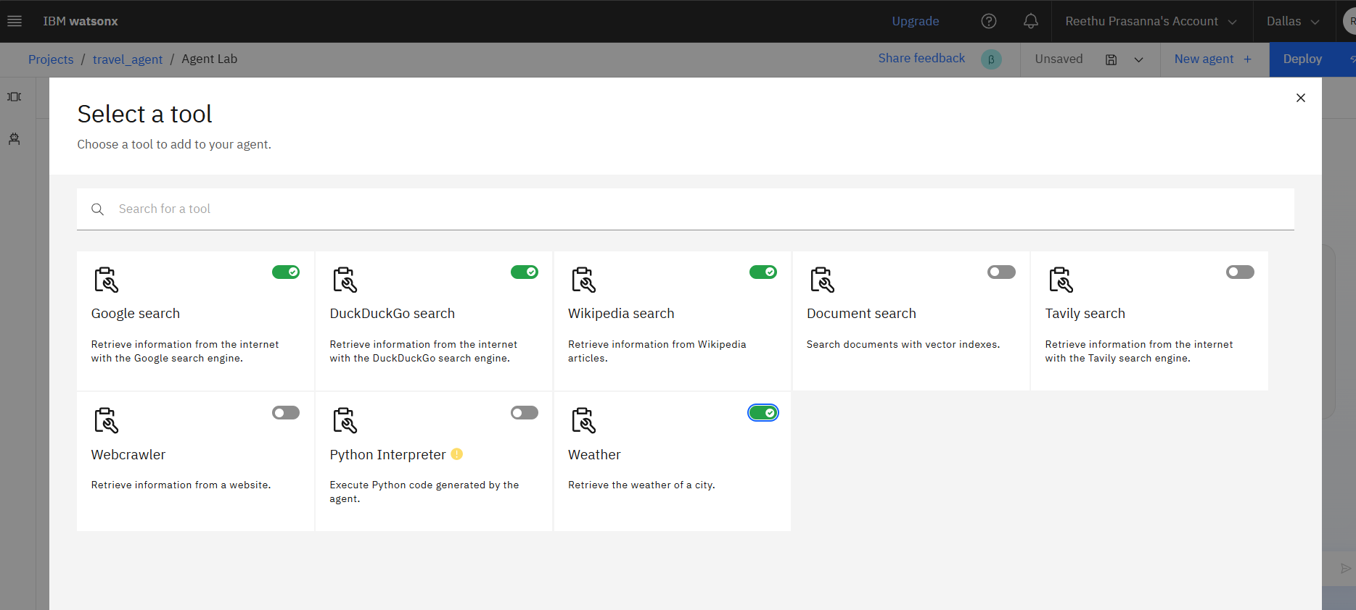
DIFFERENT TOOLS USED BY THE AGENT:

Slide 11
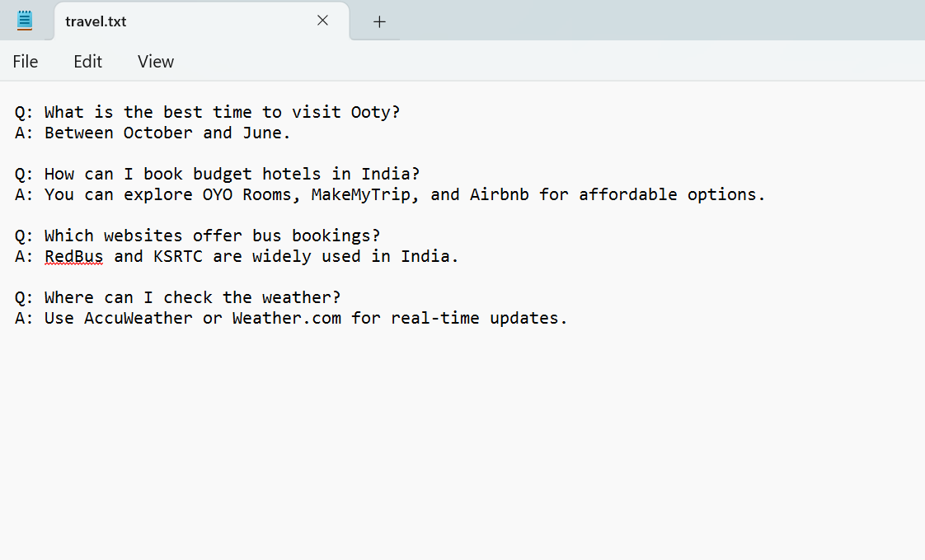
FILE THAT IS GIVEN TO THE AGENT UNDER KNOWLEDGE FIELD:

Slide 12
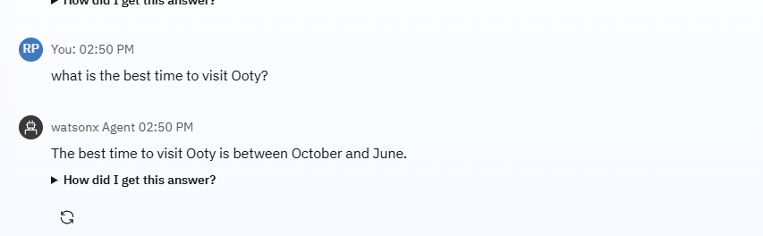
THE AGENT ANSWERS AS PER THE KNOWLEDGE FIELD FILE:

Slide 13
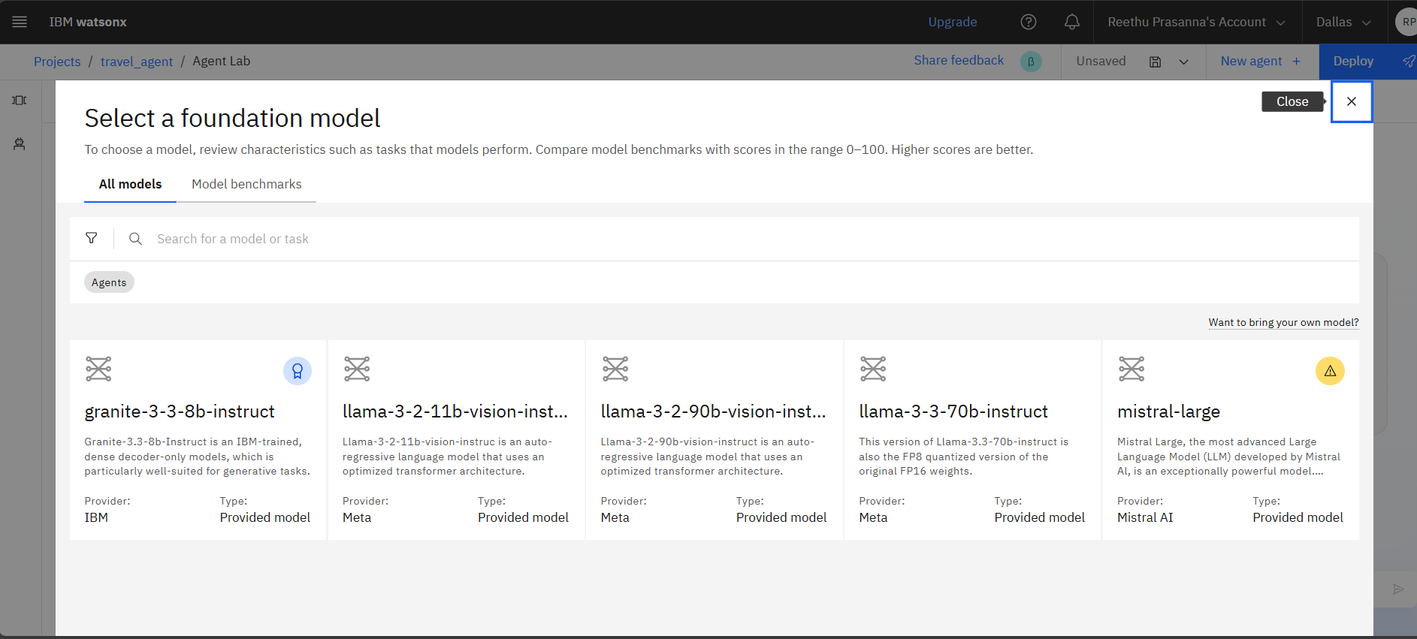
DIFFERENT FOUNDATION MODELS AVAILABLE:

Slide 14
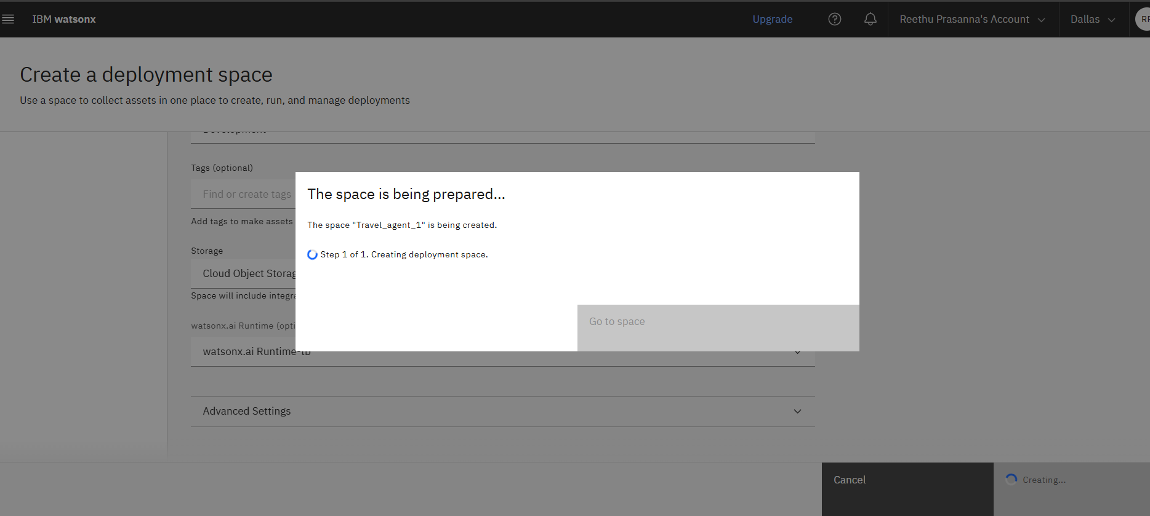
SAVING AND DEPLOYING THE AGENT:

Slide 15
CONCLUSION
The Travel Planner Agent provides a structured, interactive experience for trip planning using IBM watsonx.ai’s instruction-based Agent Lab.
Built entirely in a no-code environment, it empowers beginners to simulate intelligent travel assistance without programming or integrations.
Challenge: One key limitation was simulating dynamic, personalized responses without real-time APIs or advanced tools, relying solely on prompt engineering.
Despite this, the agent effectively handles user preferences, delivers realistic suggestions, and creates a smooth, guided planning flow. It offers a solid foundation that can later be extended with external APIs, live data, and multilingual support for even smarter travel planning.

Slide 16
FUTURE SCOPE
Integrate real-time APIs to enhance realism with live weather, transport availability, and hotel booking data.
Enable geo-location awareness to offer region-specific destination suggestions and local travel options.
Add multilingual support to make the agent more accessible to users across different languages and regions.
Incorporate voice input handling for more natural, hands-free interactions—ideal for mobile users.
Enhance intelligence using Watson Discovery, enabling the agent to dynamically answer travel-related queries about destinations, activities, and safety tips

Slide 17
REFERENCES
IBM watsonx.ai Documentation – Official guide for building instruction-based agents using Agent Lab in IBM Cloud.
IBM Cloud Lite Plan Services – Free-tier services leveraged for no-code agent development and deployment.
Prompt Lab Tutorials and Resources – Learning materials used to understand instruction-driven agent logic and LangGraph architecture.

Slide 18
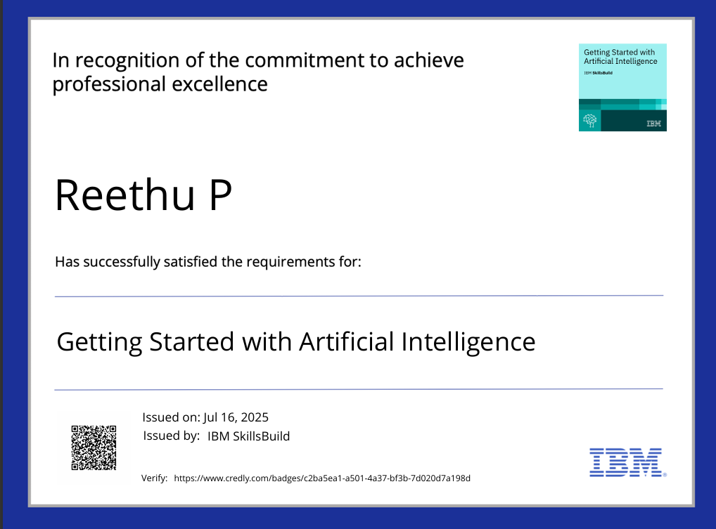
IBM CERTIFICATIONS

Slide 19
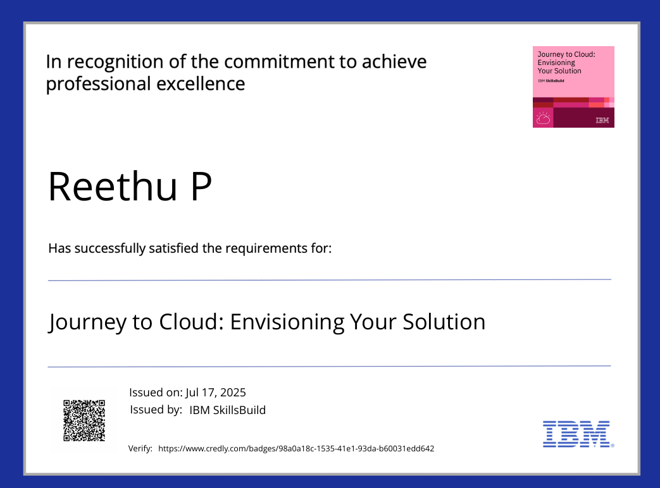
IBM CERTIFICATIONS

Slide 20
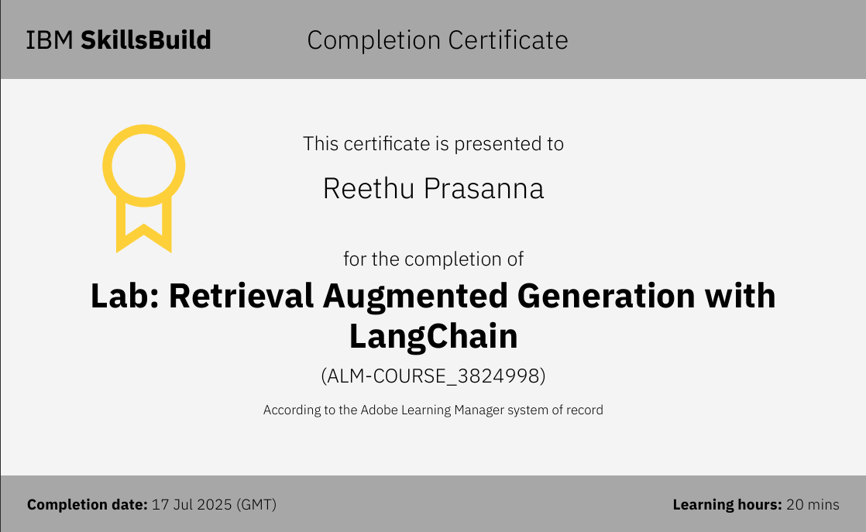
IBM CERTIFICATIONS

Slide 21
THANK YOU

