Slide 1

Morphology based Approach for Blood Vessel Segmentation in Retinal Images
Reetika GAUTAM

Slide 2
Contents
1. Introduction
1.1. Problem Statement
2. Methodology
2.1 Pipeline
2.2 Experiments & Results
3. Conclusion
3.1 Drawbacks of the algorithm
3.2 Learning Outcomes
1

Slide 3
Introduction
Retinal Blood Vessel Segmentation can be of greater importance because it carries vital information about many chronic disorders like Diabetic retinopathy (DR) .
For prediction of the early stage of these diseases, it’s important to segment the vessels from the fundus image in order to visualize the microaneurysms.
1

Slide 4
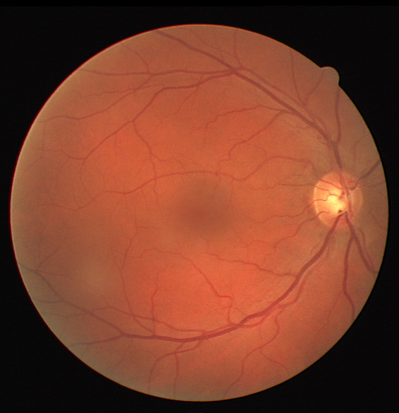
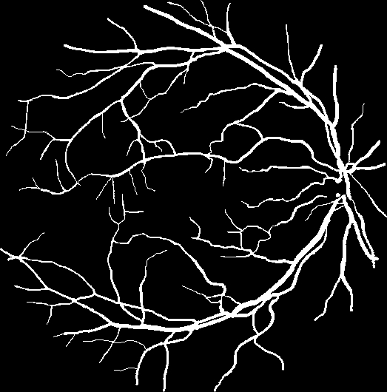
Problem Statement
Segmentation of blood vessel
Why?
→ DIABETIC RETINOPATHY
→ GLAUCOMA
→ HYPERTENSIVE RETINOPATHY
GIVEN INPUT
TARGET OUTPUT
1

Slide 5
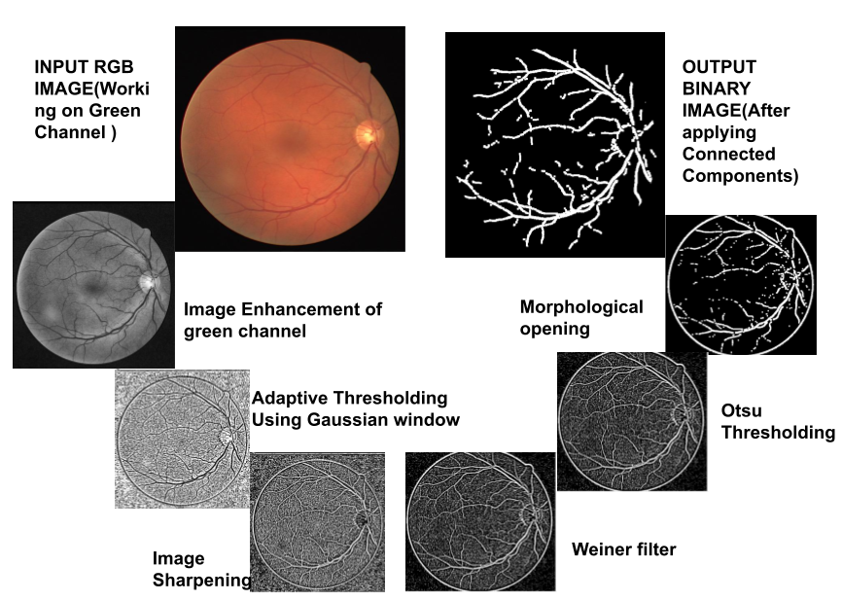
Basic Pipeline of the Algorithm
1

Slide 6
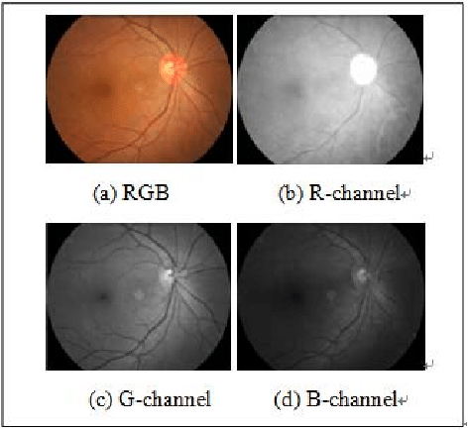
Methodology
In our implementation, we used simple image processing algorithms.
1. The Green Channel
The green band has the most necessary information related to the blood vessels in retinal image.
1

Slide 7
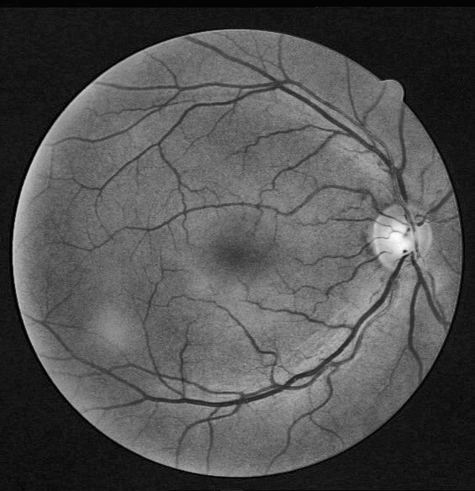
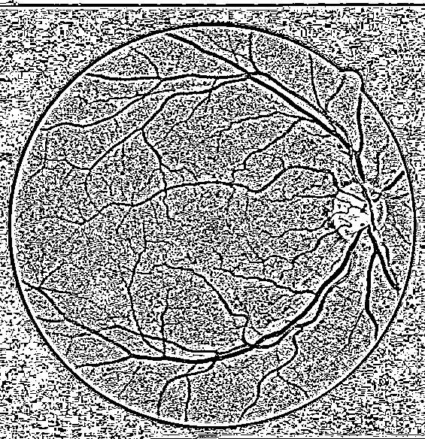
Methodology
2. CLAHE(Contrast Limited Adaptive Histogram Equalization)
It works on over-amplification of the contrast. CLAHE operates on small regions in the image, called tiles, rather than the entire image. The neighboring tiles are then combined using bilinear interpolation to remove the artificial boundaries.
3. Adaptive Thresholding
Adaptive thresholding is the method where the threshold value is calculated for smaller regions and therefore, there will be different threshold values for different regions.
1

Slide 8
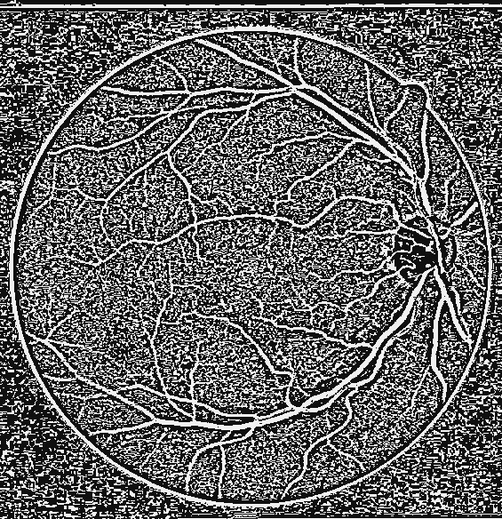
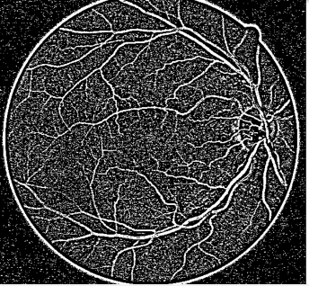
Methodology
4. Image Sharpening
Sharpening the image with filter [[-1,-1,-1],
[-1, 9,-1],
[-1,-1,-1]]
5. Image Denoising using Wiener Filter
The Wiener filtering executes an optimal tradeoff between inverse filtering and noise smoothing. It removes the additive noise and inverts the blurring simultaneously.
1

Slide 9
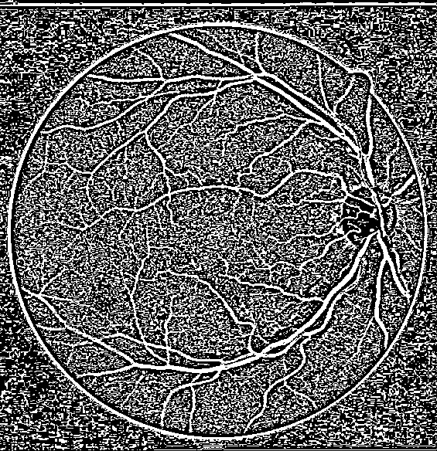
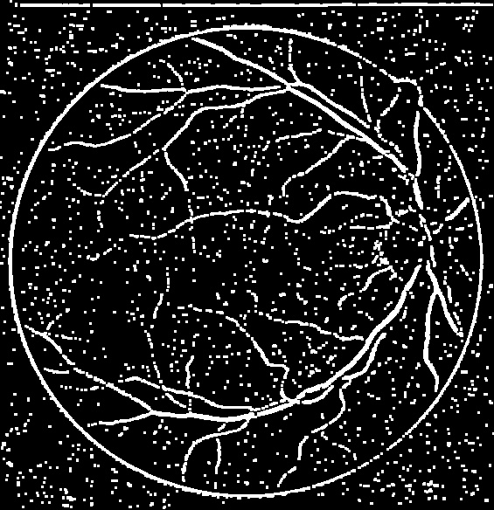
Methodology
6. Otsu thresholding
Otsu's thresholding method involves iterating through all the possible threshold values and calculating a measure of the pixels that either fall in foreground or background.
7. Morphological opening
Opening removes small objects from the foreground (usually taken as the bright pixels) of an image, placing them in the background.
1

Slide 10
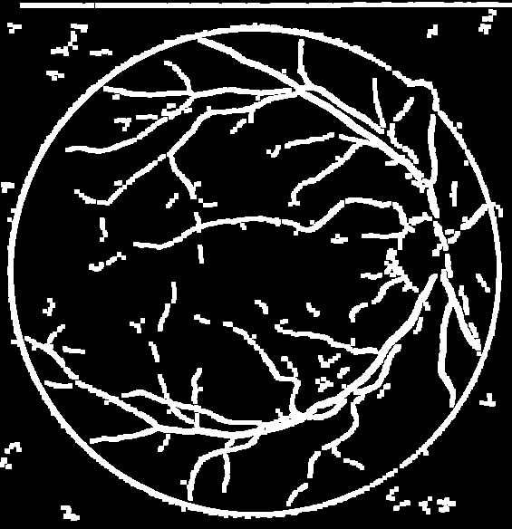
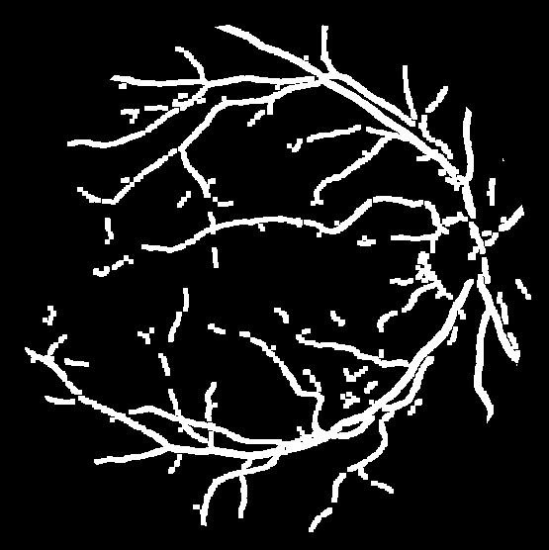
Methodology
8. Applying Connected Components
A set of pixels in which each pixel is connected to all other pixels is connected components. In our model it is used for connecting all the small disjoint blood vessels.
9. Removing Circle Using Mask
To the resultant Image, mask is eroded with 1 iteration and then multiplied with the processed image to remove the circle for a better view.
1

Slide 11
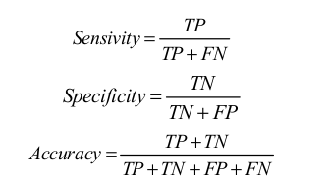
Experiment details
Dataset - The proposed method is evaluated on publicly available dataset DRIVE because this dataset provides the ground truth of retinal images precisely marked by experts
Evaluation method used:
1

Slide 12
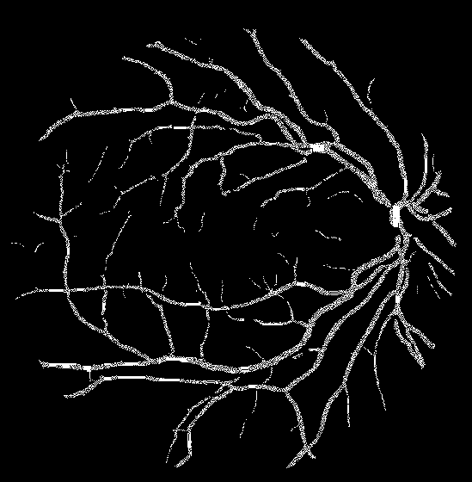
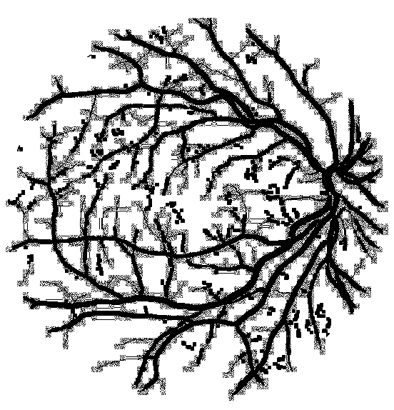
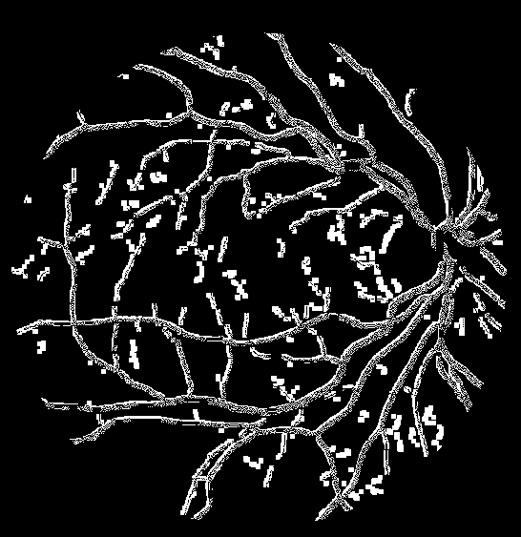
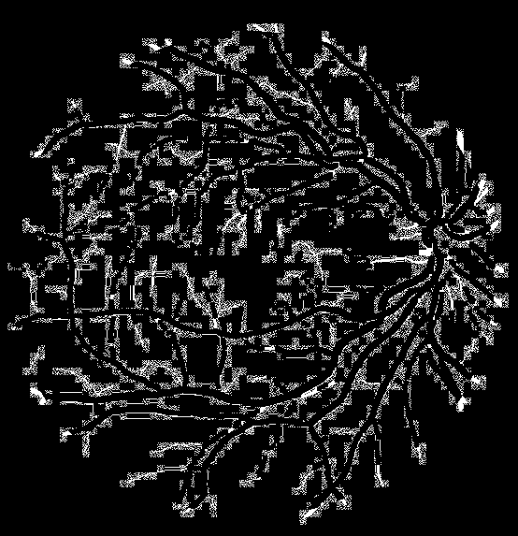
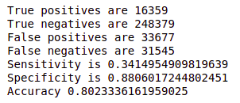
Evaluation
True positive
True negative
False positive
False negative
1

Slide 13
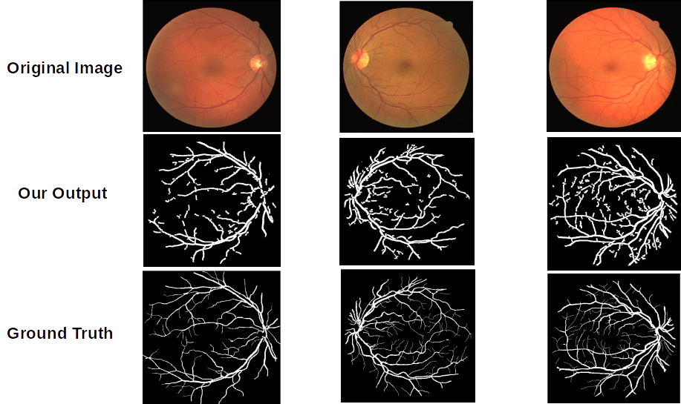
1

Slide 14
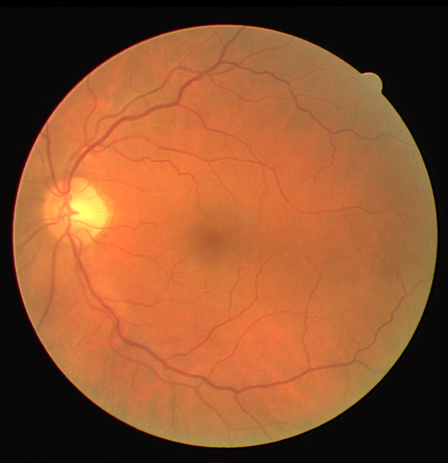
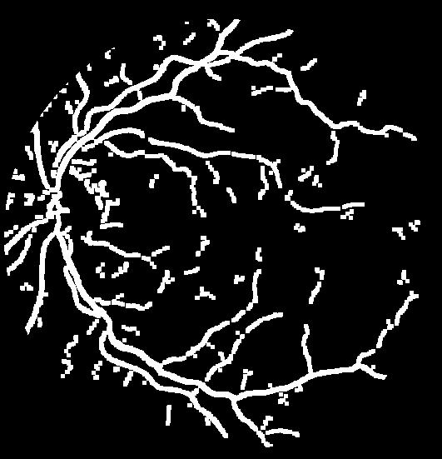
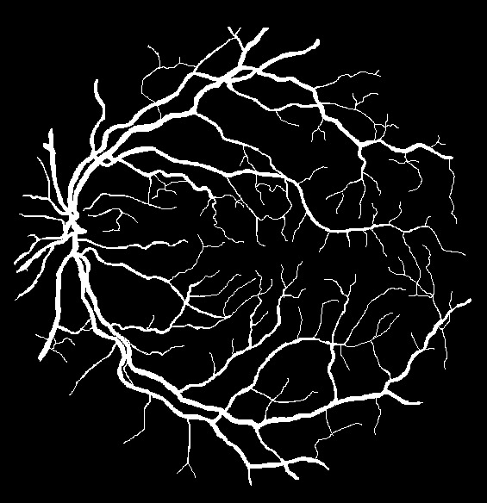
Drawbacks of our Model
Original Image
Our Output
Ground Truth
In this method, thin blood vessels get excluded from segmentation. A possible improvement is to enhance the blood vessels in the output of thresholding before applying morphological opening.
1

Slide 15
Conclusion
In this experiment, the vessels segmentation results can reach up to 80% accuracy. It segments most of the main vessels but fails for thin vessels like capillaries. Further research is needed to improve the performance.
1

Slide 16
Learning Outcome
Filtering and Morphological Operations
Evaluation methods for image processing algorithms
Implementation and analysis of the existing research works
<number>

Slide 17
References
[1] Umut Özkaya, Şaban Öztürk, Bayram Akdemir, and Levent Seyfi. An efficient retinal blood vessel segmentation using morphological operations. pages 1–7, 10 2018.
[2]https://docs.opencv.org/3.4/d3/dc0/group__imgproc__shape.html
<number>

Slide 18

<number>

