Slide 1


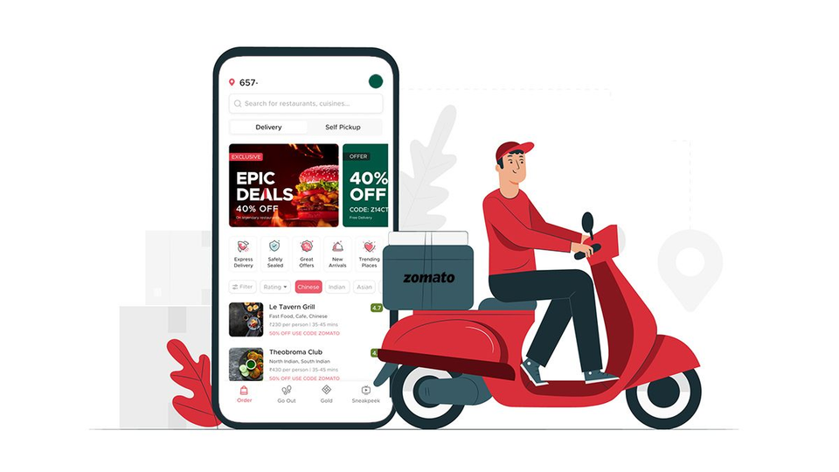
CAPSTONE PROJECT
(UNSUPERVISED -ML)
Zomato-Restaurant-Clustering & Sentiment-Analysis
BY-Reetika Srivastava
~ UNDER THE GUIDANCE OF TEAM

Slide 2


Slide 3
Project Summary
Zomato, founded by Deepinder Goyal and Pankaj Chaddah in 2008, is a renowned Indian restaurant aggregator and food delivery start-up. It serves as a platform that offers comprehensive information, including menus and user reviews, for various restaurants. Zomato also facilitates food delivery services through its partnerships with select restaurants in specific cities.
India is globally recognized for its rich and diverse culinary landscape, showcased through a plethora of restaurants and hotel resorts. This vibrant food culture reflects the essence of unity in diversity. As the restaurant industry in India continually evolves, more Indians are embracing the concept of dining out or ordering food for delivery. With the increasing number of restaurants across different states in India, there is an opportunity to explore the data and uncover valuable insights, intriguing facts, and figures about the Indian food industry in each city. Hence, this project focuses on analyzing the Zomato restaurant data for various cities in India.

Slide 4
Continue...
The project entails working with two separate files, each with self-explanatory columns. The first file contains restaurant names and metadata, which can be utilized to cluster restaurants into meaningful segments. The data within this file, such as information about cuisine and pricing, can be leveraged for conducting cost vs. benefit analysis. The second file comprises restaurant reviews, offering valuable data for sentiment analysis. Furthermore, the reviewer metadata can be utilized to identify key critics within the industry.
By delving into this project, valuable insights can be extracted, enabling a deeper understanding of the Indian food industry on a city-by-city basis. The analysis of Zomato's comprehensive restaurant data opens doors for exploring clustering techniques, sentiment analysis, and gaining insights into the dynamics of the industry.

Slide 5
Problem Statement
The objective of this project is to conduct sentiment analysis on customer reviews and derive insightful conclusions through visualizations. Additionally, the aim is to cluster Zomato restaurants into distinct segments. By utilizing data visualization techniques, the analysis facilitates quick and efficient data comprehension.
The project addresses several key business cases that directly benefit both customers and the company. It enables customers to discover the best restaurants in their locality, aiding in their decision-making process. For the company, the analysis serves as a means to identify areas of improvement and address existing shortcomings.

Slide 6
Continue...
The dataset contains crucial information regarding cuisine and costing, which can be utilized in conducting a comprehensive cost vs. benefit analysis. Moreover, sentiment analysis techniques are employed to gauge the overall sentiment expressed within the reviews. Additionally, leveraging the metadata of reviewers allows for the identification of influential critics within the industry.
By effectively clustering restaurants, conducting sentiment analysis, and leveraging available data, this project aims to provide actionable insights that enhance customer experiences and aid the company's growth.

Slide 7
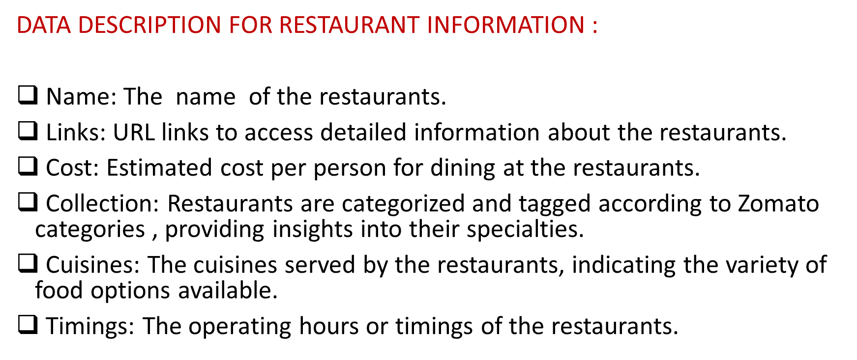

Slide 8
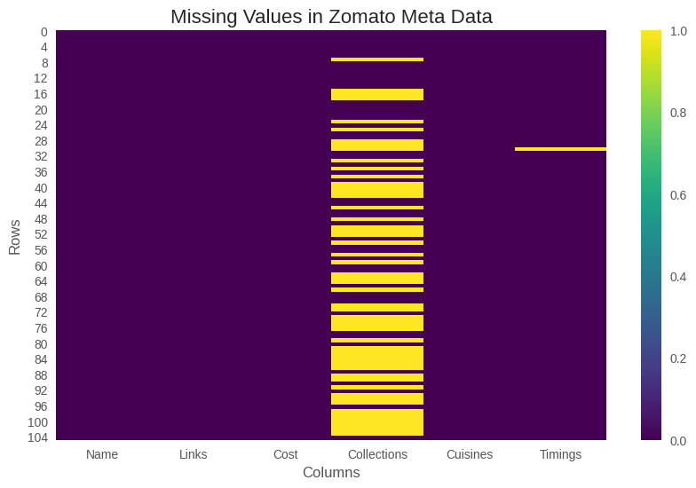

Slide 9
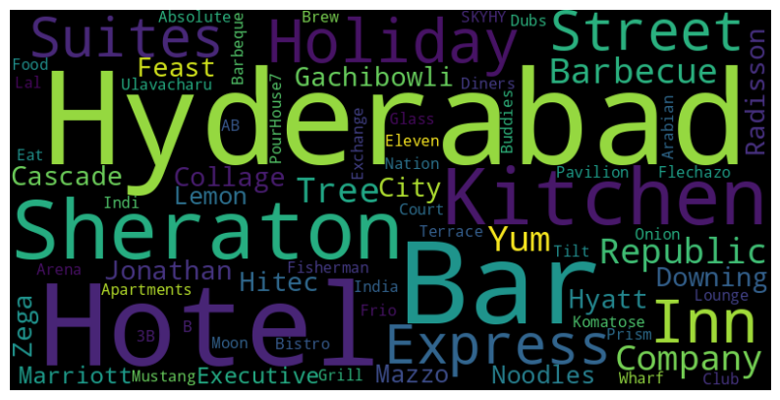
WORDCLOUD
Vis﻿ualisation of word cloud for expensive restaurants.

Slide 10
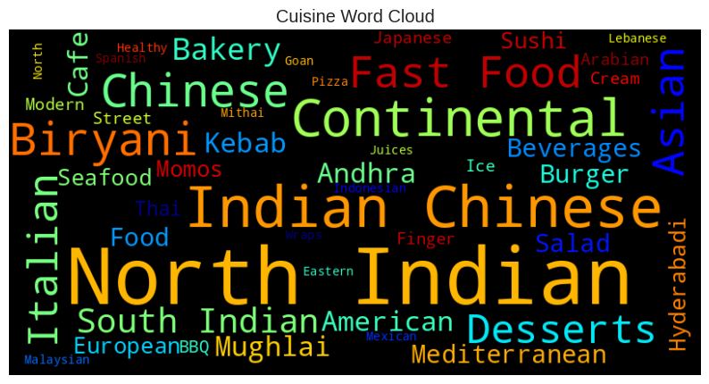
WORDCLOUD
restaurants
Visualisation of Words from 'Cuisines' features

Slide 11
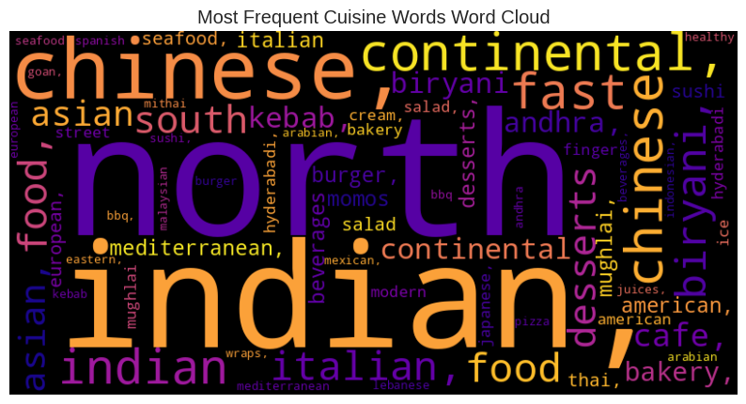
WORDCLOUD
Most nominated words from 'Cuisines' features

Slide 12
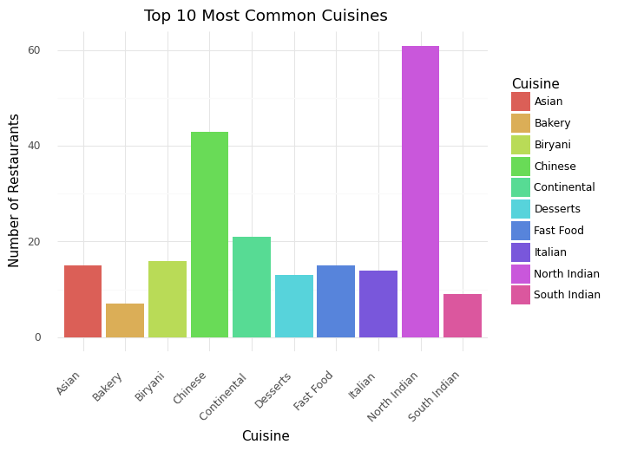
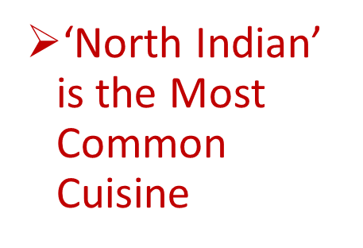
EDA

Slide 13
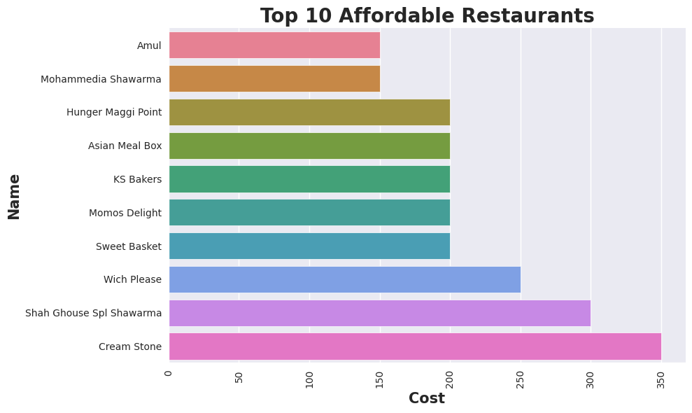
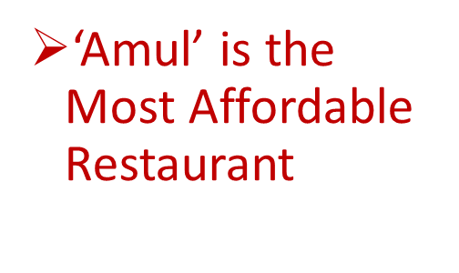
EDA

Slide 14
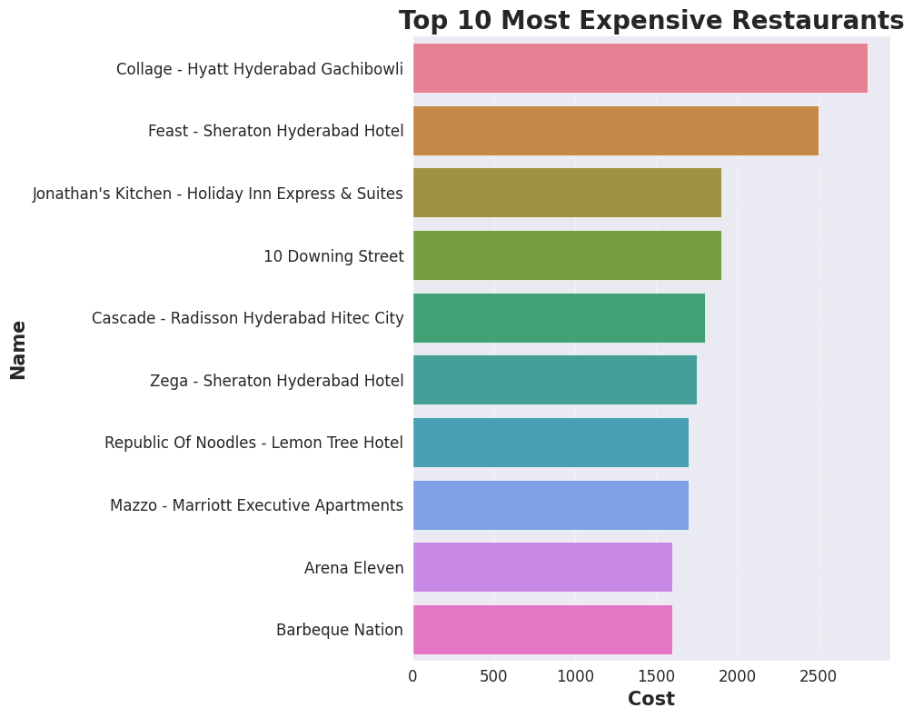
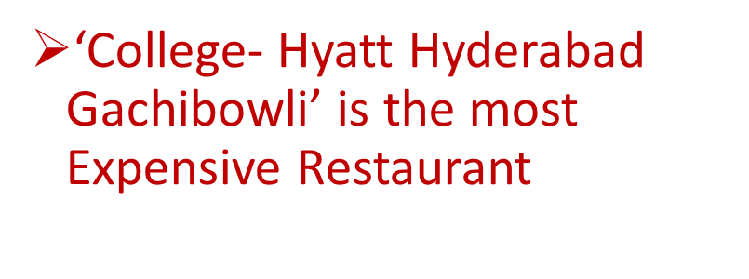
EDA

Slide 15
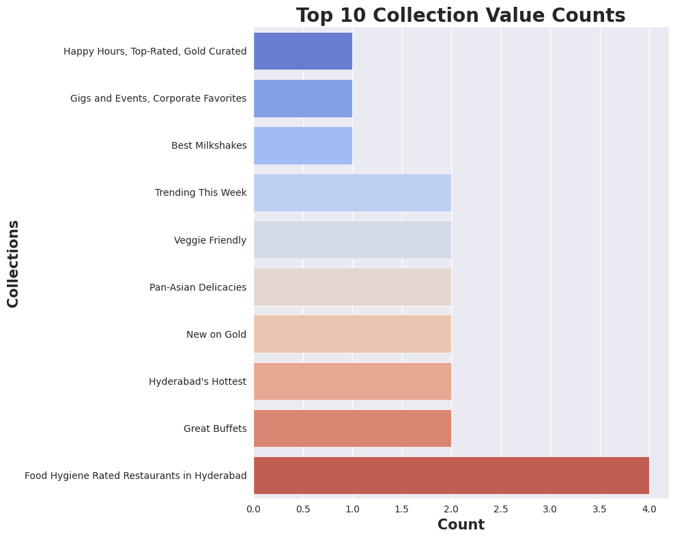
EDA

Slide 16
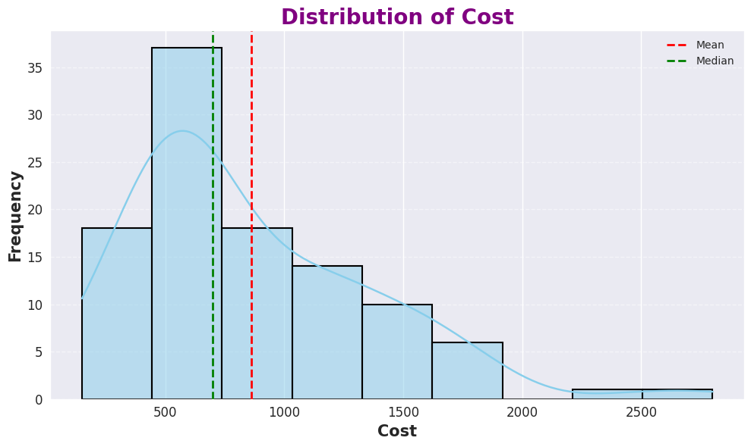
EDA

Slide 17
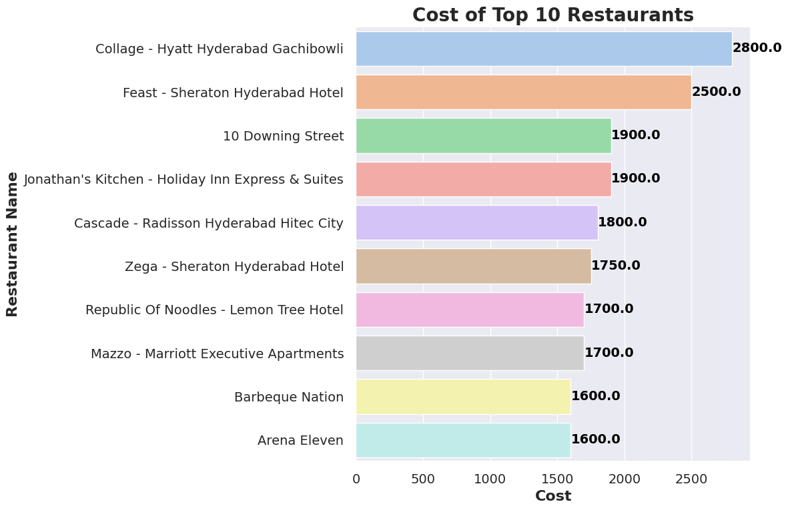
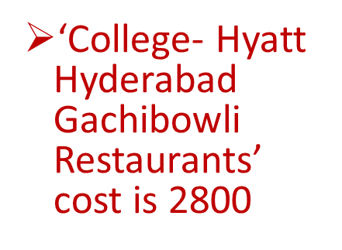
EDA

Slide 18
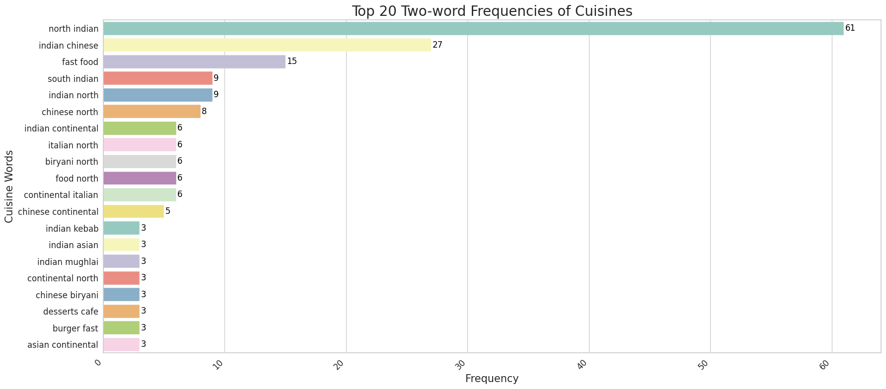
EDA

Slide 19
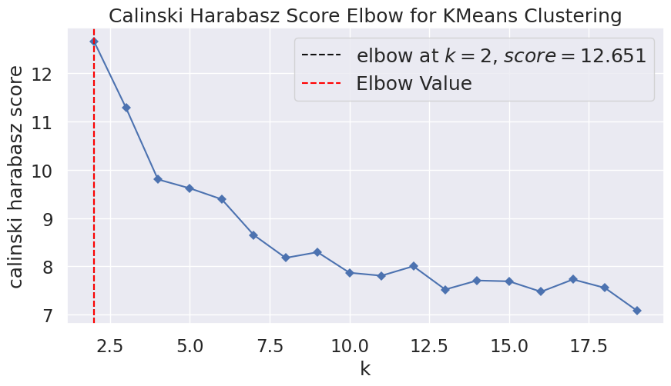

Slide 20
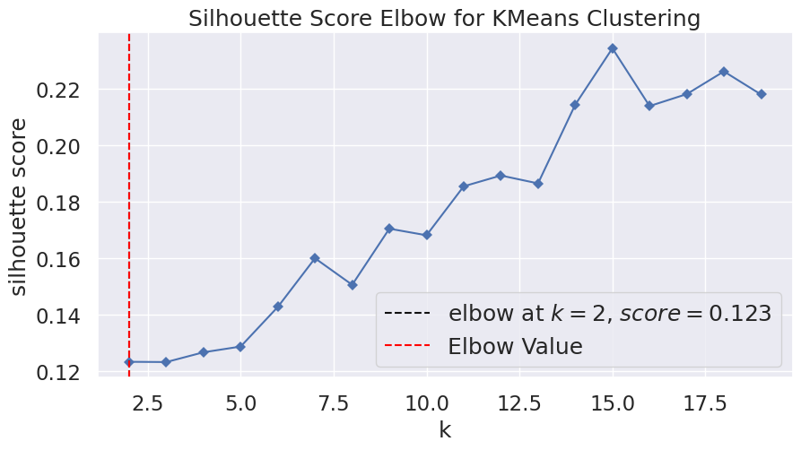

Slide 21
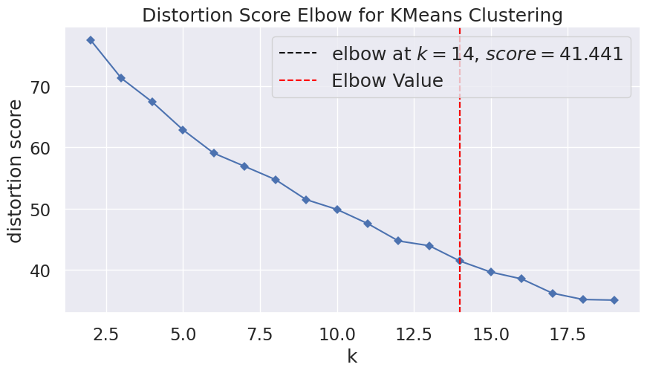

Slide 22
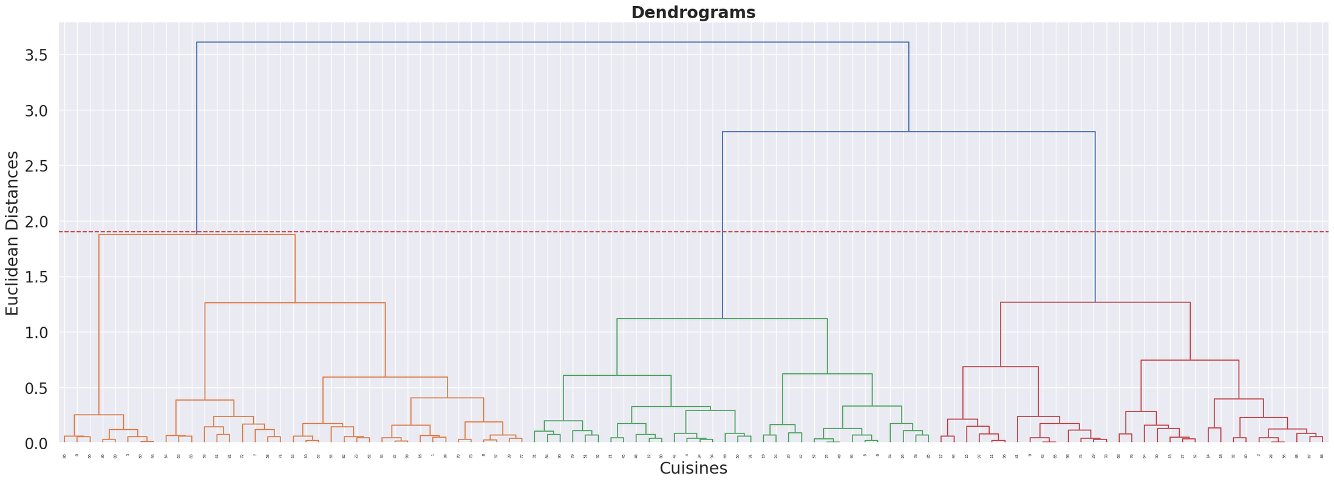

Slide 23
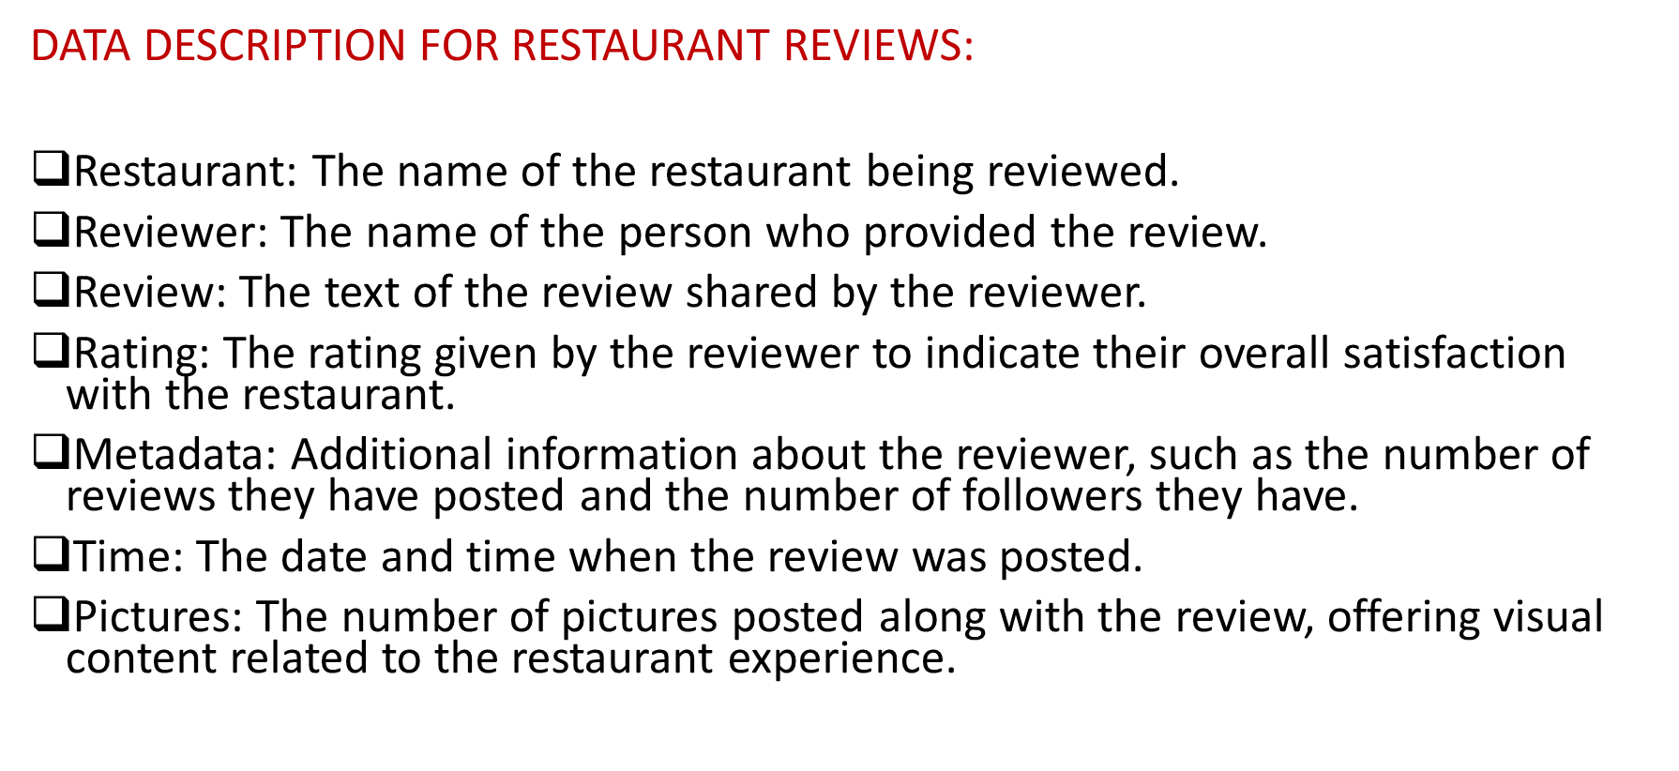

Slide 24
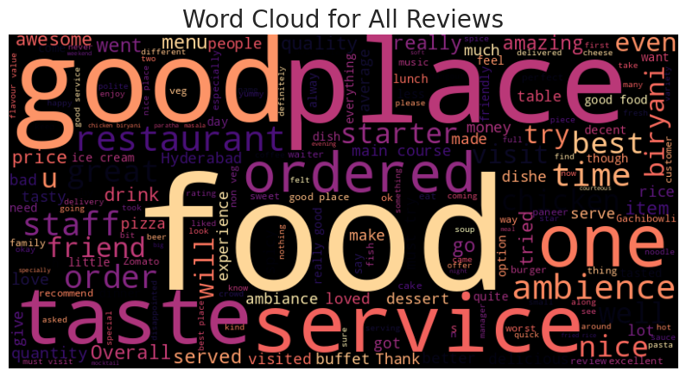
WORDCLOUD

Slide 25
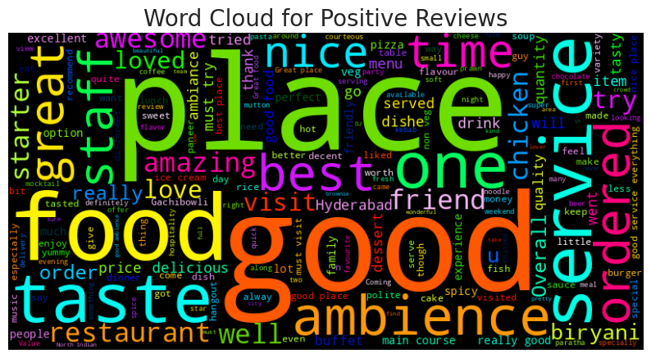
WORDCLOUD

Slide 26
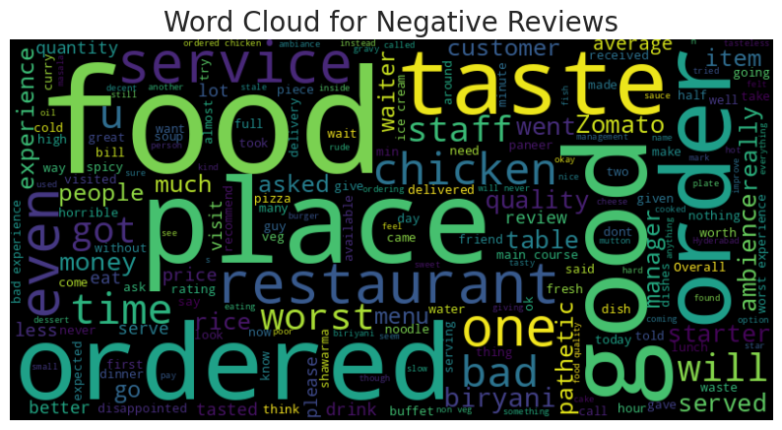
WORDCLOUD

Slide 27
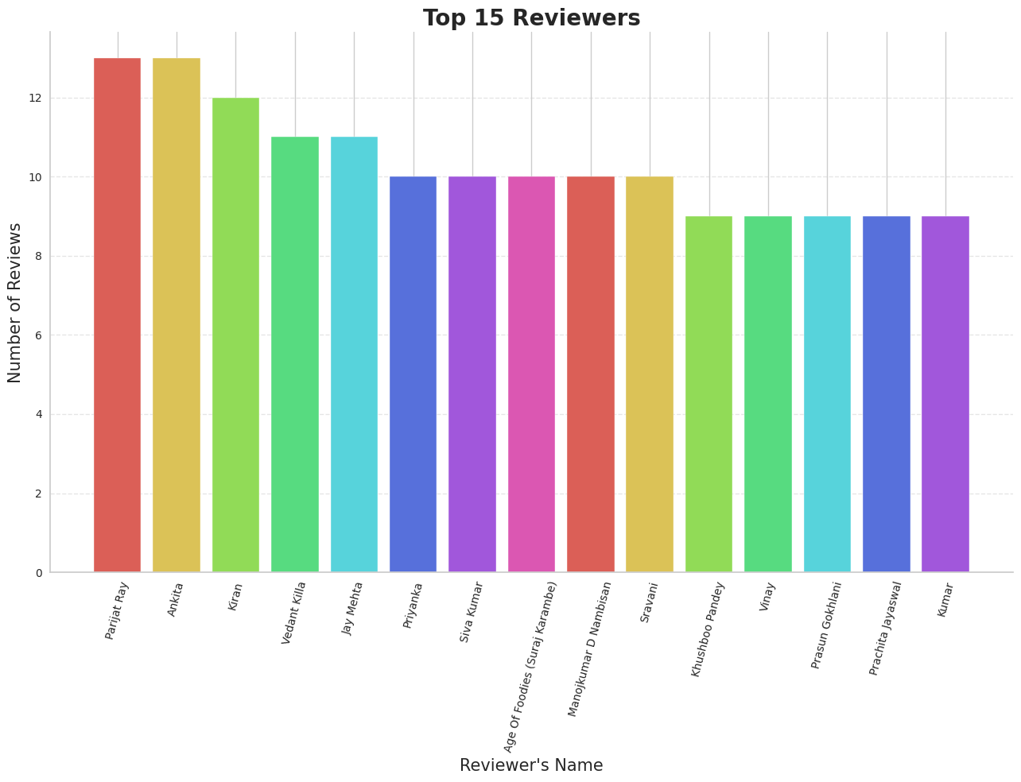
EDA

Slide 28
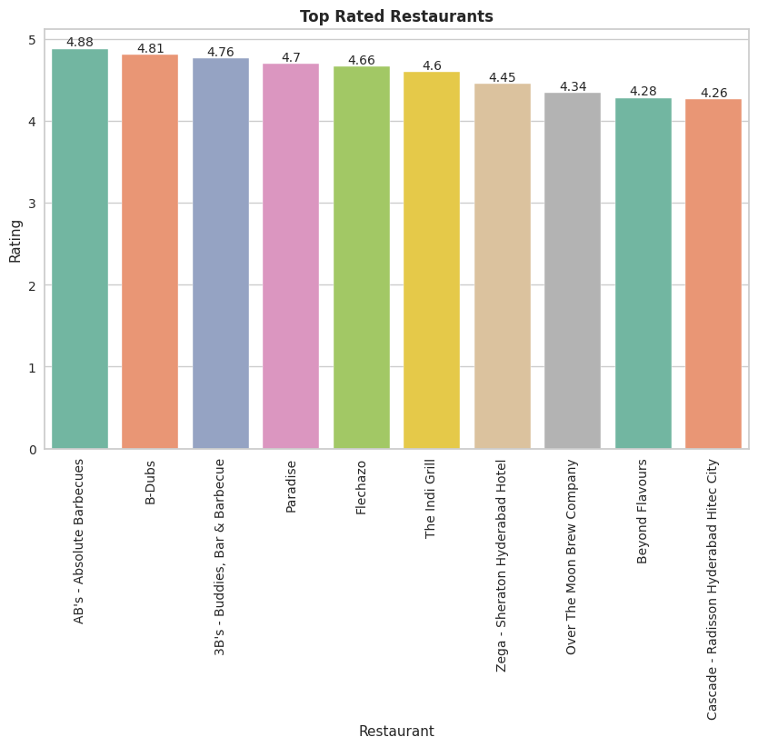
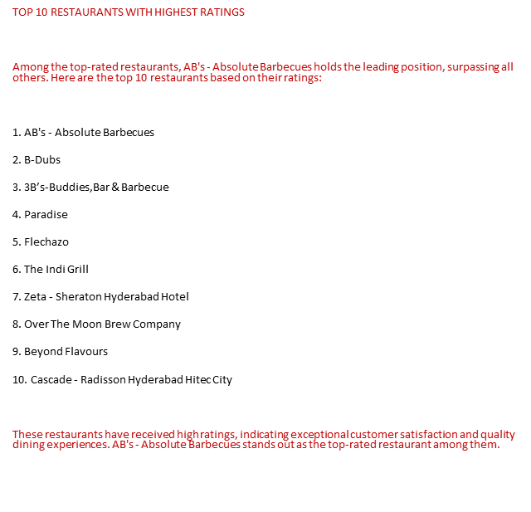
EDA

Slide 29
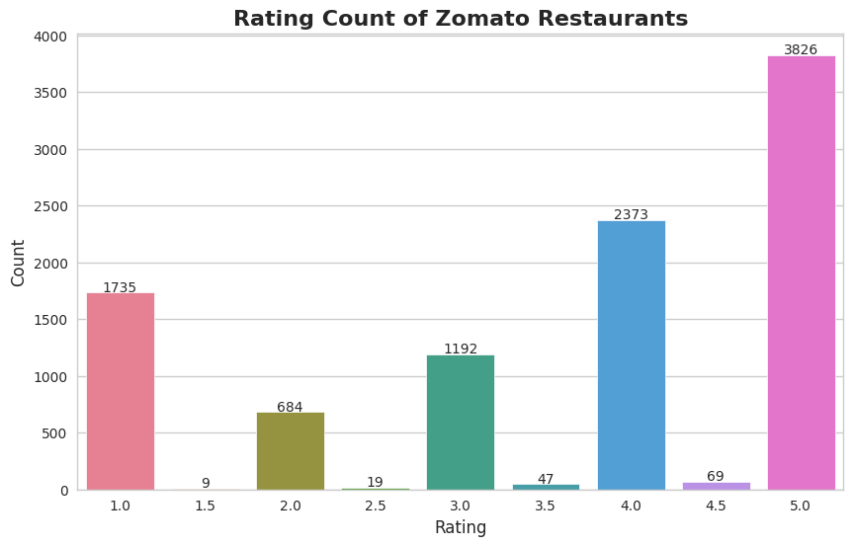
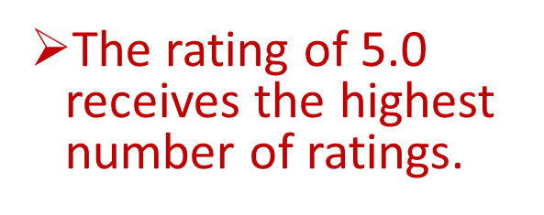
EDA

Slide 30
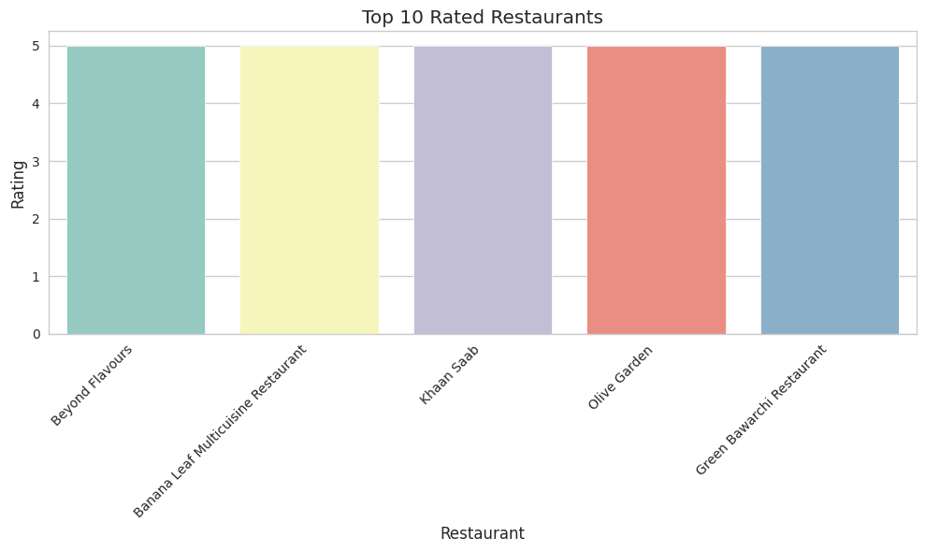
EDA

Slide 31
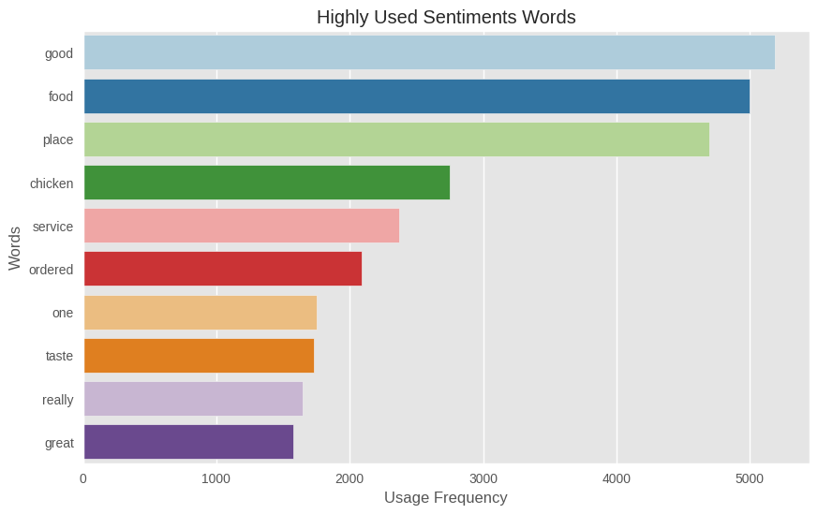

Slide 32
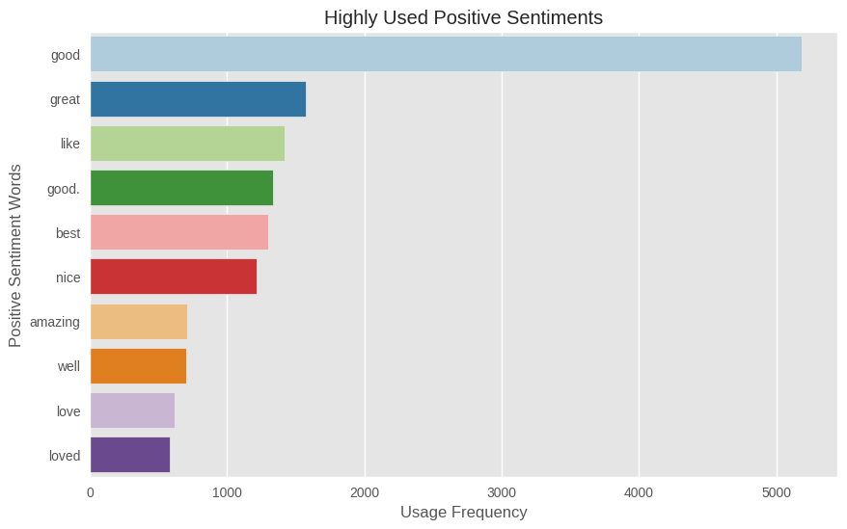

Slide 33
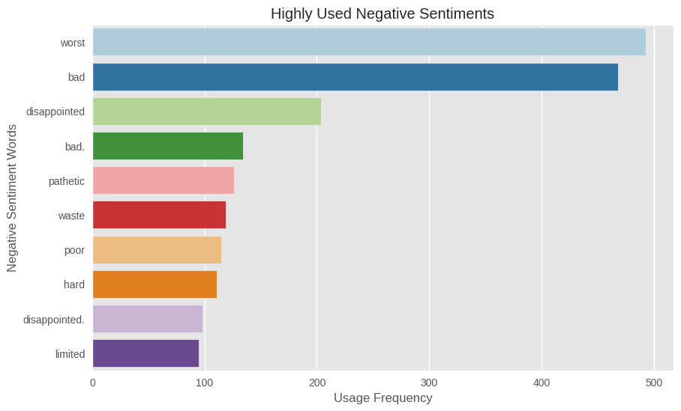

Slide 34
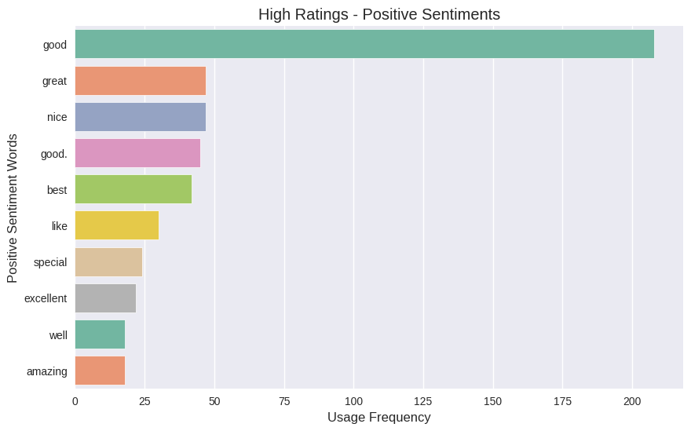

Slide 35
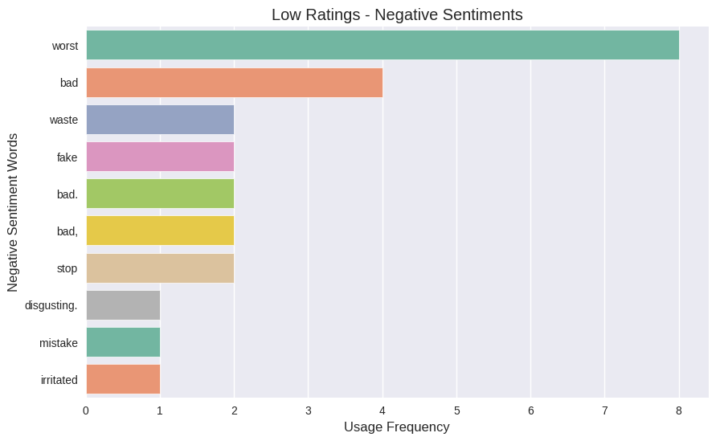

Slide 36



Slide 37
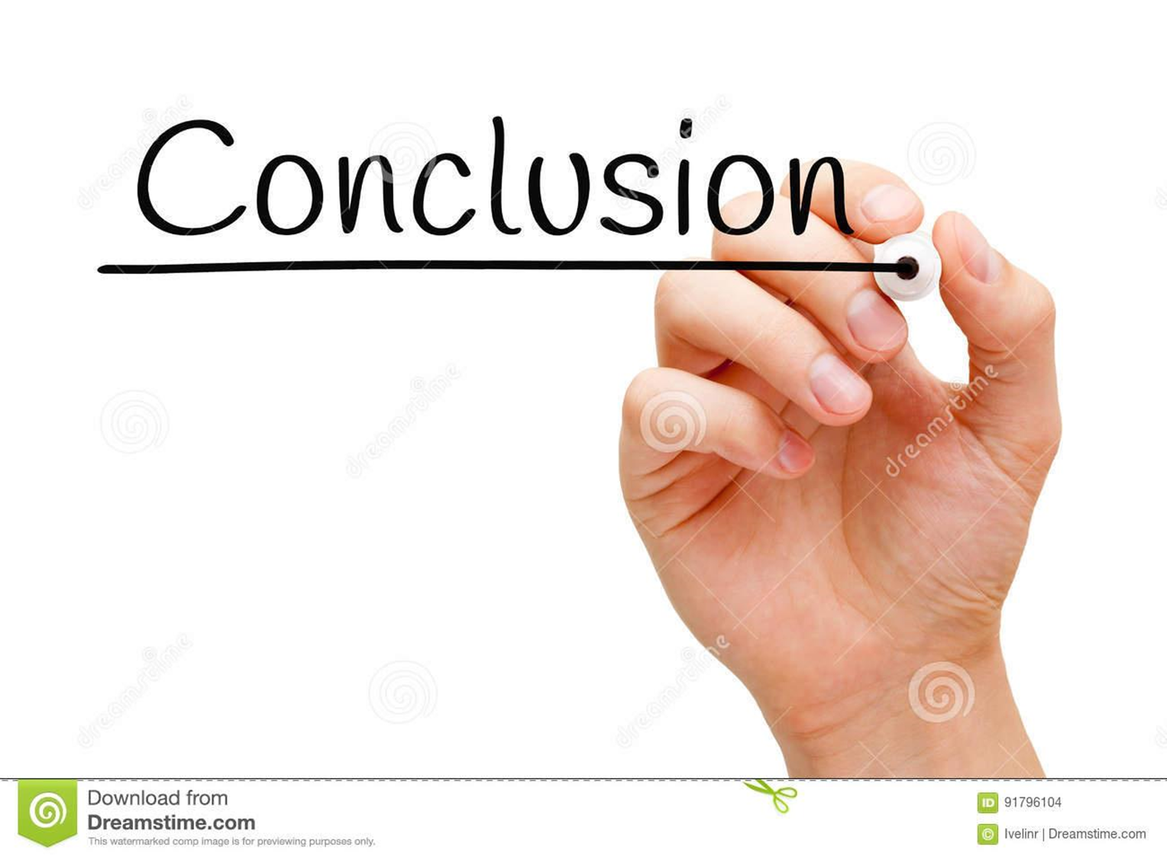
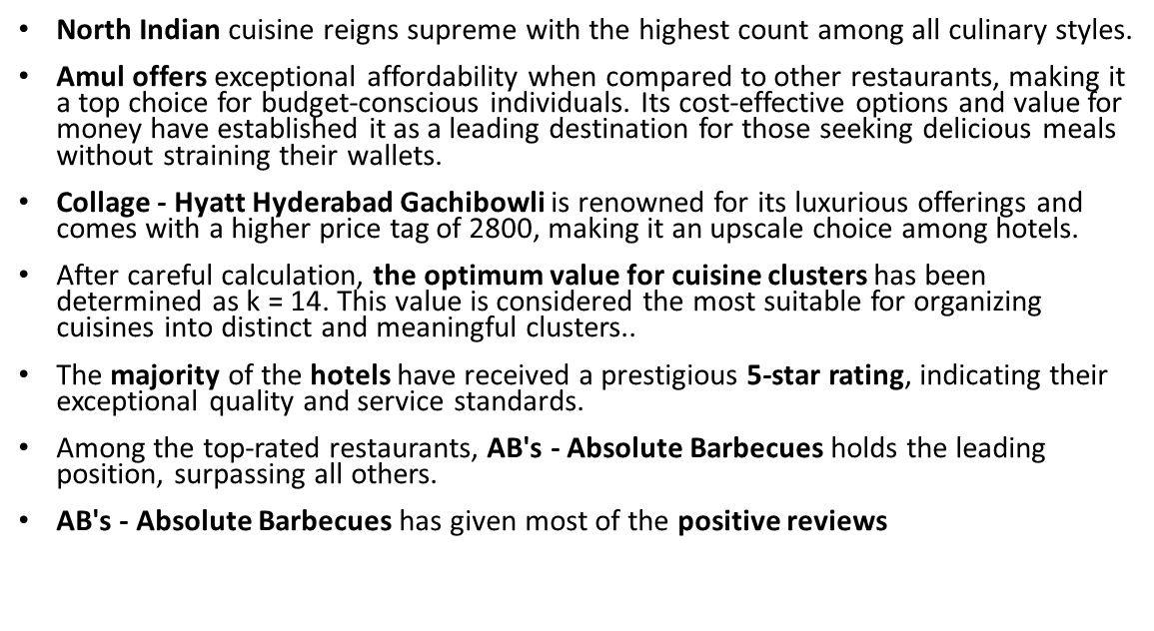

Slide 38
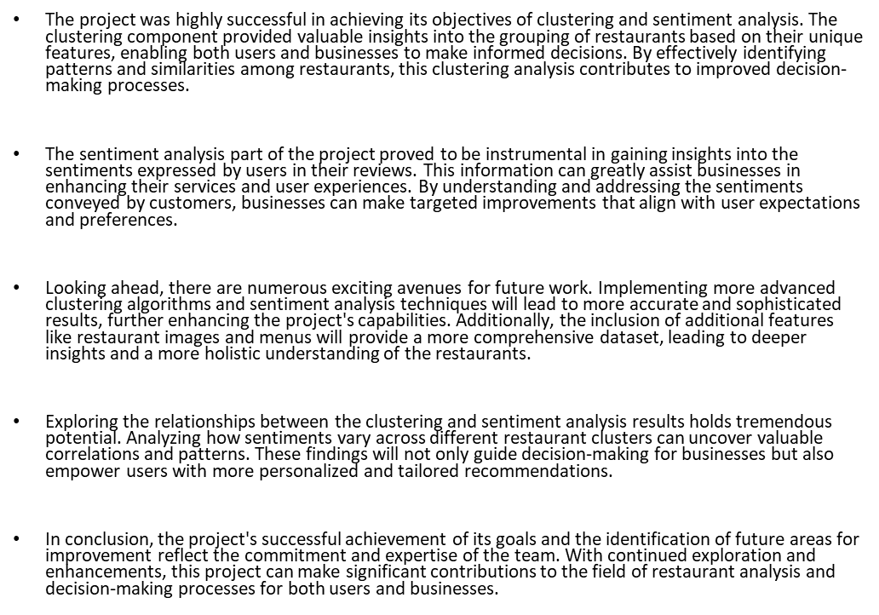

Slide 39


