Slide 1
Inheritance - 2

Slide 2
Content
Constructor and Destructor in Inheritance
Inheritance and Static Functions
Virtual class
Abstract Class
Pure Virtual Functions

Slide 3
Constructors and Destructors in Base and Derived Classes
Derived classes can have their own constructors and destructors.
When an object of a derived class is created, the base class’s constructor is executed first, followed by the derived class’s constructor.
When an object of a derived class is destroyed, its destructor is called first, then that of the base class.

Slide 4
//EXAMPLE
#include<iostream>
Using namespace std;
//base class
class base {
public:
base()
{ cout << "Constructing base\n"; }
~base()
{ cout << "Destructing base\n"; }
};
//derived class
class derived: public base {
public:
derived()
{
cout << "Constructing derived\n"; }
~derived()
{ cout << "Destructing derived\n"; }
};
int main()
{
derived ob;
// do nothing but construct and destruct ob
return 0;
}
Program Output
Constructing base
Constructing derived
Destructing derived
Destructing base

Slide 5
Constructors and Destructors with Multiple Base Classes
Constructors are called in order of derivation, left to right, as specified in derived's inheritance list.
Destructors are called in reverse order, right to left.

Slide 6
//MULTI-LEVEL
#include <iostream>
using namespace std;
class base {
public:
base()
{ cout << "Constructing base\n"; }
~base() { cout << "Destructing base\n"; }
};
class derived1 : public base {
public:
derived1() { cout << "Constructing derived1\n"; }
~derived1() { cout << "Destructing derived1\n"; }
};
class derived2: public derived1 {
public:
derived2() { cout << "Constructing derived2\n"; }
~derived2() { cout << "Destructing derived2\n"; }
};
int main()
{
derived2 ob;
// construct and destruct ob
return 0;
}
Program Output:
Constructing base
Constructing derived1
Constructing derived2
Destructing derived2
Destructing derived1
Destructing base

Slide 7
//MULTIPLE BASE CASES
#include <iostream>
using namespace std;
class base1 {
public:
base1() { cout << "Constructing base1\n"; }
~base1() { cout << "Destructing base1\n"; }
};
class base2 {
public:
base2() { cout << "Constructing base2\n"; }
~base2() { cout << "Destructing base2\n"; }
};
class derived: public base1, public base2 {
public:
derived() { cout << "Constructing derived\n"; }
~derived() { cout << "Destructing derived\n"; }
};
int main()
{
derived ob;
// construct and destruct ob
return 0;
}
Program Output:
Constructing base1
Constructing base2
Constructing derived
Destructing derived
Destructing base2
Destructing base1

Slide 8
Passing Arguments to Base Class Constructor
derived-constructor(arg-list) : base1(arg-list),
base2(arg-list),
// ...
baseN(arg-list)
{
// body of derived constructor
}

Slide 9
Order of Constructor Call
Base class constructors are always called in the derived class constructors.
Whenever you create derived class object, first the base class default constructor is executed and then the derived class's constructor finishes execution.

Slide 10
//EXAMPLE
#include <iostream>
using namespace std;
class base {
protected:
int i;
public:
base(int x)
{ i=x; cout << "Constructing base\n"; }
~base() { cout << "Destructing base\n"; }
};
class derived: public base {
int j;
public:
// derived uses x; y is passed along to base.
derived(int x, int y): base(y)
{ j=x;
cout << "Constructing derived\n"; }
~derived() { cout << "Destructing derived\n"; }
void show() { cout << i << " " << j << "\n"; }
};
int main()
{
derived ob(3, 4);
ob.show(); // displays 4 3
return 0;
}

Slide 11
//MULTIPLE BASE CASES
#include <iostream>
using namespace std;
class base1 {
protected: int i;
public:
base1(int x) { i=x; cout << "Constructing base1\n"; }
~base1() { cout << "Destructing base1\n"; }};
class base2 {
protected: int k;
public:
base2(int x) { k=x; cout << "Constructing base2\n"; }
~base2() { cout << "Destructing base1\n"; } };
class derived: public base1, public base2 {
int j;
public:
derived(int x, int y, int z): base1(y), base2(z)
{ j=x; cout << "Constructing derived\n"; }
~derived() { cout << "Destructing derived\n"; }
void show() { cout << i << " " << j << " " << k << "\n"; }
};
int main()
{ derived ob(3, 4, 5);
ob.show(); // displays 4 3 5
return 0; }

Slide 12
Here’s what actually happens when base is instantiated:
Memory for base is set aside
The appropriate Base constructor is called
The initialization list initializes variables
The body of the constructor executes
Control is returned to the caller

Slide 13
Here’s what actually happens when derived is instantiated:
Memory for derived is set aside (enough for both the Base and Derived portions)
The appropriate Derived constructor is called
The Base object is constructed first using the appropriate Base constructor. If no base constructor is specified, the default constructor will be used.
The initialization list initializes variables
The body of the constructor executes
Control is returned to the caller

Slide 14
Points to note
It is important to understand that arguments to a base-class constructor are passed via arguments to the derived class' constructor.
Even if a derived class‘ constructor does not use any arguments, it will still need to declare one if the base class requires it.
In this situation, the arguments passed to the derived class are simply passed along to the base.

Slide 15
Why is Base class Constructor called inside Derived class?
Constructors have a special job of initializing the object properly.
A Derived class constructor has access only to its own class members, but a Derived class object also have inherited property of Base class, and only base class constructor can properly initialize base class members.
Hence all the constructors are called, else object wouldn't be constructed properly.

Slide 16
// This program contains an error and will not compile.
#include <iostream>
using namespace std;
class base {
public: int i; };
class derived1 : public base {
public: int j; };
class derived2 : public base {
public: int k; };
class derived3 : public derived1, public derived2 {
public: int sum; };
int main() {
derived3 ob;
ob.i = 10; // this is ambiguous, which i???
ob.j = 20;
ob.k = 30;
// i ambiguous here, too
ob.sum = ob.i + ob.j + ob.k;
// also ambiguous, which i?
cout << ob.i << " ";
cout << ob.j << " " << ob.k ;
cout << ob.sum;
return 0;
}

Slide 17
Discussion
which ‘i’ is being referred to, the one in derived1 or the one in derived2?
Because there are two copies of base present in object ob, there are two ob.is! ->, the statement is inherently ambiguous.
There are two ways to remedy the preceding program.
The first is to apply the scope resolution operator to i and manually select one i. Example (on next slide).

Slide 18
// This program uses explicit scope resolution to select i.
#include <iostream>
using namespace std;
class base { public: int i; };
// derived1 inherits base.
class derived1 : public base {
public: int j; };
// derived2 inherits base.
class derived2 : public base {
public: int k; };
class derived3 : public derived1, public derived2 {
public: int sum; };
int main()
{
derived3 ob;
ob.derived1::i = 10; // scope resolved, use derived1's i
ob.j = 20;
ob.k = 30;
// scope resolved
ob.sum = ob.derived1::i + ob.j + ob.k;
// also resolved here
cout << ob.derived1::i << " ";
cout << ob.j << " " << ob.k << " ";
cout << ob.sum;
return 0; }

Slide 19
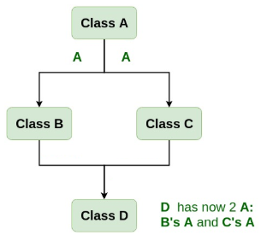


Slide 20
Discussion
As you can see, because the :: was applied, the program has manually selected derived1's version of base.
What if only one copy of base is actually required? Is there some way to prevent two copies from being included in derived3?
This solution is achieved using virtual base classes.

Slide 21
When two or more objects are derived from a common base class, you can prevent multiple copies of the base class from being present in an object derived from those objects by declaring the base class as virtual when it is inherited.
You accomplish this by preceding the base class' name with the keyword virtual when it is inherited.
For example, here is another version of the example program in which derived3 contains only one copy of base:
Example Program Next Slide

Slide 22
// This program uses virtual base classes.
#include <iostream>
using namespace std;
class base { public: int i; };
// derived1 inherits base as virtual.
class derived1 : virtual public base {
public: int j; };
// derived2 inherits base as virtual.
class derived2 : virtual public base {
public: int k; };
class derived3 : public derived1, public derived2
{ public: int sum; };
int main()
{
derived3 ob;
ob.i = 10; // now unambiguous
ob.j = 20;
ob.k = 30;
// unambiguous
ob.sum = ob.i + ob.j + ob.k;
// unambiguous
cout << ob.i << " ";
cout << ob.j << " " << ob.k << " ";
cout << ob.sum;
return 0;
}

Slide 23
Discussion
As you can see, the keyword virtual precedes the rest of the inherited class‘specification.
Now that both derived1 and derived2 have inherited base as virtual, any multiple inheritance involving them will cause only one copy of base to be present.
Therefore, in derived3, there is only one copy of base and ob.i = 10 is perfectly valid and unambiguous.

Slide 24
Inheritance and Static Functions
They are inherited into the derived class.
If you redefine a static member function in derived class, all the other overloaded functions in base class are hidden.
Static Member functions can never be virtual.

Slide 25
Virtual base class
They are used to prevent the confusion or duplicity among child classes during inheritance.
Consider the following situation:

Slide 26
class A {
public: void show() {cout<<"In A"<<endl;}
};
class B : public A {};
class C : public A {};
class D : public B, public C {};
int main() {D d; d.show(); }

Slide 27
Output
[Error] request for member 'show' is ambiguous
Need virtual keyword to fix this error

Slide 28

class A {
public: void show() {cout<<"In A"<<endl;}
};
class B : public virtual A {};
class C : public virtual A {};
class D : public B, public C {};
int main() {D d; d.show(); }

Slide 29
Abstract base class - interface
It describes the capabilities of a C++ class without committing to a particular implementation
A class is made abstract by declaring at least one of its functions as pure virtual function i.e. by placing "= 0" in its declaration

Slide 30
class Animal{
public:
virtual void sound() = 0;
void sleeping() {cout<<"Sleeping"; }
};
class Dog: public Animal{
public:
void sound() {cout<<"Woof"<<endl;}
};
int main(){
Dog obj; obj.sound(); obj.sleeping();
}

Slide 31
Output: Woof Sleeping

Slide 32
class Animal{
public:
virtual void sound() = 0;
void sleeping() {cout<<"Sleeping"; }
};
class Dog: public Animal{
public:
void sound() {cout<<"Woof"<<endl;}
};
int main(){
Animal *obj = new Dog;
obj->sound();
}

Slide 33
Output: Woof

Slide 34
Abstract Class
An abstract class is designed to act as base class. It is a design concept in program development and provides a base upon which other classes may be built.
Abstract Class is a class which contains atleast one Pure Virtual function in it. Abstract classes are used to provide an Interface for its sub classes. Classes inheriting an Abstract Class must provide definition to the pure virtual function, otherwise they will also become abstract class.

Slide 35
Characteristics of Abstract Class
Abstract class cannot be instantiated, but pointers and references of Abstract class type can be created.
Abstract class can have normal functions and variables along with a pure virtual function.
Classes inheriting an Abstract Class must implement all pure virtual functions, or else they will become Abstract too.

Slide 36
Pure Virtual Functions
Pure virtual Functions are virtual functions with no definition.
They start with virtual keyword and ends with = 0.
Syntax for a pure virtual function,
virtual void fun() = 0;

Slide 37
//Abstract base class
class Base {
public:
virtual void show() = 0; };
class Derived:public Base {
public:
void show()
{
cout << "Implementation of Virtual Function in Derived class";
}
};
int main()
{
//Base obj; (Compile Time Error)
Base *b;
Derived d;
b = &d;
b->show();
return 0;
}

Slide 38
Note:
Pure Virtual functions can be given a small definition in the Abstract class, which you want all the derived classes to have. Still you cannot create object of Abstract class.
Also, the Pure Virtual function must be defined outside the class definition. If you will define it inside the class definition, complier will give an error. Inline pure virtual definition is Illegal.

Slide 39
Polymorphism

Slide 40
Contents
Polymorphism
Function Overloading
Default Function Arguments
Ambiguity in Function Overloading

Slide 41
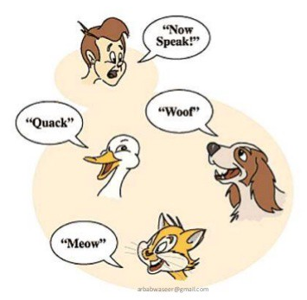
Polymorphism
The word polymorphism means having many forms. In simple words, we can define polymorphism as the ability of a message to be displayed in more than one form.
Real life example of polymorphism, a person at a same time can have different characteristic. Like a man at a same time is a father, a husband, a employee.
So a same person posses have different behavior in different situations. This is called polymorphism.

Slide 42
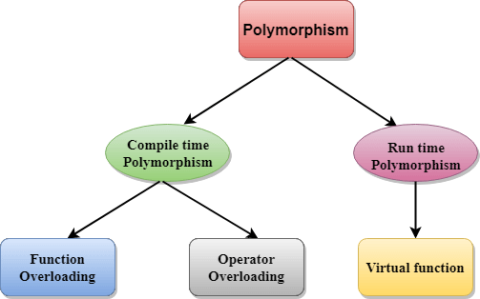
Types of Polymorphism
Compile Time Polymorphism
Run Time Polymorphism

Slide 43
Compile Time Polymorphism
Early binding refers to events that occur at compile time. In essence, early binding occurs when all information needed to call a function is known at compile time. (Put differently, early binding means that an object and a function call are bound during compilation).
Examples of early binding include normal function calls (including standard library functions), overloaded function calls, and overloaded operators.
The main advantage to early binding is efficiency. Because all information necessary to call a function is determined at compile time, these types of function calls are very fast.

Slide 44
Run Time Polymorphism
The opposite of early binding is late binding.
As it relates to C++, late binding refers to function calls that are not resolved until run time.
As function calls are not determined at compile time, the object and the function are not linked until run time.

Slide 45
Run Time Polymorphism
The main advantage to late binding is flexibility.
Unlike early binding, late binding allows you to create programs that can respond to events occurring while the program executes without having to create a large amount of "contingency code."
Keep in mind that because a function call is not resolved until run time, late binding can make for somewhat slower execution times.
Virtual functions are used to achieve late binding.

Slide 46
Function Overloading
Function overloading is the process of using the same name for two or more functions.
The secret to overloading is that each redefinition of the function must use either different types of parameters or a different number of parameters.
It is only through these differences that the compiler knows which function to call in any given situation.

Slide 47
Example
#include <iostream> using namespace std;
int myfunc(int i); // these differ in types of parameters double myfunc(double i);
int main()
{
cout << myfunc(10) << " "; // calls myfunc(int i) cout << myfunc(5.4); // calls myfunc(double i) return 0;
}

Slide 48
double myfunc(double i)
{
return i;
}
int myfunc(int i)
{
return i;
}
Output:
10 5.4

Slide 49
Example 2
#include <iostream>
using namespace std;
int myfunc(int i); // these differ in number of parameters
int myfunc(int i, int j); int main()
{
cout << myfunc(10) << " "; // calls myfunc(int i) cout << myfunc(4, 5); // calls myfunc(int i, int j)
return 0;
}

Slide 50
int myfunc(int i)
{
return i;
}
int myfunc(int i, int j)
{
return i*j;
}
Output:
10 20

Slide 51
Key Points
The key point about function overloading is that the functions must differ in regard to the types and/or number of parameters. Two functions differing only in their return types cannot be overloaded.
For example, this is an invalid attempt to overload myfunc( ):
int myfunc(int i);
float myfunc(int i);
// Error: differing return types are insufficient when overloading.
Sometimes, two function declarations will appear to differ, when in
fact they do not. For example, consider the following declarations.
void f(int *p);
void f(int p[]); // error, *p is same as p[]
Remember, to the compiler *p is the same as p[ ]. Therefore, although the two prototypes appear to differ in the types of their parameter, in actuality they do not.

Slide 52
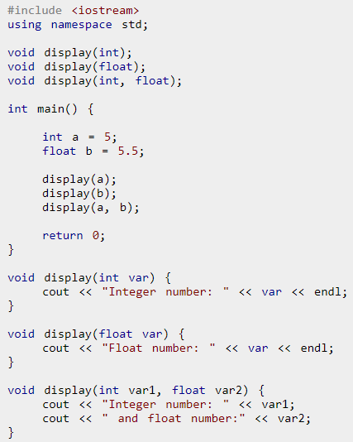
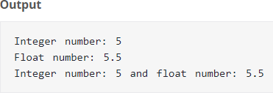
Example 3

Slide 53
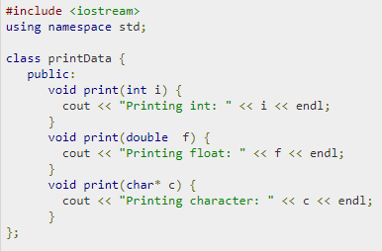
Example 4
(Function overloading in classes)

Slide 54
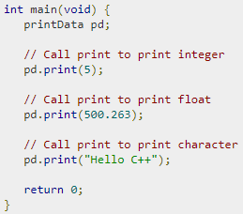


Slide 55
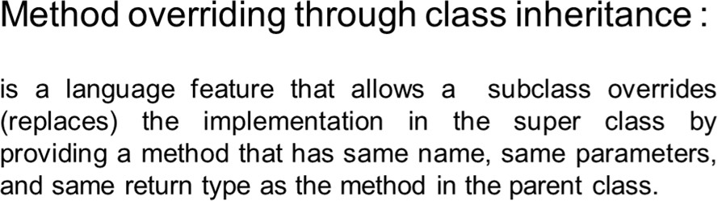
Inheritance based Polymorphism

Slide 56
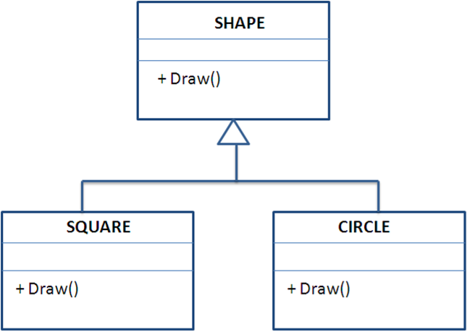
Example

Slide 57
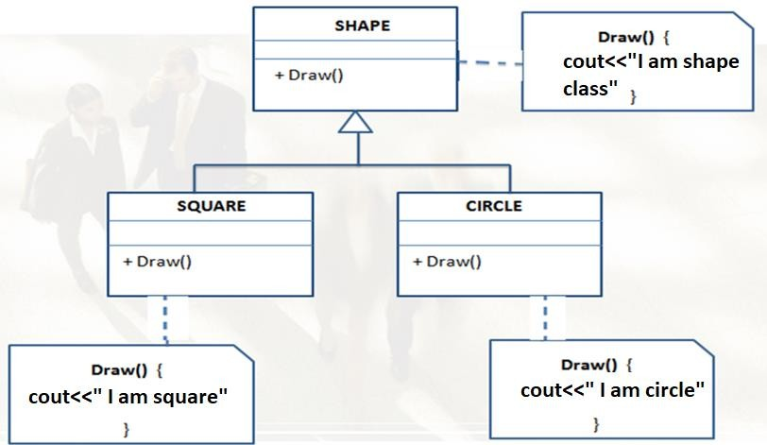

Slide 58
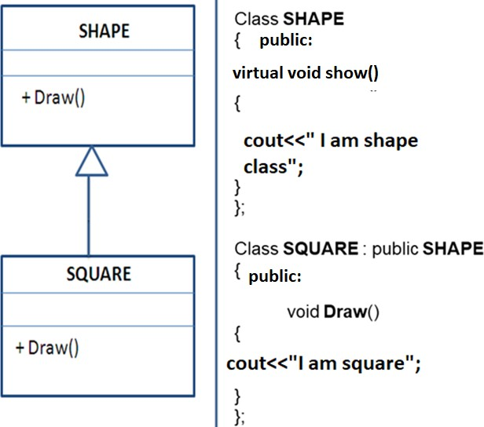

Slide 59
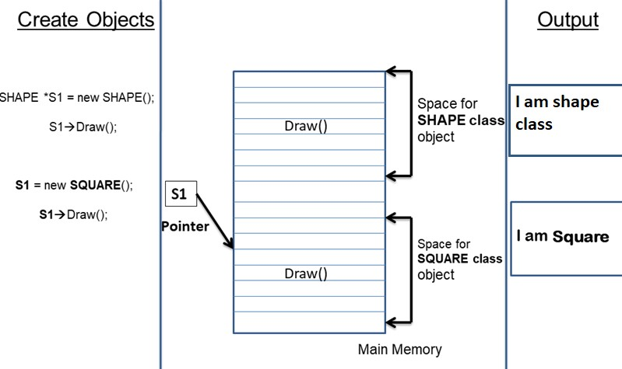

Slide 60
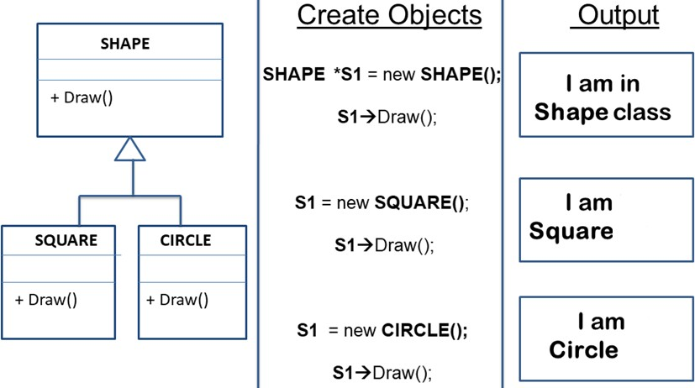
Extend the Logic

Slide 61
Virtual Functions
Be aware that the virtual function mechanism works only with pointers to objects and, with references, not with objects themselves.

Slide 62
Class Activity (15 minutes)
Can you showcase polymorphism (Drive function in various types of automobiles) in context of VEHICLES ?

Slide 63
Overloading vs overriding
Function overloading – same function name but different arguments. Functions are defined in the same class.
Function overriding – same function name and arguments. Defined in different classes.

Slide 64
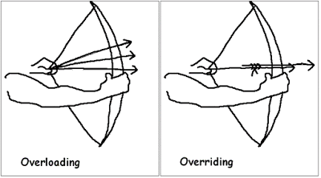

Slide 65
Compile time and Run time Polymorphism
Compile time OR static polymorphism is executed using function overloading.
Run time polymorphism or dynamic/late binding is done using function overriding and virtual functions.

Slide 66
Compile Time Polymorphism | Run-Time Polymorphism
At Compile time, which functions to be called is decided. | At Runtime, which function to be called is decided.
Also known as early or static binding | Also known as late or dynamic binding
It executes faster because the function is resolved at compilation time only. | It executes slower because the function is resolved at Run-time.
It is achieved through function and operator overloading | It is achieved through function overriding and virtual functions

Slide 67
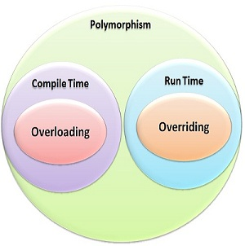

Slide 68
Default Function Arguments
C++ allows a function to assign a parameter a default value when no argument corresponding to that parameter is specified in a call to that function.
For example, this declares myfunc( ) as taking one double argument
with a default value of 0.0:
void myfunc(double d = 0.0)
{
// ...}
myfunc(198.234); // pass an explicit value myfunc(); // let function use default
The first call passes the value 198.234 to d. The second call
automatically gives d the default value zero.

Slide 69
The idea behind default argument is simple. If a function is called by passing argument/s, those arguments are used by the function.
But if the argument/s are not passed while invoking a function then, the default values are used.
Default value/s are passed to argument/s in the function prototype.

Slide 70
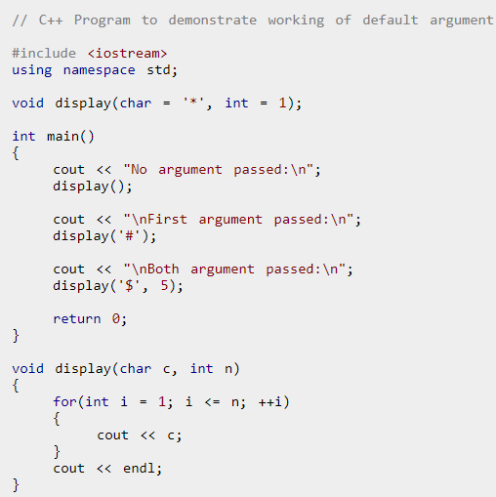
Example

Slide 71
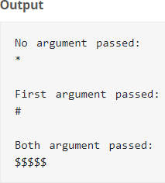

Slide 72
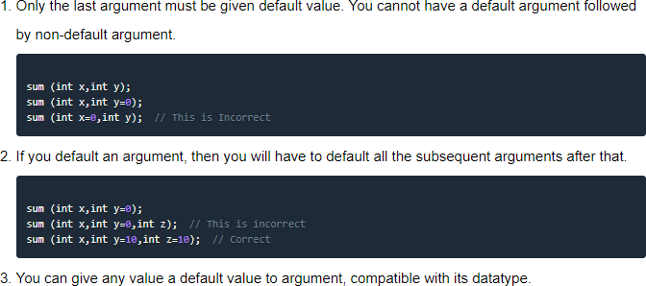
Rules for using Default Arguments

Slide 73
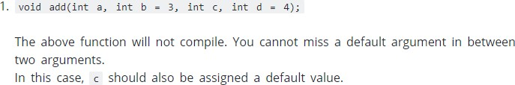
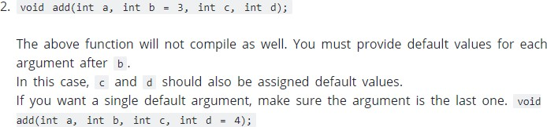
Common Mistakes when using Default Arguments

Slide 74


Slide 75
Ambiguity in Function Overloading
You can create a situation in which the compiler is unable to choose between two (or more) overloaded functions.
When this happens, the situation is said to be
ambiguous.
Ambiguous | statements are errors, | and
programs | containing ambiguity will | not
compile.

Slide 76
Ambiguity in Function Overloading
int myfunc(double d);
// ...
cout << myfunc('c');
// not an error, conversion applied
Although automatic type conversions are convenient, they are also a prime cause of ambiguity.

Slide 77
Example
#include <iostream> using namespace std; float myfunc(float i); double myfunc(double i);
int main()
{
cout << myfunc(10.1) << " "; // unambiguous, calls myfunc(double)
cout << myfunc(10); // ambiguous return 0;
}

Slide 78
Thanks

