Slide 1

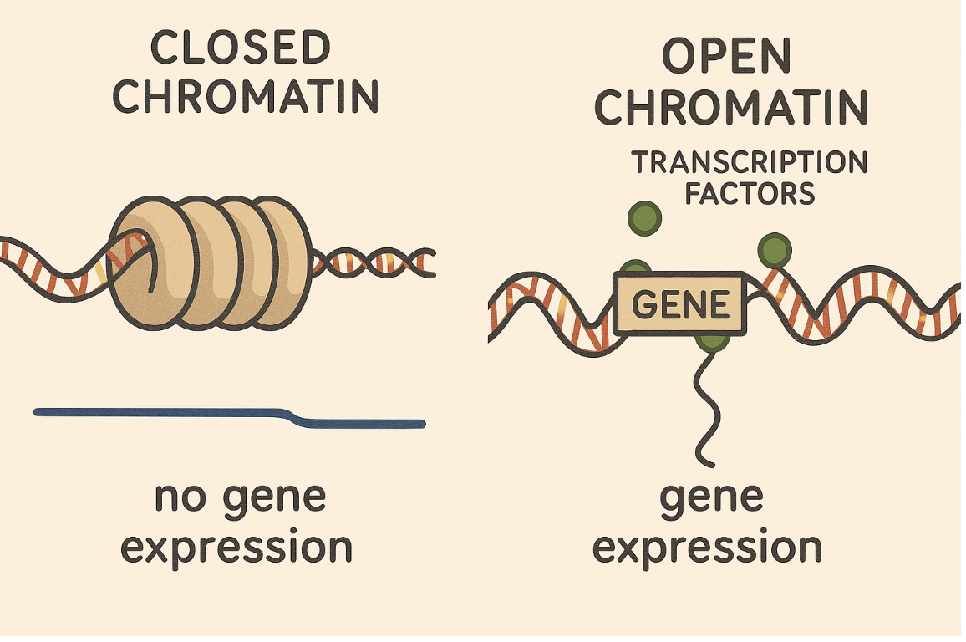
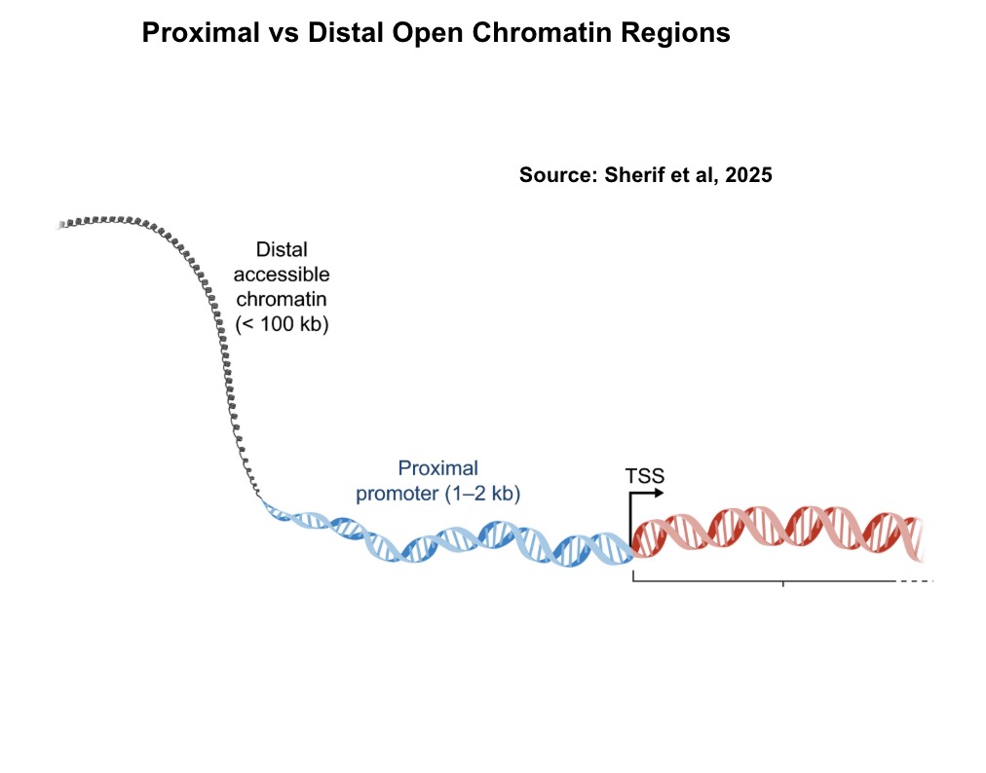
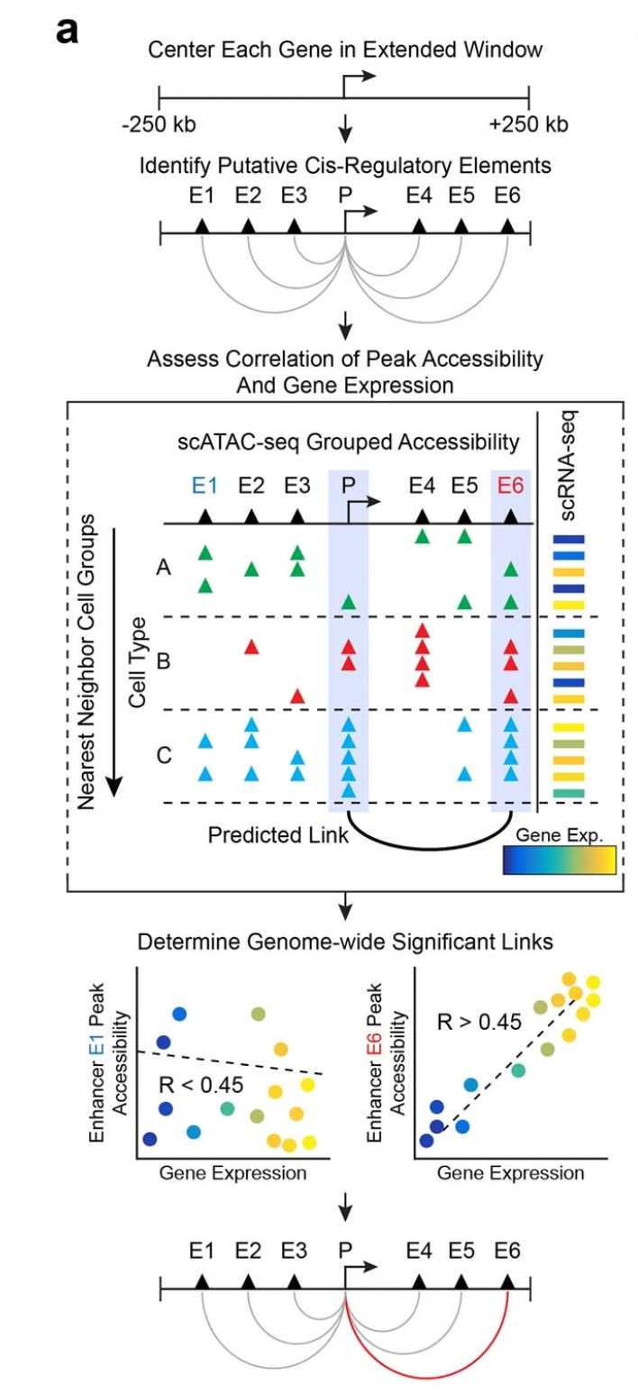
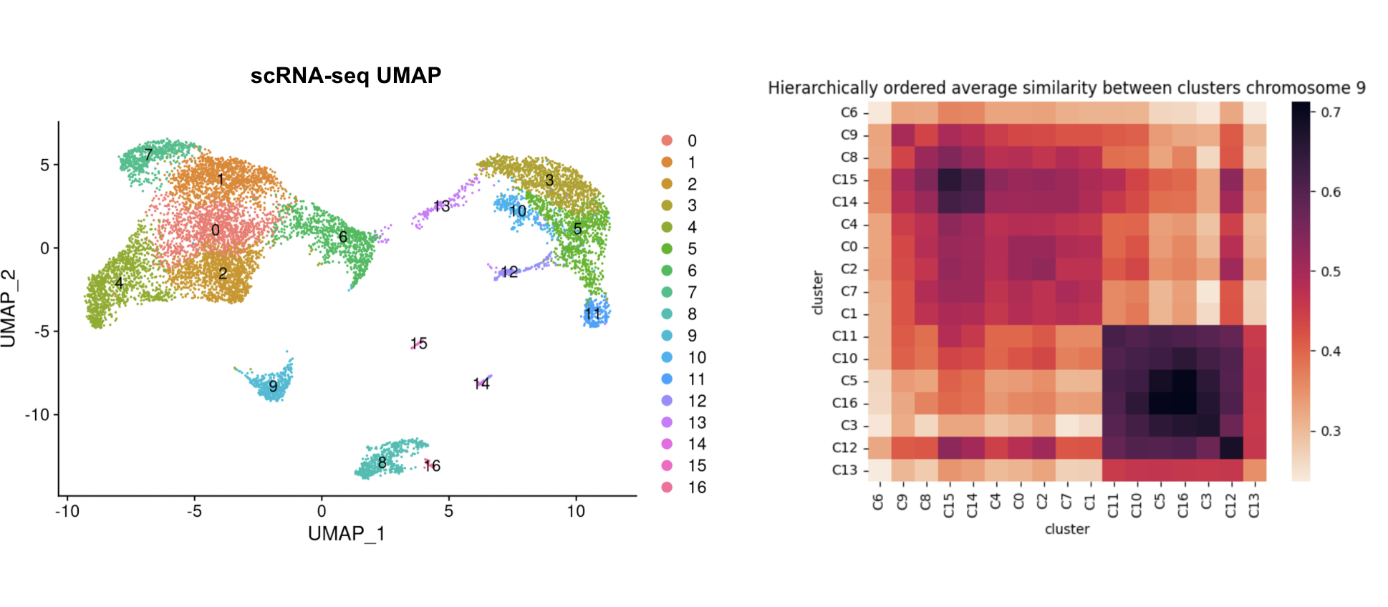
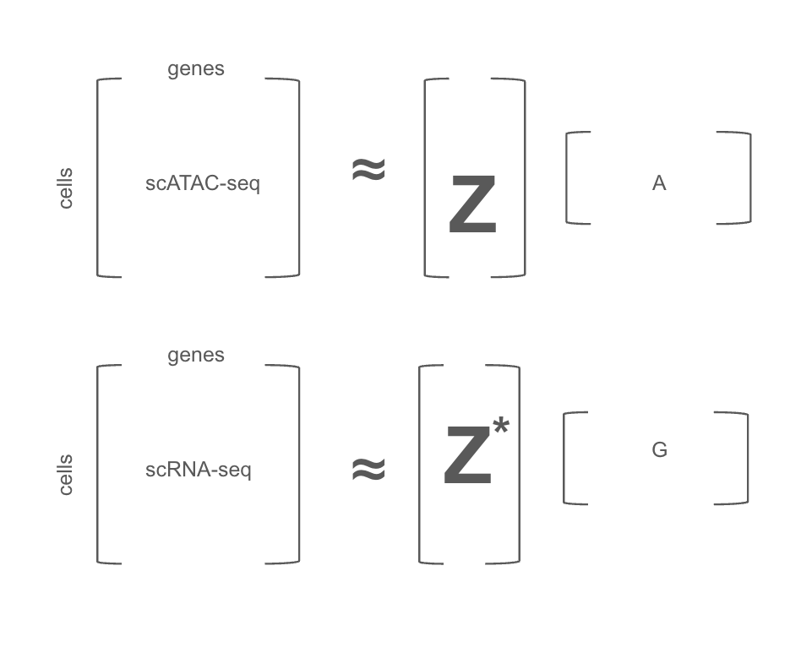
p2gNMF: Peak-to-Gene Non-Negative Matrix Factorization
Reetom Gangopadhyay, Ameya Gokhale, Pawel Przytycki
Przytycki Lab, Boston University
Abstract
p2gNMF (Peak-to-Gene Non-Negative Matrix Factorization) is a computational framework for integrating single-cell chromatin accessibility (scATAC-seq) with transcriptomic data (scRNA-seq). Unlike traditional approaches that aggregate signals across cell types to address sparsity, p2gNMF infers peak–gene relationships at the single-cell level. By aligning accessibility peaks with gene expression through joint factorization, the method uncovers regulatory influences that shape cellular identity with cell-specific resolution.
Background and Data
Chromatin accessibility controls which genes are expressed.
scATAC-seq: measures open chromatin regions (peaks).
scRNA-seq: measures gene expression levels.
By jointly analyzing both, p2gNMF uncovers regulatory modules that explain how accessibility patterns give rise to transcriptional programs.
Data tested: 10x Genomics PBMC (Peripheral Blood Mononuclear Cells) multiome dataset (paired scATAC + scRNA).
Results
- Applied p2gNMF to 9,329 PBMC multiome profiles combining scATAC-seq and scRNA-seq.
- The method produced per-cell peak-to-gene regulation matrices, enabling interpretation of cis-regulatory influences at single-cell resolution.
- Learned latent factors recapitulated known immune cell clusters and reflected biologically meaningful co-accessibility patterns.
- Compared against heuristic approaches (e.g., ArchR), p2gNMF captured direct peak-to-gene associations per cell rather than aggregated cluster-level signals.
- Correlation analysis between accessibility and expression vectors confirmed that the inferred associations were biologically coherent and consistent with known regulation.
Inquiry Justification
Most existing methods correlate peaks and genes at a global or cluster-aggregated level, which smooths away cell-to-cell variability and masks finer regulatory logic. This strategy is often a workaround for data sparsity but sacrifices resolution. In contrast, p2gNMF directly models single-cell peak–gene associations, yielding interpretable, per-cell regulatory maps that better capture cis-regulatory dynamics and variability across individual cells.
Methods
The decomposition for joint factorization was done with Non-Negative Matrix Factorization (NMF), applied separately to scATAC-seq (peaks) and scRNA-seq (genes) to produce coupled latent factors.
For cross-modality alignment, we tested multiple strategies to match latent spaces between ATAC and RNA, including:
  - Gromov–Wasserstein Optimal Transport (OT)
  - Canonical Correlation Analysis (CCA)
  - Gaussian and diffusion kernels
  - Sinkhorn OT
  - Autoencoder
We found that correlation-based alignment provided the most consistent results
Left: UMAP projection of scRNA-seq profiles from 9,329 PBMCs,
Right: Hierarchically ordered similarity matrix of cluster-level accessibility on chromosome 9
- The UMAP shows clear separation of cell clusters, hence p2gNMF captures known cell state identities.
- The heatmap shows cluster-specific chromatin co-accessibility patterns (darker color is better), demonstrating that p2gNMF recovers meaningful regulatory programs.
Research Question
How can we computationally model regulatory relationships between chromatin accessibility and gene expression to infer cell-specific, rather than cell-type-averaged, peak–gene associations at single-cell resolution?
Conclusion
p2gNMF is a scalable method for mapping chromatin accessibility to gene expression. It enables new biological insights into regulatory architecture and provides a foundation for Bayesian extensions that incorporate prior knowledge and quantify uncertainty.
Example readout from ArchR

