Slide 1
Q.What is wrapper class?Explain the need of wrapper class in java.
Wrapper classes in Java
The wrapper class in Java provides the mechanism to convert primitive into object and object into primitive.
Since J2SE 5.0, autoboxing and unboxing feature convert primitives into objects and objects into primitives automatically. The automatic conversion of primitive into an object is known as autoboxing and vice-versa unboxing.

Slide 2
Need of Wrapper classes in Java
Java is an object-oriented programming language, so we need to deal with objects many times like in Collections, Serialization, Synchronization, etc. Let us see the different scenarios, where we need to use the wrapper classes.
Change the value in Method: Java supports only call by value. So, if we pass a primitive value, it will not change the original value. But, if we convert the primitive value in an object, it will change the original value

Slide 3
Serialization: We need to convert the objects into streams to perform the serialization. If we have a primitive value, we can convert it in objects through the wrapper classes.
Synchronization: Java synchronization works with objects in Multithreading.
java.util package: The java.util package provides the utility classes to deal with objects.
Collection Framework: Java collection framework works with objects only. All classes of the collection framework (ArrayList, LinkedList, Vector, HashSet, LinkedHashSet, TreeSet, PriorityQueue, ArrayDeque, etc.) deal with objects only.

Slide 4
The eight classes of the java.lang package are known as wrapper classes in Java. The list of eight wrapper classes are given below:
Primitive Type | Wrapper class
boolean | Boolean
char | Character
byte | Byte
short | Short
int | Integer
long | Long
float | Float
double | Double

Slide 5
Q.Explain the concept of Array in java.
Java Arrays
Normally, an array is a collection of similar type of elements which has contiguous memory location.
Java array is an object which contains elements of a similar data type. Additionally, The elements of an array are stored in a contiguous memory location. It is a data structure where we store similar elements. We can store only a fixed set of elements in a Java array.
Array in Java is index-based, the first element of the array is stored at the 0th index, 2nd element is stored on 1st index and so on.

Slide 6
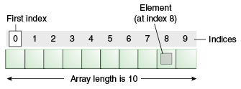
Unlike C/C++, we can get the length of the array using the length member. In C/C++, we need to use the sizeof operator. In Java, array is an object of a dynamically generated class. Java array inherits the Object class, and implements the Serializable as well as Cloneable interfaces. We can store primitive values or objects in an array in Java. Like C/C++, we can also create single dimentional or multidimentional arrays in Java.
Moreover, Java provides the feature of anonymous arrays which is not available in C/C++.

Slide 7
Advantages Code Optimization: It makes the code optimized, we can retrieve or sort the data efficiently. Random access: We can get any data located at an index position.
Disadvantages
Size Limit: We can store only the fixed size of elements in the array. It doesn't grow its size at runtime. To solve this problem, collection framework is used in Java which grows automatically.

Slide 8
Q.What are different access specifiers in java?
Access Specifiers In Java
Definition :
- Java Access Specifiers (also known as Visibility Specifiers ) regulate access to classes, fields and methods in Java.These Specifiers determine whether a field or method in a class, can be used or invoked by another method in another class or sub-class. Access Specifiers can be used to restrict access. Access Specifiers are an integral part of object-oriented programming.

Slide 9
Types Of Access Specifiers :
In java we have four Access Specifiers and they are listed below.
1. public
2. private
3. protected
4. default(no specifier)

Slide 10
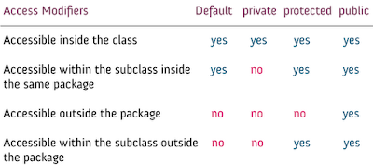

Slide 11
Q.Explain bitwise operators in java.
Java defines several bitwise operators, which can be applied to the integer types, long, int, short, char, and byte.
Bitwise operator works on bits and performs the bit-by-bit operation. Assume if a = 60 and b = 13; now in binary format they will be as follows −
a = 0011 1100
b = 0000 1101
-----------------
a&b = 0000 1100
a|b = 0011 1101
a^b = 0011 0001
~a = 1100 0011

Slide 12
The following table lists the bitwise operators − Assume integer variable A holds 60 and variable B holds 13 then −
Operator | Description | Example
& (bitwise and) | Binary AND Operator copies a bit to the result if it exists in both operands. | (A & B) will give 12 which is 0000 1100
| (bitwise or) | Binary OR Operator copies a bit if it exists in either operand. | (A | B) will give 61 which is 0011 1101
^ (bitwise XOR) | Binary XOR Operator copies the bit if it is set in one operand but not both. | (A ^ B) will give 49 which is 0011 0001
~ (bitwise compliment) | Binary Ones Complement Operator is unary and has the effect of 'flipping' bits. | (~A ) will give -61 which is 1100 0011 in 2's complement form due to a signed binary number.
<< (left shift) | Binary Left Shift Operator. The left operands value is moved left by the number of bits specified by the right operand. | A << 2 will give 240 which is 1111 0000
>> (right shift) | Binary Right Shift Operator. The left operands value is moved right by the number of bits specified by the right operand. | A >> 2 will give 15 which is 1111
>>> (zero fill right shift) | Shift right zero fill operator. The left operands value is moved right by the number of bits specified by the right operand and shifted values are filled up with zeros. | A >>>2 will give 15 which is 0000 1111

Slide 13
Q.Explain abstract class in java.
Abstract class in Java
A class which is declared as abstract is known as an abstract class. It can have abstract and non-abstract methods. It needs to be extended and its method implemented. It cannot be instantiated.
Points to Remember
An abstract class must be declared with an abstract keyword.
It can have abstract and non-abstract methods.
It cannot be instantiated.
It can have constructors and static methods also.
It can have final methods which will force the subclass not to change the body of the method.

Slide 14
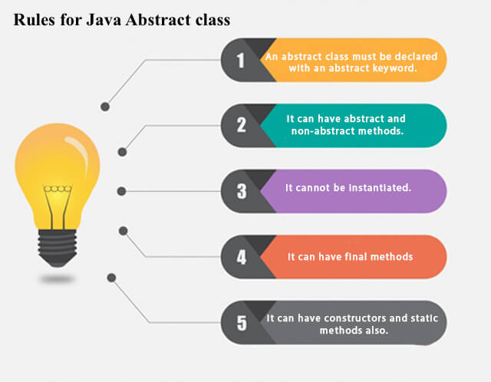

Slide 15
Example of abstract class abstract class A{} Abstract Method in Java A method which is declared as abstract and does not have implementation is known as an abstract method. Example of abstract method abstract void printStatus();//no method body and abstract

