Slide 1
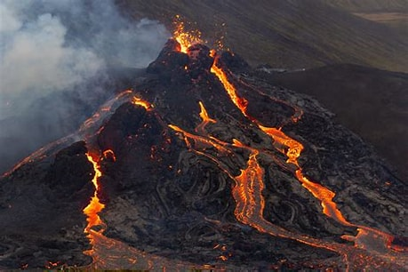


2023
SCIENCE
MY FAVOURITE
Mount Vesuvius
VOLCANOES
PROJECT
Elevation:1,281m
Kilauea
VOLCANOES
Elevation:1,247m
Krakatoa
Elevation:813m

Slide 2
2023
SCIENCE
PROJECT
VOLCANOES
MY FAVOURITE
VOLCANOES
Mount Vesuvius
Elevation:1,281m
Kilauea
Elevation:1,247m
Krakatoa
Elevation:813m

Slide 3
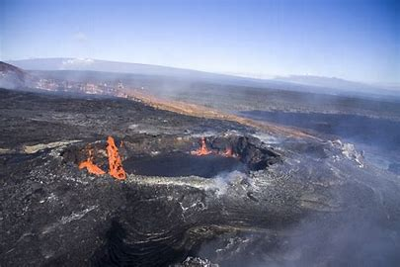
Mount Vesuvius
Mount Vesuvius (/vɪˈsuːviəs/ viss-OO-vee-əs)^{[a]} is a somma-stratovolcano located on the Gulf of Naples in Campania, Italy, about 9 km (5.6 mi) east of Naples and a short distance from the shore. It is one of several volcanoes forming the Campanian volcanic arc. Vesuvius consists of a large cone partially encircled by the steep rim of a summit caldera, resulting from the collapse of an earlier, much higher structure.

