Slide 1
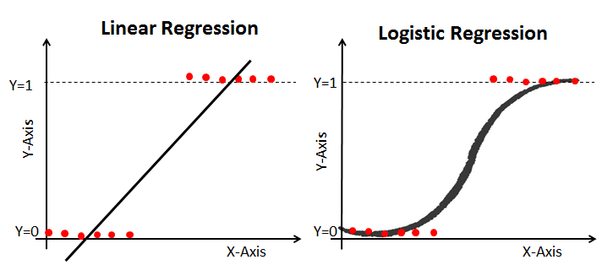
C in logistic regression parameter
It is used to represent the regularization strength and floats.
“Regularization is any modification we make to a learning algorithm that is intended to reduce its generalization error but not its training error. ” In other words: regularization can be used to train models that generalize better on unseen data, by preventing the algorithm from over fitting the training dataset.
C is a floating point number.
It’s by default 1.0.
Also we can easily increase regularization by making the number smaller usually you’ll tune it in powers of 10 like 0.001,0.1,1,10,100,……,etc.

