Slide 1
C in logistic regression parameter

Slide 2
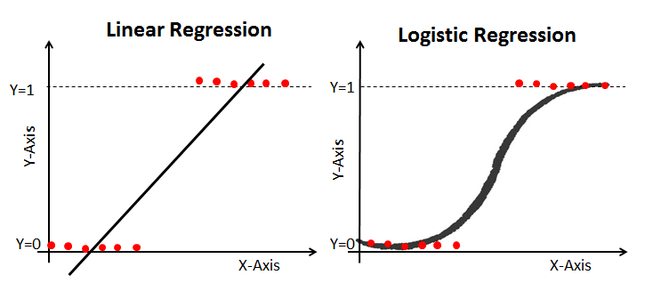
logistic regression
Logistic regression is used to solve classification problems, and the most common use case is binary logistic regression, where the outcome is binary (yes or no). In the real world, you can see logistic regression applied across multiple areas and fields.
health care, financial industry,..etc

Slide 3
C in logistic regression parameter
It is used to represent the regularization strength and floats.
Inverse of regularization strength; must be a positive float. Like in support vector machines, smaller values specify stronger regularization.
C is a floating point number.
It’s by default 1.0.
Also we can easily increase regularization by making the number smaller usually you’ll tune it in powers of 10 like 0.001,0.1,1,……,etc.

