Slide 1
Regression Metrics
Negative Mean Absolute Error

Slide 2

Formula
n = The number of errors
| Xi - X |= The absolute errors.
The difference between an expected value and a predicted value can be positive or negative and will necessarily be positive when calculating the MAE.
MAE Values can range from 0 to ∞

Slide 3
Calculation
Stock Price = 100
The Formula | Expected Value – Predicted Value |
If the Expected Value greater than the Predicted Value | 100-105 | = -5 but it converts negative Value into Positive Value 5.
If the Expected Value less than the Predicted Value |100 – 95 | the Answer return as 5

Slide 4
Advantages
It is an easy to calculate evaluation metric.
It measures accuracy for continuous variables.
Mean Absolute Error Punish small errors only caused by outliers.

Slide 5
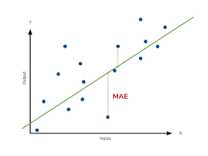
Disadvantage
MAE is the average distance between the real data and the predicted data, but fails to punish large errors in prediction.

