Slide 1
Regression Metrics
Negative Mean Absolute Error

Slide 2
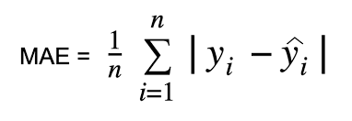
Formula

Slide 3
Advantages
It is an easy to calculate evaluation metric.
MAE does not penalize high errors caused by outliers

Slide 4
DisAdvantage
Sometimes the large errors coming from the outliers end up being treated as the same as low errors.

Slide 5
Cost Analysis
Indicate the financial advantages for the customer
Compare quality and price with those of the competition

