Slide 1
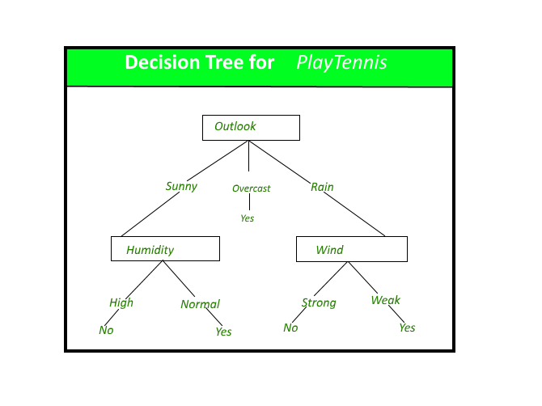
Decision Tree
Decision Tree is the most powerful and popular tool for classification and prediction. A Decision tree is a flowchart-like tree structure, where each internal node denotes a test on an attribute, each branch represents an outcome of the test, and each leaf node (terminal node) holds a class label.

Slide 2
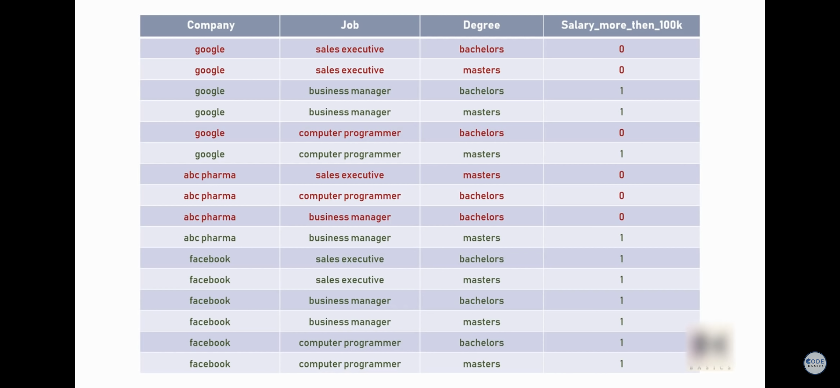

Slide 3
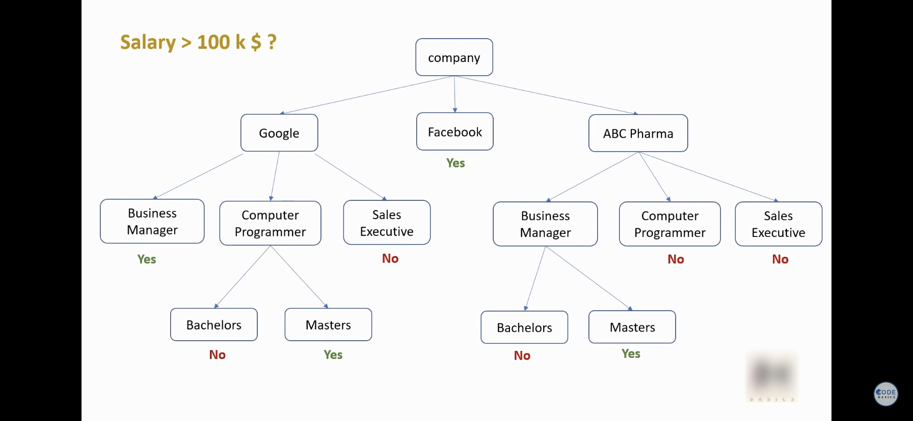

Slide 4
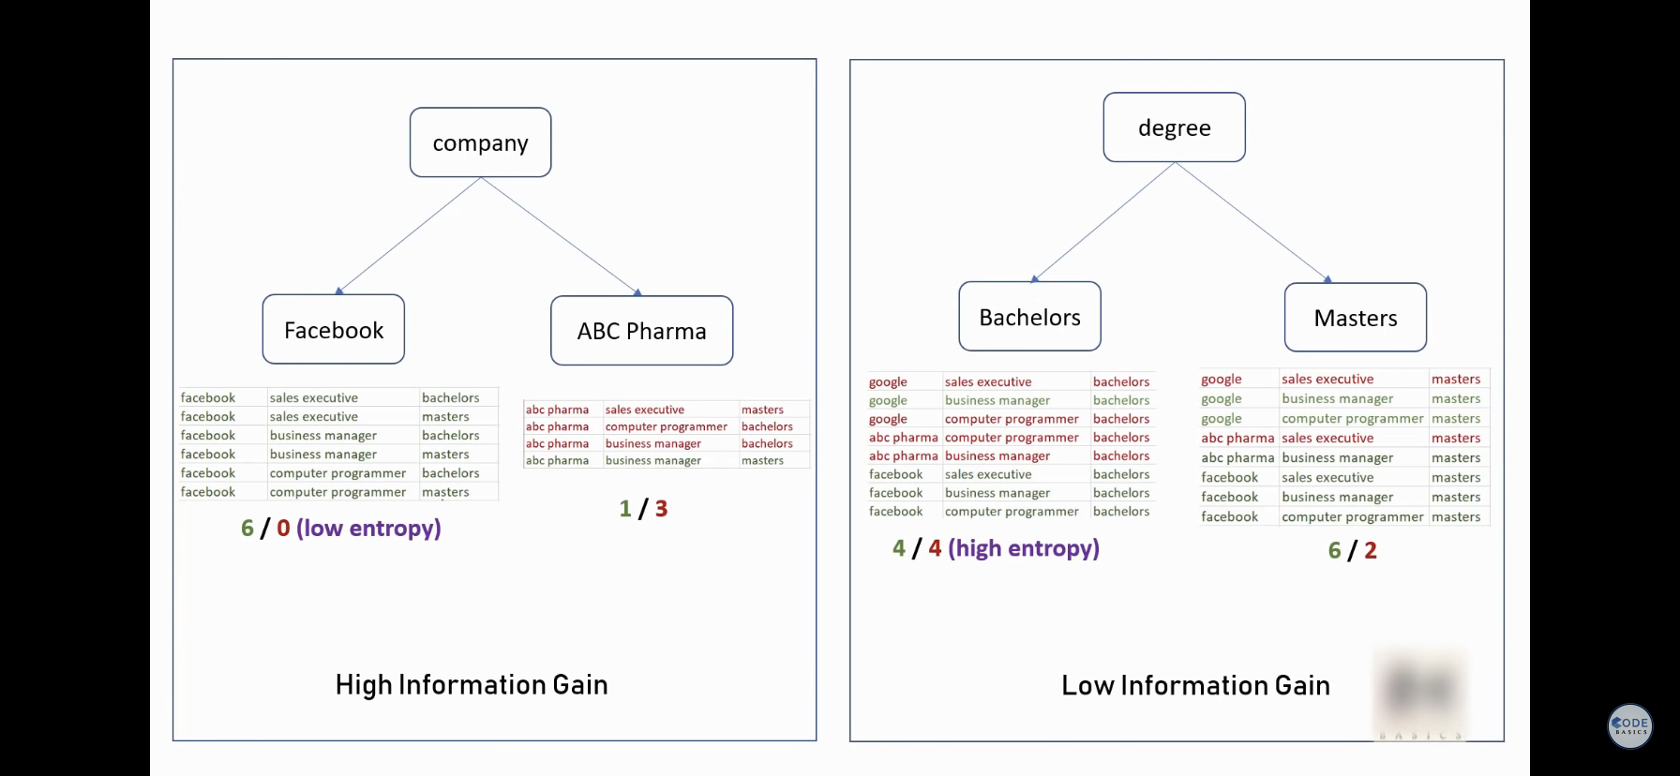

Slide 5
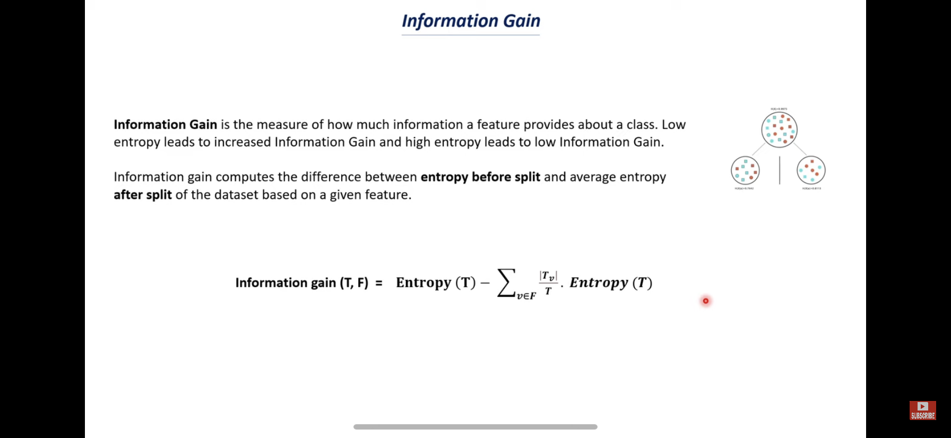

Slide 6
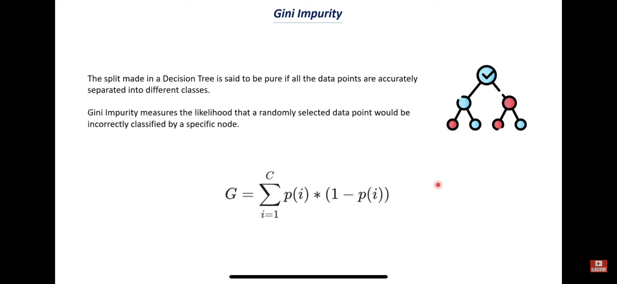

Slide 7
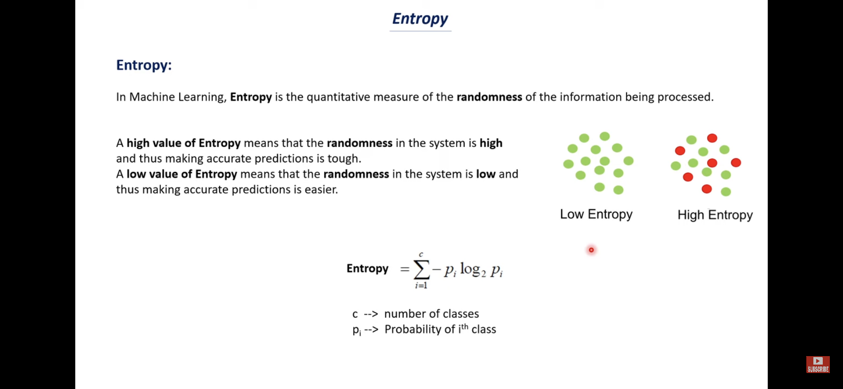

Slide 8
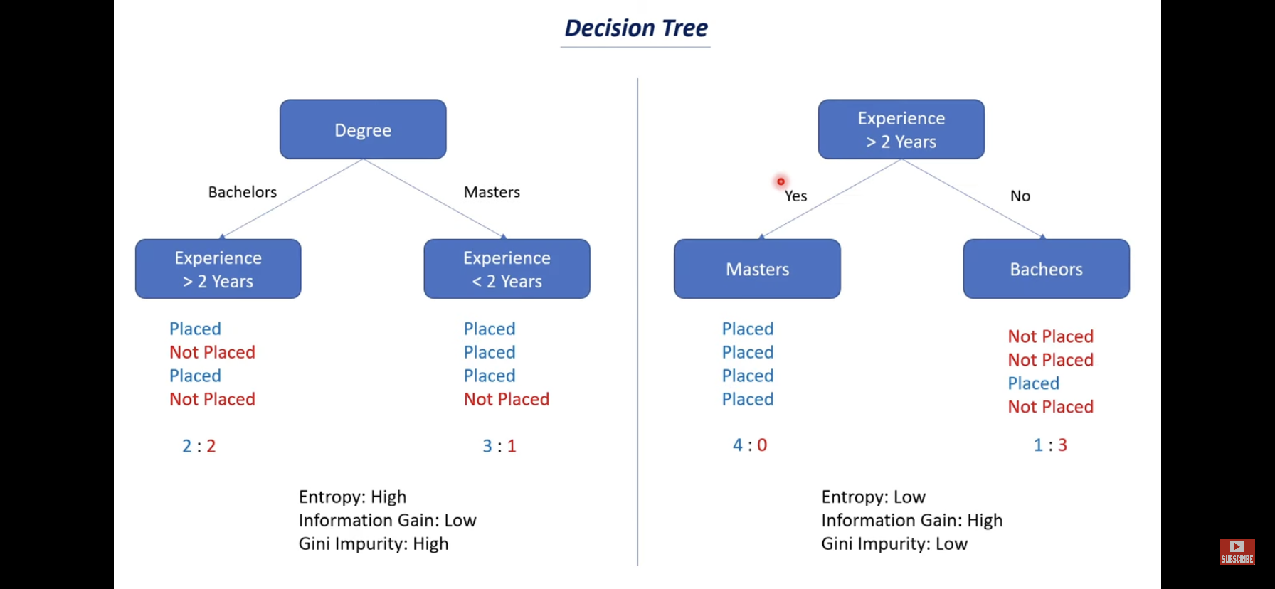

Slide 9
