Slide 1

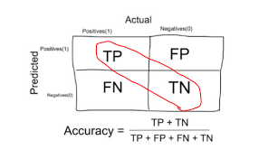
ACCURACY
It’s an evaluation metric and It is the ratio of total number of correct prediction to total number of predictions.
Training Accuracy:
--->The performance of our actual dataset that is fed into the machine learning model to discover and learn patterns
Testing Accuracy:
-->Once machine learning model is built (with training data), the unseen data is used to test model. This evaluation is called testing accuacry

