Slide 1



| December 2022
ROC
01
BY AJEET SINGH

Slide 2
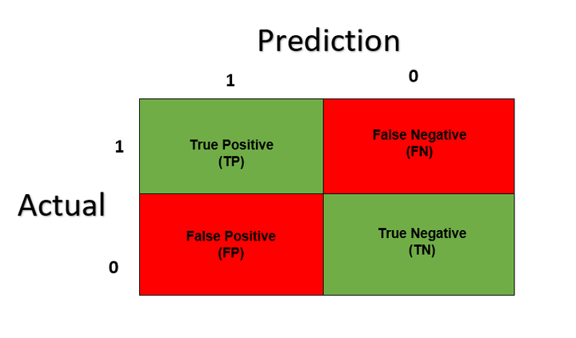

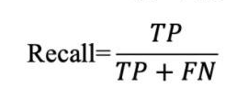
Confusion Matrix
A Confusion matrix is an N x N matrix used for evaluating the performance of a classification model, where N is the number of target classes. The matrix compares the actual target values with those predicted by the machine learning model.

Slide 3
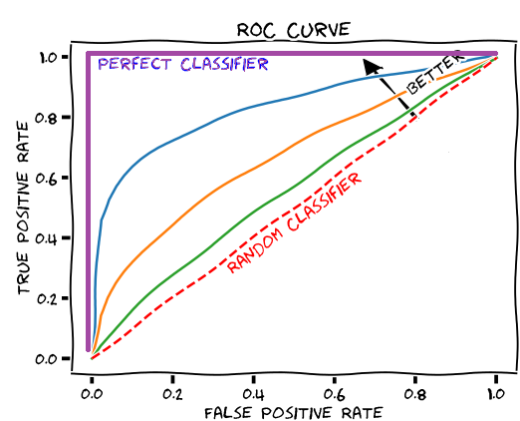
ROC curve gives you a curve of TP Vs FP rate.Based on certain thresold,you can figure out,what should be your Tp vs Fp rate for your model

Slide 4
Reference
https://medium.com/analytics-vidhya/what-is-a-confusion-matrix-d1c0f8feda5
https://glassboxmedicine.com/2019/02/23/measuring-performance-auc-auroc/
https://www.youtube.com/watch?v=4jRBRDbJemM&ab_channel=StatQuestwithJoshStarmer

