Slide 1

F1 SCORE

Slide 2
F1 score is a machine learning evaluation metric that measures a model’s accuracy. It combines the precision and recall scores of a model.
The accuracy metric computes how many times a model made a correct prediction across the entire dataset. This can be a reliable metric only if the dataset is class-balanced; each class of the dataset has the same number of samples.
Precision measures how many of the “positive” predictions made by the model were correct.
Recall measures how many of the positive class samples present in the dataset were correctly identified by the model.

Slide 3
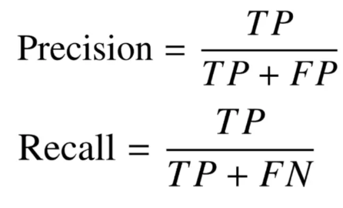
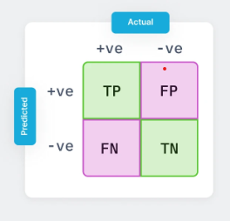
The F1 score combines precision and recall using their harmonic mean and maximizing the F1 score implies simultaneously maximizing both precision and recall.

Slide 4
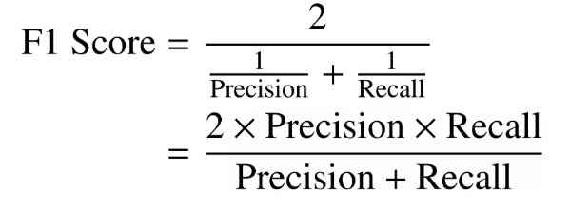
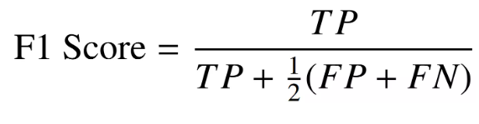
The F1 score is calculated as the harmonic mean of the precision and recall scores, as shown below. It ranges from 0-100%, and a higher F1 score denotes a quality classifier.
The harmonic mean encourages similar values for precision and recall. That is, the more the precision and recall scores deviate from each other, the worse the harmonic mean.

