Slide 1
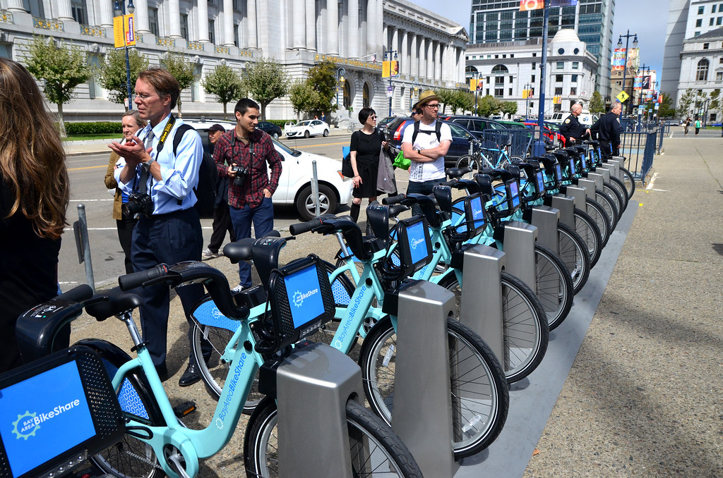
How does a bike-share navigate speedy success
This Photo by Unknown Author is licensed under CC BY-NC-ND

Slide 2
● Where is your data located?
https://divvy-tripdata.s3.amazonaws.com/index.html
● How is the data organized?
The data were kept in zip files saved by yyyymm
● Are there issues with bias or credibility in this data? Does your data ROCCC?
The data type is inner data with high credibility
● How are you addressing licensing, privacy, security, and accessibility?
The data has been made available by Motivate International Inc. under this license.

Slide 3

How do annual members and casual riders use Cyclistic bikes differently?
Why would casual riders buy Cyclistic annual memberships?

Slide 4

Tools used to perform the study:
Excel sheet (data cleaning & visualization)
SQL (data cleaning)
R (data cleaning & visualization)

Slide 5
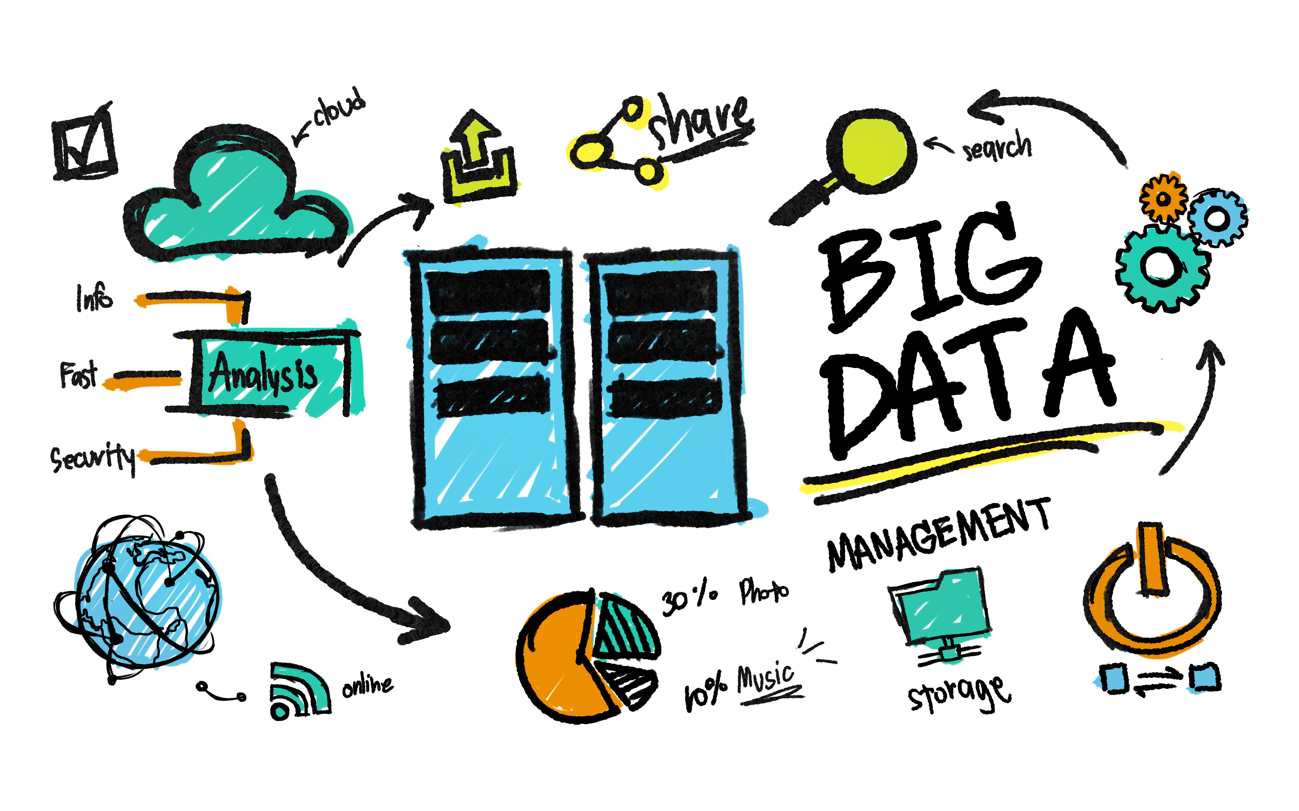
The study covered the data from Q1 of each 2019 & 2020 focus on how casual clients and members acted and the differences in act between the two types of clients; in order to give us a prediction about how we can attract more casual clients to become members.

Slide 9
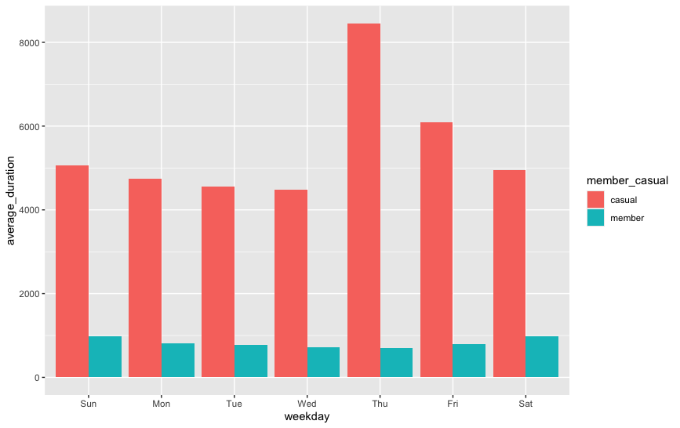

Slide 10

The analysis show that the casual clients use the service more often and for a longer distances than the member during the whole weekdays , we can use that in a campaign to enable the casual clients to see the benefit of being member .

