Slide 1
SIMO / MISO combining schemes Assignment - 05
REFAT KHAN

Slide 2
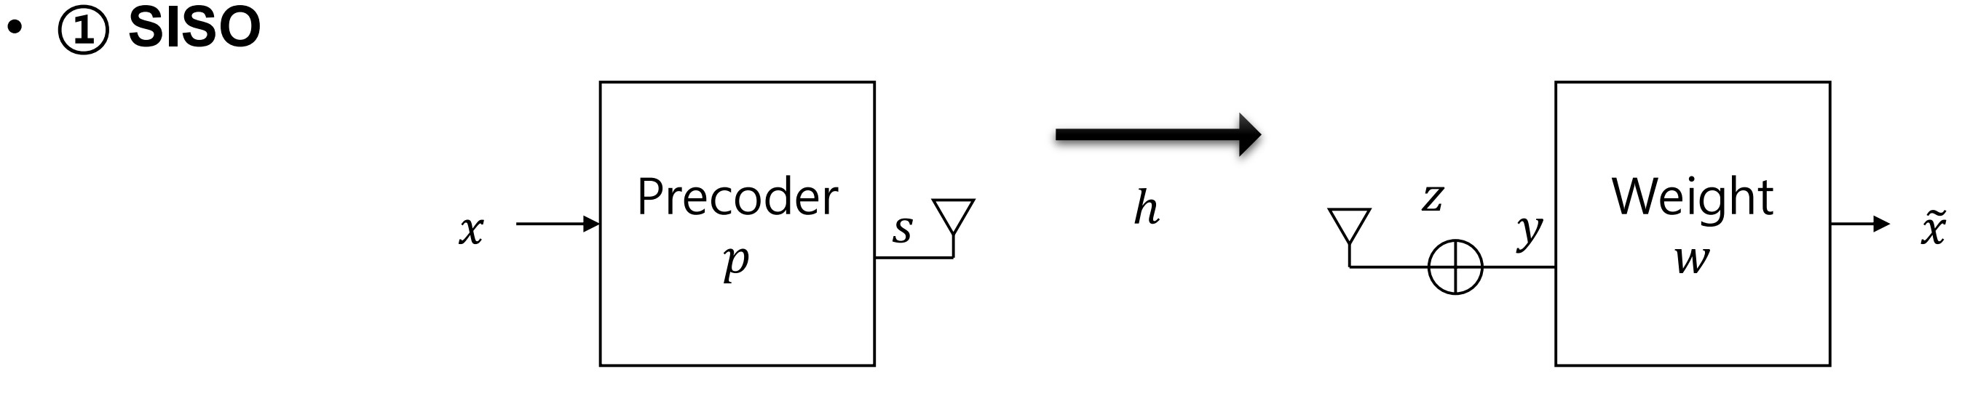
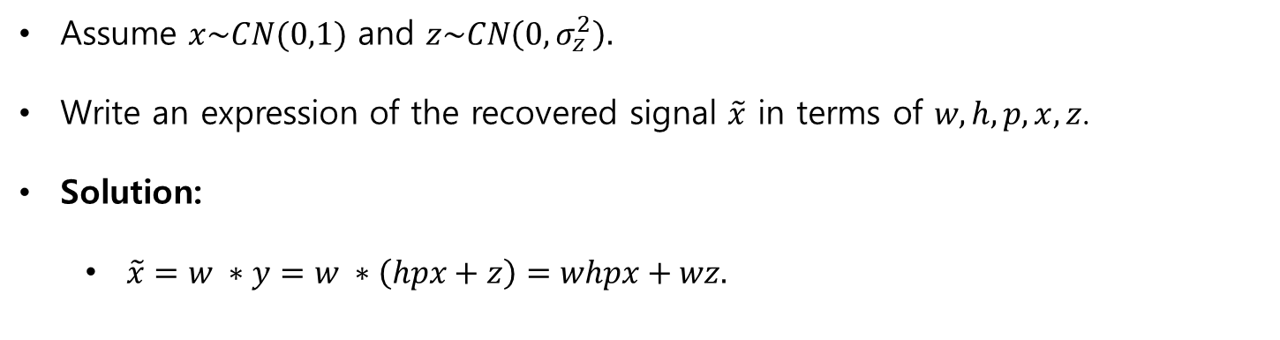
SISO
Assume $x\sim CN(0,1)$ and $z\sim CN\left(0,σ_{z}^{2}\right).$
Write an expression of the recovered signal $\tilde{x}$ in terms of $w,h,p,x,z$.
Solution:
$\tilde{x}=w ∗y=w ∗\left(hpx+z\right)=whpx+wz.$

Slide 3
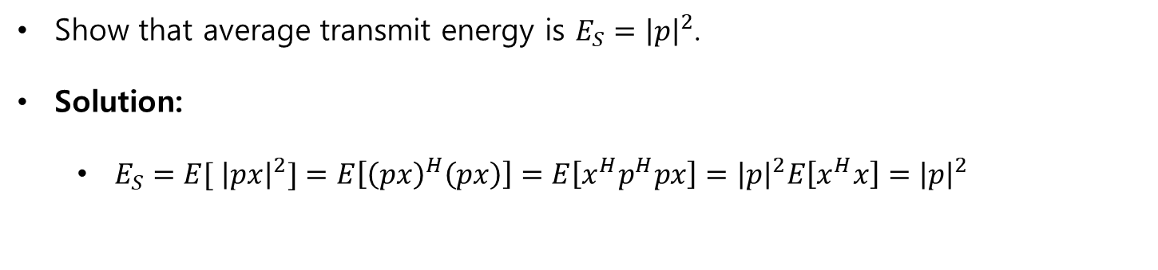
SISO
Show that average transmit energy is $E_{S}={\left|p\right|}^{2}$.
Solution:
$E_{S}={E[ \left|px\right|}^{2}]=E\left[{\left(px\right)}^{H}\left(px\right)\right]=E\left[x^{H}p^{H}px\right]={\left|p\right|}^{2}E\left[x^{H}x\right]={\left|p\right|}^{2}$

Slide 4
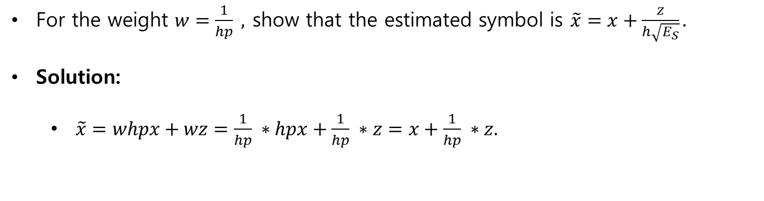
SISO
For the weight $w=\frac{1}{hp} ,$ show that the estimated symbol is $\tilde{x}=x+\frac{z}{h\sqrt{E_{S}}}.$
Solution:
$\tilde{x}=whpx+wz=\frac{1}{hp} ∗hpx+\frac{1}{hp} ∗z=x+\frac{1}{hp} ∗z.$

Slide 5
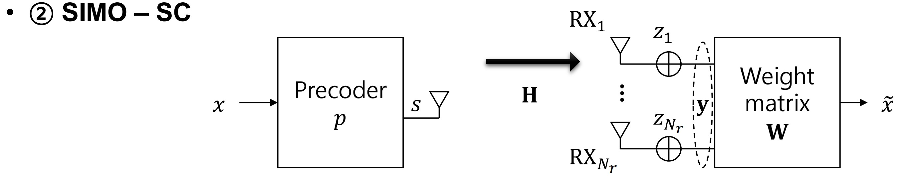
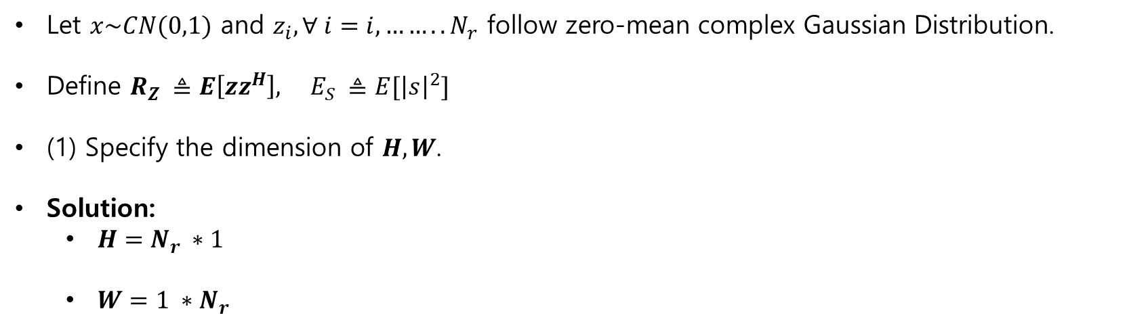
SIMO SC
Let $x\sim CN(0,1)$ and $z_{i}, ∀ i=i,……..N_{r}$ follow zero-mean complex Gaussian Distribution.
Define $R_{Z} ≜E\left[zz^{H}\right], E_{S} ≜E[{\left|s\right|}^{2}]$
(1) Specify the dimension of $H, W$.
Solution:
$H=N_{r} ∗1$
$W=1 ∗N_{r}$

Slide 6
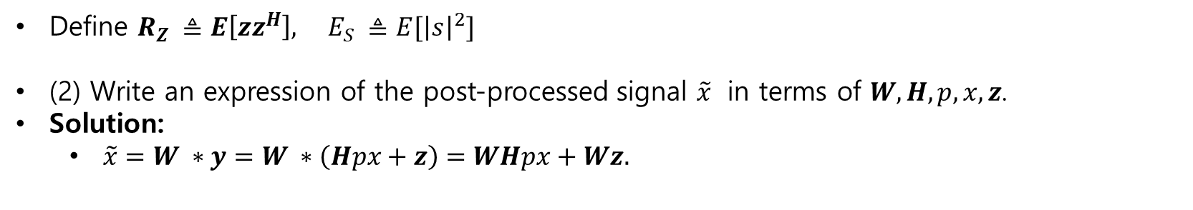
SIMO SC
Define $R_{Z} ≜E\left[zz^{H}\right], E_{S} ≜E[{\left|s\right|}^{2}]$
(2) Write an expression of the post-processed signal $\tilde{x}$ in terms of $W,H,p,x,z$.
Solution:
$\tilde{x}=W ∗y=W ∗\left(Hpx+z\right)=WHpx+Wz.$

Slide 7
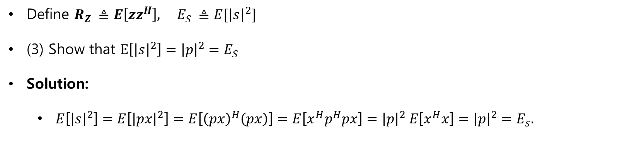
SIMO SC
Define $R_{Z} ≜E\left[zz^{H}\right], E_{S} ≜E[{\left|s\right|}^{2}]$
(3) Show that $E\left[{\left|s\right|}^{2}\right]={\left|p\right|}^{2}=E_{S}$
Solution:
$E\left[{\left|s\right|}^{2}\right]=E\left[{\left|px\right|}^{2}\right]=E\left[{\left(px\right)}^{H}\left(px\right)\right]=E\left[x^{H}p^{H}px\right]={\left|p\right|}^{2} E\left[x^{H}x\right]={\left|p\right|}^{2}=E_{s}.$

Slide 8
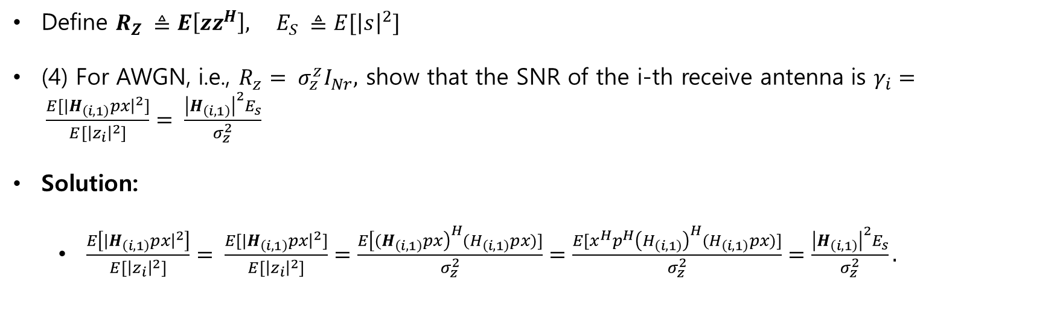
SIMO SC
Define $R_{Z} ≜E\left[zz^{H}\right], E_{S} ≜E[{\left|s\right|}^{2}]$
(4) For AWGN, i.e., $R_{z}= σ_{z}^{z}I_{Nr},$ show that the SNR of the i-th receive antenna is $γ_{i}= \frac{E[{|H}_{\left(i,1\right)}px{\left.​\right|}^{2}]}{E[{\left|z_{i}\right|}^{2}]}= \frac{{\left|H_{\left(i,1\right)}\right|}^{2}E_{s}}{σ_{z}^{2}}$
Solution:
$\frac{E\left[{|H}_{\left(i,1\right)}px{\left.​\right|}^{2}\right]}{E[{\left|z_{i}\right|}^{2}]}= \frac{E[{|H}_{\left(i,1\right)}px{\left.​\right|}^{2}]}{E[{\left|z_{i}\right|}^{2}]}=\frac{E{\left[{(H}_{\left(i,1\right)}px\right)}^{H}(H_{\left(i,1\right)}px)]}{σ_{z}^{2}}=\frac{E[x^{H}p^{H}{\left(H_{\left(i,1\right)}\right)}^{H}(H_{\left(i,1\right)}px)]}{σ_{z}^{2}}=\frac{{\left|H_{\left(i,1\right)}\right|}^{2}E_{s}}{σ_{z}^{2}}.$

Slide 9
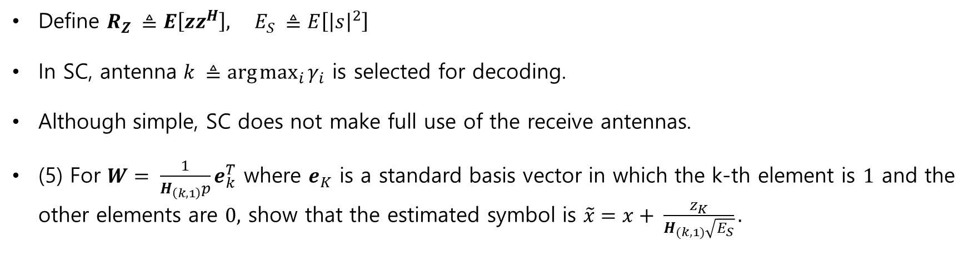
SIMO SC
Define $R_{Z} ≜E\left[zz^{H}\right], E_{S} ≜E\left[{\left|s\right|}^{2}\right]$
In SC, antenna $k ≜\arg{\max_{i}{γ_{i}}}$ is selected for decoding.
Although simple, SC does not make full use of the receive antennas.
(5) For $W= \frac{1}{H_{\left(k,1\right)}p}e_{k}^{T}$ where $e_{K}$ is a standard basis vector in which the k-th element is $1$ and the other elements are $0,$ show that the estimated symbol is $\tilde{x}=x+ \frac{z_{K}}{H_{(k,1)}\sqrt{E_{S}}}.$

Slide 10
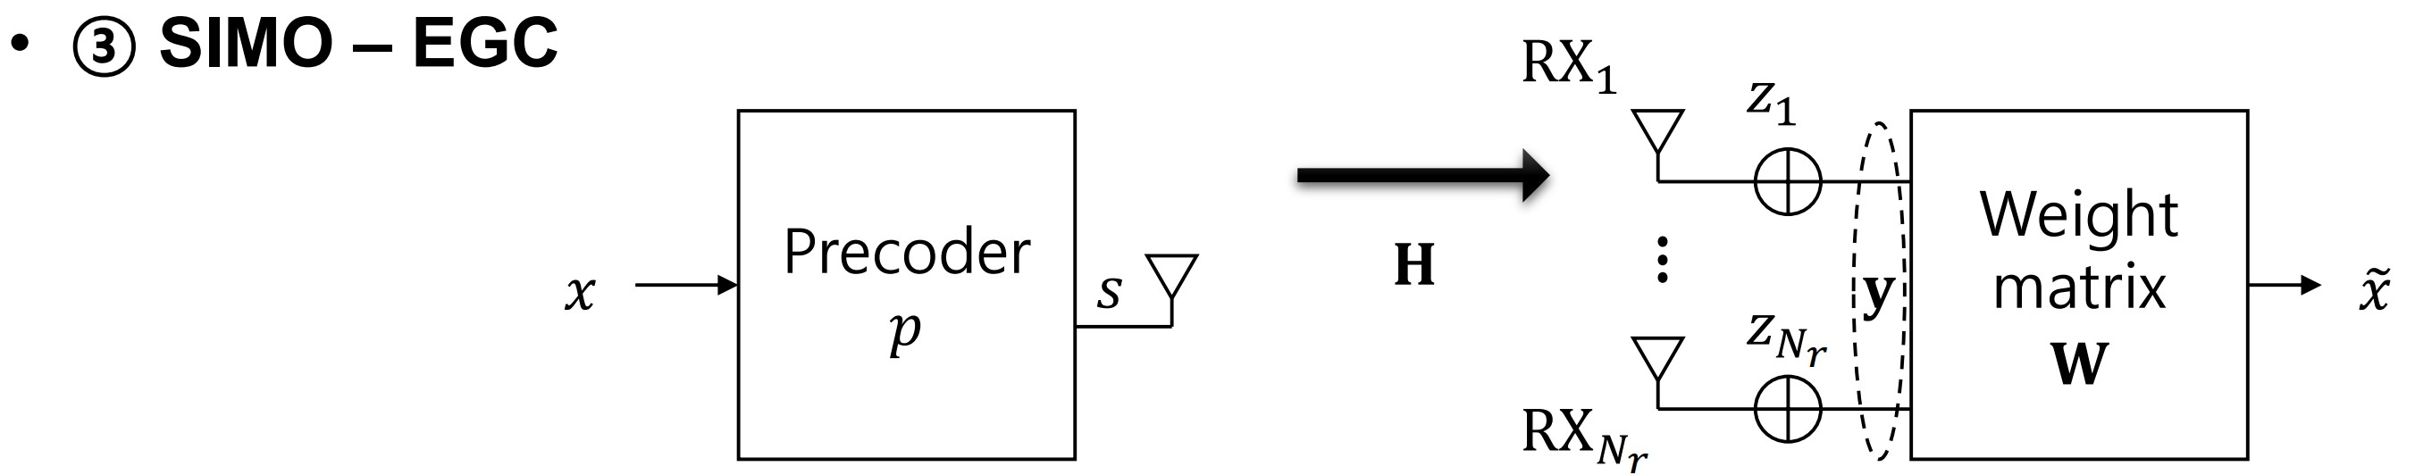
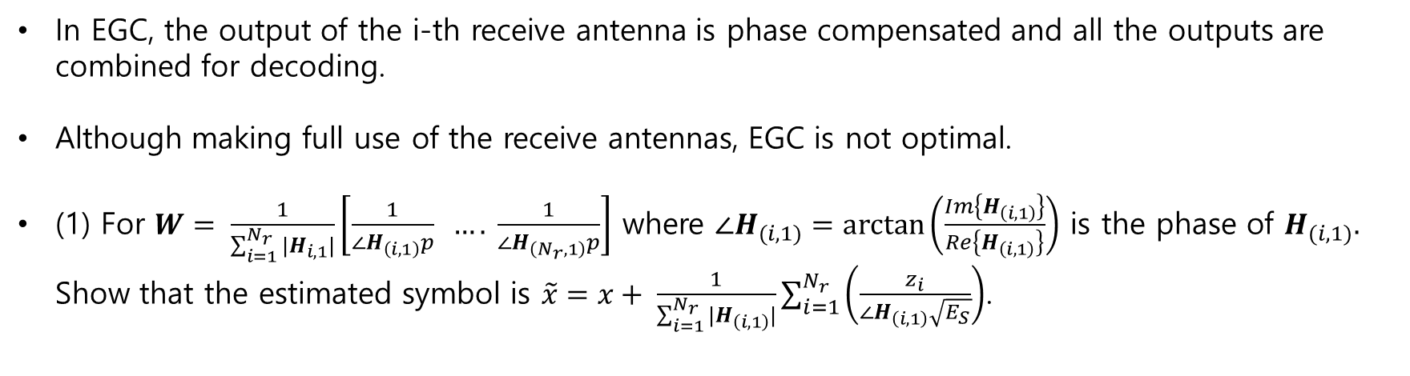
SIMO EGC
In EGC, the output of the i-th receive antenna is phase compensated and all the outputs are combined for decoding.
Although making full use of the receive antennas, EGC is not optimal.
(1) For $W= \frac{1}{\sum_{i=1}^{N_{r}}{|H_{i,1}|}}\left[\frac{1}{{∠H}_{\left(i,1\right)}p} …. \frac{1}{∠H_{\left(N_{r},1\right)}p}\right]$ where $∠H_{(i,1)}=\arctan\left(\frac{Im\left\{H_{\left(i,1\right)}\right\}}{Re\left\{H_{\left(i,1\right)}\right\}}\right)$ is the phase of $H_{(i,1)}.$ Show that the estimated symbol is $\tilde{x}=x+ \frac{1}{\sum_{i=1}^{N_{r}}{|H_{\left(i,1\right)}|}}\sum_{i=1}^{N_{r}}{\left(\frac{z_{i}}{∠H_{\left(i,1\right)}\sqrt{E_{S}}}\right)}$.

Slide 11
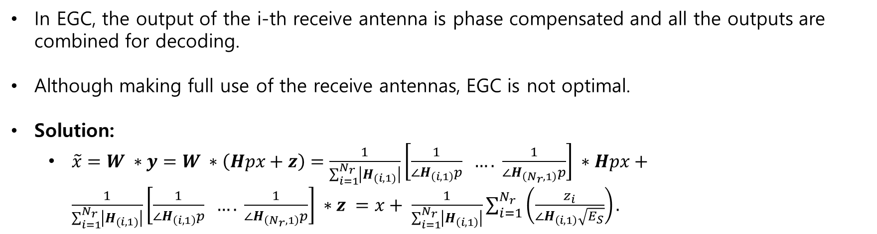
SIMO EGC
In EGC, the output of the i-th receive antenna is phase compensated and all the outputs are combined for decoding.
Although making full use of the receive antennas, EGC is not optimal.
Solution:
$\tilde{x}=W ∗y=W ∗\left(Hpx+z\right)=\frac{1}{\sum_{i=1}^{N_{r}}{\left|H_{(i,1)}\right|}}\left[\frac{1}{{∠H}_{\left(i,1\right)}p} …. \frac{1}{∠H_{\left(N_{r},1\right)}p}\right] ∗Hpx+\frac{1}{\sum_{i=1}^{N_{r}}{\left|H_{(i,1)}\right|}}\left[\frac{1}{{∠H}_{\left(i,1\right)}p} …. \frac{1}{∠H_{\left(N_{r},1\right)}p}\right] ∗z =x+ \frac{1}{\sum_{i=1}^{N_{r}}{\left|H_{\left(i,1\right)}\right|}}\sum_{i=1}^{N_{r}}{\left(\frac{z_{i}}{∠H_{\left(i,1\right)}\sqrt{E_{S}}}\right)}.$

Slide 12
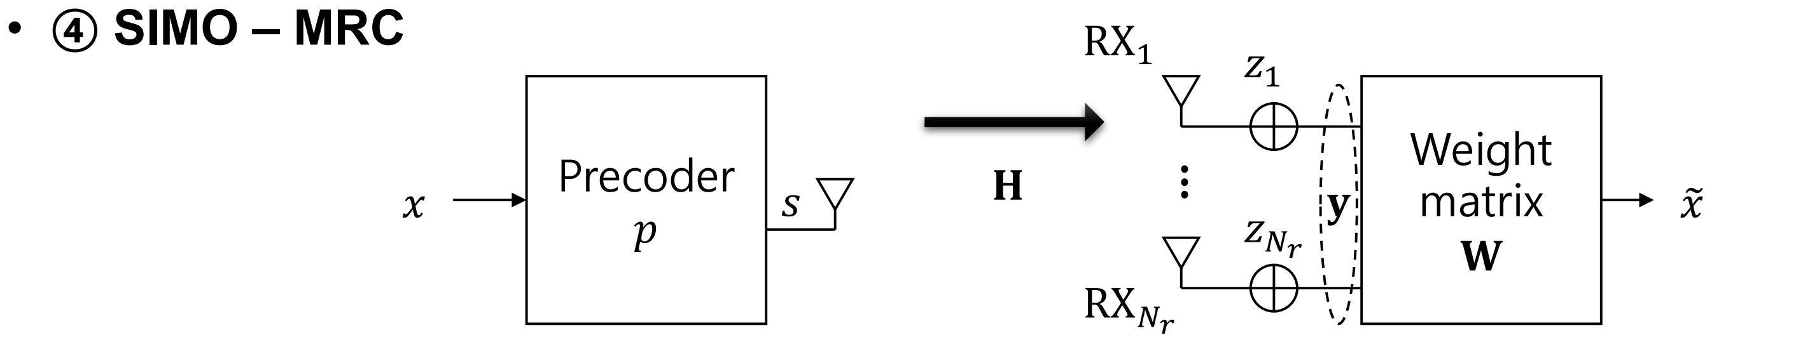
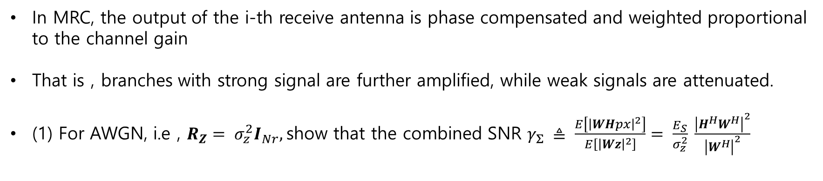
SIMO MRC
In MRC, the output of the i-th receive antenna is phase compensated and weighted proportional to the channel gain
That is , branches with strong signal are further amplified, while weak signals are attenuated.
(1) For AWGN, i.e , $R_{Z}= σ_{z}^{2}I_{Nr},$show that the combined SNR $γ_{Σ} ≜ \frac{E\left[{\left|WHpx\right|}^{2}\right]}{E\left[{\left|Wz\right|}^{2}\right]}= \frac{E_{S}}{σ_{z}^{2}} \frac{{\left|H^{H}W^{H}\right|}^{2}}{{\left|W^{H}\right|}^{2}}$

Slide 13
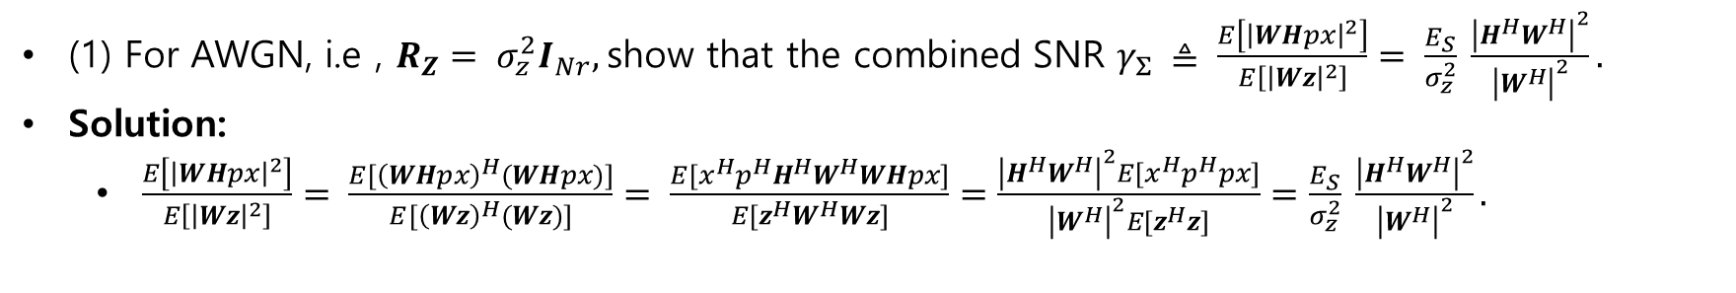
SIMO MRC
(1) For AWGN, i.e , $R_{Z}= σ_{z}^{2}I_{Nr},$show that the combined SNR $γ_{Σ} ≜ \frac{E\left[{\left|WHpx\right|}^{2}\right]}{E\left[{\left|Wz\right|}^{2}\right]}= \frac{E_{S}}{σ_{z}^{2}} \frac{{\left|H^{H}W^{H}\right|}^{2}}{{\left|W^{H}\right|}^{2}}.$
Solution:
$\frac{E\left[{\left|WHpx\right|}^{2}\right]}{E\left[{\left|Wz\right|}^{2}\right]}= \frac{E[{\left(WHpx\right)}^{H}(WHpx)]}{E[{\left(Wz\right)}^{H}(Wz)]}= \frac{E[x^{H}p^{H}H^{H}W^{H}WHpx]}{E[z^{H}W^{H}Wz]}=\frac{{\left|H^{H}W^{H}\right|}^{2}E[x^{H}p^{H}px]}{{\left|W^{H}\right|}^{2}E[z^{H}z]}=\frac{E_{S}}{σ_{z}^{2}} \frac{{\left|H^{H}W^{H}\right|}^{2}}{{\left|W^{H}\right|}^{2}}.$

Slide 14
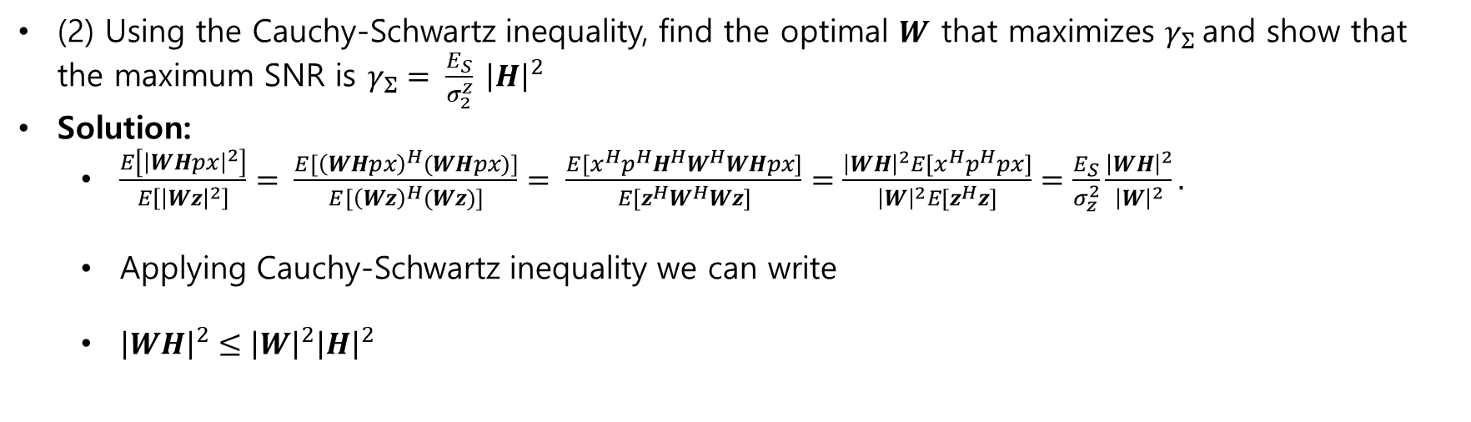
SIMO MRC
(2) Using the Cauchy-Schwartz inequality, find the optimal $W$ that maximizes $γ_{Σ}$and show that the maximum SNR is $γ_{Σ}= \frac{E_{S}}{σ_{2}^{z}} {\left|H\right|}^{2}$
Solution:
$\frac{E\left[{\left|WHpx\right|}^{2}\right]}{E\left[{\left|Wz\right|}^{2}\right]}= \frac{E[{\left(WHpx\right)}^{H}(WHpx)]}{E[{\left(Wz\right)}^{H}(Wz)]}= \frac{E[x^{H}p^{H}H^{H}W^{H}WHpx]}{E[z^{H}W^{H}Wz]}=\frac{{\left|WH\right|}^{2}E[x^{H}p^{H}px]}{{\left|W\right|}^{2}E[z^{H}z]}=\frac{E_{S}}{σ_{z}^{2}}\frac{{\left|WH\right|}^{2}}{{\left|W\right|}^{2}}.$
Applying Cauchy-Schwartz inequality we can write
${\left|WH\right|}^{2}≤{\left|W\right|}^{2}{\left|H\right|}^{2}$

Slide 15
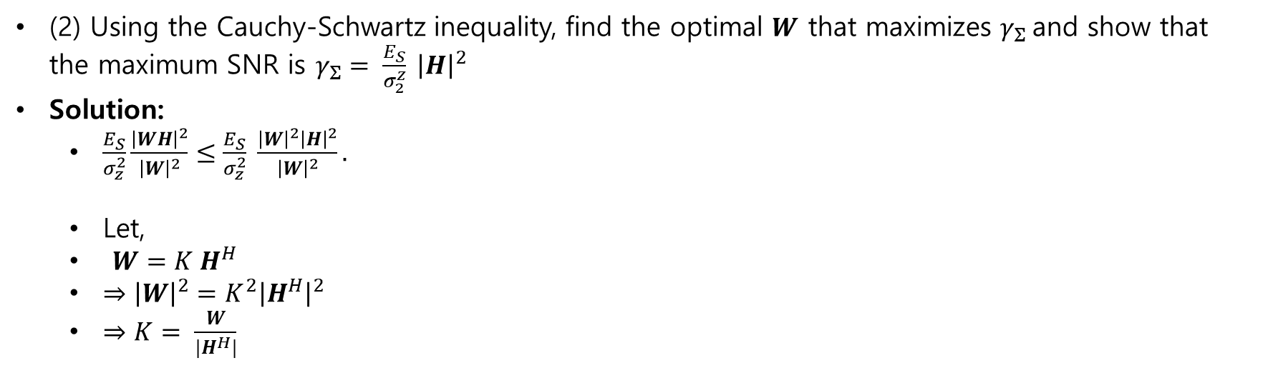
SIMO MRC
(2) Using the Cauchy-Schwartz inequality, find the optimal $W$ that maximizes $γ_{Σ}$and show that the maximum SNR is $γ_{Σ}= \frac{E_{S}}{σ_{2}^{z}} {\left|H\right|}^{2}$
Solution:
$\frac{E_{S}}{σ_{z}^{2}}\frac{{\left|WH\right|}^{2}}{{\left|W\right|}^{2}}≤\frac{E_{S}}{σ_{z}^{2}} \frac{{\left|W\right|}^{2}{\left|H\right|}^{2}}{{\left|W\right|}^{2}}.$
Let,
$W=K H^{H}$
$⇒{\left|W\right|}^{2}=K^{2}{\left|H^{H}\right|}^{2}$
$⇒K= \frac{W}{|H^{H}|}$

Slide 16
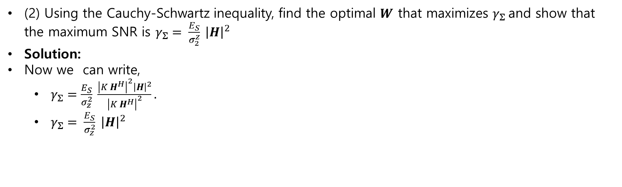
SIMO MRC
(2) Using the Cauchy-Schwartz inequality, find the optimal $W$ that maximizes $γ_{Σ}$and show that the maximum SNR is $γ_{Σ}= \frac{E_{S}}{σ_{2}^{z}} {\left|H\right|}^{2}$
Solution:
Now we can write,
$γ_{Σ}=\frac{E_{S}}{σ_{z}^{2}} \frac{{\left|K H^{H}\right|}^{2}{\left|H\right|}^{2}}{{\left|K H^{H}\right|}^{2}}.$
$γ_{Σ}= \frac{E_{S}}{σ_{z}^{2}} {\left|H\right|}^{2}$

Slide 17
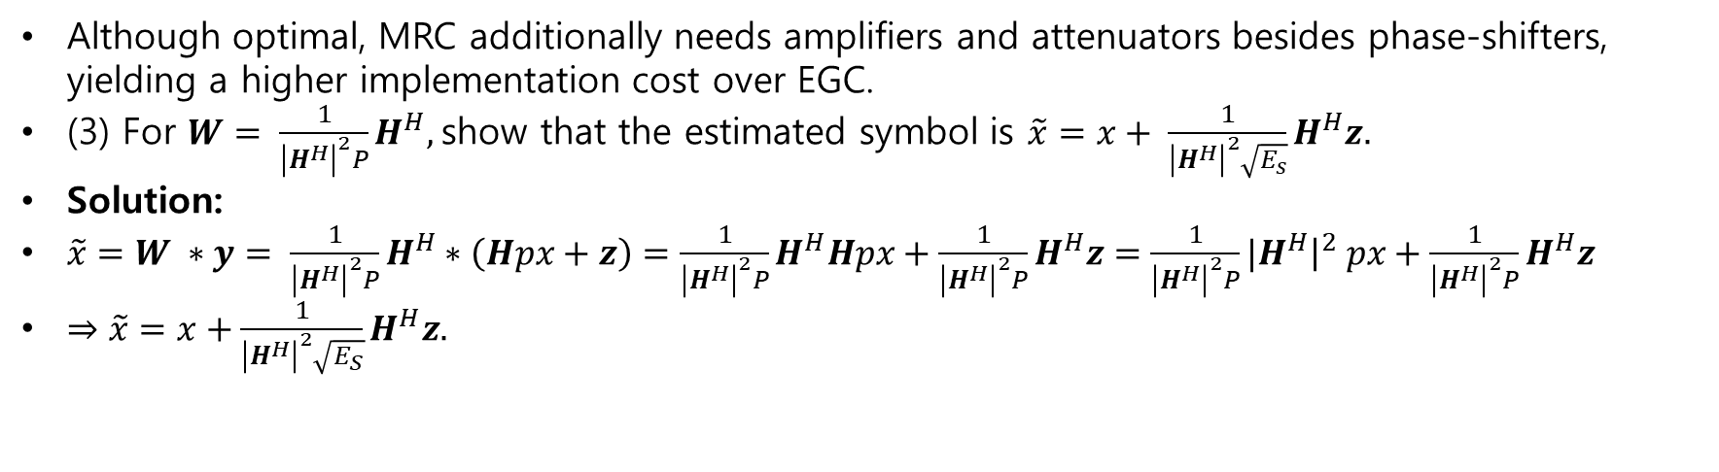
SIMO MRC
Although optimal, MRC additionally needs amplifiers and attenuators besides phase-shifters, yielding a higher implementation cost over EGC.
(3) For $W= \frac{1}{{\left|H^{H}\right|}^{2}P}H^{H},$show that the estimated symbol is $\tilde{x}=x+ \frac{1}{{\left|H^{H}\right|}^{2}\sqrt{E_{s}}}H^{H}z.$
Solution:
$\tilde{x}=W ∗y= \frac{1}{{\left|H^{H}\right|}^{2}P}H^{H}∗\left(Hpx+z\right)=\frac{1}{{\left|H^{H}\right|}^{2}P}H^{H}Hpx+\frac{1}{{\left|H^{H}\right|}^{2}P}H^{H}z=\frac{1}{{\left|H^{H}\right|}^{2}P}{|H}^{H}{\left.​\right|}^{2} px+\frac{1}{{\left|H^{H}\right|}^{2}P}H^{H}z$
$⇒\tilde{x}=x+\frac{1}{{\left|H^{H}\right|}^{2}\sqrt{E_{S}}}H^{H}z.$

Slide 18
SIMO MRC
Although optimal, MRC additionally needs amplifiers and attenuators besides phase-shifters, yielding a higher implementation cost over EGC.
(3) For $W= \frac{1}{{\left|H^{H}\right|}^{2}P}H^{H},$show that the estimated symbol is $\tilde{x}=x+ \frac{1}{{\left|H^{H}\right|}^{2}\sqrt{E_{s}}}H^{H}z.$
Solution:
$\tilde{x}=W ∗y= \frac{1}{{\left|H^{H}\right|}^{2}P}H^{H}∗\left(Hpx+z\right)=\frac{1}{{\left|H^{H}\right|}^{2}P}H^{H}Hpx+\frac{1}{{\left|H^{H}\right|}^{2}P}H^{H}z=\frac{1}{{\left|H^{H}\right|}^{2}P}{|H}^{H}{\left.​\right|}^{2} px+\frac{1}{{\left|H^{H}\right|}^{2}P}H^{H}z$
$⇒\tilde{x}=x+\frac{1}{{\left|H^{H}\right|}^{2}\sqrt{E_{S}}}H^{H}z.$

Slide 19
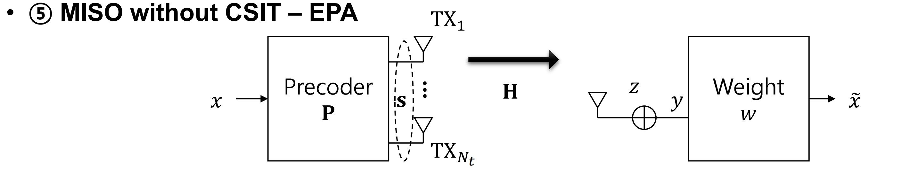
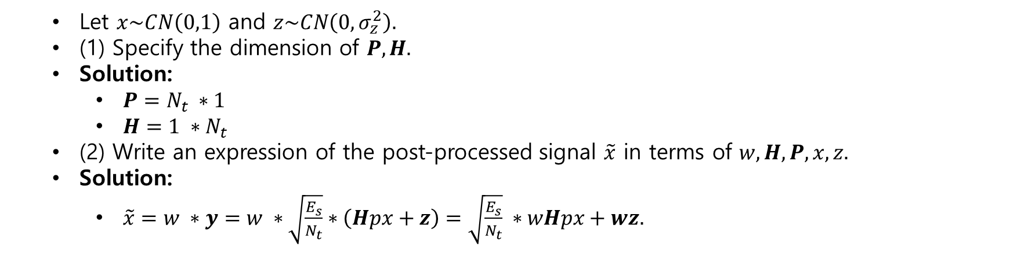
MISO without CSIT - EPA
Let $x\sim CN\left(0,1\right)$ and $z\sim CN\left(0,σ_{z}^{2}\right).$
(1) Specify the dimension of $P,H.$
Solution:
$P=N_{t} ∗1$
$H=1 ∗N_{t}$
(2) Write an expression of the post-processed signal $\tilde{x}$ in terms of $w,H,P,x,z.$
Solution:
$\tilde{x}=w ∗y=w ∗\sqrt{\frac{E_{s}}{N_{t}}}∗\left(Hpx+z\right)=\sqrt{\frac{E_{s}}{N_{t}}} ∗wHpx+wz.$

Slide 20
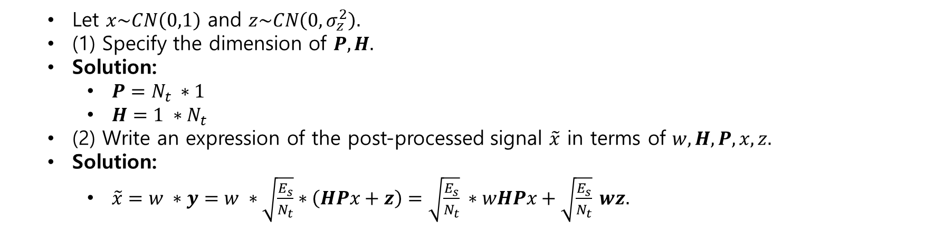
MISO without CSIT-EPA
Let $x\sim CN\left(0,1\right)$ and $z\sim CN\left(0,σ_{z}^{2}\right).$
(1) Specify the dimension of $P,H.$
Solution:
$P=N_{t} ∗1$
$H=1 ∗N_{t}$
(2) Write an expression of the post-processed signal $\tilde{x}$ in terms of $w,H,P,x,z.$
Solution:
$\tilde{x}=w ∗y=w ∗\sqrt{\frac{E_{s}}{N_{t}}}∗\left(HPx+z\right)=\sqrt{\frac{E_{s}}{N_{t}}} ∗wHPx+\sqrt{\frac{E_{s}}{N_{t}}} wz.$

Slide 21
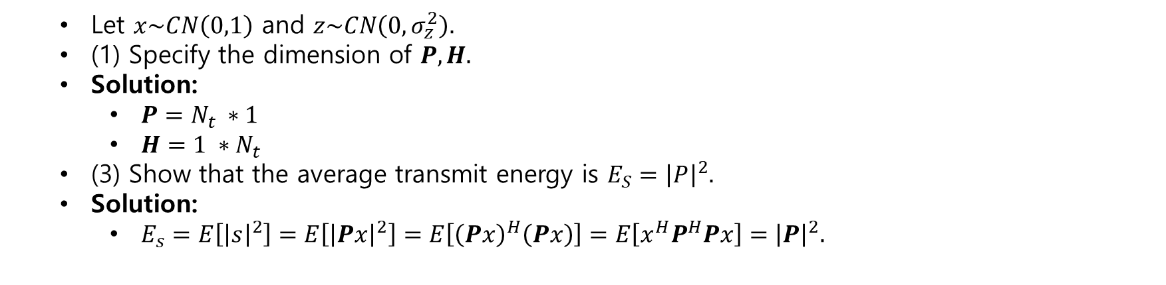
MISO without CSIT-EPA
Let $x\sim CN\left(0,1\right)$ and $z\sim CN\left(0,σ_{z}^{2}\right).$
(1) Specify the dimension of $P,H.$
Solution:
$P=N_{t} ∗1$
$H=1 ∗N_{t}$
(3) Show that the average transmit energy is $E_{S}={\left|P\right|}^{2}.$
Solution:
$E_{s}=E\left[{\left|s\right|}^{2}\right]=E\left[{\left|Px\right|}^{2}\right]=E\left[{\left(Px\right)}^{H}\left(Px\right)\right]=E\left[x^{H}P^{H}Px\right]={\left|P\right|}^{2}.$

Slide 22
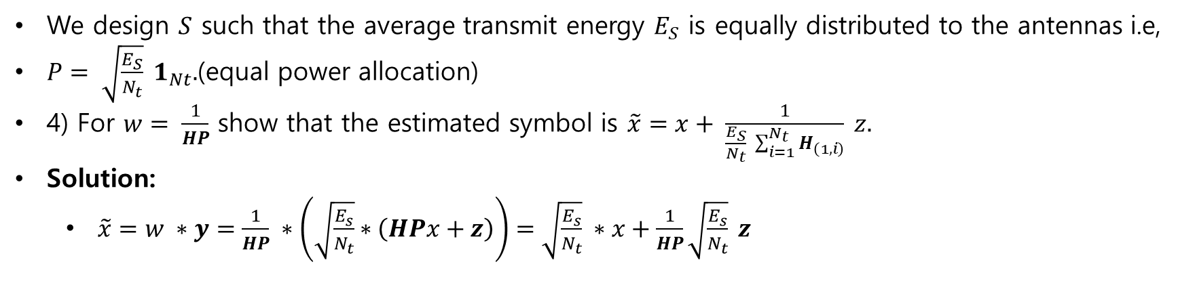
MISO without CSIT-EPA
We design $S$ such that the average transmit energy $E_{S}$ is equally distributed to the antennas i.e,
$P= \sqrt{\frac{E_{S}}{N_{t}}} 1_{Nt}.$(equal power allocation)
4) For $w= \frac{1}{HP}$ show that the estimated symbol is $\tilde{x}=x+ \frac{1}{\frac{E_{S}}{N_{t}} \sum_{i=1}^{N_{t}}{H_{\left(1,i\right)}}} z.$
Solution:
$\tilde{x}=w ∗y=\frac{1}{HP} ∗\left(\sqrt{\frac{E_{s}}{N_{t}}}∗\left(HPx+z\right)\right)=\sqrt{\frac{E_{s}}{N_{t}}} ∗x+\frac{1}{HP}\sqrt{\frac{E_{s}}{N_{t}}} z$

Slide 23
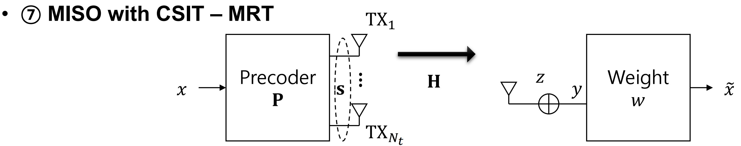
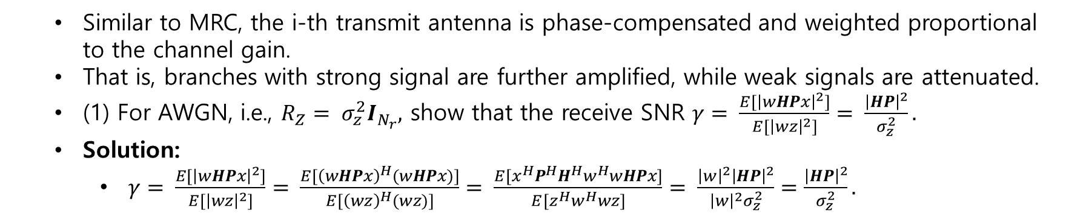
MISO with CSIT-MRT
Similar to MRC, the i-th transmit antenna is phase-compensated and weighted proportional to the channel gain.
That is, branches with strong signal are further amplified, while weak signals are attenuated.
(1) For AWGN, i.e., $R_{Z}= σ_{z}^{2}I_{N_{r}},$ show that the receive SNR $γ= \frac{E[{\left|wHPx\right|}^{2}]}{E[{\left|wz\right|}^{2}]}= \frac{{\left|HP\right|}^{2}}{σ_{z}^{2}}.$
Solution:
$γ= \frac{E[{\left|wHPx\right|}^{2}]}{E[{\left|wz\right|}^{2}]}= \frac{E[{\left(wHPx\right)}^{H}(wHPx)]}{E[{\left(wz\right)}^{H}(wz)]}= \frac{E[x^{H}P^{H}H^{H}w^{H}wHPx]}{E[z^{H}w^{H}wz]}= \frac{{\left|w\right|}^{2}{\left|HP\right|}^{2}}{{\left|w\right|}^{2}σ_{z}^{2}}=\frac{{\left|HP\right|}^{2}}{σ_{z}^{2}}.$

Slide 24
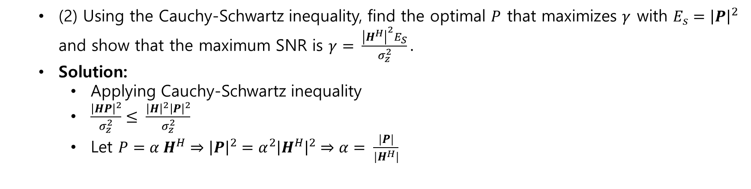
MISO with CSIT-MRT
(2) Using the Cauchy-Schwartz inequality, find the optimal $P$ that maximizes $γ$ with $E_{s}={\left|P\right|}^{2}$ and show that the maximum SNR is $γ= \frac{{\left|H^{H}\right|}^{2}E_{S}}{σ_{z}^{2}}.$
Solution:
Applying Cauchy-Schwartz inequality
$\frac{{\left|HP\right|}^{2}}{σ_{z}^{2}}≤ \frac{{\left|H\right|}^{2}{\left|P\right|}^{2}}{σ_{z}^{2}}$
Let $P=α H^{H}⇒{\left|P\right|}^{2}=α^{2}{\left|H^{H}\right|}^{2}⇒α= \frac{|P|}{|H^{H}|}$

Slide 25
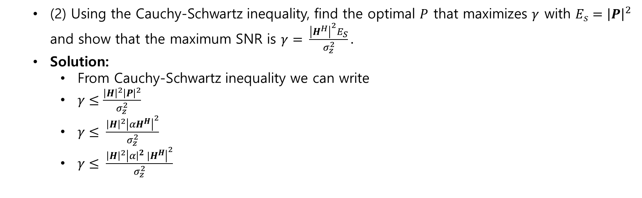
MISO with CSIT-MRT
(2) Using the Cauchy-Schwartz inequality, find the optimal $P$ that maximizes $γ$ with $E_{s}={\left|P\right|}^{2}$ and show that the maximum SNR is $γ= \frac{{\left|H^{H}\right|}^{2}E_{S}}{σ_{z}^{2}}.$
Solution:
From Cauchy-Schwartz inequality we can write
$γ≤\frac{{\left|H\right|}^{2}{\left|P\right|}^{2}}{σ_{z}^{2}}$
$γ≤ \frac{{\left|H\right|}^{2}{\left|αH^{H}\right|}^{2}}{σ_{z}^{2}}$
$γ≤ \frac{{\left|H\right|}^{2}{\left|α{{\left.​\right|}^{2} |H}^{H}\right|}^{2}}{σ_{z}^{2}}$

Slide 26
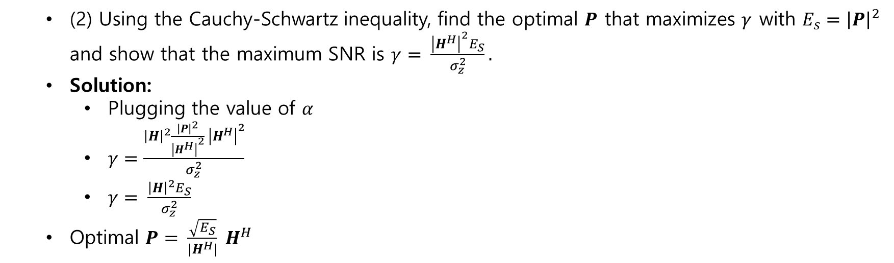
MISO with CSIT-MRT
(2) Using the Cauchy-Schwartz inequality, find the optimal $P$ that maximizes $γ$ with $E_{s}={\left|P\right|}^{2}$ and show that the maximum SNR is $γ= \frac{{\left|H^{H}\right|}^{2}E_{S}}{σ_{z}^{2}}.$
Solution:
Plugging the value of $α$
$γ=\frac{{\left|H\right|}^{2}\frac{{\left|P\right|}^{2}}{{\left|H^{H}\right|}^{2}} {\left|H^{H}\right|}^{2}}{σ_{z}^{2}}$
$γ= \frac{{\left|H\right|}^{2}E_{S}}{σ_{z}^{2}}$
Optimal $P= \frac{\sqrt{E_{S}}}{|H^{H}|} H^{H}$

Slide 27
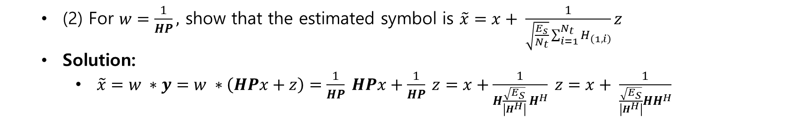
MISO with CSIT-MRT
(2) For $w=\frac{1}{HP},$ show that the estimated symbol is $\tilde{x}=x+ \frac{1}{\sqrt{\frac{E_{s}}{N_{t}}}\sum_{i=1}^{N_{t}}{H_{\left(1,i\right)}}}z$
Solution:
$\tilde{x}=w ∗y=w ∗\left(HPx+z\right)=\frac{1}{HP} HPx+\frac{1}{HP} z=x+\frac{1}{H\frac{\sqrt{E_{S}}}{\left|H^{H}\right|} H^{H}} z=x+ \frac{1}{\frac{\sqrt{E_{S}}}{\left|H^{H}\right|}HH^{H}}$

Slide 28
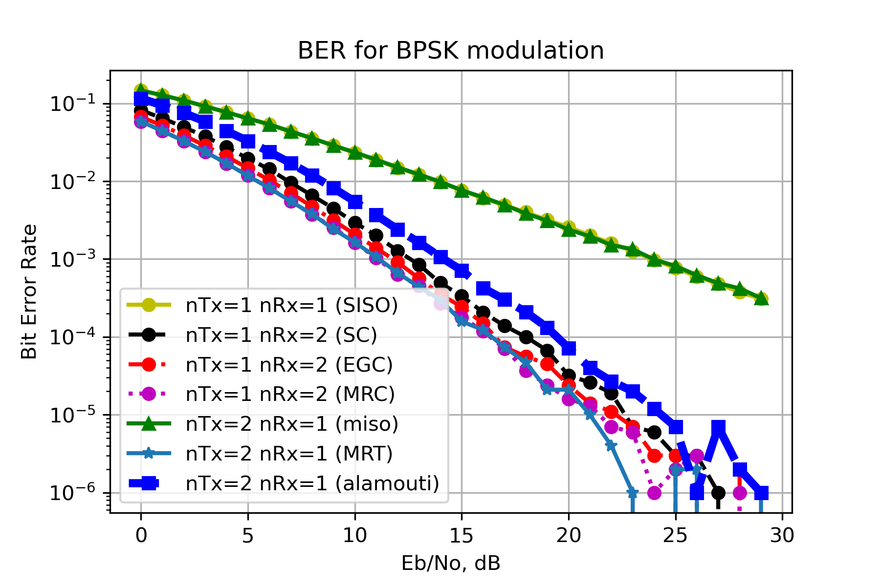
Numerical results

Slide 29
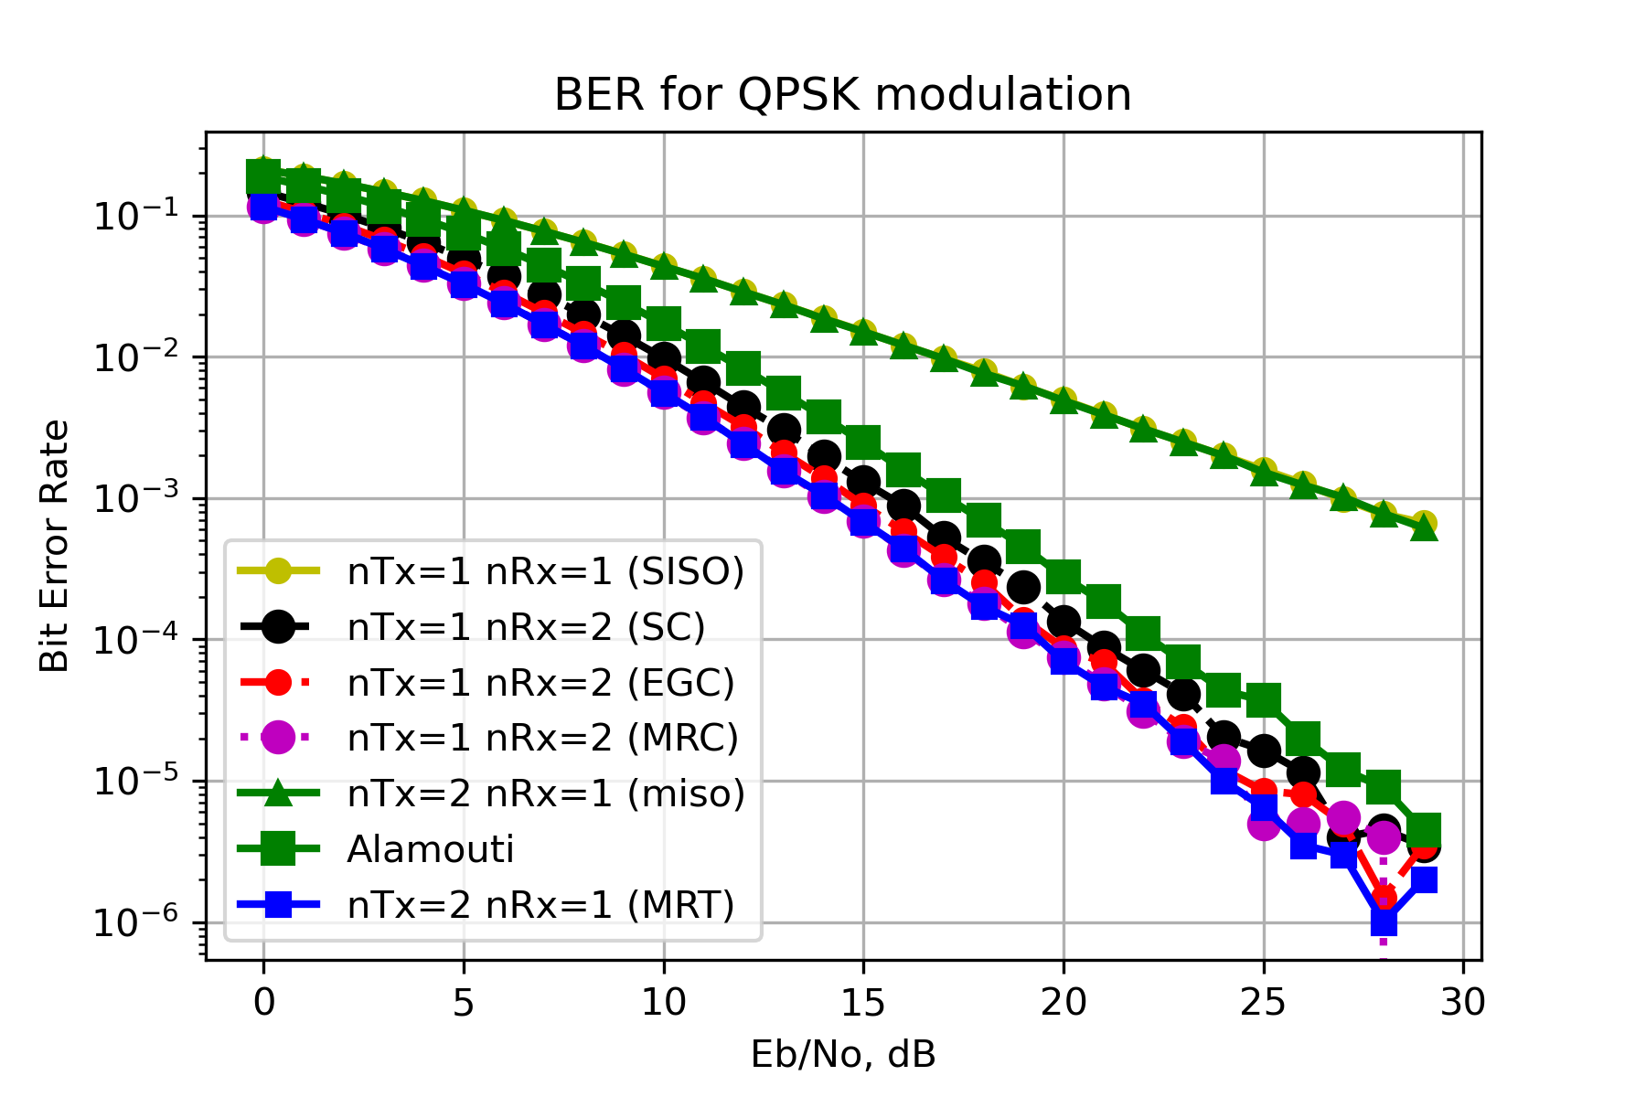
Numerical result

Slide 30
Numerical Results

Slide 31
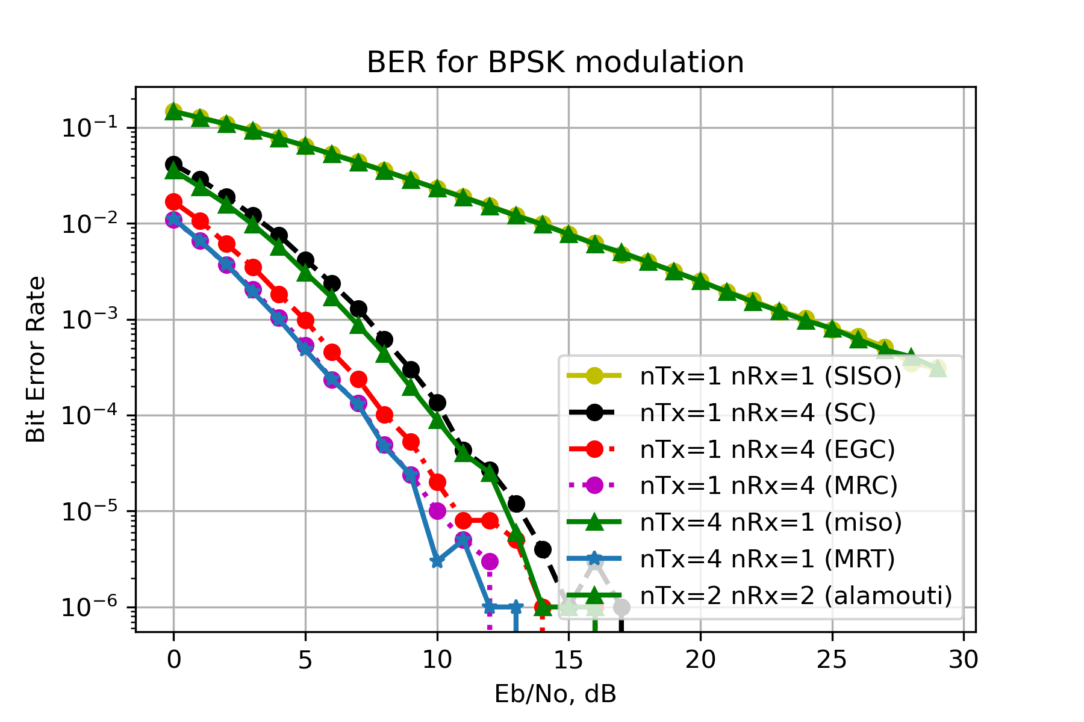
Numerical Results

Slide 32
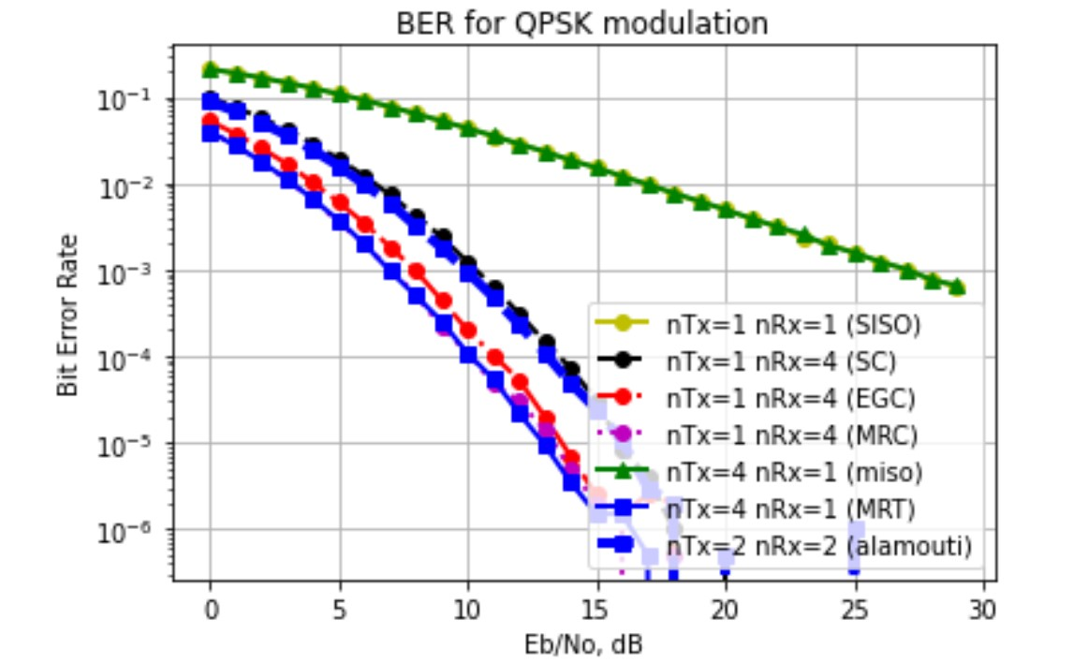
Numerical Results

Slide 33
Assignment 06
Capacity of MIMO Systems

Slide 34
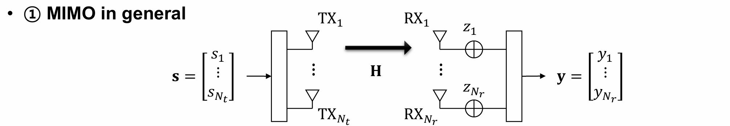
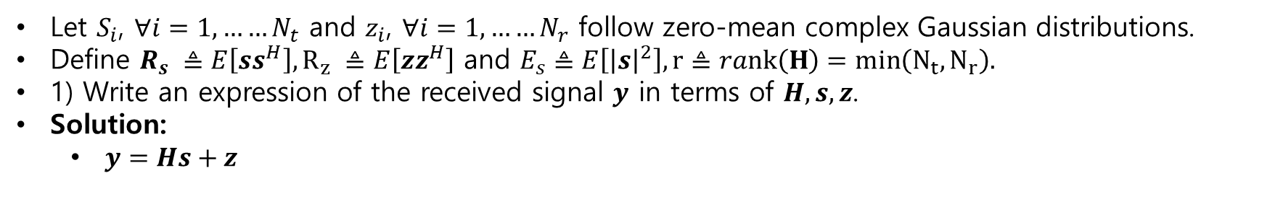
Capacity of MIMO systems
Let $S_{i}$, $∀i=1,……N_{t}$ and $z_{i}$, $∀i=1,……N_{r}$ follow zero-mean complex Gaussian distributions.
Define $R_{s} ≜E\left[ss^{H}\right], R_{z} ≜E\left[zz^{H}\right]$ and $E_{s}≜E\left[{\left|s\right|}^{2}\right], r≜rank\left(H\right)=min\left(N_{t}, N_{r}\right).$
1) Write an expression of the received signal $y$ in terms of $H,s,z$.
Solution:
$y=Hs+z$

Slide 35
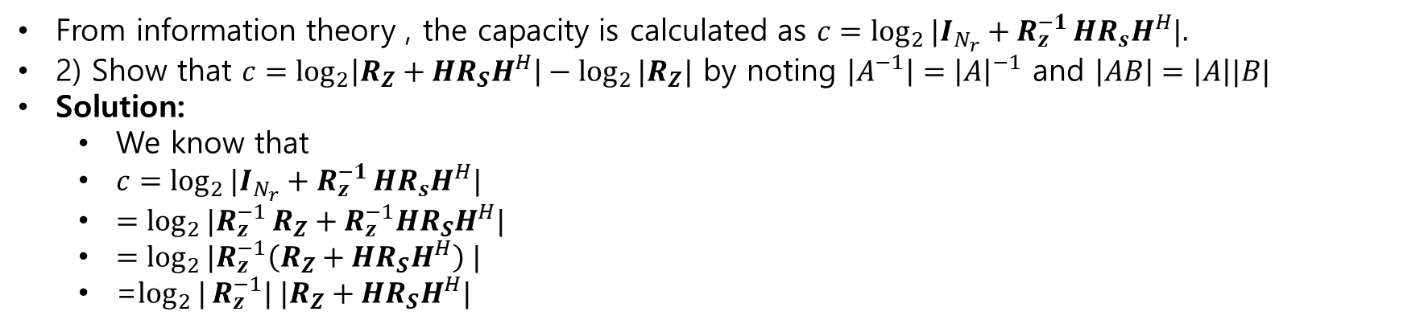
Capacity of MIMO systems
From information theory , the capacity is calculated as $c=\log_{2}{|I_{N_{r}}+R_{z}^{−1}}HR_{s}H^{H}|.$
2) Show that $c=\log_{2}\left|R_{Z}+HR_{S}H^{H}\right|−\log_{2}{|R_{Z}|}$ by noting $\left|A^{−1}\right|={\left|A\right|}^{−1}$ and $\left|AB\right|=\left|A\right||B|$
Solution:
We know that
$c=\log_{2}{|I_{N_{r}}+R_{z}^{−1}}HR_{s}H^{H}|$
$=\log_{2}{|R_{z}^{−1}}R_{Z}+R_{z}^{−1}HR_{S}H^{H}|$
$=\log_{2}{|R_{z}^{−1}\left(R_{Z}+HR_{S}H^{H}\right) |}$
=$\log_{2}{|}R_{z}^{−1}| |R_{Z}+HR_{S}H^{H}|$

Slide 36
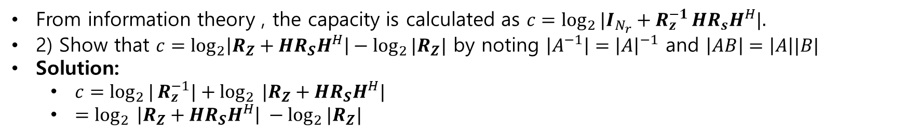
Capacity of MIMO systems
From information theory , the capacity is calculated as $c=\log_{2}{|I_{N_{r}}+R_{z}^{−1}}HR_{s}H^{H}|.$
2) Show that $c=\log_{2}\left|R_{Z}+HR_{S}H^{H}\right|−\log_{2}{|R_{Z}|}$ by noting $\left|A^{−1}\right|={\left|A\right|}^{−1}$ and $\left|AB\right|=\left|A\right||B|$
Solution:
$c=\log_{2}{|}R_{z}^{−1}|+\log_{2}$ $|R_{Z}+HR_{S}H^{H}|$
$=\log_{2}$ $\left|R_{Z}+HR_{S}H^{H}\right| −\log_{2}{|R_{Z}|}$

Slide 37
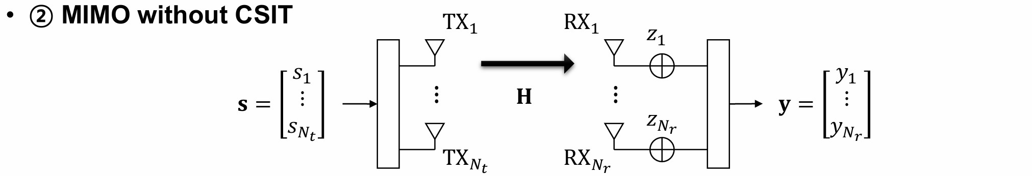
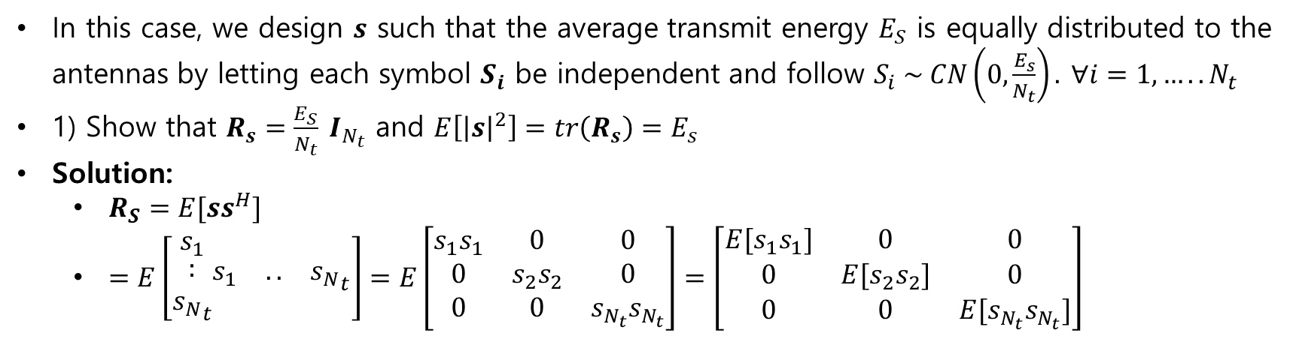
Capacity of MIMO systems
In this case, we design $s$ such that the average transmit energy $E_{S}$ is equally distributed to the antennas by letting each symbol $S_{i}$ be independent and follow $S_{i} \sim CN\left(0,\frac{E_{s}}{N_{t}}\right).$ $∀i=1,…..N_{t}$
1) Show that $R_{s}=\frac{E_{S}}{N_{t}} I_{N_{t}}$ and $E\left[{\left|s\right|}^{2}\right]=tr\left(R_{s}\right)=E_{s}$
Solution:
$R_{S}=E[ss^{H}]$
$=E\left[\begin{matrix}s_{1} \\ \begin{matrix}: \\ {s_{N}}_{t}\end{matrix}\end{matrix}\begin{matrix}s_{1} & .. & {s_{N}}_{t}\end{matrix}\right]=E\left[\begin{matrix}s_{1}s_{1} & 0 & 0 \\ 0 & s_{2}s_{2} & 0 \\ 0 & 0 & s_{N_{t}}s_{N_{t}}\end{matrix}\right]=\left[\begin{matrix}{E[s}_{1}s_{1}] & 0 & 0 \\ 0 & {E[s}_{2}s_{2}] & 0 \\ 0 & 0 & {E[s}_{N_{t}}s_{N_{t}}]\end{matrix}\right]$

Slide 38
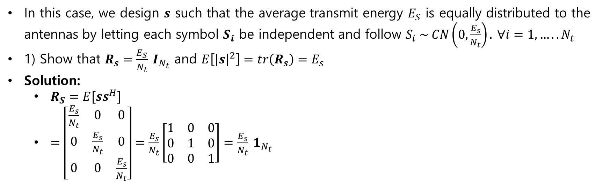
Capacity of MIMO systems
In this case, we design $s$ such that the average transmit energy $E_{S}$ is equally distributed to the antennas by letting each symbol $S_{i}$ be independent and follow $S_{i} \sim CN\left(0,\frac{E_{s}}{N_{t}}\right).$ $∀i=1,…..N_{t}$
1) Show that $R_{s}=\frac{E_{S}}{N_{t}} I_{N_{t}}$ and $E\left[{\left|s\right|}^{2}\right]=tr\left(R_{s}\right)=E_{s}$
Solution:
$R_{S}=E[ss^{H}]$
$=\left[\begin{matrix}\frac{E_{s}}{N_{t}} & 0 & 0 \\ 0 & \frac{E_{s}}{N_{t}} & 0 \\ 0 & 0 & \frac{E_{s}}{N_{t}}\end{matrix}\right]=\frac{E_{s}}{N_{t}}\left[\begin{matrix}1 & 0 & 0 \\ 0 & 1 & 0 \\ 0 & 0 & 1\end{matrix}\right]=\frac{E_{s}}{N_{t}} 1_{N_{t}}$

Slide 39
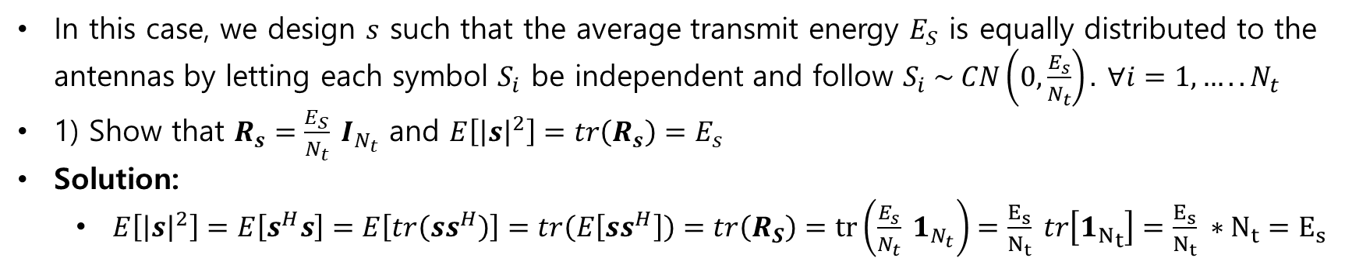
Capacity of MIMO systems
In this case, we design $s$ such that the average transmit energy $E_{S}$ is equally distributed to the antennas by letting each symbol $S_{i}$ be independent and follow $S_{i} \sim CN\left(0,\frac{E_{s}}{N_{t}}\right).$ $∀i=1,…..N_{t}$
1) Show that $R_{s}=\frac{E_{S}}{N_{t}} I_{N_{t}}$ and $E\left[{\left|s\right|}^{2}\right]=tr\left(R_{s}\right)=E_{s}$
Solution:
$E\left[{\left|s\right|}^{2}\right]=E\left[s^{H}s\right]=E\left[tr\left(ss^{H}\right)\right]=tr\left(E\left[ss^{H}\right]\right)=tr\left(R_{S}\right)=tr\left(\frac{E_{s}}{N_{t}} 1_{N_{t}}\right)=\frac{E_{s}}{N_{t}} tr\left[{1_{N}}_{t}\right]=\frac{E_{s}}{N_{t}} ∗N_{t}=E_{s}$

Slide 40
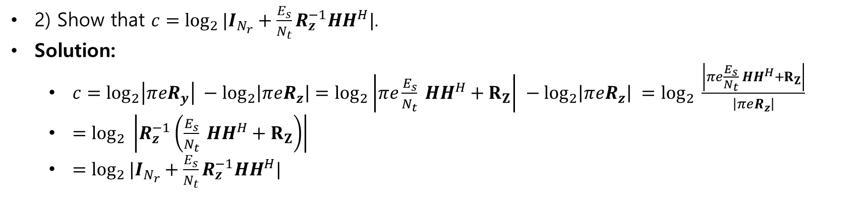
Capacity of MIMO systems
2) Show that $c=\log_{2}{|I_{N_{r}}+\frac{E_{s}}{N_{t}}}R_{z}^{−1}HH^{H}|$.
Solution:
$c=\log_{2}\left|πeR_{y}\right| −\log_{2}\left|πeR_{z}\right|=\log_{2}\left|πe\frac{E_{s}}{N_{t}} HH^{H}+R_{Z}\right| −\log_{2}\left|πeR_{z}\right| =\log_{2}{ \frac{\left|πe\frac{E_{s}}{N_{t}} HH^{H}+R_{Z}\right|}{\left|πeR_{z}\right|}}$
$=\log_{2}{ \left|R_{z}^{−1}\left(\frac{E_{s}}{N_{t}} HH^{H}+R_{Z}\right)\right|}$
$=\log_{2}{|I_{N_{r}}+\frac{E_{s}}{N_{t}}}R_{z}^{−1}HH^{H}|$

Slide 41
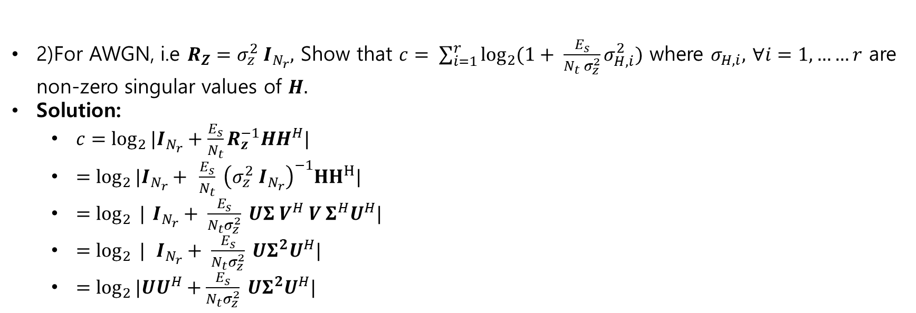
Capacity of MIMO systems
2)For AWGN, i.e $R_{Z}=σ_{z}^{2} I_{N_{r}},$ Show that $c= \sum_{i=1}^{r}{\log_{2}{(1+ \frac{E_{s}}{N_{t} σ_{z}^{2}}σ_{H,i}^{2})}}$ where $σ_{H,i},$ $∀i=1,……r$ are non-zero singular values of $H.$
Solution:
$c=\log_{2}{|I_{N_{r}}+\frac{E_{s}}{N_{t}}}R_{z}^{−1}HH^{H}|$
$=\log_{2}{|I_{N_{r}}+ }$ $\frac{E_{s}}{N_{t}} {\left(σ_{z}^{2} I_{N_{r}}\right)}^{−1}{HH}^{H}|$
$=\log_{2}{ |}$ $I_{N_{r}}+ \frac{E_{s}}{{N_{t}σ}_{z}^{2}} UΣ V^{H} V Σ^{H}U^{H}|$
$=\log_{2}{ |} I_{N_{r}}+ \frac{E_{s}}{{N_{t}σ}_{z}^{2}} UΣ^{2}U^{H}|$
$=\log_{2}{|UU^{H}+\frac{E_{s}}{{N_{t}σ}_{z}^{2}} UΣ^{2}U^{H}|}$

Slide 42
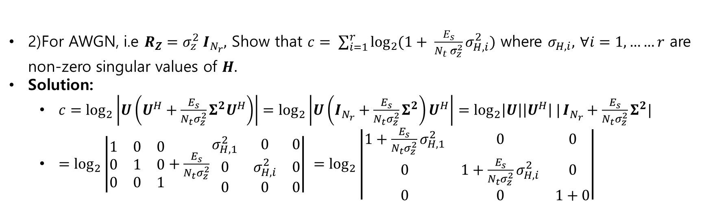
Capacity of MIMO systems
2)For AWGN, i.e $R_{Z}=σ_{z}^{2} I_{N_{r}},$ Show that $c= \sum_{i=1}^{r}{\log_{2}{(1+ \frac{E_{s}}{N_{t} σ_{z}^{2}}σ_{H,i}^{2})}}$ where $σ_{H,i},$ $∀i=1,……r$ are non-zero singular values of $H.$
Solution:
$c=\log_{2}\left|U\left(U^{H}+\frac{E_{s}}{{N_{t}σ}_{z}^{2}}Σ^{2}U^{H}\right)\right|=\log_{2}\left|U\left(I_{N_{r}}+\frac{E_{s}}{{N_{t}σ}_{z}^{2}}Σ^{2}\right)U^{H}\right|=\log_{2}\left|U\right|\left|U^{H}\right| |I_{N_{r}}+\frac{E_{s}}{{N_{t}σ}_{z}^{2}}Σ^{2}|$
$=\log_{2}\left|\begin{matrix}1 & 0 & 0 \\ 0 & 1 & 0 \\ 0 & 0 & 1\end{matrix}+\frac{E_{s}}{{N_{t}σ}_{z}^{2}}\begin{matrix}σ_{H,1}^{2} & 0 & 0 \\ 0 & σ_{H,i}^{2} & 0 \\ 0 & 0 & 0\end{matrix}\right| =\log_{2}\left|\begin{matrix}1+\frac{E_{s}}{{N_{t}σ}_{z}^{2}}σ_{H,1}^{2} & 0 & 0 \\ 0 & 1+\frac{E_{s}}{{N_{t}σ}_{z}^{2}}σ_{H,i}^{2} & 0 \\ 0 & 0 & 1+0\end{matrix}\right|$

Slide 43
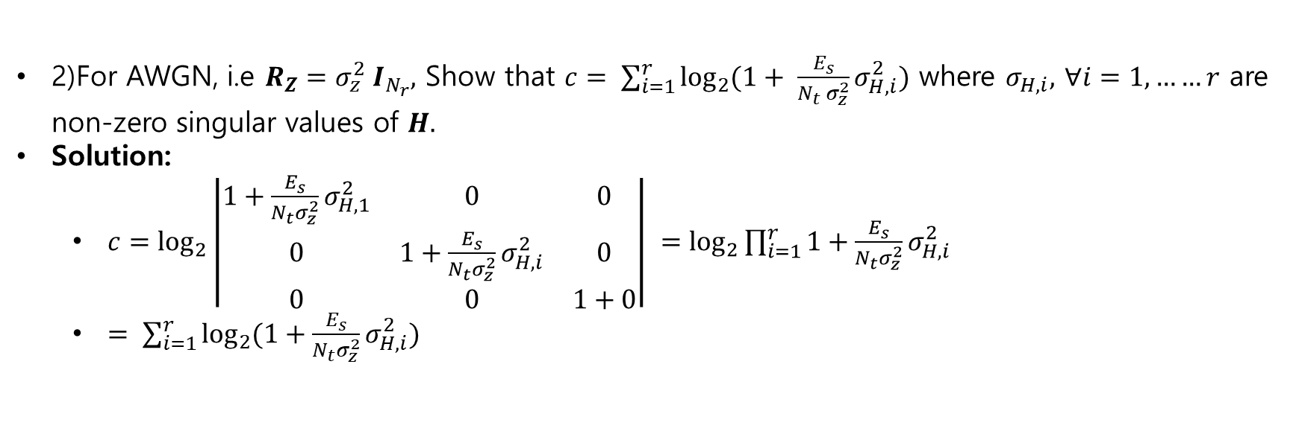
Capacity of MIMO systems
2)For AWGN, i.e $R_{Z}=σ_{z}^{2} I_{N_{r}},$ Show that $c= \sum_{i=1}^{r}{\log_{2}{(1+ \frac{E_{s}}{N_{t} σ_{z}^{2}}σ_{H,i}^{2})}}$ where $σ_{H,i},$ $∀i=1,……r$ are non-zero singular values of $H.$
Solution:
$c=\log_{2}\left|\begin{matrix}1+\frac{E_{s}}{{N_{t}σ}_{z}^{2}}σ_{H,1}^{2} & 0 & 0 \\ 0 & 1+\frac{E_{s}}{{N_{t}σ}_{z}^{2}}σ_{H,i}^{2} & 0 \\ 0 & 0 & 1+0\end{matrix}\right| =\log_{2}{\prod_{i=1}^{r}{1+\frac{E_{s}}{{N_{t}σ}_{z}^{2}}σ_{H,i}^{2}}}$
$= \sum_{i=1}^{r}{\log_{2}{(1+\frac{E_{s}}{{N_{t}σ}_{z}^{2}}σ_{H,i}^{2})}}$

Slide 44
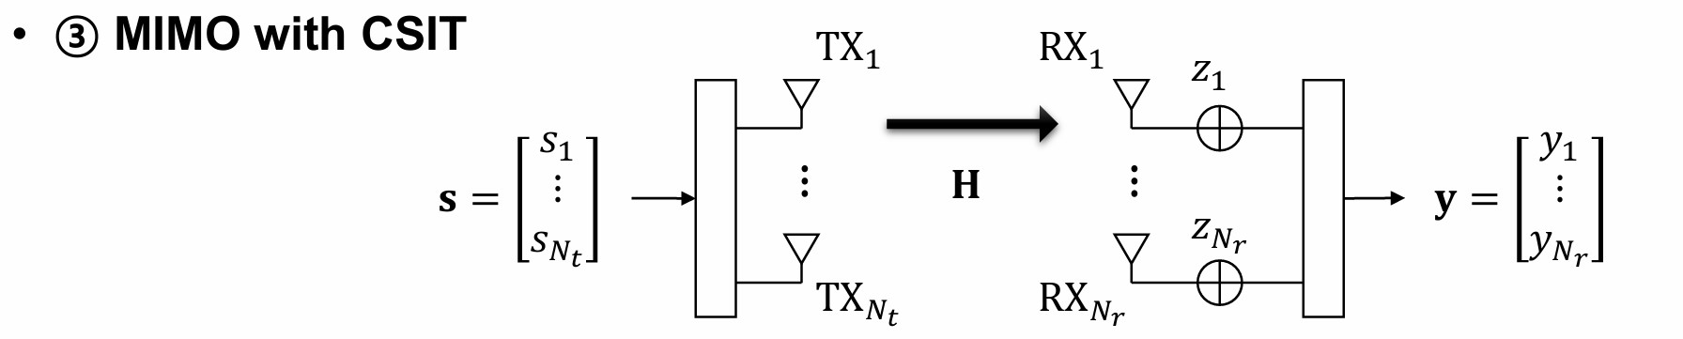
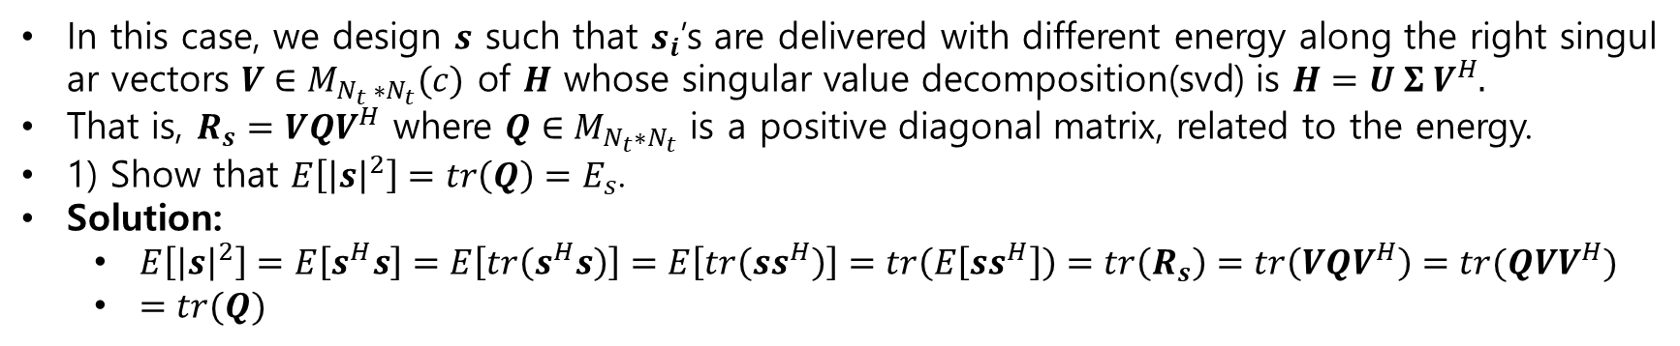
Capacity of MIMO systems
In this case, we design $s$ such that $s_{i}$’s are delivered with different energy along the right singular vectors $V∈M_{N_{t} ∗N_{t}}(c)$ of $H$ whose singular value decomposition(svd) is $H=U Σ V^{H}.$
That is, $R_{s}=VQV^{H}$ where $Q∈M_{N_{t}∗N_{t}}$ is a positive diagonal matrix, related to the energy.
1) Show that $E\left[{\left|s\right|}^{2}\right]=tr\left(Q\right)=E_{s}$.
Solution:
$E\left[{\left|s\right|}^{2}\right]=E\left[s^{H}s\right]=E\left[tr\left(s^{H}s\right)\right]=E\left[tr\left(ss^{H}\right)\right]=tr\left(E\left[ss^{H}\right]\right)=tr\left(R_{s}\right)=tr\left(VQV^{H}\right)=tr(QVV^{H})$
$=tr(Q)$

Slide 45
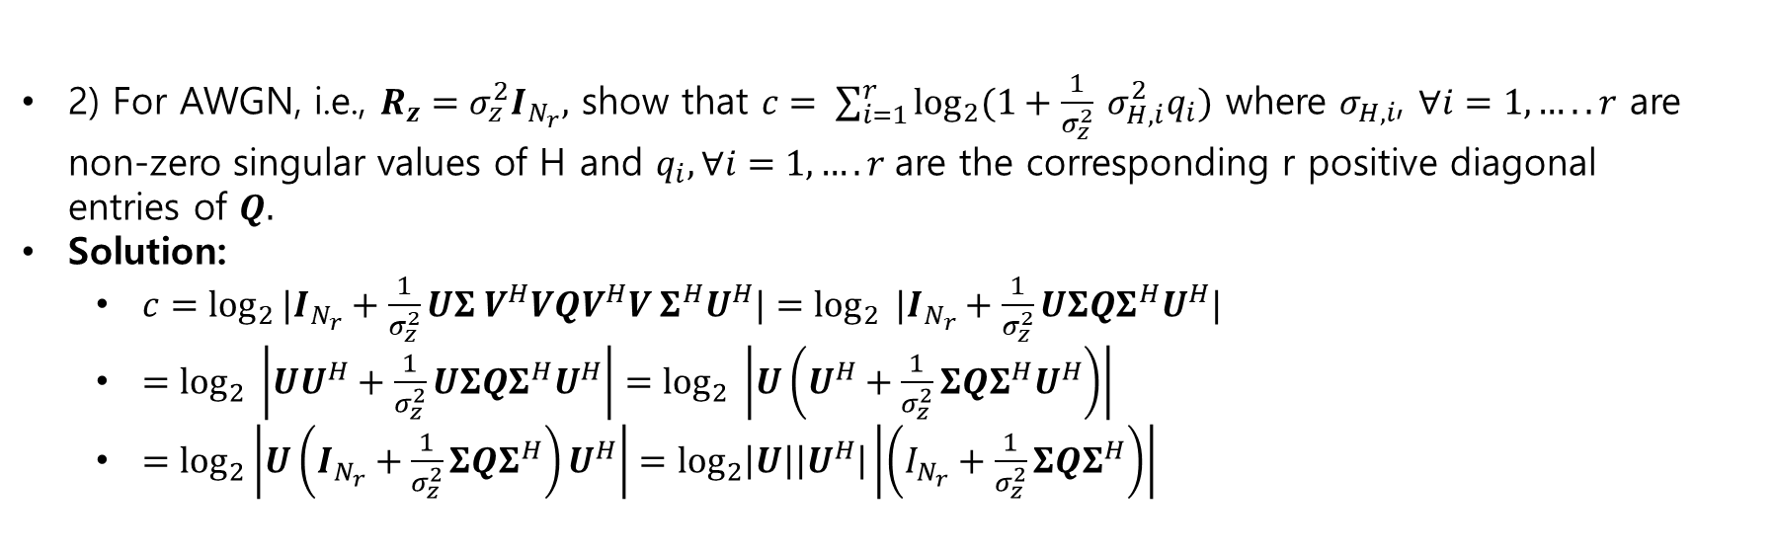
Capacity of MIMO systems
2) For AWGN, i.e., $R_{z}=σ_{z}^{2}I_{N_{r}},$ show that $c= \sum_{i=1}^{r}{\log_{2}{(1+\frac{1}{σ_{z}^{2}} σ_{H,i}^{2}q_{i})}}$ where $σ_{H,i}$, $∀i=1,…..r$ are non-zero singular values of H and $q_{i}, ∀i=1,….r$are the corresponding r positive diagonal entries of $Q.$
Solution:
$c=\log_{2}{|I_{N_{r}}+\frac{1}{σ_{z}^{2}}UΣ V^{H}VQV^{H}V Σ^{H}U^{H}|}=\log_{2}{ |I_{N_{r}}+\frac{1}{σ_{z}^{2}}UΣQΣ^{H}U^{H}|}$
$=\log_{2}{ \left|UU^{H}+\frac{1}{σ_{z}^{2}}UΣQΣ^{H}U^{H}\right|}=\log_{2}{ \left|U\left(U^{H}+\frac{1}{σ_{z}^{2}}ΣQΣ^{H}U^{H}\right)\right|}$
$=\log_{2}\left|U\left(I_{N_{r}}+\frac{1}{σ_{z}^{2}}ΣQΣ^{H}\right)U^{H}\right|=\log_{2}\left|U\right|\left|U^{H}\right|\left|\left(I_{N_{r}}+\frac{1}{σ_{z}^{2}}ΣQΣ^{H}\right)\right|$

Slide 46

Capacity of MIMO systems
2) For AWGN, i.e., $R_{z}=σ_{z}^{2}I_{N_{r}},$ show that $c= \sum_{i=1}^{r}{\log_{2}{(1+\frac{1}{σ_{z}^{2}} σ_{H,i}^{2}q_{i})}}$ where $σ_{H,i}$, $∀i=1,…..r$ are non-zero singular values of H and $q_{i}, ∀i=1,….r$are the corresponding r positive diagonal entries of $Q.$
Solution:
$c=\log_{2}{|I_{N_{r}}+\frac{1}{σ_{z}^{2}}UΣ V^{H}VQV^{H}V Σ^{H}U^{H}|}=\log_{2}{ |I_{N_{r}}+\frac{1}{σ_{z}^{2}}UΣQΣ^{H}U^{H}|}$
$=\log_{2}{ \left|UU^{H}+\frac{1}{σ_{z}^{2}}UΣQΣ^{H}U^{H}\right|}=\log_{2}{ \left|U\left(U^{H}+\frac{1}{σ_{z}^{2}}ΣQΣ^{H}U^{H}\right)\right|}$
$=\log_{2}\left|U\left(I_{N_{r}}+\frac{1}{σ_{z}^{2}}ΣQΣ^{H}\right)U^{H}\right|=\log_{2}\left|U\right|\left|U^{H}\right|\left|\left(I_{N_{r}}+\frac{1}{σ_{z}^{2}}ΣQΣ^{H}\right)\right|$

Slide 47

Capacity of MIMO systems
Solution:
$c=\log_{2}\left|U\right|\left|U^{H}\right|\left|\left(I_{N_{r}}+\frac{1}{σ_{z}^{2}}ΣQΣ^{H}\right)\right|$
$=\log_{2}{|\begin{matrix}1 & 0 & 0 \\ 0 & 1 & 0 \\ 0 & 0 & 1\end{matrix}+\frac{1}{σ_{z}^{2}}}$ $\begin{matrix}σ_{H,1} & 0 & 0 \\ 0 & σ_{H,i} & 0 \\ 0 & 0 & 0\end{matrix} \begin{matrix}q_{1} & 0 & 0 \\ 0 & q_{i} & 0 \\ 0 & 0 & q_{r}\end{matrix}\begin{matrix}σ_{H,1}^{H} & 0 & 0 \\ 0 & σ_{H,i}^{H} & 0 \\ 0 & 0 & 0\end{matrix}$|
$=\log_{2}{|\begin{matrix}1+\frac{1}{σ_{z}^{2}}σ_{H,1}^{2}q_{1} & 0 & 0 \\ 0 & 1+\frac{1}{σ_{z}^{2}}σ_{H,2}^{2}q_{2} & 0 \\ 0 & 0 & 1+\frac{1}{σ_{z}^{2}}σ_{H,i}^{2}q_{i}\end{matrix}|} = \sum_{i=1}^{r}{\log_{2}{(1+\frac{1}{σ_{z}^{2}}σ_{H,i}^{2}q_{i})} }$

Slide 48
Capacity of MIMO systems
Solution:
$c=\log_{2}\left|U\right|\left|U^{H}\right|\left|\left(I_{N_{r}}+\frac{1}{σ_{z}^{2}}ΣQΣ^{H}\right)\right|$
$=\log_{2}{|\begin{matrix}1 & 0 & 0 \\ 0 & 1 & 0 \\ 0 & 0 & 1\end{matrix}+\frac{1}{σ_{z}^{2}}}$ $\begin{matrix}σ_{H,1} & 0 & 0 \\ 0 & σ_{H,i} & 0 \\ 0 & 0 & 0\end{matrix} \begin{matrix}q_{1} & 0 & 0 \\ 0 & q_{i} & 0 \\ 0 & 0 & q_{r}\end{matrix}\begin{matrix}σ_{H,1}^{H} & 0 & 0 \\ 0 & σ_{H,i}^{H} & 0 \\ 0 & 0 & 0\end{matrix}$|
$=\log_{2}{|\begin{matrix}1+\frac{1}{σ_{z}^{2}}σ_{H,1}^{2}q_{1} & 0 & 0 \\ 0 & 1+\frac{1}{σ_{z}^{2}}σ_{H,2}^{2}q_{2} & 0 \\ 0 & 0 & 1+\frac{1}{σ_{z}^{2}}σ_{H,i}^{2}q_{i}\end{matrix}|} = \sum_{i=1}^{r}{\log_{2}{(1+\frac{1}{σ_{z}^{2}}σ_{H,i}^{2}q_{i})} }$

Slide 49

Capacity of MIMO systems
Show that $q_{i,opt}=μ − \frac{σ_{z}^{2}}{σ_{H,i}^{2}}$ where $μ≜\frac{1}{r}\left(E_{s}+ \sum_{i=1}^{r}{\frac{σ_{z}^{2}}{σ_{H,i}^{2}}}\right)$
Solution:
The optimal solution is one of the stationary points with $\frac{∂g(\left\{q_{i}\right\},λ)}{∂q_{i}}=0, ∀i=1,…..r,\frac{∂g\left(\left\{q_{i}\right\},λ\right)}{∂λ}=0.$
$\frac{∂g(\left\{q_{i}\right\},λ)}{∂q_{i}}=\frac{1}{∂q_{i}}\left(\sum_{i=1}^{r}{\log_{2}{(1+\frac{1}{σ_{z}^{2}}σ_{H,i}^{2}}q_{i}}\right)+λ(\sum_{i=1}^{r}{q_{i}−E_{s}})$
$=\frac{1}{ln2} ∗ \frac{1}{1+\frac{σ_{H,i}^{2}}{σ_{z}^{2}} q_{i}} ∗ \frac{σ_{H,i}^{2}}{σ_{z}^{2}}+λ=0$

Slide 50

Capacity of MIMO systems
Show that $q_{i,opt}=μ − \frac{σ_{z}^{2}}{σ_{H,i}^{2}}$ where $μ≜\frac{1}{r}\left(E_{s}+ \sum_{i=1}^{r}{\frac{σ_{z}^{2}}{σ_{H,i}^{2}}}\right)$
Solution:
$\frac{1}{ln2} ∗ \frac{1}{1+\frac{σ_{H,i}^{2}}{σ_{z}^{2}} q_{i}} ∗ \frac{σ_{H,i}^{2}}{σ_{z}^{2}}=−λ⇒σ_{H,i}^{2}=−ln2\left(1+\frac{σ_{H,i}^{2}}{σ_{z}^{2}} q_{i}\right)⇒q_{i}=−\frac{1}{ln2λ}−\frac{σ_{z}^{2}}{σ_{H,i}^{2}}$
Now , $\sum_{i=1}^{r}{q_{i} −E_{s}=0}$
$⇒$ $\sum_{i=1}^{r}{−\frac{1}{ln2λ}−\frac{σ_{z}^{2}}{σ_{H,i}^{2}}−E_{s}=0}$

Slide 51

Capacity of MIMO systems
Show that $q_{i,opt}=μ − \frac{σ_{z}^{2}}{σ_{H,i}^{2}}$ where $μ≜\frac{1}{r}\left(E_{s}+ \sum_{i=1}^{r}{\frac{σ_{z}^{2}}{σ_{H,i}^{2}}}\right)$
Solution:
$⇒$ $\sum_{i=1}^{r}{−\frac{1}{ln2λ}−\frac{σ_{z}^{2}}{σ_{H,i}^{2}}−E_{s}=0}$
$⇒−\frac{r}{ln2λ}=E_{s}+ \sum_{i=1}^{r}{\frac{σ_{z}^{2}}{σ_{H,i}^{2}}}$
$⇒−\frac{1}{ln2λ}=\frac{1}{r}\left(E_{s}+\sum_{i=1}^{r}{\frac{σ_{z}^{2}}{σ_{H,i}^{2}}}\right)$

Slide 52

Capacity of MIMO systems
For high SNR , i.e …….$E_{s}≫σ_{z}^{2}$ show that $q_{i,opt}=\frac{E_{s}}{r}$
Solution:
From previous equation we can write
$q_{i,opt}=\frac{1}{r} \left(E_{s}+ \sum_{i=1}^{r}{\frac{σ_{z}^{2}}{σ_{H,i}^{2}}}\right)$
Since $E_{s}≫σ_{z}^{2}$ then $\sum_{i=1}^{r}{\frac{σ_{z}^{2}}{σ_{H,i}^{2}}}=0$
$q_{i,opt}= \frac{E_{s}}{r}$

Slide 53

Capacity of MIMO systems
4) For high SNR with $N_{t}=N_{r},$ show that $C$ becomes equivalent to the case without CSIT.
Solution:
$c= \sum_{i=1}^{r}{\log_{2}{(1+\frac{1}{σ_{z}^{2}} σ_{H,i}^{2}q_{i})}}$
For high SNR with full rank of antenna there is no need to choose optimal one.
So, $q_{i}=\frac{E_{s}}{N_{t}}$
$c= \sum_{i=1}^{r}{\log_{2}{(1+ \frac{E_{s}}{N_{t} σ_{z}^{2}}σ_{H,i}^{2})}}$

Slide 54

MIMO with CSIT
3) Show that$qi,opt=μ−\frac{σ^{2}z}{σ^{2}\left(H,i\right)}$ where $μ=\frac{1}{r}[Es+ \sum_{i=1}^{r}{\frac{σ^{2}z}{σ^{2}\left(H,i\right)}}]$
Now
$\frac{∂g\left(\left\{qi\right\},λ\right)}{∂qi}=0⇒\frac{\frac{1}{σ^{2}z} σ^{2}H,i}{1+\frac{1}{σ^{2}z} σ^{2}H,i qi}+λ=0⇒qi=−\frac{1}{λ} −\frac{σ^{2}z}{σ^{2} H,i}⇒μ − \frac{σ^{2}z}{σ^{2} H,i}$ $where μ=−\frac{1}{λ}$
Now
$\frac{∂g\left(\left\{qi\right\},λ\right\}}{∂λ}=0⇒qi−Es=0⇒−\frac{1}{λ} −\frac{σ^{2}z}{σ^{2 }H,i}−Es=0⇒ μ=\frac{1}{r}[Es+ \sum_{i=1}^{r}{\frac{σ^{2}z}{σ^{2} \left( H,i\right)}}]$
4) For the high SNR i.e $Es≫σ^{2}z$ show that $qi,opt=\frac{Es}{r}$
Solution)
$qi=\frac{1}{r}[Es+ \sum_{i=1}^{r}{\frac{σ^{2}z}{σ^{2}\left(H,i\right)}}]− \frac{σ^{2}z}{σ^{2 (}H,i)}$ for high SNR $Es≫σ^{2}z$so$qi,opt=\frac{Es}{r}$

Slide 55

MIMO with CSIT
5)For the high snr $Nt=Nr=r$, show that $c$becomes equivalent to the case without CSIT
Solution)
$c=log2\left|1 + \frac{Es}{Nt} \frac{1}{σ^{2}z }σ^{2} H,i \right|$
$c=log2\left|1 + \frac{Es}{r} \frac{1}{σ^{2}z }σ^{2} H,i \right|$

Slide 56

Numerical Result

Slide 57

Numerical results

Slide 58
Assignment-07
1. MIMO linear processing
MIMO without CSIT
2)RxMF
3)RxZF
4)RxMMSE
MIMO with CSIT
5) Joint SVD
6)Numerical result

Slide 59


MIMO with linear processing
Let $x_{i}, ∀i=1,…….N_{s} and z_{i}, ∀i=1,…..N_{r}$follow zero-mean complex Gaussian distribution
Define $Rx ≜E\left[xx^{H}\right]=INs$
$Rz ≜E \left[{zz}^{H}\right]$
$E_{s}≜E\left[{\left|s\right|}^{2}\right]$
$N_{s}≜r=rank\left(H\right)=min\left(N_{t},N_{r}\right)$

Slide 60

MIMO with linear processing
Q1) Specify the dimension of $P, H, W$
Solution)
$P=N_{t} ∗N_{s}$
$H=N_{r} ∗N_{t}$
$W=N_{s} ∗Nr$
Q2)Write an expression of the post-Processed signal $\tilde{x}$ in terms of $W,H,P,x,z$
Solution)
$\tilde{x}=W.y=W\left(HPx+z\right)=WHPx+Wz$
Q3) Show that $E\left[{\left|s\right|}^{2}\right]={{\left|\left|P\right|\right|}_{F}}^{2}=E_{s}$
$E\left[{\left|s\right|}^{2}\right]=E\left[{\left|Px\right|}^{2}\right]=E\left[{\left(Px\right)}^{H}\left(Px\right)\right]=E\left[x^{H}P^{H}Px\right]=E\left[tr\left(x^{H}P^{H}Px\right)\right]=tr\left(E\left[x^{H}P^{H}Px\right]\right) =tr\left(E\left[Pxx^{H}P^{H}\right]\right)={{\left|\left|P\right|\right|}_{F}}^{2}$

Slide 61

MIMO with linear processing
Q4) Show that the capacity is expressed by
$c=log2|INs+{\left(WRzW^{H}\right)}^{−1}WHPP^{H}H^{H}W^{H}|$
$R\tilde{x}=E\left[\tilde{x}{\tilde{ x}}^{H}\right]=E\left[\left(WHPx+Wz\right){\left(WHPx+Wz\right)}^{H}\right]$
$=E[\left(WHPx+Wz\right)(x^{H}P^{H}H^{H}W^{H}+z^{H}W^{H})]$
$=E[WHPxx^{H}P^{H}H^{H}W^{H}+WHPxz^{H}W^{H}+Wzx^{H}P^{H}H^{H}W^{H}+Wzz^{H}W^{H}]$
$= WHPE\left[xx^{H}\right]P^{H}H^{H}W^{H}+ W E[zz^{H}]W^{H}$
$=WHPP^{H}H^{H}W^{H}+{WRzW}^{H}$
$R_{\tilde{n}} =E\left[\left(Wz\right){\left(Wz\right)}^{H}\right]=E\left[Wzz^{H}W^{H}\right]=WE\left[zz^{H}\right]W^{H}=WRzW^{H}$
$c=\log_{2}\left|πe R\tilde{x}\right| −\log_{2}\left|πe R\tilde{n}\right|=log2\left|πe\left(WHPP^{H}H^{H}W^{H}+{WRzW}^{H}\right)\right|−log2|πe WRzW^{H}|$
$=log2\frac{\left|πe\left({WHPP}^{H}H^{H}W^{H}+{WRzW}^{H}\right)\right|}{|πe WRzW^{H}|}=log2\frac{\left|\left(WHPP^{H}H^{H}W^{H}+{WRzW}^{H}\right)\right|}{|WRzW^{H}|}$
$=log2|INs+{\left(WRzW^{H}\right)}^{−1}(WHPP^{H}H^{H}W^{H})$|

Slide 62

MIMO without CSIT – RxMF
Q1) Show that $E\left[{\tilde{x}}^{H}\tilde{x}\right]=tr\left(WHP\right)$and $E\left[{\left|Wz\right|}^{2}\right]=tr\left(WRzW^{H}\right)$
Solution)
$E\left[{\tilde{x}}^{H} \tilde{x}\right]=E\left[{\left(WHPx+Wz\right)}^{H}\left(WHPx+Wz\right)\right]=E[{( x}^{H}P^{H}H^{H}W^{H}+z^{H}W^{H})\left(WHPx+Wz\right)]$
$=E[{(x}^{H}P^{H}H^{H}W^{H}WHPx+x^{H}P^{H}H^{H}W^{H }Wz+z^{H}W^{H }WHPx+z^{H}W^{H}Wz]$
$=E[tr{(x}^{H}P^{H}H^{H}W^{H}WHPx)+x^{H}P^{H}H^{H}W^{H }Wz+z^{H}W^{H }WHPx+{tr(z}^{H}W^{H}Wz)]$
$=E[tr(WHPxx^{H}P^{H}H^{H}W^{H})+x^{H}P^{H}H^{H}W^{H }Wz+z^{H}W^{H }WHPx+tr(Wzz^{H}W^{H})]$
$=tr(WHPE[xx^{H}]P^{H}H^{H}W^{H})+x^{H}P^{H}H^{H}W^{H }Wz+z^{H}W^{H }WHPx+tr(WE[zz^{H}]W^{H})]$
$=tr\left(WHPP^{H}H^{H}W^{H}\right)+tr(WR_{z}W^{H})$

Slide 63

MIMO without CSIT – RxMF
For simplicity , we let $δ=tr(P^{H}H^{H}Rz^{−1}HP)$ and $λopt=−1$such that $Wopt=P^{H}H^{H}Rz^{−1}$
Q5) Show that $c=log2|INs+P^{H}H^{H}Rz^{−H}HP|$
The capacity is expressed by
$c=log2|INs+{\left(WRzW^{H}\right)}^{−1}(WHPP^{H}H^{H}W^{H})\text{|}$
$=log2|{\left(WRzW^{H}\right)}^{−1}{\left(WRzW^{H}\right)}^{ }+{\left(WRzW^{H}\right)}^{−1}(WHPP^{H}H^{H}W^{H})|$
$=log2|{\left(WRzW^{H}\right)}^{−1}(WRzW^{H}+WHPP^{H}H^{H}W^{H})|$
$=log2|$ ${\left(WRzW^{H}\right)}^{−1}$|$|(WRzW^{H}+WHPP^{H}H^{H}W^{H})|$
$=log2{\left|P^{H}H^{H}Rz^{−1}RzRz^{−H}HP\right|}^{−1}|P^{H}H^{H}Rz^{−1}Rz Rz^{−H}HP+P^{H}H^{H}Rz^{−1}$ $HPP^{H}H^{H}$ $Rz^{−H}HP$|
$= log2{\left|P^{H}H^{H}Rz^{−H}HP\right|}^{−1}$ $|P^{H}H^{H}Rz^{−H}HP+P^{H}H^{H}Rz^{−1}HPP^{H}H^{H}$ $Rz^{−H}HP$|
$=log2$ ${\left|P^{H}H^{H}Rz^{−H}HP\right|}^{−1}|P^{H}H^{H}Rz^{−H}HP(I+ P^{H}H^{H}Rz^{−1}HP)|$
$=log2{\left|P^{H}H^{H}Rz^{−H}HP\right|}^{−1}\left|P^{H}H^{H}Rz^{−H}HP\right|\left|I+ P^{H}H^{H}Rz^{−1}HP\right|$
$=log2$ $\left|I+ P^{H}H^{H}Rz^{−1}HP\right|$

