Slide 1

Optimization Problem
P1) $\underset{x}{\underbrace{max}}$ $\left(x−1\right)\left(x+3\right)$
Subject to : $x≥−5$
$x≥−1$
$\left|x\right|≤4$

Slide 2
Optimization Problem

Slide 3

Optimization Problem
So, the feasible region x is $−1≤x≤4$
Optimal solution $x^{∗}=4$
The objective function is $21$ when $x=x^{∗}$

Slide 4

Optimization Problem
P2) $\underset{x}{\underbrace{min}}$ $log2\left(1+\frac{1}{x}\right)$
Subject to $x^{2}≤3$
$x≤3$
$x≥−1$
$x≥0.5$

Slide 5










































































































Optimization Problem
Graph:
$$x^{2}≤3$$
$$x^{2}≤3$$
$$(0,0)$$
$$x≤3$$
$$x≥−1$$
$$x≥0.5$$

Slide 6

Optimization Problem
So, the feasible region x is $0.5≤x≤1.732$
Optimal solution $x^{∗}=1.732$
The objective function is $0.6575$ when $x=x^{∗}$

Slide 7

Optimization Problem
P3) $\underset{x}{\underbrace{max}} \sqrt{|x|}$
Subject to : $\left(x−4\right)\left(x+1\right)≥0$
$\left(x+6\right)\left(x−3\right)\left(x+2\right)≤0$

Slide 8




























Optimization Problem
$$\left(x−4\right)\left(x+1\right)≥0$$
$$\left(x−4\right)\left(x+1\right)≥0$$
$$x=−1$$
$$x=3$$
$$x=4$$
$$x=−2$$

Slide 9

Optimization Problem
So, the feasible region x is $−2≤x≤−1$
Optimal solution $x^{∗}=−2$
The objective function is $1.414$ when $x=x^{∗}$

Slide 10

Optimization Problem
P4) $\underset{x}{\underbrace{min}}$ $cosx$
Subject to $x≤\frac{3π}{2}$
$x≤ \frac{4π}{3}$
$x≤ \frac{5π}{4}$
$x ≥\frac{π}{3}$
$x≥−\frac{π}{2}$
$x ≥ −\frac{3π}{2}$

Slide 11






Optimization Problem
$$−\frac{3π}{2}$$
$$−\frac{π}{2}$$
$$5π/4$$
$$\frac{π}{3}$$
$$\frac{4π}{3}$$
$$\frac{3π}{2}$$

Slide 12

Optimization Problem
So, the feasible region x is $\frac{π}{3}≤x≤\frac{5π}{4}$
Optimal solution $x^{∗}=−π$
The objective function is $−1$ when $x=x^{∗}$

Slide 13

Optimization Problem
P5)$\underset{x}{\underbrace{ max}}$ $\frac{4}{\left(x−2\right)\left(x+2\right)}$
Subject to $\left|x^{3}\right|≥0$
$x≥−5$
$x≤4$
$x≥−7$
$x≤6$

Slide 14




Optimization Problem
$$x≥−7$$
$$x≥−5$$
$$x≤4$$
$$x≤6$$

Slide 15

Optimization Problem
So, the feasible region x is $−5≤x<−2$ and $−2<x<2 and 2<x≤4$
Optimal solution $x^{∗}=4$
The objective function is $0.33$ when $x=x^{∗}$

Slide 16




































































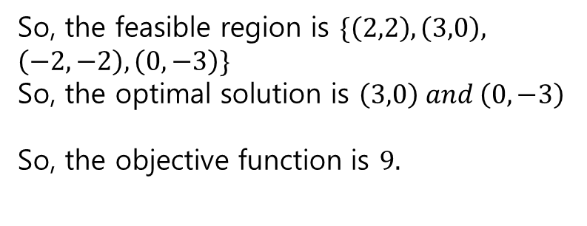









Optimization Problem
P6)$\underset{x1,x2}{\underbrace{min}}$ ${\left(x1 −3\right)}^{2}+{\left(x2+3\right)}^{2}$
Subject to $x1^{2}+x2^{2}≤9$
$x1≥x2$
Feasible region
So, the feasible region is $\{\left(2,2\right),\left(3,0\right),$
$\left(−2,−2\right),\left(0,−3\right)\}$
So, the optimal solution is $\left(3,0\right) and \left(0,−3\right)$
So, the objective function is $9.$

Slide 17



























Optimization Problem

Slide 18

Optimization problem
So, the feasible region is $\{\left(2,0\right),\left(−1,3\right),\left(−1,6\right),(8,6)\}$
Optimal solution $x1=(8 , 6)$
The objective function is $x1=8$

Slide 19

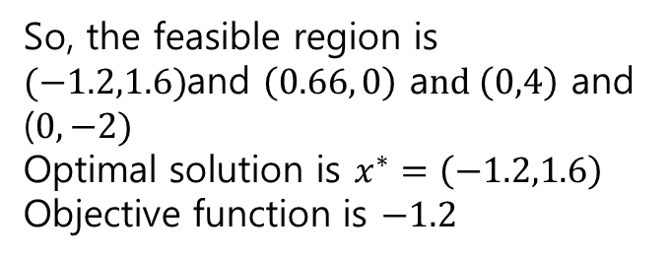




Optimization Problem
$\underset{x1,x2}{\underbrace{min}}$ $x1$
Subject to $x2≤2x1+4$
$x2≥−3x1 −2$
$x1≤0$
(0,4)
So, the feasible region is
$(−1.2,1.6)$and $\left(0.66, 0\right)$ a$nd \left(0,4\right)$ and ($0,−2)$
Optimal solution is $x^{∗}=\left(−1.2,1.6\right)$
Objective function is $−1.2$
(-1.2,1.6)
(-$0.66,0)$
(0,-2)

Slide 20




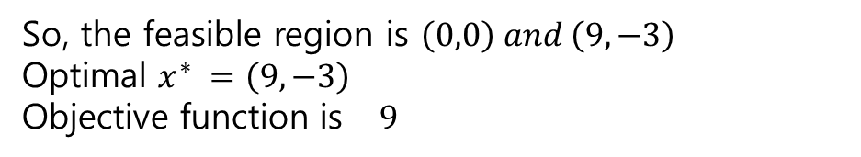



Optimization Problem
$\underset{x1,x2}{\underbrace{max}}$ $x1$
Subject to : ${x2}^{2}≥x1$
$−\frac{x1}{3}≥x2$
$${x2}^{2}≥x1$$
$$−\frac{x1}{3}≥x2$$
$$(0,0)$$
So, the feasible region is $\left(0,0\right) and \left(9,−3\right)$
Optimal $x^{∗} =\left(9,−3\right)$
Objective function is $9$
$$(9,−3)$$

Slide 21

Optimization Problem
$\underset{x1,x2}{\underbrace{min}}$ $x1$
Subject to $\left(x2−2\right)\left(x2+4\right)−3≤x1$
$x2≤−\frac{3}{2}$

Slide 22

















Optimization Problem
$$x2≤2x1$$
$\underset{x1,x2}{\underbrace{max}}$ $x1^{2}+x2^{2}$
Subject to $x2≤2x1$
$x2≥\frac{3}{4} x1$
Feasible region is only $( 0 , 0 )$
$$x2≥\frac{3}{4}x1$$

Slide 23












Optimization Problem
$\underset{x1,x2}{\underbrace{min}}$ $x1^{2}+x2^{2}$
Subject to $x2≥−x1$
$x1≥0$
$x2≥0$
$$x1≥0$$
$$x2≥0$$
$$x2≥−x1$$

