Slide 1
Space Division Multiplexing combined with OFDM
REFAT KHAN

Slide 2
Table of Contents
Broadband Wireless Communication Systems
Impact of Receiver diversity techniques
Some Diversity techniques
Frequency and Time diversity
Space diversity
Polarization diversity
Selection diversity
Maximal Ratio and Equal Gain Combining
Multi-Antenna Link: Signal model and SDM techniques
Signal model

Slide 3
Broadband Wireless Communication Systems
One example of a broadband wireless communication system is a wireless computer
network. Wireless computer networks are in demand in offices and universities.
Another example of a broadband wireless communication system is a wireless
communication system that uses Space Division Multiplexing (SDM). SDM is a technique
that transmits different data streams on different transmit antennas simultaneously.
This thesis will compare a number of SDM algorithms and combine the best algorithm
with Orthogonal Frequency Division Multiplexing (OFDM) to avoid Inter Symbol
Interference (ISI).

Slide 4
Impact of Receiver diversity techniques
Before SDM techniques were developed, receiver diversity was seen as a powerful communication receiver technique that provided wireless link improvement at relatively low cost.
Diversity techniques try to solve the problem that transmission errors occur when the transmission channel attenuation is large, i.e., when the channel is in a deep fade.

Slide 5
Frequency and Time diversity
Frequency diversity is a technique that improves the performance of wireless systems by transmitting the same signal on multiple frequencies. The receiver then selects the frequency that has suffered least from fading or combines the signals from all frequencies to improve the estimation of the transmitted signal.
Time diversity transmits the same signal multiple times, with a time spacing between transmissions that is greater than the coherence time of the channel. This ensures that the multiple repetitions of the signal will be received with independent fading conditions.

Slide 6
Space diversity
Space diversity, also known as antenna diversity, is a technique that improves the performance of wireless systems by using multiple antennas. The antennas are separated by a distance of half a radio wavelength or more, which ensures that the signals received by the antennas are uncorrelated. This means that if one antenna receives a weak signal, another antenna is likely to receive a strong signal.

Slide 7
Polarization diversity
In wireless communication, polarization diversity is used to enhance reliability. It involves transmitting the same signal on two antennas with different polarizations, exploiting uncorrelated paths and combining horizontally and vertically polarized signals at the receiver for improved quality. This provides two diversity branches, simplifies antenna placement, but mixing with other diversity methods may degrade performance. The choice of diversity technique depends on the specific communication environment and system requirements.

Slide 8
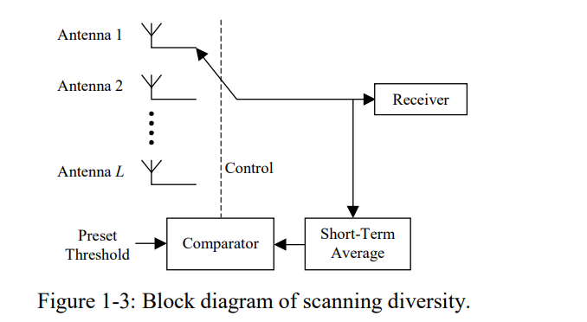
Selection diversity
Selection Diversity The highest instantaneous SNR branch is connected to the demodulator.

Slide 9
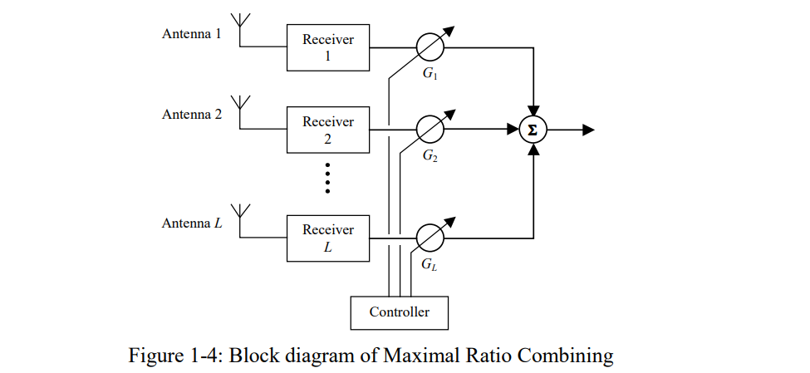
Maximal Ratio and Equal Gain Combining
Maximal Ratio combining : Maximum Ratio Combining (MRC) is an optimization technique for combining signals that are carrying the same information.
Equal Gain combining : An Equal Gain Combiner is obtained when the gains used in MRC are all set to unity. The disadvantage is that (like MRC) an individual receiver for each antenna element is needed. However, the possibility of producing an acceptable signal from a number of unacceptable inputs is still retained, and the performance is only marginally inferior to MRC and usually superior to selection diversity.

Slide 10
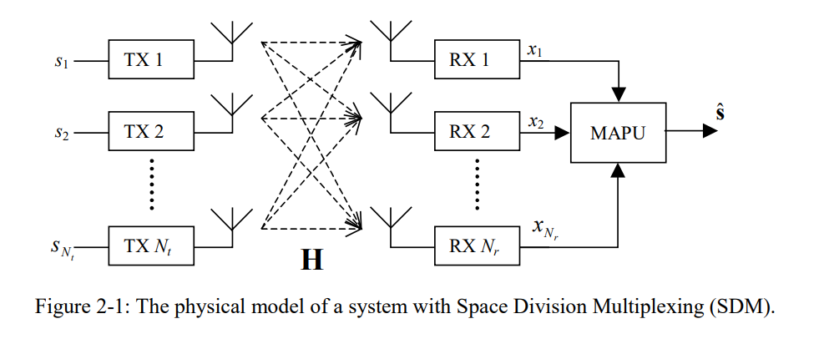
Multi-Antenna Link: Signal model and SDM techniques
One way to increase the capacity of wireless communication systems is by exploiting the spatial dimension using multiple antennas at the receiver as well as at the transmitter. This type of transmission is called Space Division Multiplexing (SDM).
In this chapter, a number of different decoding algorithms for SDM will be discussed and their performance will be compared.

Slide 11
Signal model
We consider a communication system comprising N_{t} transmit (TX) and N_{r} receive (RX) antennas that operates in a Rayleigh flat-fading environment and exploits the spatial dimension by using Space Division Multiplexing (SDM).
A channel is said to be a Rayleigh fading channel when the channel impulse response is modelled as a zero-mean complex-valued gaussian process .
In this case, the envelope of the channel impulse response at any time instant has a Rayleigh probability distribution and the phase is uniformly distributed in the interval (0,2π).
This can be shown as follows. Suppose we model the channel impulse response H as a zero-mean complex gaussian variable, like:
H = A + jB

Slide 12
Signal model
Where A and B are zero-mean statistically independent real guassian variables, each having a variance σ²/2. The variance of the complex gaussian variable H can be shown to be:
var(H ) = E[H ² ]− E[H ]² = E[(A + jB)(A + jB)] = E[A² + 2 jAB + B ² ]= E[A² ]+ E[B ² ]= σ ²
We introduce a new variable
Y = A² + B ²
Here Y is chi-squared Random variable

Slide 13
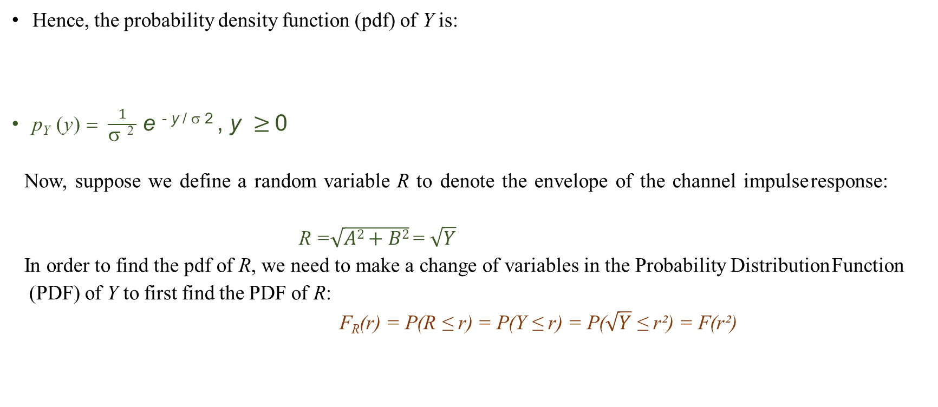
Signal model
Hence, the probability density function (pdf) of Y is:
p_{Y} (y) = $\frac{1}{\text{s} \text{2 }}$ e ^{- y /} $\text{s}$ ² , y $≥$0
Now, suppose we define a random variable R to denote the envelope of the channel impulse response:
R =$\sqrt{A2+B2}$ = $\sqrt{Y}$
In order to find the pdf of R, we need to make a change of variables in the Probability Distribution Function
(PDF) of Y to first find the PDF of R:
F_{R}(r) = P(R ≤ r) = P(Y ≤ r) = P($\sqrt{Y}$ ≤ r²) = F(r²)

Slide 14
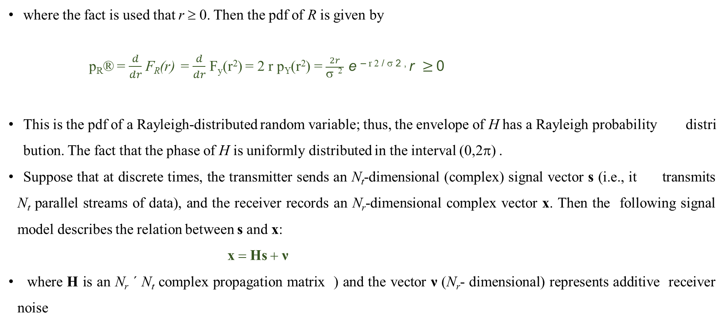
Signal model
where the fact is used that r ≥ 0. Then the pdf of R is given by
p_{R}® = $\frac{d}{dr}$ F_{R}(r) = $\frac{d}{dr}$ F_{y}(r²) = 2 r p_{Y}(r²) = $\frac{2r}{\text{s} \text{2 }}$ e ^{– r 2 /} $\text{s}$ ^{2 ,} r $≥$0
This is the pdf of a Rayleigh-distributed random variable; thus, the envelope of H has a Rayleigh probability distribution. The fact that the phase of H is uniformly distributed in the interval (0,2π) .
Suppose that at discrete times, the transmitter sends an N_{t}-dimensional (complex) signal vector s (i.e., it transmits N_{t} parallel streams of data), and the receiver records an N_{r}-dimensional complex vector x. Then the following signal model describes the relation between s and x:
x = Hs + ν
where H is an N_{r} × N_{t} complex propagation matrix ) and the vector ν (N_{r}- dimensional) represents additive receiver noise

Slide 15
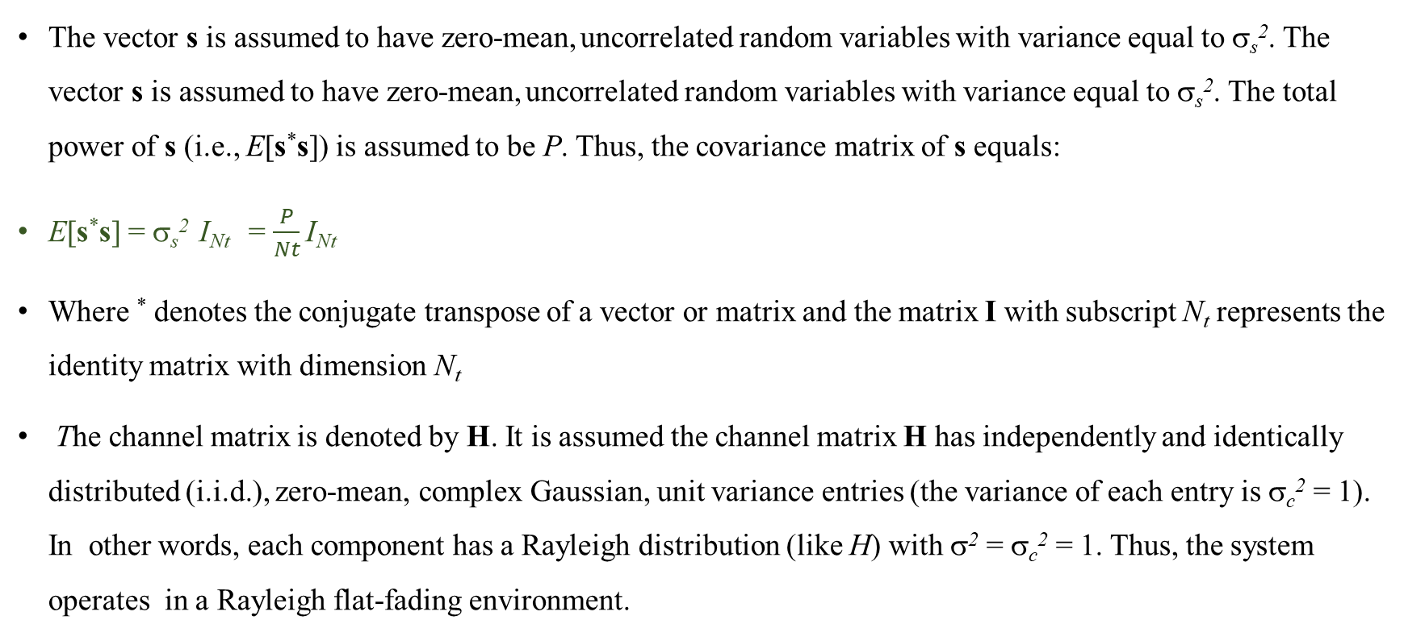
Signal model
The vector s is assumed to have zero-mean, uncorrelated random variables with variance equal to σ_{s}². The vector s is assumed to have zero-mean, uncorrelated random variables with variance equal to σ_{s}². The total power of s (i.e., E[s*s]) is assumed to be P. Thus, the covariance matrix of s equals:
E[s*s] = σ_{s}² I_{Nt} = $\frac{P}{Nt}$ I_{Nt}
Where * denotes the conjugate transpose of a vector or matrix and the matrix I with subscript N_{t} represents the identity matrix with dimension N_{t}
The channel matrix is denoted by H. It is assumed the channel matrix H has independently and identically distributed (i.i.d.), zero-mean, complex Gaussian, unit variance entries (the variance of each entry is σ_{c}² = 1). In other words, each component has a Rayleigh distribution (like H) with σ² = σ_{c}² = 1. Thus, the system operates in a Rayleigh flat-fading environment.

Slide 16
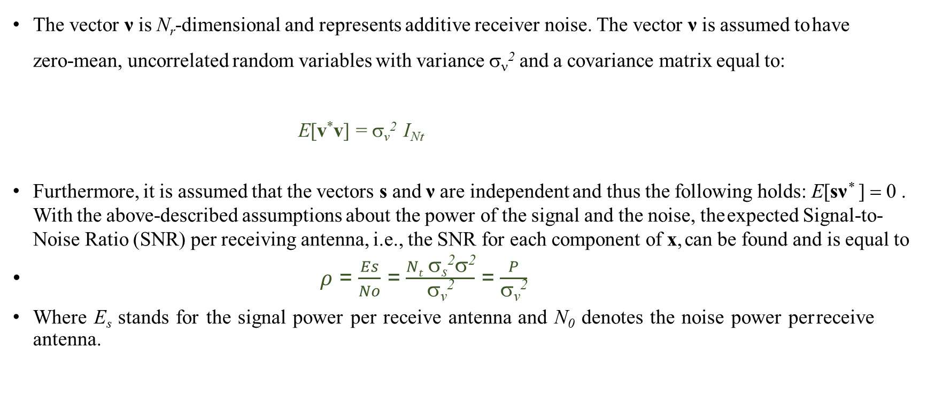
Signal model
The vector ν is N_{r}-dimensional and represents additive receiver noise. The vector ν is assumed to have zero-mean, uncorrelated random variables with variance σ_{ν}² and a covariance matrix equal to:
E[v*v] = σ_{v}² I_{Nt}
Furthermore, it is assumed that the vectors s and ν are independent and thus the following holds: E[sν* ] = 0 . With the above-described assumptions about the power of the signal and the noise, the expected Signal-to- Noise Ratio (SNR) per receiving antenna, i.e., the SNR for each component of x, can be found and is equal to
$ρ$ = $\frac{Es}{No}$ = $\frac{Nt \text{s}\text{s}\text{2}\text{s}\text{2}}{\text{s}\text{v}\text{2}}$ = $\frac{P}{\text{s}\text{v}\text{2}}$
Where E_{s} stands for the signal power per receive antenna and N₀ denotes the noise power per receive antenna.

Slide 17
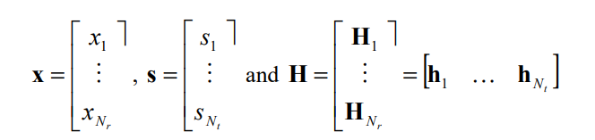
Signal model
In order to explain the different Space Division Multiplexing techniques, the following notations will be used
where x_{i} and s_{i} represent the i-th element of x and s respectively. H_{i} and h_{i} denote the i-th row and i-th column of H, respectively.
In the following sections, a number of SDM decoding techniques for the receiver will be discussed and compared.

Slide 18
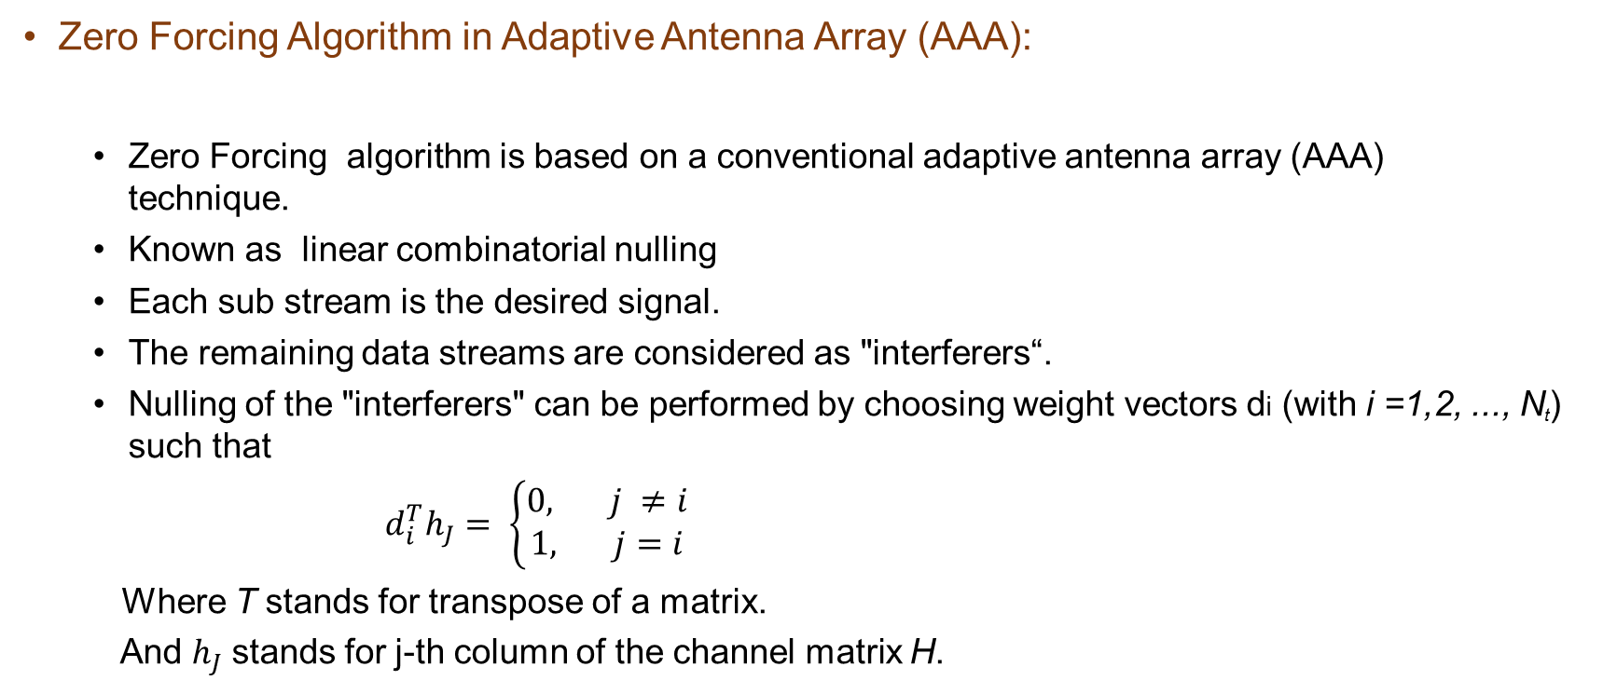
The Zero Forcing Algorithm
Zero Forcing Algorithm in Adaptive Antenna Array (AAA):
Zero Forcing algorithm is based on a conventional adaptive antenna array (AAA) technique.
Known as linear combinatorial nulling
Each sub stream is the desired signal.
The remaining data streams are considered as "interferers“.
Nulling of the "interferers" can be performed by choosing weight vectors di (with i =1,2, ..., N_{t}) such that
$d_{i}^{T}h_{J}= \left\{\begin{aligned}0, j ≠i \\ 1, j=i\end{aligned}\right.$
Where T stands for transpose of a matrix.
And $h_{J}$stands for j-th column of the channel matrix H.

Slide 19
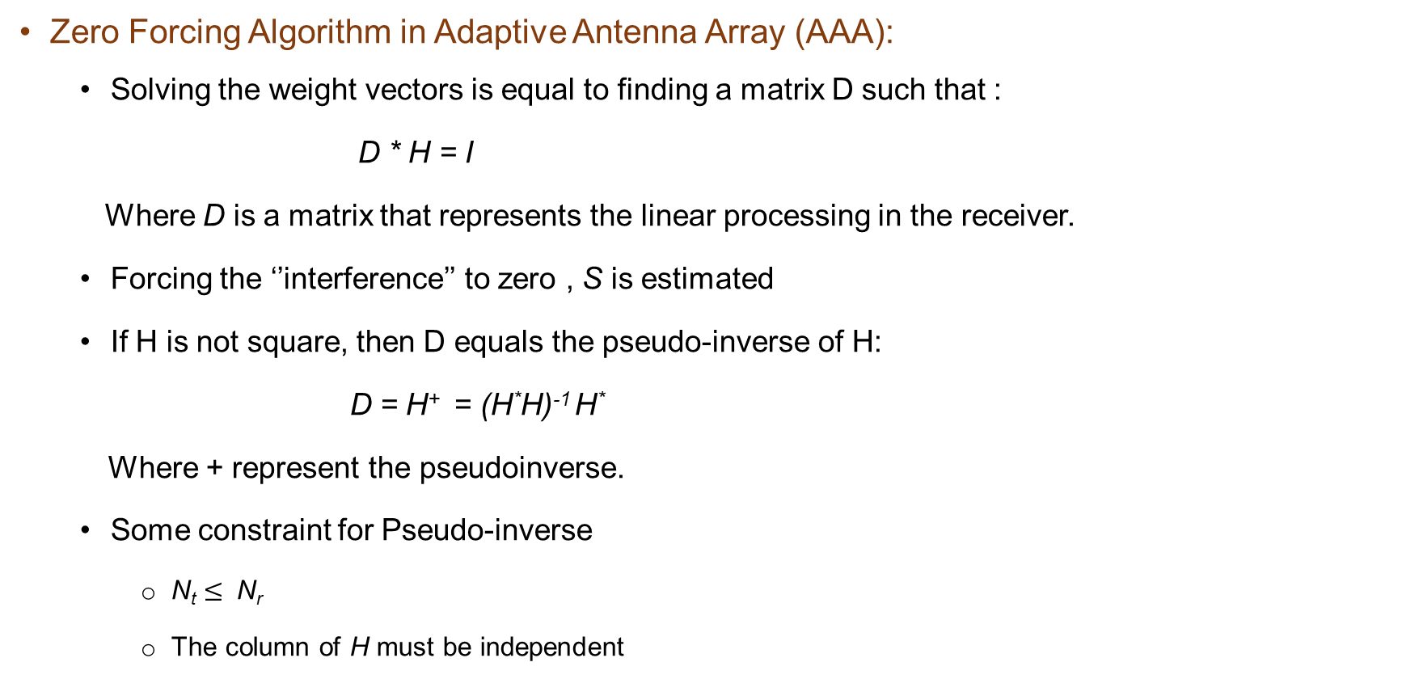
The Zero Forcing Algorithm
Zero Forcing Algorithm in Adaptive Antenna Array (AAA):
Solving the weight vectors is equal to finding a matrix D such that :
D * H = I
Where D is a matrix that represents the linear processing in the receiver.
Forcing the ‘’interference’’ to zero , S is estimated
If H is not square, then D equals the pseudo-inverse of H:
D = H⁺ = (H*H)⁻¹ H*
Where + represent the pseudoinverse.
Some constraint for Pseudo-inverse
N_{t} $≤$ N_{r}
The column of H must be independent

Slide 20
The Zero Forcing Algorithm
Zero Forcing Algorithm in Adaptive Antenna Array (AAA):
If the inverse is the exists, the estimates of S can be found by:
S_{est} = Dx
= (H*H)⁻¹ H* x
Or equivalently:
S_{est} = H⁺ x
And for i-th S_{est} can be written as :
(S_{est})_{i} = H_{i}⁺ x
H_{i}⁺ represent the i-th row of H⁺ , is equal to the transpose of the i-th weight vector d_{i}
d_{i} is the so-called nulling vector.

Slide 21
The Zero Forcing Algorithm
Zero Forcing Algorithm in Adaptive Antenna Array (AAA):
The ZF algorithm's performance can be tested through simulations, and its behavior can be theoretically understood by comparing it with the MRC system.
Understanding the diversity order helps relate the ZF algorithm to the MRC system.
This comparison gives valuable insights into the ZF algorithm's performance, making it crucial for evaluating wireless systems.

Slide 22
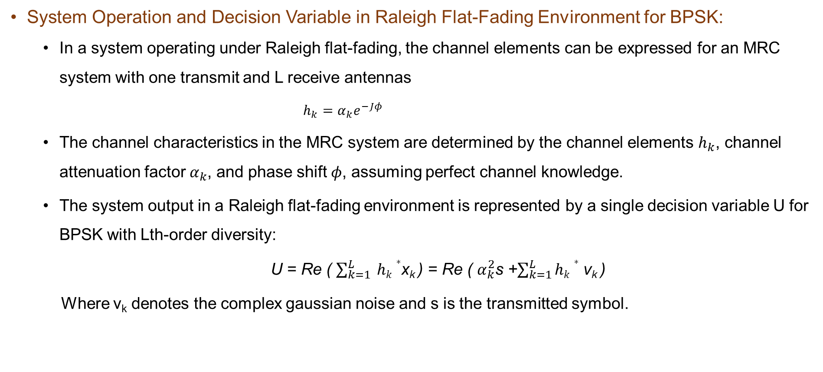
Theoretical BER
System Operation and Decision Variable in Raleigh Flat-Fading Environment for BPSK:
In a system operating under Raleigh flat-fading, the channel elements can be expressed for an MRC system with one transmit and L receive antennas
$h_{k}=α_{k}ⅇ^{−Jφ}$
The channel characteristics in the MRC system are determined by the channel elements $h_{k}$, channel attenuation factor $α_{k}$, and phase shift $φ$, assuming perfect channel knowledge.
The system output in a Raleigh flat-fading environment is represented by a single decision variable U for BPSK with Lth-order diversity:
U = Re ( $\sum_{k=1}^{L}{ hk∗}$x_{k} ) = Re ( $α_{k}^{2}$s +$\sum_{k=1}^{L}{hk∗}$ v_{k} )
Where v_{k} denotes the complex gaussian noise and s is the transmitted symbol.

Slide 23
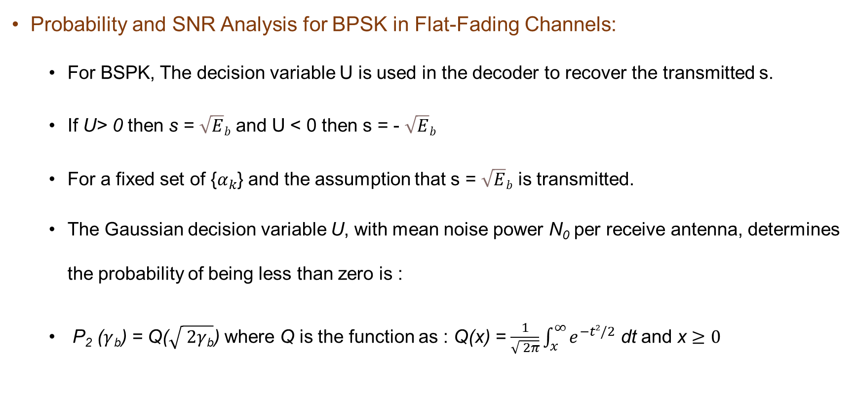
Theoretical BER
Probability and SNR Analysis for BPSK in Flat-Fading Channels:
For BSPK, The decision variable U is used in the decoder to recover the transmitted s.
If U> 0 then s = $\sqrt{E}b$ and U < 0 then s = - $\sqrt{E}b$
For a fixed set of {$α_{k}$} and the assumption that s = $\sqrt{E}b$ is transmitted.
The Gaussian decision variable U, with mean noise power N₀ per receive antenna, determines the probability of being less than zero is :
P₂ ($γ$_{b}) = Q($\sqrt{ 2γ\text{b}}$) where Q is the function as : Q(x) = $\frac{1}{\sqrt{ 2π}}\int_{x}^{∞}{e^{−t2/2}}$ dt and x $≥0$

Slide 24
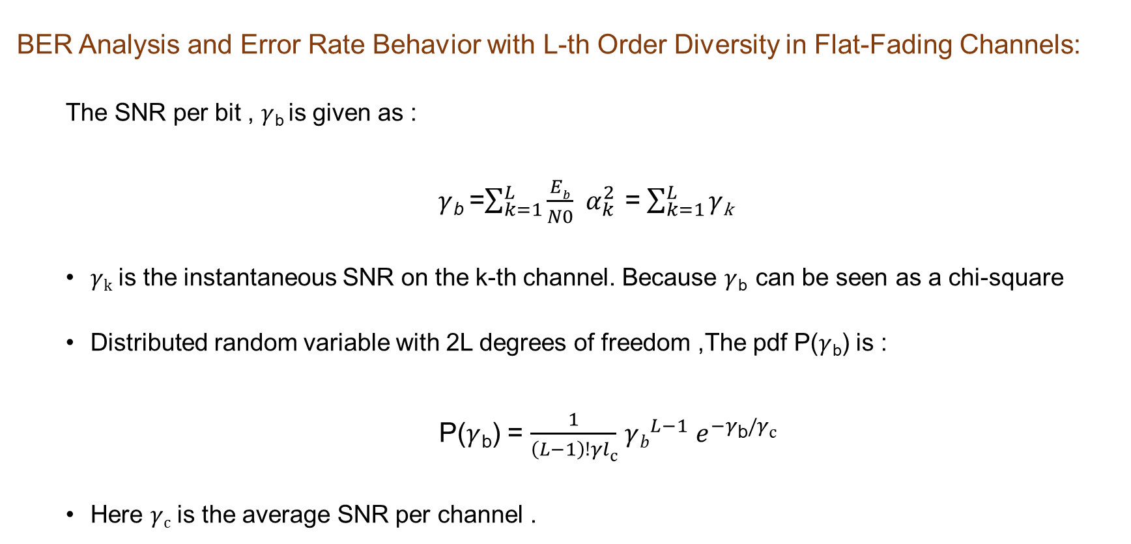
Theoretical BER
BER Analysis and Error Rate Behavior with L-th Order Diversity in Flat-Fading Channels:
The SNR per bit , $γ$_{b} is given as :
$γ$_{b} =$\sum_{k=1}^{L}{\frac{Eb}{N0} }$ $α_{k}^{2}$ = $\sum_{k=1}^{L}{γ\text{k}}$
$γ\text{k}$ is the instantaneous SNR on the k-th channel. Because $γ$_{b} can be seen as a chi-square
Distributed random variable with 2L degrees of freedom ,The pdf P($γ$_{b}) is :
P($γ$_{b}) = $\frac{1}{\left(L−1\right)!γl\text{c}}$ $γb^{L−1}$ $e^{−γ\text{b}/γ\text{c}}$
Here $γ\text{c}$ is the average SNR per channel .

Slide 25
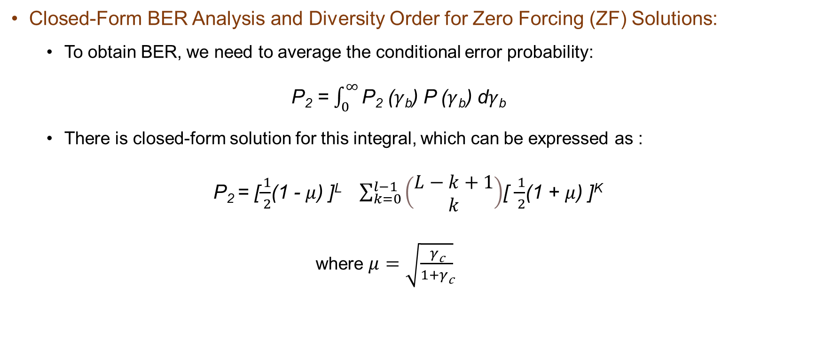
Theoretical BER
Closed-Form BER Analysis and Diversity Order for Zero Forcing (ZF) Solutions:
To obtain BER, we need to average the conditional error probability:
P₂ = $\int_{0}^{∞}{\text{P}\text{2} \text{(}γ\text{b}\text{)}}$ P ($γ$_{b}) d$γ\text{b}$
There is closed-form solution for this integral, which can be expressed as :
P₂ = [$\frac{ 1}{ 2}$(1 - $μ$) ]^{L} $\sum_{k=0}^{l−1}{\left(\begin{matrix}L−k+1 \\ k\end{matrix}\right)}$[ $\frac{ 1}{ 2}$(1 + $μ$) ]^{K}
where $μ=$ $\sqrt{\frac{γ\text{c}}{1+γ\text{c}}}$

Slide 26
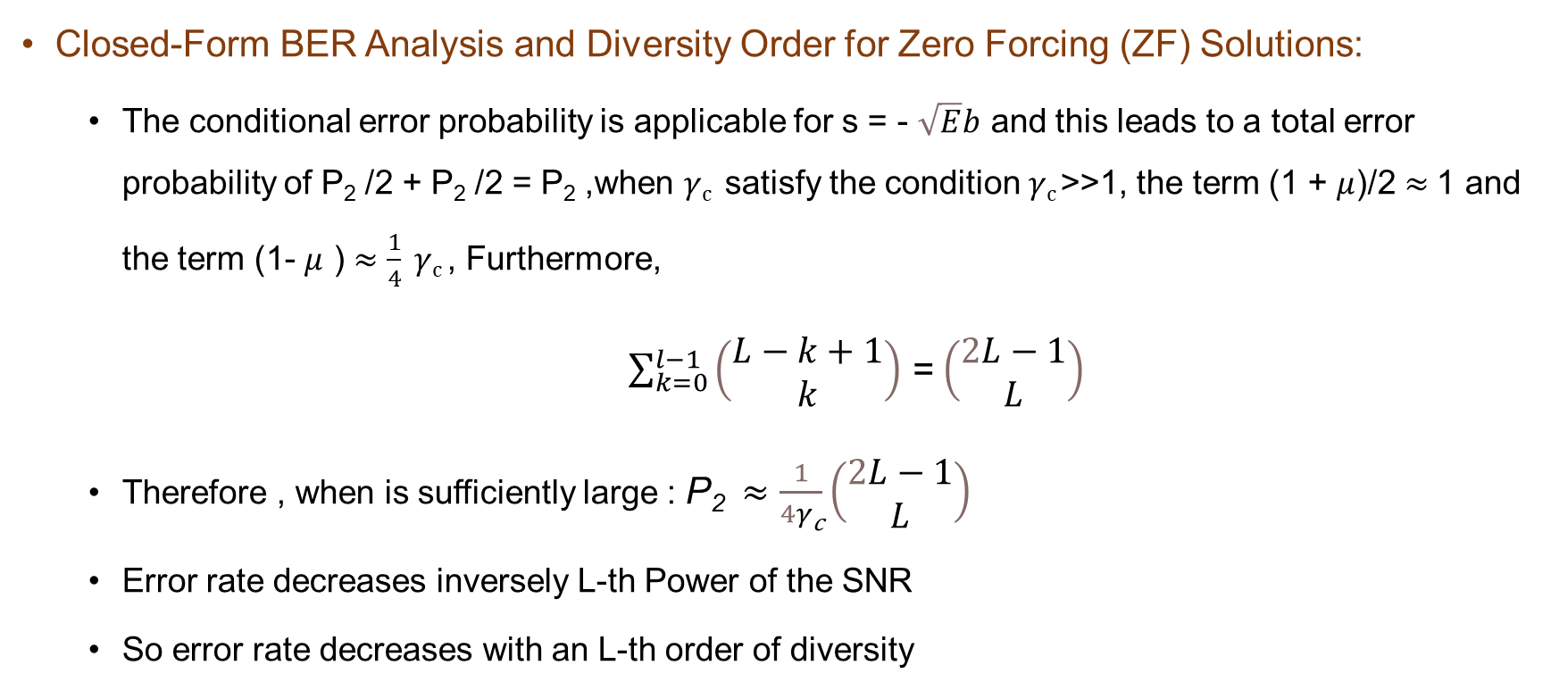
Theoretical BER
Closed-Form BER Analysis and Diversity Order for Zero Forcing (ZF) Solutions:
The conditional error probability is applicable for s = - $\sqrt{E}b$ and this leads to a total error probability of P₂ /2 + P₂ /2 = P₂ ,when $γ\text{c}$ satisfy the condition $γ\text{c}$>>1, the term (1 + $μ$)/2 $≈$1 and the term (1- $μ$ ) $≈\frac{1}{4} γ\text{c}$, Furthermore,
$\sum_{k=0}^{l−1}{\left(\begin{matrix}L−k+1 \\ k\end{matrix}\right)}$ = $\left(\begin{matrix}2L−1 \\ L\end{matrix}\right)$
Therefore , when is sufficiently large : P₂ $≈$ $\frac{1}{4γ\text{c}}\left(\begin{matrix}2L−1 \\ L\end{matrix}\right)$
Error rate decreases inversely L-th Power of the SNR
So error rate decreases with an L-th order of diversity

Slide 27
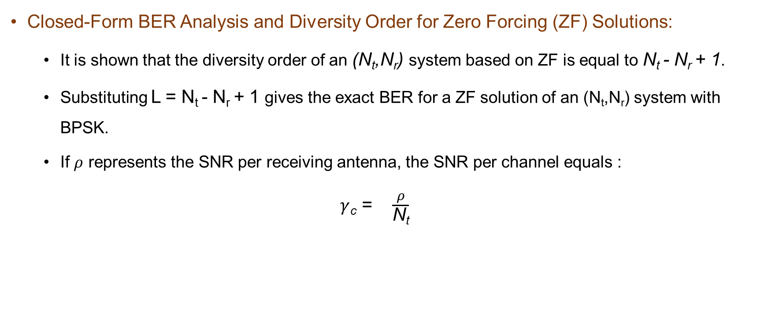
Theoretical BER
Closed-Form BER Analysis and Diversity Order for Zero Forcing (ZF) Solutions:
It is shown that the diversity order of an (N_{t},N_{r}) system based on ZF is equal to N_{t} - N_{r} + 1.
Substituting L = N_{t} - N_{r} + 1 gives the exact BER for a ZF solution of an (N_{t},N_{r}) system with BPSK.
If $ρ$ represents the SNR per receiving antenna, the SNR per channel equals :
$γ$_{c} = $\frac{ρ}{\text{N}\text{t}}$

Slide 28
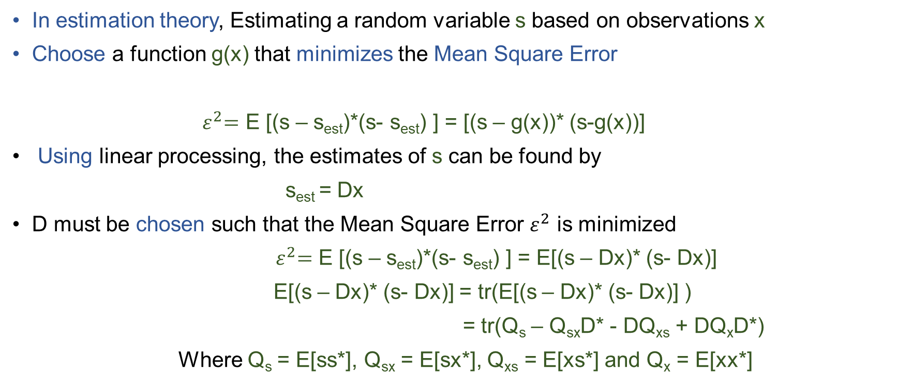
The Minimum Mean Square Error solution
In estimation theory, Estimating a random variable s based on observations x
Choose a function g(x) that minimizes the Mean Square Error
${ ε}^{2}=$ E [(s – s_{est})*(s- s_{est}) ] = [(s – g(x))* (s-g(x))]
Using linear processing, the estimates of s can be found by
s_{est} = Dx
D must be chosen such that the Mean Square Error $ε^{2}$ is minimized
${ ε}^{2}=$ E [(s – s_{est})*(s- s_{est}) ] = E[(s – Dx)* (s- Dx)]
E[(s – Dx)* (s- Dx)] = tr(E[(s – Dx)* (s- Dx)] )
= tr(Q_{s} – Q_{sx}D* - DQ_{xs} + DQ_{x}D*)
Where Q_{s} = E[ss*], Q_{sx} = E[sx*], Q_{xs} = E[xs*] and Q_{x} = E[xx*]

Slide 29
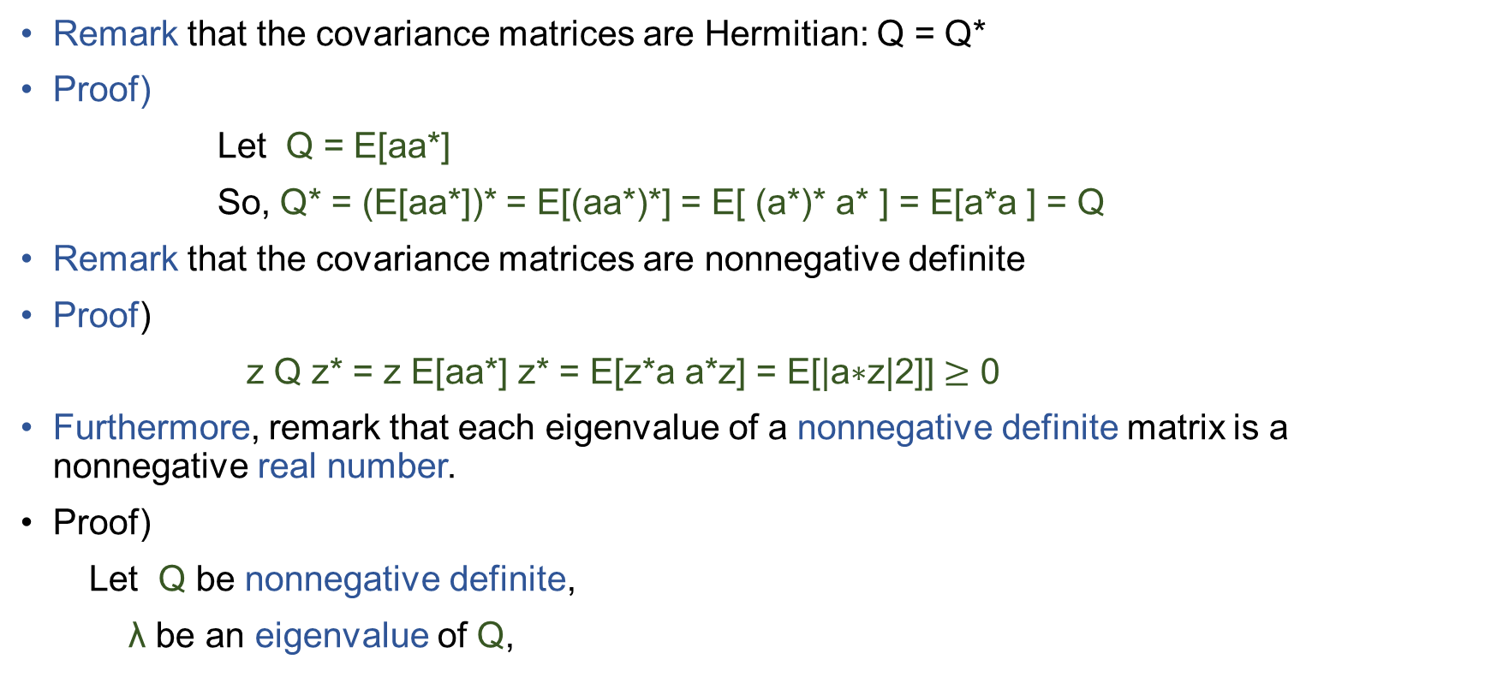
The Minimum Mean Square Error solution
Remark that the covariance matrices are Hermitian: Q = Q*
Proof)
Let Q = E[aa*]
So, Q* = (E[aa*])* = E[(aa*)*] = E[ (a*)* a* ] = E[a*a ] = Q
Remark that the covariance matrices are nonnegative definite
Proof)
z Q z* = z E[aa*] z* = E[z*a a*z] = E[$\text{|}\text{a}\text{∗}\text{z}\text{|2]}$] $≥$ 0
Furthermore, remark that each eigenvalue of a nonnegative definite matrix is a nonnegative real number.
Proof)
Let Q be nonnegative definite,
λ be an eigenvalue of Q,

Slide 30
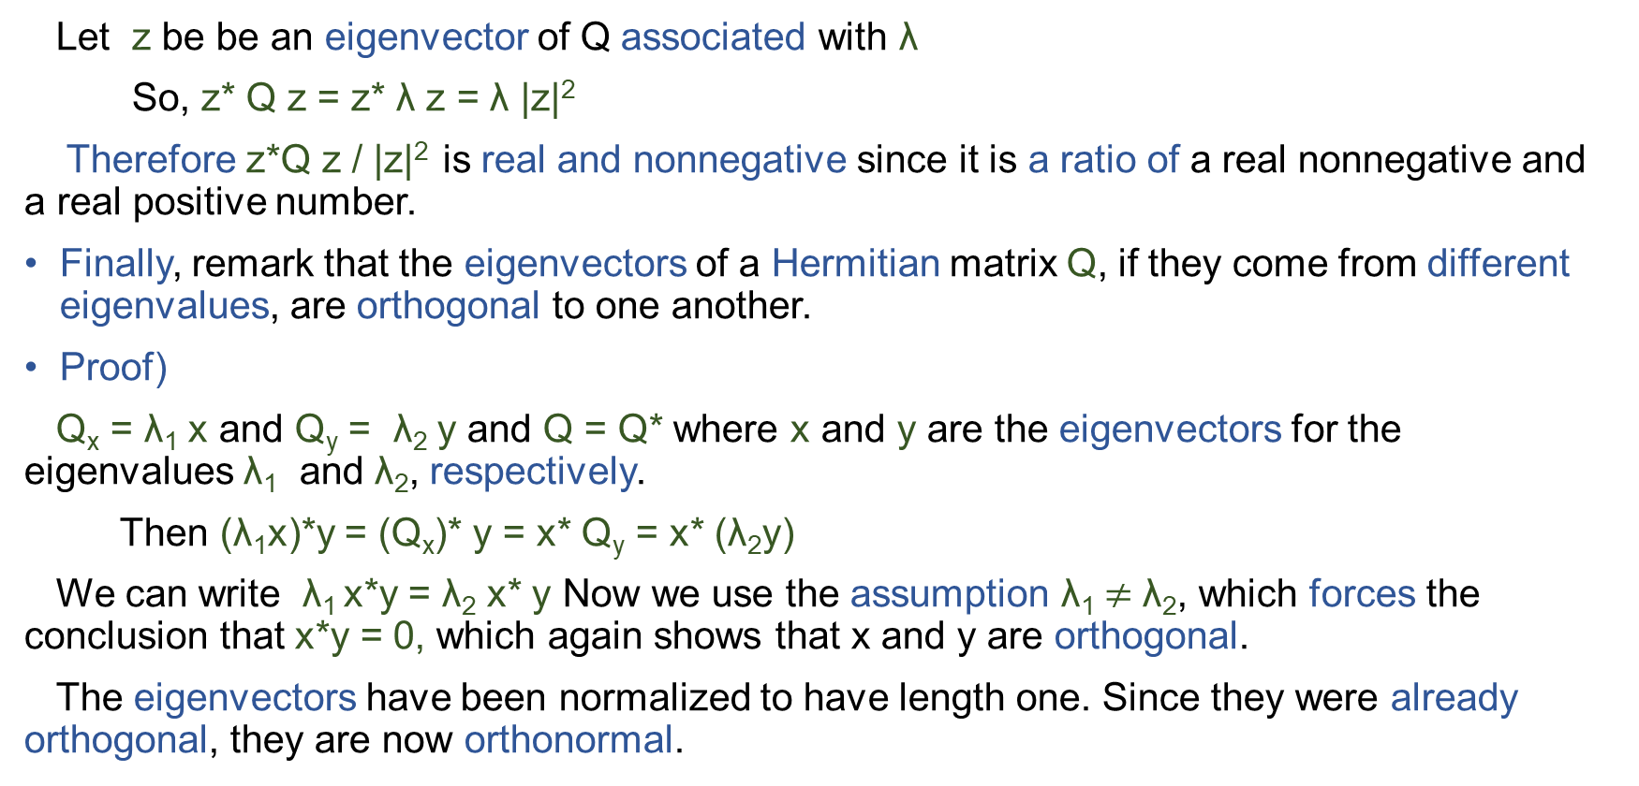
The Minimum Mean Square Error solution
Let z be be an eigenvector of Q associated with λ
So, z* Q z = z* λ z = λ |z|²
Therefore z*Q z / |z|² is real and nonnegative since it is a ratio of a real nonnegative and a real positive number.
Finally, remark that the eigenvectors of a Hermitian matrix Q, if they come from different eigenvalues, are orthogonal to one another.
Proof)
Q_{x} = λ₁ x and Q_{y} = λ₂ y and Q = Q* where x and y are the eigenvectors for the eigenvalues λ₁ and λ₂, respectively.
Then (λ₁x)*y = (Q_{x})* y = x* Q_{y} = x* (λ₂y)
We can write λ₁ x*y = λ₂ x* y Now we use the assumption λ₁$≠$ λ₂, which forces the conclusion that x*y = 0, which again shows that x and y are orthogonal.
The eigenvectors have been normalized to have length one. Since they were already orthogonal, they are now orthonormal.

Slide 31
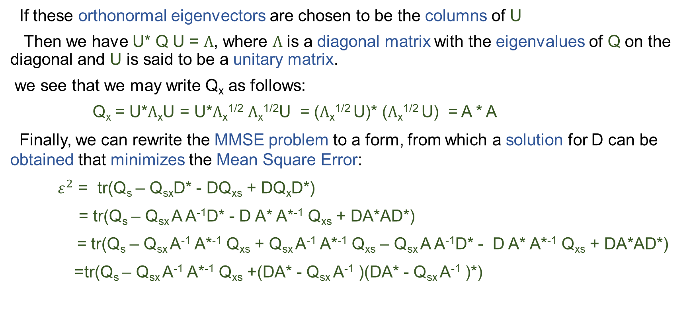
The Minimum Mean Square Error solution
If these orthonormal eigenvectors are chosen to be the columns of U
Then we have U* Q U = $Ʌ$, where $Ʌ$ is a diagonal matrix with the eigenvalues of Q on the diagonal and U is said to be a unitary matrix.
we see that we may write Q_{x} as follows:
Q_{x} = U*$Ʌ$_{x}U = U*$Ʌ$_{x}^{1/2} $Ʌ$_{x}^{1/2}U = ($Ʌ$_{x}^{1/2} U)* ($Ʌ$_{x}^{1/2} U) = A * A
Finally, we can rewrite the MMSE problem to a form, from which a solution for D can be obtained that minimizes the Mean Square Error:
${ ε}^{2}$ = tr(Q_{s} – Q_{sx}D* - DQ_{xs} + DQ_{x}D*)
= tr(Q_{s} – Q_{sx} A A⁻¹D* - D A* A*⁻¹ Q_{xs} + DA*AD*)
= tr(Q_{s} – Q_{sx} A⁻¹ A*⁻¹ Q_{xs} + Q_{sx} A⁻¹ A*⁻¹ Q_{xs} – Q_{sx} A A⁻¹D* - D A* A*⁻¹ Q_{xs} + DA*AD*)
=tr(Q_{s} – Q_{sx} A⁻¹ A*⁻¹ Q_{xs} +(DA* - Q_{sx} A⁻¹ )(DA* - Q_{sx} A⁻¹ )*)

Slide 32
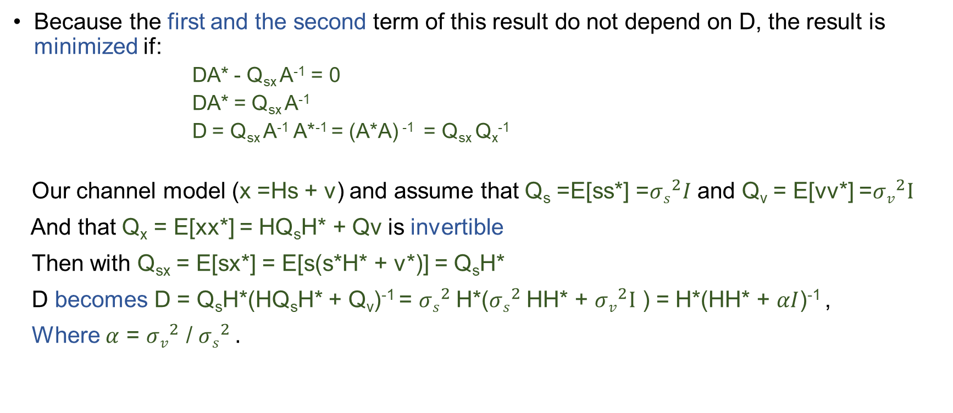
The Minimum Mean Square Error solution
Because the first and the second term of this result do not depend on D, the result is minimized if:
DA* - Q_{sx} A⁻¹ = 0
DA* = Q_{sx} A⁻¹
D = Q_{sx} A⁻¹ A*⁻¹ = (A*A) ⁻¹ = Q_{sx} Q_{x}⁻¹
Our channel model (x =Hs + v) and assume that Q_{s} =E[ss*] =${σs}^{2}I$ and Q_{v} = E[vv*] =${σv}^{2}I$
And that Q_{x} = E[xx*] = HQ_{s}H* + Qv is invertible
Then with Q_{sx} = E[sx*] = E[s(s*H* + v*)] = Q_{s}H*
D becomes D = Q_{s}H*(HQ_{s}H* + Q_{v})⁻¹ = ${σs}^{2}$H*(${σs}^{2}$HH* + ${σv}^{2}I$ ) = H*(HH* + $αI$)⁻¹ ,
Where $α$ = ${σv}^{2}$ / ${σs}^{2} .$

Slide 33
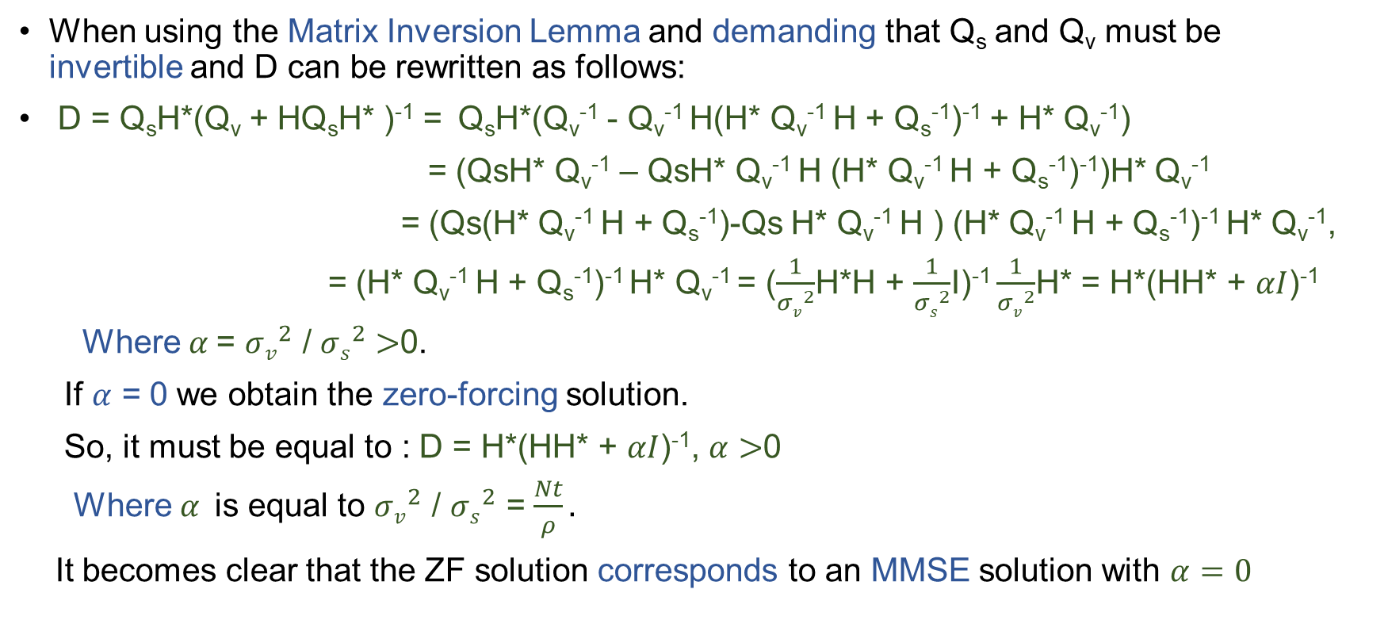
The Minimum Mean Square Error solution
When using the Matrix Inversion Lemma and demanding that Q_{s} and Q_{v} must be invertible and D can be rewritten as follows:
D = Q_{s}H*(Q_{v} + HQ_{s}H* )⁻¹ = Q_{s}H*(Q_{v}⁻¹ - Q_{v}⁻¹ H(H* Q_{v}⁻¹ H + Q_{s}⁻¹)⁻¹ + H* Q_{v}⁻¹)
= (QsH* Q_{v}⁻¹ – QsH* Q_{v}⁻¹ H (H* Q_{v}⁻¹ H + Q_{s}⁻¹)⁻¹)H* Q_{v}⁻¹
= (Qs(H* Q_{v}⁻¹ H + Q_{s}⁻¹)-Qs H* Q_{v}⁻¹ H ) (H* Q_{v}⁻¹ H + Q_{s}⁻¹)⁻¹ H* Q_{v}⁻¹,
= (H* Q_{v}⁻¹ H + Q_{s}⁻¹)⁻¹ H* Q_{v}⁻¹ = ($\frac{1}{{σv}^{2}}$H*H + $\frac{1}{{σs}^{2}}$I)⁻¹ $\frac{1}{{σv}^{2}}$H* = H*(HH* + $αI$)⁻¹
Where $α$= ${σv}^{2}$ / ${σs}^{2}>$0.
If $α$ = 0 we obtain the zero-forcing solution.
So, it must be equal to : D = H*(HH* + $αI$)⁻¹, $α$ $>$0
Where $α$is equal to ${σv}^{2}$ / ${σs}^{2}$ = $\frac{Nt}{ρ}.$
It becomes clear that the ZF solution corresponds to an MMSE solution with $α=0$

Slide 34
Zero Forcing with Decision Feedback Decoding
Superior performance can be achieved by symbol cancellation
Symbol cancellation involves:
Decoding the most reliable element first.
Improving decoding of other elements.
Linear nulling (ZF or MMSE) used for detection.
Decision Feedback Decoding (DFB) is analogous to decision feedback equalization.
DFB modifies the receiver vector by subtracting interference from already detected components.
When symbol cancellation is used components of s are detected becomes important to the overall performance of the system.

Slide 35
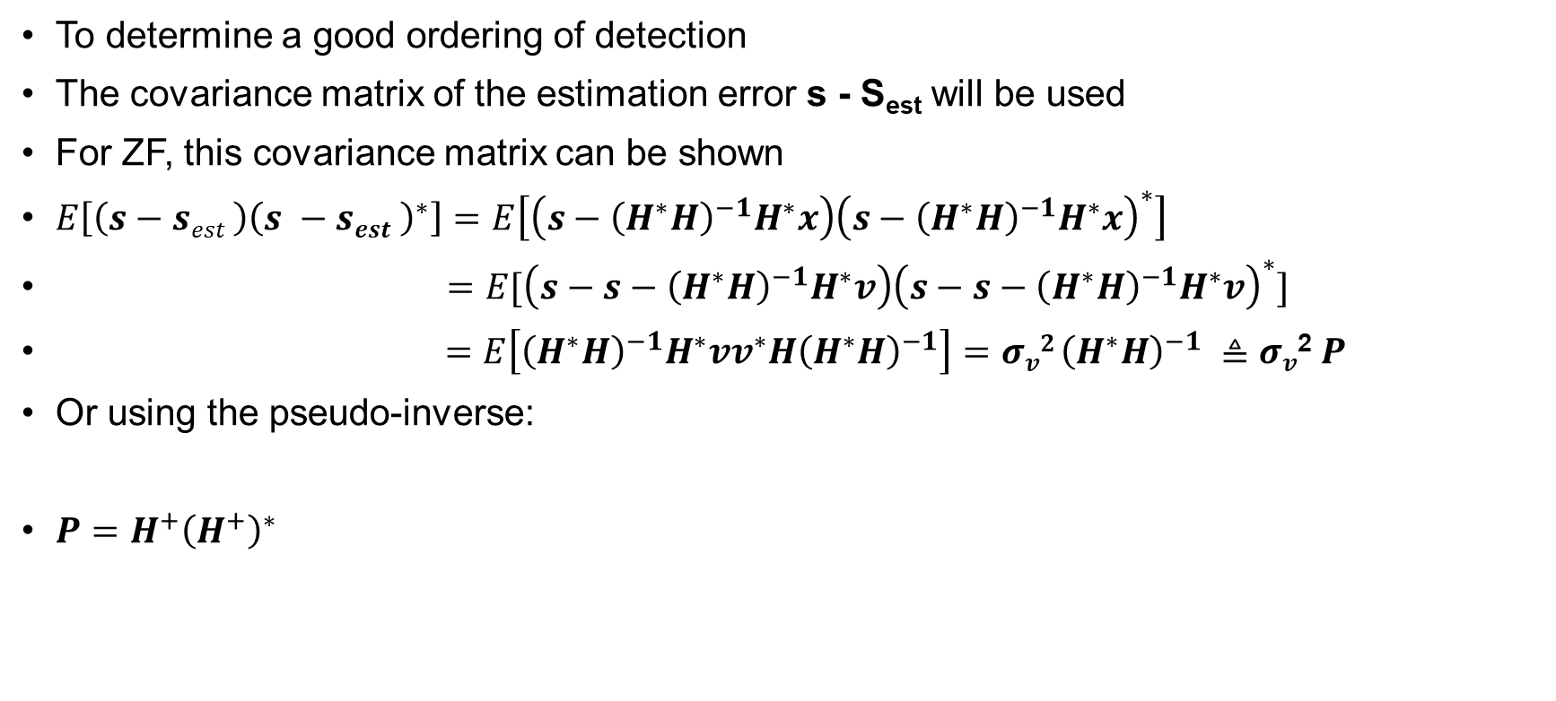
Zero Forcing with Decision Feedback Decoding
To determine a good ordering of detection
The covariance matrix of the estimation error s - S_{est} will be used
For ZF, this covariance matrix can be shown
$E\left[\left(s−sest \right){\left(s −sest \right)}^{∗}\right]=E\left[\left(s−{\left(H^{∗}H\right)}^{−1}H^{∗}x\right){\left(s−{\left(H^{∗}H\right)}^{−1}H^{∗}x\right)}^{∗}\right]$
$=E[\left(s−s−{\left(H^{∗}H\right)}^{−1}H^{∗}v\right){\left(s−s−{\left(H^{∗}H\right)}^{−1}H^{∗}v\right)}^{∗}]$
$=E\left[{\left(H^{∗}H\right)}^{−1}H^{∗}vv^{∗}H{\left(H^{∗}H\right)}^{−1}\right]=σv{2 \left(H^{∗}H\right)}^{−1} ≜$ $σv$² $P$
Or using the pseudo-inverse:
$P=H^{+}{\left(H^{+}\right)}^{∗}$

Slide 36
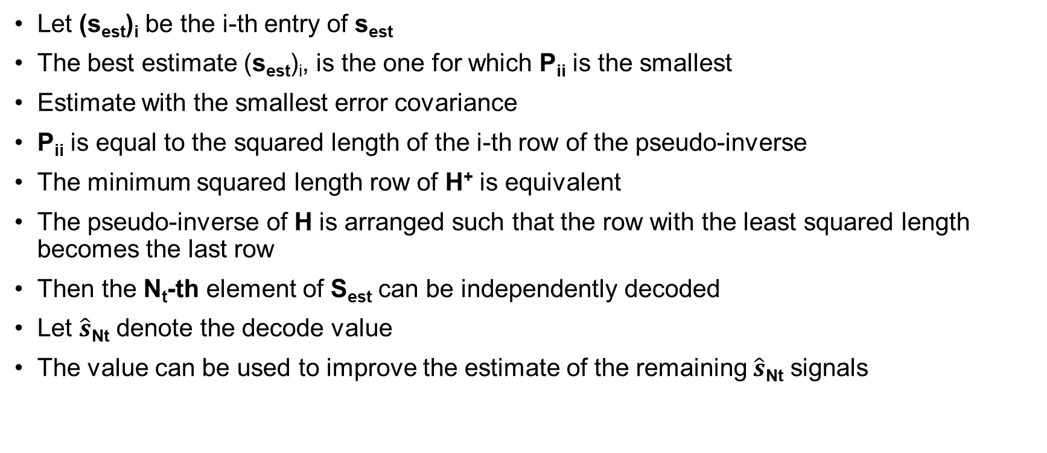
Zero Forcing with Decision Feedback Decoding
Let (s_{est})_{i} be the i-th entry of s_{est}
The best estimate (s_{est})_{i}, is the one for which P_{ii} is the smallest
Estimate with the smallest error covariance
P_{ii} is equal to the squared length of the i-th row of the pseudo-inverse
The minimum squared length row of H⁺ is equivalent
The pseudo-inverse of H is arranged such that the row with the least squared length becomes the last row
Then the N_{t}-th element of S_{est} can be independently decoded
Let $\hat{s}$_{Nt} denote the decode value
The value can be used to improve the estimate of the remaining $\hat{s}$_{Nt} signals

Slide 37
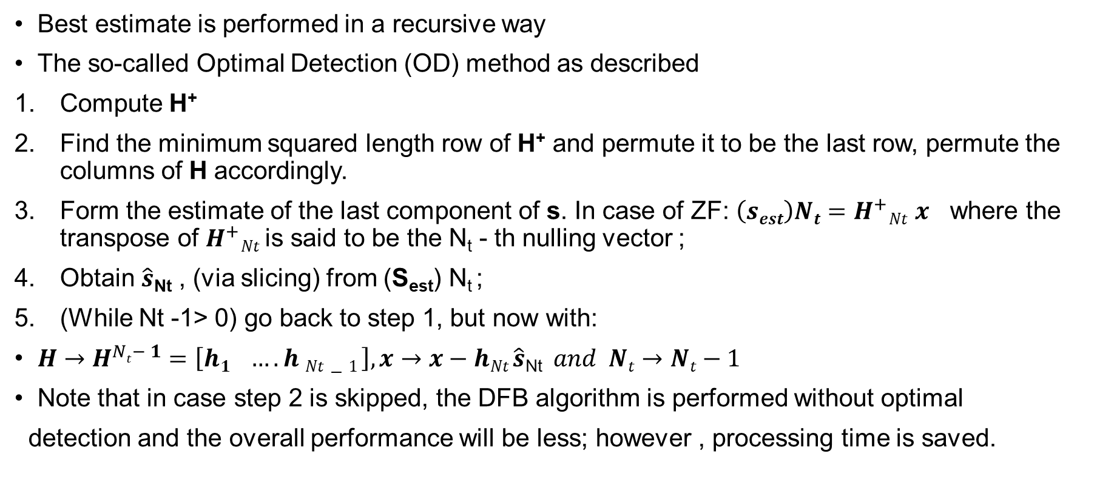
Zero Forcing with Decision Feedback Decoding
Best estimate is performed in a recursive way
The so-called Optimal Detection (OD) method as described
Compute H⁺
Find the minimum squared length row of H⁺ and permute it to be the last row, permute the columns of H accordingly.
Form the estimate of the last component of s. In case of ZF: $\left(sest\right)Nt=H^{+}Nt x$ where the transpose of $H^{+}Nt$is said to be the N_{t} - th nulling vector ;
Obtain $\hat{s}$_{Nt} , (via slicing) from (S_{est}) N_{t} ;
(While Nt -1> 0) go back to step 1, but now with:
$H→H^{Nt− 1}=\left[h1 …. h Nt−1 \right],x→x−hNt \hat{s}\text{Nt} and Nt→Nt−1$
Note that in case step 2 is skipped, the DFB algorithm is performed without optimal
detection and the overall performance will be less; however , processing time is saved.

Slide 38
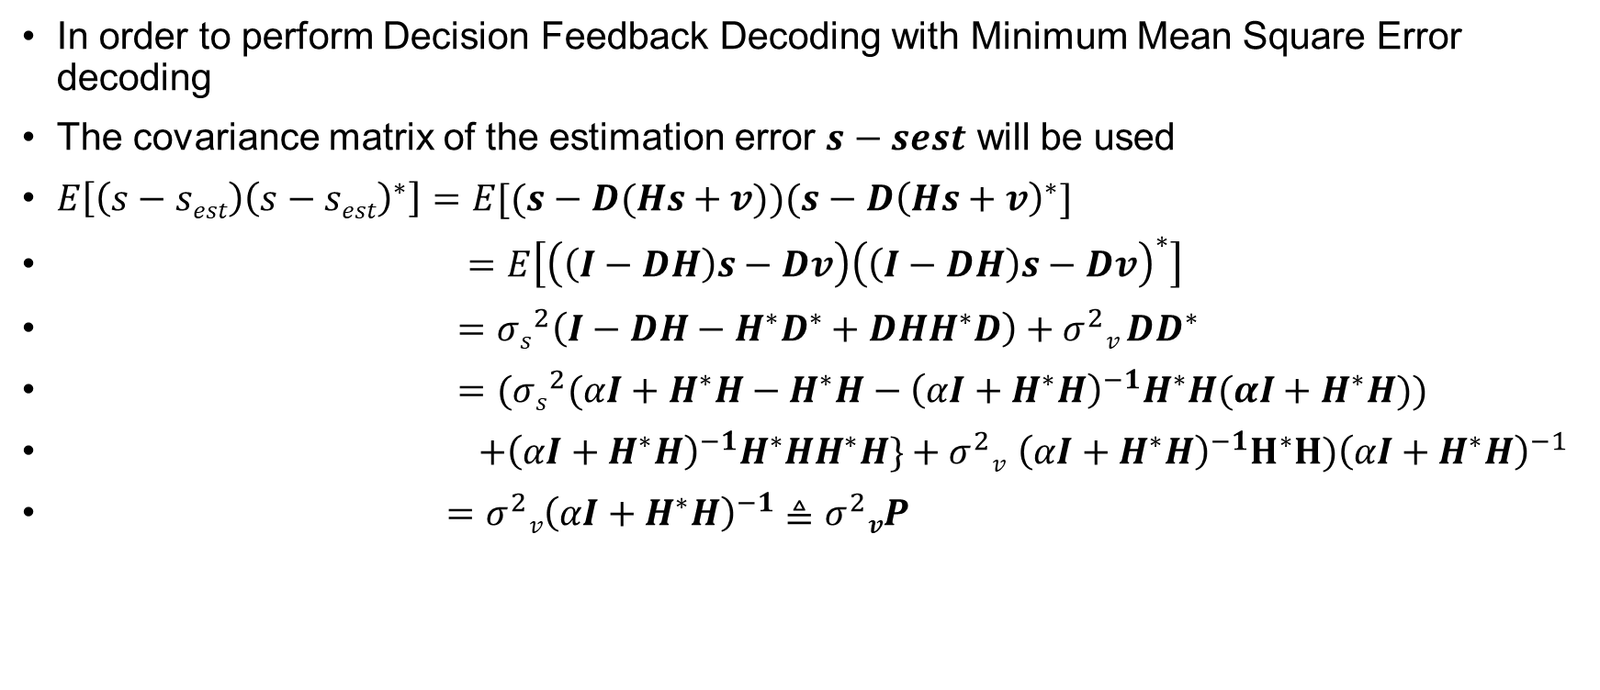
MMSE with Decision Feedback Decoding
In order to perform Decision Feedback Decoding with Minimum Mean Square Error decoding
The covariance matrix of the estimation error $s−sest$ will be used
$E\left[\left(s−sest\right){\left(s−sest\right)}^{∗}\right]=E[(s−D(Hs+v))(s−D{\left(Hs+v\right)}^{∗}]$
$=E\left[\left(\left(I−DH\right)s−Dv\right){\left(\left(I−DH\right)s−Dv\right)}^{∗}\right]$
$=σs^{2}\left(I−DH−H^{∗}D^{∗}+DHH^{∗}D\right)+σ^{2}v DD^{∗}$
$=(σs^{2}(αI+H^{∗}H−H^{∗}H−{\left(αI+H^{∗}H\right)}^{−1}H^{∗}H(αI+H^{∗}H))$
$+{\left(αI+H^{∗}H\right)}^{−1}H^{∗}HH^{∗}H\}+σ^{2}v {\left(αI+H^{∗}H\right)}^{−1}H^{∗}H){\left(αI+H^{∗}H\right)}^{−1}$
$=σ^{2}v{\left(αI+H^{∗}H\right)}^{−1}$ $≜σ^{2}vP$

Slide 39
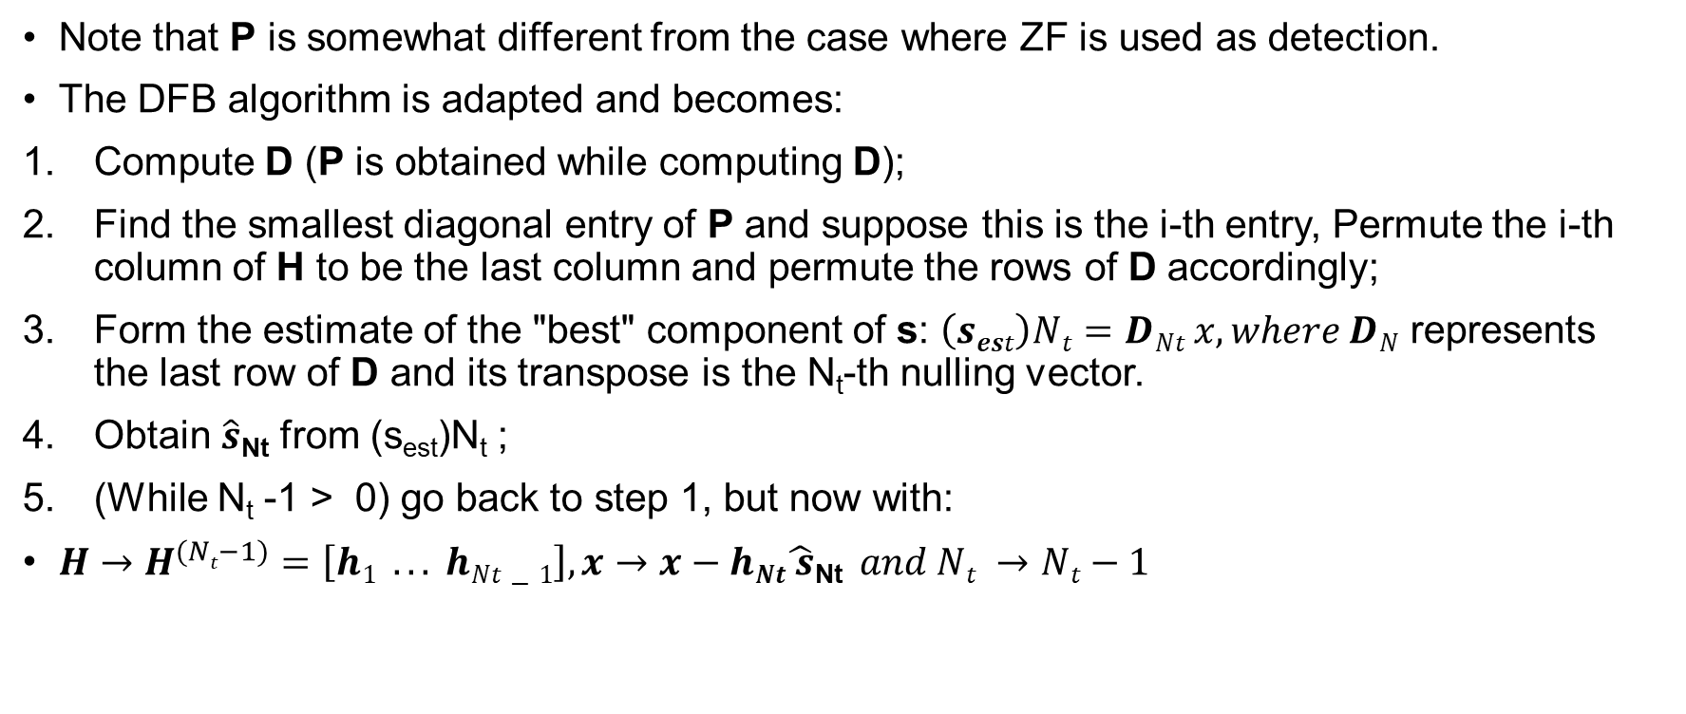
MMSE with Decision Feedback Decoding
Note that P is somewhat different from the case where ZF is used as detection.
The DFB algorithm is adapted and becomes:
Compute D (P is obtained while computing D);
Find the smallest diagonal entry of P and suppose this is the i-th entry, Permute the i-th column of H to be the last column and permute the rows of D accordingly;
Form the estimate of the "best" component of s: $\left(sest\right)Nt=DNt x, where DN$ represents the last row of D and its transpose is the N_{t}-th nulling vector.
Obtain $\hat{s}$_{Nt} from (s_{est})N_{t} ;
(While N_{t} -1 > 0) go back to step 1, but now with:
$H→H^{(Nt−1)}=\left[h1 .. . hNt−1\right],x→x−hNt\hat{ s}\text{Nt} and Nt →Nt−1$

Slide 40

Calculus problem
$\frac{∂tr(p,λ)}{∂PRe}$=$\frac{∂tr\{tr\left(GHPRs\right)+λ(tr\left(PRsP^{H}−E tr\right)\}}{∂PRe}$
=$\frac{∂tr[\left(GH\left(PRe+j PIm\right)Rs\right)+λ\{tr\left(\left(PRe+jPim\right)Rs\left(PRe+jPim\right)−Etr\right)\})]}{∂PRe}$

Slide 41
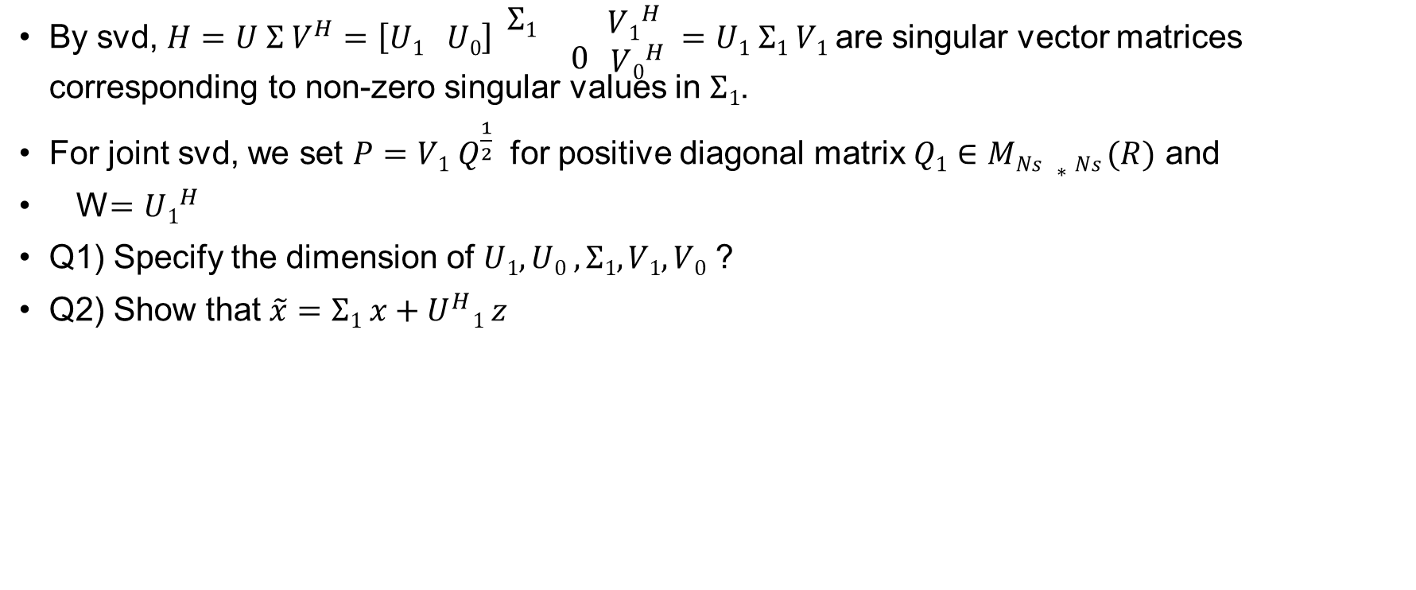
MIMO with CSIT – Joint SVD
By svd, $H=U Σ V^{H}=\left[U1 U0\right] \begin{matrix} Σ1 & \\ & 0\end{matrix} \begin{matrix}V1^{H} \\ V0^{H} \end{matrix}$ $=U1 Σ1 V1$are singular vector matrices corresponding to non-zero singular values in $Σ1$.
For joint svd, we set $P=V1 Q^{\frac{1}{2}}$ for positive diagonal matrix $Q1∈MNs ∗Ns (R)$ and
W$=U1^{H}$
Q1) Specify the dimension of $U1, U0 , Σ1, V1, V0$ ?
Q2) Show that $\tilde{x}=Σ1 x+U^{H}1 z$

Slide 42
Assignment-07
1. MIMO linear processing
MIMO without CSIT
2)RxMF
3)RxZF
4)RxMMSE
MIMO with CSIT
5) Joint SVD
6)Numerical result

Slide 43
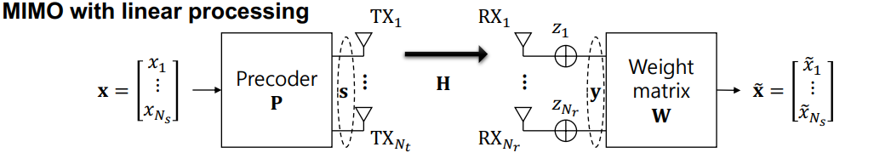
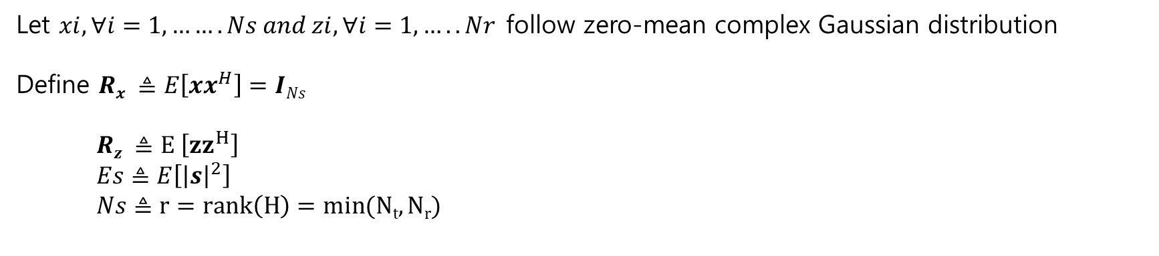
MIMO with linear processing
Let $xi, ∀i=1,…….Ns and zi, ∀i=1,…..Nr$follow zero-mean complex Gaussian distribution
Define $Rx ≜E\left[xx^{H}\right]=INs$
$Rz ≜E \left[{zz}^{H}\right]$
$Es≜E\left[{\left|s\right|}^{2}\right]$
$Ns≜r=rank\left(H\right)=min(Nt,Nr)$

Slide 44
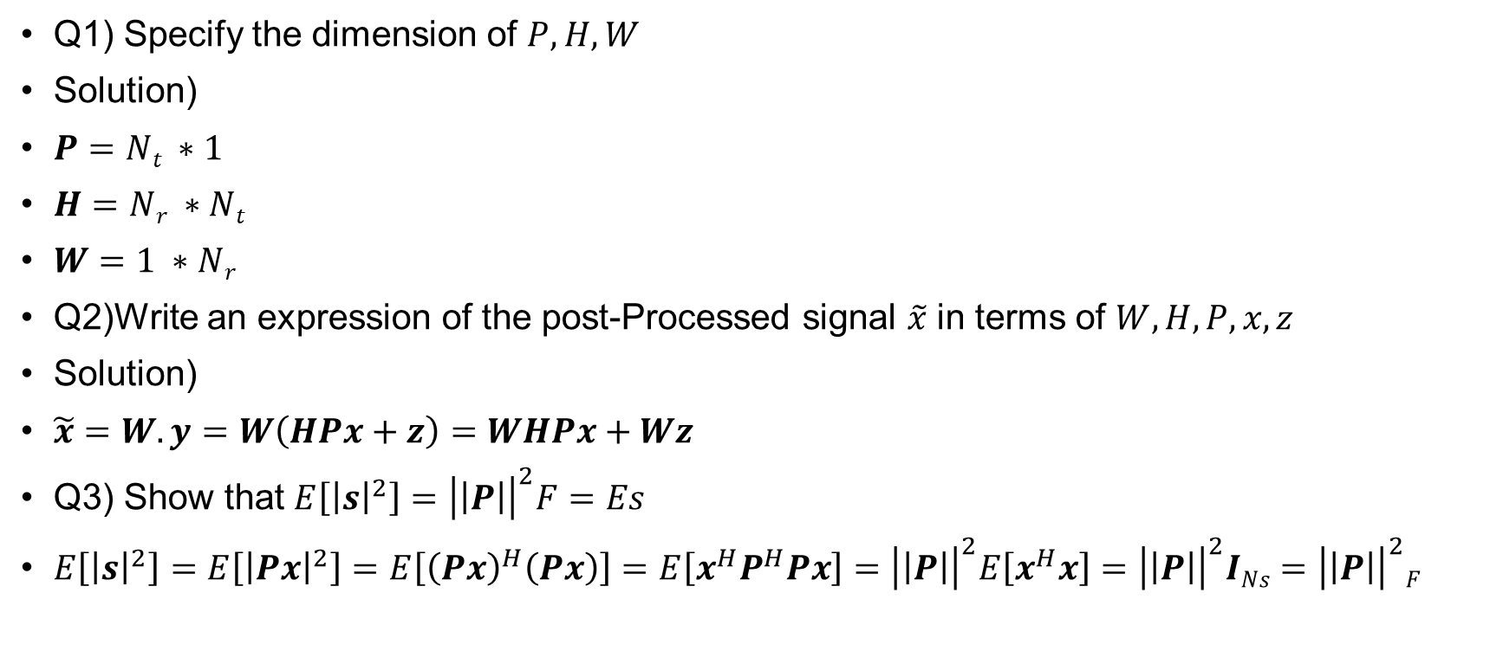
MIMO with linear processing
Q1) Specify the dimension of $P, H, W$
Solution)
$P=Nt ∗1$
$H=Nr ∗Nt$
$W=1 ∗Nr$
Q2)Write an expression of the post-Processed signal $\tilde{x}$ in terms of $W,H,P,x,z$
Solution)
$\tilde{x}=W.y=W\left(HPx+z\right)=WHPx+Wz$
Q3) Show that $E\left[{\left|s\right|}^{2}\right]={\left|\left|P\right|\right|}^{2}F=Es$
$E\left[{\left|s\right|}^{2}\right]=E\left[{\left|Px\right|}^{2}\right]=E\left[{\left(Px\right)}^{H}\left(Px\right)\right]=E\left[x^{H}P^{H}Px\right]={\left|\left|P\right|\right|}^{2}E\left[x^{H}x\right]={\left|\left|P\right|\right|}^{2}INs={\left|\left|P\right|\right|}^{2}F$

Slide 45
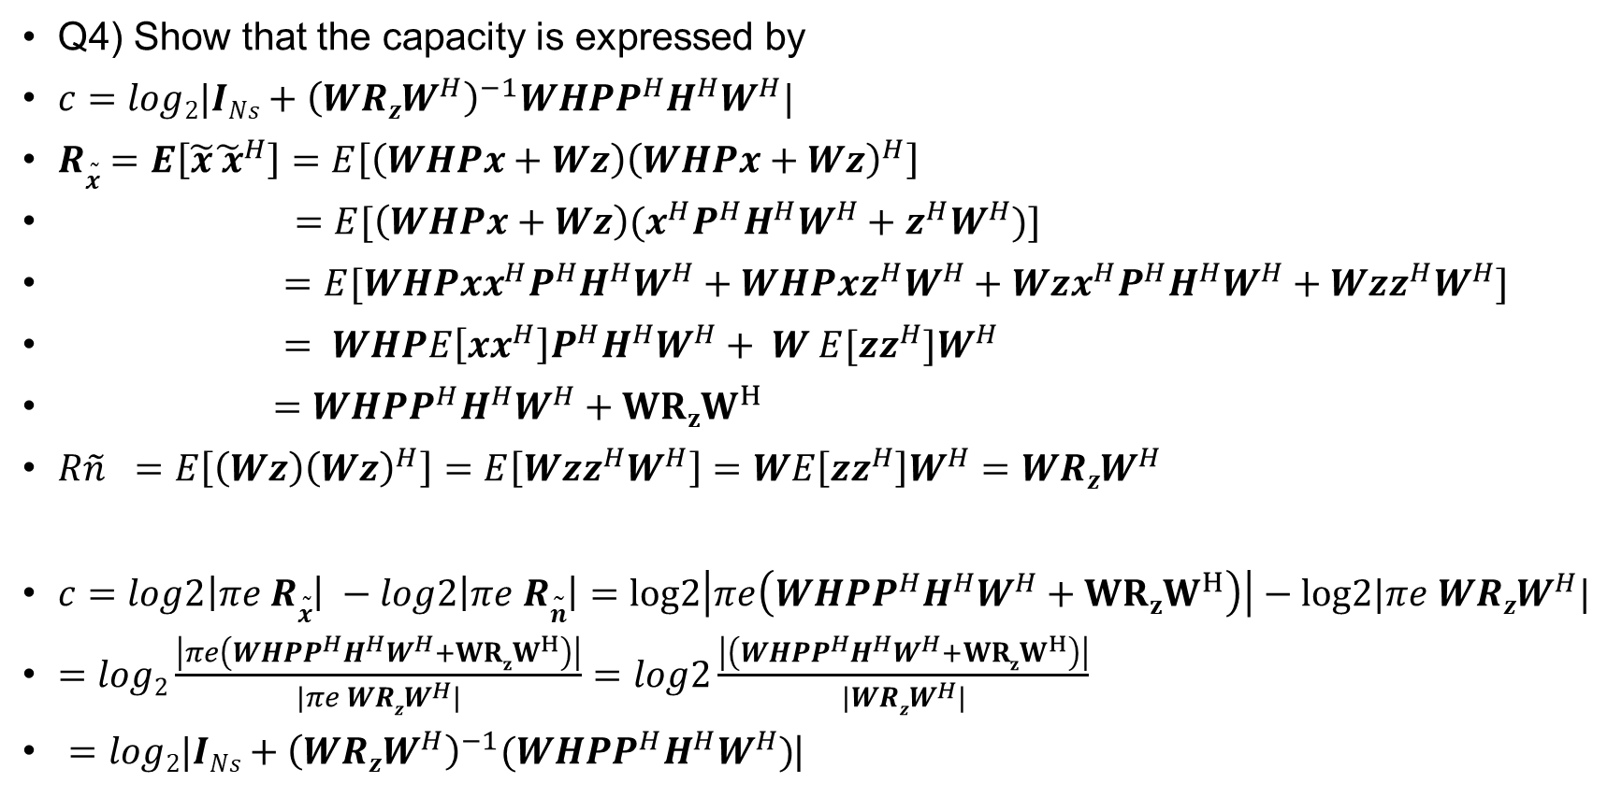
MIMO with linear processing
Q4) Show that the capacity is expressed by
$c=log2|INs+{\left(WRzW^{H}\right)}^{−1}WHPP^{H}H^{H}W^{H}|$
$R\tilde{x}=E\left[\tilde{x}{\tilde{ x}}^{H}\right]=E\left[\left(WHPx+Wz\right){\left(WHPx+Wz\right)}^{H}\right]$
$=E[\left(WHPx+Wz\right)(x^{H}P^{H}H^{H}W^{H}+z^{H}W^{H})]$
$=E[WHPxx^{H}P^{H}H^{H}W^{H}+WHPxz^{H}W^{H}+Wzx^{H}P^{H}H^{H}W^{H}+Wzz^{H}W^{H}]$
$= WHPE\left[xx^{H}\right]P^{H}H^{H}W^{H}+ W E[zz^{H}]W^{H}$
$=WHPP^{H}H^{H}W^{H}+{WRzW}^{H}$
$R\tilde{n} =E\left[\left(Wz\right){\left(Wz\right)}^{H}\right]=E\left[Wzz^{H}W^{H}\right]=WE\left[zz^{H}\right]W^{H}=WRzW^{H}$
$c=log2\left|πe R\tilde{x}\right| −log2\left|πe R\tilde{n}\right|=log2\left|πe\left(WHPP^{H}H^{H}W^{H}+{WRzW}^{H}\right)\right|−log2|πe WRzW^{H}|$
$=log2\frac{\left|πe\left({WHPP}^{H}H^{H}W^{H}+{WRzW}^{H}\right)\right|}{|πe WRzW^{H}|}=log2\frac{\left|\left(WHPP^{H}H^{H}W^{H}+{WRzW}^{H}\right)\right|}{|WRzW^{H}|}$
$=log2|INs+{\left(WRzW^{H}\right)}^{−1}(WHPP^{H}H^{H}W^{H})$|

Slide 46
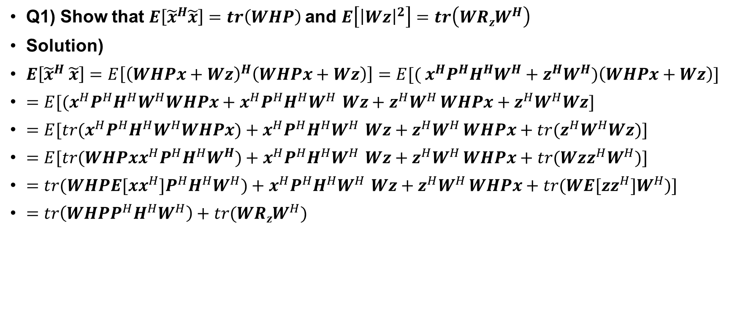
MIMO without CSIT – RxMF
Q1) Show that $E\left[{\tilde{x}}^{H}\tilde{x}\right]=tr\left(WHP\right)$and $E\left[{\left|Wz\right|}^{2}\right]=tr\left(WRzW^{H}\right)$
Solution)
$E\left[{\tilde{x}}^{H} \tilde{x}\right]=E\left[{\left(WHPx+Wz\right)}^{H}\left(WHPx+Wz\right)\right]=E[{( x}^{H}P^{H}H^{H}W^{H}+z^{H}W^{H})\left(WHPx+Wz\right)]$
$=E[{(x}^{H}P^{H}H^{H}W^{H}WHPx+x^{H}P^{H}H^{H}W^{H }Wz+z^{H}W^{H }WHPx+z^{H}W^{H}Wz]$
$=E[tr{(x}^{H}P^{H}H^{H}W^{H}WHPx)+x^{H}P^{H}H^{H}W^{H }Wz+z^{H}W^{H }WHPx+{tr(z}^{H}W^{H}Wz)]$
$=E[tr(WHPxx^{H}P^{H}H^{H}W^{H})+x^{H}P^{H}H^{H}W^{H }Wz+z^{H}W^{H }WHPx+tr(Wzz^{H}W^{H})]$
$=tr(WHPE[xx^{H}]P^{H}H^{H}W^{H})+x^{H}P^{H}H^{H}W^{H }Wz+z^{H}W^{H }WHPx+tr(WE[zz^{H}]W^{H})]$
$=tr\left(WHPP^{H}H^{H}W^{H}\right)+tr(WRzW^{H})$

Slide 47
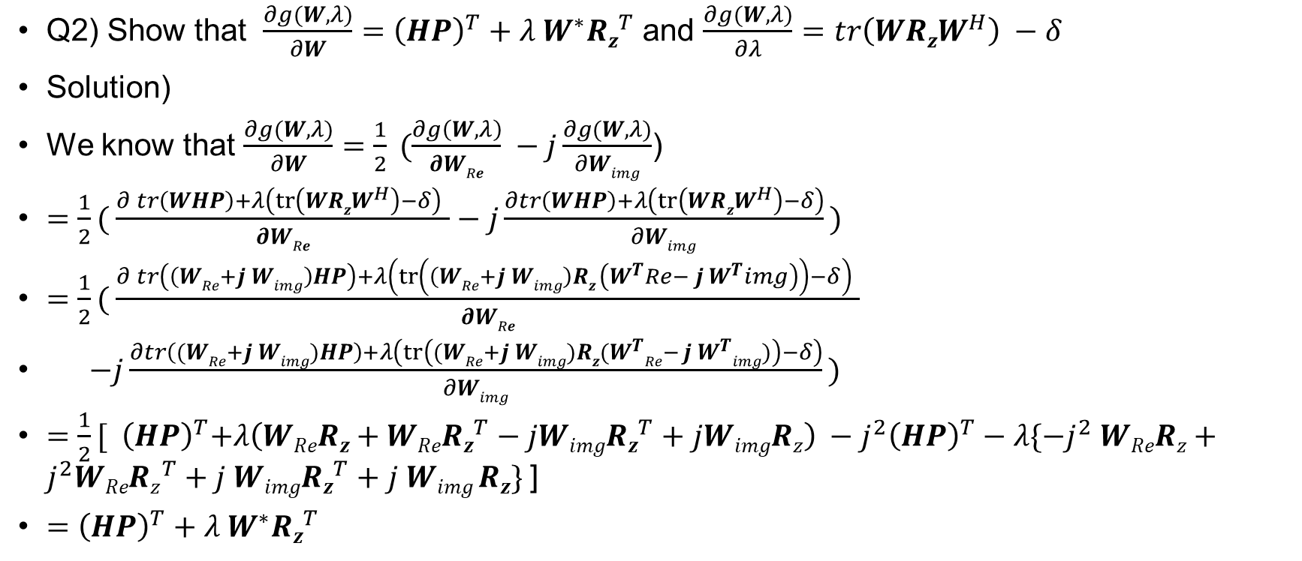
MIMO without CSIT – RxMF
Q2) Show that $\frac{∂g(W,λ)}{∂W}={\left(HP\right)}^{T}+λ{ W}^{∗}Rz^{T}$ and $\frac{∂g(W,λ)}{∂λ}=tr\left(WRzW^{H}\right) −δ$
Solution)
We know that $\frac{∂g(W,λ)}{∂W}=\frac{1}{2} (\frac{∂g\left(W,λ\right)}{∂WRe} −j\frac{∂g(W,λ)}{∂Wimg}$)
$=\frac{1}{2}( \frac{∂ tr\left(WHP\right)+λ\left(tr\left(WRzW^{H}\right)−δ\right) }{∂WRe}−j\frac{∂tr\left(WHP\right)+λ\left(tr\left(WRzW^{H}\right)−δ\right)}{∂Wimg} )$
$=\frac{1}{2}( \frac{∂ tr\left(\left(WRe+j Wimg\right)HP\right)+λ\left(tr\left(\left(WRe+j Wimg\right)Rz \left(W^{T}Re− j W^{T}img\right)\right)−δ\right) }{∂WRe}$
$−j\frac{∂tr\left((WRe+j Wimg)HP\right)+λ\left(tr\left((WRe+j Wimg)Rz(W^{T}Re− j W^{T}img)\right)−δ\right)}{∂Wimg} )$
$=\frac{1}{2}[{ \left(HP\right)}^{T}+λ\left(WReRz+WReRz^{T}−jWimgRz^{T}+jWimgRz\right) −j^{2}{\left(HP\right)}^{T}−λ\{−j^{2} WReRz+j^{2}WReRz^{T}+j Wimg{Rz}^{T}+j Wimg Rz\}$]
$={\left(HP\right)}^{T}+λ{ W}^{∗}Rz^{T}$

Slide 48
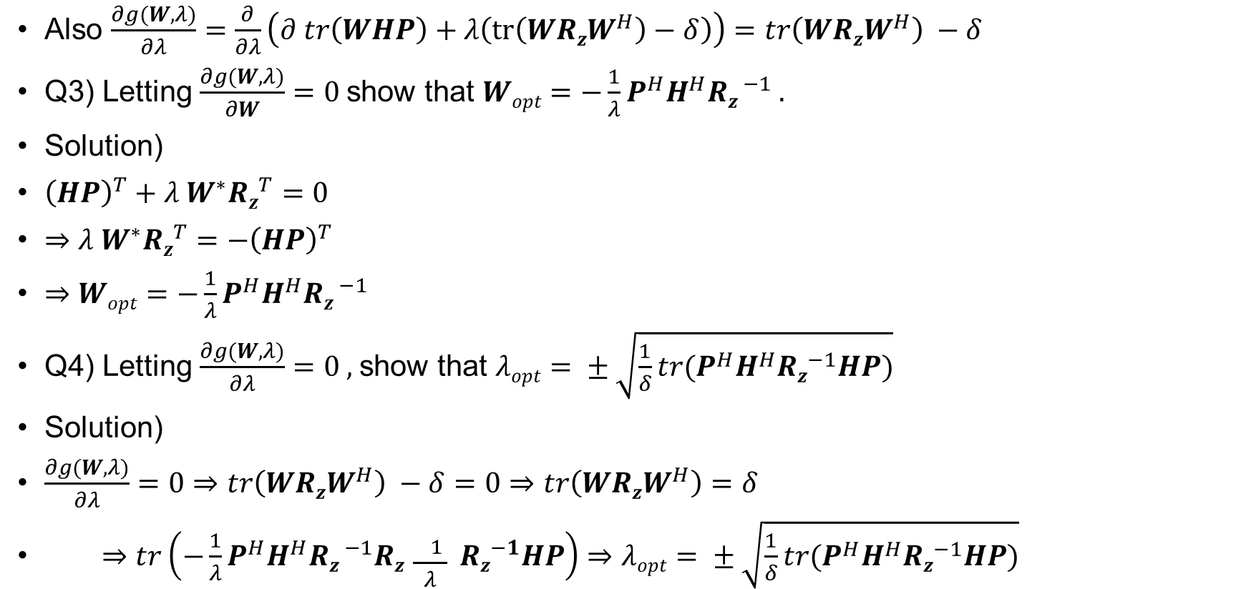
MIMO without CSIT – RxMF
Also $\frac{∂g(W,λ)}{∂λ}=\frac{∂}{∂λ}\left(∂ tr\left(WHP\right)+λ\left(tr\left(WRzW^{H}\right)−δ\right)\right)=tr\left(WRzW^{H}\right) −δ$
Q3) Letting $\frac{∂g(W,λ)}{∂W}=0$show that $Wopt=−\frac{1}{λ}P^{H}H^{H}Rz^{ −1} .$
Solution)
${\left(HP\right)}^{T}+λ{ W}^{∗}Rz^{T}=0$
$⇒λ{ W}^{∗}Rz^{T}=−{\left(HP\right)}^{T}$
$⇒Wopt=−\frac{1}{λ}P^{H}H^{H}Rz^{ −1}$
Q4) Letting $\frac{∂g(W,λ)}{∂λ}=0 ,$show that $λopt= ± \sqrt{\frac{1}{δ}tr(P^{H}H^{H}Rz^{−1}HP)}$
Solution)
$\frac{∂g(W,λ)}{∂λ}=0⇒tr\left(WRzW^{H}\right) −δ=0⇒tr\left(WRzW^{H}\right)=δ$
$⇒tr\left(−\frac{1}{λ}P^{H}H^{H}Rz^{ −1}Rz \frac{− 1 }{λ} Rz^{−1}HP\right)⇒λopt= ± \sqrt{\frac{1}{δ}tr(P^{H}H^{H}Rz^{−1}HP)}$

Slide 49
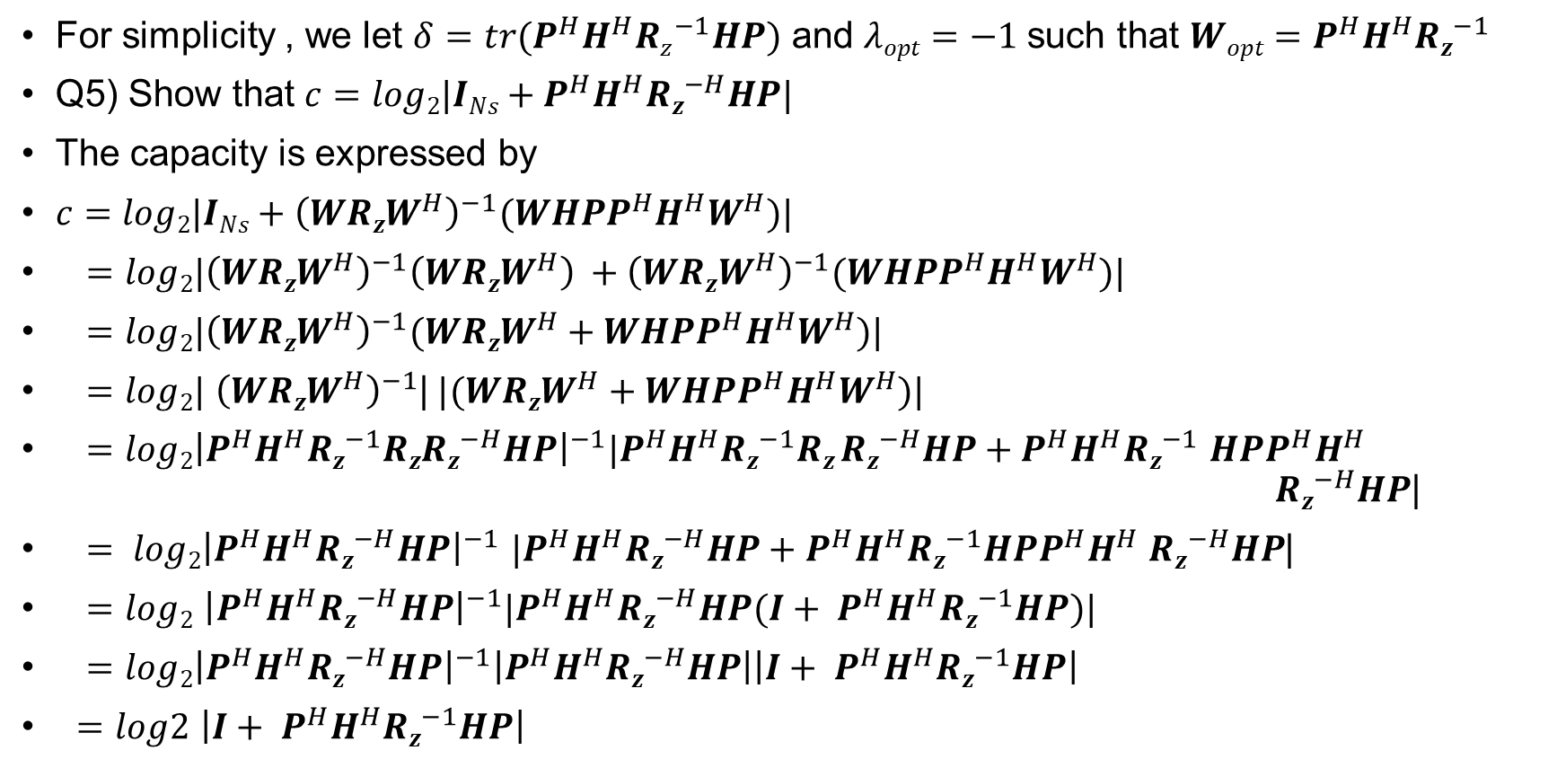
MIMO without CSIT – RxMF
For simplicity , we let $δ=tr(P^{H}H^{H}Rz^{−1}HP)$ and $λopt=−1$such that $Wopt=P^{H}H^{H}Rz^{−1}$
Q5) Show that $c=log2|INs+P^{H}H^{H}Rz^{−H}HP|$
The capacity is expressed by
$c=log2|INs+{\left(WRzW^{H}\right)}^{−1}(WHPP^{H}H^{H}W^{H})\text{|}$
$=log2|{\left(WRzW^{H}\right)}^{−1}{\left(WRzW^{H}\right)}^{ }+{\left(WRzW^{H}\right)}^{−1}(WHPP^{H}H^{H}W^{H})|$
$=log2|{\left(WRzW^{H}\right)}^{−1}(WRzW^{H}+WHPP^{H}H^{H}W^{H})|$
$=log2|$ ${\left(WRzW^{H}\right)}^{−1}$|$|(WRzW^{H}+WHPP^{H}H^{H}W^{H})|$
$=log2{\left|P^{H}H^{H}Rz^{−1}RzRz^{−H}HP\right|}^{−1}|P^{H}H^{H}Rz^{−1}Rz Rz^{−H}HP+P^{H}H^{H}Rz^{−1}$ $HPP^{H}H^{H}$ $Rz^{−H}HP$|
$= log2{\left|P^{H}H^{H}Rz^{−H}HP\right|}^{−1}$ $|P^{H}H^{H}Rz^{−H}HP+P^{H}H^{H}Rz^{−1}HPP^{H}H^{H}$ $Rz^{−H}HP$|
$=log2$ ${\left|P^{H}H^{H}Rz^{−H}HP\right|}^{−1}|P^{H}H^{H}Rz^{−H}HP(I+ P^{H}H^{H}Rz^{−1}HP)|$
$=log2{\left|P^{H}H^{H}Rz^{−H}HP\right|}^{−1}\left|P^{H}H^{H}Rz^{−H}HP\right|\left|I+ P^{H}H^{H}Rz^{−1}HP\right|$
$=log2$ $\left|I+ P^{H}H^{H}Rz^{−1}HP\right|$

Slide 50

MIMO without CSIT – RxMF
Q6)For AWGN , i.e $Rz=σ{z }^{2} INr.$
Show that $c=log2 |INs+\frac{1}{σ^{2 }z} P^{H}H^{H}HP|$
Solution)
$c=log2$ $\left|INS+ P^{H}H^{H}Rz^{−1}HP\right|$
$=log2|INS+P^{H}H^{H}\frac{1}{σ^{2 }z}HP|$

Slide 51
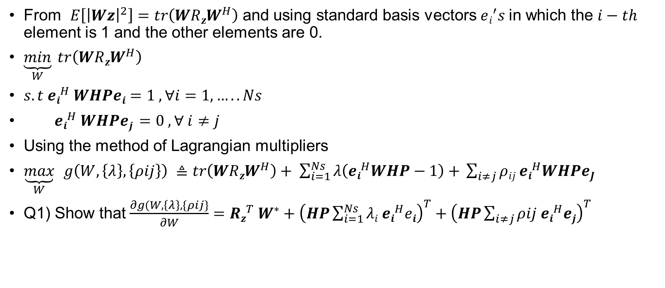
MIMO without CSIT – RxZF
From $E\left[{\left|Wz\right|}^{2}\right]=tr\left(WRzW^{H}\right)$ and using standard basis vectors $ei^{′}s$in which the $i−th$ element is 1 and the other elements are 0.
$\underset{W}{\underbrace{min}} tr\left(WRzW^{H}\right)$
$s.t ei^{H} WHPei=1 , ∀i=1,…..Ns$
$ei^{H} WHPej =0 , ∀ i≠j$
Using the method of Lagrangian multipliers
$\underset{W}{\underbrace{max}}$ $g\left(W,\left\{λ\right\},\left\{ρij\right\}\right) ≜tr\left(WRzW^{H}\right)+ \sum_{i=1}^{Ns}{λ\left(ei^{H}WHP−1\right)+ }\sum_{i≠j}{ρij ei^{H}WHPeJ}$
Q1) Show that $\frac{∂g(W,\left\{λ\right\},\{ρij\}}{∂W}=Rz^{T} W^{∗}+{\left(HP\sum_{i=1}^{Ns}{λi ei^{H}ei}\right)}^{T}+{\left(HP\sum_{i≠j}{ρij ei^{H}ej}\right)}^{T}$

Slide 52
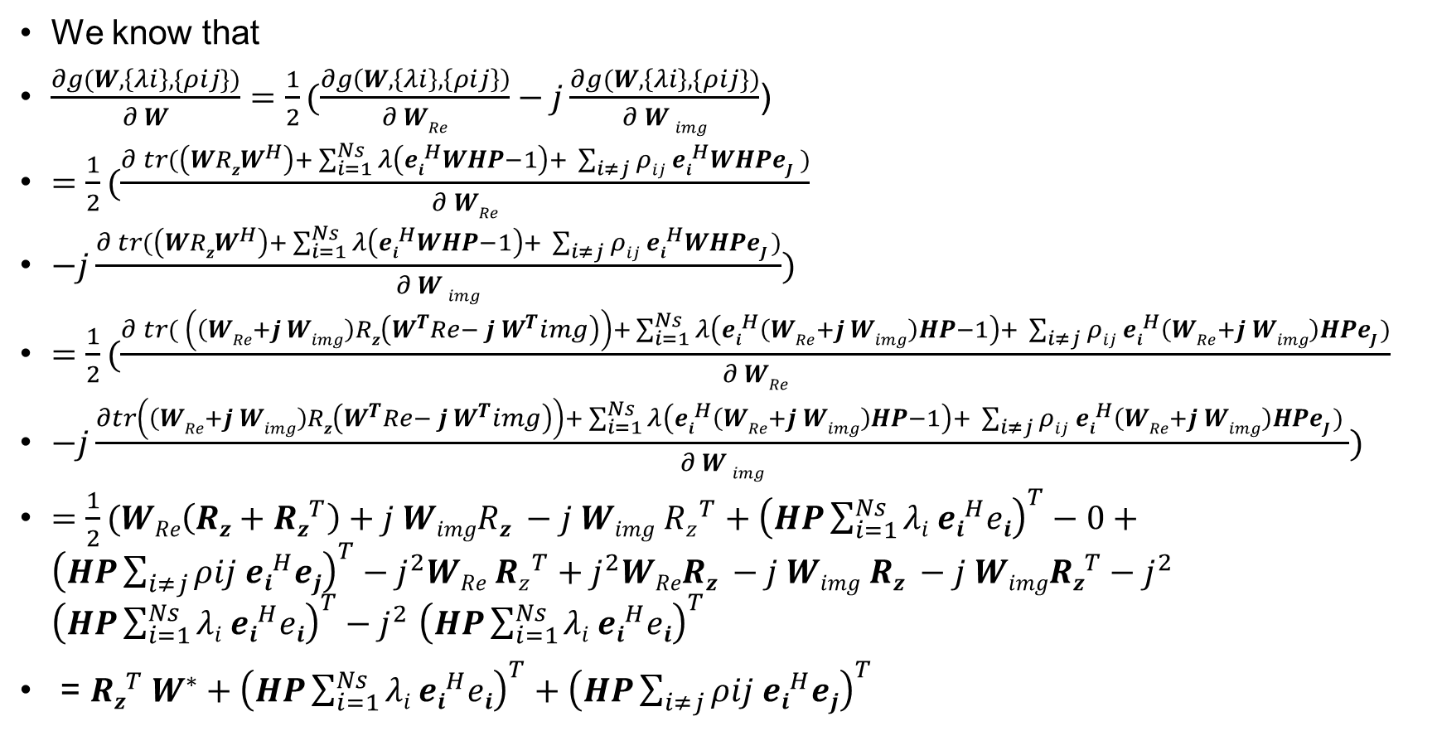
MIMO without CSIT – RxZF
We know that
$\frac{∂g(W,\left\{λi\right\},\{ρij\})}{∂ W}=\frac{1}{2}(\frac{∂g\left(W,\left\{λi\right\},\left\{ρij\right\}\right)}{∂ WRe}−j\frac{∂g(W,\left\{λi\right\},\{ρij\})}{∂ W img}$)
$=\frac{1}{2}(\frac{∂ tr(\left(WRzW^{H}\right)+ \sum_{i=1}^{Ns}{λ\left(ei^{H}WHP−1\right)+ }\sum_{i≠j}{ρij ei^{H}WHPeJ })}{∂ WRe}$
$−j\frac{∂ tr(\left(WRzW^{H}\right)+ \sum_{i=1}^{Ns}{λ\left(ei^{H}WHP−1\right)+ }\sum_{i≠j}{ρij ei^{H}WHPeJ )}}{∂ W img})$
$=\frac{1}{2}(\frac{∂ tr( \left(\left(WRe+j Wimg\right)Rz\left(W^{T}Re− j W^{T}img\right)\right)+ \sum_{i=1}^{Ns}{λ\left(ei^{H}\left(WRe+j Wimg\right)HP−1\right)+ }\sum_{i≠j}{ρij ei^{H}\left(WRe+j Wimg\right)HPeJ )}}{∂ WRe}$
$−j\frac{∂tr\left(\left(WRe+j Wimg\right)Rz\left(W^{T}Re− j W^{T}img\right)\right)+ \sum_{i=1}^{Ns}{λ\left(ei^{H}\left(WRe+j Wimg\right)HP−1\right)+ }\sum_{i≠j}{ρij ei^{H}\left(WRe+j Wimg\right)HPeJ ) }}{∂ W img})$
$=\frac{1}{2}(WRe\left(Rz+Rz^{T}\right)+j WimgRz −j Wimg Rz^{T}+{\left(HP\sum_{i=1}^{Ns}{λi ei^{H}ei}\right)}^{T}−0+{\left(HP\sum_{i≠j}{ρij ei^{H}ej}\right)}^{T}−j^{2}WRe Rz^{T}+j^{2}WReRz −j Wimg Rz −j WimgRz^{T}−j^{2}$ ${\left(HP\sum_{i=1}^{Ns}{λi ei^{H}ei}\right)}^{T}−j^{2}$ ${\left(HP\sum_{i=1}^{Ns}{λi ei^{H}ei}\right)}^{T}$
= $Rz^{T} W^{∗}+{\left(HP\sum_{i=1}^{Ns}{λi ei^{H}ei}\right)}^{T}+{\left(HP\sum_{i≠j}{ρij ei^{H}ej}\right)}^{T}$

Slide 53
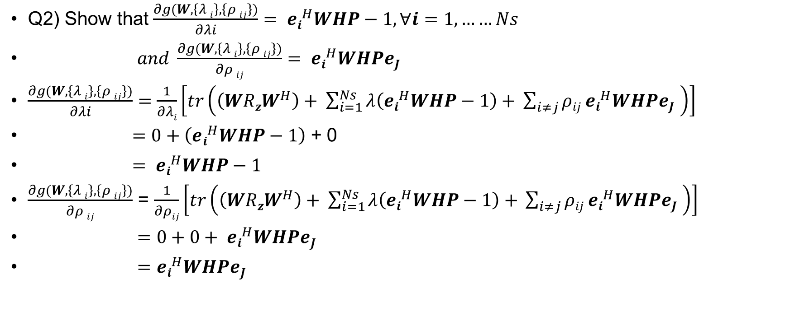
MIMO without CSIT – RxZF
Q2) Show that $\frac{∂g(W,\left\{λ i\right\},\left\{ρ ij\right\})}{∂λi}= ei^{H}WHP−1,∀i=1,……Ns$
$and \frac{∂g(W,\left\{λ i\right\},\left\{ρ ij\right\})}{∂ρ ij}= ei^{H}WHPeJ$
$\frac{∂g(W,\left\{λ i\right\},\left\{ρ ij\right\})}{∂λi}=\frac{1}{∂λi}\left[tr\left(\left(WRzW^{H}\right)+ \sum_{i=1}^{Ns}{λ\left(ei^{H}WHP−1\right)+ }\sum_{i≠j}{ρij ei^{H}WHPeJ }\right)\right]$
$=0+\left(ei^{H}WHP−1\right)$ + 0
$= ei^{H}WHP−1$
$\frac{∂g(W,\left\{λ i\right\},\left\{ρ ij\right\})}{∂ρ ij}$ = $\frac{1}{∂ρij}\left[tr\left(\left(WRzW^{H}\right)+ \sum_{i=1}^{Ns}{λ\left(ei^{H}WHP−1\right)+ }\sum_{i≠j}{ρij ei^{H}WHPeJ }\right)\right]$
$=0+0+ ei^{H}WHPeJ$
$=ei^{H}WHPeJ$

Slide 54
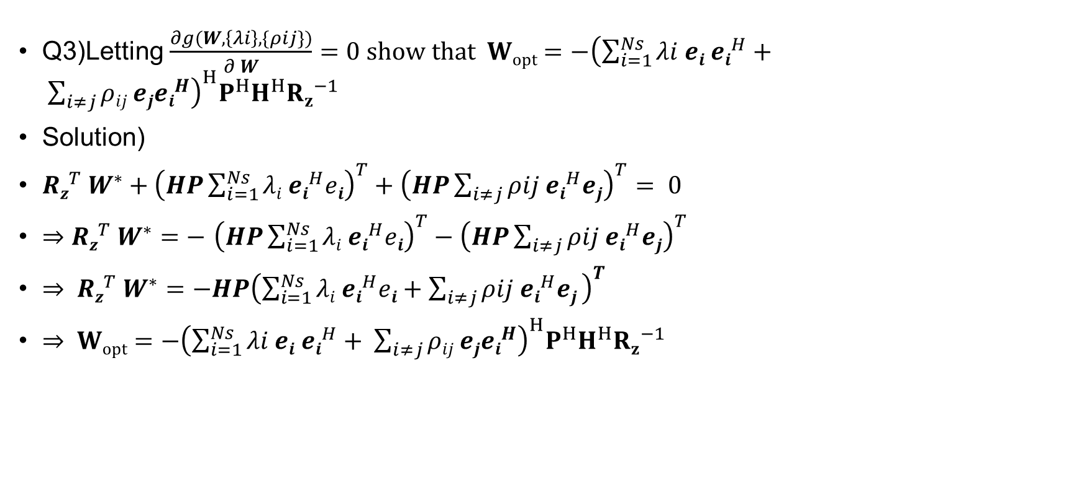
MIMO without CSIT – RxZF
Q3)Letting $\frac{∂g(W,\left\{λi\right\},\{ρij\})}{∂ W}=0 show that Wopt=−{\left(\sum_{i=1}^{Ns}{λi ei ei^{H}}+ \sum_{i≠j}{ρij ejei^{H}}\right)}^{H}P^{H}H^{H}{Rz}^{−1}$
Solution)
$Rz^{T} W^{∗}+{\left(HP\sum_{i=1}^{Ns}{λi ei^{H}ei}\right)}^{T}+{\left(HP\sum_{i≠j}{ρij ei^{H}ej}\right)}^{T}= 0$
$⇒$ $Rz^{T} W^{∗}=−$ ${\left(HP\sum_{i=1}^{Ns}{λi ei^{H}ei}\right)}^{T}−{\left(HP\sum_{i≠j}{ρij ei^{H}ej}\right)}^{T}$
$⇒ Rz^{T} W^{∗}=−HP{\left(\sum_{i=1}^{Ns}{λi ei^{H}ei}+\sum_{i≠j}{ρij ei^{H}ej} \right)}^{T}$
$⇒ Wopt=−{\left(\sum_{i=1}^{Ns}{λi ei ei^{H}}+ \sum_{i≠j}{ρij ejei^{H}}\right)}^{H}P^{H}H^{H}{Rz}^{−1}$

Slide 55
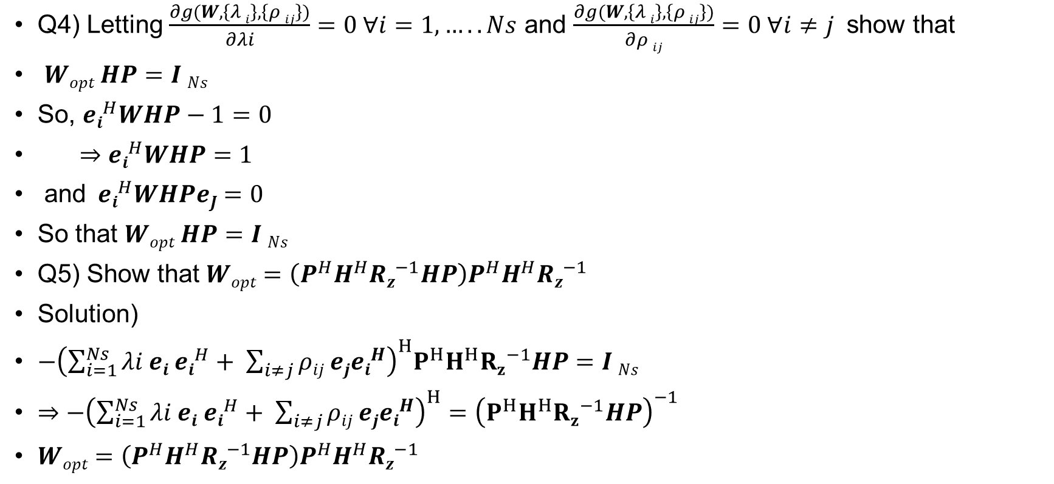
MIMO without CSIT – RxZF
Q4) Letting $\frac{∂g(W,\left\{λ i\right\},\left\{ρ ij\right\})}{∂λi}=0 ∀i=1,…..Ns$ and $\frac{∂g(W,\left\{λ i\right\},\left\{ρ ij\right\})}{∂ρ ij}=0 ∀i≠j$ show that
$Wopt HP=I Ns$
So, $ei^{H}WHP−1=0$
$⇒$ $ei^{H}WHP=1$
and$ei^{H}WHPeJ=0$
So that $Wopt HP=I Ns$
Q5) Show that $Wopt=\left(P^{H}H^{H}Rz^{−1}HP\right)P^{H}H^{H}Rz^{−1}$
Solution)
$−{\left(\sum_{i=1}^{Ns}{λi ei ei^{H}}+ \sum_{i≠j}{ρij ejei^{H}}\right)}^{H}P^{H}H^{H}{Rz}^{−1}HP=I Ns$
$⇒$ $−{\left(\sum_{i=1}^{Ns}{λi ei ei^{H}}+ \sum_{i≠j}{ρij ejei^{H}}\right)}^{H}={\left(P^{H}H^{H}{Rz}^{−1}HP\right)}^{−1}$
$Wopt=\left(P^{H}H^{H}Rz^{−1}HP\right)P^{H}H^{H}Rz^{−1}$

Slide 56

MIMO without CSIT – RxZF
Q6) Show that $c=log2 |INs+P^{H}H^{H}Rz^{−1}HP|$
Q7) For AWGN ,i.e $Rz=σ^{2}z INr$show that $c=log2 |INs+P^{H}H^{H}\frac{1}{σ^{2}z}HP|$

Slide 57
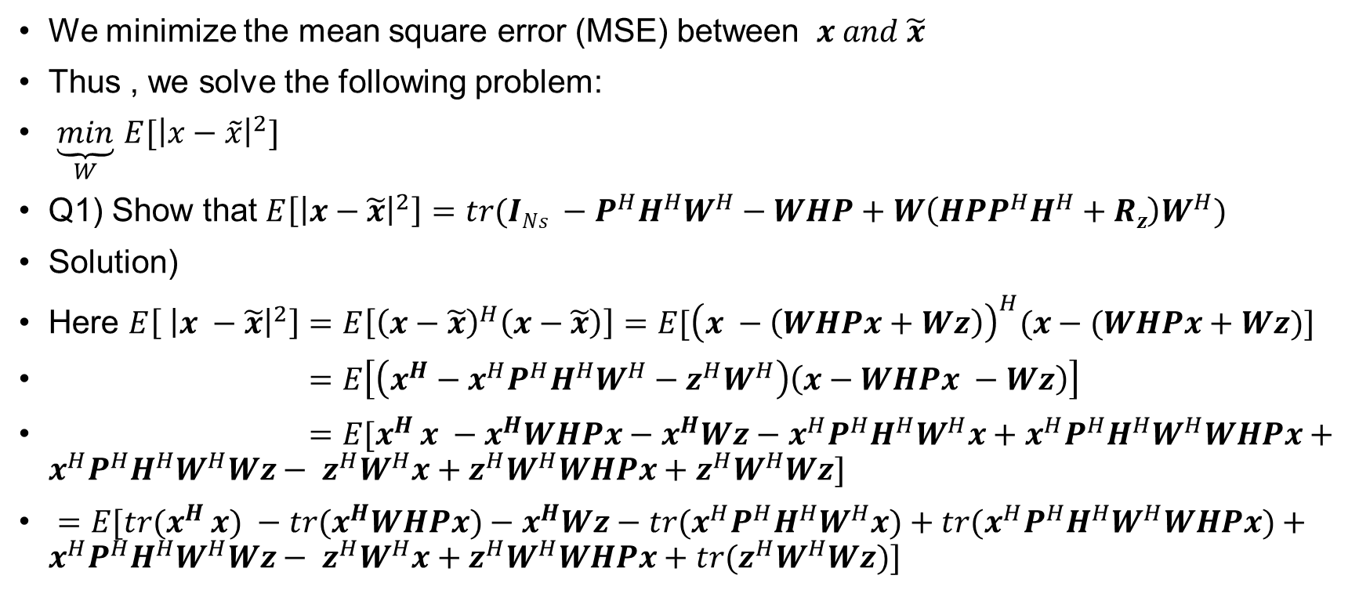
MIMO without CSIT – RxMMSE
We minimize the mean square error (MSE) between $x and \tilde{x}$
Thus , we solve the following problem:
$\underset{W}{\underbrace{min}}$ $E[{\left|x−\tilde{x}\right|}^{2}]$
Q1) Show that $E\left[{\left|x−\tilde{x}\right|}^{2}\right]=tr(INs −P^{H}H^{H}W^{H}−WHP+W\left(HPP^{H}H^{H}+Rz\right)W^{H})$
Solution)
Here $E\left[ {\left|x −\tilde{x}\right|}^{2}\right]=E\left[{\left(x−\tilde{x}\right)}^{H}\left(x−\tilde{x}\right)\right]=E[{\left(x −\left(WHPx+Wz\right)\right)}^{H}(x−(WHPx+Wz)]$
$=E\left[\left(x^{H}−x^{H}P^{H}H^{H}W^{H}−z^{H}W^{H}\right)\left(x−WHPx −Wz\right)\right]$
$=E[x^{H }x −x^{H}WHPx−x^{H}Wz−x^{H}P^{H}H^{H}W^{H}x+x^{H}P^{H}H^{H}W^{H}WHPx+x^{H}P^{H}H^{H}W^{H}Wz− z^{H}W^{H}x+z^{H}W^{H}WHPx+z^{H}W^{H}Wz]$
$=E[{tr(x}^{H }x) −tr(x^{H}WHPx)−x^{H}Wz−{tr(x}^{H}P^{H}H^{H}W^{H}x)+{tr(x}^{H}P^{H}H^{H}W^{H}WHPx)+x^{H}P^{H}H^{H}W^{H}Wz− z^{H}W^{H}x+z^{H}W^{H}WHPx+{tr(z}^{H}W^{H}Wz)]$

Slide 58
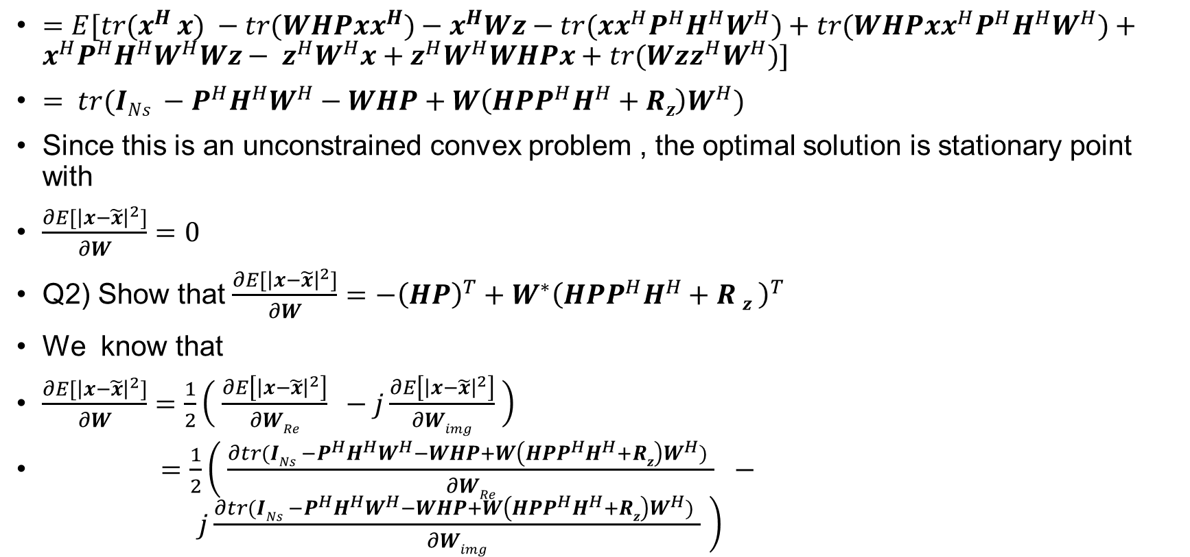
MIMO without CSIT – RxMMSE
$=E[{tr(x}^{H }x) −tr(WHPxx^{H})−x^{H}Wz−{tr(xx}^{H}P^{H}H^{H}W^{H})+{tr(WHPxx}^{H}P^{H}H^{H}W^{H})+x^{H}P^{H}H^{H}W^{H}Wz− z^{H}W^{H}x+z^{H}W^{H}WHPx+{tr(Wzz}^{H}W^{H})]$
$= tr(INs −P^{H}H^{H}W^{H}−WHP+W\left(HPP^{H}H^{H}+Rz\right)W^{H})$
Since this is an unconstrained convex problem , the optimal solution is stationary point with
$\frac{∂E[{\left|x−\tilde{x}\right|}^{2}]}{∂W}=0$
Q2) Show that $\frac{∂E[{\left|x−\tilde{x}\right|}^{2}]}{∂W}=$ $−{\left(HP\right)}^{T}+W^{∗}{\left(HPP^{H}H^{H}+R z \right)}^{T}$
We know that
$\frac{∂E[{\left|x−\tilde{x}\right|}^{2}]}{∂W}=\frac{1}{2}\left( \frac{∂E\left[{\left|x−\tilde{x}\right|}^{2}\right]}{∂WRe} −j\frac{∂E\left[{\left|x−\tilde{x}\right|}^{2}\right]}{∂Wimg} \right)$
$=\frac{1}{2}\left( \frac{∂tr(INs −P^{H}H^{H}W^{H}−WHP+W\left(HPP^{H}H^{H}+Rz\right)W^{H}) }{∂WRe} − j\frac{∂tr(INs −P^{H}H^{H}W^{H}−WHP+W\left(HPP^{H}H^{H}+Rz\right)W^{H}) }{∂Wimg} \right)$

Slide 59
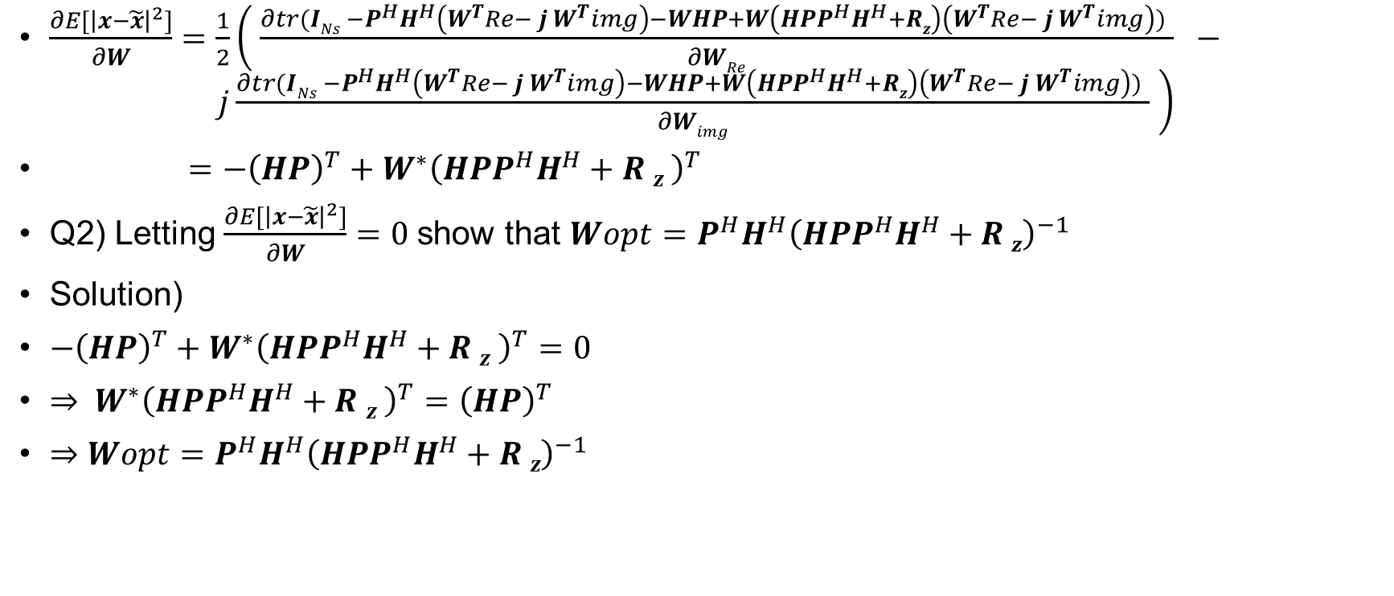
MIMO without CSIT – RxMMSE
$\frac{∂E[{\left|x−\tilde{x}\right|}^{2}]}{∂W}$ $=\frac{1}{2}\left( \frac{∂tr(INs −P^{H}H^{H}\left(W^{T}Re− j W^{T}img\right)−WHP+W\left(HPP^{H}H^{H}+Rz\right)\left(W^{T}Re− j W^{T}img\right)) }{∂WRe} − j\frac{∂tr(INs −P^{H}H^{H}\left(W^{T}Re− j W^{T}img\right)−WHP+W\left(HPP^{H}H^{H}+Rz\right)\left(W^{T}Re− j W^{T}img\right)) }{∂Wimg} \right)$
$=$ $−{\left(HP\right)}^{T}+W^{∗}{\left(HPP^{H}H^{H}+R z \right)}^{T}$
Q2) Letting $\frac{∂E[{\left|x−\tilde{x}\right|}^{2}]}{∂W}=0$show that $Wopt=P^{H}H^{H}{\left(HPP^{H}H^{H}+R z\right)}^{−1}$
Solution)
$−{\left(HP\right)}^{T}+W^{∗}{\left(HPP^{H}H^{H}+R z \right)}^{T}=0$
$⇒ W^{∗}{\left(HPP^{H}H^{H}+R z \right)}^{T}={\left(HP\right)}^{T}$
$⇒Wopt=P^{H}H^{H}{\left(HPP^{H}H^{H}+R z\right)}^{−1}$

Slide 60
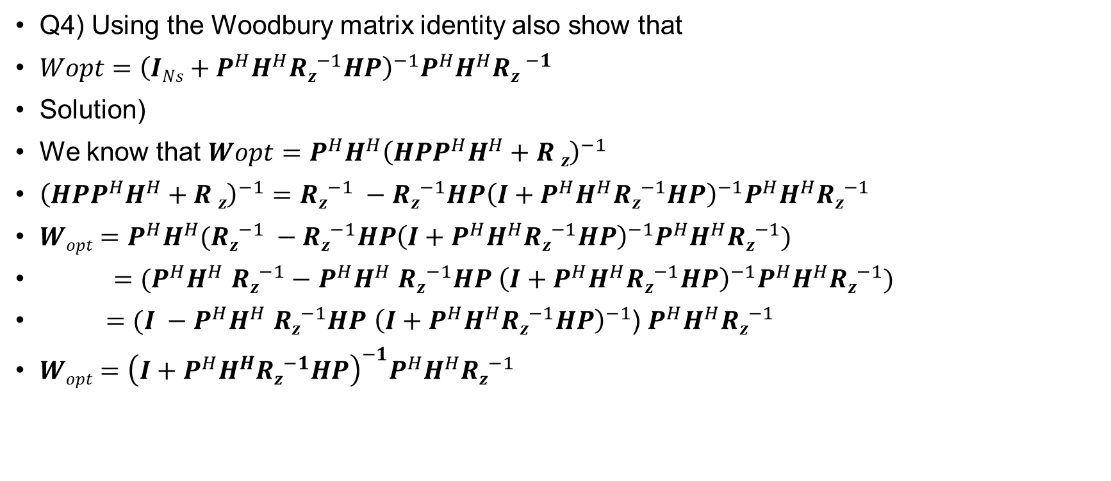
MIMO without CSIT – RxMMSE
Q4) Using the Woodbury matrix identity also show that
$Wopt={\left(INs+P^{H}H^{H}Rz^{−1}HP\right)}^{−1}P^{H}H^{H}R{z }^{−1}$
Solution)
We know that $Wopt=P^{H}H^{H}{\left(HPP^{H}H^{H}+R z\right)}^{−1}$
${\left(HPP^{H}H^{H}+R z\right)}^{−1}=Rz^{−1} −Rz^{−1}HP{\left(I+P^{H}H^{H}Rz^{−1}HP\right)}^{−1}P^{H}H^{H}Rz^{−1}$
$Wopt=P^{H}H^{H}(Rz^{−1} −Rz^{−1}HP{\left(I+P^{H}H^{H}Rz^{−1}HP\right)}^{−1}P^{H}H^{H}Rz^{−1})$
$=$ $(P^{H}H^{H}$ $Rz^{−1}−$ $P^{H}H^{H}$ $Rz^{−1}HP$ ${\left(I+P^{H}H^{H}Rz^{−1}HP\right)}^{−1}P^{H}H^{H}Rz^{−1})$
$=(I −P^{H}H^{H} Rz^{−1}HP {\left(I+P^{H}H^{H}Rz^{−1}HP\right)}^{−1}$) $P^{H}H^{H}Rz^{−1}$
$Wopt={\left(I+P^{H}H^{H}Rz^{−1}HP\right)}^{−1}P^{H}H^{H}Rz^{−1}$

Slide 61
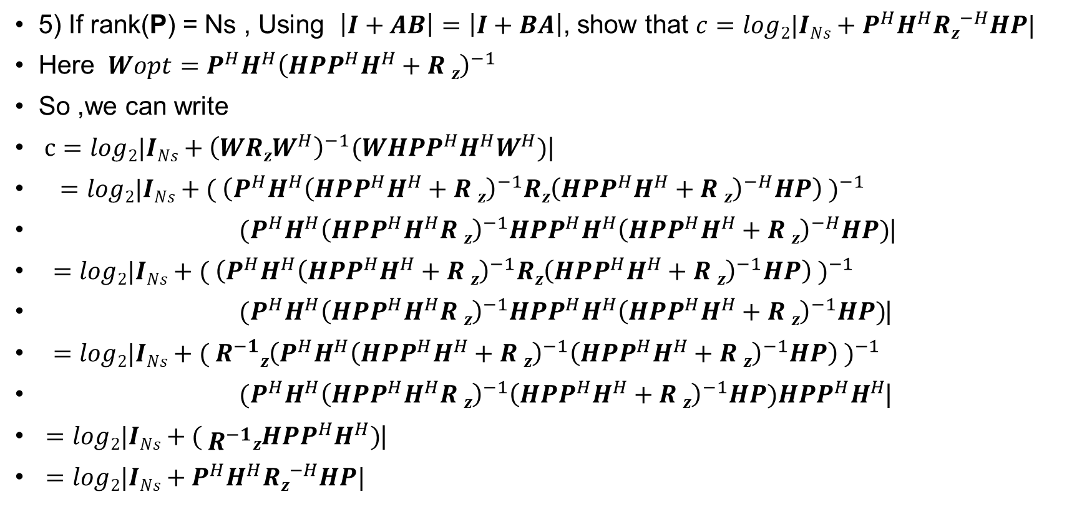
MIMO without CSIT – RxMMSE
5) If rank(P) = Ns , Using $\left|I+AB\right|=\left|I+BA\right|$, show that $c=log2|INs+P^{H}H^{H}Rz^{−H}HP|$
Here $Wopt=P^{H}H^{H}{\left(HPP^{H}H^{H}+R z\right)}^{−1}$
So ,we can write
$c=log2|INs+{\left(WRzW^{H}\right)}^{−1}(WHPP^{H}H^{H}W^{H})$|
$=$ $log2|INs+( {\left(P^{H}H^{H}{\left(HPP^{H}H^{H}+R z\right)}^{−1}Rz{\left(HPP^{H}H^{H}+R z\right)}^{−H}HP\right) )}^{−1}$
$(P^{H}H^{H}{\left(HPP^{H}H^{H}R z\right)}^{−1}HPP^{H}H^{H}{\left(HPP^{H}H^{H}+R z\right)}^{−H}HP)$|
$=$ $log2|INs+( {\left(P^{H}H^{H}{\left(HPP^{H}H^{H}+R z\right)}^{−1}Rz{\left(HPP^{H}H^{H}+R z\right)}^{−1}HP\right) )}^{−1}$
$(P^{H}H^{H}{\left(HPP^{H}H^{H}R z\right)}^{−1}HPP^{H}H^{H}{\left(HPP^{H}H^{H}+R z\right)}^{−1}HP)$|
$=$ $log2|INs+( {R^{−1}z\left(P^{H}H^{H}{\left(HPP^{H}H^{H}+R z\right)}^{−1}{\left(HPP^{H}H^{H}+R z\right)}^{−1}HP\right) )}^{−1}$
$(P^{H}H^{H}{\left(HPP^{H}H^{H}R z\right)}^{−1}{\left(HPP^{H}H^{H}+R z\right)}^{−1}HP)HPP^{H}H^{H}$|
$=$ $log2|INs+( R^{−1}zHPP^{H}H^{H})$|
$=log2|INs+P^{H}H^{H}Rz^{−H}HP|$

Slide 62

MIMO without CSIT – RxMMSE
6) if rank $\left(P\right)=Ns$for AWGN i.e $Rz=σ^{2}z INr$show that $c=log2 |INs+ \frac{1}{σ^{2}z}P^{H}H^{H}PH|$
We can write $c=log2|INs+P^{H}H^{H}Rz^{−H}HP|$
Just plugging the $Rz=σ^{2}z INr$ we can write $c=log2 |INs+ \frac{1}{σ^{2}z}P^{H}H^{H}PH|$

Slide 63

MIMO with CSIT – joint SVD
By SVD, $H=U Σ V^{H}=\left[U1 U0\right]\left[\begin{matrix}Σ1 & 0 \\ 0 & 0\end{matrix}\right]\begin{matrix}V^{H}1 \\ V^{H}0\end{matrix}=U1 Σ1 V^{H}1$ where$U1$ and$V^{H}1$ are singular vector matrices corresponding to non-zero singular values in $Σ1$
For joint SVD,
We set $P=V1Q^{1/2}$ for positive diagonal matrix $Q1∈M Ns ∗Ns$and $W=U1^{H}$
Q1) Specify the dimension of $U1, U0 , Σ1 , V1, V0$
Let's denote the dimension,
$H=Nr ∗Nt$
$U=Nr ∗Nr$
$Σ=Nr ∗Nt$
Let $Q^{\frac{1}{2}}$ be a positive diagonal matrix of size $Ns ∗Ns$(where $Ns$ is the number of selected singular values)

Slide 64

MIMO with CSIT – joint SVD
$U1$ is obtained by selecting the columns corresponding to the non-zero singular values from $U$ and it is size of $Nr ∗Ns .$
So $U1$ = $Nr ∗Ns$
$Σ1$ is a square diagonal matrix of size $Ns ∗Ns$ containing the non-zero singular values.
So $Σ1$ = $Ns ∗Ns$
$V1$ is obtained by selecting the columns corresponding to the non-zero singular values from$V$ and it is size of $Ns ∗Nt .$
$U0$ is obtained by selecting the columns corresponding to the zero singular values from $U$
and it is of size $Nr ∗(Nr −Ns)$
So, $U0$ $=Nr ∗(Nr −Ns)$
$V0$ is obtained the selecting the columns corresponding to the non-zero singular values from $V$ and it is of size $\left(Nt −Ns\right)∗Nt$
So $V0$ = $\left(Nt −Ns\right)∗Nt$

Slide 65

MIMO with CSIT – joint SVD
2) Show that $\tilde{x}=Σ1 x+{U1}^{H} z$
Solution)
We can write $\tilde{x}=W ∗y$
$=W ∗\left(HPx+z\right)$
$=WHPx+Wz$
$={U1}^{H} {U1}^{H}Σ1 {V1}^{H}V1Q^{1/2}x+{U1}^{H}z$
$=$ $Σ1$ $Q^{1/2}x+{U1}^{H}z$

Slide 66

MIMO with CSIT – joint SVD
3) Show that $E\left[{\left|S\right|}^{2}\right]=tr\left(Q1\right)=Es$
Solution)
$E\left[{\left|s\right|}^{2}\right]=E\left[{\left|Px\right|}^{2}\right]$
$=E\left[{\left(Px\right)}^{H}Px\right]$
$=E\left[{\left(V1{Q1}^{\frac{1}{2}}x\right)}^{H}\left({V1Q1}^{\frac{1}{2}}x\right)\right]$
$=E[tr({\left(V1{Q1}^{\frac{1}{2}}x\right)}^{H}\left(V1{Q1}^{\frac{1}{2}}x\right))]$
$=E\left[tr\left(x^{H}{Q1}^{\frac{1}{2}}{V1}^{H}V1{Q1}^{\frac{1}{2}}x\right)\right]$
$=E\left[tr\left(x^{H}{Q1}^{\frac{1}{2}}{Q1}^{\frac{1}{2}}x\right)\right]$
$=E\left[tr\left({Q1}^{\frac{1}{2}}xx^{H}{Q1}^{\frac{1}{2}}\right)\right]$
$=tr\left({Q1}^{\frac{1}{2}}E\left[{xx}^{H}\right]{Q1}^{\frac{1}{2}}\right)=tr(Q1)$

Slide 67

MIMO with CSIT – joint SVD
4)For AWGN, i.e , $Rz={σz}^{2}INr$, Show that $c= \sum_{i=1}^{Ns}{log2(1+ \frac{1}{{σz}^{2}}{σH,i}^{2}qi)}$ i.e achieving the MIMO capacity when $qi^{′}s$are optimized.
Solution)
Capacity is expressed by
$c=log2|INs+{\left(WRzW^{H}\right)}^{−1}WHPP^{H}H^{H}W^{H}|$
But here $Rz={σz}^{2}INr$ , $P=V1{Q1}^{1/2}$ and $W= {U1}^{H}$
So, plugging those values in capacity equation we can write,
$c=log2|INs+{\left({U1}^{H}{σz}^{2}INrU1\right)}^{−1}{U1}^{H}HPP^{H}H^{H}U1|$
$=log2|INs+{\frac{1}{{σz}^{2}}\left({U1}^{H}U1\right)}^{−1}{U1}^{H}HPP^{H}H^{H}U1|$
$=log2|INs+\frac{1}{{σz}^{2}}{U1}^{H}HPP^{H}H^{H}U1|$

Slide 68

MIMO with CSIT – joint SVD
$c=log2|INs+\frac{1}{{σz}^{2}}{U1}^{H}U1Σ1{V1}^{H}V1{Q1}^{\frac{1}{2}}{Q1}^{\frac{1}{2}}{V1}^{H}V1Σ^{H}{U1}^{H}U1|$
$=$ $log2|INs+$ $\frac{1}{{σz}^{2}}$ $Σ1$Q₁ $Σ^{H}|$
$=log2|INs+$ $\frac{1}{{σz}^{2}}$ $\left[\begin{matrix}σ H,1 & ⋯ & 0 \\ ⋮ & ⋱ & ⋮ \\ 0 & ⋯ & σ H,Ns\end{matrix}\right]\left[\begin{matrix}q1 & ⋯ & 0 \\ ⋮ & ⋱ & ⋮ \\ 0 & ⋯ & qNs\end{matrix}\right]\left[\begin{matrix}{σ H,1}^{H} & ⋯ & 0 \\ ⋮ & ⋱ & ⋮ \\ 0 & ⋯ & {σH,Ns}^{H}\end{matrix}\right]|$
$=log2|\left[\begin{matrix}1 & ⋯ & 0 \\ ⋮ & ⋱ & ⋮ \\ 0 & ⋯ & 1\end{matrix}\right]+$ $\frac{1}{{σz}^{2}}$ $\left[\begin{matrix}σ H,1 & ⋯ & 0 \\ ⋮ & ⋱ & ⋮ \\ 0 & ⋯ & σ H,Ns\end{matrix}\right]\left[\begin{matrix}q1 & ⋯ & 0 \\ ⋮ & ⋱ & ⋮ \\ 0 & ⋯ & qNs\end{matrix}\right]\left[\begin{matrix}{σ H,1}^{H} & ⋯ & 0 \\ ⋮ & ⋱ & ⋮ \\ 0 & ⋯ & {σH,Ns}^{H}\end{matrix}\right]|$
$=log2\prod_{i=1}^{Ns}{(1+ \frac{1}{{σz}^{2}}{σH,i}^{2}qi)}$
$=$ $\sum_{i=1}^{Ns}{log2(1+ \frac{1}{{σz}^{2}}{σH,i}^{2}qi)}$

Slide 69

MIMO with CSIT – joint SVD
5)Letting $P=V1{Q1}^{\frac{1}{2}}$ for RxMF , RxZF, RxMMSE show that $c$ becomes equivalent to the case with CSIT, i.e achieving the MIMO capacity when $qi^{′}s$ are optimized.
Solution)
For AWGN, Capacity for RxMF , RxZF, RxMMSE is
$c=log2|\frac{1}{{σz}^{2}}P^{H}H^{H}HP|$
$=log2|\frac{1}{{σz}^{2}} {\left(V1{Q1}^{\frac{1}{2}}\right)}^{H}V1Σ^{H}{U1}^{H} U1 ΣV1^{H}V1{Q1}^{\frac{1}{2}}|$
$=log2|\frac{1}{{σz}^{2}}{Q1}^{\frac{1}{2}}V1^{H}$ $V1Σ^{H}{U1}^{H} U1 ΣV1^{H}V1{Q1}^{\frac{1}{2}}|$
$=log2|\frac{1}{{σz}^{2}}{Q1}^{\frac{1}{2}}Σ^{H}Σ{Q1}^{\frac{1}{2}}|$
$=log2|\frac{1}{{σz}^{2}}Σ^{2}Q1|$ which is equivalent to the case with csit i.e $c=\sum_{i=1}^{Ns}{log2(1+ \frac{1}{{σz}^{2}}{σH,i}^{2}qi)}$
when$qi^{′}s$ are optimized.

Slide 70

MIMO with CSIT – joint SVD
In the absence of the CSIT, one possible design for the precoder is $P= \sqrt{\frac{Es}{Ns}} \begin{matrix}1 & 0 & 0 \\ 0 & INs & 0 \\ 0 & 0 & 0\end{matrix}$
Such that average transmit energy $Es$is equally distributed to the symbols and by assigning $xi^{′}s$to Tx_{i}’s in order. $\left(Nt−Ns\right)$antenna are unused.
Q1) Show that $E\left[{\left|s\right|}^{2}\right]=Es$
Solution)
$E\left[{\left|s\right|}^{2}\right]=E\left[{\left|Px\right|}^{2}\right]=E\left[{\left(Px\right)}^{H}\left(Px\right)\right]=E\left[x^{H}P^{H}Px\right]=E\left[tr\left(x^{H}P^{H}Px\right)\right]=E[tr(Pxx^{H}P^{H})]$
$=tr\left(P E\left[{xx}^{H}\right]{ P}^{H}\right)=tr\left({PP}^{H}\right)=tr\left(\sqrt{\frac{Es}{Ns}} \begin{matrix}1 & 0 & 0 \\ 0 & INs & 0 \\ 0 & 0 & 0\end{matrix} \sqrt{\frac{Es}{Ns}} \begin{matrix}1 & 0 & 0 \\ 0 & INs & 0 \\ 0 & 0 & 0\end{matrix}\right)=tr(\frac{Es}{Ns}∗INs)$
$=\frac{Es}{Ns} tr\left(INs\right)=\frac{Es}{Ns} ∗Ns=Es$

Slide 71


SIMO
Let $x\sim CN\left(0,1\right) and Zi, ∀i=1,…….Nr$ follow zero-mean complex Gaussian distributions.
Define $Rz ≜ E\left[{zz}^{H}\right], Es ≜E[{\left|s\right|}^{2}]$
Q1) Specify the dimension of H, W
Solution)
$H=Nr∗1$
$W=1 ∗Nr$

Slide 72

SIMO
Q2) Write an expression of the post-processed signal $\tilde{x}$in terms of $W, H, P, x, z$
Solution)
$\tilde{x}=W ∗y=W∗\left(HPx+z\right)=WHPx+Wz$
Q3) Show that capacity is expressed by
$c=log2(1+ \frac{EsWHH^{H}W^{H}}{WRzW^{H}})$
Solution)
We know that $c=log2\left|πeR\tilde{x}\right| −log2|πe R\tilde{z}|$
$R\tilde{x}=E\left[\tilde{x} {\tilde{x}}^{H}\right]$
$=E\left[\left(WHPx+Wz\right){\left(WHPx+Wz\right)}^{H}\right]$
$=E[(WHPx+Wz)(x^{H}P^{H}H^{H}W^{H}+z^{H}z)]$
$=E[WHPxx^{H}P^{H}H^{H}W^{H}+Wzz^{H}W^{H}]$
$=[WHPP^{H}H^{H}W^{H}+WRzW^{H}]$

Slide 73

SIMO
$R\tilde{z}=E[\tilde{z}{\tilde{z}}^{H}]$
$=E[\left(Wz\right){\left(Wz\right)}^{H}]$
$=E[Wzz^{H}W^{H}]$
$=WRzW^{H}$
So now we can write
$c=log2\left|πeR\tilde{x}\right| −log2|πe R\tilde{z}|$
$=log2\frac{\left|πeR\tilde{x}\right|}{|πe R\tilde{z}| }$
$=log2\frac{\left|πe\right||R\tilde{x}|}{\left|πe\right||R\tilde{z}|}$
$=log2\frac{|R\tilde{x}|}{|R\tilde{z}|}$

Slide 74

SIMO
$c=log2\frac{|R\tilde{x}|}{|R\tilde{z}|}$
$=log2\frac{|WHPP^{H}H^{H}W^{H}+WRzW^{H}|}{|WRzW^{H}|}$
$=log2| ({WRzW^{H})}^{−1} (WHPP^{H}H^{H}W^{H}+WRzW^{H})|$
$=log2 | {\left(WRzW^{H}\right)}^{−1}WHPP^{H}H^{H}W^{H}+{\left(WRzW^{H}\right)}^{−1}WRzW^{H}|$
$=log2|1+{\left(WRzW^{H}\right)}^{−1}WHPP^{H}H^{H}W^{H}|$
$=log2|1+ \frac{WH{\left|P\right|}^{2}H^{H}W^{H}}{WRzW^{H}}|$ $(WRzW^{H}$)$=(1 ∗Nr ∗Nr ∗Nr ∗Nr ∗1)$
$=log2|1+ \frac{WHEsH^{H}W^{H}}{WRzW^{H}}|$ $PP^{H}=P^{H}P={\left|P\right|}^{2} P is here dimensional$

Slide 75

SIMO
Q5) For AWGN, i.e, $Rz={σz}^{2}INr, show that c=log2(1+ \frac{Es}{σ^{2}z} \frac{{\left|H^{H}W^{H}\right|}^{2}}{{\left|W^{H}\right|}^{2}})$
Solution)
$c=log2(1+ \frac{EsWHH^{H}W^{H}}{WRzW^{H}})$
$=log2( 1+ \frac{Es}{{σz}^{2}} \frac{WHH^{H}W^{H}}{WW^{H}} )$
$=log2(1+\frac{Es}{{σz}^{2}} \frac{{\left|H^{H}W^{H}\right|}^{2}}{{\left|W^{H}\right|}^{2}})$

Slide 76

SIMO
Q6)Using the Cauchy-Schwartz inequality ,Find the optimal $W$ that maximizes $c$ and showthat the maximum capacity is $c=log2( 1 + \frac{Es}{{σz}^{2}}{\left|H\right|}^{2})$
Solution)
From Cauchy-Schwartz inequality we can write
${\left|H^{H}W^{H}\right|}^{2}≤{\left|H^{H}\right|}^{2}{\left|W^{H}\right|}^{2}$
$log2\left(1+\frac{Es}{{σz}^{2}} \frac{{\left|H^{H}W^{H}\right|}^{2}}{{\left|W^{H}\right|}^{2}}\right)≤log2\left(1+\frac{Es}{{σz}^{2}} \frac{{\left|H^{H}\right|}^{2}{\left|W^{H}\right|}^{2}}{{\left|W^{H}\right|}^{2}}\right)$
$≤log2(1+ \frac{Es}{{σz}^{2}} {\left|H^{H}\right|}^{2})$
Let $W=KH⇒W^{2}=K^{2} H^{2}⇒K= \frac{|W|}{|H|}$
Then $c=log2\left(1+\frac{Es}{{σz}^{2}} \frac{{\left|H^{H}\right|}^{2}{\left|{KH}^{H}\right|}^{2}}{{\left|{KH}^{H}\right|}^{2}}\right)⇒log2(1+ \frac{Es}{{σz}^{2}} {\left|H^{H}\right|}^{2})$

Slide 77

SIMO
For $W= \frac{1}{{\left|H^{H}\right|}^{2}P}H^{H}$the estimated symbol is $\tilde{x}=x+ \frac{1}{{\left|H^{H}\right|}^{2}\sqrt{Es}} H^{H}z$
$R\tilde{x}=E[\tilde{x}{\tilde{x}}^{H}]$
$=E[\left(x+ \frac{1}{{\left|H^{H}\right|}^{2}\sqrt{Es}} H^{H}z\right){\left(x+ \frac{1}{{\left|H^{H}\right|}^{2}\sqrt{Es}} H^{H}z\right)}^{H}]$
$=E[\left(x+ \frac{1}{{\left|H^{H}\right|}^{2}\sqrt{Es}} H^{H}z\right) \left(x^{H}+ z^{H}H\frac{1}{{\left|H\right|}^{2}\sqrt{Es}} \right)]$
$=E[xx^{H}+\frac{1}{{\left|H^{H}\right|}^{2}\sqrt{Es}}H^{H}zz^{H}H\frac{1}{{\left|H\right|}^{2}\sqrt{Es}}]$
$=(1+ \frac{1}{{\left|H^{H}\right|}^{2}Es}H^{H}{σz}^{2} H\frac{1}{{\left|H\right|}^{2}})$
$=(1+\frac{{σz}^{2}}{{\left|H^{H}\right|}^{2}Es})$

Slide 78

SIMO
$R\tilde{z}=E\left[zz^{H}\right]$
$=E[ \left(\frac{1}{{\left|H^{H}\right|}^{2}\sqrt{Es}} H^{H}z\right){\left(\frac{1}{{\left|H^{H}\right|}^{2}\sqrt{Es}} H^{H}z\right)}^{H}]$
$=\frac{{σz}^{2}}{{\left|H^{H}\right|}^{2}Es}$
$c=log2\left|πeR\tilde{x}\right| −log2|πe R\tilde{z}|$
$=log2\frac{\left|πeR\tilde{x}\right|}{|πe R\tilde{z}| }$
$=log2\frac{\left|πe\right||R\tilde{x}|}{\left|πe\right||R\tilde{z}|}$
$=log2\frac{|R\tilde{x}|}{|R\tilde{z}|}$
$=log2 \frac{|(1+\frac{{σz}^{2}}{{\left|H^{H}\right|}^{2}Es})| }{|\frac{{σz}^{2}}{{\left|H^{H}\right|}^{2}Es}|}$ $=log2| 1+{\left(\frac{{σz}^{2}}{{\left|H^{H}\right|}^{2}Es}\right)}^{−1}|$

Slide 79


MISO
Let $x\sim CN\left(0,1\right) and z\sim \left(0,{σz}^{2}\right)$
Q1) Specify the dimension of P , H
Solution)
$P=Nt ∗1$
$H=1 ∗Nt$

Slide 80

MISO
Q2) Write an expression of the post-processed signal $\tilde{x}$ in terms of $w,H,P,x,z$
$\tilde{x}=w ∗y=w ∗\left(HPx+z\right)=wHPx+wz$
Q3) Show that average transmit energy $Es={\left|P\right|}^{2}$
Solution)
$Es=E\left[{\left|s\right|}^{2}\right]$
$=E\left[{\left|Px\right|}^{2}\right]$
$=E[{\left(Px\right)}^{H}(Px)]$
$=E[x^{H}P^{H}Px]$
$=E[x^{H}{\left|P\right|}^{2}x]$
$= {\left|P\right|}^{2} E[x^{H}x]$
$= {\left|P\right|}^{2}$

Slide 81

MISO
Q4) Show that the capacity is expressed by
$c=log2(1+ \frac{{\left|HP\right|}^{2}}{{σz}^{2}})$
Solution)
$R\tilde{x}=E[\tilde{x}{\tilde{x}}^{H}]$
$=E[\left(wHPx+wz\right){\left(wHPx+wz\right)}^{H}]$
$=E[\left(wHPx+wz\right)(x^{H}P^{H}H^{H}w^{H}+z^{H}w^{H}]$
$=E\left[wHPxx^{H}P^{H}H^{H}w^{H}+wzz^{H}w^{H}\right]$
$=wHPP^{H}H^{H}w^{H}+{σz}^{2} ww^{H}$
$R\tilde{z} =E[\tilde{z}{\tilde{z}}^{H}]$
$=E\left[\left(wz\right){\left(wz\right)}^{H}\right]$
$=E\left[wzz^{H}w\right]= {σz}^{2} ww^{H}$

Slide 82

MISO
$c=log2\left|πeR\tilde{x}\right| −log2|πe R\tilde{z}|$
$=log2\frac{\left|πeR\tilde{x}\right|}{|πe R\tilde{z}| }$
$=log2\frac{\left|πe\right||R\tilde{x}|}{\left|πe\right||R\tilde{z}|}$
$=log2\frac{|R\tilde{x}|}{|R\tilde{z}|}$
$=log2 \frac{|wHPP^{H}H^{H}w^{H}+{σz}^{2} ww^{H}|}{|{σz}^{2} ww^{H}|}$
$=log2| \frac{HPP^{H}H^{H}}{{σz}^{2}}+1|$
$=log2|1+ \frac{{\left|HP\right|}^{2}}{{σz}^{2}}|$

Slide 83

MISO
First Approach : We design $s$ such that the average transmit energy $Es$ is equally distributed to the antennas , i.e
$P= \sqrt{\frac{Es}{Nt}} 1Nt$ (Equal power allocation)
Q5) Show that the capacity is $c=log2(1+ \frac{Es}{Nt {σz}^{2}}{\left|H1Nt\right|}^{2})$
Solution)
$c=log2(1+ \frac{{\left|HP\right|}^{2}}{{σz}^{2}})$
$=log2(1+ \frac{{\left|H\sqrt{\frac{Es}{Nt}} 1Nt\right|}^{2}}{{σz}^{2}})$
$=log2(1+ \frac{Es}{Nt {σz}^{2}}{\left|H1Nt\right|}^{2})$

Slide 84

MISO
Second approach: We design $P= \sqrt{Es} e1$ such that the average transmit energy $Es$is concentrated by assigning $x to TX1 \left(Nt −1\right)$ are unused.
Q6) Show that the capacity is $c= log2(1+ \frac{Es}{Nt {σz}^{2}}{\left|H\left(1,1\right) \right|}^{2})$
Solution)
$c=log2(1+ \frac{{\left|HP\right|}^{2}}{{σz}^{2}})$
$= log2(1+ \frac{{\left|H\sqrt{Es} e1\right|}^{2}}{{σz}^{2}})$
$= log2(1+ \frac{Es}{Nt {σz}^{2}}{\left|H\left(1,1\right) \right|}^{2})$

Slide 85


MISO
In this case , we can optimize the precoder P to achieve the maximum capacity P
Q1) Using the Cauchy-Schwartz inequality find the optimal P that maximizes $c$with $Es={\left|P\right|}^{2}$
Show that maximum capacity is $c=log2( 1+ \frac{{\left|H^{H}\right|}^{2}}{{σz}^{2}} )$

Slide 86

MISO
Solution)
$c=log2(1+ \frac{{\left|HP\right|}^{2}}{{σz}^{2}})$
Applying the Cauchy-Schwartz inequality
$log2\left(1+ \frac{{\left|HP\right|}^{2}}{{σz}^{2}}\right)≤log2(1+ \frac{{\left|H{\left.​\right|}^{2}|P\right|}^{2}}{{σz}^{2}})$
Let $P=α H^{H}$
$⇒{\left|P\right|}^{2}=α^{2}{\left|H^{H}\right|}^{2}$
$⇒α = \frac{|P|}{|H^{H}|}$
Substituting the $P value$
$c = log2(1+ \frac{{\left|H{\left.​\right|}^{2}|α H^{H}\right|}^{2}}{{σz}^{2}})$

Slide 87

MISO
$c = log2(1+ \frac{{\left|H{\left.​\right|}^{2}{\left|α\right|}^{2}| H^{H}\right|}^{2}}{{σz}^{2}})$
$=log2\left(1+ \frac{{\left|H\right|}^{2} \frac{{\left|P\right|}^{2}}{{\left|H^{H}\right|}^{2}}{\left|H^{H}\right|}^{2}}{{σz}^{2}}\right)$
$=log2(1+ \frac{Es {\left|H\right|}^{2}}{{σz}^{2}})$
Q2)Show that MRT achieves the maximum capacity $c=log2(1+ \frac{{\left|H^{H}\right|}^{2}Es }{{σz}^{2}})$
Solution)
$P= \frac{\sqrt{Es}}{|H^{H}|} H^{H}$

Slide 88

MISO
$\tilde{x}=w ∗y=w ∗\left(HPx+z\right)=wHPx+wz=wH\frac{\sqrt{Es}}{|H^{H}|} H^{H}x+wz$
$R\tilde{x}=E[\tilde{x}{\tilde{x}}^{H}]$
$=E[\left(wH\frac{\sqrt{Es}}{|H^{H}|} H^{H}x+wz\right){\left(wH\frac{\sqrt{Es}}{|H^{H}|} H^{H}x+wz\right)}^{H}]$
$=E[wH\frac{\sqrt{Es}}{\left|H^{H}\right|} H^{H}xx^{H}H\frac{\sqrt{Es}}{\left|H^{H}\right|}H^{H}w^{H} +wzz^{H}w^{H}]$
$= [\frac{Es}{{\left|H^{H}\right|}^{2}}wH H^{H}HH^{H}w^{H} +{σz}^{2}ww^{H}]$
$=$ $\frac{Es}{{\left|H^{H}\right|}^{2}}wH {\left|H\right|}^{2}H^{H}w^{H} +{σz}^{2}ww^{H}$
$= \frac{Es}{{\left|H^{H}\right|}^{2}}w$ ${\left|H\right|}^{2}HH^{H}$ $w^{H}$ $+{σz}^{2}ww^{H}$
$=$ $\frac{Es}{{\left|H^{H}\right|}^{2}}w$ ${\left|H\right|}^{2}{\left|H^{H}\right|}^{2}w^{H}+{σz}^{2}ww^{H}$

Slide 89

MISO
$R\tilde{z}=E[\tilde{z}{\tilde{z}}^{H}]$
$=E[\left(wz\right){\left(wz\right)}^{H}]$
$=E[wzz^{H}w^{H}]$
$= {σz}^{2}ww^{H}$
$c=log2\left|πeR\tilde{x}\right| −log2|πe R\tilde{z}|$
$=log2\frac{\left|πeR\tilde{x}\right|}{|πe R\tilde{z}| }$
$=log2\frac{\left|πe\right||R\tilde{x}|}{\left|πe\right||R\tilde{z}|}$
$=log2\frac{|R\tilde{x}|}{|R\tilde{z}|}$
$= log2\frac{|\frac{Es}{{\left|H^{H}\right|}^{2}}w {\left|H\right|}^{2}{\left|H^{H}\right|}^{2}w^{H}+{σz}^{2}ww^{H}|}{|{σz}^{2}ww^{H}|}=$ $log2\left|1+ \frac{\frac{Es}{{\left|H^{H}\right|}^{2}}{\left|H\right|}^{2}{\left|H^{H}\right|}^{2}}{{σz}^{2}}\right|=log2|1+ \frac{Es{\left|H\right|}^{2}}{{σz}^{2}}|$

Slide 90


SISO
Assume $x\sim CN\left(0,1\right) and z\sim CN\left(0,{σz}^{2}\right)$
Q1) Write an expression of the received signal $\tilde{x }$in terms of $w,h,p,x,z$
Solution)
$\tilde{x} =w ∗y=w ∗\left(hpx+z\right)=whpxz+wz$

Slide 91

SISO
Q2) Show that the average transmit energy is $Es={\left|p\right|}^{2}$
Solution)
$Es=E\left[{\left|px\right|}^{2}\right]$
$=E\left[{\left(px\right)}^{H}\left(px\right)\right]$
$=E\left[x^{H}p^{H}px\right]$
$={\left|p\right|}^{2}E\left[xx^{H}\right]$
$={\left|p\right|}^{2}$
Q3) Show that the capacity is expressed by $c=log2(1+ \frac{{\left|h\right|}^{2}Es}{{σz}^{2}})$
Solution)
$R\tilde{x} =E[\tilde{x}{\tilde{x}}^{H}]$
$=E[\left(whpxz+wz\right){\left(whpxz+wz\right)}^{H}]$

Slide 92

SISO
$R\tilde{x}$ $=E[\left(whpx+wz\right)(x^{H}p^{H}h^{H}w^{H}+z^{H}w^{H})]$
$=E[whpxx^{H}p^{H}h^{H}w^{H}+wzz^{H}w^{H}]$
$=$ $whpp^{H}h^{H}w^{H}+{σz}^{2}ww^{H}$
$R\tilde{z}=E[\tilde{z}{\tilde{z}}^{H}]$
$=E[\left(wz\right){\left(wz\right)}^{H}]$
$=E[wzz^{H}w^{H}]$
$= {σz}^{2}ww^{H}$
$c=log2\left|πeR\tilde{x}\right| −log2|πe R\tilde{z}|$
$=log2\frac{\left|πeR\tilde{x}\right|}{|πe R\tilde{z}| }$
$=log2\frac{\left|πe\right||R\tilde{x}|}{\left|πe\right||R\tilde{z}|}$
$=log2\frac{|R\tilde{x}|}{|R\tilde{z}|}$

Slide 93

SISO
$c=log2\frac{|whpp^{H}h^{H}w^{H}+{σz}^{2}ww^{H}|}{|{σz}^{2}ww^{H}|}$
$c=log2(1+ \frac{{\left|h\right|}^{2}Es}{{σz}^{2}})$

Slide 94


MIMO with DFB(V-BLAST)
Let $xi$, $∀i=1,…….Ns$ and $zi, ∀i=1,……Nr$ follow zero mean Gaussian distributions.
Define $Rx ≜E\left[xx^{H}\right]=INs, Rz ≜E\left[zz^{H}\right], Es ≜E\left[{\left|s\right|}^{2}\right], Ns ≜r=rank\left(H\right)=\min\left(Nt,Nr\right)$
We successively cancel the interference by already detected components of x from the received signal y.
The order in which the components of x are detected becomes important to the overall performance.

Slide 95

MIMO with DFB(V-BLAST)
Q1) Show that
$R(x−x ̃) ≜E\left[\left(x−\tilde{x}\right){\left(x−\tilde{x}\right)}^{H}\right]=INs −P^{H}H^{H}W^{H}−WHP+WHPP^{H}H^{H}W^{H}+WRzW^{H}$
Solution)
$R(x−x ̃) ≜E\left[\left(x−\tilde{x}\right){\left(x−\tilde{x}\right)}^{H}\right]$
$=E[\left(x−\left(WHPx+Wz\right)\right){\left(x−\left(WHPx+Wz\right)\right)}^{H}]$
$=E[\left(x−WHPx−Wz\right){\left(x−WHPx−Wz\right)}^{H}]$
$=E[\left(x−WHPx−Wz\right)(x^{H} −x^{H}P^{H}H^{H}W^{H} −z^{H}W^{H})]$
$=E\left[xx^{H}−xx^{H}P^{H}H^{H}W^{H}−WHPxx^{H}+WHPxx^{H}P^{H}H^{H}W^{H}+Wzz^{H}W^{H}\right]$
$=(INs −P^{H}H^{H}W^{H}−WHP+WHPP^{H}H^{H}W^{H}+WRzW^{H}$)

Slide 96

MIMO with DFB(V-BLAST)
2) Show that $\left[R(x−\tilde{x})\right](i,i)$represent the MSE of the i-th symbol $xi.$
Solution)
$\left[R\left(x−\tilde{x}\right)\right]\left(i,i\right)=E[\left(xi−\tilde{x}i\right){\left(xi−\tilde{x }i\right)}^{H}]$
$=E[\left(xi−\left(WHPxi+Wzi\right)\right){\left(xi−\left(WHPxi+Wzi\right)\right)}^{H}]$
$=(INs −P^{H}H^{H}W^{H}−WHP+WHPP^{H}H^{H}W^{H}+WRzW^{H}$)
The MSE is the average of the squared errors over all elements:
$MSE=\frac{1}{Ns} \sum_{i=1}^{Ns}{{\left(\tilde{x}i −xi\right)}^{2}}$
Now ,${\left(\tilde{x}i −xi\right)}^{2}=E[{\left(\tilde{x}i −xi\right)}^{H}\left(\tilde{x}i −xi\right)]$
$=E[{\left(\left(WHPxi+Wzi\right)−xi \right)}^{H}(\left(WHPxi+Wzi\right)−xi)]$
$=E[({xi}^{H}P^{H}H^{H}W^{H}+{zi}^{H}W^{H}−{xi}^{H})(WHPx+Wzi−xi)]$

Slide 97

MIMO with DFB(V-BLAST)
$=E[({xi}^{H}P^{H}H^{H}W^{H}+z^{H}W^{H}−{xi}^{H})(WHPx+Wz−xi)]$
$=E[{xi}^{H}P^{H}H^{H}W^{H}WHPx −{xi}^{H}P^{H}H^{H}W^{H}xi+z^{H}W^{H}Wz +{xi}^{H}xi]$
$=E\left[tr\left(WHPx{xi}^{H}P^{H}H^{H}W^{H}\right)\right] −E\left[tr\left(xi{xi}^{H}P^{H}H^{H}W^{H}\right)\right]+E[tr\left(Wzz^{H}W^{H}\right)+E[{xi}^{H}xi]$
$=tr\left(WHPP^{H}H^{H}W^{H}\right) −tr\left(P^{H}H^{H}W^{H}\right) −tr\left(P^{H}H^{H}W^{H}\right)+tr\left(WRzW^{H}\right)+INs$
We then decode $\tilde{x}i$ with the smallest $\left[R(x −\tilde{x}) \right]\left(i,i\right)$ as $\hat{x}i$
After that, by noting $y=HPx+z$
$=\left[\left[HP\right]\left[:1\right]………\left[HP\right]\left[:,Ns\right]\right]\begin{matrix}x1 \\ x2 \\ xNs\end{matrix}+z$
$=\left[\left[HP\right]\right]\left[:1\right]\left[x1\right]+…+ \left[HP\right]\left[:,Ns\right]xNs+z$
We exclude the interference by $\hat{x}i$ from $y, i.e y ←y −\left[HP\right]\left[:,i\right]\hat{x}i$

Slide 98

MIMO with DFB(V-BLAST)
We calculate $R(x−\tilde{x} )$ again with $y←y−\left[HP\right]\left[:,i\right]\hat{x}i$ and determine the next symbol to decode
3) Show that obtaining $R(x−\tilde{x} )$ again with $y←y−\left[HP\right]\left[:,i\right]\hat{x}i$ is equivalent to obtaining
$R(x−\tilde{x} )$ with $HP←[\left[HP\right]\left[:,1\right]…….\left[HP\right]\left[:,i−1\right]\left[HP\right]\left[:,i+1\right]….[HP][:,Ns]]$
Solution)
Let’s denote updated $y$as $y^{′}=y −\left[HP\right]\left[:i\right]\hat{x}i$ and
$HP$ as ${\left(HP\right)}^{′}=[\left[HP\right]\left[:,1\right]…….\left[HP\right]\left[:,i−1\right]\left[HP\right]\left[:,i+1\right]….[HP][:,Ns]]$
Let’s denote the error term between the transmitted symbols and the estimated symbols as $e=x −\tilde{x}$
To compute $R(x−\tilde{x} )$ again using the updated $y^{′}$ and ${\left(HP\right)}^{′}$ , We have
$R\left(x−\tilde{x} \right)=E[\left(e\right){\left(e\right)}^{H}]$

Slide 99

MIMO with DFB(V-BLAST)
After updating $y$ and $HP$ , the covariance matrix becomes :
$R\left(x−\tilde{x}\right)=E[\left(x−\tilde{x}\right){\left(x−\tilde{x}\right)}^{H}]$
This represent the MSE between the transmitted symbols and the estimated symbols , considering the exclusion of the interference caused by the previously decoded symbol $\hat{x}i$

Slide 100

MIMO with MF-DFB
1) Show that $Rx−\tilde{x}=INs−P^{H}H^{H}{Rz}^{−H}HP+P^{H}H^{H}Rz^{−1}HPP^{H}H^{H}{Rz}^{−H}HP$
Solution)
$Rx−\tilde{x}=(INs −P^{H}H^{H}W^{H}−WHP+WHPP^{H}H^{H}W^{H}+WRzW^{H}$)
For MF $W=P^{H}H^{H}Rz^{−1}$
$Rx−\tilde{x}=(INs −P^{H}H^{H}{{(P}^{H}H^{H}Rz^{−1})}^{H}−P^{H}H^{H}Rz^{−1}HP+ { P}^{H}H^{H}Rz^{−1}HPP^{H}H^{H}{{(P}^{H}H^{H}Rz^{−1})}^{H}+P^{H}H^{H}Rz^{−1}Rz{{(P}^{H}H^{H}Rz^{−1})}^{H}$)
$=(INs−P^{H}H^{H}{Rz}^{−H}HP−P^{H}H^{H}Rz^{−1}HP+P^{H}H^{H}Rz^{−1}HPP^{H}H^{H}{Rz}^{−H}HP+{ P}^{H}H^{H}Rz^{−1}HP$
$=(INs −P^{H}H^{H}W^{H}−WHP+WHPP^{H}H^{H}W^{H}+WRzW^{H}\text{)}$

Slide 101

MIMO with ZF-DFB
$Rx−\tilde{x}=(INs −P^{H}H^{H}W^{H}−WHP+WHPP^{H}H^{H}W^{H}+WRzW^{H}$)
For ZF $W={\left(P^{H}H^{H}Rz^{−1}HP\right)}^{−1}P^{H}H^{H}Rz^{−1}$
$Rx−\tilde{x}$ =$INs −P^{H}H^{H}{{(\left(P^{H}H^{H}Rz^{−1}HP\right)}^{−1}P^{H}H^{H}Rz^{−1})}^{H}−{\left(P^{H}H^{H}Rz^{−1}HP\right)}^{−1}P^{H}H^{H}Rz^{−1}HP+{\left(P^{H}H^{H}Rz^{−1}HP\right)}^{−1}P^{H}H^{H}Rz^{−1}HPP^{H}H^{H}{\left({\left(P^{H}H^{H}Rz^{−1}HP\right)}^{−1}P^{H}H^{H}Rz^{−1}\right)}^{H}+{\left(P^{H}H^{H}Rz^{−1}HP\right)}^{−1}P^{H}H^{H}Rz^{−1}Rz{\left({\left(P^{H}H^{H}Rz^{−1}HP\right)}^{−1}P^{H}H^{H}Rz^{−1}\right)}^{H}$
$=INs−P^{H}H^{H}Rz^{−1}HP{\left(P^{H}H^{H}Rz^{−1}HP\right)}^{−1}−{\left(P^{H}H^{H}Rz^{−1}HP\right)}^{−1}P^{H}H^{H}Rz^{−1}HP+{\left(P^{H}H^{H}Rz^{−1}HP\right)}^{−1}P^{H}H^{H}Rz^{−1}HPP^{H}H^{H}Rz^{−1}HP$ ${\left(P^{H}H^{H}Rz^{−1}HP\right)}^{−1}+{\left(P^{H}H^{H}Rz^{−1}HP\right)}^{−1}P^{H}H^{H}Rz^{−1}HP{\left(P^{H}H^{H}Rz^{−1}HP\right)}^{−1}$
$=$ ${\left(P^{H}H^{H}Rz^{−1}HP\right)}^{−1}$ $\left(P^{H}H^{H}Rz^{−1}HP\right)−P^{H}H^{H}Rz^{−1}HP{\left(P^{H}H^{H}Rz^{−1}HP\right)}^{−1}−{\left(P^{H}H^{H}Rz^{−1}HP\right)}^{−1}P^{H}H^{H}Rz^{−1}HP+{\left(P^{H}H^{H}Rz^{−1}HP\right)}^{−1}P^{H}H^{H}Rz^{−1}HPP^{H}H^{H}Rz^{−1}HP {\left(P^{H}H^{H}Rz^{−1}HP\right)}^{−1}+{\left(P^{H}H^{H}Rz^{−1}HP\right)}^{−1}P^{H}H^{H}Rz^{−1}HP{\left(P^{H}H^{H}Rz^{−1}HP\right)}^{−1}$
$=INs −INs −INs+INs ∗INs+INs ∗ {\left(P^{H}H^{H}Rz^{−1}HP\right)}^{−1}$

Slide 102

MIMO with ZF-DFB
$=INs −INs −INs+INs+INs ∗ {\left(P^{H}H^{H}Rz^{−1}HP\right)}^{−1}$
$= INs ∗ {\left(P^{H}H^{H}Rz^{−1}HP\right)}^{−1}$
$= {\left(P^{H}H^{H}Rz^{−1}HP\right)}^{−1}$

Slide 103

MIMO with MMSE-DFB
$R(x−\tilde{x})=(INs −P^{H}H^{H}W^{H}−WHP+WHPP^{H}H^{H}W^{H}+WRzW^{H}$)
For MMSE $W={\left(INs+P^{H}H^{H}Rz^{−1}HP\right)}^{−1}P^{H}H^{H}Rz^{−1}$
$R(x−\tilde{x})=INs −P^{H}H^{H}{({\left(INs+P^{H}H^{H}Rz^{−1}HP\right)}^{−1}P^{H}H^{H}Rz^{−1} )}^{H}−{\left(INs+P^{H}H^{H}Rz^{−1}HP\right)}^{−1}P^{H}H^{H}Rz^{−1} HP+{\left(INs+P^{H}H^{H}Rz^{−1}HP\right)}^{−1}P^{H}H^{H}Rz^{−1}$
$HPP^{H}H^{H}{({\left(INs+P^{H}H^{H}Rz^{−1}HP\right)}^{−1}P^{H}H^{H}Rz^{−1})}^{H}+{\left(INs+P^{H}H^{H}Rz^{−1}HP\right)}^{−1}P^{H}H^{H}Rz^{−1}$
$Rz{({\left(INs+P^{H}H^{H}Rz^{−1}HP\right)}^{−1}P^{H}H^{H}Rz^{−1} )}^{H}$
$=$ $INs −P^{H}H^{H}Rz^{−1}HP{\left(INs+P^{H}H^{H}Rz^{−1}HP\right)}^{−1}−$ ${\left(INs+P^{H}H^{H}Rz^{−1}HP\right)}^{−1}P^{H}H^{H}Rz^{−1} HP+{\left(INs+P^{H}H^{H}Rz^{−1}HP\right)}^{−1}P^{H}H^{H}Rz^{−1}HPP^{H}H^{H}Rz^{−1}HP{\left(INs+P^{H}H^{H}Rz^{−1}HP\right)}^{−1}+{\left(INs+P^{H}H^{H}Rz^{−1}HP\right)}^{−1}P^{H}H^{H}Rz^{−1}HP{\left(INs+P^{H}H^{H}Rz^{−1}HP\right)}^{−1}$

