Slide 1
Assignment-5
REFAT KHAN

Slide 2
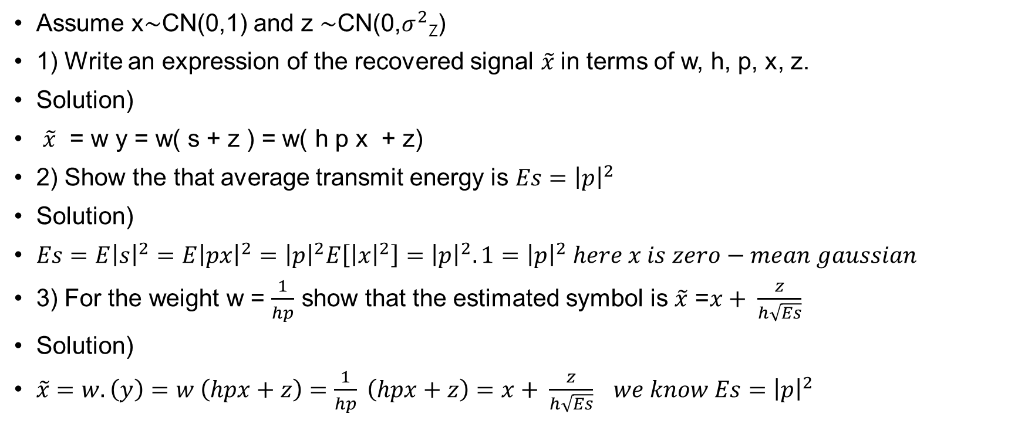
SISO
Assume x$\sim$CN(0,1) and z $\sim$CN(0,$σ^{2}$_{Z})
1) Write an expression of the recovered signal $\tilde{x}$in terms of w, h, p, x, z.
Solution)
$\tilde{x}$ = w y = w( s + z ) = w( h p x + z)
2) Show the that average transmit energy is $Es={\left|p\right|}^{2}$
Solution)
$Es=E{\left|s\right|}^{2}=E{\left|px\right|}^{2}={\left|p\right|}^{2}E\left[{\left|x\right|}^{2}\right]={\left|p\right|}^{2}.1={\left|p\right|}^{2} here x is zero−mean gaussian$
3) For the weight w = $\frac{1}{hp}$ show that the estimated symbol is $\tilde{x}$ =$x+ \frac{z}{h\sqrt{Es}}$
Solution)
$\tilde{x}$ $=w.\left(y\right)=w \left(hpx+z\right)=\frac{1}{hp} \left(hpx+z\right)=x+ \frac{z}{h\sqrt{Es}} we know Es={\left|p\right|}^{2}$

Slide 3
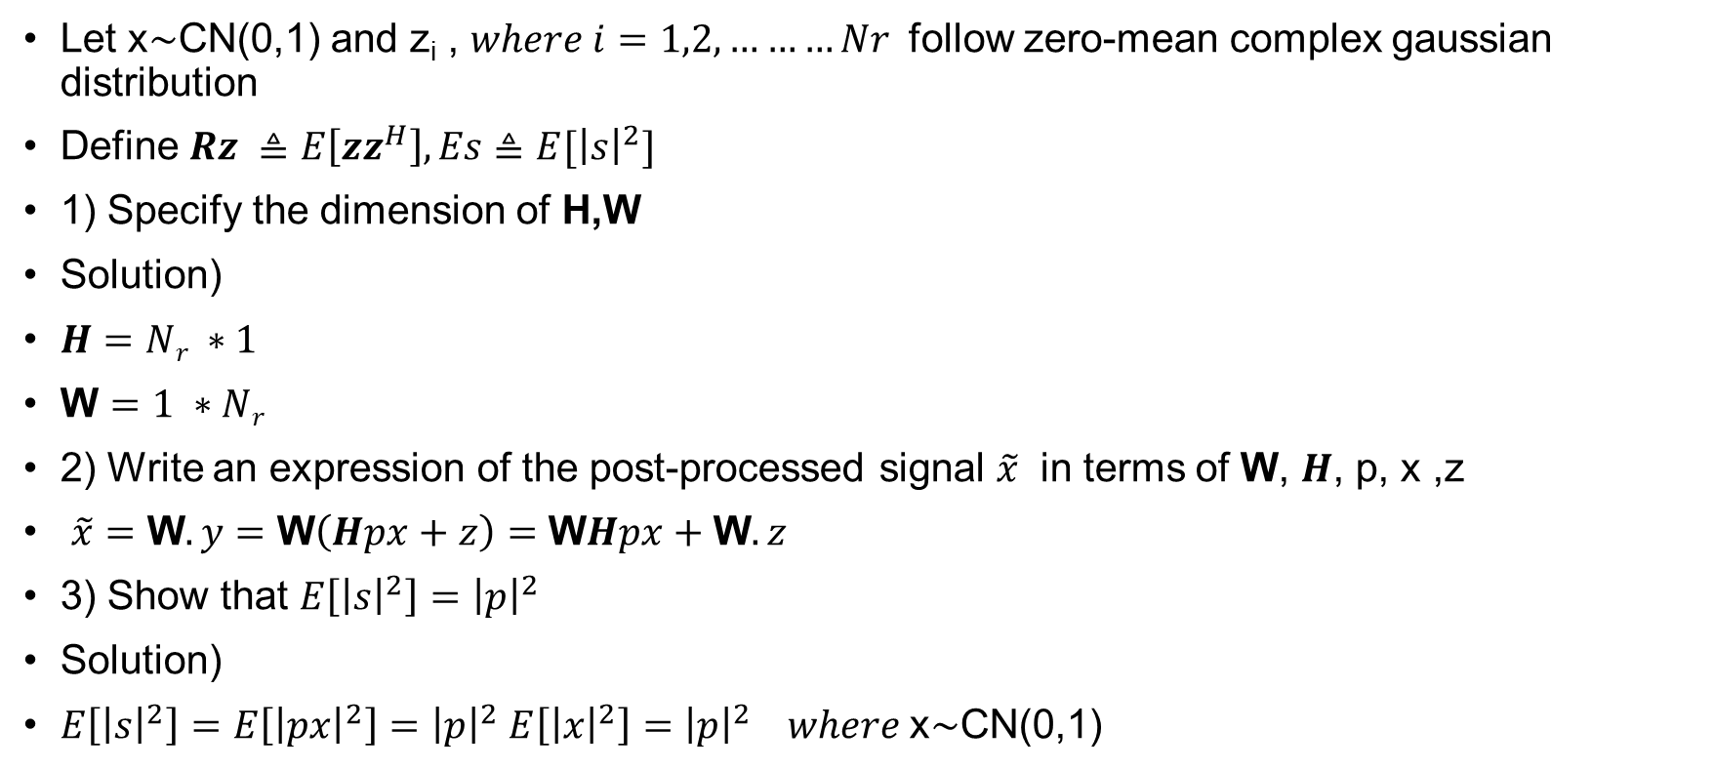
SIMO(Selection Combining)
Let x$\sim$CN(0,1) and z_{i} , $where i=1,2,………Nr$ follow zero-mean complex gaussian distribution
Define $Rz ≜E\left[zz^{H}\right], Es≜E[{\left|s\right|}^{2}]$
1) Specify the dimension of H,W
Solution)
$H=Nr ∗1$
W $=1 ∗Nr$
2) Write an expression of the post-processed signal $\tilde{x}$ in terms of W, $H$, p, x ,z
$\tilde{x}=\text{W}.y=\text{W}\left(Hpx+z\right)=\text{W}Hpx+\text{W}.z$
3) Show that $E\left[{\left|s\right|}^{2}\right]={\left|p\right|}^{2}$
Solution)
$E\left[{\left|s\right|}^{2}\right]=E\left[{\left|px\right|}^{2}\right]={\left|p\right|}^{2} E\left[{\left|x\right|}^{2}\right]={\left|p\right|}^{2} where \text{x}\sim \text{CN}\text{(0,1)}$

Slide 4
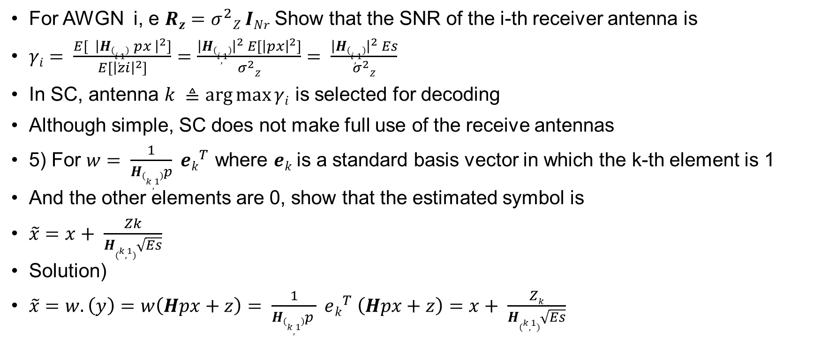
SIMO(Selection Combining)
For AWGN i, e $Rz=σ^{2}Z INr$ Show that the SNR of the i-th receiver antenna is
$γi= \frac{E[{ \left|H\left(i,1\right) px \right|}^{2}]}{E[{\left|zi\right|}^{2}]}$ $=$ $\frac{{\left|H\left(i,1\right)\right|}^{2} E[{\left|px\right|}^{2}]}{σ^{2}Z}$ $= \frac{{\left|H\left(i,1\right)\right|}^{2} Es}{σ^{2}Z}$
In SC, antenna $k ≜\arg{\max{γi}}$ is selected for decoding
Although simple, SC does not make full use of the receive antennas
5) For $w= \frac{1}{H\left(k,1\right)p} ek^{T}$ where $ek$is a standard basis vector in which the k-th element is 1
And the other elements are 0, show that the estimated symbol is
$\tilde{x}=x+ \frac{Zk}{H(k,1)\sqrt{Es}}$
Solution)
$\tilde{x}=w.\left(y\right)=w\left(Hpx+z\right)= \frac{1}{H\left(k,1\right)p } ek^{T} \left(Hpx+z\right)=x+ \frac{Zk}{H(k,1)\sqrt{Es}}$

Slide 5
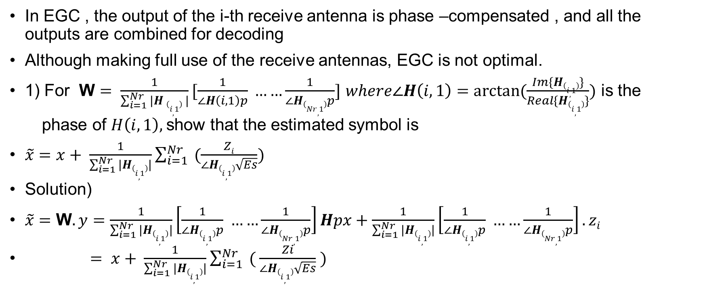
SIMO-EGC
In EGC , the output of the i-th receive antenna is phase –compensated , and all the outputs are combined for decoding
Although making full use of the receive antennas, EGC is not optimal.
1) For W $= \frac{1}{\sum_{i=1}^{Nr}{|H \left(i,1\right) |}}[\frac{1}{∠H\left(i,1\right)p} ……\frac{1}{∠H\left(Nr,1\right)p}]$ $where∠H\left(i,1\right)=arctan⁡(\frac{Im\{H\left(i,1\right)\}}{Real\{H\left(i,1\right)\}})$ is the
phase of $H\left(i,1\right),$show that the estimated symbol is
$\tilde{x}=x+ \frac{1}{\sum_{i=1}^{Nr}{|H\left(i,1\right)|}}\sum_{i=1}^{Nr}{ (\frac{Zi}{∠H\left(i,1\right)\sqrt{Es}})}$
Solution)
$\tilde{x}=\text{W}.y=\frac{1}{\sum_{i=1}^{Nr}{|H\left(i,1\right)|}}\left[\frac{1}{∠H\left(i,1\right)p} ……\frac{1}{∠H\left(Nr,1\right)p}\right]Hpx+\frac{1}{\sum_{i=1}^{Nr}{|H\left(i,1\right)|}}\left[\frac{1}{∠H\left(i,1\right)p} ……\frac{1}{∠H\left(Nr,1\right)p}\right].zi$
$= x+ \frac{1}{\sum_{i=1}^{Nr}{|H\left(i,1\right)|}}\sum_{i=1}^{Nr}{ ( \frac{Zi}{∠H\left(i,1\right)\sqrt{Es}} )}$

Slide 6
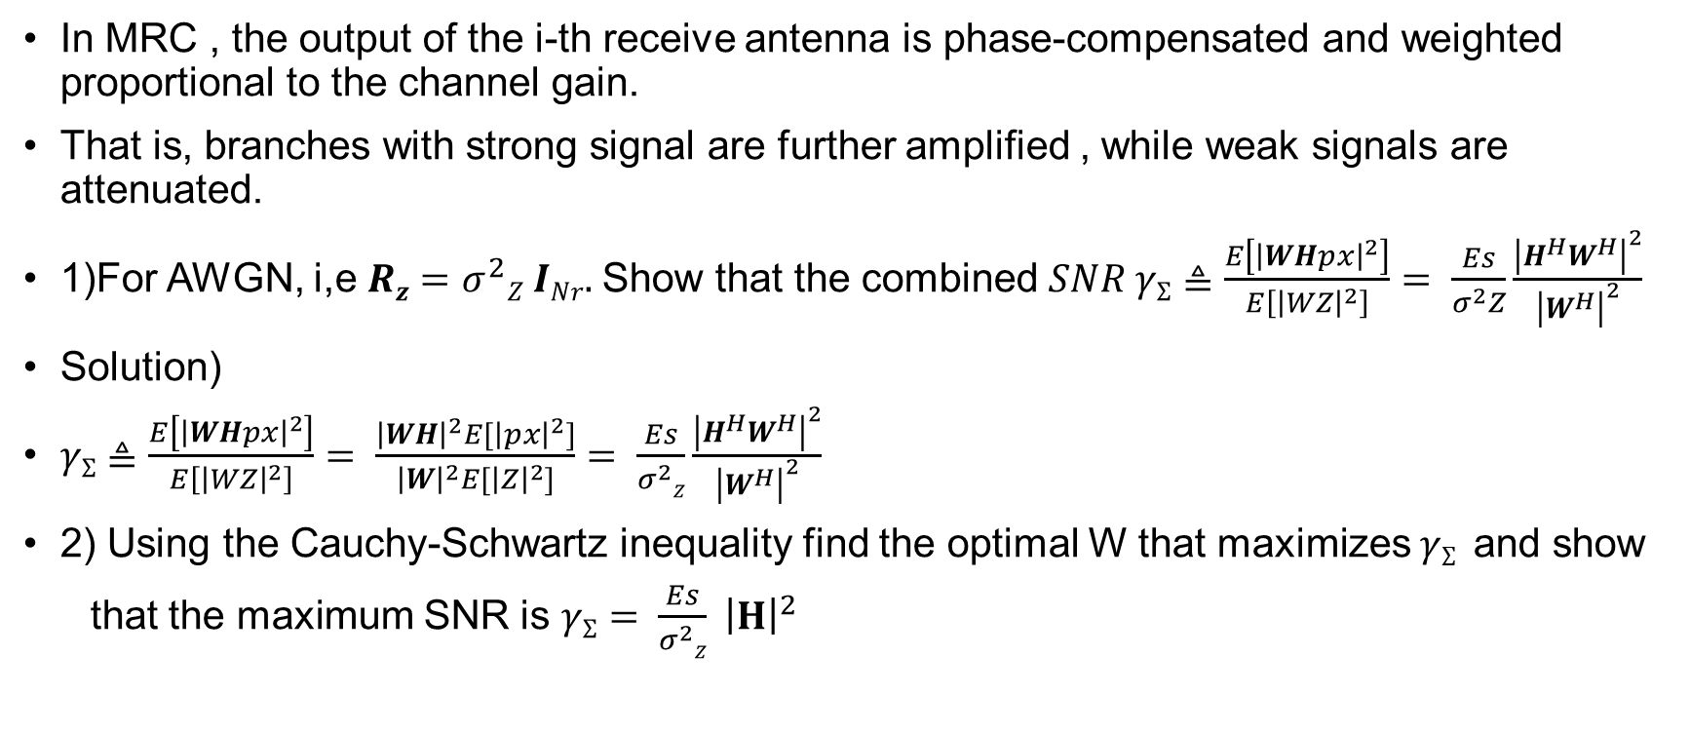
SIMO-MRC
In MRC , the output of the i-th receive antenna is phase-compensated and weighted proportional to the channel gain.
That is, branches with strong signal are further amplified , while weak signals are attenuated.
1)For AWGN, i,e $Rz=σ^{2}Z INr.$Show that the combined $SNR γΣ≜\frac{E\left[{\left|WHpx\right|}^{2}\right]}{E\left[{\left|WZ\right|}^{2}\right]}= \frac{Es}{σ^{2}Z}\frac{{\left|H^{H}W^{H}\right|}^{2}}{{\left|W^{H}\right|}^{2}}$
Solution)
$γΣ≜\frac{E\left[{\left|WHpx\right|}^{2}\right]}{E\left[{\left|WZ\right|}^{2}\right]}$ $= \frac{{\left|WH\right|}^{2}E[{\left|px\right|}^{2}]}{{\left|W\right|}^{2}E[{\left|Z\right|}^{2}]}= \frac{Es}{σ^{2}Z}\frac{{\left|H^{H}W^{H}\right|}^{2}}{{\left|W^{H}\right|}^{2}}$
2) Using the Cauchy-Schwartz inequality find the optimal W that maximizes $γΣ$ and show
that the maximum SNR is $γΣ$ $= \frac{Es}{σ^{2}Z} {\left|H\right|}^{2}$

Slide 7
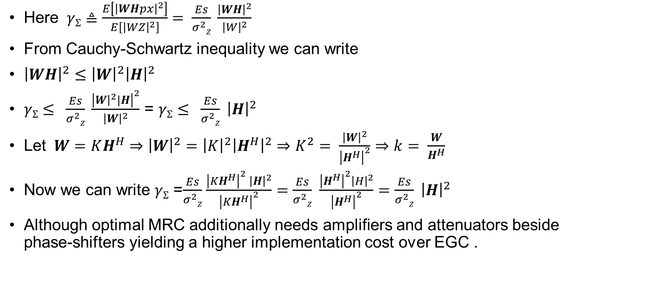
SIMO-MRC
Here $γΣ≜\frac{E\left[{\left|WHpx\right|}^{2}\right]}{E\left[{\left|WZ\right|}^{2}\right]}$ $= \frac{Es}{σ^{2}Z} \frac{{\left|WH\right|}^{2}}{{\left|W\right|}^{2}}$
From Cauchy-Schwartz inequality we can write
${\left|WH\right|}^{2}$ $≤{\left|W\right|}^{2}{\left|H\right|}^{2}$
$γΣ$ $≤ \frac{Es}{σ^{2}Z} \frac{{\left|W{\left.​\right|}^{2}|H\right|}^{2}}{{\left|W\right|}^{2}}$ = $γΣ$ $≤ \frac{Es}{σ^{2}Z}$ ${\left|H\right|}^{2}$
Let $W=KH^{H}⇒{\left|W\right|}^{2}={\left|K\right|}^{2}{\left|H^{H}\right|}^{2}⇒K^{2}= \frac{{\left|W\right|}^{2}}{{\left|H^{H}\right|}^{2}}⇒k= \frac{W}{H^{H}}$
Now we can write $γΣ$ =$\frac{Es}{σ^{2}Z}$ $\frac{{\left|KH^{H}\right|}^{2} {\left|H\right|}^{2}}{{\left|KH^{H}\right|}^{2}}=\frac{Es}{σ^{2}Z}$ $\frac{{\left|H^{H}\right|}^{2}{\left|H\right|}^{2}}{{\left|H^{H}\right|}^{2}}=\frac{Es}{σ^{2}Z}$ ${\left|H\right|}^{2}$
Although optimal MRC additionally needs amplifiers and attenuators beside phase-shifters yielding a higher implementation cost over EGC .

Slide 8

SIMO-MRC
3) For $W= \frac{1}{{\left|H^{H}\right|}^{2}p}H^{H}$show that the estimated symbol is $\tilde{x}=x+ \frac{1}{{\left|H^{H}\right|}^{2}\sqrt{Es}} H^{H}Z$
We know
$\tilde{x}=W.y= \frac{1}{{\left|H^{H}\right|}^{2}p}H^{H}$(H p x + Z) $= \frac{1}{{\left|H^{H}\right|}^{2}p}H^{H}$H p x $+ \frac{1}{{\left|H^{H}\right|}^{2}p}H^{H} Z=x+\frac{1}{{\left|H^{H}\right|}^{2}\sqrt{Es}}H^{H} \text{Z}$

Slide 9
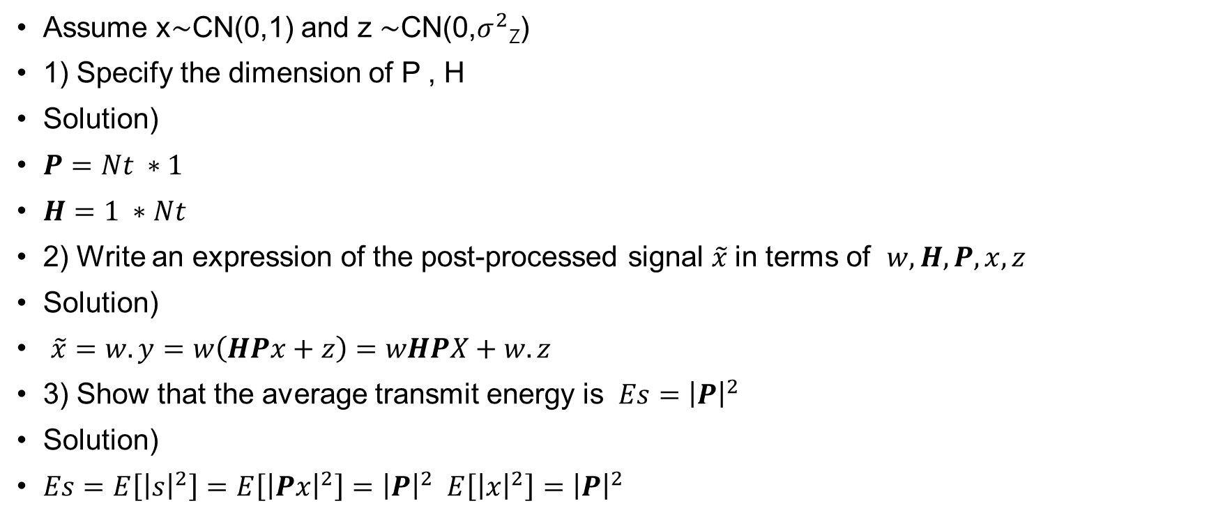
MISO without CSIT-EPA
Assume x$\sim$CN(0,1) and z $\sim$CN(0,$σ^{2}$_{Z})
1) Specify the dimension of P , H
Solution)
$P=Nt ∗1$
$H=1 ∗Nt$
2) Write an expression of the post-processed signal $\tilde{x}$in terms of $w,H,P,x,z$
Solution)
$\tilde{x}=w.y=w\left(HPx+z\right)=wHPX+w.z$
3) Show that the average transmit energy is $Es={\left|P\right|}^{2}$
Solution)
$Es=E\left[{\left|s\right|}^{2}\right]=E\left[{\left|Px\right|}^{2}\right]={\left|P\right|}^{2} E\left[{\left|x\right|}^{2}\right]={\left|P\right|}^{2}$

Slide 10
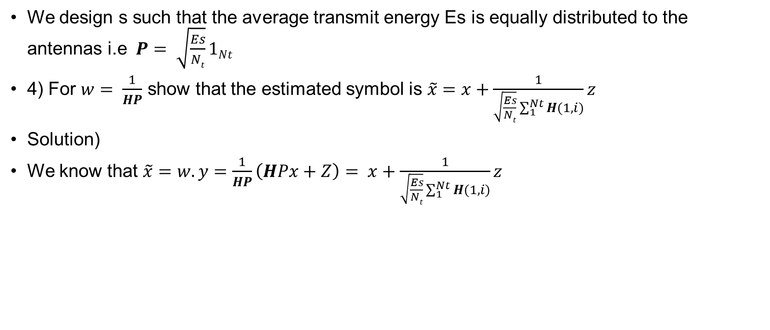
MISO without CSIT-EPA
We design s such that the average transmit energy Es is equally distributed to the antennas i.e $P= \sqrt{\frac{Es}{Nt}}1Nt$
4) For $w= \frac{1}{HP}$ show that the estimated symbol is $\tilde{x}$ $=x+\frac{1}{\sqrt{\frac{Es}{Nt}}\sum_{1}^{Nt}{H(1,i)}}z$
Solution)
We know that $\tilde{x}=w.y=\frac{1}{HP}\left(HPx+Z\right)= x+\frac{1}{\sqrt{\frac{Es}{Nt}}\sum_{1}^{Nt}{H(1,i)}}z$

Slide 11
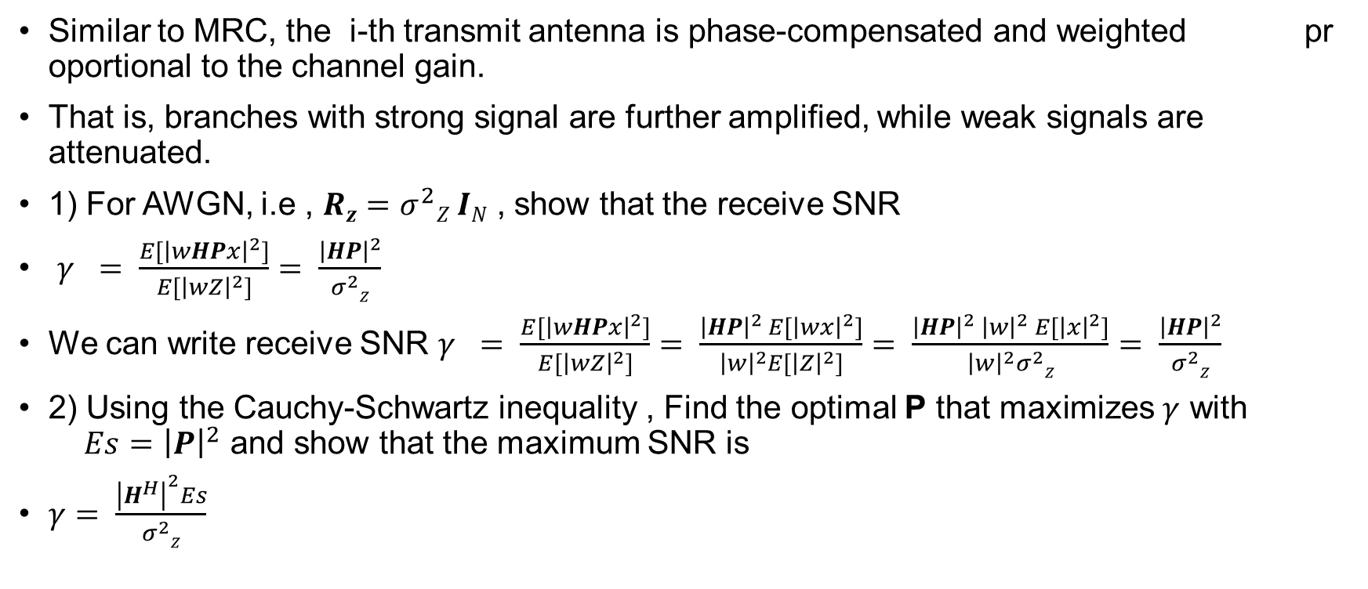
MISO with CSIT-MRT
Similar to MRC, the i-th transmit antenna is phase-compensated and weighted proportional to the channel gain.
That is, branches with strong signal are further amplified, while weak signals are attenuated.
1) For AWGN, i.e , $Rz=σ^{2}Z IN$ , show that the receive SNR
$γ = \frac{E[{\left|wHPx\right|}^{2}]}{E[{\left|wZ\right|}^{2}]}= \frac{{\left|HP\right|}^{2}}{σ^{2}Z}$
We can write receive SNR $γ = \frac{E[{\left|wHPx\right|}^{2}]}{E[{\left|wZ\right|}^{2}]}$ $= \frac{{\left|HP\right|}^{2} E[{\left|wx\right|}^{2}]}{{\left|w\right|}^{2}E[{\left|Z\right|}^{2}]}= \frac{{\left|HP\right|}^{2} {\left|w\right|}^{2} E[{\left|x\right|}^{2}]}{{\left|w\right|}^{2}σ^{2}Z}= \frac{{\left|HP\right|}^{2}}{σ^{2}Z}$
2) Using the Cauchy-Schwartz inequality , Find the optimal P that maximizes $γ$ with $Es={\left|P\right|}^{2}$ and show that the maximum SNR is
$γ= \frac{{\left|H^{H}\right|}^{2}Es}{σ^{2}Z}$

Slide 12
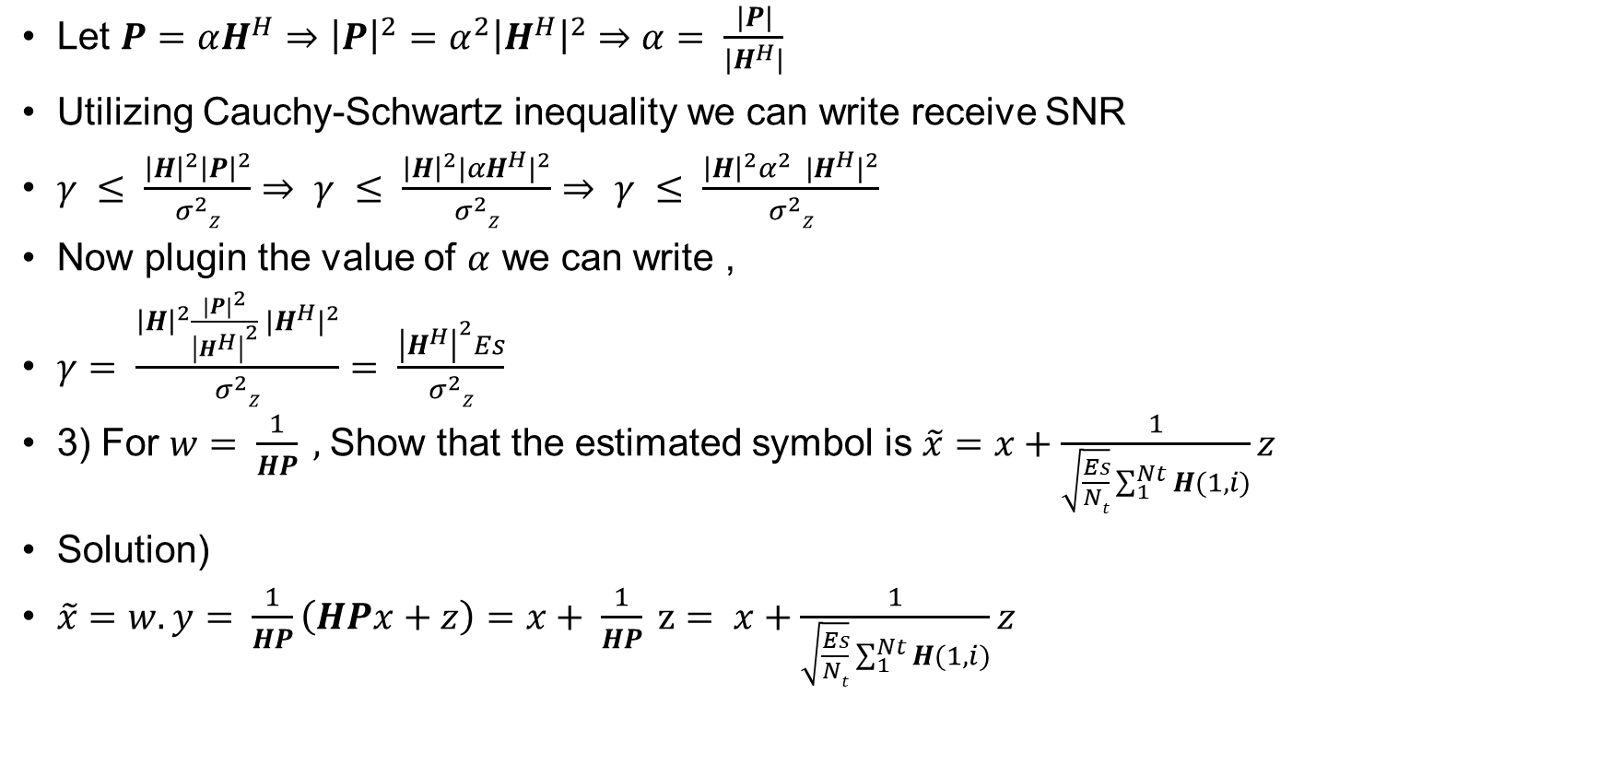
MISO with CSIT-MRT
Let $P=αH^{H}⇒{\left|P\right|}^{2}=α^{2}{\left|H^{H}\right|}^{2}⇒α= \frac{|P|}{|H^{H}|}$
Utilizing Cauchy-Schwartz inequality we can write receive SNR
$γ ≤ \frac{{\left|H\right|}^{2}{\left|P\right|}^{2}}{σ^{2}Z}$ $⇒ γ ≤ \frac{{\left|H\right|}^{2}{|αH^{H}|}^{2}}{σ^{2}Z}$ $⇒ γ ≤ \frac{{\left|H\right|}^{2}{α^{2} |H^{H}|}^{2}}{σ^{2}Z}$
Now plugin the value of $α$ we can write ,
$γ= \frac{{\left|H\right|}^{2}{\frac{{\left|P\right|}^{2}}{{\left|H^{H}\right|}^{2}} |H^{H}|}^{2}}{σ^{2}Z}$ $= \frac{{\left|H^{H}\right|}^{2}Es}{σ^{2}Z}$
3) For $w= \frac{1}{HP} ,$Show that the estimated symbol is $\tilde{x}$ $=x+\frac{1}{\sqrt{\frac{Es}{Nt}}\sum_{1}^{Nt}{H(1,i)}}z$
Solution)
$\tilde{x}=w.y= \frac{1}{HP}\left(HPx+z\right)=x+ \frac{1}{HP} z= x+\frac{1}{\sqrt{\frac{Es}{Nt}}\sum_{1}^{Nt}{H(1,i)}}z$

Slide 13
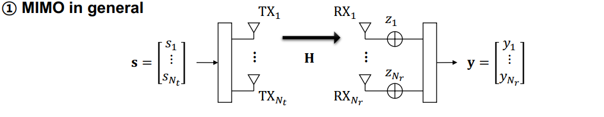

Capacity of MIMO systems
Let s_{i} , where i = 1,,……….N_{t} and z_{i} , where i = 1,…….N_{r} follow zero mean complex Gaussian
distributions.
Define $Rs ≜E\left[ss^{H}\right], Rz ≜E\left[zz^{H}\right], Es≜E\left[{\left|s\right|}^{2}\right] , r≜rank\left(H\right)=\min\left(Nt,Nr\right)$
1) Write the expression of the received signal $y$ in terms of H, s, z

Slide 14
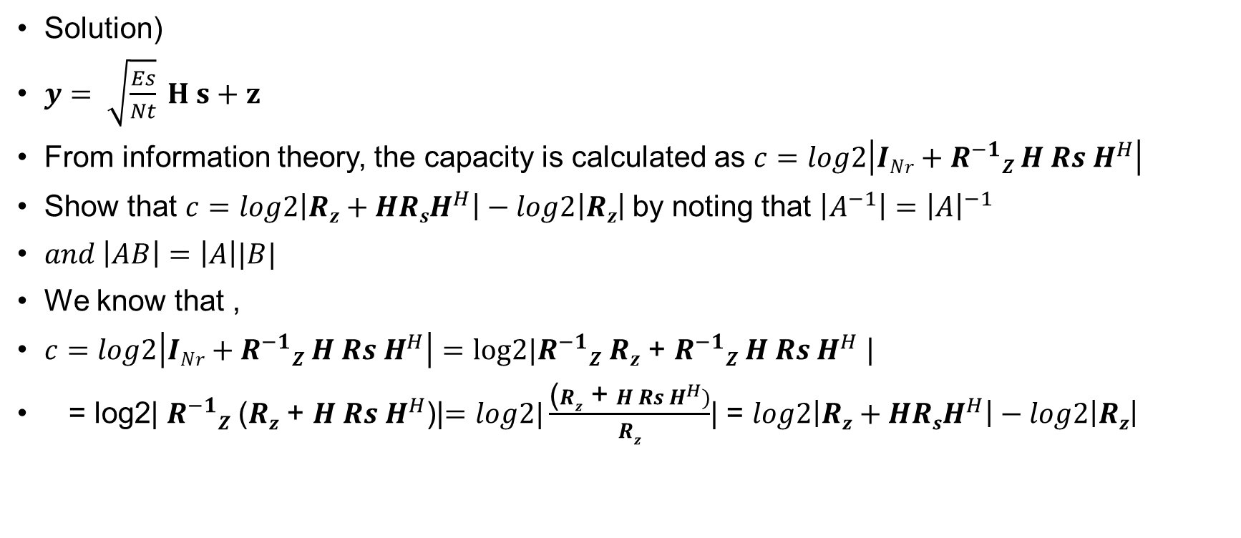
Capacity of MIMO systems
Solution)
$y= \sqrt{\frac{Es}{Nt}} H s+z$
From information theory, the capacity is calculated as $c=log2\left|INr+R^{−1}Z H Rs H^{H}\right|$
Show that $c=log2\left|Rz+HRsH^{H}\right|−log2\left|Rz\right|$by noting that $\left|A^{−1}\right|={\left|A\right|}^{−1}$
$and \left|AB\right|=\left|A\right||B|$
We know that ,
$c=log2\left|INr+R^{−1}Z H Rs H^{H}\right|=log2|R^{−1}Z$ $Rz$ + $R^{−1}Z H Rs H^{H}$ |
= log2| $R^{−1}Z$ ($Rz$ + $H Rs H^{H}$)|$=log2|\frac{\text{(}Rz\text{ + }H Rs H^{H})}{Rz}$| = $log2\left|Rz+HRsH^{H}\right|−log2\left|Rz\right|$

Slide 15
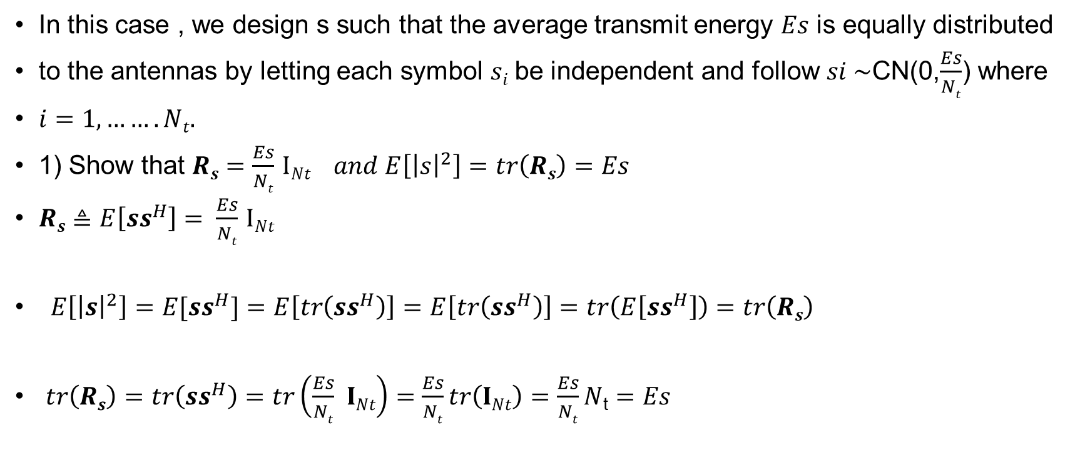
MIMO without CSIT
In this case , we design s such that the average transmit energy $Es$ is equally distributed
to the antennas by letting each symbol $si$be independent and follow $si \sim$CN(0,$\frac{Es}{Nt}$) where
$i=1,…….Nt.$
1) Show that $Rs=\frac{Es}{Nt}$ $INt$ $and E\left[{\left|s\right|}^{2}\right]$ $=tr\left(Rs\right)=Es$
$Rs≜E\left[ss^{H}\right]= \frac{Es}{Nt}$ $INt$
$E\left[{\left|s\right|}^{2}\right]=E[ss^{H}]=E\left[tr\left(ss^{H}\right)\right]=E\left[tr\left(ss^{H}\right)\right]=tr\left(E\left[ss^{H}\right]\right)=tr\left(Rs\right)$
$tr\left(Rs\right)=tr\left(ss^{H}\right)=tr\left(\frac{Es}{Nt} INt\right)=\frac{Es}{Nt}tr\left(INt\right)=\frac{Es}{Nt}N$_{t} $=Es$

Slide 16
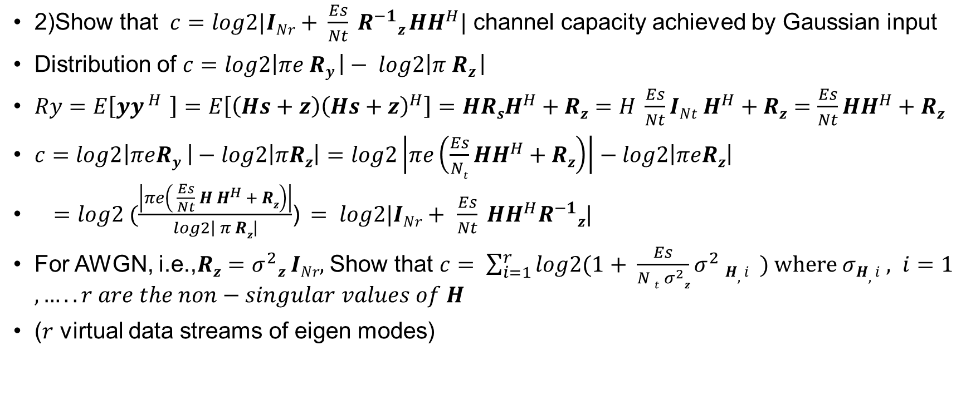
MIMO without CSIT
2)Show that $c=log2|INr+ \frac{Es}{Nt} R^{−1}z HH^{H}|$ channel capacity achieved by Gaussian input
Distribution of $c=log2\left|πe Ry \right|− log2\left|π Rz \right|$
$Ry=E\left[yy^{ H }\right]=E\left[\left(Hs+z\right){\left(Hs+z\right)}^{H}\right]=HRsH^{H}+Rz=H \frac{Es}{Nt}{INt H}^{H}+Rz=\frac{Es}{Nt}HH^{H}+Rz$
$c=log2\left|πeRy \right|−log2\left|πRz\right|=log2\left|πe\left(\frac{Es}{Nt}HH^{H}+Rz\right)\right|−log2\left|πeRz\right|$
$=log2 (\frac{\left|πe\left( \frac{Es}{Nt} H H^{H }+ Rz\right)\right|}{log2\left| π Rz\right|}$)$= log2|INr+$ $\frac{Es}{Nt} HH^{H}R^{−1}z|$
For AWGN, i.e.,$Rz=σ^{2}z INr,$ Show that $c= \sum_{i=1}^{r}{log2(1+ \frac{Es}{N t{ σ}^{2}z}σ^{2} H,i} ) where σH,i , i=1,…..r are the non−singular values of H$
($r$ virtual data streams of eigen modes)

Slide 17
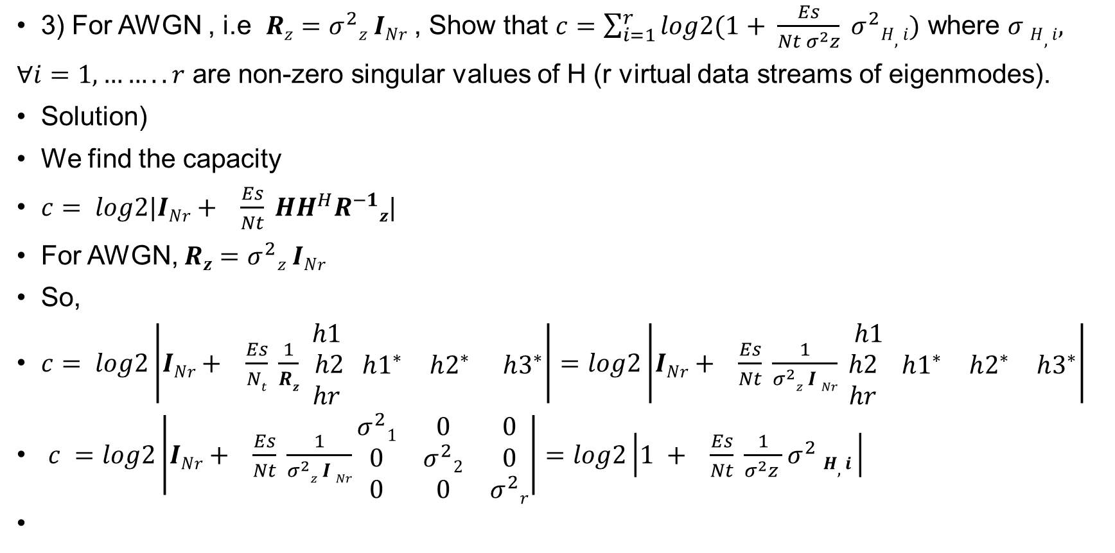
MIMO without CSIT
3) For AWGN , i.e $Rz=σ^{2}z INr$ , Show that $c=\sum_{i=1}^{r}{log2(1+ \frac{Es}{Nt σ^{2}z} σ^{2}H,i)}$ where $σ H,i,$
∀$i=1,……..r$ are non-zero singular values of H (r virtual data streams of eigenmodes).
Solution)
We find the capacity
$c= log2|INr+ \frac{Es}{Nt} HH^{H}R^{−1}z|$
For AWGN, $Rz=σ^{2}z INr$
So,
$c= log2\left|INr+ \frac{Es}{Nt} \frac{1}{Rz}\begin{matrix} h1 \\ h2 \\ hr\end{matrix} \begin{matrix} h1^{∗} & h2^{∗} & h3^{∗}\end{matrix}\right|=log2\left|INr+ \frac{Es}{Nt} \frac{1}{σ^{2}z I Nr}\begin{matrix} h1 \\ h2 \\ hr\end{matrix} \begin{matrix} h1^{∗} & h2^{∗} & h3^{∗}\end{matrix}\right|$
$c =log2\left|INr+ \frac{Es}{Nt} \frac{1}{σ^{2}z I Nr}\begin{matrix}σ^{2}1 & 0 & 0 \\ 0 & σ^{2}2 & 0 \\ 0 & 0 & σ^{2}r\end{matrix}\right|=log2\left|1 + \frac{Es}{Nt} \frac{1}{σ^{2}z }σ^{2} H,i \right|$

Slide 18
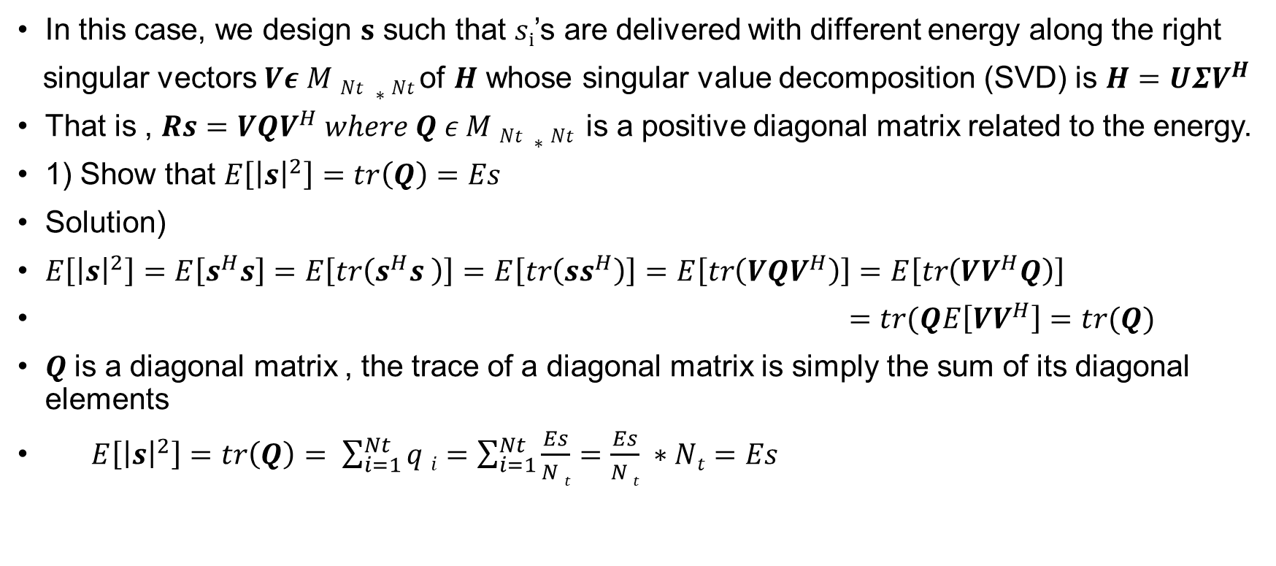
MIMO with CSIT
In this case, we design 𝐬 such that 𝑠_{i}’s are delivered with different energy along the right
singular vectors $Vε M Nt ∗Nt$of $H$ whose singular value decomposition (SVD) is $H=UΣV^{H}$
That is , $Rs={VQV}^{H} where Q ε M Nt ∗Nt$ is a positive diagonal matrix related to the energy.
1) Show that $E\left[{\left|s\right|}^{2}\right]=tr\left(Q\right)=Es$
Solution)
$E\left[{\left|s\right|}^{2}\right]=E\left[s^{H}s\right]=E\left[tr\left(s^{H}s \right)\right]=E\left[tr\left(ss^{H}\right)\right]=E\left[tr\left({VQV}^{H}\right)\right]=E\left[tr\left(VV^{H}Q\right)\right]$
$=tr(QE\left[VV^{H}\right]=tr(Q)$
$Q$is a diagonal matrix , the trace of a diagonal matrix is simply the sum of its diagonal elements
$E\left[{\left|s\right|}^{2}\right]=tr\left(Q\right)= \sum_{i=1}^{Nt}{q i}=\sum_{i=1}^{Nt}{\frac{Es}{N t}}=\frac{Es}{N t} ∗Nt=Es$

Slide 19
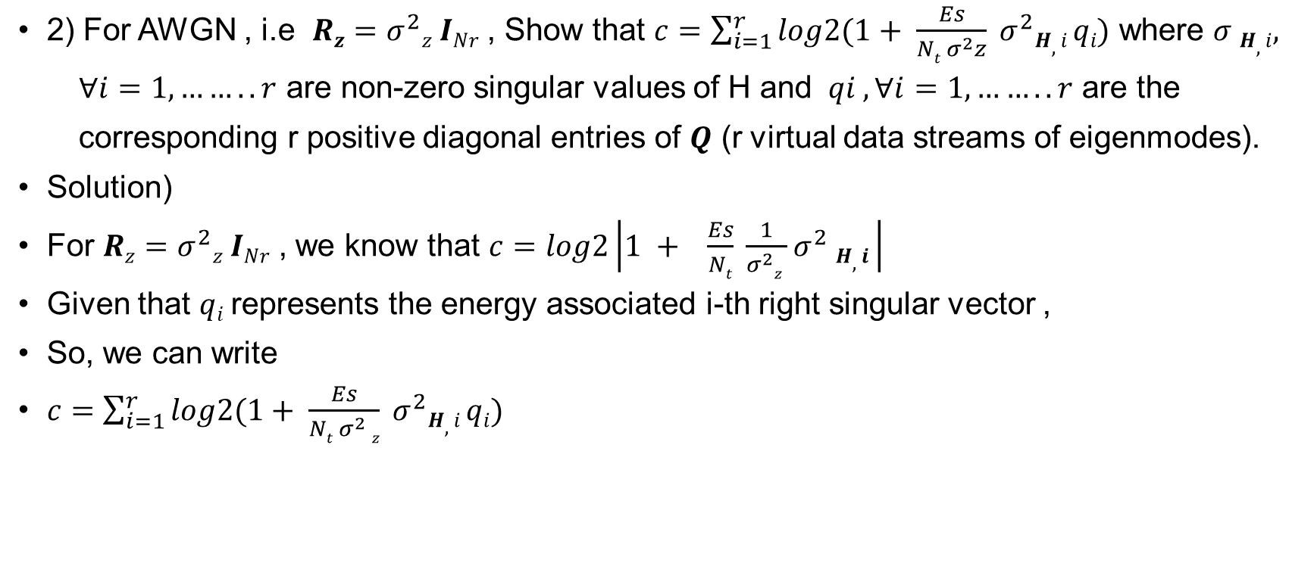
MIMO with CSIT
2) For AWGN , i.e $Rz=σ^{2}z INr$ , Show that $c=\sum_{i=1}^{r}{log2(1+ \frac{Es}{Nt σ^{2}z} σ^{2}H,i qi)}$ where $σ H,i,$
∀$i=1,……..r$ are non-zero singular values of H and $qi ,\text{∀}i=1,……..r$ are the
corresponding r positive diagonal entries of $Q$ (r virtual data streams of eigenmodes).
Solution)
For $Rz=σ^{2}z INr$ , we know that $c=log2\left|1 + \frac{Es}{Nt} \frac{1}{σ^{2}z }σ^{2} H,i \right|$
Given that $qi$represents the energy associated i-th right singular vector ,
So, we can write
$c=\sum_{i=1}^{r}{log2(1+ \frac{Es}{Nt σ^{2} z} σ^{2}H,i qi)}$

Slide 20
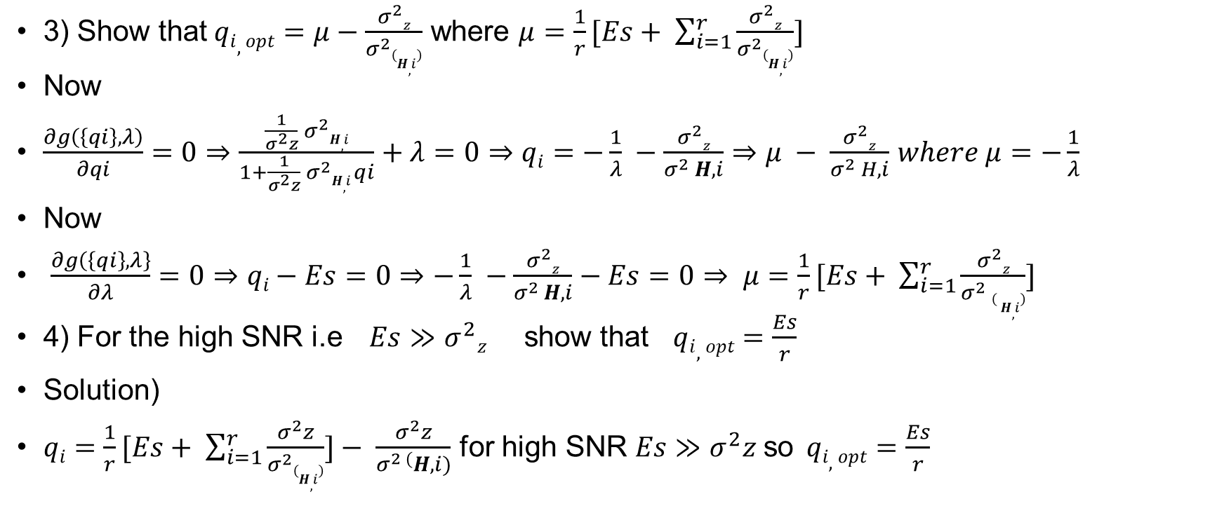
MIMO with CSIT
3) Show that$qi,opt=μ−\frac{σ^{2}z}{σ^{2}\left(H,i\right)}$ where $μ=\frac{1}{r}[Es+ \sum_{i=1}^{r}{\frac{σ^{2}z}{σ^{2}\left(H,i\right)}}]$
Now
$\frac{∂g\left(\left\{qi\right\},λ\right)}{∂qi}=0⇒\frac{\frac{1}{σ^{2}z} σ^{2}H,i}{1+\frac{1}{σ^{2}z} σ^{2}H,i qi}+λ=0⇒qi=−\frac{1}{λ} −\frac{σ^{2}z}{σ^{2} H,i}⇒μ − \frac{σ^{2}z}{σ^{2} H,i}$ $where μ=−\frac{1}{λ}$
Now
$\frac{∂g\left(\left\{qi\right\},λ\right\}}{∂λ}=0⇒qi−Es=0⇒−\frac{1}{λ} −\frac{σ^{2}z}{σ^{2 }H,i}−Es=0⇒ μ=\frac{1}{r}[Es+ \sum_{i=1}^{r}{\frac{σ^{2}z}{σ^{2} \left( H,i\right)}}]$
4) For the high SNR i.e $Es≫σ^{2}z$ show that $qi,opt=\frac{Es}{r}$
Solution)
$qi=\frac{1}{r}[Es+ \sum_{i=1}^{r}{\frac{σ^{2}z}{σ^{2}\left(H,i\right)}}]− \frac{σ^{2}z}{σ^{2 (}H,i)}$ for high SNR $Es≫σ^{2}z$so$qi,opt=\frac{Es}{r}$

Slide 21

MIMO with CSIT
5)For the high snr $Nt=Nr=r$, show that $c$becomes equivalent to the case without CSIT
Solution)
$c=log2\left|1 + \frac{Es}{Nt} \frac{1}{σ^{2}z }σ^{2} H,i \right|$
$c=log2\left|1 + \frac{Es}{r} \frac{1}{σ^{2}z }σ^{2} H,i \right|$

Slide 22
Assignment-07
1. MIMO linear processing
MIMO without CSIT
2)RxMF
3)RxZF
4)RxMMSE
MIMO with CSIT
5) Joint SVD
6)Numerical result

Slide 23
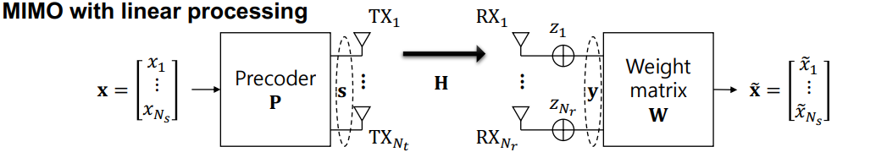
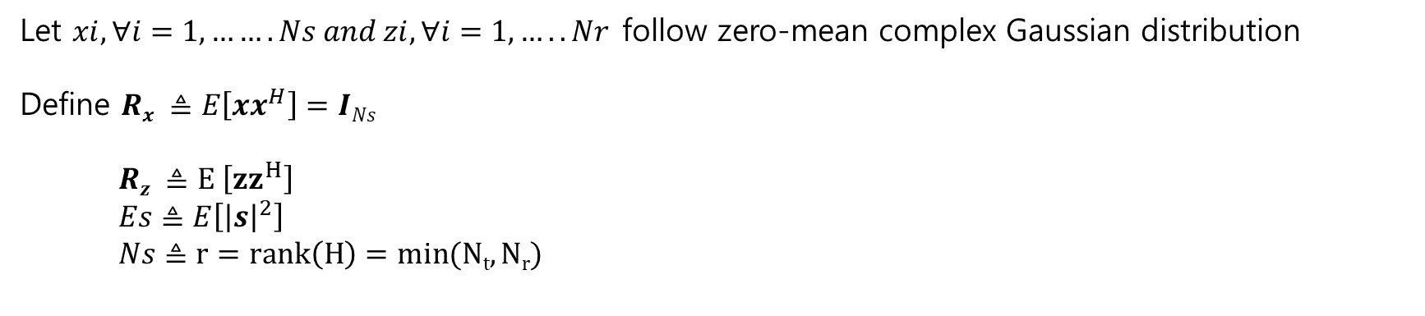
MIMO with linear processing
Let $xi, ∀i=1,…….Ns and zi, ∀i=1,…..Nr$follow zero-mean complex Gaussian distribution
Define $Rx ≜E\left[xx^{H}\right]=INs$
$Rz ≜E \left[{zz}^{H}\right]$
$Es≜E\left[{\left|s\right|}^{2}\right]$
$Ns≜r=rank\left(H\right)=min(Nt,Nr)$

Slide 24
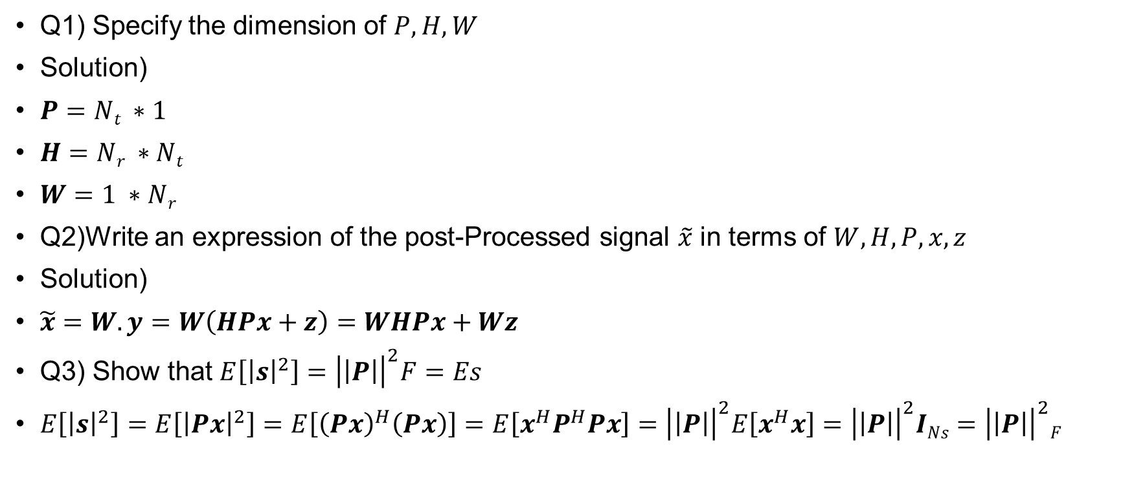
MIMO with linear processing
Q1) Specify the dimension of $P, H, W$
Solution)
$P=Nt ∗1$
$H=Nr ∗Nt$
$W=1 ∗Nr$
Q2)Write an expression of the post-Processed signal $\tilde{x}$ in terms of $W,H,P,x,z$
Solution)
$\tilde{x}=W.y=W\left(HPx+z\right)=WHPx+Wz$
Q3) Show that $E\left[{\left|s\right|}^{2}\right]={\left|\left|P\right|\right|}^{2}F=Es$
$E\left[{\left|s\right|}^{2}\right]=E\left[{\left|Px\right|}^{2}\right]=E\left[{\left(Px\right)}^{H}\left(Px\right)\right]=E\left[x^{H}P^{H}Px\right]={\left|\left|P\right|\right|}^{2}E\left[x^{H}x\right]={\left|\left|P\right|\right|}^{2}INs={\left|\left|P\right|\right|}^{2}F$

Slide 25
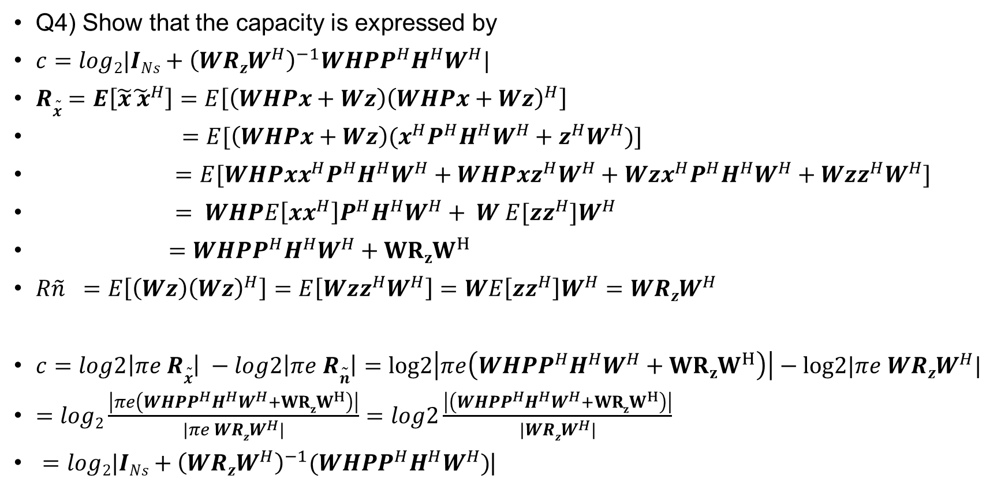
MIMO with linear processing
Q4) Show that the capacity is expressed by
$c=log2|INs+{\left(WRzW^{H}\right)}^{−1}WHPP^{H}H^{H}W^{H}|$
$R\tilde{x}=E\left[\tilde{x}{\tilde{ x}}^{H}\right]=E\left[\left(WHPx+Wz\right){\left(WHPx+Wz\right)}^{H}\right]$
$=E[\left(WHPx+Wz\right)(x^{H}P^{H}H^{H}W^{H}+z^{H}W^{H})]$
$=E[WHPxx^{H}P^{H}H^{H}W^{H}+WHPxz^{H}W^{H}+Wzx^{H}P^{H}H^{H}W^{H}+Wzz^{H}W^{H}]$
$= WHPE\left[xx^{H}\right]P^{H}H^{H}W^{H}+ W E[zz^{H}]W^{H}$
$=WHPP^{H}H^{H}W^{H}+{WRzW}^{H}$
$R\tilde{n} =E\left[\left(Wz\right){\left(Wz\right)}^{H}\right]=E\left[Wzz^{H}W^{H}\right]=WE\left[zz^{H}\right]W^{H}=WRzW^{H}$
$c=log2\left|πe R\tilde{x}\right| −log2\left|πe R\tilde{n}\right|=log2\left|πe\left(WHPP^{H}H^{H}W^{H}+{WRzW}^{H}\right)\right|−log2|πe WRzW^{H}|$
$=log2\frac{\left|πe\left({WHPP}^{H}H^{H}W^{H}+{WRzW}^{H}\right)\right|}{|πe WRzW^{H}|}=log2\frac{\left|\left(WHPP^{H}H^{H}W^{H}+{WRzW}^{H}\right)\right|}{|WRzW^{H}|}$
$=log2|INs+{\left(WRzW^{H}\right)}^{−1}(WHPP^{H}H^{H}W^{H})$|

Slide 26
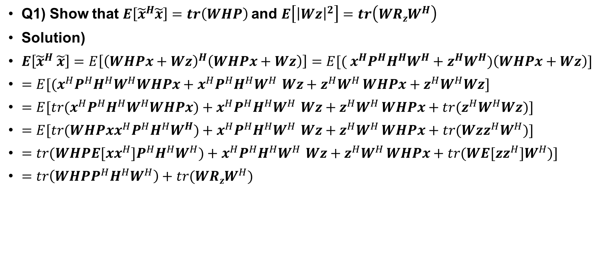
MIMO without CSIT – RxMF
Q1) Show that $E\left[{\tilde{x}}^{H}\tilde{x}\right]=tr\left(WHP\right)$and $E\left[{\left|Wz\right|}^{2}\right]=tr\left(WRzW^{H}\right)$
Solution)
$E\left[{\tilde{x}}^{H} \tilde{x}\right]=E\left[{\left(WHPx+Wz\right)}^{H}\left(WHPx+Wz\right)\right]=E[{( x}^{H}P^{H}H^{H}W^{H}+z^{H}W^{H})\left(WHPx+Wz\right)]$
$=E[{(x}^{H}P^{H}H^{H}W^{H}WHPx+x^{H}P^{H}H^{H}W^{H }Wz+z^{H}W^{H }WHPx+z^{H}W^{H}Wz]$
$=E[tr{(x}^{H}P^{H}H^{H}W^{H}WHPx)+x^{H}P^{H}H^{H}W^{H }Wz+z^{H}W^{H }WHPx+{tr(z}^{H}W^{H}Wz)]$
$=E[tr(WHPxx^{H}P^{H}H^{H}W^{H})+x^{H}P^{H}H^{H}W^{H }Wz+z^{H}W^{H }WHPx+tr(Wzz^{H}W^{H})]$
$=tr(WHPE[xx^{H}]P^{H}H^{H}W^{H})+x^{H}P^{H}H^{H}W^{H }Wz+z^{H}W^{H }WHPx+tr(WE[zz^{H}]W^{H})]$
$=tr\left(WHPP^{H}H^{H}W^{H}\right)+tr(WRzW^{H})$

Slide 27
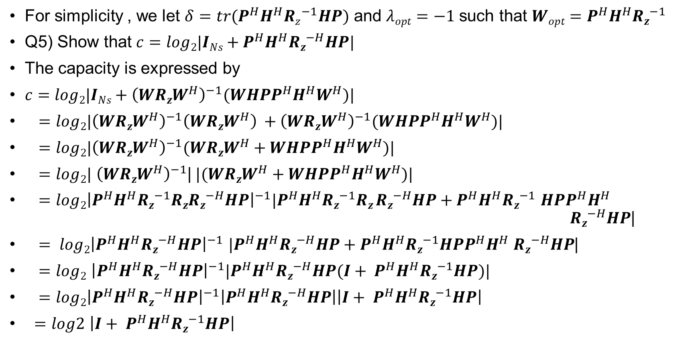
MIMO without CSIT – RxMF
For simplicity , we let $δ=tr(P^{H}H^{H}Rz^{−1}HP)$ and $λopt=−1$such that $Wopt=P^{H}H^{H}Rz^{−1}$
Q5) Show that $c=log2|INs+P^{H}H^{H}Rz^{−H}HP|$
The capacity is expressed by
$c=log2|INs+{\left(WRzW^{H}\right)}^{−1}(WHPP^{H}H^{H}W^{H})\text{|}$
$=log2|{\left(WRzW^{H}\right)}^{−1}{\left(WRzW^{H}\right)}^{ }+{\left(WRzW^{H}\right)}^{−1}(WHPP^{H}H^{H}W^{H})|$
$=log2|{\left(WRzW^{H}\right)}^{−1}(WRzW^{H}+WHPP^{H}H^{H}W^{H})|$
$=log2|$ ${\left(WRzW^{H}\right)}^{−1}$|$|(WRzW^{H}+WHPP^{H}H^{H}W^{H})|$
$=log2{\left|P^{H}H^{H}Rz^{−1}RzRz^{−H}HP\right|}^{−1}|P^{H}H^{H}Rz^{−1}Rz Rz^{−H}HP+P^{H}H^{H}Rz^{−1}$ $HPP^{H}H^{H}$ $Rz^{−H}HP$|
$= log2{\left|P^{H}H^{H}Rz^{−H}HP\right|}^{−1}$ $|P^{H}H^{H}Rz^{−H}HP+P^{H}H^{H}Rz^{−1}HPP^{H}H^{H}$ $Rz^{−H}HP$|
$=log2$ ${\left|P^{H}H^{H}Rz^{−H}HP\right|}^{−1}|P^{H}H^{H}Rz^{−H}HP(I+ P^{H}H^{H}Rz^{−1}HP)|$
$=log2{\left|P^{H}H^{H}Rz^{−H}HP\right|}^{−1}\left|P^{H}H^{H}Rz^{−H}HP\right|\left|I+ P^{H}H^{H}Rz^{−1}HP\right|$
$=log2$ $\left|I+ P^{H}H^{H}Rz^{−1}HP\right|$

