Slide 1
Disguised Full-Duplex Covert Communication *Jihwan Moon
2024.02.13
Presented by
Refat Khan
Department of Mobile Convergence Engineering, Hanbat National University

Slide 2
Table of Contents
Introduction
System Model
Problem Formulation
Proposed Solution
Numerical Results
Discussion
Conclusion

Slide 3
Introduction
Securing Wireless Communication:
Wireless technology transforms lives, but cyberattacks pose a threat, leading to potential information leaks.
To cope with this, cryptography has widely been adopted.
Yet, it has limitations: complex key generation and susceptibility to powerful eavesdroppers, especially challenging for IoT devices.
These downsides have led researchers to examine the possibility of utilizing physical layer security.
Its key feature is the ability to block wireless links to eavesdroppers using techniques like nullifying beamforming or introducing artificial noise.

Slide 4
Introduction
Challenges of Secure Communication:
Security Threats:
Opponents can conduct traffic analysis by collecting metadata during transmission.
Vulnerabilities include capturing source and destination addresses, request-response frequency, etc
Need for Covert Communications:
Transmit data in a manner that avoids detection or suspicion.
Combining cryptography and physical layer security can prevent eavesdropping, but covert communications are necessary to counter traffic analysis threats.

Slide 5
Introduction
Investigating Covert Communications:
System Overview:
Setup involves a source node and disguised full-duplex (FD) destination node.
Objective:
Ensure covert transmission to a hidden node while warden node surveillance.
Research Scope:
Explore channel uncertainty at the warden node.
Determine the lower bound of the expected minimum detection error probability (DEP).
Research Outcomes:
Numerical results demonstrating covert rate performance under diverse DEP requirements
Emphasis on the significance of secure and covert communication strategies against advanced security threats.

Slide 6
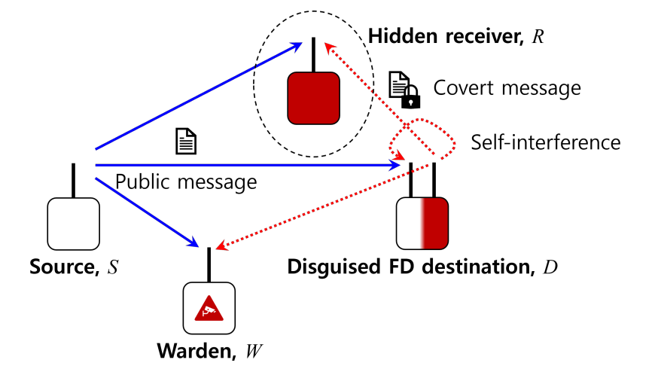
System Model
Figure. System Model

Slide 7
System Model
Covert Communication System Overview:
Communication Setup:
Source node (S) transmitting a public message to the destination node (D)
Covert transmission conducted by the seemingly receive-only destination node
Covert signal transmitted to the hidden receiver (R) using an unseen antenna
Transmission Environment:
Full-duplex (FD) communication implemented, allowing simultaneous transmission and reception
Warden node (W) monitoring for suspicious communications
Key Focus:
Ensuring secure and undetectable transmission from the destination to the hidden node
Under surveillance of a warden node

Slide 8
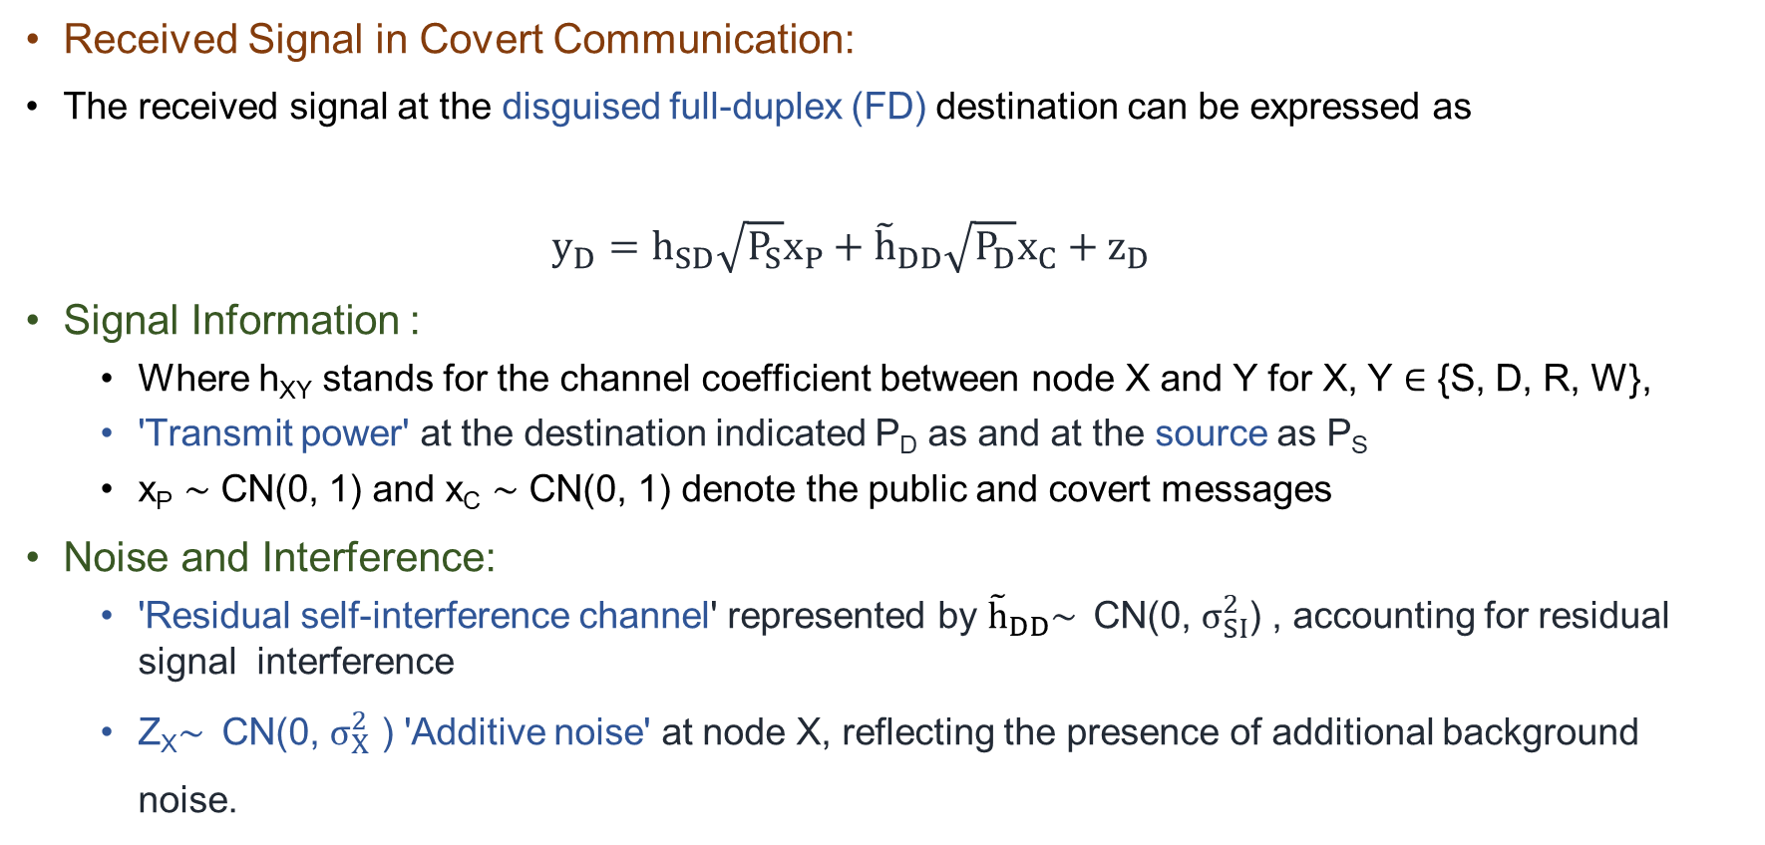
System Model
Received Signal in Covert Communication:
The received signal at the disguised full-duplex (FD) destination can be expressed as
$y_{D}=h_{SD}\sqrt{P_{S}}x_{P}+{\tilde{h}}_{DD}\sqrt{P_{D}}x_{C}+z_{D}$
Signal Information :
Where h_{XY} stands for the channel coefficient between node X and Y for X, Y ∈ {S, D, R, W},
'Transmit power' at the destination indicated P_{D} as and at the source as P_{S}
x_{P} ∼ CN(0, 1) and x_{C} ∼ CN(0, 1) denote the public and covert messages
Noise and Interference:
'Residual self-interference channel' represented by ${\tilde{h}}_{DD}\sim$ CN(0, $σ_{SI}^{2}$) , accounting for residual signal interference
Z_{X}$\sim$ CN(0, $σ_{X}^{2}$ ) 'Additive noise' at node X, reflecting the presence of additional background noise.

Slide 9
System Model
CSI information:
The destination node can keep the CSI of the source node h_{SD} since the covert transmission occurs internally under the normal S-D communications.
The hidden receiver can also easily estimate the CSI of the source and destination nodes.
If pilot sequences are informed from the destination node in advance during channel estimation.
Availability of CSI on the warden node, we assume the worst-case covert communications scenario in this work,
Meaning that the warden has the perfect knowledge of the CSI from the destination and hidden receiver to identify the worst-case achievable covert rate as a performance guideline in practice

Slide 10
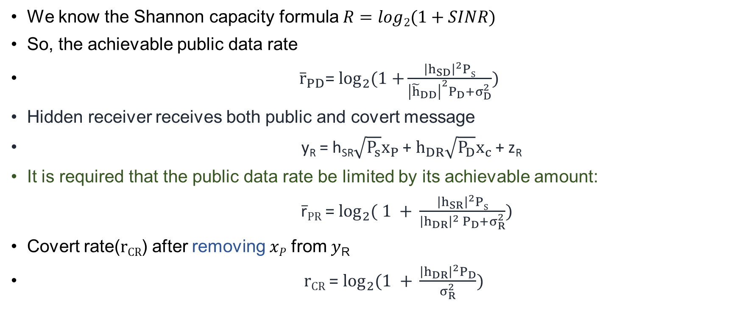
System Model
We know the Shannon capacity formula $R=log2(1+SINR)$
So, the achievable public data rate
${\overline{r}}_{PD}$= $\log_{2}{(1+}\frac{{\left|h_{SD}\right|}^{2}PS}{{\left|{\tilde{h}}_{DD}\right|}^{2}P_{D}+σ_{D}^{2}})$
Hidden receiver receives both public and covert message
y_{R} = h_{SR}$\sqrt{P_{s}}x_{P}$ + $h_{DR}\sqrt{P_{D}}x_{c}$+ z_{R}
It is required that the public data rate be limited by its achievable amount:
r̅_{PR} = $\log_{2}{( 1 + }\frac{{\left|h_{SR}\right|}^{2}PS}{{\left|h_{DR}\right|}^{2} P_{D}+σ_{R}^{2}})$
Covert rate(r_{CR}) after removing 𝑥_{𝑃} from 𝑦_{R}
r_{CR} = $\log_{2}{(1 + }\frac{{\left|h_{DR}\right|}^{2}P_{D}}{σ_{R}^{2}})$

Slide 11
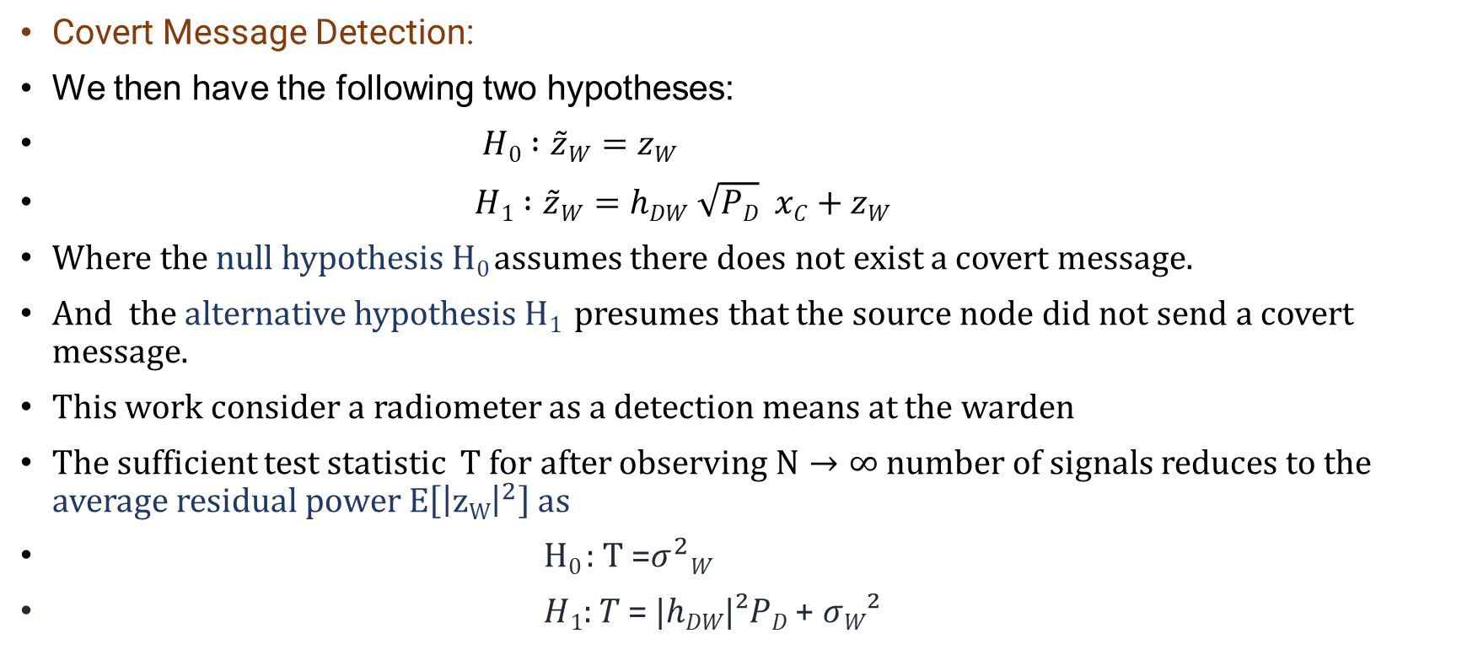
System Model
Covert Message Detection:
We then have the following two hypotheses:
$H0 :\tilde{z}W=zW$
$H1 :\tilde{z}W=hDW \sqrt{PD}$ $xC+zW$
Where the null hypothesis $H0$assumes there does not exist a covert message.
And the alternative hypothesis $H1$ presumes that the source node did not send a covert message.
This work consider a radiometer as a detection means at the warden
The sufficient test statistic $T$for after observing $N→∞$number of signals reduces to the average residual power $E\left[{\left|zW\right|}^{2}\right] as$
H₀ : T =$σ^{2}W$
𝐻₁: 𝑇 = |ℎ_{𝐷𝑊}|²𝑃_{𝐷} + 𝜎_{𝑊}²

Slide 12
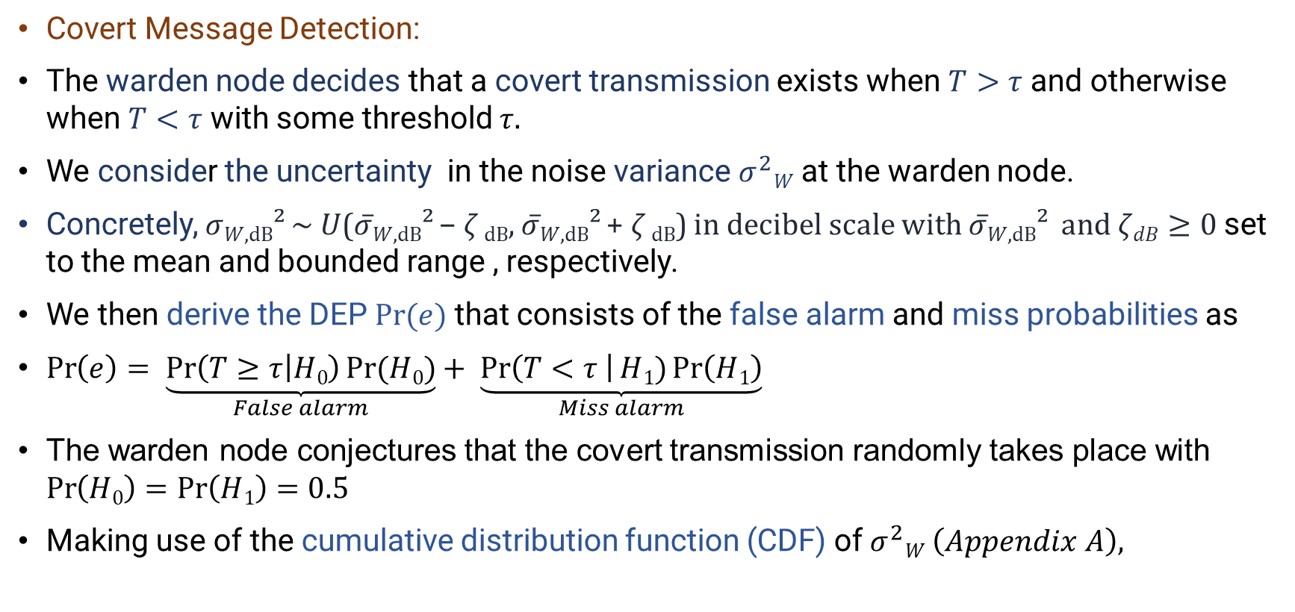
System Model
Covert Message Detection:
The warden node decides that a covert transmission exists when $T>τ$ and otherwise when $T<τ$ with some threshold $τ.$
We consider the uncertainty in the noise variance $σ^{2}W$ at the warden node.
Concretely, 𝜎_{𝑊,dB}² ~ 𝑈(𝜎̅_{𝑊,dB}² − $ζ$ _{dB}, 𝜎̅_{𝑊,dB}² + $ζ$ _{dB}) in decibel scale with 𝜎̅_{𝑊,dB}² and $ζdB≥0$set to the mean and bounded range , respectively.
We then derive the DEP $Pr⁡(e)$ that consists of the false alarm and miss probabilities as
$\operatorname{Pr}\left(e\right)= \underset{False alarm}{\underbrace{\operatorname{Pr}\left(T≥τ | H0\right)Pr⁡(H0)}}+ \underset{Miss alarm}{\underbrace{\operatorname{Pr}\left(T<τ \right|H1)\operatorname{Pr}\left(H1\right)}}$
The warden node conjectures that the covert transmission randomly takes place with $\operatorname{Pr}\left(H0\right)=\operatorname{Pr}\left(H1\right)=0.5$
Making use of the cumulative distribution function (CDF) of $σ^{2}W \left(Appendix A\right),$

Slide 13
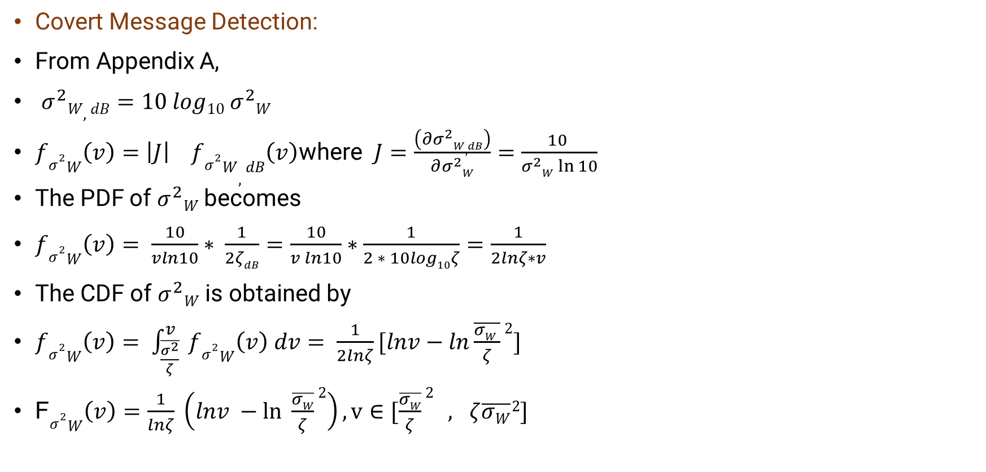
System Model
Covert Message Detection:
From Appendix A,
$σ^{2}W,dB=10 log10{ σ}^{2}W$
$fσ^{2}W\left(v\right)=\left|J\right| fσ^{2}W,dB\left(v\right)$where $J=\frac{\left(∂σ^{2}W,dB\right)}{∂σ^{2}W}=\frac{10 }{σ^{2}W\ln{10}}$
The PDF of $σ^{2}W$becomes
$fσ^{2}W\left(v\right)= \frac{10}{vln10}∗ \frac{1}{2ζdB}=\frac{10}{v ln10}∗\frac{1}{2 ∗ 10log10ζ}=\frac{1}{2lnζ∗v}$
The CDF of $σ^{2}W$ is obtained by
$fσ^{2}W\left(v\right)= \int_{\frac{\overline{σ^{2}}}{ζ}}^{v}{ fσ^{2}W\left(v\right) dv= \frac{1}{2lnζ}[lnv−ln\frac{\overline{σW }}{ζ}2]}$
F$σ^{2}W\left(v\right)=\frac{1}{lnζ} \left(lnv −\ln{ \frac{\overline{σW}}{ζ}}2\right), v∈[\frac{\overline{σW}}{ζ}2 , ζ\overline{σW}2]$

Slide 14
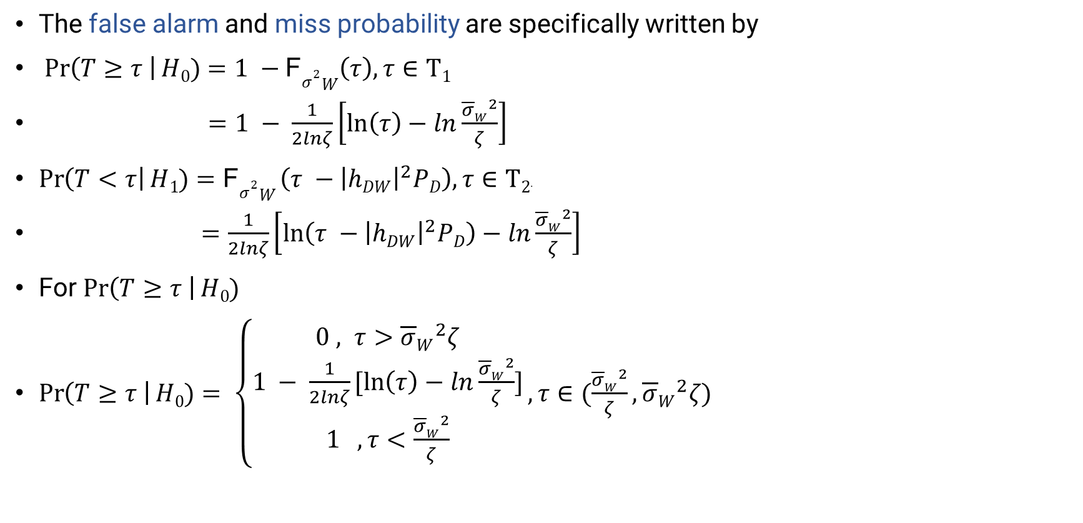
System Model
The false alarm and miss probability are specifically written by
$\operatorname{Pr}\left(T≥τ \right|H0)=1 −\text{F}σ^{2}W\left(τ\right), τ∈Τ1$
$=1 − \frac{1}{2lnζ}\left[\ln\left(τ\right)−ln\frac{{\overline{σ}W}^{2}}{ζ}\right]$
$\operatorname{Pr}\left(T<τ\right|H1)=\text{F}σ^{2}W \left(τ −{\left|hDW\right|}^{2}PD\right),τ∈Τ2$.
$=\frac{1}{2lnζ}\left[\ln\left(τ −{\left|hDW\right|}^{2}PD\right)−ln\frac{{\overline{σ}W}^{2}}{ζ}\right]$
For $\operatorname{Pr}\left(T≥τ \right|H0)$
$\operatorname{Pr}\left(T≥τ \right|H0)= \left\{\begin{aligned}0 , τ>{\overline{σ}W}^{2}ζ \\ 1 − \frac{1}{2lnζ}[\ln\left(τ\right)−ln\frac{{\overline{σ}W}^{2}}{ζ}] \\ 1 , τ<\frac{{\overline{σ}W}^{2}}{ζ}\end{aligned}\right.,τ∈(\frac{{\overline{σ}W}^{2}}{ζ},{\overline{σ}W}^{2}ζ)$

Slide 15
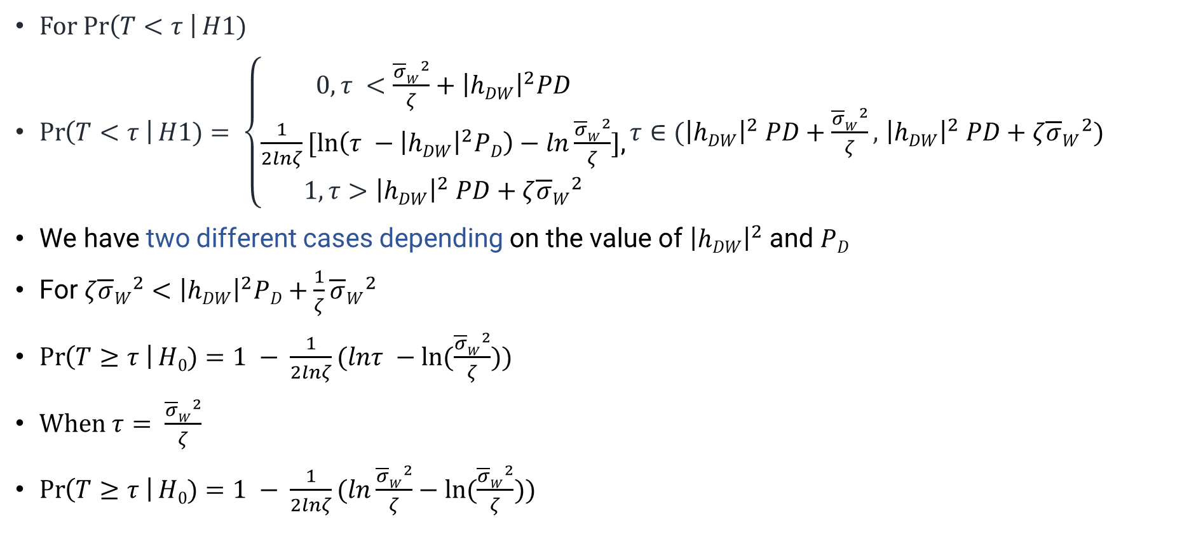
System Model
For $\operatorname{Pr}\left(T<τ \right|H1)$
$\operatorname{Pr}\left(T<τ \right|H1)= \left\{\begin{aligned}0, τ <\frac{{\overline{σ}W}^{2}}{ζ}+{\left|hDW\right|}^{2}PD \\ \frac{1}{2lnζ}[\ln\left(τ −{\left|hDW\right|}^{2}PD\right)−ln\frac{{\overline{σ}W}^{2}}{ζ}]\text{,} \\ 1, τ>{\left|hDW\right|}^{2} PD+ζ{\overline{σ}W}^{2}\end{aligned}\right.τ∈({\left|hDW\right|}^{2} PD+\frac{{\overline{σ}W}^{2}}{ζ},$ ${\left|hDW\right|}^{2} PD+ζ{\overline{σ}W}^{2})$
We have two different cases depending on the value of ${\left|hDW\right|}^{2}$ and $PD$
For $ζ{\overline{σ}W}^{2}<{\left|hDW\right|}^{2}PD+\frac{1}{ζ}{\overline{σ}W}^{2}$
$\operatorname{Pr}\left(T≥τ \right|H0)=1 − \frac{1}{2lnζ}(lnτ −ln⁡(\frac{{\overline{σ}W}^{2}}{ζ}))$
When $τ= \frac{{\overline{σ}W}^{2}}{ζ}$
$\operatorname{Pr}\left(T≥τ \right|H0)=1 − \frac{1}{2lnζ}(ln\frac{{\overline{σ}W}^{2}}{ζ}−ln⁡(\frac{{\overline{σ}W}^{2}}{ζ}))$

Slide 16

System Model
$\operatorname{Pr}\left(T≥τ \right|H0)=1 − \frac{1}{2lnζ} ∗0$
$=1$
When $τ=ζ{\overline{σ}W}^{2}$
$\operatorname{Pr}\left(T≥τ \right|H0)=1 − \frac{1}{2lnζ}(ln⁡(ζ {\overline{σ}W}^{2}) −ln⁡(\frac{{\overline{σ}W}^{2}}{ζ}))$
$=1 −\frac{1}{2lnζ}(\ln\left(\frac{ζ{\overline{σ}W}^{2}}{\frac{{\overline{σ}W}^{2}}{ζ}} \right))$
$=1 −\frac{1}{2lnζ}\ln\left(ζ^{2}\right)$
$=1 −\frac{1}{2lnζ} ∗2lnζ$
$=0$

Slide 17
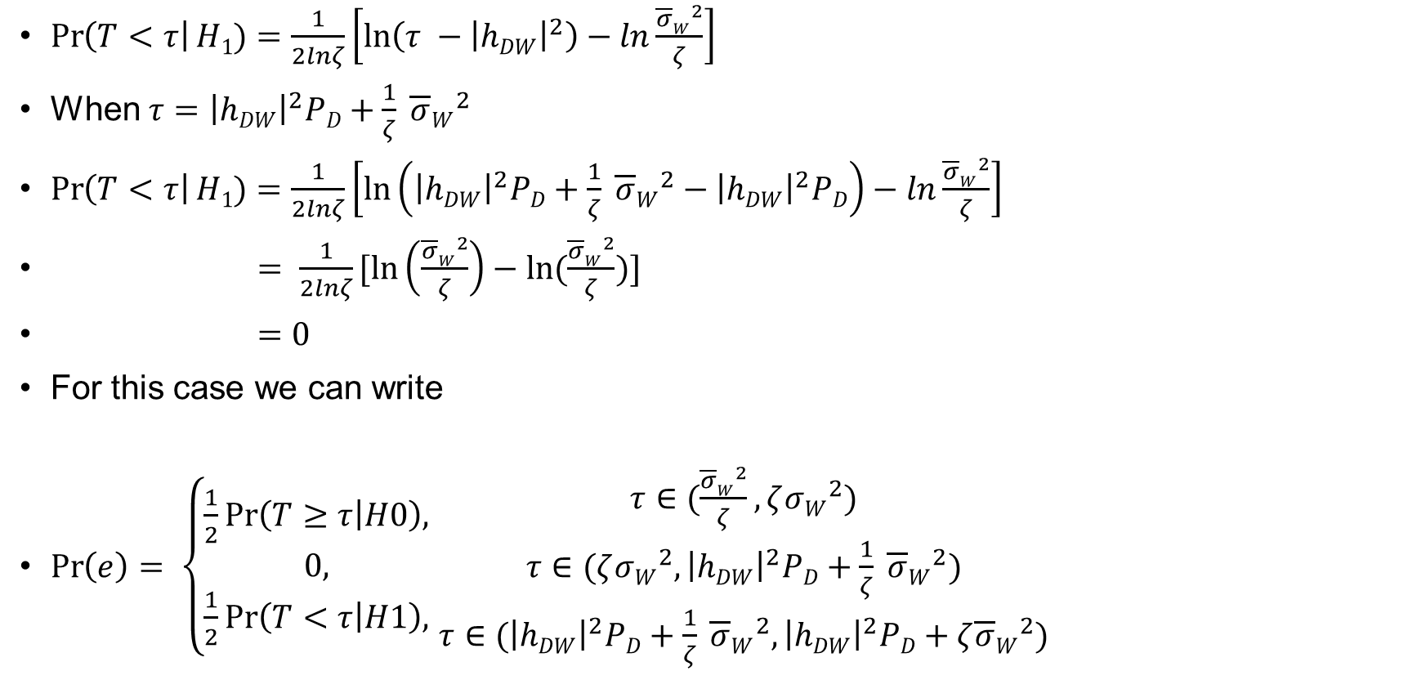
System Model
$\operatorname{Pr}\left(T<τ\right|H1)=\frac{1}{2lnζ}\left[\ln\left(τ −{\left|hDW\right|}^{2}\right)−ln\frac{{\overline{σ}W}^{2}}{ζ}\right]$
When $τ={\left|hDW\right|}^{2}PD+\frac{1}{ζ} {\overline{σ}W}^{2}$
$\operatorname{Pr}\left(T<τ\right|H1)=\frac{1}{2lnζ}\left[\ln\left({\left|hDW\right|}^{2}PD+\frac{1}{ζ} {\overline{σ}W}^{2}−{\left|hDW\right|}^{2}PD\right)−ln\frac{{\overline{σ}W}^{2}}{ζ}\right]$
$= \frac{1}{2lnζ}[ln\left(\frac{{\overline{σ}W}^{2}}{ζ}\right)−ln(\frac{{\overline{σ}W}^{2}}{ζ})]$
$=0$
For this case we can write
$\operatorname{Pr}\left(e\right)= \left\{\begin{aligned}\frac{1}{2}\operatorname{Pr}\left(T≥τ | H0\right), \\ 0, \\ \frac{1}{2}\operatorname{Pr}\left(T<τ | H1\right),\end{aligned}\right.$ $\begin{matrix}τ∈(\frac{{\overline{σ}W}^{2}}{ζ},ζ{σW}^{2}) \\ τ∈(ζ{σW}^{2},{\left|hDW\right|}^{2}PD+\frac{1}{ζ} {\overline{σ}W}^{2}) \\ τ∈({\left|hDW\right|}^{2}PD+\frac{1}{ζ} {\overline{σ}W}^{2},{\left|hDW\right|}^{2}PD+ζ{\overline{σ}W}^{2})\end{matrix}$

Slide 18
System Model
$$ζ{\overline{σ}W}^{2}<{\left|hDW\right|}^{2}PD+\frac{1}{ζ}{\overline{σ}W}^{2}$$
A rough curve of Pr(error)
1/2
Pr(error)
 |  | 0
Maximum error =Random guess
0 $\frac{{\overline{σ}W}^{2}}{ζ}$ $ζ{σW}^{2}$ ${ \left|hDW\right|}^{2}PD+\frac{1}{ζ} {\overline{σ}W}^{2 }{ \left|hDW\right|}^{2}PD+ζ{\overline{σ}W}^{2}$ $τ$

Slide 19
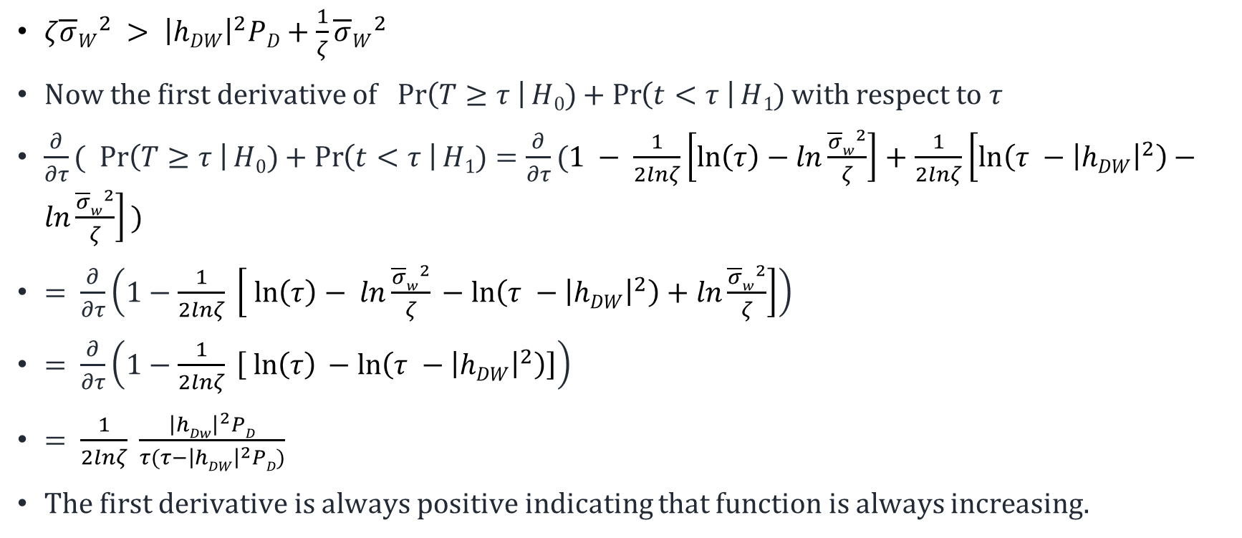
System Model
$ζ{\overline{σ}W}^{2} > {\left|hDW\right|}^{2}PD+\frac{1}{ζ}{\overline{σ}W}^{2}$
Now the first derivative of $\operatorname{Pr}\left(T≥τ \right|H0)+\operatorname{Pr}\left(t<τ \right|H1)$with respect to $τ$
$\frac{∂}{∂τ}(\operatorname{Pr}\left(T≥τ \right|H0)+\operatorname{Pr}\left(t<τ \right|H1)=\frac{∂}{∂τ}(1 − \frac{1}{2lnζ}\left[\ln\left(τ\right)−ln\frac{{\overline{σ}w}^{2}}{ζ}\right]+$ $\frac{1}{2lnζ}\left[\ln\left(τ −{\left|hDW\right|}^{2}\right)−ln\frac{{\overline{σ}w}^{2}}{ζ}\right] )$
$= \frac{∂}{∂τ}\left(1−\frac{1}{2lnζ} \left[\ln\left(τ\right)− ln\frac{{\overline{σ}w}^{2}}{ζ} −\ln\left(τ −{\left|hDW\right|}^{2}\right)+ln\frac{{\overline{σ}w}^{2}}{ζ}\right]\right)$
$= \frac{∂}{∂τ}\left(1−\frac{1}{2lnζ} \left[\ln\left(τ\right) −\ln\left(τ −{\left|hDW\right|}^{2}\right)\right]\right)$
$= \frac{1}{2lnζ} \frac{{\left|hDw\right|}^{2}PD}{τ(τ−{\left|hDW\right|}^{2}PD)}$
The first derivative is always positive indicating that function is always increasing.

Slide 20

System Model
For $ζ{\overline{σ}W}^{2} > {\left|hDW\right|}^{2}PD+\frac{1}{ζ}{\overline{σ}W}^{2}$
$\operatorname{Pr}\left(e\right)= \left\{\begin{aligned}\frac{1}{2}\operatorname{Pr}\left(T≥τ \right|H0), τ∈(\frac{{\overline{σ}W}^{2}}{ζ},{\left|hDW\right|}^{2}PD+\frac{{\overline{σ}W}^{2}}{ζ}) \\ \frac{1}{2} \left(\operatorname{Pr}\left(T≥τ \right|H0\right)+\operatorname{Pr}\left(T<τ \right|H1), τ∈({\left|hDW\right|}^{2}PD+\frac{{\overline{σ}W}^{2}}{ζ},ζ {\overline{σ}W}^{2}) \\ \frac{1}{2}\left(\operatorname{Pr}\left(T<τ \right|H1\right) , τ∈( ζ {\overline{σ}W}^{2},{\left|hDW\right|}^{2}PD+ζ {\overline{σ}W}^{2})\end{aligned}\right.$
Pr(error)
½
 |  | 0
Maximum error
= Random
guess
0 $\frac{{\overline{σ}W}^{2}}{ζ}$ ${ \left|hDW\right|}^{2}PD+\frac{{\overline{σ}W}^{2}}{ζ}$ $ζ {\overline{σ}W}^{2}$ ${\left|hDW\right|}^{2}PD+ζ {\overline{σ}W}^{2}$ $τ$

Slide 21
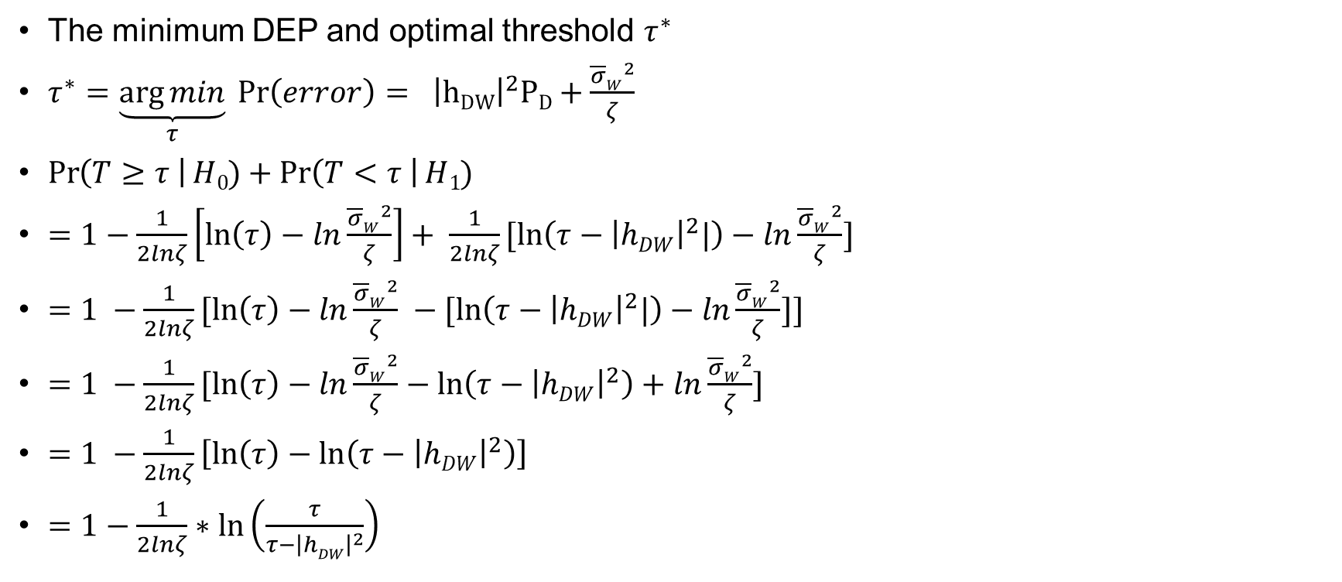
System Model
The minimum DEP and optimal threshold $τ^{∗}$
$τ^{∗}=\underset{τ}{\underbrace{\arg{min}}} \operatorname{Pr}\left(error\right)= { \left|hDW\right|}^{2}PD+\frac{{\overline{σ}W}^{2}}{ζ}$
$\operatorname{Pr}\left(T≥τ \right|H0)+\operatorname{Pr}\left(T<τ \right|H1)$
$=1−\frac{1}{2lnζ}\left[\ln\left(τ\right)−ln\frac{{\overline{σ}W}^{2}}{ζ}\right]+ \frac{1}{2lnζ}[\ln\left(τ−{\left|hDW\right|}^{2}|\right)−ln\frac{{\overline{σ}W}^{2}}{ζ}]$
$=1 −\frac{1}{2lnζ}[\ln\left(τ\right)−ln\frac{{\overline{σ}W}^{2}}{ζ} −[\ln\left(τ−{\left|hDW\right|}^{2}|\right)−ln\frac{{\overline{σ}W}^{2}}{ζ}]]$
$=1 −\frac{1}{2lnζ}[\ln\left(τ\right)−ln\frac{{\overline{σ}W}^{2}}{ζ}−ln\left(τ−{\left|hDW\right|}^{2}\right)+ln\frac{{\overline{σ}W}^{2}}{ζ}]$
$=1 −\frac{1}{2lnζ}\left[\ln\left(τ\right)−ln\left(τ−{\left|hDW\right|}^{2}\right)\right]$
$=1−\frac{1}{2lnζ}∗\ln\left(\frac{τ}{τ−{\left|hDW\right|}^{2}}\right)$

Slide 22
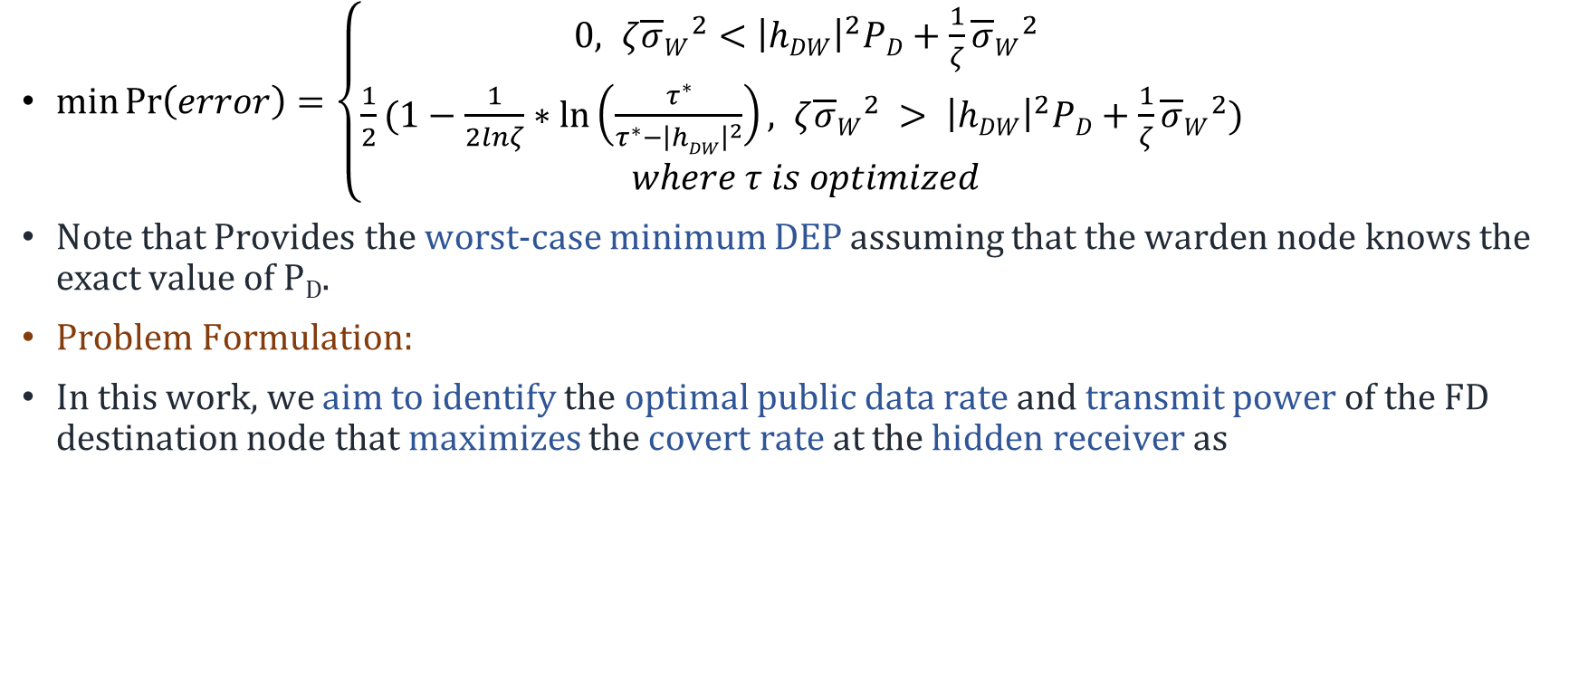
System Model
$\min{\operatorname{Pr}\left(error\right)=\left\{\begin{aligned}0, ζ{\overline{σ}W}^{2}<{\left|hDW\right|}^{2}PD+\frac{1}{ζ}{\overline{σ}W}^{2} \\ &\frac{1}{2}(1−\frac{1}{2lnζ}∗\ln\left(\frac{τ^{∗}}{τ^{∗}−{\left|hDW\right|}^{2}}\right), ζ{\overline{σ}W}^{2} > {\left|hDW\right|}^{2}PD+\frac{1}{ζ}{\overline{σ}W}^{2}) \\ where τ is optimized\end{aligned}\right.}$
Note that Provides the worst-case minimum DEP assuming that the warden node knows the exact value of P_{D}.
Problem Formulation:
In this work, we aim to identify the optimal public data rate and transmit power of the FD destination node that maximizes the covert rate at the hidden receiver as

Slide 23
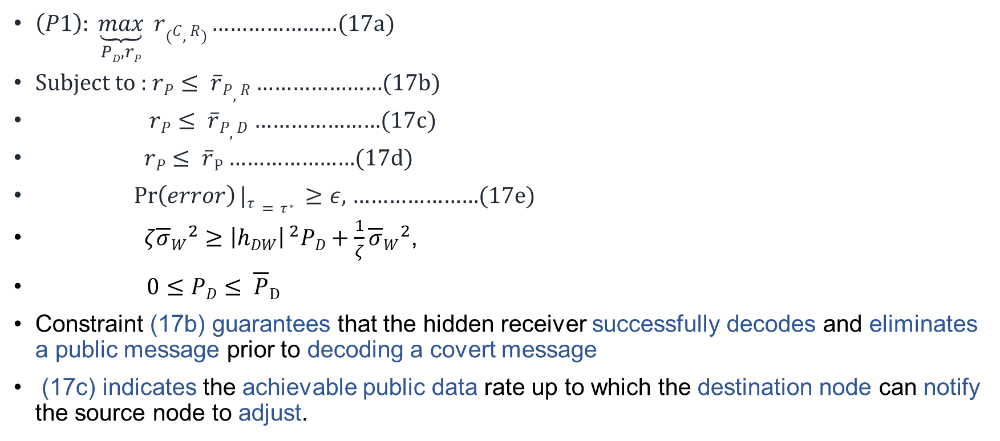
System Model
$\left(P1\right): \underset{PD,rP}{\underbrace{max}} r(C,R)$ …………………(17a)
Subject to : $rP≤ \overline{r}P,R$ …………………(17b)
$rP≤ \overline{r}P,D$ …………………(17c)
$rP≤ \overline{r}P$ …………………(17d)
$\operatorname{Pr}\left(error\right)|τ=τ^{∗} ≥ε,$ …………………(17e)
$ζ{\overline{σ}W}^{2}≥{\left|hDW\right|}^{ 2}PD+\frac{1}{ζ}{\overline{σ}W}^{2}$,
$0≤PD≤ \overline{P}D$
Constraint (17b) guarantees that the hidden receiver successfully decodes and eliminates a public message prior to decoding a covert message
(17c) indicates the achievable public data rate up to which the destination node can notify the source node to adjust.

Slide 24
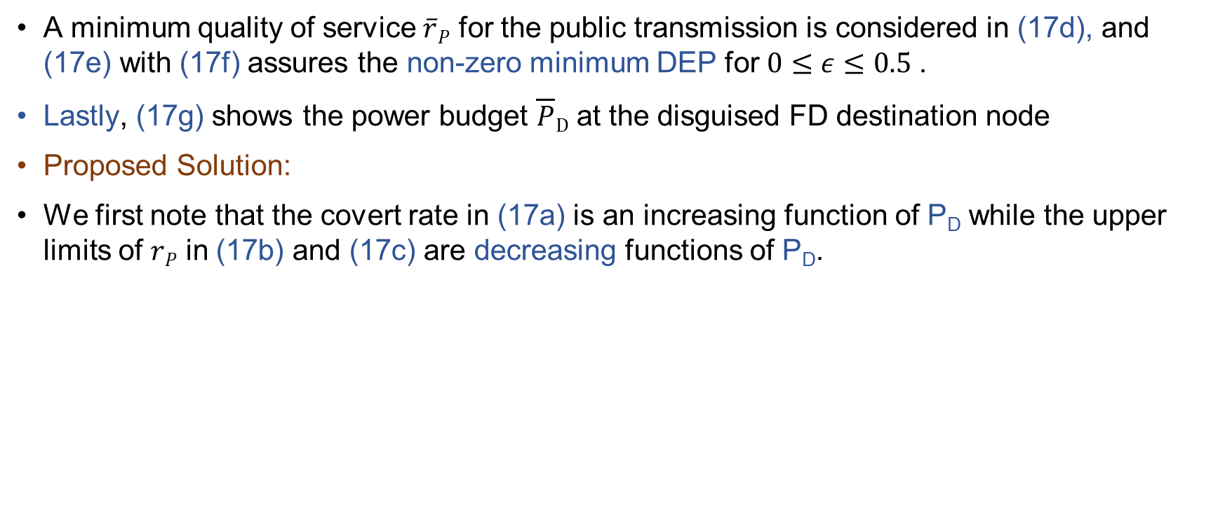
System Model
A minimum quality of service $\overline{r}P$ for the public transmission is considered in (17d), and (17e) with (17f) assures the non-zero minimum DEP for $0≤ε≤0.5$.
Lastly, (17g) shows the power budget $\overline{P}D$ at the disguised FD destination node
Proposed Solution:
We first note that the covert rate in (17a) is an increasing function of P_{D} while the upper limits of $rP$ in (17b) and (17c) are decreasing functions of P_{D}.

Slide 25

System Model
Proof)
$rP≤ \overline{r}P,R$
$rP≤ \log_{2}{( 1 + }\frac{{\left|h_{SR}\right|}^{2}PS}{{\left|h_{DR}\right|}^{2} P_{D}+σ_{R}^{2}} )$
$\frac{∂rP}{∂PD}≤ \frac{∂}{∂PD}(\log_{2}{( 1 + }\frac{{\left|h_{SR}\right|}^{2}PS}{{\left|h_{DR}\right|}^{2} P_{D}+σ_{R}^{2}} ))$
$≤\frac{−{\left|h_{SR}\right|}^{2}PS{\left|h_{DR}\right|}^{2}}{{\left({\left|h_{DR}\right|}^{2} P_{D}+σ_{R}^{2}\right)}^{2}}$
This differentiation result always negative that’s indicate that $\left(17b\right)$ is decreasing function

Slide 26
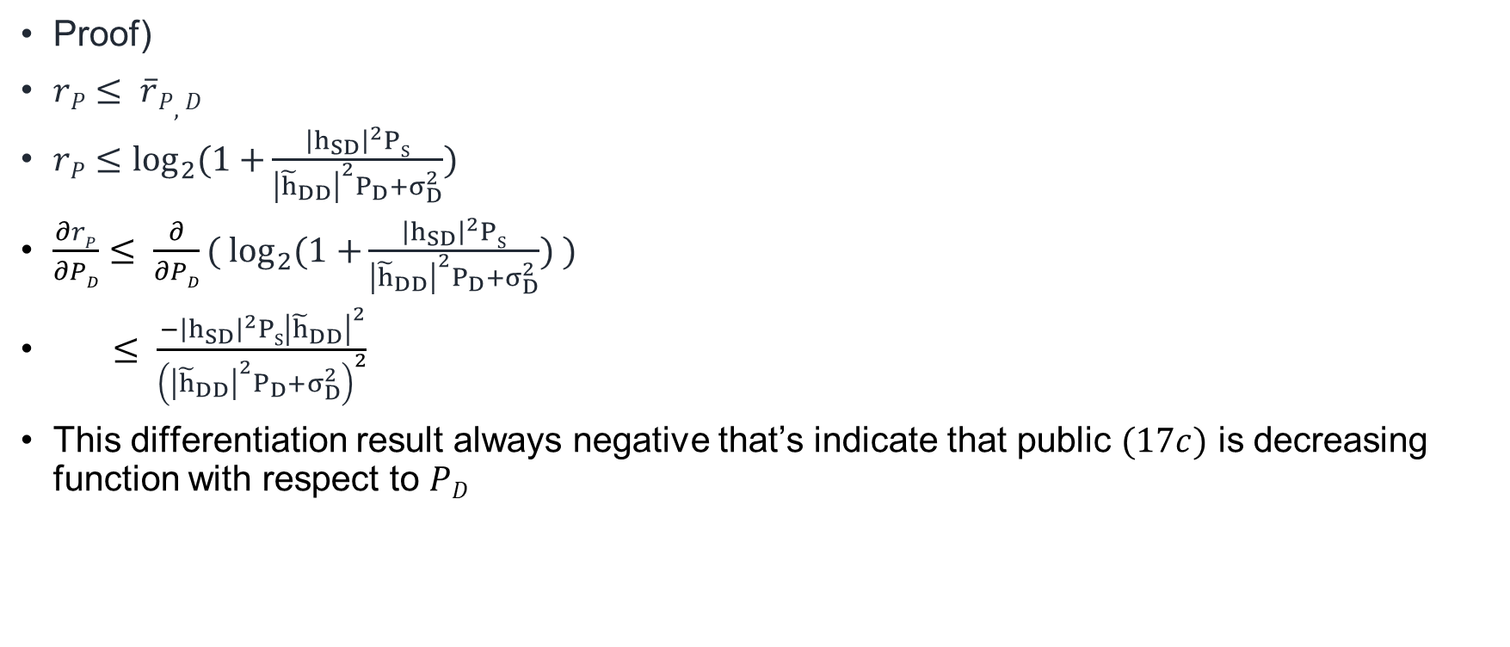
System Model
Proof)
$rP≤ \overline{r}P,D$
$rP≤\log_{2}{(1+}\frac{{\left|h_{SD}\right|}^{2}PS}{{\left|{\tilde{h}}_{DD}\right|}^{2}P_{D}+σ_{D}^{2}})$
$\frac{∂rP}{∂PD}≤ \frac{∂}{∂PD}{( log}_{2}{(1+}\frac{{\left|h_{SD}\right|}^{2}PS}{{\left|{\tilde{h}}_{DD}\right|}^{2}P_{D}+σ_{D}^{2}}) )$
$≤ \frac{−{\left|h_{SD}\right|}^{2}PS{\left|{\tilde{h}}_{DD}\right|}^{2}}{{\left({\left|{\tilde{h}}_{DD}\right|}^{2}P_{D}+σ_{D}^{2}\right)}^{2}}$
This differentiation result always negative that’s indicate that public $(17c)$ is decreasing function with respect to $PD$

Slide 27
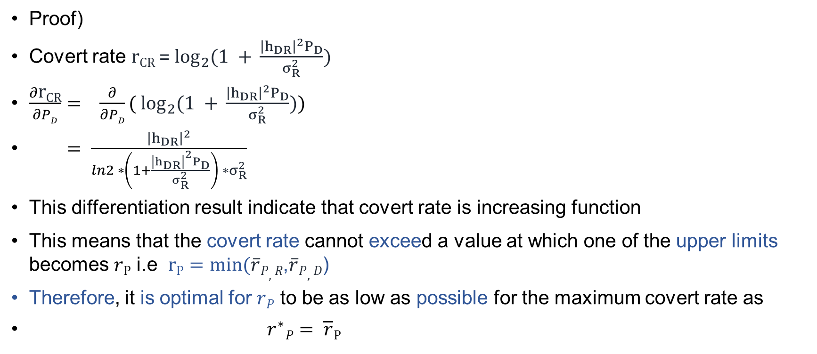
System Model
Proof)
Covert rate r_{CR} = $\log_{2}{(1 + }\frac{{\left|h_{DR}\right|}^{2}P_{D}}{σ_{R}^{2}})$
$\frac{∂\text{r}\text{CR}}{∂PD}= \frac{∂}{∂PD}(\log_{2}{(1 + }\frac{{\left|h_{DR}\right|}^{2}P_{D}}{σ_{R}^{2}}))$
$= \frac{{\left|h_{DR}\right|}^{2}}{ln2 ∗\left(1+\frac{{\left|h_{DR}\right|}^{2}P_{D}}{σ_{R}^{2}}\right) ∗σ_{R}^{2}}$
This differentiation result indicate that covert rate is increasing function
This means that the covert rate cannot exceed a value at which one of the upper limits becomes $rP$ i.e $rP=min⁡(\overline{r}P,R$,$\overline{r}P,D$)
Therefore, it is optimal for $rP$ to be as low as possible for the maximum covert rate as
$r^{∗}P= \overline{r}P$

Slide 28
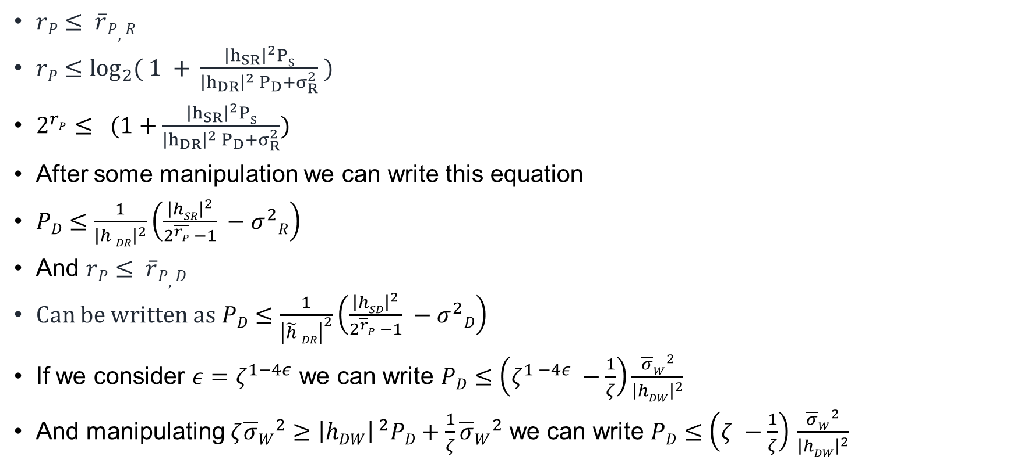
System Model
$rP≤ \overline{r}P,R$
$rP≤\log_{2}{( 1 + }\frac{{\left|h_{SR}\right|}^{2}PS}{{\left|h_{DR}\right|}^{2} P_{D}+σ_{R}^{2}} )$
$2^{rP}≤ (1+\frac{{\left|h_{SR}\right|}^{2}PS}{{\left|h_{DR}\right|}^{2} P_{D}+σ_{R}^{2}})$
After some manipulation we can write this equation
$PD≤\frac{1}{{\left|h DR\right|}^{2}}\left(\frac{{\left|hSR\right|}^{2}}{2^{\overline{rP}} −1} −σ^{2}R\right)$
And $rP≤ \overline{r}P,D$
Can be written as$PD≤\frac{1}{{\left|\tilde{h} DR\right|}^{2}}\left(\frac{{\left|hSD\right|}^{2}}{2^{\overline{r}P} −1} −σ^{2}D\right)$
If we consider $ε=ζ^{1−4ε}$ we can write $PD≤\left(ζ^{1 −4ε} −\frac{1}{ζ}\right)\frac{{\overline{σ}W}^{2}}{{\left|hDW\right|}^{2}}$
And manipulating $ζ{\overline{σ}W}^{2}≥{\left|hDW\right|}^{ 2}PD+\frac{1}{ζ}{\overline{σ}W}^{2}$ we can write $PD≤\left(ζ −\frac{1}{ζ}\right)$ $\frac{{\overline{σ}W}^{2}}{{\left|hDW\right|}^{2}}$

Slide 29
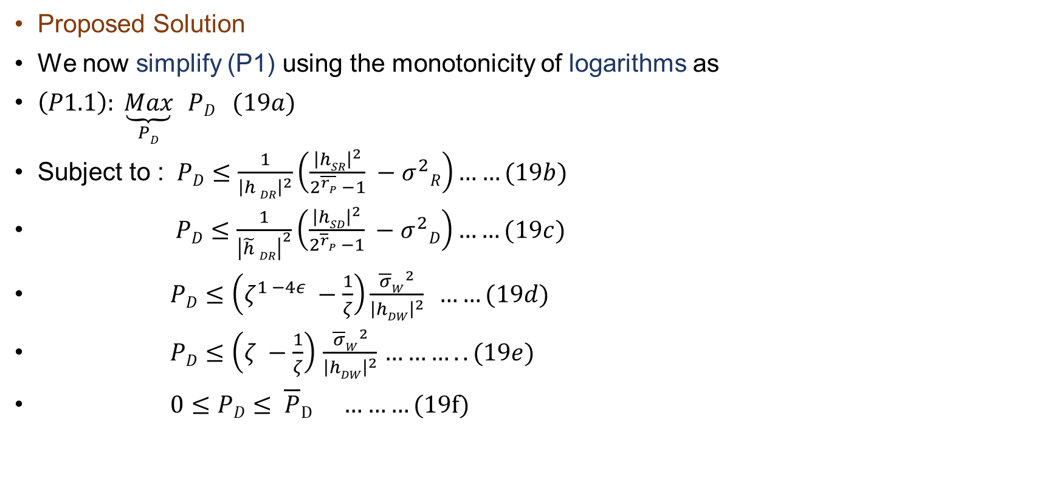
System Model
Proposed Solution
We now simplify (P1) using the monotonicity of logarithms as
$\left(P1.1\right): \underset{PD}{\underbrace{Max}}$ $PD (19a)$
Subject to : $PD≤\frac{1}{{\left|h DR\right|}^{2}}\left(\frac{{\left|hSR\right|}^{2}}{2^{\overline{rP}} −1} −σ^{2}R\right)……(19b)$
$PD≤\frac{1}{{\left|\tilde{h} DR\right|}^{2}}\left(\frac{{\left|hSD\right|}^{2}}{2^{\overline{r}P} −1} −σ^{2}D\right)……(19c)$
$PD≤\left(ζ^{1 −4ε} −\frac{1}{ζ}\right)\frac{{\overline{σ}W}^{2}}{{\left|hDW\right|}^{2}}$ $……(19d)$
$PD≤\left(ζ −\frac{1}{ζ}\right)$ $\frac{{\overline{σ}W}^{2}}{{\left|hDW\right|}^{2}}$ $………..(19e)$
$0≤PD≤ \overline{P}D ………(19f)$

Slide 30
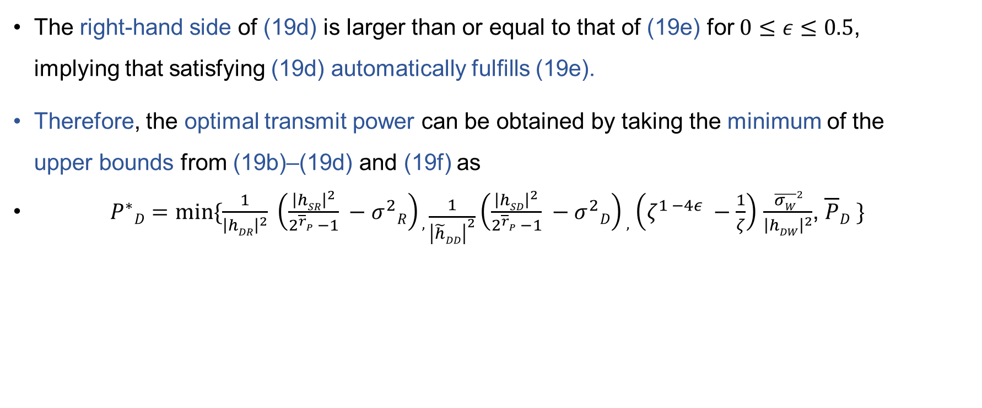
System Model
The right-hand side of (19d) is larger than or equal to that of (19e) for $0≤ε≤0.5$, implying that satisfying (19d) automatically fulfills (19e).
Therefore, the optimal transmit power can be obtained by taking the minimum of the upper bounds from (19b)–(19d) and (19f) as
$P^{∗}D=min⁡\{\frac{1}{{\left|hDR\right|}^{2}} \left(\frac{{\left|hSR\right|}^{2}}{2^{\overline{r}P} −1} −σ^{2}R\right), \frac{1}{{\left|\tilde{h}DD\right|}^{2}}\left(\frac{{\left|hSD\right|}^{2}}{2^{\overline{r}P} −1} −σ^{2}D\right),$ $\left(ζ^{1 −4ε} −\frac{1}{ζ}\right)$ $\frac{\overline{σW}2}{{\left|hDW\right|}^{2}}$, $\overline{P}D \}$

Slide 31
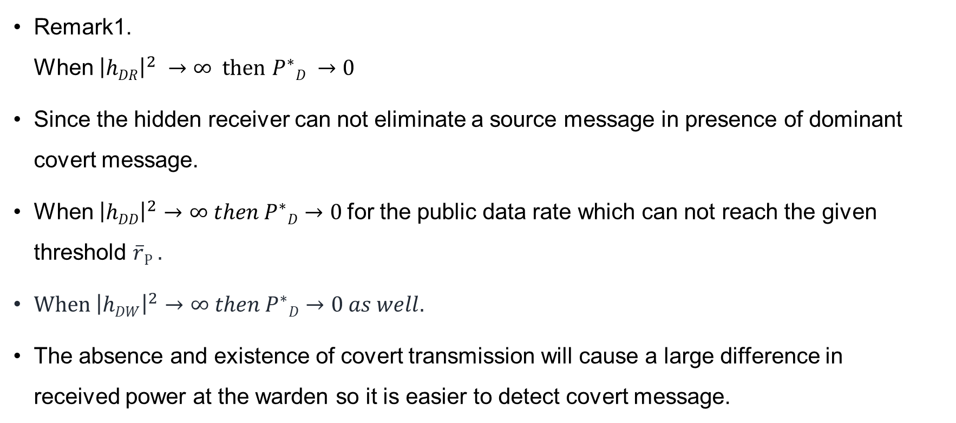
System Model
Remark1. When ${\left|hDR\right|}^{2} →∞ then$ $P^{∗}D →0$
Since the hidden receiver can not eliminate a source message in presence of dominant covert message.
When ${\left|hDD\right|}^{2}→∞ then P^{∗}D→0$for the public data rate which can not reach the given threshold $\overline{r}P$ .
When ${\left|hDW\right|}^{2}→∞ then P^{∗}D→0 as well.$
The absence and existence of covert transmission will cause a large difference in received power at the warden so it is easier to detect covert message.

Slide 32
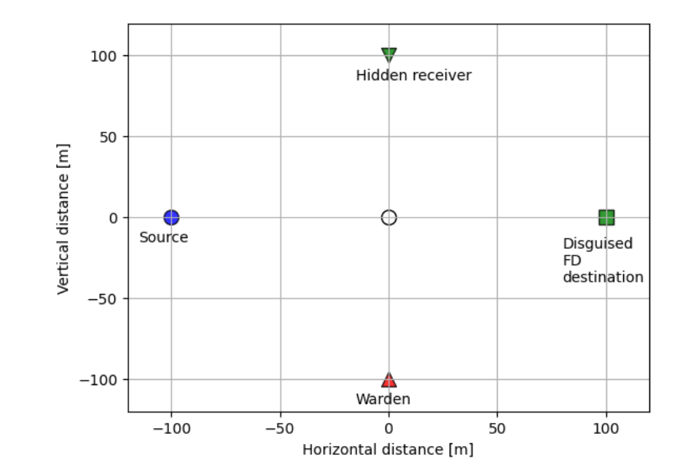
Numerical results
Figure2. Node Placement

Slide 33
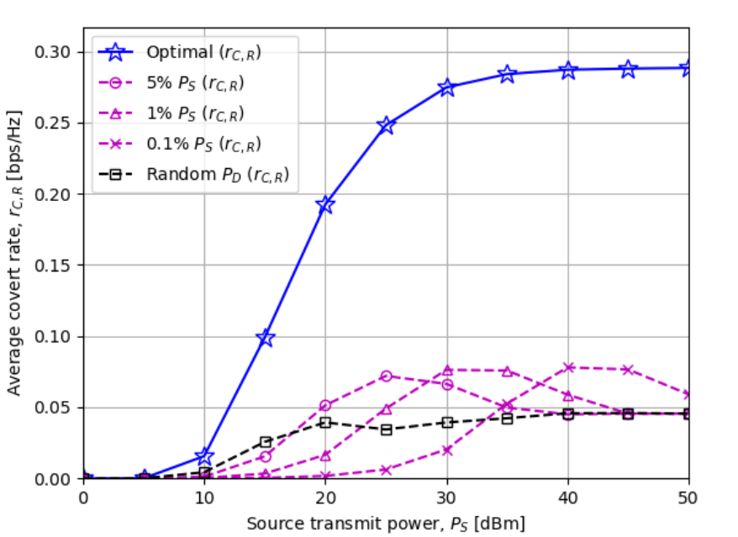
Numerical results
Figure3. The average covert rat$rCR versus the source node power Ps$

Slide 34
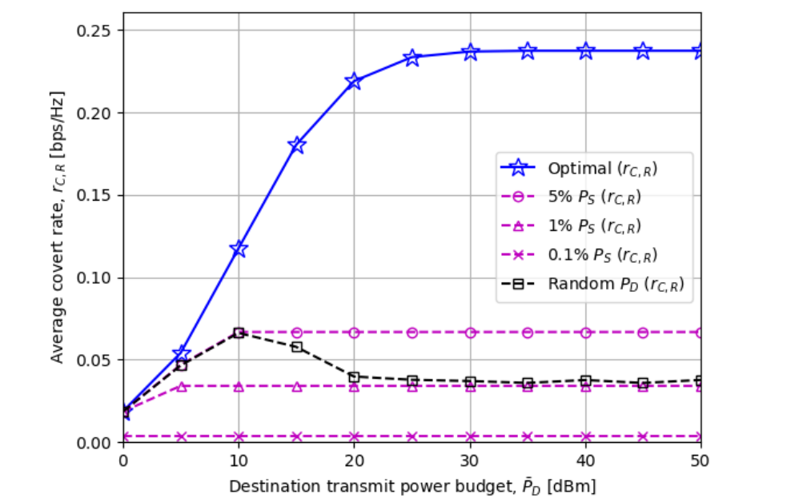
Numerical result
Figure 4. The average covert rate rCR versus the destination node power budget $\overline{PD}$

Slide 35
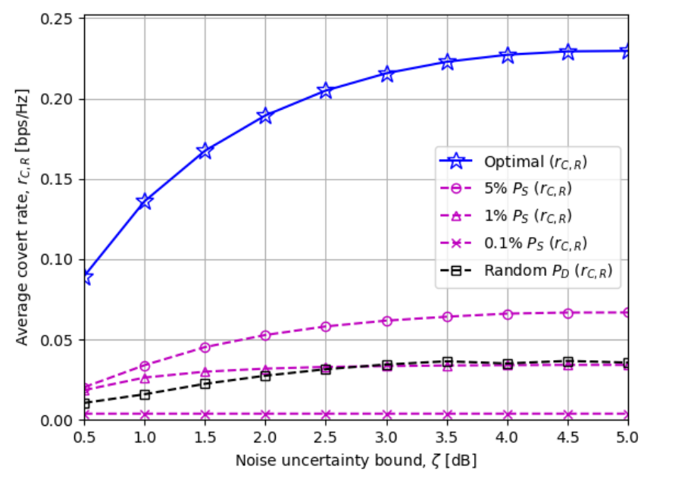
Numerical Results
Figure5.The average covert rate rCR versus the noise uncertainty bound $ζ[dB]$

Slide 36
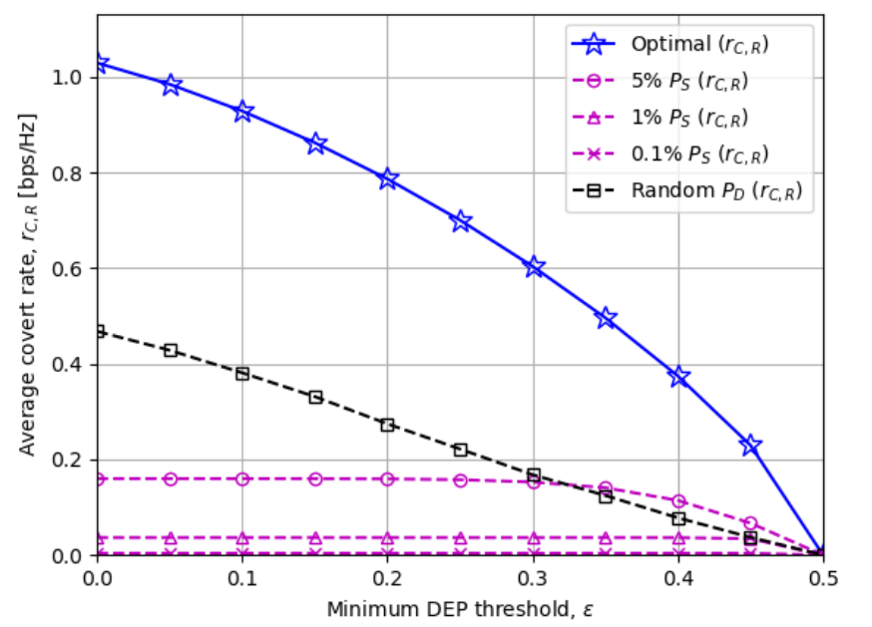
Numerical Results
Figure6.The average covert rate r_{CR} versus the minimum DEP threshold $ε$

Slide 37
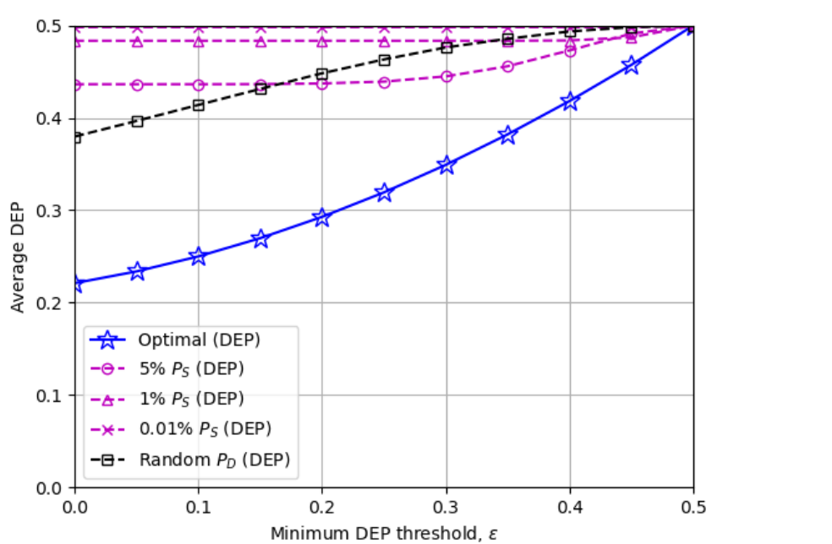
Numerical Results
Figure7. The average DEP versus the minimum DEP threshold $ε$

Slide 38
Discussion
Performance:
Figures 3–7 show how adjusting transmit power at the destination influences covert rate performance.
Figure 3 highlights a connection between low source power and higher covert rates with more destination power, and vice versa.
Figure 7 indicates the importance of optimizing destination power for the best covert rate and minimum DEP threshold trade-off.

Slide 39
Conclusion
Covert Communication System:
Source node communicates with a disguised FD destination node.
Destination node covertly sends critical messages to a hidden receiver, avoiding warden surveillance.
Optimization Goals:
Studied optimal public data rate and transmit power for FD destination node.
Objective: Maximize covert rate at the hidden receiver.
Closed-Form Solution Insights:
Optimal destination transmit power trends:
Approaches zero with an extremely strong destination–receiver link.
Approaches zero if self-interference isn't sufficiently suppressed.
Approaches zero with exceptionally high destination–warden channel gain

Slide 40
Conclusion
Numerical Results:
Phenomenon observed: Higher covert rate with more destination power when source power is low (and vice versa).
Optimal destination power achieves the best balance between covert rate and minimum DEP threshold.
Practical Considerations:
Work provides performance insights from an information-theoretic perspective.
Future research suggestions: Explore practical modulations and imperfect CSI.

Slide 41
Thank you for your Listening. For any queries, please email me at: refatkhanuits@gmail.com

Slide 42
Conclusion
Quality CSI is indispensable for minimizing the Detection Error Probability (DEP) at the AF relay.
Accurate CSI facilitates optimal signal processing, enhancing the reliability and effectiveness of covert communication strategies.
High-quality CSI ensures robust covert communication, strengthening the security and efficiency of the system.

Slide 43

$\left(P1\right): \underset{PD,rP}{\underbrace{max}} \min{Pr⁡(error)}$…………………(17a)
Subject to : $rP≤ \overline{r}P,R$ …………………(17b)
$rP≤ \overline{r}P,D$ …………………(17c)
$rP≤ \overline{r}P$ …………………(17d)
$r(C,R)≥ \overline{r}c$
$ζ{\overline{σ}W}^{2}≥{\left|hDW\right|}^{ 2}PD+\frac{1}{ζ}{\overline{σ}W}^{2}$,
$0≤PD≤ \overline{P}D$

