Slide 1
Covert Communication for a Disguised Full-Duplex vehicle with channel Distribution Information
2024.02.01
KICS Winter Conference 2024
Refat Khan, *Jihwan Moon
Department of Mobile Convergence Engineering, Hanbat National University

Slide 2
Table of Contents
Introduction
Method
Numerical Result
Conclusion

Slide 3
Introduction
Challenges of Secure Communication:
Security Threats:
Opponents can conduct traffic analysis by collecting metadata during transmission.
Vulnerabilities include capturing source and destination addresses, request-response frequency, etc
Need for Covert Communications:
Transmit data in a manner that avoids detection or suspicion.
Combining cryptography and physical layer security can prevent eavesdropping, but covert communications are necessary to counter traffic analysis threats.

Slide 4
Introduction
Vehicular Communications Overview:
Growing area of communication between vehicles and roadside infrastructure.
Enabled by advances in wireless communication technologies.
Real-Time Information Sharing:
Facilitates real-time sharing of information between vehicles and infrastructure.
Enhances safety, communication between passengers, and connectivity to the Internet.
Applications for Safety and Connectivity:
Applications designed to increase the safety of vehicles.
Supports communication between passengers and the Internet.

Slide 5
Introduction
Investigating Covert Communications:
System Overview:
Setup involves a source vehicle and disguised full-duplex (FD) destination vehicle.
Objective:
Ensure covert transmission to a hidden vehicle while warden vehicle surveillance.
Research Scope:
Explore channel uncertainty at the warden vehicle.
Determine the lower bound of the expected minimum detection error probability (DEP).
Research Outcomes:
Numerical results demonstrating covert rate performance under diverse DEP requirements
Emphasis on the significance of secure and covert communication strategies against advanced security threats.

Slide 6
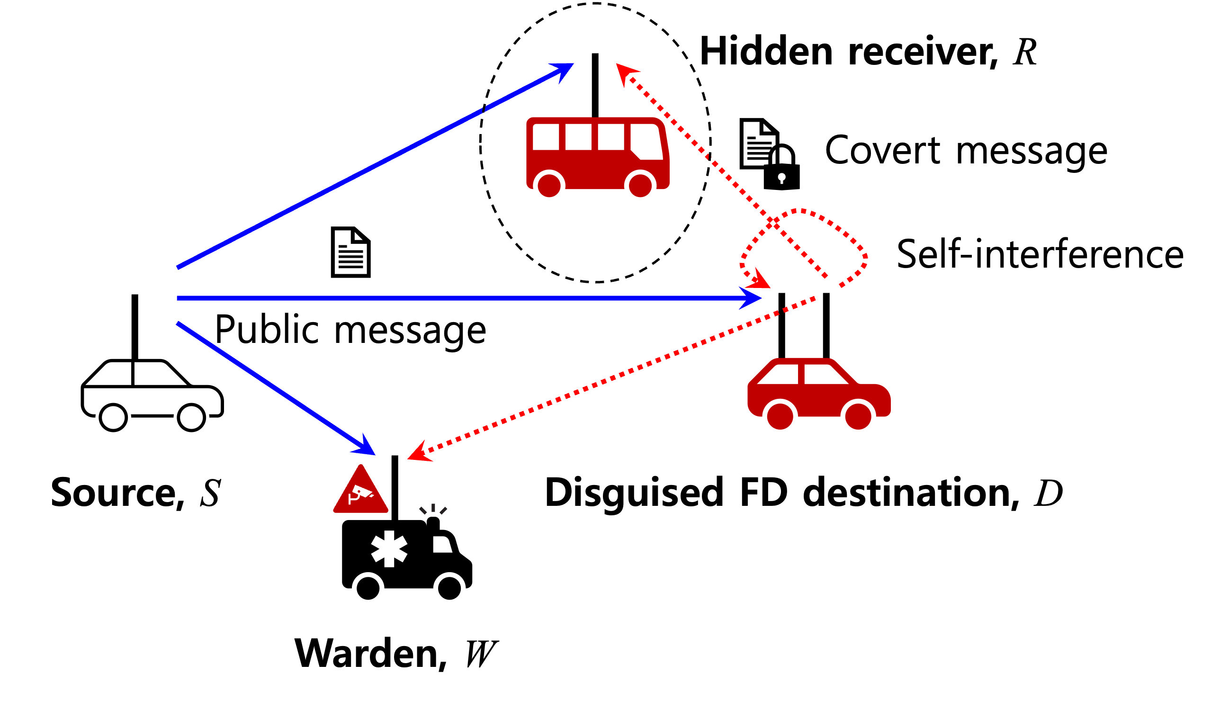
Method
Figure. Node Placement

Slide 7
Method
Covert Communication System Overview:
Communication Setup:
Source vehicle (S) transmitting a public message to the destination vehicle (D)
Covert transmission conducted by the seemingly receive-only destination vehicle
Covert signal transmitted to the hidden vehicle (R) using an unseen antenna
Transmission Environment:
Full-duplex (FD) communication implemented, allowing simultaneous transmission and reception
Warden vehicle (W) monitoring for suspicious communications
Key Focus:
Ensuring secure and undetectable transmission from the destination to the hidden vehicle
Under surveillance of a warden vehicle

Slide 8
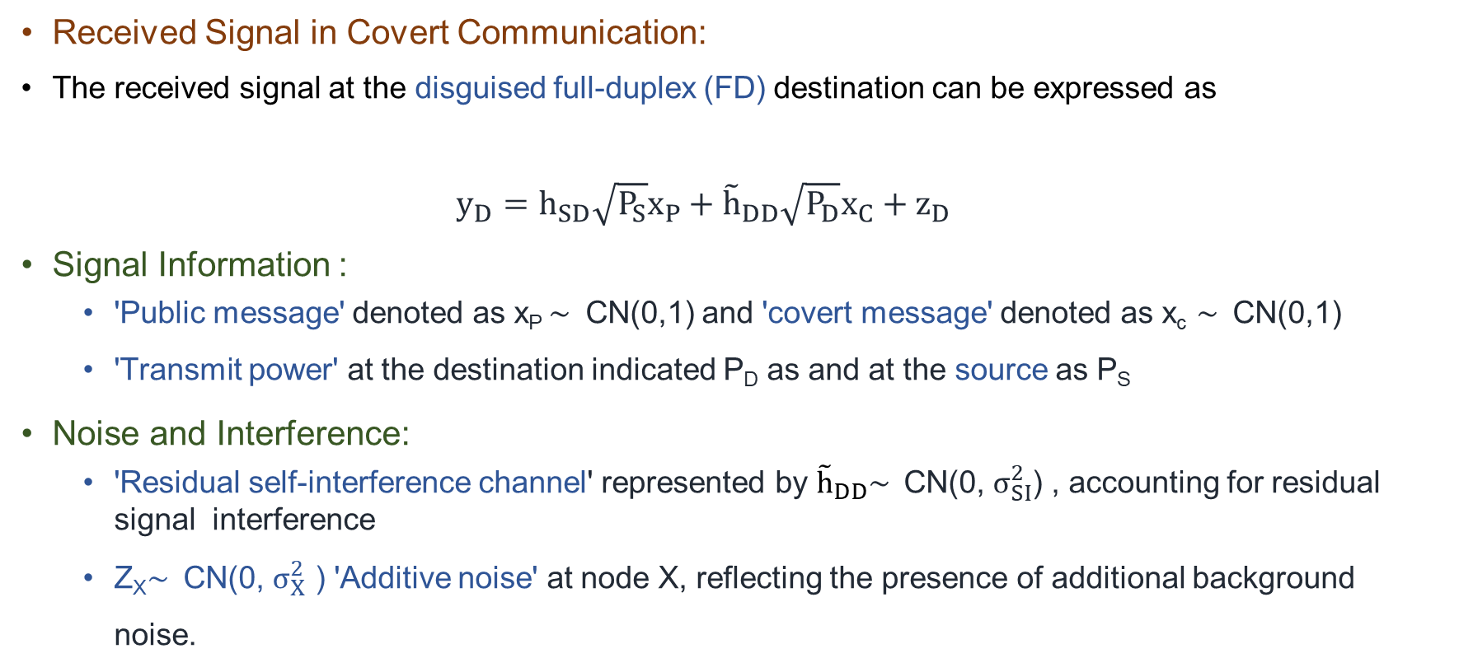
Method
Received Signal in Covert Communication:
The received signal at the disguised full-duplex (FD) destination can be expressed as
$y_{D}=h_{SD}\sqrt{P_{S}}x_{P}+{\tilde{h}}_{DD}\sqrt{P_{D}}x_{C}+z_{D}$
Signal Information :
'Public message' denoted as x_{P} $\sim$ CN(0,1) and 'covert message' denoted as x_{c} $\sim$ CN(0,1)
'Transmit power' at the destination indicated P_{D} as and at the source as P_{S}
Noise and Interference:
'Residual self-interference channel' represented by ${\tilde{h}}_{DD}\sim$ CN(0, $σ_{SI}^{2}$) , accounting for residual signal interference
Z_{X}$\sim$ CN(0, $σ_{X}^{2}$ ) 'Additive noise' at node X, reflecting the presence of additional background noise.

Slide 9
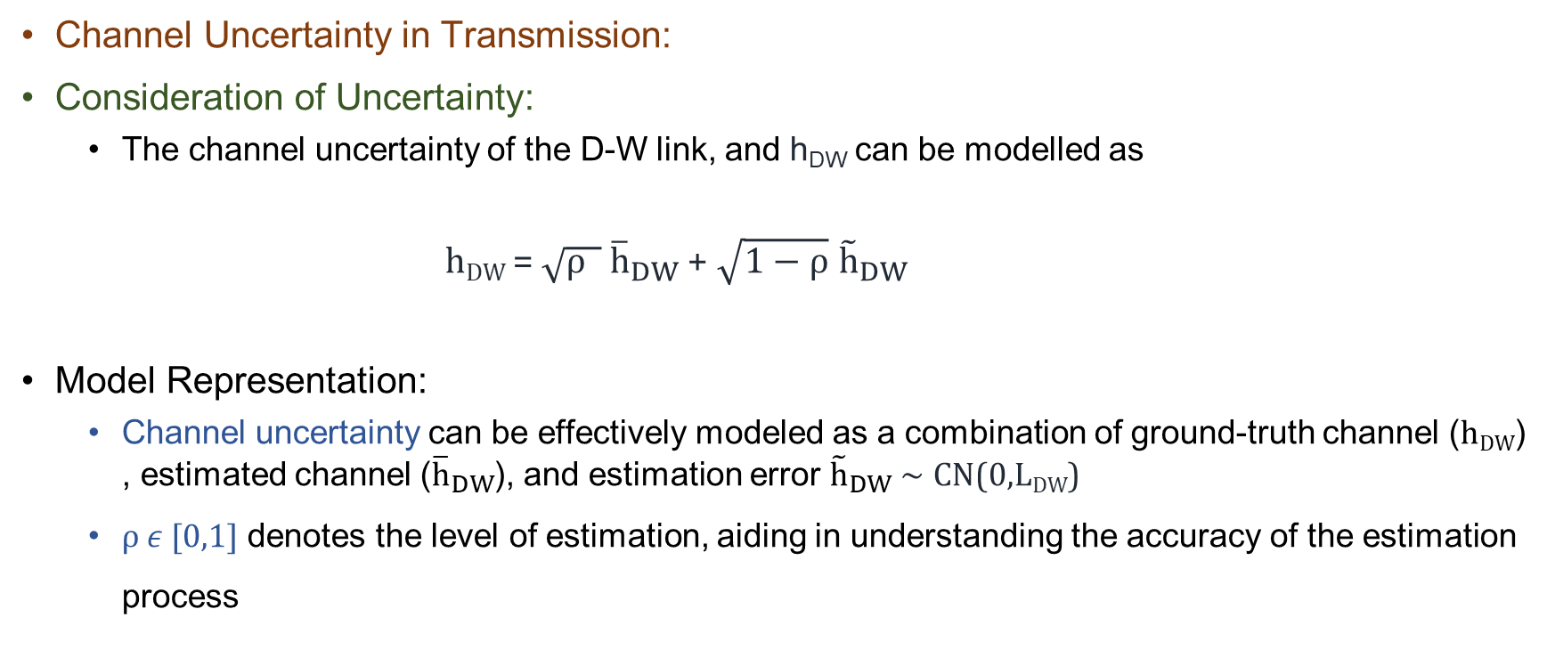
Method
Channel Uncertainty in Transmission:
Consideration of Uncertainty:
The channel uncertainty of the D-W link, and h_{DW} can be modelled as
h_{DW} = $\sqrt{ρ }$ ${\overline{h}}_{DW}$+ $\sqrt{1−ρ}$ ${\tilde{h}}_{DW}$
Model Representation:
Channel uncertainty can be effectively modeled as a combination of ground-truth channel (h_{DW}), estimated channel (${\overline{h}}_{DW}$), and estimation error ${\tilde{h}}_{DW} \sim$ CN(0,L_{DW})
$ρ ε$[0,1] denotes the level of estimation, aiding in understanding the accuracy of the estimation process

Slide 10
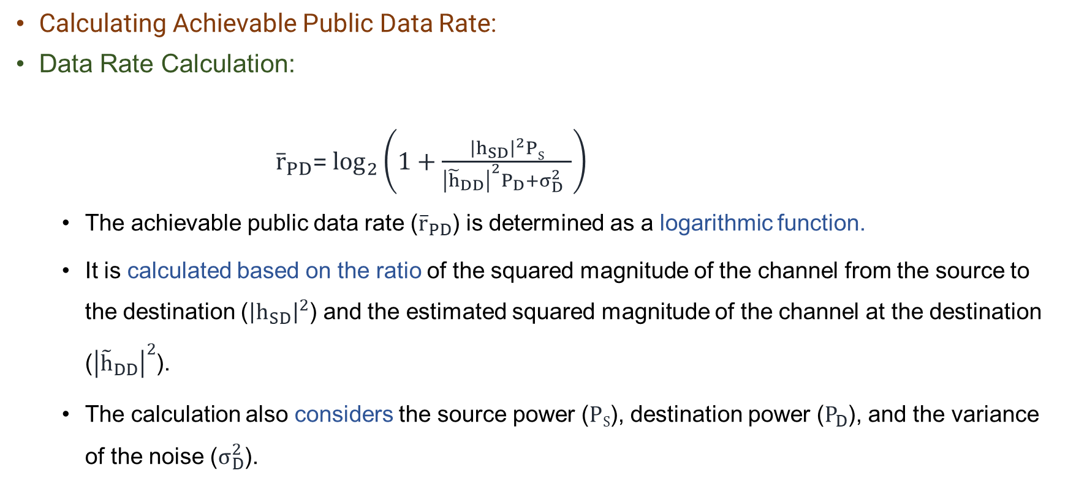
Method
Calculating Achievable Public Data Rate:
Data Rate Calculation:
${\overline{r}}_{PD}$= $\log_{2}\left(1+\frac{{\left|h_{SD}\right|}^{2}PS}{{\left|{\tilde{h}}_{DD}\right|}^{2}P_{D}+σ_{D}^{2} }\right)$
The achievable public data rate (${\overline{r}}_{PD}$) is determined as a logarithmic function.
It is calculated based on the ratio of the squared magnitude of the channel from the source to the destination (${\left|h_{SD}\right|}^{2}$) and the estimated squared magnitude of the channel at the destination (${\left|{\tilde{h}}_{DD}\right|}^{2}$).
The calculation also considers the source power ($PS$), destination power ($P_{D}$), and the variance of the noise ($σ_{D}^{2}$).

Slide 11
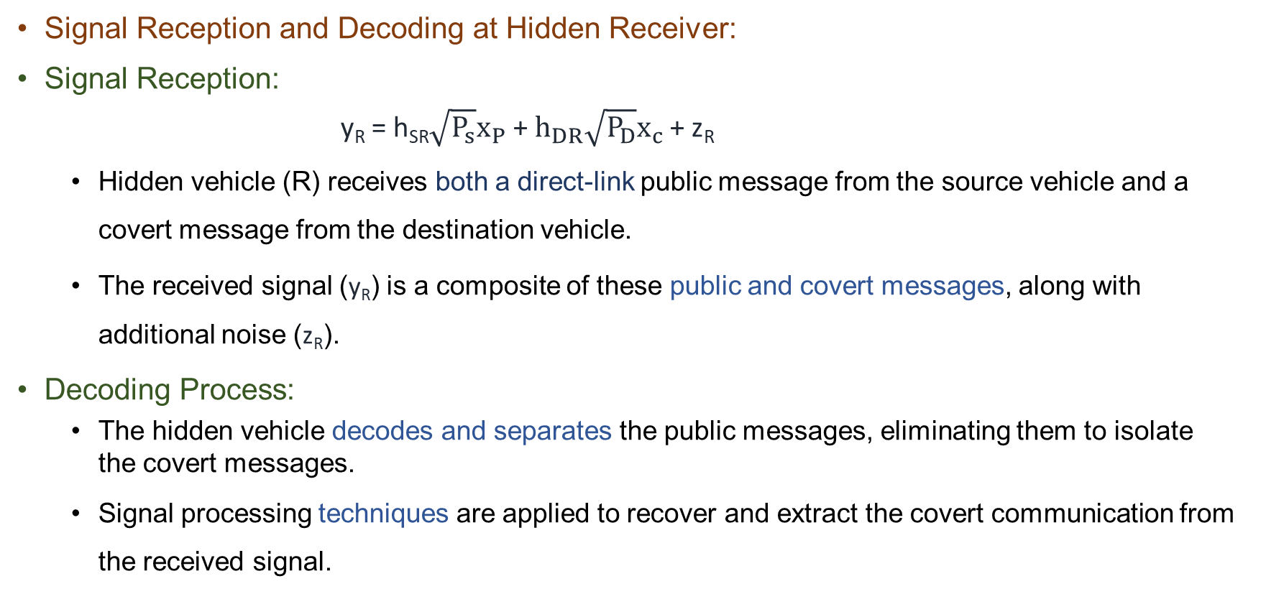
Method
Signal Reception and Decoding at Hidden Receiver:
Signal Reception:
y_{R} = h_{SR}$\sqrt{P_{s}}x_{P}$ + $h_{DR}\sqrt{P_{D}}x_{c}$+ z_{R}
Hidden vehicle (R) receives both a direct-link public message from the source vehicle and a covert message from the destination vehicle.
The received signal (y_{R}) is a composite of these public and covert messages, along with additional noise (z_{R}).
Decoding Process:
The hidden vehicle decodes and separates the public messages, eliminating them to isolate the covert messages.
Signal processing techniques are applied to recover and extract the covert communication from the received signal.

Slide 12
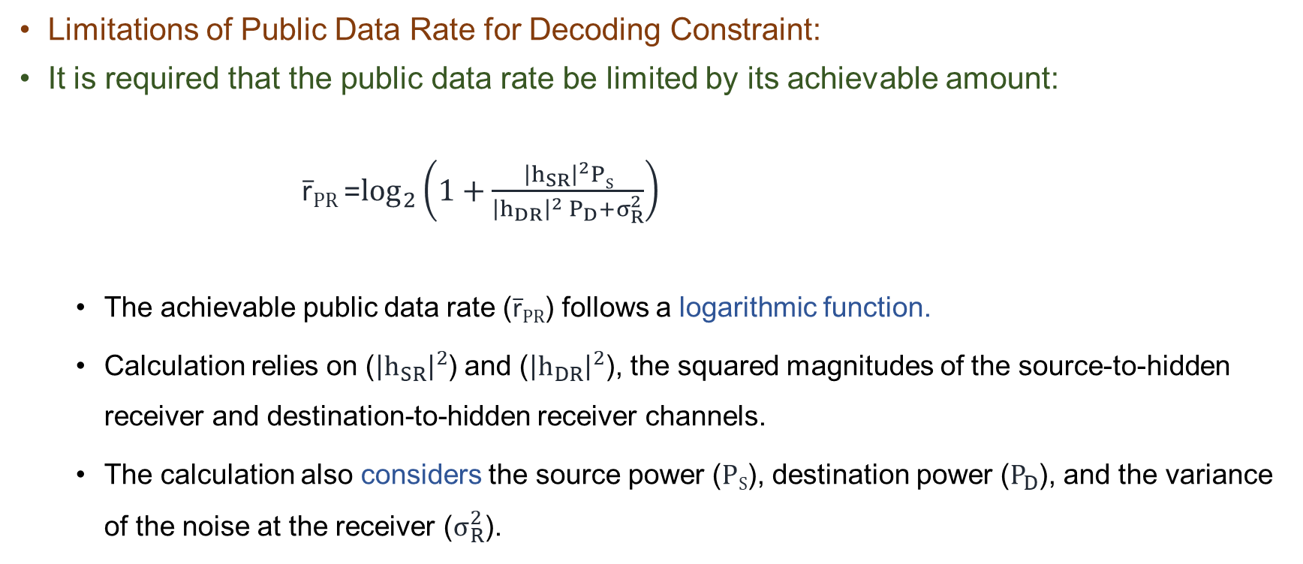
Method
Limitations of Public Data Rate for Decoding Constraint:
It is required that the public data rate be limited by its achievable amount:
r̅_{PR} =$\log_{2}\left(1+\frac{{\left|h_{SR}\right|}^{2}PS}{{\left|h_{DR}\right|}^{2} P_{D}+σ_{R}^{2}}\right)$
The achievable public data rate (r̅_{PR}) follows a logarithmic function.
Calculation relies on (${\left|h_{SR}\right|}^{2}$) and (${\left|h_{DR}\right|}^{2}$), the squared magnitudes of the source-to-hidden receiver and destination-to-hidden receiver channels.
The calculation also considers the source power ($PS$), destination power ($P_{D}$), and the variance of the noise at the receiver ($σ_{R}^{2}$).

Slide 13
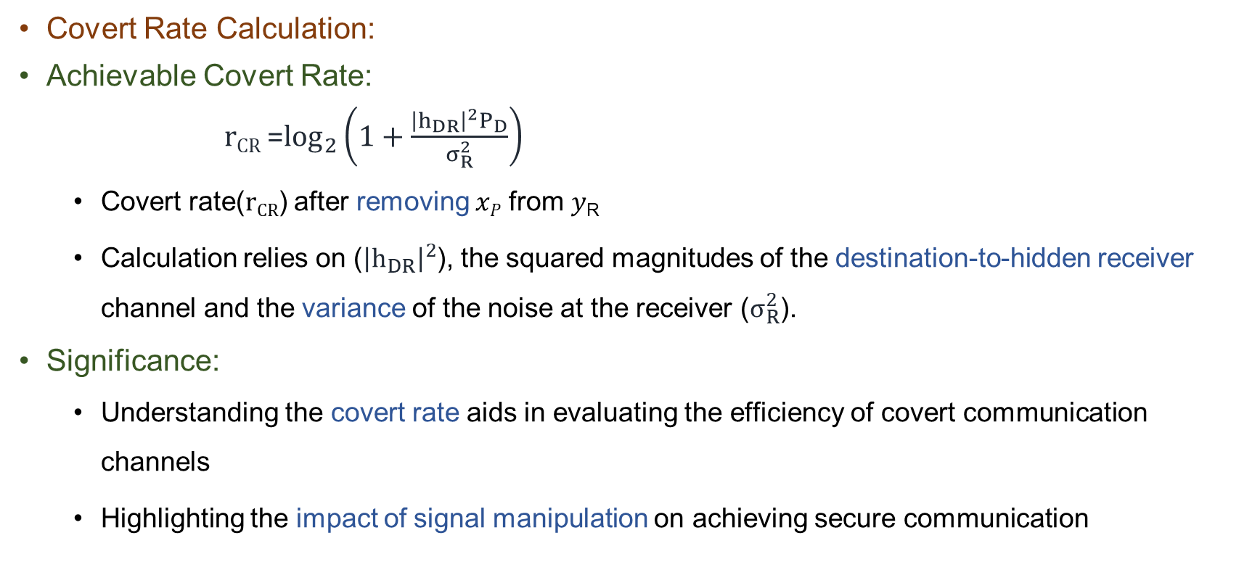
Method
Covert Rate Calculation:
Achievable Covert Rate:
r_{CR} =$\log_{2}\left(1+\frac{{\left|h_{DR}\right|}^{2}P_{D}}{σ_{R}^{2}}\right)$
Covert rate(r_{CR}) after removing 𝑥_{𝑃} from 𝑦_{R}
Calculation relies on (${\left|h_{DR}\right|}^{2}$), the squared magnitudes of the destination-to-hidden receiver channel and the variance of the noise at the receiver ($σ_{R}^{2}$).
Significance:
Understanding the covert rate aids in evaluating the efficiency of covert communication channels
Highlighting the impact of signal manipulation on achieving secure communication

Slide 14
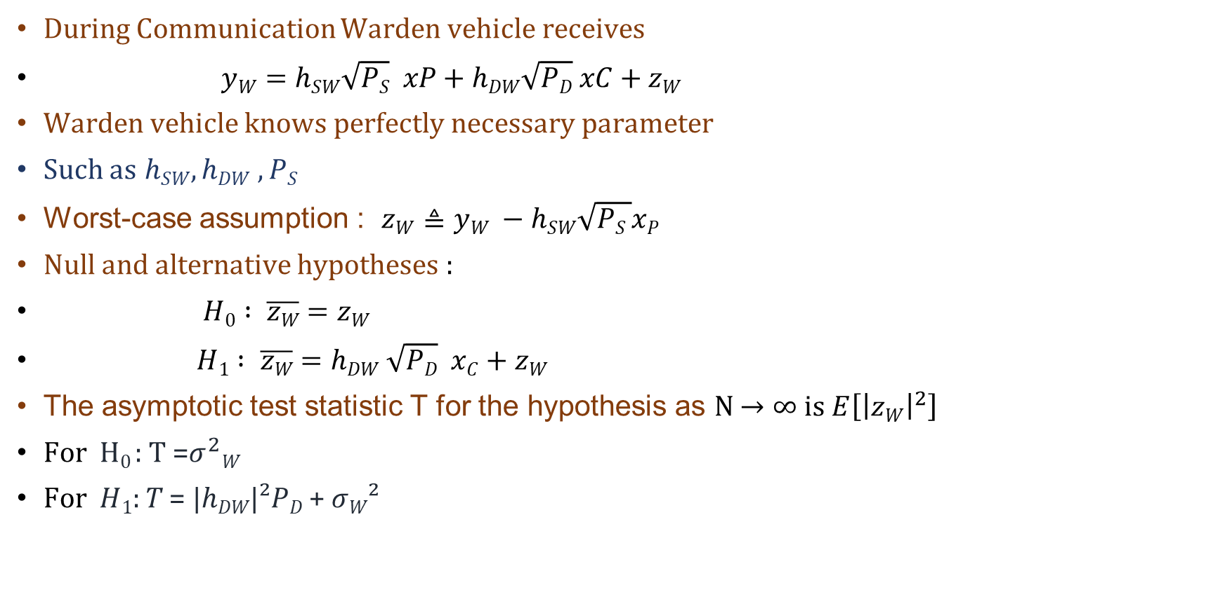
Method
During Communication Warden vehicle receives
$yW=hSW\sqrt{PS} xP+hDW\sqrt{PD} xC+zW$
Warden vehicle knows perfectly necessary parameter
Such as $hSW,hDW$ $,PS$
Worst-case assumption : $zW≜yW −hSW\sqrt{PS }xP$
Null and alternative hypotheses :
$H0 : \overline{zW}$ $=zW$
$H1 : \overline{zW}$ $=hDW \sqrt{PD}$ $xC+zW$
The asymptotic test statistic T for the hypothesis as N $→∞$is $E\left[{\left|zW\right|}^{2}\right]$
For H₀ : T =$σ^{2}W$
For 𝐻₁: 𝑇 = |ℎ_{𝐷𝑊}|²𝑃_{𝐷} + 𝜎_{𝑊}²

Slide 15
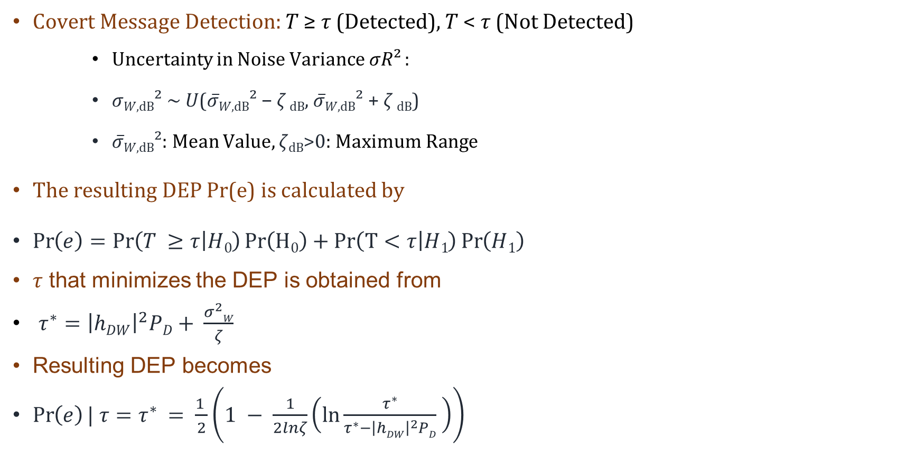
Method
Covert Message Detection: 𝑇 ≥ 𝜏 (Detected), 𝑇 < 𝜏 (Not Detected)
Uncertainty in Noise Variance 𝜎𝑅² :
𝜎_{𝑊,dB}² ~ 𝑈(𝜎̅_{𝑊,dB}² − $ζ$ _{dB}, 𝜎̅_{𝑊,dB}² + $ζ$ _{dB})
𝜎̅_{𝑊,dB}²: Mean Value, 𝜁_{dB}>0: Maximum Range
The resulting DEP Pr(e) is calculated by
$\operatorname{Pr}\left(e\right)=\operatorname{Pr}\left(T ≥τ | H0\right)Pr\left(H0\right)+Pr\left(T<τ | H1\right)\operatorname{Pr}\left(H1\right)$
$τ$ that minimizes the DEP is obtained from
$τ^{∗}={\left|hDW\right|}^{2}PD+ \frac{σ^{2}W}{ζ}$
Resulting DEP becomes
$\operatorname{Pr}\left(e\right)| τ=τ^{∗ }= \frac{1 }{2}\left(1 − \frac{1}{2lnζ}\left(ln\frac{τ^{∗}}{τ^{∗}−{\left|hDW\right|}^{2}PD} \right)\right)$

Slide 16
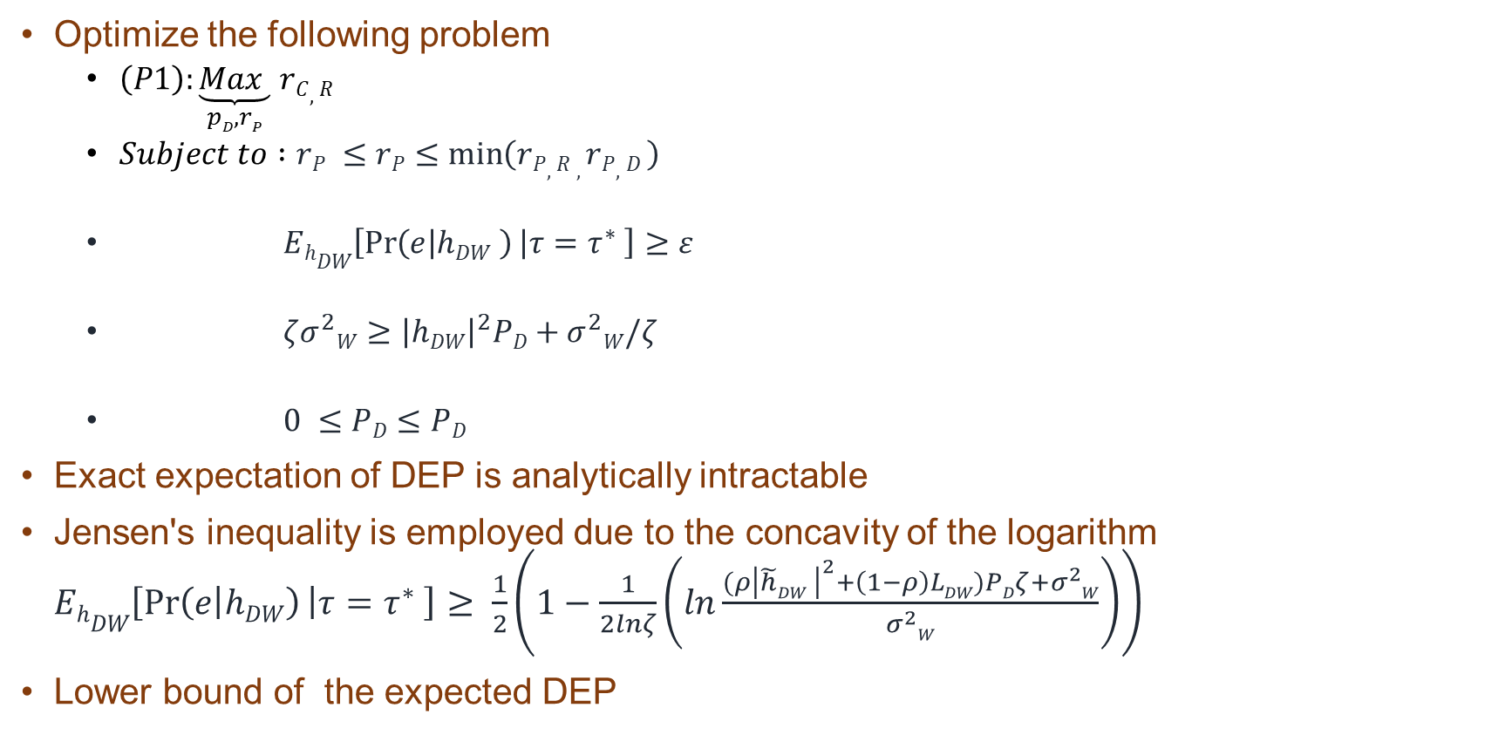
Method
Optimize the following problem
$\left(P1\right):\underset{pD,rP}{\underbrace{Max }}$ $rC,R$
$Subject to :rP ≤rP≤\min\left(rP,R ,rP,D \right)$
$EhDW\left[\operatorname{Pr}\left(e | hDW \right) | τ=τ^{∗} \right]≥ε$
$ζσ^{2}W≥{\left|hDW\right|}^{2}PD+σ^{2}W/ζ$
$0 ≤PD≤PD$
Exact expectation of DEP is analytically intractable
Jensen's inequality is employed due to the concavity of the logarithm$EhDW\left[\operatorname{Pr}\left(e | hDW\right) | τ=τ^{∗} \right]≥ \frac{1}{2}\left(1−\frac{1}{2lnζ}\left(ln\frac{(ρ{\left|\tilde{h}DW \right|}^{2}+\left(1−ρ\right)LDW)PDζ+σ^{2}W}{σ^{2}W}\right)\right)$
Lower bound of the expected DEP

Slide 17
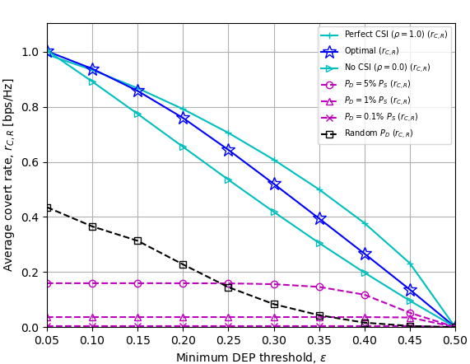
Numerical Result
Figure. Average covert rate vs DEP threshold
The graph illustrates the average worst-case covert rate under perfect and imperfect CSI conditions as the minimum DEP threshold varies.
It emphasizes the significance of acquiring reliable CSI for optimal performance.

Slide 18
Conclusion
Quality CSI is indispensable for minimizing the Detection Error Probability (DEP) at the AF relay.
Accurate CSI facilitates optimal signal processing, enhancing the reliability and effectiveness of covert communication strategies.
High-quality CSI ensures robust covert communication, strengthening the security and efficiency of the system.

Slide 19
Thank you for your Listening. For any queries, please email me at: refatkhanuits@gmail.com

