Slide 1
A Channel Uncertainty-Aware Covert Transmission for a Disguised Full-Duplex Device
2023.11.27
2023 KIEES Radio Science and Communications Conference
Refat Khan, *Jihwan Moon
Department of Mobile Convergence Engineering, Hanbat National University

Slide 2
Table of Contents
Abstract
Introduction
System model
Numerical results
Conclusion

Slide 3
Abstract
System Overview:
The source node communicates with a fully disguised full-duplex (FD) destination node
Covert transmission of confidential messages to a hidden receiver; evading warden node surveillance
Research Focus:
Investigating the impact of channel uncertainty on covert communication
Deriving lower bound for expected minimum detection error probability (DEP) at the warden node
Key Finding:
Covert rate performance displayed for varying DEP requirements
Highlighting the significance of secure communication in challenging environments

Slide 4
Introduction
Challenges of Secure Communication:
Security Threats:
Opponents can conduct traffic analysis by collecting metadata during transmission.
Vulnerabilities include capturing source and destination addresses, request-response frequency, etc
Need for Covert Communications:
Transmit data in a manner that avoids detection or suspicion.
Combining cryptography and physical layer security can prevent eavesdropping, but covert communications are necessary to counter traffic analysis threats.

Slide 5
Introduction
Investigating Covert Communications:
System Overview:
Communication setup involving a source node and a disguised full-duplex (FD) destination node
Objective: Ensuring covert transmission of confidential messages to a hidden receiver without warden node surveillance
Research Scope:
Exploration of channel uncertainty at the warden node
Focus on determining the lower bound of the expected minimum detection error probability (DEP) at the warden node
Research Outcomes:
Presentation of numerical results showcasing covert rate performance under various DEP requirements
Underlining the importance of secure and covert communication strategies in the face of sophisticated security threats

Slide 6
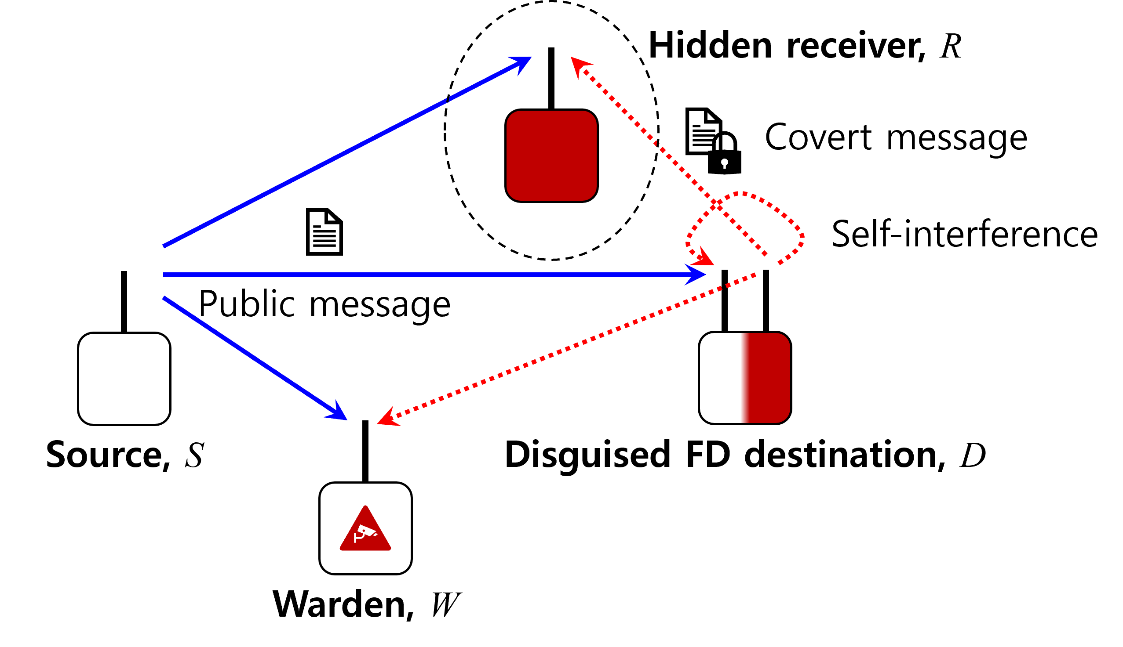
System Model
Figure. Node Placement

Slide 7
System Model
Covert Communication System Overview:
Communication Setup:
Source node (S) transmitting a public message to the destination node (D)
Covert transmission conducted by the seemingly receive-only destination node
Covert signal transmitted to the hidden receiver (R) using an unseen antenna
Transmission Environment:
Full-duplex (FD) communication implemented, allowing simultaneous transmission and reception
Warden node (W) monitoring for suspicious communications
Key Focus
Ensuring secure and undetectable transmission from the destination to the hidden receiver
Under Surveillance of a warden node

Slide 8
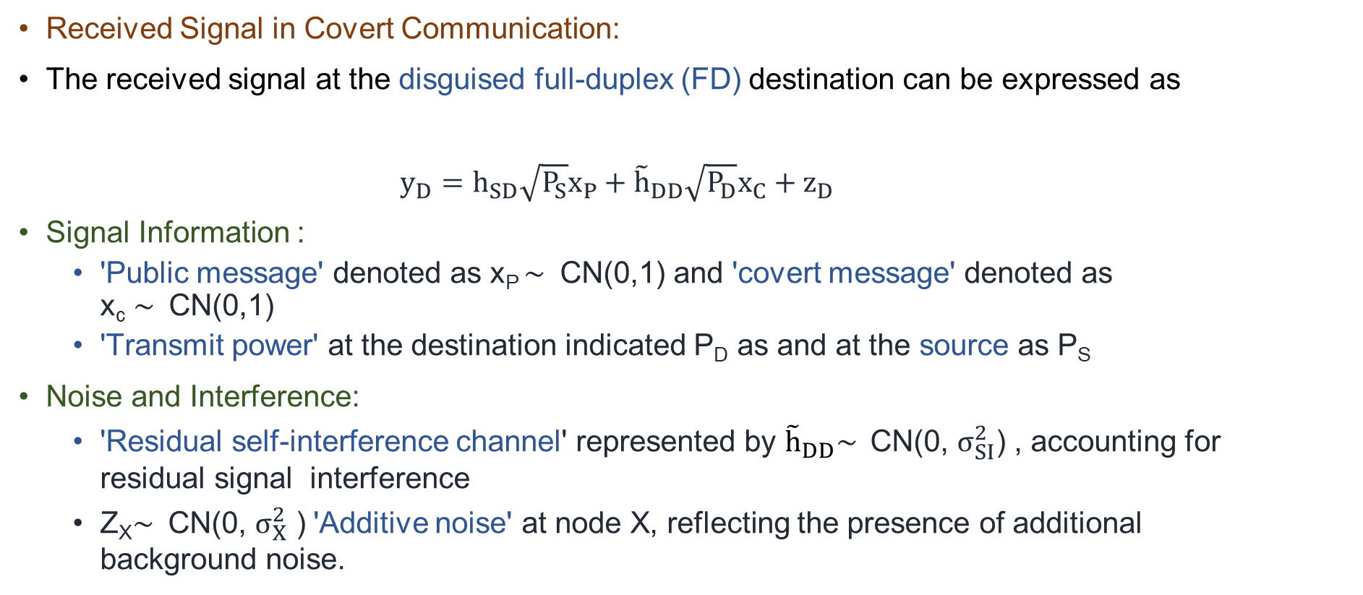
System Model
Received Signal in Covert Communication:
The received signal at the disguised full-duplex (FD) destination can be expressed as
$y_{D}=h_{SD}\sqrt{P_{S}}x_{P}+{\tilde{h}}_{DD}\sqrt{P_{D}}x_{C}+z_{D}$
Signal Information :
'Public message' denoted as x_{P} $\sim$ CN(0,1) and 'covert message' denoted as x_{c} $\sim$ CN(0,1)
'Transmit power' at the destination indicated P_{D} as and at the source as P_{S}
Noise and Interference:
'Residual self-interference channel' represented by ${\tilde{h}}_{DD}\sim$ CN(0, $σ_{SI}^{2}$) , accounting for residual signal interference
Z_{X}$\sim$ CN(0, $σ_{X}^{2}$ ) 'Additive noise' at node X, reflecting the presence of additional background noise.

Slide 9
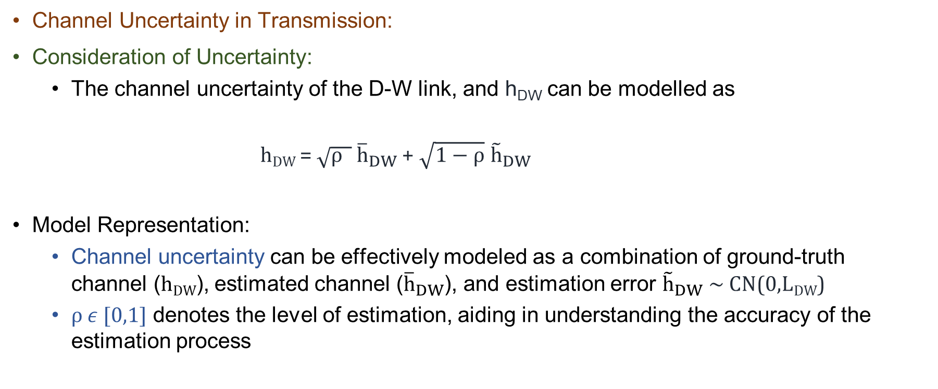
System Model
Channel Uncertainty in Transmission:
Consideration of Uncertainty:
The channel uncertainty of the D-W link, and h_{DW} can be modelled as
h_{DW} = $\sqrt{ρ }$ ${\overline{h}}_{DW}$+ $\sqrt{1−ρ}$ ${\tilde{h}}_{DW}$
Model Representation:
Channel uncertainty can be effectively modeled as a combination of ground-truth channel (h_{DW}), estimated channel (${\overline{h}}_{DW}$), and estimation error ${\tilde{h}}_{DW} \sim$ CN(0,L_{DW})
$ρ ε$[0,1] denotes the level of estimation, aiding in understanding the accuracy of the estimation process

Slide 10
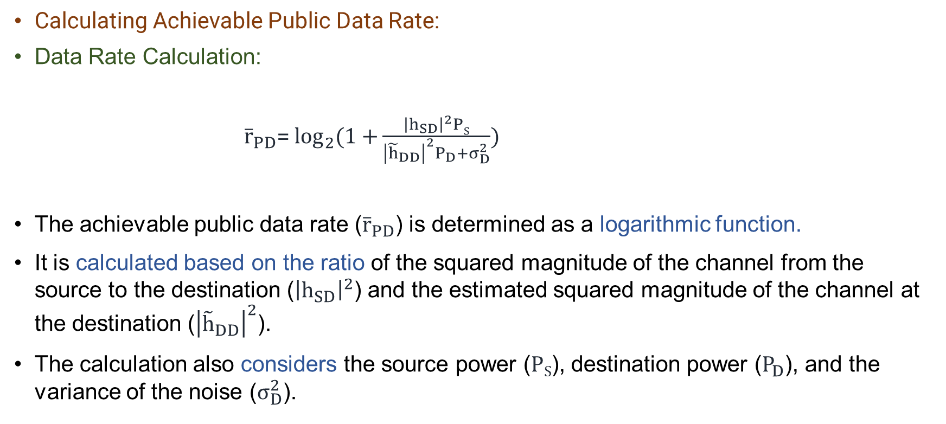
System Model
Calculating Achievable Public Data Rate:
Data Rate Calculation:
${\overline{r}}_{PD}$= $\log_{2}{(1+}\frac{{\left|h_{SD}\right|}^{2}PS}{{\left|{\tilde{h}}_{DD}\right|}^{2}P_{D}+σ_{D}^{2}})$
The achievable public data rate (${\overline{r}}_{PD}$) is determined as a logarithmic function.
It is calculated based on the ratio of the squared magnitude of the channel from the source to the destination (${\left|h_{SD}\right|}^{2}$) and the estimated squared magnitude of the channel at the destination (${\left|{\tilde{h}}_{DD}\right|}^{2}$).
The calculation also considers the source power ($PS$), destination power ($P_{D}$), and the variance of the noise ($σ_{D}^{2}$).

Slide 11
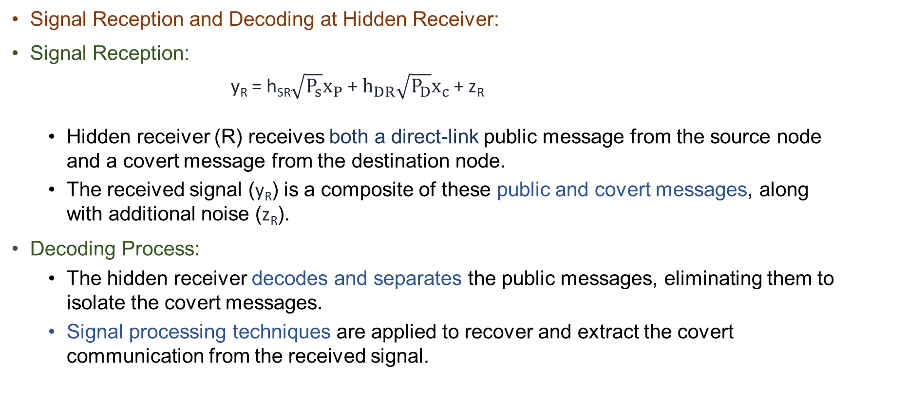
System Model
Signal Reception and Decoding at Hidden Receiver:
Signal Reception:
y_{R} = h_{SR}$\sqrt{P_{s}}x_{P}$ + $h_{DR}\sqrt{P_{D}}x_{c}$+ z_{R}
Hidden receiver (R) receives both a direct-link public message from the source node and a covert message from the destination node.
The received signal (y_{R}) is a composite of these public and covert messages, along with additional noise (z_{R}).
Decoding Process:
The hidden receiver decodes and separates the public messages, eliminating them to isolate the covert messages.
Signal processing techniques are applied to recover and extract the covert communication from the received signal.

Slide 12
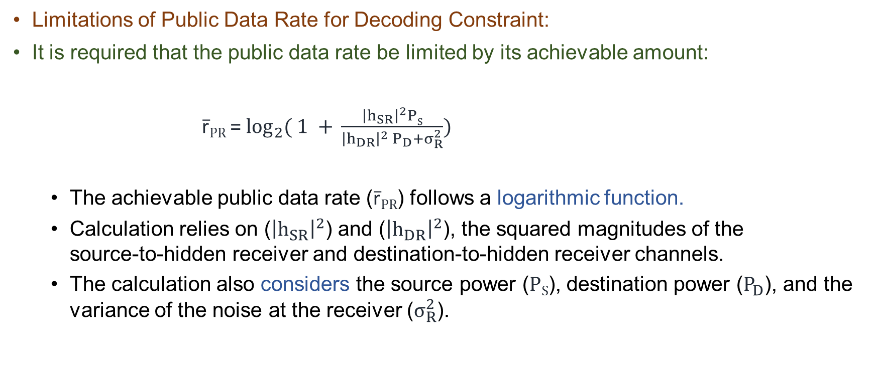
System Model
Limitations of Public Data Rate for Decoding Constraint:
It is required that the public data rate be limited by its achievable amount:
r̅_{PR} = $\log_{2}{( 1 + }\frac{{\left|h_{SR}\right|}^{2}PS}{{\left|h_{DR}\right|}^{2} P_{D}+σ_{R}^{2}})$
The achievable public data rate (r̅_{PR}) follows a logarithmic function.
Calculation relies on (${\left|h_{SR}\right|}^{2}$) and (${\left|h_{DR}\right|}^{2}$), the squared magnitudes of the source-to-hidden receiver and destination-to-hidden receiver channels.
The calculation also considers the source power ($PS$), destination power ($P_{D}$), and the variance of the noise at the receiver ($σ_{R}^{2}$).

Slide 13
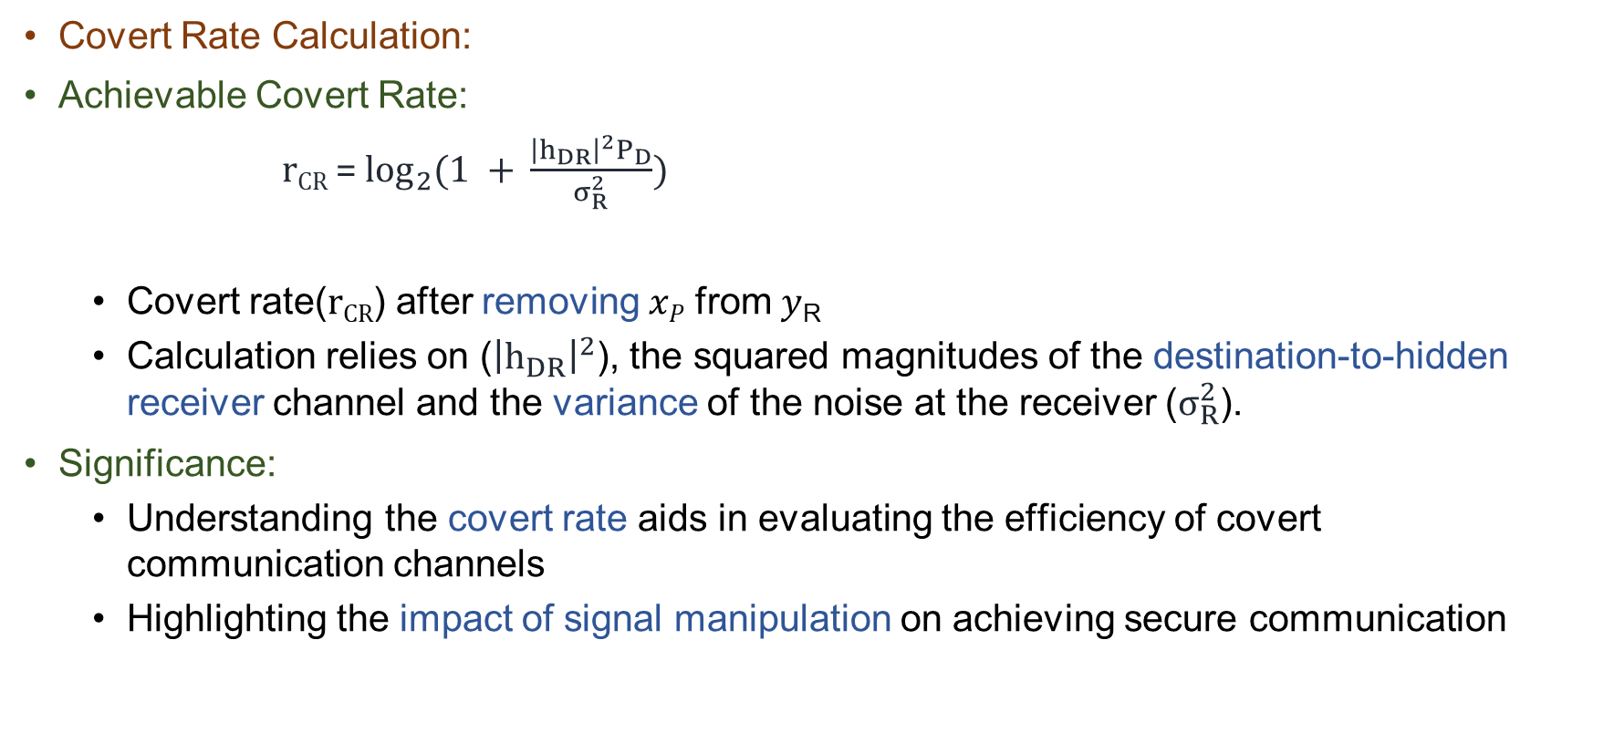
System Model
Covert Rate Calculation:
Achievable Covert Rate:
r_{CR} = $\log_{2}{(1 + }\frac{{\left|h_{DR}\right|}^{2}P_{D}}{σ_{R}^{2}})$
Covert rate(r_{CR}) after removing 𝑥_{𝑃} from 𝑦_{R}
Calculation relies on (${\left|h_{DR}\right|}^{2}$), the squared magnitudes of the destination-to-hidden receiver channel and the variance of the noise at the receiver ($σ_{R}^{2}$).
Significance:
Understanding the covert rate aids in evaluating the efficiency of covert communication channels
Highlighting the impact of signal manipulation on achieving secure communication

Slide 14
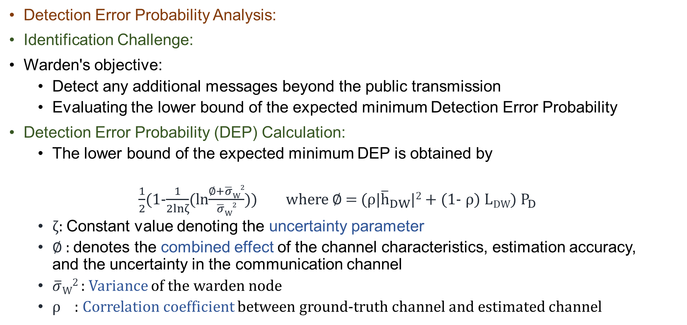
System Model
Detection Error Probability Analysis:
Identification Challenge:
Warden's objective:
Detect any additional messages beyond the public transmission
Evaluating the lower bound of the expected minimum Detection Error Probability
Detection Error Probability (DEP) Calculation:
The lower bound of the expected minimum DEP is obtained by
$\frac{1}{2}$(1-$\frac{1}{2lnζ}$(ln$\frac{∅+\overline{σ}W2}{\overline{σ}W2}$)) where $∅$ = ($ρ$|${\overline{h}}_{DW}$|² + (1- $ρ$) L_{DW}) $P_{D}$
ζ: Constant value denoting the uncertainty parameter
$∅$ : denotes the combined effect of the channel characteristics, estimation accuracy, and the uncertainty in the communication channel
$\overline{σ}W2$​ : Variance of the warden node
$ρ$ : Correlation coefficient between ground-truth channel and estimated channel

Slide 15
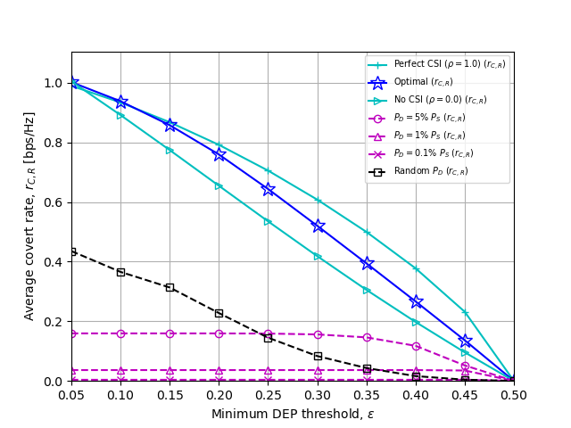
Numerical Result
Figure. Average covert rate vs DEP threshold with $ρ$ = 0.75
The graph illustrates the average worst-case covert rate under perfect and imperfect CSI conditions as the minimum DEP threshold varies. It emphasizes the significance of acquiring reliable CSI for optimal performance.

Slide 16
Conclusion
Quality CSI is indispensable for minimizing the Detection Error Probability (DEP) at the AF relay.
Accurate CSI facilitates optimal signal processing, enhancing the reliability and effectiveness of covert communication strategies.
High-quality CSI ensures robust covert communication, strengthening the security and efficiency of the system.

Slide 17
Thank you for your Listening. For any queries, please email me at: refatkhanuits@gmail.com

