Slide 1
SIMO / MISO combining schemes Assignment - 05
REFAT KHAN

Slide 2
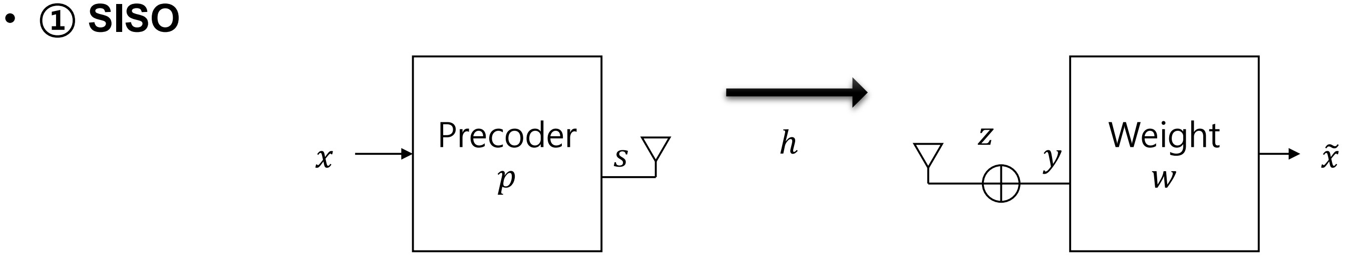
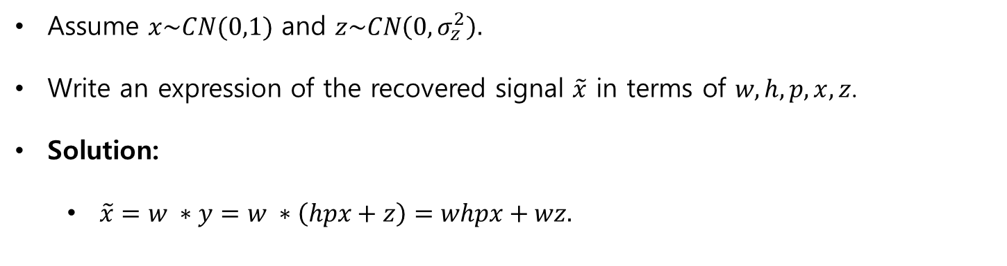
SISO
Assume $x\sim CN(0,1)$ and $z\sim CN\left(0,σ_{z}^{2}\right).$
Write an expression of the recovered signal $\tilde{x}$ in terms of $w,h,p,x,z$.
Solution:
$\tilde{x}=w ∗y=w ∗\left(hpx+z\right)=whpx+wz.$

Slide 3
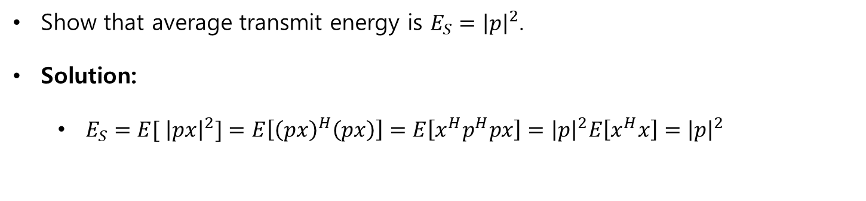
SISO
Show that average transmit energy is $E_{S}={\left|p\right|}^{2}$.
Solution:
$E_{S}={E[ \left|px\right|}^{2}]=E\left[{\left(px\right)}^{H}\left(px\right)\right]=E\left[x^{H}p^{H}px\right]={\left|p\right|}^{2}E\left[x^{H}x\right]={\left|p\right|}^{2}$

Slide 4
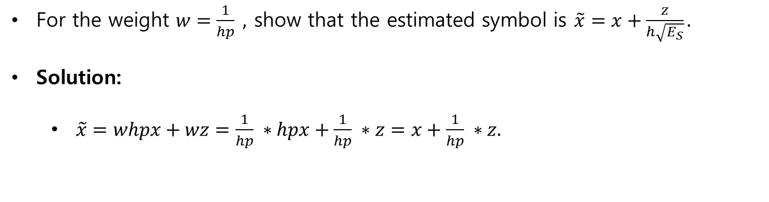
SISO
For the weight $w=\frac{1}{hp} ,$ show that the estimated symbol is $\tilde{x}=x+\frac{z}{h\sqrt{E_{S}}}.$
Solution:
$\tilde{x}=whpx+wz=\frac{1}{hp} ∗hpx+\frac{1}{hp} ∗z=x+\frac{1}{hp} ∗z.$

Slide 5
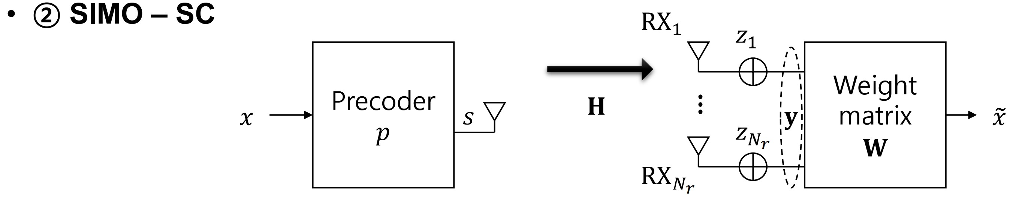
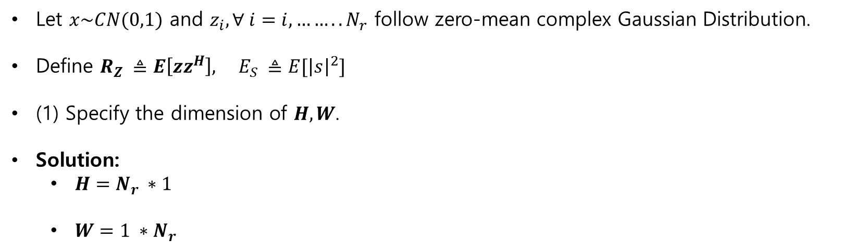
SIMO SC
Let $x\sim CN(0,1)$ and $z_{i}, ∀ i=i,……..N_{r}$ follow zero-mean complex Gaussian Distribution.
Define $R_{Z} ≜E\left[zz^{H}\right], E_{S} ≜E[{\left|s\right|}^{2}]$
(1) Specify the dimension of $H, W$.
Solution:
$H=N_{r} ∗1$
$W=1 ∗N_{r}$

Slide 6
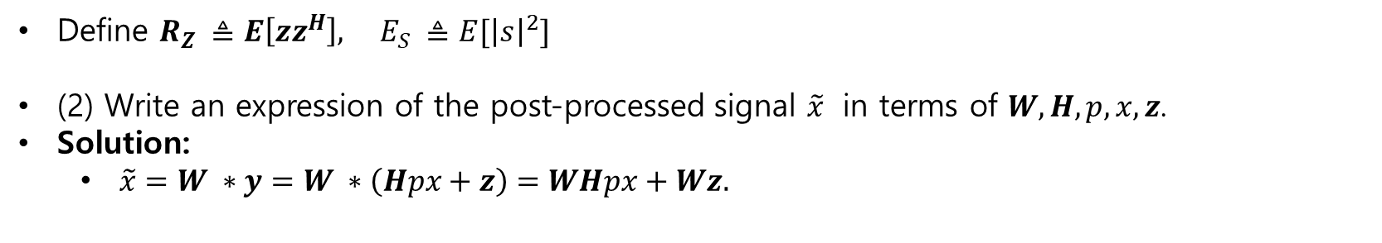
SIMO SC
Define $R_{Z} ≜E\left[zz^{H}\right], E_{S} ≜E[{\left|s\right|}^{2}]$
(2) Write an expression of the post-processed signal $\tilde{x}$ in terms of $W,H,p,x,z$.
Solution:
$\tilde{x}=W ∗y=W ∗\left(Hpx+z\right)=WHpx+Wz.$

Slide 7
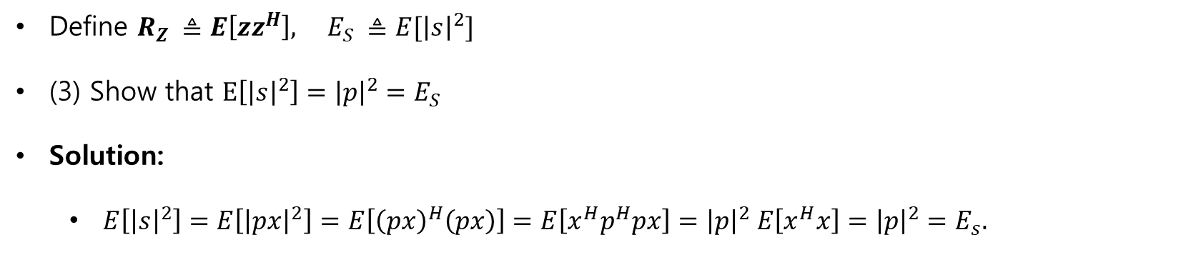
SIMO SC
Define $R_{Z} ≜E\left[zz^{H}\right], E_{S} ≜E[{\left|s\right|}^{2}]$
(3) Show that $E\left[{\left|s\right|}^{2}\right]={\left|p\right|}^{2}=E_{S}$
Solution:
$E\left[{\left|s\right|}^{2}\right]=E\left[{\left|px\right|}^{2}\right]=E\left[{\left(px\right)}^{H}\left(px\right)\right]=E\left[x^{H}p^{H}px\right]={\left|p\right|}^{2} E\left[x^{H}x\right]={\left|p\right|}^{2}=E_{s}.$

Slide 8
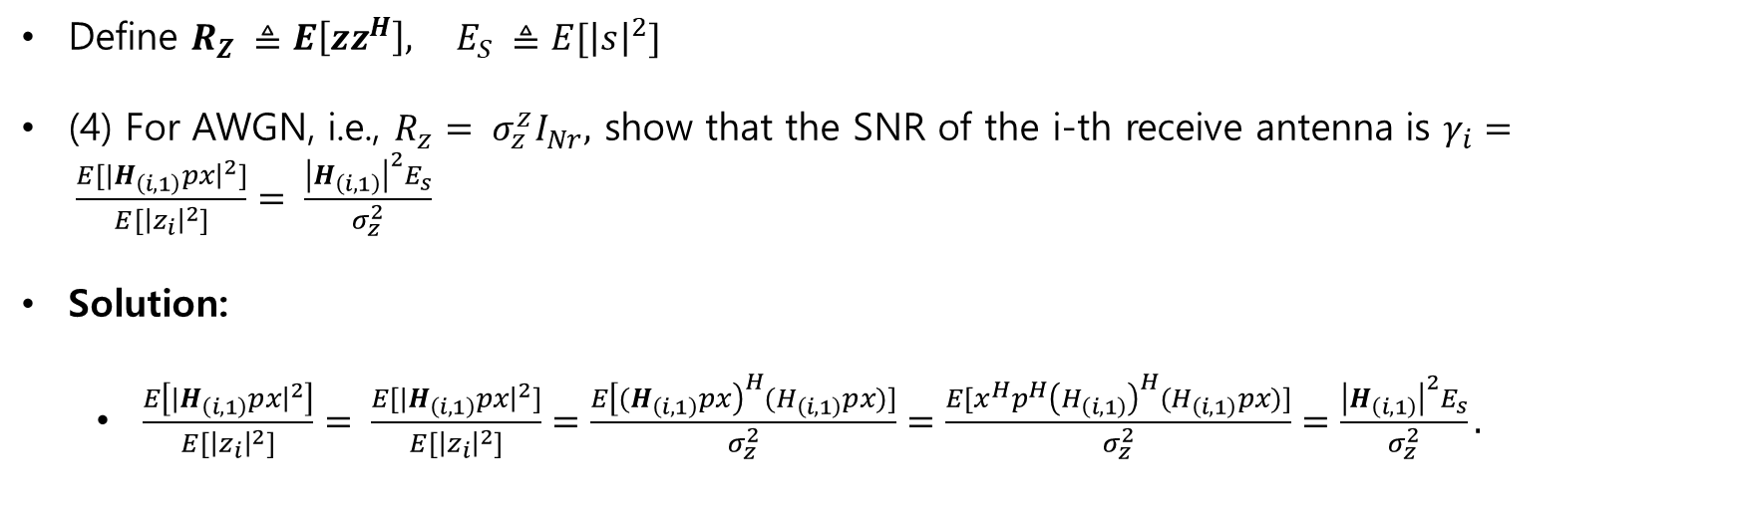
SIMO SC
Define $R_{Z} ≜E\left[zz^{H}\right], E_{S} ≜E[{\left|s\right|}^{2}]$
(4) For AWGN, i.e., $R_{z}= σ_{z}^{z}I_{Nr},$ show that the SNR of the i-th receive antenna is $γ_{i}= \frac{E[{|H}_{\left(i,1\right)}px{\left.​\right|}^{2}]}{E[{\left|z_{i}\right|}^{2}]}= \frac{{\left|H_{\left(i,1\right)}\right|}^{2}E_{s}}{σ_{z}^{2}}$
Solution:
$\frac{E\left[{|H}_{\left(i,1\right)}px{\left.​\right|}^{2}\right]}{E[{\left|z_{i}\right|}^{2}]}= \frac{E[{|H}_{\left(i,1\right)}px{\left.​\right|}^{2}]}{E[{\left|z_{i}\right|}^{2}]}=\frac{E{\left[{(H}_{\left(i,1\right)}px\right)}^{H}(H_{\left(i,1\right)}px)]}{σ_{z}^{2}}=\frac{E[x^{H}p^{H}{\left(H_{\left(i,1\right)}\right)}^{H}(H_{\left(i,1\right)}px)]}{σ_{z}^{2}}=\frac{{\left|H_{\left(i,1\right)}\right|}^{2}E_{s}}{σ_{z}^{2}}.$

Slide 9
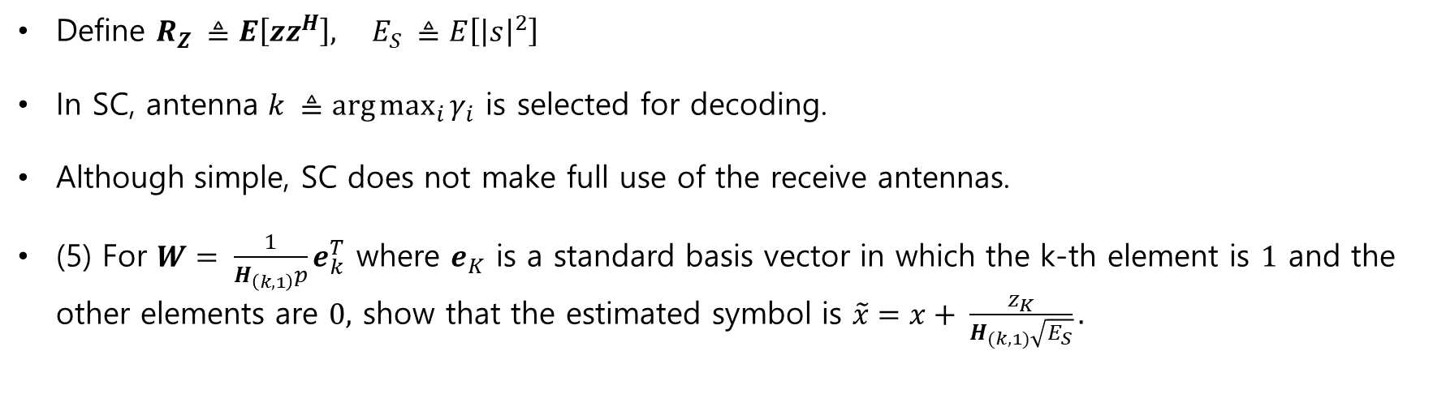
SIMO SC
Define $R_{Z} ≜E\left[zz^{H}\right], E_{S} ≜E\left[{\left|s\right|}^{2}\right]$
In SC, antenna $k ≜\arg{\max_{i}{γ_{i}}}$ is selected for decoding.
Although simple, SC does not make full use of the receive antennas.
(5) For $W= \frac{1}{H_{\left(k,1\right)}p}e_{k}^{T}$ where $e_{K}$ is a standard basis vector in which the k-th element is $1$ and the other elements are $0,$ show that the estimated symbol is $\tilde{x}=x+ \frac{z_{K}}{H_{(k,1)}\sqrt{E_{S}}}.$

Slide 10
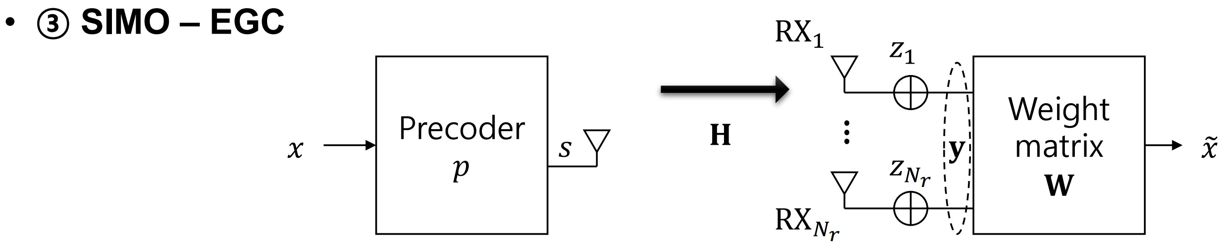
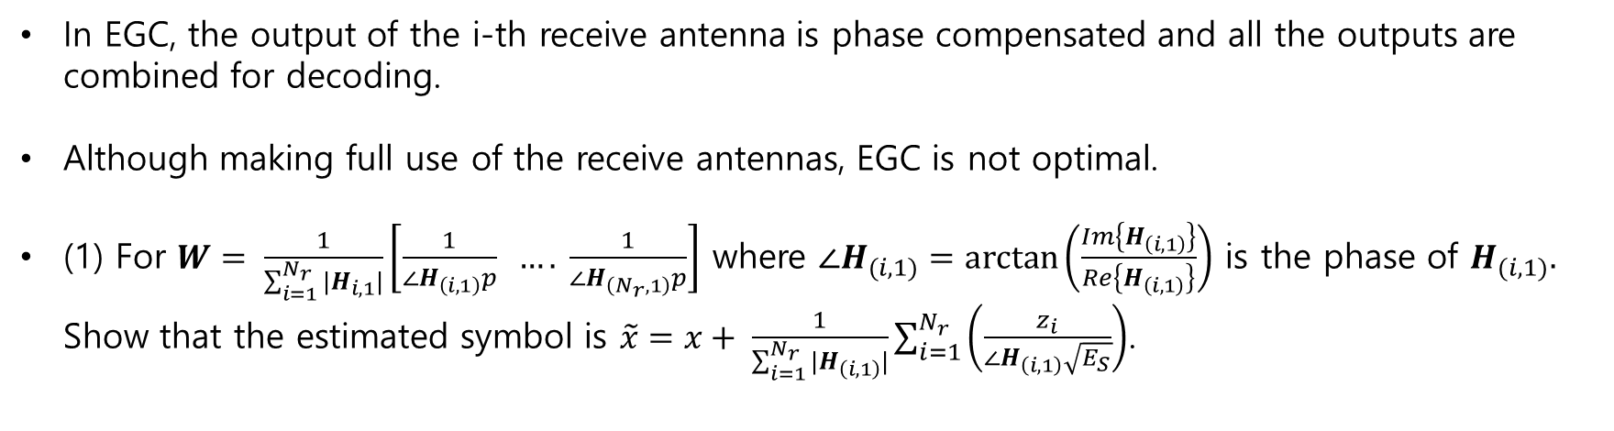
SIMO EGC
In EGC, the output of the i-th receive antenna is phase compensated and all the outputs are combined for decoding.
Although making full use of the receive antennas, EGC is not optimal.
(1) For $W= \frac{1}{\sum_{i=1}^{N_{r}}{|H_{i,1}|}}\left[\frac{1}{{∠H}_{\left(i,1\right)}p} …. \frac{1}{∠H_{\left(N_{r},1\right)}p}\right]$ where $∠H_{(i,1)}=\arctan\left(\frac{Im\left\{H_{\left(i,1\right)}\right\}}{Re\left\{H_{\left(i,1\right)}\right\}}\right)$ is the phase of $H_{(i,1)}.$ Show that the estimated symbol is $\tilde{x}=x+ \frac{1}{\sum_{i=1}^{N_{r}}{|H_{\left(i,1\right)}|}}\sum_{i=1}^{N_{r}}{\left(\frac{z_{i}}{∠H_{\left(i,1\right)}\sqrt{E_{S}}}\right)}$.

Slide 11
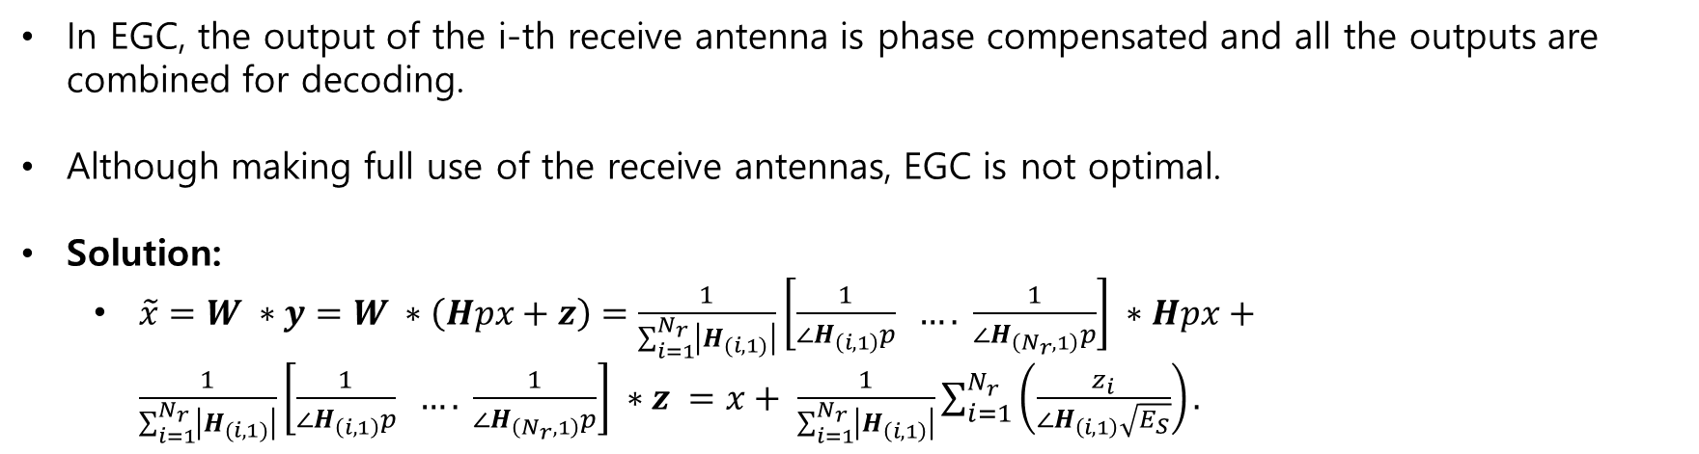
SIMO EGC
In EGC, the output of the i-th receive antenna is phase compensated and all the outputs are combined for decoding.
Although making full use of the receive antennas, EGC is not optimal.
Solution:
$\tilde{x}=W ∗y=W ∗\left(Hpx+z\right)=\frac{1}{\sum_{i=1}^{N_{r}}{\left|H_{(i,1)}\right|}}\left[\frac{1}{{∠H}_{\left(i,1\right)}p} …. \frac{1}{∠H_{\left(N_{r},1\right)}p}\right] ∗Hpx+\frac{1}{\sum_{i=1}^{N_{r}}{\left|H_{(i,1)}\right|}}\left[\frac{1}{{∠H}_{\left(i,1\right)}p} …. \frac{1}{∠H_{\left(N_{r},1\right)}p}\right] ∗z =x+ \frac{1}{\sum_{i=1}^{N_{r}}{\left|H_{\left(i,1\right)}\right|}}\sum_{i=1}^{N_{r}}{\left(\frac{z_{i}}{∠H_{\left(i,1\right)}\sqrt{E_{S}}}\right)}.$

Slide 12
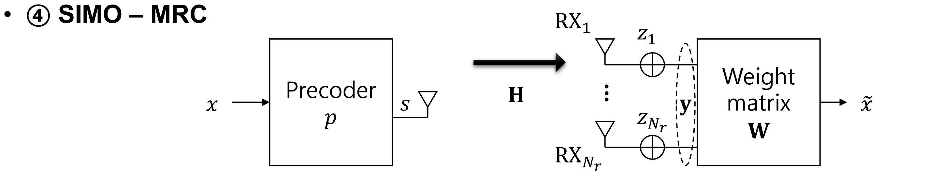
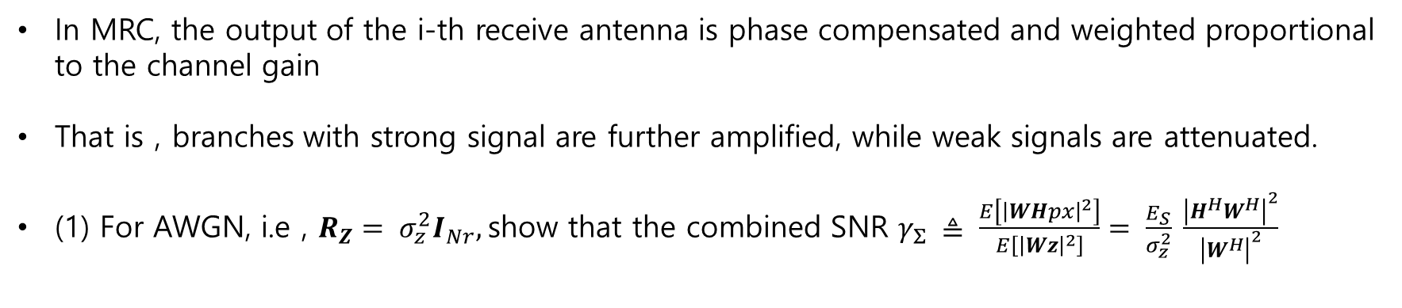
SIMO MRC
In MRC, the output of the i-th receive antenna is phase compensated and weighted proportional to the channel gain
That is , branches with strong signal are further amplified, while weak signals are attenuated.
(1) For AWGN, i.e , $R_{Z}= σ_{z}^{2}I_{Nr},$show that the combined SNR $γ_{Σ} ≜ \frac{E\left[{\left|WHpx\right|}^{2}\right]}{E\left[{\left|Wz\right|}^{2}\right]}= \frac{E_{S}}{σ_{z}^{2}} \frac{{\left|H^{H}W^{H}\right|}^{2}}{{\left|W^{H}\right|}^{2}}$

Slide 13
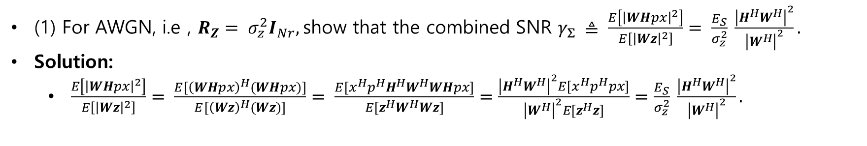
SIMO MRC
(1) For AWGN, i.e , $R_{Z}= σ_{z}^{2}I_{Nr},$show that the combined SNR $γ_{Σ} ≜ \frac{E\left[{\left|WHpx\right|}^{2}\right]}{E\left[{\left|Wz\right|}^{2}\right]}= \frac{E_{S}}{σ_{z}^{2}} \frac{{\left|H^{H}W^{H}\right|}^{2}}{{\left|W^{H}\right|}^{2}}.$
Solution:
$\frac{E\left[{\left|WHpx\right|}^{2}\right]}{E\left[{\left|Wz\right|}^{2}\right]}= \frac{E[{\left(WHpx\right)}^{H}(WHpx)]}{E[{\left(Wz\right)}^{H}(Wz)]}= \frac{E[x^{H}p^{H}H^{H}W^{H}WHpx]}{E[z^{H}W^{H}Wz]}=\frac{{\left|H^{H}W^{H}\right|}^{2}E[x^{H}p^{H}px]}{{\left|W^{H}\right|}^{2}E[z^{H}z]}=\frac{E_{S}}{σ_{z}^{2}} \frac{{\left|H^{H}W^{H}\right|}^{2}}{{\left|W^{H}\right|}^{2}}.$

Slide 14
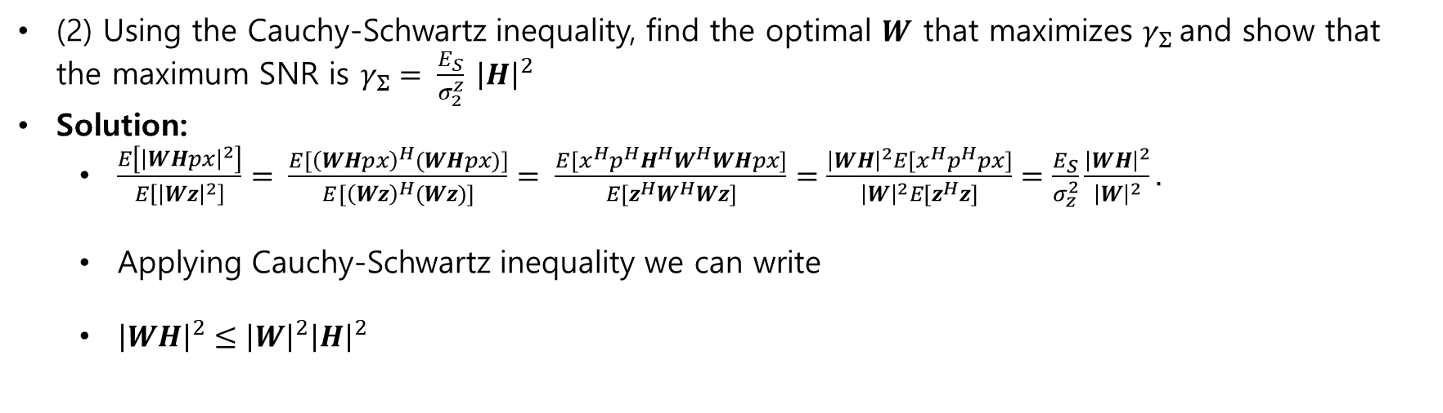
SIMO MRC
(2) Using the Cauchy-Schwartz inequality, find the optimal $W$ that maximizes $γ_{Σ}$and show that the maximum SNR is $γ_{Σ}= \frac{E_{S}}{σ_{2}^{z}} {\left|H\right|}^{2}$
Solution:
$\frac{E\left[{\left|WHpx\right|}^{2}\right]}{E\left[{\left|Wz\right|}^{2}\right]}= \frac{E[{\left(WHpx\right)}^{H}(WHpx)]}{E[{\left(Wz\right)}^{H}(Wz)]}= \frac{E[x^{H}p^{H}H^{H}W^{H}WHpx]}{E[z^{H}W^{H}Wz]}=\frac{{\left|WH\right|}^{2}E[x^{H}p^{H}px]}{{\left|W\right|}^{2}E[z^{H}z]}=\frac{E_{S}}{σ_{z}^{2}}\frac{{\left|WH\right|}^{2}}{{\left|W\right|}^{2}}.$
Applying Cauchy-Schwartz inequality we can write
${\left|WH\right|}^{2}≤{\left|W\right|}^{2}{\left|H\right|}^{2}$

Slide 15
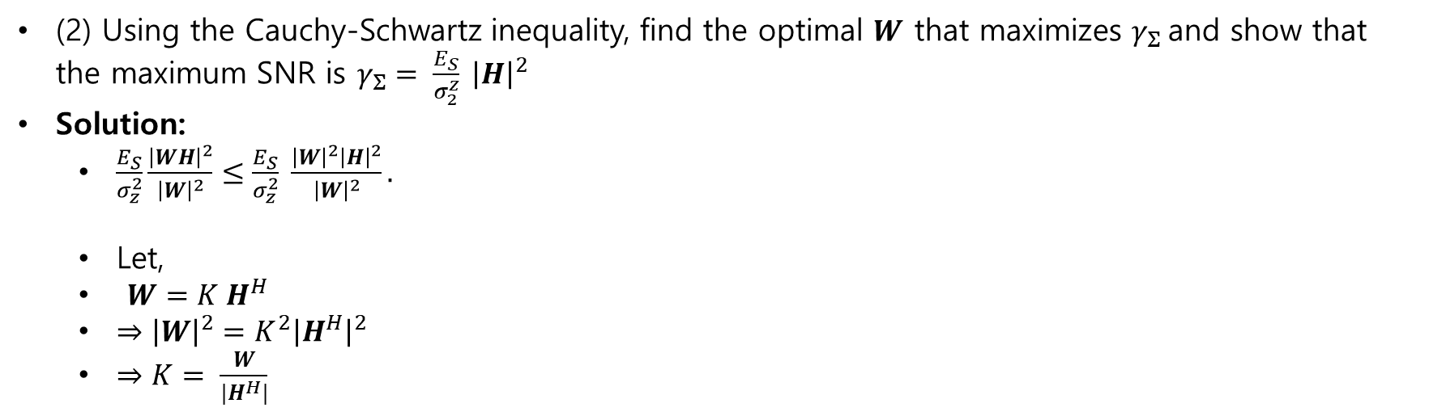
SIMO MRC
(2) Using the Cauchy-Schwartz inequality, find the optimal $W$ that maximizes $γ_{Σ}$and show that the maximum SNR is $γ_{Σ}= \frac{E_{S}}{σ_{2}^{z}} {\left|H\right|}^{2}$
Solution:
$\frac{E_{S}}{σ_{z}^{2}}\frac{{\left|WH\right|}^{2}}{{\left|W\right|}^{2}}≤\frac{E_{S}}{σ_{z}^{2}} \frac{{\left|W\right|}^{2}{\left|H\right|}^{2}}{{\left|W\right|}^{2}}.$
Let,
$W=K H^{H}$
$⇒{\left|W\right|}^{2}=K^{2}{\left|H^{H}\right|}^{2}$
$⇒K= \frac{W}{|H^{H}|}$

Slide 16
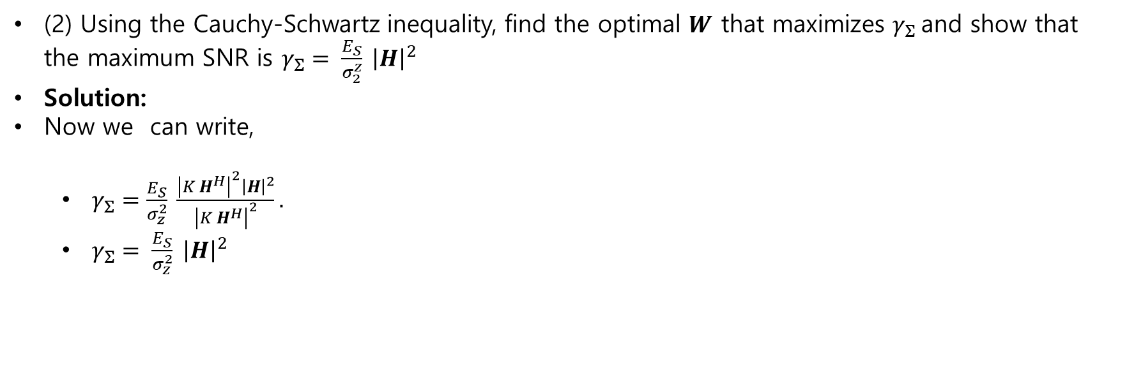
SIMO MRC
(2) Using the Cauchy-Schwartz inequality, find the optimal $W$ that maximizes $γ_{Σ}$and show that the maximum SNR is $γ_{Σ}= \frac{E_{S}}{σ_{2}^{z}} {\left|H\right|}^{2}$
Solution:
Now we can write,
$γ_{Σ}=\frac{E_{S}}{σ_{z}^{2}} \frac{{\left|K H^{H}\right|}^{2}{\left|H\right|}^{2}}{{\left|K H^{H}\right|}^{2}}.$
$γ_{Σ}= \frac{E_{S}}{σ_{z}^{2}} {\left|H\right|}^{2}$

Slide 17
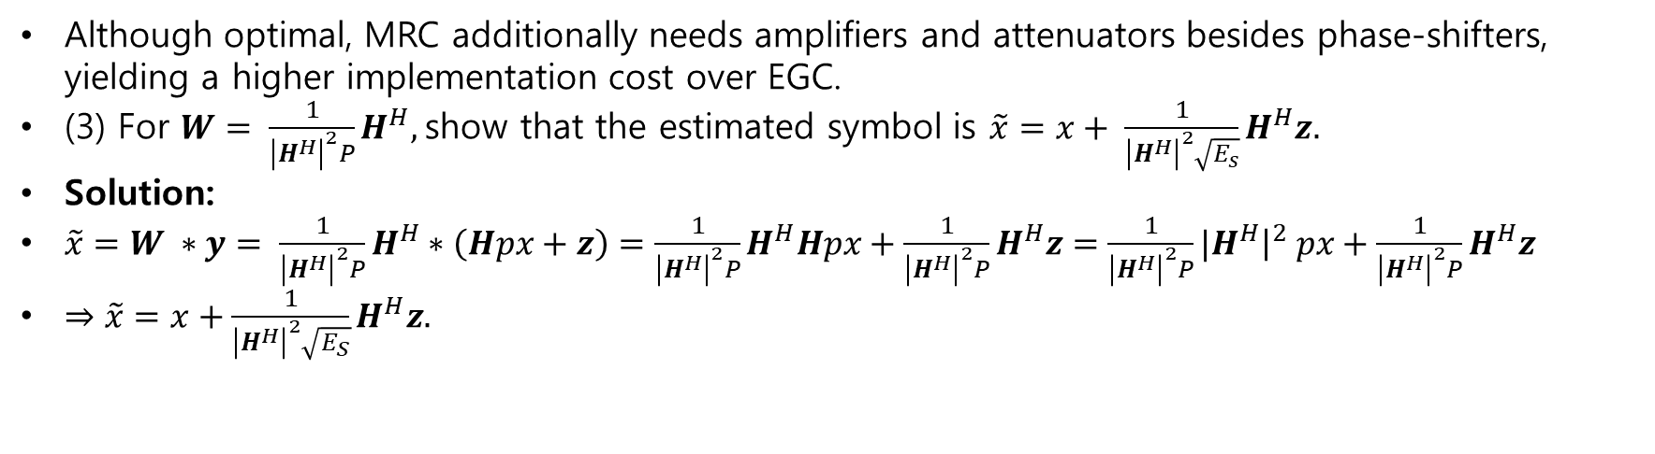
SIMO MRC
Although optimal, MRC additionally needs amplifiers and attenuators besides phase-shifters, yielding a higher implementation cost over EGC.
(3) For $W= \frac{1}{{\left|H^{H}\right|}^{2}P}H^{H},$show that the estimated symbol is $\tilde{x}=x+ \frac{1}{{\left|H^{H}\right|}^{2}\sqrt{E_{s}}}H^{H}z.$
Solution:
$\tilde{x}=W ∗y= \frac{1}{{\left|H^{H}\right|}^{2}P}H^{H}∗\left(Hpx+z\right)=\frac{1}{{\left|H^{H}\right|}^{2}P}H^{H}Hpx+\frac{1}{{\left|H^{H}\right|}^{2}P}H^{H}z=\frac{1}{{\left|H^{H}\right|}^{2}P}{|H}^{H}{\left.​\right|}^{2} px+\frac{1}{{\left|H^{H}\right|}^{2}P}H^{H}z$
$⇒\tilde{x}=x+\frac{1}{{\left|H^{H}\right|}^{2}\sqrt{E_{S}}}H^{H}z.$

Slide 18
SIMO MRC
Although optimal, MRC additionally needs amplifiers and attenuators besides phase-shifters, yielding a higher implementation cost over EGC.
(3) For $W= \frac{1}{{\left|H^{H}\right|}^{2}P}H^{H},$show that the estimated symbol is $\tilde{x}=x+ \frac{1}{{\left|H^{H}\right|}^{2}\sqrt{E_{s}}}H^{H}z.$
Solution:
$\tilde{x}=W ∗y= \frac{1}{{\left|H^{H}\right|}^{2}P}H^{H}∗\left(Hpx+z\right)=\frac{1}{{\left|H^{H}\right|}^{2}P}H^{H}Hpx+\frac{1}{{\left|H^{H}\right|}^{2}P}H^{H}z=\frac{1}{{\left|H^{H}\right|}^{2}P}{|H}^{H}{\left.​\right|}^{2} px+\frac{1}{{\left|H^{H}\right|}^{2}P}H^{H}z$
$⇒\tilde{x}=x+\frac{1}{{\left|H^{H}\right|}^{2}\sqrt{E_{S}}}H^{H}z.$

Slide 19
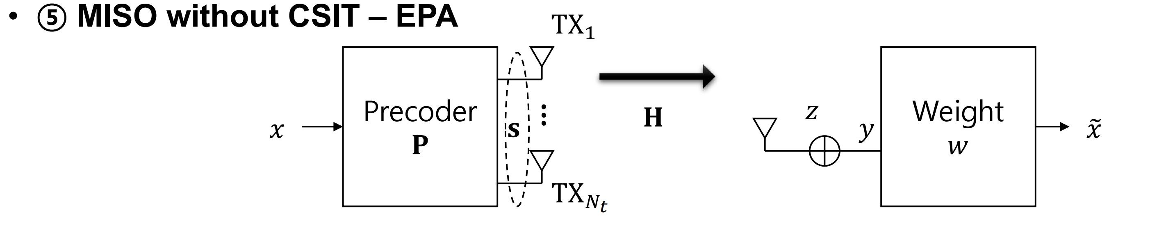
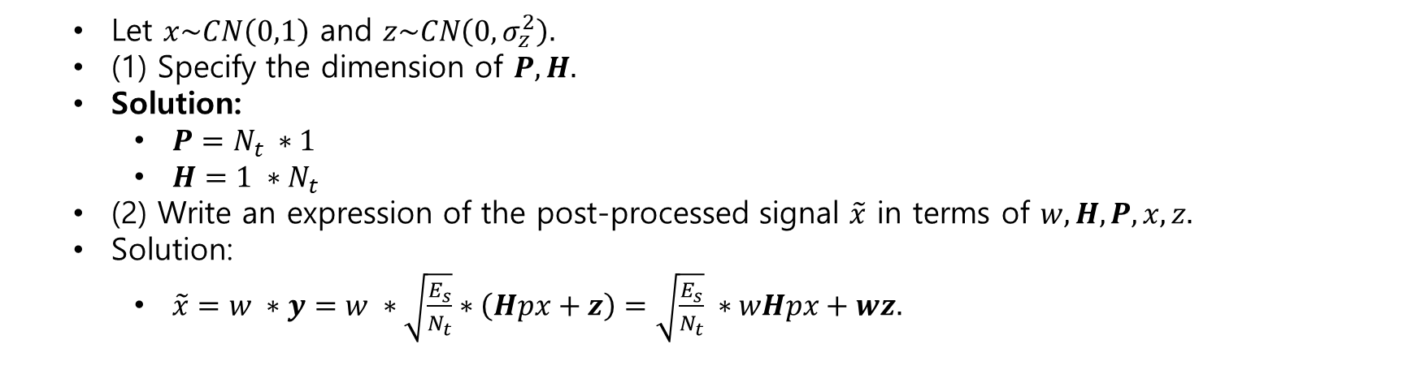
MISO without CSIT - EPA
Let $x\sim CN\left(0,1\right)$ and $z\sim CN\left(0,σ_{z}^{2}\right).$
(1) Specify the dimension of $P,H.$
Solution:
$P=N_{t} ∗1$
$H=1 ∗N_{t}$
(2) Write an expression of the post-processed signal $\tilde{x}$ in terms of $w,H,P,x,z.$
Solution:
$\tilde{x}=w ∗y=w ∗\sqrt{\frac{E_{s}}{N_{t}}}∗\left(Hpx+z\right)=\sqrt{\frac{E_{s}}{N_{t}}} ∗wHpx+wz.$

Slide 20
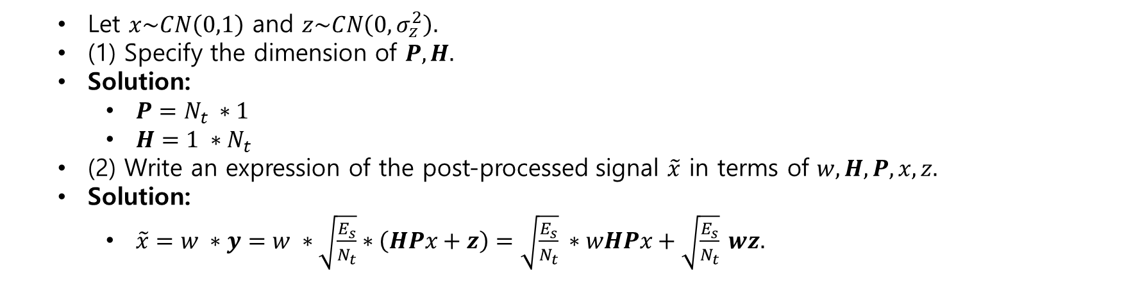
MISO without CSIT-EPA
Let $x\sim CN\left(0,1\right)$ and $z\sim CN\left(0,σ_{z}^{2}\right).$
(1) Specify the dimension of $P,H.$
Solution:
$P=N_{t} ∗1$
$H=1 ∗N_{t}$
(2) Write an expression of the post-processed signal $\tilde{x}$ in terms of $w,H,P,x,z.$
Solution:
$\tilde{x}=w ∗y=w ∗\sqrt{\frac{E_{s}}{N_{t}}}∗\left(HPx+z\right)=\sqrt{\frac{E_{s}}{N_{t}}} ∗wHPx+\sqrt{\frac{E_{s}}{N_{t}}} wz.$

Slide 21
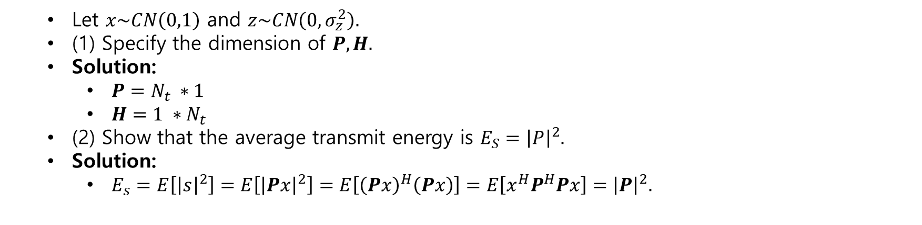
MISO without CSIT-EPA
Let $x\sim CN\left(0,1\right)$ and $z\sim CN\left(0,σ_{z}^{2}\right).$
(1) Specify the dimension of $P,H.$
Solution:
$P=N_{t} ∗1$
$H=1 ∗N_{t}$
(2) Show that the average transmit energy is $E_{S}={\left|P\right|}^{2}.$
Solution:
$E_{s}=E\left[{\left|s\right|}^{2}\right]=E\left[{\left|Px\right|}^{2}\right]=E\left[{\left(Px\right)}^{H}\left(Px\right)\right]=E\left[x^{H}P^{H}Px\right]={\left|P\right|}^{2}.$

Slide 22
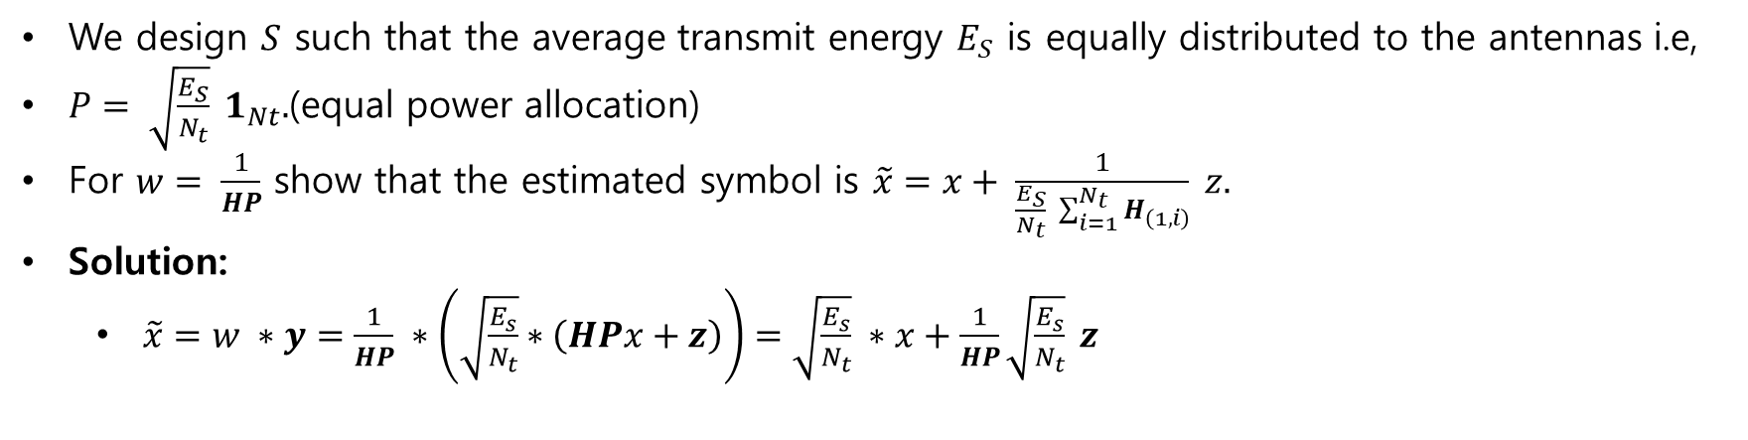
MISO without CSIT-EPA
We design $S$ such that the average transmit energy $E_{S}$ is equally distributed to the antennas i.e,
$P= \sqrt{\frac{E_{S}}{N_{t}}} 1_{Nt}.$(equal power allocation)
For $w= \frac{1}{HP}$ show that the estimated symbol is $\tilde{x}=x+ \frac{1}{\frac{E_{S}}{N_{t}} \sum_{i=1}^{N_{t}}{H_{\left(1,i\right)}}} z.$
Solution:
$\tilde{x}=w ∗y=\frac{1}{HP} ∗\left(\sqrt{\frac{E_{s}}{N_{t}}}∗\left(HPx+z\right)\right)=\sqrt{\frac{E_{s}}{N_{t}}} ∗x+\frac{1}{HP}\sqrt{\frac{E_{s}}{N_{t}}} z$

Slide 23
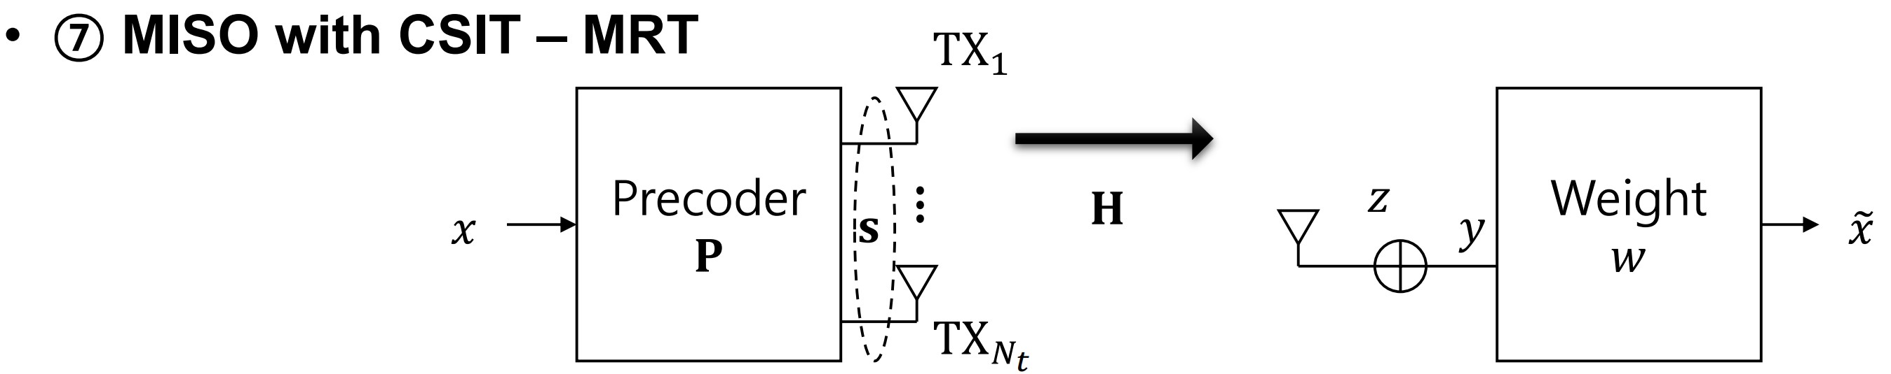
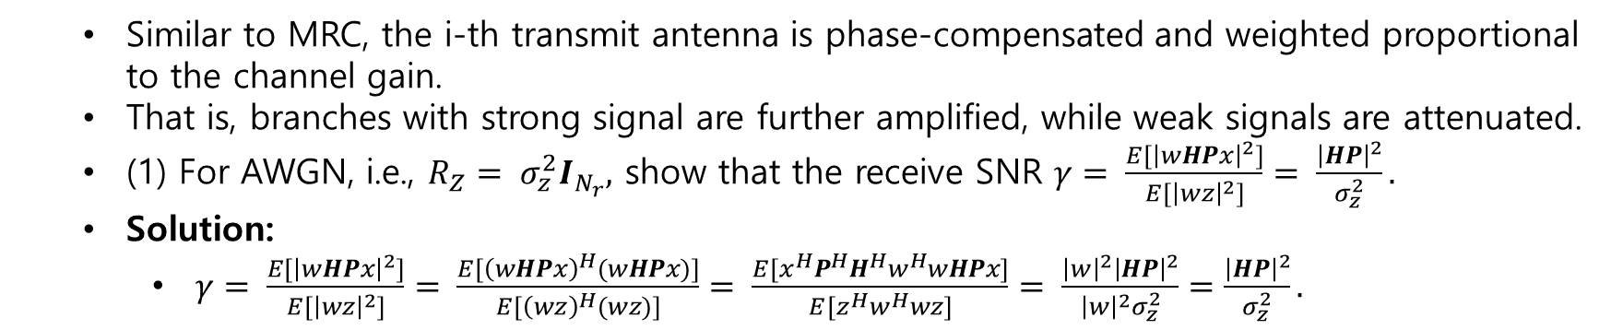
MISO with CSIT-MRT
Similar to MRC, the i-th transmit antenna is phase-compensated and weighted proportional to the channel gain.
That is, branches with strong signal are further amplified, while weak signals are attenuated.
(1) For AWGN, i.e., $R_{Z}= σ_{z}^{2}I_{N_{r}},$ show that the receive SNR $γ= \frac{E[{\left|wHPx\right|}^{2}]}{E[{\left|wz\right|}^{2}]}= \frac{{\left|HP\right|}^{2}}{σ_{z}^{2}}.$
Solution:
$γ= \frac{E[{\left|wHPx\right|}^{2}]}{E[{\left|wz\right|}^{2}]}= \frac{E[{\left(wHPx\right)}^{H}(wHPx)]}{E[{\left(wz\right)}^{H}(wz)]}= \frac{E[x^{H}P^{H}H^{H}w^{H}wHPx]}{E[z^{H}w^{H}wz]}= \frac{{\left|w\right|}^{2}{\left|HP\right|}^{2}}{{\left|w\right|}^{2}σ_{z}^{2}}=\frac{{\left|HP\right|}^{2}}{σ_{z}^{2}}.$

Slide 24
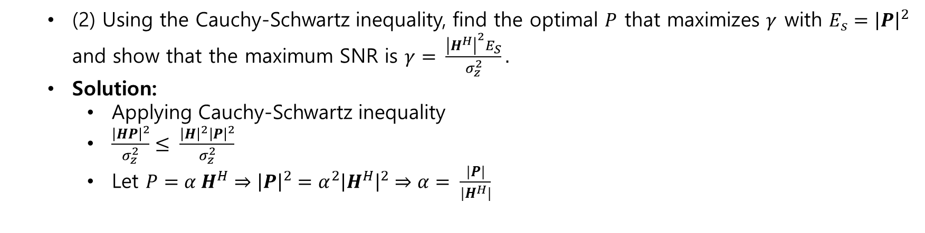
MISO with CSIT-MRT
(2) Using the Cauchy-Schwartz inequality, find the optimal $P$ that maximizes $γ$ with $E_{s}={\left|P\right|}^{2}$ and show that the maximum SNR is $γ= \frac{{\left|H^{H}\right|}^{2}E_{S}}{σ_{z}^{2}}.$
Solution:
Applying Cauchy-Schwartz inequality
$\frac{{\left|HP\right|}^{2}}{σ_{z}^{2}}≤ \frac{{\left|H\right|}^{2}{\left|P\right|}^{2}}{σ_{z}^{2}}$
Let $P=α H^{H}⇒{\left|P\right|}^{2}=α^{2}{\left|H^{H}\right|}^{2}⇒α= \frac{|P|}{|H^{H}|}$

Slide 25
MISO with CSIT-MRT
(2) Using the Cauchy-Schwartz inequality, find the optimal $P$ that maximizes $γ$ with $E_{s}={\left|P\right|}^{2}$ and show that the maximum SNR is $γ= \frac{{\left|H^{H}\right|}^{2}E_{S}}{σ_{z}^{2}}.$
Solution:
Applying Cauchy-Schwartz inequality
$\frac{{\left|HP\right|}^{2}}{σ_{z}^{2}}≤ \frac{{\left|H\right|}^{2}{\left|P\right|}^{2}}{σ_{z}^{2}}$
Let $P=α H^{H}⇒{\left|P\right|}^{2}=α^{2}{\left|H^{H}\right|}^{2}⇒α= \frac{|P|}{|H^{H}|}$

Slide 26
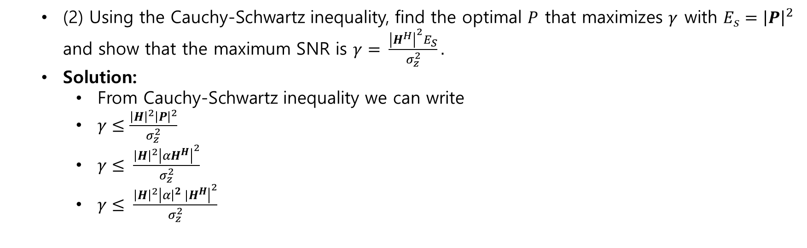
MISO with CSIT-MRT
(2) Using the Cauchy-Schwartz inequality, find the optimal $P$ that maximizes $γ$ with $E_{s}={\left|P\right|}^{2}$ and show that the maximum SNR is $γ= \frac{{\left|H^{H}\right|}^{2}E_{S}}{σ_{z}^{2}}.$
Solution:
From Cauchy-Schwartz inequality we can write
$γ≤\frac{{\left|H\right|}^{2}{\left|P\right|}^{2}}{σ_{z}^{2}}$
$γ≤ \frac{{\left|H\right|}^{2}{\left|αH^{H}\right|}^{2}}{σ_{z}^{2}}$
$γ≤ \frac{{\left|H\right|}^{2}{\left|α{{\left.​\right|}^{2} |H}^{H}\right|}^{2}}{σ_{z}^{2}}$

Slide 27
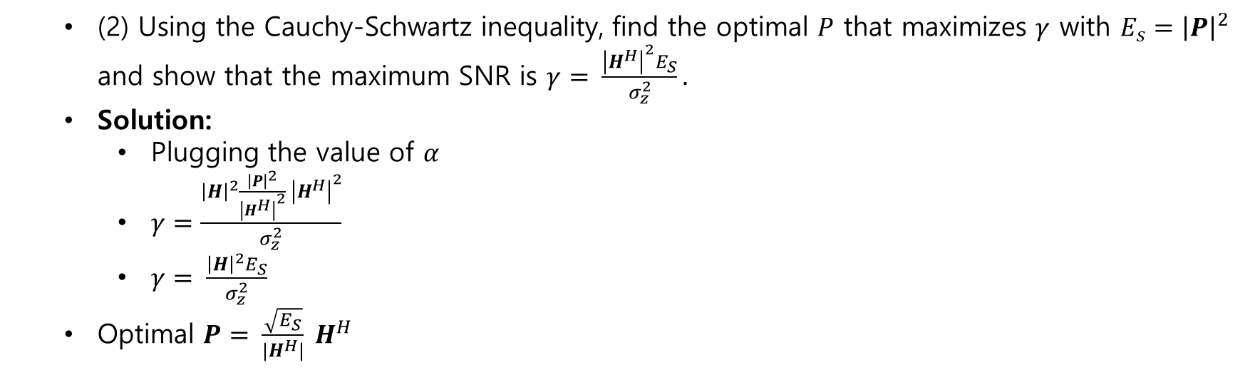
MISO with CSIT-MRT
(2) Using the Cauchy-Schwartz inequality, find the optimal $P$ that maximizes $γ$ with $E_{s}={\left|P\right|}^{2}$ and show that the maximum SNR is $γ= \frac{{\left|H^{H}\right|}^{2}E_{S}}{σ_{z}^{2}}.$
Solution:
Plugging the value of $α$
$γ=\frac{{\left|H\right|}^{2}\frac{{\left|P\right|}^{2}}{{\left|H^{H}\right|}^{2}} {\left|H^{H}\right|}^{2}}{σ_{z}^{2}}$
$γ= \frac{{\left|H\right|}^{2}E_{S}}{σ_{z}^{2}}$
Optimal $P= \frac{\sqrt{E_{S}}}{|H^{H}|} H^{H}$

Slide 28
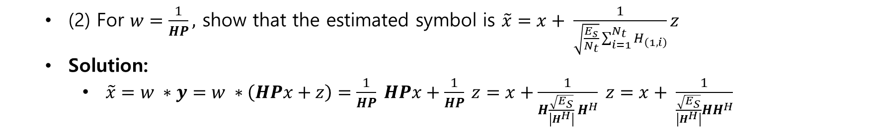
MISO with CSIT-MRT
(2) For $w=\frac{1}{HP},$ show that the estimated symbol is $\tilde{x}=x+ \frac{1}{\sqrt{\frac{E_{s}}{N_{t}}}\sum_{i=1}^{N_{t}}{H_{\left(1,i\right)}}}z$
Solution:
$\tilde{x}=w ∗y=w ∗\left(HPx+z\right)=\frac{1}{HP} HPx+\frac{1}{HP} z=x+\frac{1}{H\frac{\sqrt{E_{S}}}{\left|H^{H}\right|} H^{H}} z=x+ \frac{1}{\frac{\sqrt{E_{S}}}{\left|H^{H}\right|}HH^{H}}$

Slide 29
Assignment 06
Capacity of MIMO Systems

Slide 30
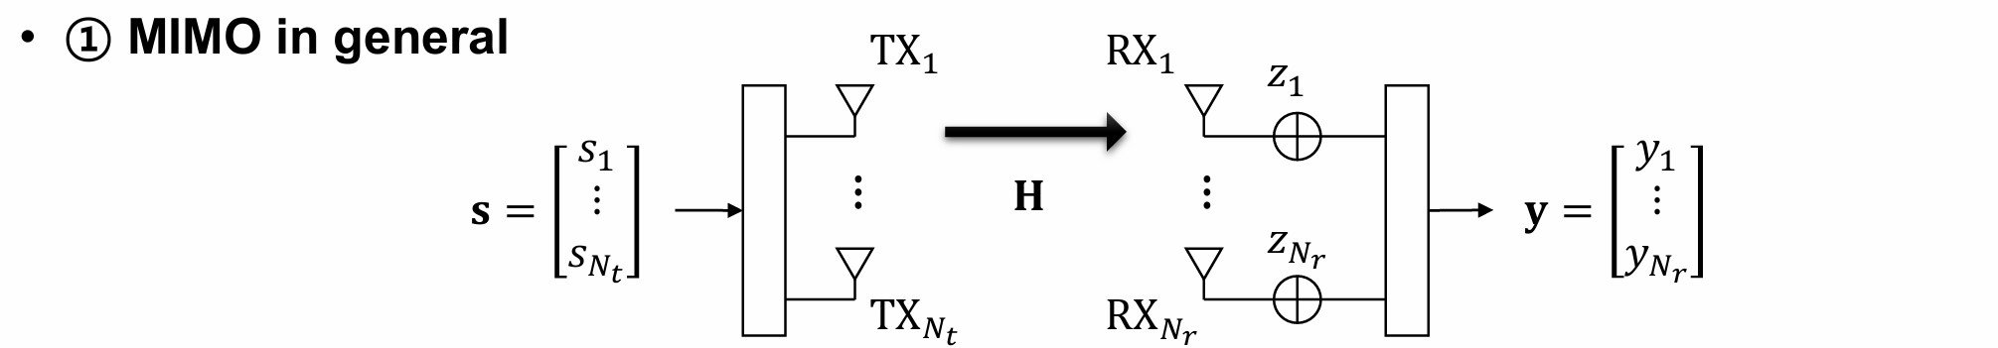
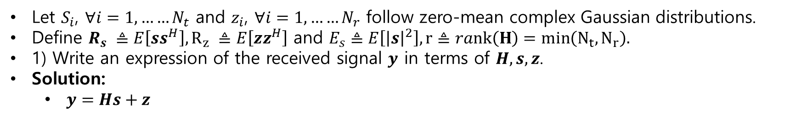
Capacity of MIMO systems
Let $S_{i}$, $∀i=1,……N_{t}$ and $z_{i}$, $∀i=1,……N_{r}$ follow zero-mean complex Gaussian distributions.
Define $R_{s} ≜E\left[ss^{H}\right], R_{z} ≜E\left[zz^{H}\right]$ and $E_{s}≜E\left[{\left|s\right|}^{2}\right], r≜rank\left(H\right)=min\left(N_{t}, N_{r}\right).$
1) Write an expression of the received signal $y$ in terms of $H,s,z$.
Solution:
$y=Hs+z$

Slide 31
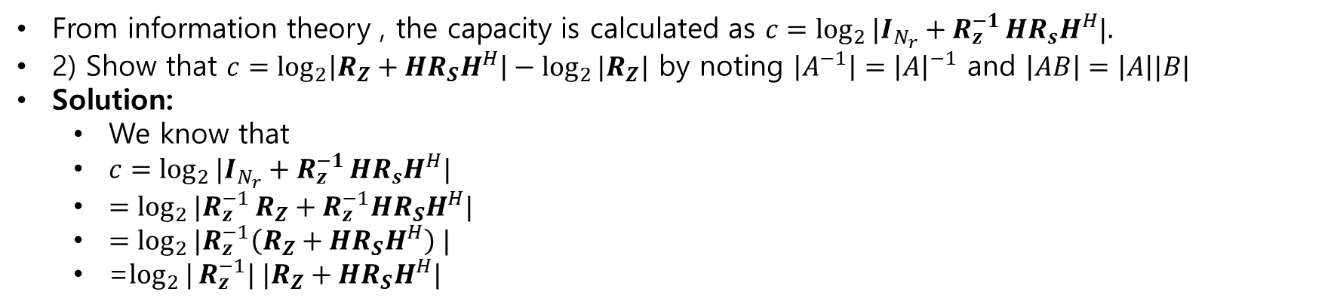
Capacity of MIMO systems
From information theory , the capacity is calculated as $c=\log_{2}{|I_{N_{r}}+R_{z}^{−1}}HR_{s}H^{H}|.$
2) Show that $c=\log_{2}\left|R_{Z}+HR_{S}H^{H}\right|−\log_{2}{|R_{Z}|}$ by noting $\left|A^{−1}\right|={\left|A\right|}^{−1}$ and $\left|AB\right|=\left|A\right||B|$
Solution:
We know that
$c=\log_{2}{|I_{N_{r}}+R_{z}^{−1}}HR_{s}H^{H}|$
$=\log_{2}{|R_{z}^{−1}}R_{Z}+R_{z}^{−1}HR_{S}H^{H}|$
$=\log_{2}{|R_{z}^{−1}\left(R_{Z}+HR_{S}H^{H}\right) |}$
=$\log_{2}{|}R_{z}^{−1}| |R_{Z}+HR_{S}H^{H}|$

Slide 32
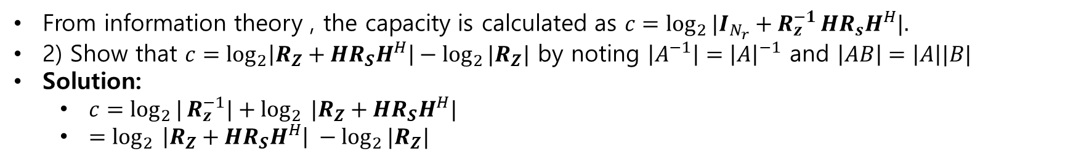
Capacity of MIMO systems
From information theory , the capacity is calculated as $c=\log_{2}{|I_{N_{r}}+R_{z}^{−1}}HR_{s}H^{H}|.$
2) Show that $c=\log_{2}\left|R_{Z}+HR_{S}H^{H}\right|−\log_{2}{|R_{Z}|}$ by noting $\left|A^{−1}\right|={\left|A\right|}^{−1}$ and $\left|AB\right|=\left|A\right||B|$
Solution:
$c=\log_{2}{|}R_{z}^{−1}|+\log_{2}$ $|R_{Z}+HR_{S}H^{H}|$
$=\log_{2}$ $\left|R_{Z}+HR_{S}H^{H}\right| −\log_{2}{|R_{Z}|}$

Slide 33
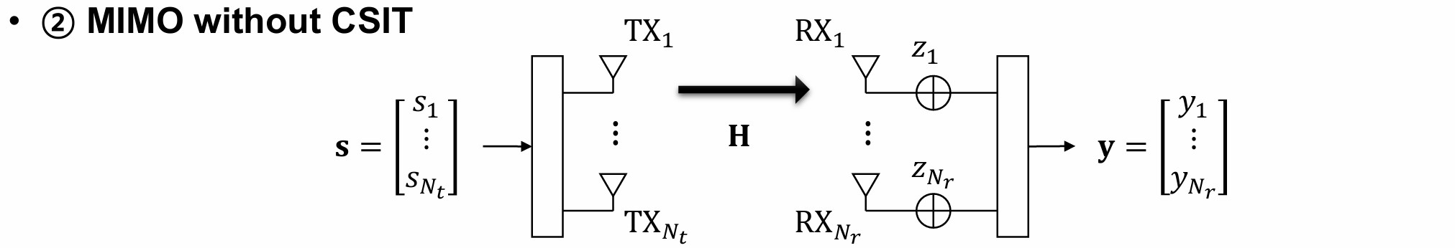
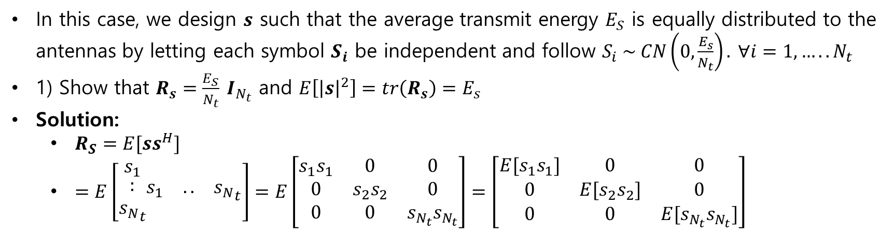
Capacity of MIMO systems
In this case, we design $s$ such that the average transmit energy $E_{S}$ is equally distributed to the antennas by letting each symbol $S_{i}$ be independent and follow $S_{i} \sim CN\left(0,\frac{E_{s}}{N_{t}}\right).$ $∀i=1,…..N_{t}$
1) Show that $R_{s}=\frac{E_{S}}{N_{t}} I_{N_{t}}$ and $E\left[{\left|s\right|}^{2}\right]=tr\left(R_{s}\right)=E_{s}$
Solution:
$R_{S}=E[ss^{H}]$
$=E\left[\begin{matrix}s_{1} \\ \begin{matrix}: \\ {s_{N}}_{t}\end{matrix}\end{matrix}\begin{matrix}s_{1} & .. & {s_{N}}_{t}\end{matrix}\right]=E\left[\begin{matrix}s_{1}s_{1} & 0 & 0 \\ 0 & s_{2}s_{2} & 0 \\ 0 & 0 & s_{N_{t}}s_{N_{t}}\end{matrix}\right]=\left[\begin{matrix}{E[s}_{1}s_{1}] & 0 & 0 \\ 0 & {E[s}_{2}s_{2}] & 0 \\ 0 & 0 & {E[s}_{N_{t}}s_{N_{t}}]\end{matrix}\right]$

Slide 34
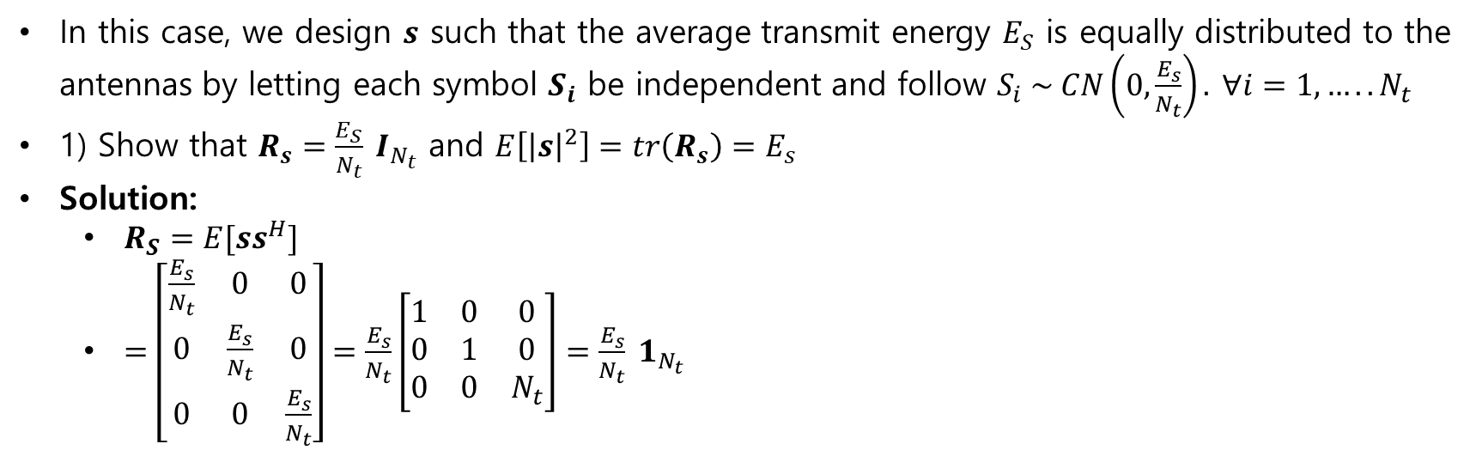
Capacity of MIMO systems
In this case, we design $s$ such that the average transmit energy $E_{S}$ is equally distributed to the antennas by letting each symbol $S_{i}$ be independent and follow $S_{i} \sim CN\left(0,\frac{E_{s}}{N_{t}}\right).$ $∀i=1,…..N_{t}$
1) Show that $R_{s}=\frac{E_{S}}{N_{t}} I_{N_{t}}$ and $E\left[{\left|s\right|}^{2}\right]=tr\left(R_{s}\right)=E_{s}$
Solution:
$R_{S}=E[ss^{H}]$
$=\left[\begin{matrix}\frac{E_{s}}{N_{t}} & 0 & 0 \\ 0 & \frac{E_{s}}{N_{t}} & 0 \\ 0 & 0 & \frac{E_{s}}{N_{t}}\end{matrix}\right]=\frac{E_{s}}{N_{t}}\left[\begin{matrix}1 & 0 & 0 \\ 0 & 1 & 0 \\ 0 & 0 & N_{t}\end{matrix}\right]=\frac{E_{s}}{N_{t}} 1_{N_{t}}$

Slide 35
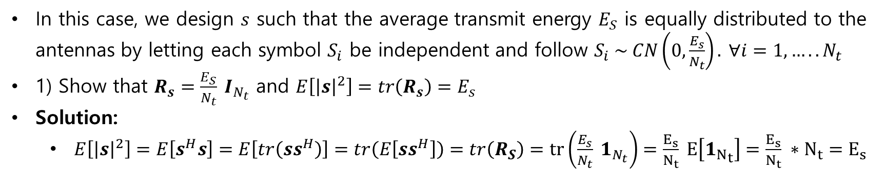
Capacity of MIMO systems
In this case, we design $s$ such that the average transmit energy $E_{S}$ is equally distributed to the antennas by letting each symbol $S_{i}$ be independent and follow $S_{i} \sim CN\left(0,\frac{E_{s}}{N_{t}}\right).$ $∀i=1,…..N_{t}$
1) Show that $R_{s}=\frac{E_{S}}{N_{t}} I_{N_{t}}$ and $E\left[{\left|s\right|}^{2}\right]=tr\left(R_{s}\right)=E_{s}$
Solution:
$E\left[{\left|s\right|}^{2}\right]=E\left[s^{H}s\right]=E\left[tr\left(ss^{H}\right)\right]=tr\left(E\left[ss^{H}\right]\right)=tr\left(R_{S}\right)=tr\left(\frac{E_{s}}{N_{t}} 1_{N_{t}}\right)=\frac{E_{s}}{N_{t}} E\left[{1_{N}}_{t}\right]=\frac{E_{s}}{N_{t}} ∗N_{t}=E_{s}$

Slide 36
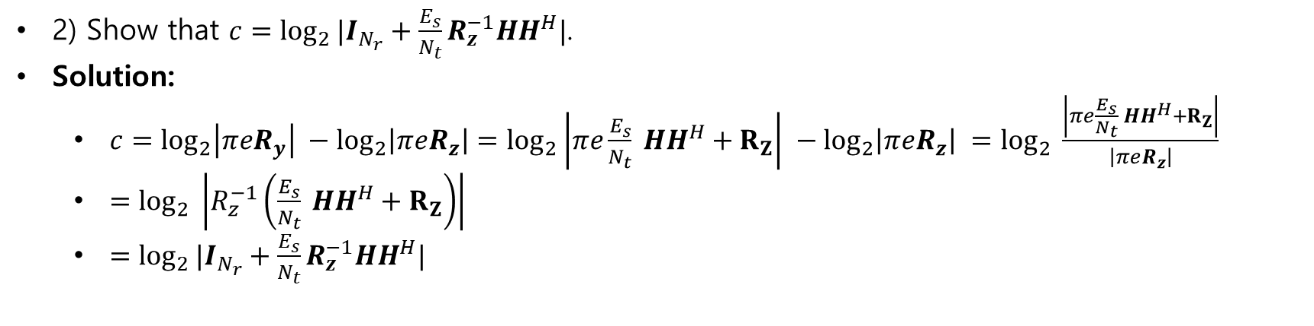
Capacity of MIMO systems
2) Show that $c=\log_{2}{|I_{N_{r}}+\frac{E_{s}}{N_{t}}}R_{z}^{−1}HH^{H}|$.
Solution:
$c=\log_{2}\left|πeR_{y}\right| −\log_{2}\left|πeR_{z}\right|=\log_{2}\left|πe\frac{E_{s}}{N_{t}} HH^{H}+R_{Z}\right| −\log_{2}\left|πeR_{z}\right| =\log_{2}{ \frac{\left|πe\frac{E_{s}}{N_{t}} HH^{H}+R_{Z}\right|}{\left|πeR_{z}\right|}}$
$=\log_{2}{ \left|R_{z}^{−1}\left(\frac{E_{s}}{N_{t}} HH^{H}+R_{Z}\right)\right|}$
$=\log_{2}{|I_{N_{r}}+\frac{E_{s}}{N_{t}}}R_{z}^{−1}HH^{H}|$

Slide 37
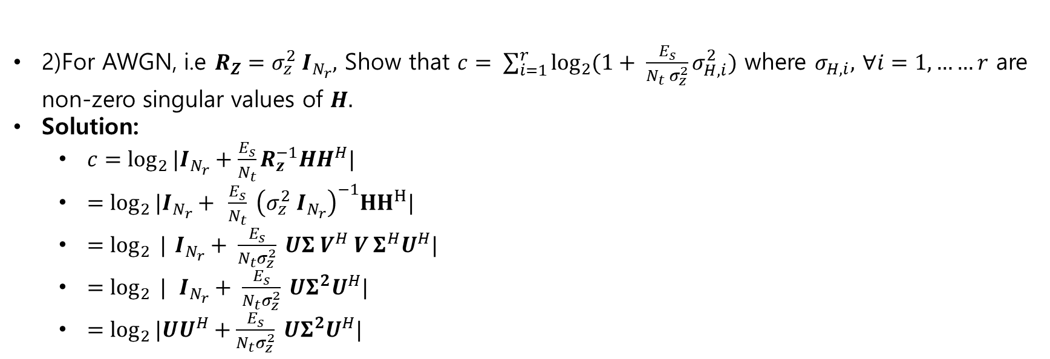
Capacity of MIMO systems
2)For AWGN, i.e $R_{Z}=σ_{z}^{2} I_{N_{r}},$ Show that $c= \sum_{i=1}^{r}{\log_{2}{(1+ \frac{E_{s}}{N_{t} σ_{z}^{2}}σ_{H,i}^{2})}}$ where $σ_{H,i},$ $∀i=1,……r$ are non-zero singular values of $H.$
Solution:
$c=\log_{2}{|I_{N_{r}}+\frac{E_{s}}{N_{t}}}R_{z}^{−1}HH^{H}|$
$=\log_{2}{|I_{N_{r}}+ }$ $\frac{E_{s}}{N_{t}} {\left(σ_{z}^{2} I_{N_{r}}\right)}^{−1}{HH}^{H}|$
$=\log_{2}{ |}$ $I_{N_{r}}+ \frac{E_{s}}{{N_{t}σ}_{z}^{2}} UΣ V^{H} V Σ^{H}U^{H}|$
$=\log_{2}{ |} I_{N_{r}}+ \frac{E_{s}}{{N_{t}σ}_{z}^{2}} UΣ^{2}U^{H}|$
$=\log_{2}{|UU^{H}+\frac{E_{s}}{{N_{t}σ}_{z}^{2}} UΣ^{2}U^{H}|}$

Slide 38
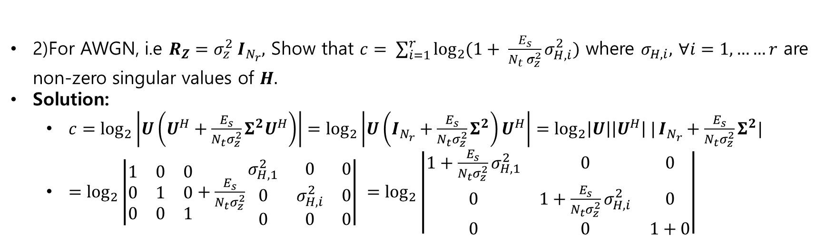
Capacity of MIMO systems
2)For AWGN, i.e $R_{Z}=σ_{z}^{2} I_{N_{r}},$ Show that $c= \sum_{i=1}^{r}{\log_{2}{(1+ \frac{E_{s}}{N_{t} σ_{z}^{2}}σ_{H,i}^{2})}}$ where $σ_{H,i},$ $∀i=1,……r$ are non-zero singular values of $H.$
Solution:
$c=\log_{2}\left|U\left(U^{H}+\frac{E_{s}}{{N_{t}σ}_{z}^{2}}Σ^{2}U^{H}\right)\right|=\log_{2}\left|U\left(I_{N_{r}}+\frac{E_{s}}{{N_{t}σ}_{z}^{2}}Σ^{2}\right)U^{H}\right|=\log_{2}\left|U\right|\left|U^{H}\right| |I_{N_{r}}+\frac{E_{s}}{{N_{t}σ}_{z}^{2}}Σ^{2}|$
$=\log_{2}\left|\begin{matrix}1 & 0 & 0 \\ 0 & 1 & 0 \\ 0 & 0 & 1\end{matrix}+\frac{E_{s}}{{N_{t}σ}_{z}^{2}}\begin{matrix}σ_{H,1}^{2} & 0 & 0 \\ 0 & σ_{H,i}^{2} & 0 \\ 0 & 0 & 0\end{matrix}\right| =\log_{2}\left|\begin{matrix}1+\frac{E_{s}}{{N_{t}σ}_{z}^{2}}σ_{H,1}^{2} & 0 & 0 \\ 0 & 1+\frac{E_{s}}{{N_{t}σ}_{z}^{2}}σ_{H,i}^{2} & 0 \\ 0 & 0 & 1+0\end{matrix}\right|$

Slide 39
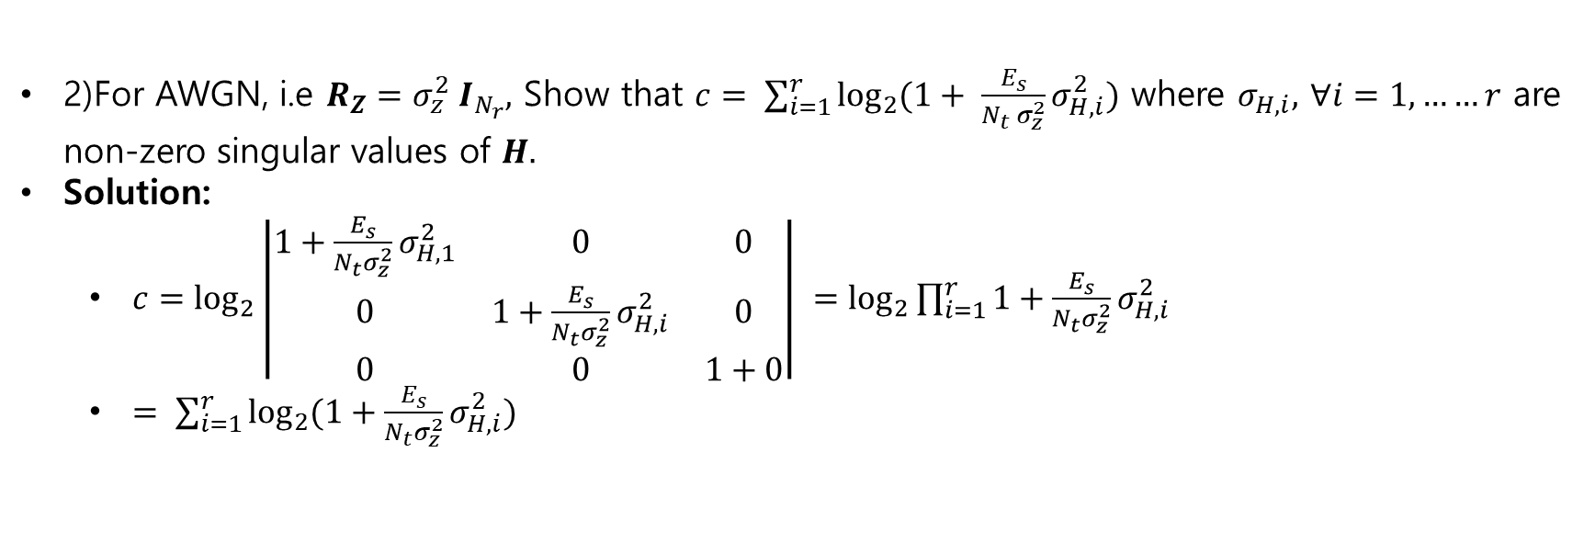
Capacity of MIMO systems
2)For AWGN, i.e $R_{Z}=σ_{z}^{2} I_{N_{r}},$ Show that $c= \sum_{i=1}^{r}{\log_{2}{(1+ \frac{E_{s}}{N_{t} σ_{z}^{2}}σ_{H,i}^{2})}}$ where $σ_{H,i},$ $∀i=1,……r$ are non-zero singular values of $H.$
Solution:
$c=\log_{2}\left|\begin{matrix}1+\frac{E_{s}}{{N_{t}σ}_{z}^{2}}σ_{H,1}^{2} & 0 & 0 \\ 0 & 1+\frac{E_{s}}{{N_{t}σ}_{z}^{2}}σ_{H,i}^{2} & 0 \\ 0 & 0 & 1+0\end{matrix}\right| =\log_{2}{\prod_{i=1}^{r}{1+\frac{E_{s}}{{N_{t}σ}_{z}^{2}}σ_{H,i}^{2}}}$
$= \sum_{i=1}^{r}{\log_{2}{(1+\frac{E_{s}}{{N_{t}σ}_{z}^{2}}σ_{H,i}^{2})}}$

Slide 40
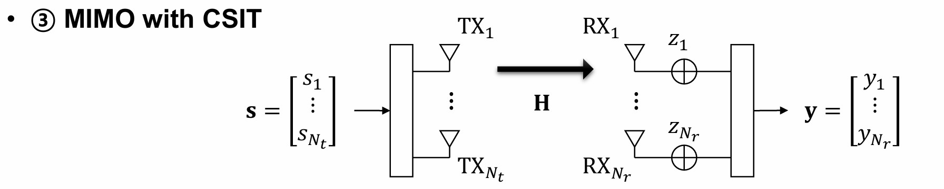
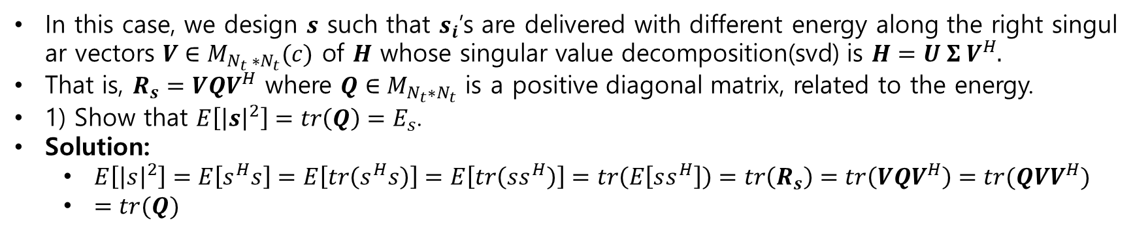
Capacity of MIMO systems
In this case, we design $s$ such that $s_{i}$’s are delivered with different energy along the right singular vectors $V∈M_{N_{t} ∗N_{t}}(c)$ of $H$ whose singular value decomposition(svd) is $H=U Σ V^{H}.$
That is, $R_{s}=VQV^{H}$ where $Q∈M_{N_{t}∗N_{t}}$ is a positive diagonal matrix, related to the energy.
1) Show that $E\left[{\left|s\right|}^{2}\right]=tr\left(Q\right)=E_{s}$.
Solution:
$E\left[{\left|s\right|}^{2}\right]=E\left[s^{H}s\right]=E\left[tr\left(s^{H}s\right)\right]=E\left[tr\left(ss^{H}\right)\right]=tr\left(E\left[ss^{H}\right]\right)=tr\left(R_{s}\right)=tr\left(VQV^{H}\right)=tr(QVV^{H})$
$=tr(Q)$

Slide 41
Capacity of MIMO systems
In this case, we design $s$ such that $s_{i}$’s are delivered with different energy along the right singular vectors $V∈M_{N_{t} ∗N_{t}}(c)$ of $H$ whose singular value decomposition(svd) is $H=U Σ V^{H}.$
That is, $R_{s}=VQV^{H}$ where $Q∈M_{N_{t}∗N_{t}}$ is a positive diagonal matrix, related to the energy.
1) Show that $E\left[{\left|s\right|}^{2}\right]=tr\left(Q\right)=E_{s}$.
Solution:
$E\left[{\left|s\right|}^{2}\right]=E\left[s^{H}s\right]=E\left[tr\left(s^{H}s\right)\right]=E\left[tr\left(ss^{H}\right)\right]=tr\left(E\left[ss^{H}\right]\right)=tr\left(R_{s}\right)=tr\left(VQV^{H}\right)=tr(QVV^{H})$
$=tr(Q)$

Slide 42
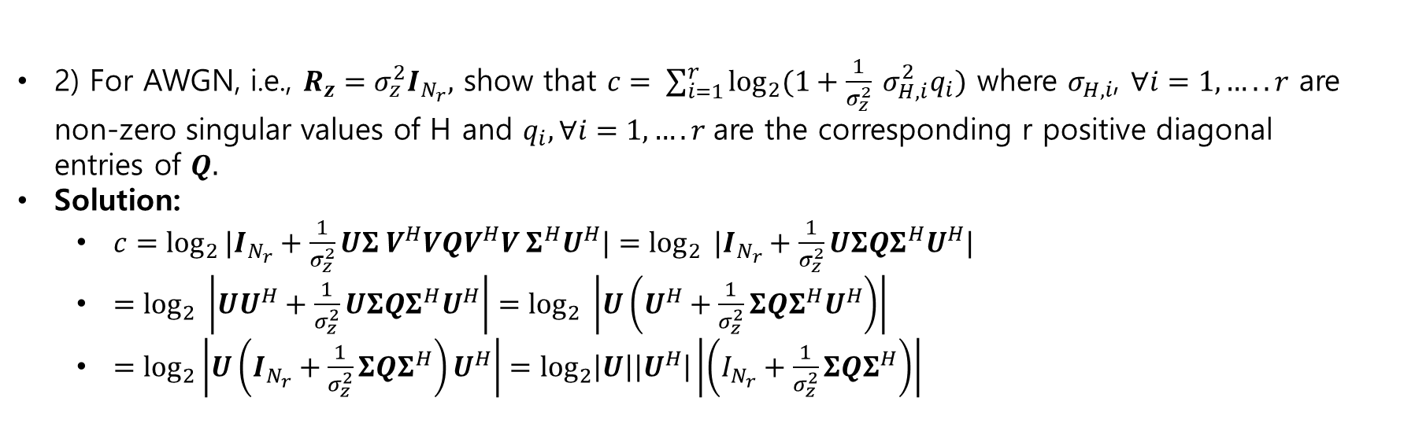
Capacity of MIMO systems
2) For AWGN, i.e., $R_{z}=σ_{z}^{2}I_{N_{r}},$ show that $c= \sum_{i=1}^{r}{\log_{2}{(1+\frac{1}{σ_{z}^{2}} σ_{H,i}^{2}q_{i})}}$ where $σ_{H,i}$, $∀i=1,…..r$ are non-zero singular values of H and $q_{i}, ∀i=1,….r$are the corresponding r positive diagonal entries of $Q.$
Solution:
$c=\log_{2}{|I_{N_{r}}+\frac{1}{σ_{z}^{2}}UΣ V^{H}VQV^{H}V Σ^{H}U^{H}|}=\log_{2}{ |I_{N_{r}}+\frac{1}{σ_{z}^{2}}UΣQΣ^{H}U^{H}|}$
$=\log_{2}{ \left|UU^{H}+\frac{1}{σ_{z}^{2}}UΣQΣ^{H}U^{H}\right|}=\log_{2}{ \left|U\left(U^{H}+\frac{1}{σ_{z}^{2}}ΣQΣ^{H}U^{H}\right)\right|}$
$=\log_{2}\left|U\left(I_{N_{r}}+\frac{1}{σ_{z}^{2}}ΣQΣ^{H}\right)U^{H}\right|=\log_{2}\left|U\right|\left|U^{H}\right|\left|\left(I_{N_{r}}+\frac{1}{σ_{z}^{2}}ΣQΣ^{H}\right)\right|$

Slide 43
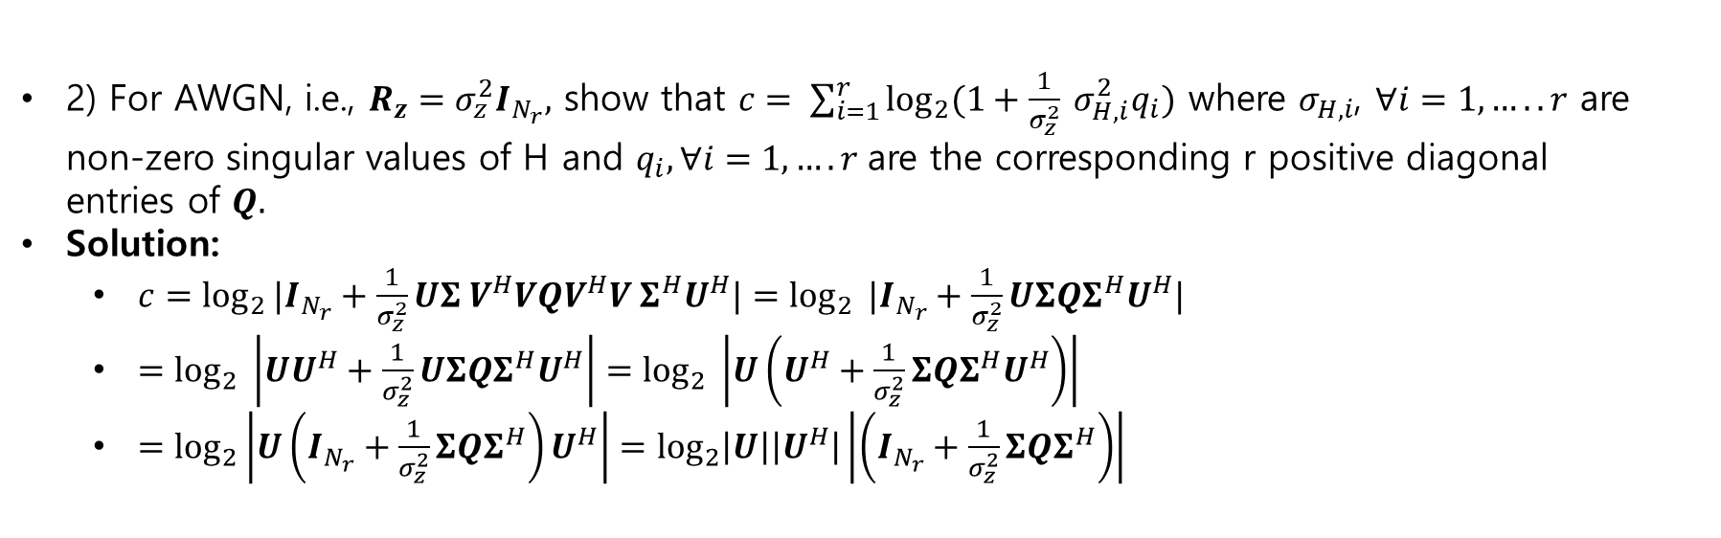
Capacity of MIMO systems
2) For AWGN, i.e., $R_{z}=σ_{z}^{2}I_{N_{r}},$ show that $c= \sum_{i=1}^{r}{\log_{2}{(1+\frac{1}{σ_{z}^{2}} σ_{H,i}^{2}q_{i})}}$ where $σ_{H,i}$, $∀i=1,…..r$ are non-zero singular values of H and $q_{i}, ∀i=1,….r$are the corresponding r positive diagonal entries of $Q.$
Solution:
$c=\log_{2}{|I_{N_{r}}+\frac{1}{σ_{z}^{2}}UΣ V^{H}VQV^{H}V Σ^{H}U^{H}|}=\log_{2}{ |I_{N_{r}}+\frac{1}{σ_{z}^{2}}UΣQΣ^{H}U^{H}|}$
$=\log_{2}{ \left|UU^{H}+\frac{1}{σ_{z}^{2}}UΣQΣ^{H}U^{H}\right|}=\log_{2}{ \left|U\left(U^{H}+\frac{1}{σ_{z}^{2}}ΣQΣ^{H}U^{H}\right)\right|}$
$=\log_{2}\left|U\left(I_{N_{r}}+\frac{1}{σ_{z}^{2}}ΣQΣ^{H}\right)U^{H}\right|=\log_{2}\left|U\right|\left|U^{H}\right|\left|\left(I_{N_{r}}+\frac{1}{σ_{z}^{2}}ΣQΣ^{H}\right)\right|$

Slide 44
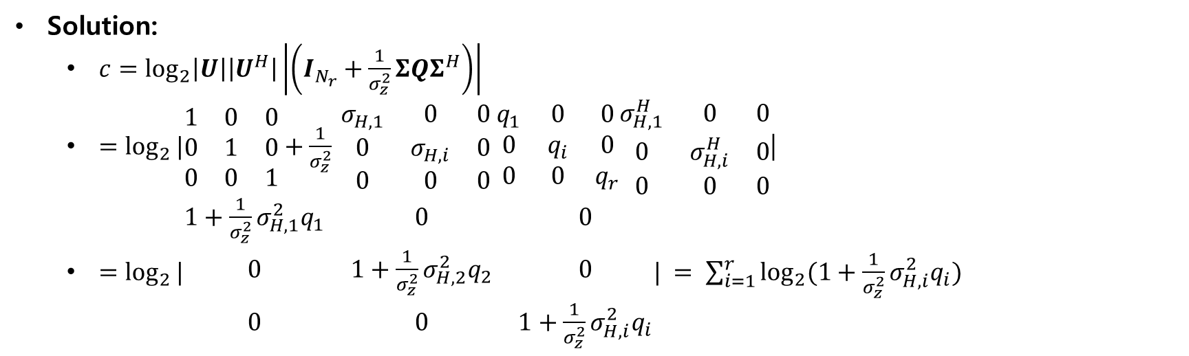
Capacity of MIMO systems
Solution:
$c=\log_{2}\left|U\right|\left|U^{H}\right|\left|\left(I_{N_{r}}+\frac{1}{σ_{z}^{2}}ΣQΣ^{H}\right)\right|$
$=\log_{2}{|\begin{matrix}1 & 0 & 0 \\ 0 & 1 & 0 \\ 0 & 0 & 1\end{matrix}+\frac{1}{σ_{z}^{2}}}$ $\begin{matrix}σ_{H,1} & 0 & 0 \\ 0 & σ_{H,i} & 0 \\ 0 & 0 & 0\end{matrix} \begin{matrix}q_{1} & 0 & 0 \\ 0 & q_{i} & 0 \\ 0 & 0 & q_{r}\end{matrix}\begin{matrix}σ_{H,1}^{H} & 0 & 0 \\ 0 & σ_{H,i}^{H} & 0 \\ 0 & 0 & 0\end{matrix}$|
$=\log_{2}{|\begin{matrix}1+\frac{1}{σ_{z}^{2}}σ_{H,1}^{2}q_{1} & 0 & 0 \\ 0 & 1+\frac{1}{σ_{z}^{2}}σ_{H,2}^{2}q_{2} & 0 \\ 0 & 0 & 1+\frac{1}{σ_{z}^{2}}σ_{H,i}^{2}q_{i}\end{matrix}|} = \sum_{i=1}^{r}{\log_{2}{(1+\frac{1}{σ_{z}^{2}}σ_{H,i}^{2}q_{i})} }$

Slide 45
Capacity of MIMO systems
Solution:
$c=\log_{2}\left|U\right|\left|U^{H}\right|\left|\left(I_{N_{r}}+\frac{1}{σ_{z}^{2}}ΣQΣ^{H}\right)\right|$
$=\log_{2}{|\begin{matrix}1 & 0 & 0 \\ 0 & 1 & 0 \\ 0 & 0 & 1\end{matrix}+\frac{1}{σ_{z}^{2}}}$ $\begin{matrix}σ_{H,1} & 0 & 0 \\ 0 & σ_{H,i} & 0 \\ 0 & 0 & 0\end{matrix} \begin{matrix}q_{1} & 0 & 0 \\ 0 & q_{i} & 0 \\ 0 & 0 & q_{r}\end{matrix}\begin{matrix}σ_{H,1}^{H} & 0 & 0 \\ 0 & σ_{H,i}^{H} & 0 \\ 0 & 0 & 0\end{matrix}$|
$=\log_{2}{|\begin{matrix}1+\frac{1}{σ_{z}^{2}}σ_{H,1}^{2}q_{1} & 0 & 0 \\ 0 & 1+\frac{1}{σ_{z}^{2}}σ_{H,2}^{2}q_{2} & 0 \\ 0 & 0 & 1+\frac{1}{σ_{z}^{2}}σ_{H,i}^{2}q_{i}\end{matrix}|} = \sum_{i=1}^{r}{\log_{2}{(1+\frac{1}{σ_{z}^{2}}σ_{H,i}^{2}q_{i})} }$

Slide 46
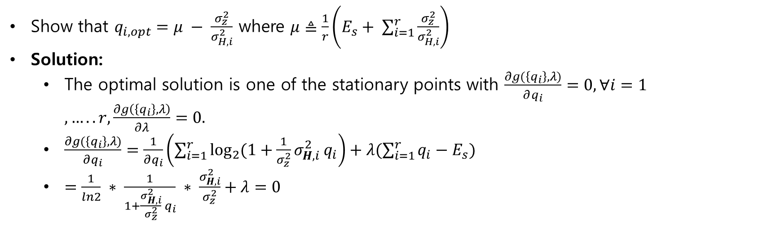
Capacity of MIMO systems
Show that $q_{i,opt}=μ − \frac{σ_{z}^{2}}{σ_{H,i}^{2}}$ where $μ≜\frac{1}{r}\left(E_{s}+ \sum_{i=1}^{r}{\frac{σ_{z}^{2}}{σ_{H,i}^{2}}}\right)$
Solution:
The optimal solution is one of the stationary points with $\frac{∂g(\left\{q_{i}\right\},λ)}{∂q_{i}}=0, ∀i=1,…..r,\frac{∂g\left(\left\{q_{i}\right\},λ\right)}{∂λ}=0.$
$\frac{∂g(\left\{q_{i}\right\},λ)}{∂q_{i}}=\frac{1}{∂q_{i}}\left(\sum_{i=1}^{r}{\log_{2}{(1+\frac{1}{σ_{z}^{2}}σ_{H,i}^{2}}q_{i}}\right)+λ(\sum_{i=1}^{r}{q_{i}−E_{s}})$
$=\frac{1}{ln2} ∗ \frac{1}{1+\frac{σ_{H,i}^{2}}{σ_{z}^{2}} q_{i}} ∗ \frac{σ_{H,i}^{2}}{σ_{z}^{2}}+λ=0$

Slide 47
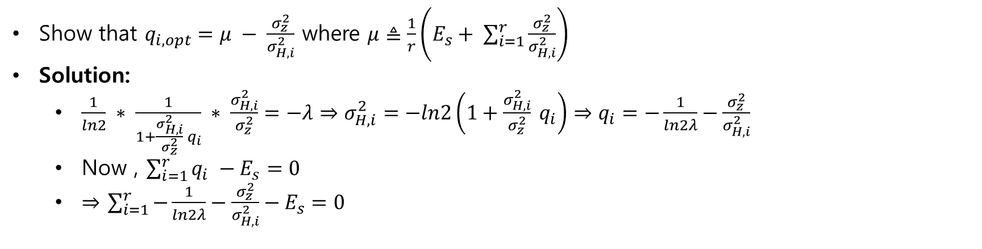
Capacity of MIMO systems
Show that $q_{i,opt}=μ − \frac{σ_{z}^{2}}{σ_{H,i}^{2}}$ where $μ≜\frac{1}{r}\left(E_{s}+ \sum_{i=1}^{r}{\frac{σ_{z}^{2}}{σ_{H,i}^{2}}}\right)$
Solution:
$\frac{1}{ln2} ∗ \frac{1}{1+\frac{σ_{H,i}^{2}}{σ_{z}^{2}} q_{i}} ∗ \frac{σ_{H,i}^{2}}{σ_{z}^{2}}=−λ⇒σ_{H,i}^{2}=−ln2\left(1+\frac{σ_{H,i}^{2}}{σ_{z}^{2}} q_{i}\right)⇒q_{i}=−\frac{1}{ln2λ}−\frac{σ_{z}^{2}}{σ_{H,i}^{2}}$
Now , $\sum_{i=1}^{r}{q_{i} −E_{s}=0}$
$⇒$ $\sum_{i=1}^{r}{−\frac{1}{ln2λ}−\frac{σ_{z}^{2}}{σ_{H,i}^{2}}−E_{s}=0}$

Slide 48

Capacity of MIMO systems
Show that $q_{i,opt}=μ − \frac{σ_{z}^{2}}{σ_{H,i}^{2}}$ where $μ≜\frac{1}{r}\left(E_{s}+ \sum_{i=1}^{r}{\frac{σ_{z}^{2}}{σ_{H,i}^{2}}}\right)$
Solution:
$⇒$ $\sum_{i=1}^{r}{−\frac{1}{ln2λ}−\frac{σ_{z}^{2}}{σ_{H,i}^{2}}−E_{s}=0}$
$⇒−\frac{r}{ln2λ}=E_{s}+ \sum_{i=1}^{r}{\frac{σ_{z}^{2}}{σ_{H,i}^{2}}}$
$⇒−\frac{1}{ln2λ}=\frac{1}{r}\left(E_{s}+\sum_{i=1}^{r}{\frac{σ_{z}^{2}}{σ_{H,i}^{2}}}\right)$

Slide 49

Capacity of MIMO systems
For high SNR , i.e …….$E_{s}≫σ_{z}^{2}$ show that $q_{i,opt}=\frac{E_{s}}{r}$
Solution:
From previous equation we can write
$q_{i,opt}=\frac{1}{r} \left(E_{s}+ \sum_{i=1}^{r}{\frac{σ_{z}^{2}}{σ_{H,i}^{2}}}\right)$
Since $E_{s}≫σ_{z}^{2}$ then $\sum_{i=1}^{r}{\frac{σ_{z}^{2}}{σ_{H,i}^{2}}}=0$
$q_{i,opt}= \frac{E_{s}}{r}$

Slide 50

Capacity of MIMO systems
4) For high SNR with $N_{t}=N_{r},$ show that $C$ becomes equivalent to the case without CSIT.
Solution:
$c= \sum_{i=1}^{r}{\log_{2}{(1+\frac{1}{σ_{z}^{2}} σ_{H,i}^{2}q_{i})}}$
For high SNR with full rank of antenna there is no need to choose optimal one.
So, $q_{i}=\frac{E_{s}}{N_{t}}$
$c= \sum_{i=1}^{r}{\log_{2}{(1+ \frac{E_{s}}{N_{t} σ_{z}^{2}}σ_{H,i}^{2})}}$

Slide 51

MIMO with CSIT
3) Show that$qi,opt=μ−\frac{σ^{2}z}{σ^{2}\left(H,i\right)}$ where $μ=\frac{1}{r}[Es+ \sum_{i=1}^{r}{\frac{σ^{2}z}{σ^{2}\left(H,i\right)}}]$
Now
$\frac{∂g\left(\left\{qi\right\},λ\right)}{∂qi}=0⇒\frac{\frac{1}{σ^{2}z} σ^{2}H,i}{1+\frac{1}{σ^{2}z} σ^{2}H,i qi}+λ=0⇒qi=−\frac{1}{λ} −\frac{σ^{2}z}{σ^{2} H,i}⇒μ − \frac{σ^{2}z}{σ^{2} H,i}$ $where μ=−\frac{1}{λ}$
Now
$\frac{∂g\left(\left\{qi\right\},λ\right\}}{∂λ}=0⇒qi−Es=0⇒−\frac{1}{λ} −\frac{σ^{2}z}{σ^{2 }H,i}−Es=0⇒ μ=\frac{1}{r}[Es+ \sum_{i=1}^{r}{\frac{σ^{2}z}{σ^{2} \left( H,i\right)}}]$
4) For the high SNR i.e $Es≫σ^{2}z$ show that $qi,opt=\frac{Es}{r}$
Solution)
$qi=\frac{1}{r}[Es+ \sum_{i=1}^{r}{\frac{σ^{2}z}{σ^{2}\left(H,i\right)}}]− \frac{σ^{2}z}{σ^{2 (}H,i)}$ for high SNR $Es≫σ^{2}z$so$qi,opt=\frac{Es}{r}$

Slide 52

MIMO with CSIT
5)For the high snr $Nt=Nr=r$, show that $c$becomes equivalent to the case without CSIT
Solution)
$c=log2\left|1 + \frac{Es}{Nt} \frac{1}{σ^{2}z }σ^{2} H,i \right|$
$c=log2\left|1 + \frac{Es}{r} \frac{1}{σ^{2}z }σ^{2} H,i \right|$

Slide 53
Assignment-07
1. MIMO linear processing
MIMO without CSIT
2)RxMF
3)RxZF
4)RxMMSE
MIMO with CSIT
5) Joint SVD
6)Numerical result

Slide 54


MIMO with linear processing
Let $xi, ∀i=1,…….Ns and zi, ∀i=1,…..Nr$follow zero-mean complex Gaussian distribution
Define $Rx ≜E\left[xx^{H}\right]=INs$
$Rz ≜E \left[{zz}^{H}\right]$
$Es≜E\left[{\left|s\right|}^{2}\right]$
$Ns≜r=rank\left(H\right)=min(Nt,Nr)$

Slide 55

MIMO with linear processing
Q1) Specify the dimension of $P, H, W$
Solution)
$P=Nt ∗1$
$H=Nr ∗Nt$
$W=1 ∗Nr$
Q2)Write an expression of the post-Processed signal $\tilde{x}$ in terms of $W,H,P,x,z$
Solution)
$\tilde{x}=W.y=W\left(HPx+z\right)=WHPx+Wz$
Q3) Show that $E\left[{\left|s\right|}^{2}\right]={\left|\left|P\right|\right|}^{2}F=Es$
$E\left[{\left|s\right|}^{2}\right]=E\left[{\left|Px\right|}^{2}\right]=E\left[{\left(Px\right)}^{H}\left(Px\right)\right]=E\left[x^{H}P^{H}Px\right]={\left|\left|P\right|\right|}^{2}E\left[x^{H}x\right]={\left|\left|P\right|\right|}^{2}INs={\left|\left|P\right|\right|}^{2}F$

Slide 56

MIMO with linear processing
Q4) Show that the capacity is expressed by
$c=log2|INs+{\left(WRzW^{H}\right)}^{−1}WHPP^{H}H^{H}W^{H}|$
$R\tilde{x}=E\left[\tilde{x}{\tilde{ x}}^{H}\right]=E\left[\left(WHPx+Wz\right){\left(WHPx+Wz\right)}^{H}\right]$
$=E[\left(WHPx+Wz\right)(x^{H}P^{H}H^{H}W^{H}+z^{H}W^{H})]$
$=E[WHPxx^{H}P^{H}H^{H}W^{H}+WHPxz^{H}W^{H}+Wzx^{H}P^{H}H^{H}W^{H}+Wzz^{H}W^{H}]$
$= WHPE\left[xx^{H}\right]P^{H}H^{H}W^{H}+ W E[zz^{H}]W^{H}$
$=WHPP^{H}H^{H}W^{H}+{WRzW}^{H}$
$R\tilde{n} =E\left[\left(Wz\right){\left(Wz\right)}^{H}\right]=E\left[Wzz^{H}W^{H}\right]=WE\left[zz^{H}\right]W^{H}=WRzW^{H}$
$c=log2\left|πe R\tilde{x}\right| −log2\left|πe R\tilde{n}\right|=log2\left|πe\left(WHPP^{H}H^{H}W^{H}+{WRzW}^{H}\right)\right|−log2|πe WRzW^{H}|$
$=log2\frac{\left|πe\left({WHPP}^{H}H^{H}W^{H}+{WRzW}^{H}\right)\right|}{|πe WRzW^{H}|}=log2\frac{\left|\left(WHPP^{H}H^{H}W^{H}+{WRzW}^{H}\right)\right|}{|WRzW^{H}|}$
$=log2|INs+{\left(WRzW^{H}\right)}^{−1}(WHPP^{H}H^{H}W^{H})$|

Slide 57

MIMO without CSIT – RxMF
Q1) Show that $E\left[{\tilde{x}}^{H}\tilde{x}\right]=tr\left(WHP\right)$and $E\left[{\left|Wz\right|}^{2}\right]=tr\left(WRzW^{H}\right)$
Solution)
$E\left[{\tilde{x}}^{H} \tilde{x}\right]=E\left[{\left(WHPx+Wz\right)}^{H}\left(WHPx+Wz\right)\right]=E[{( x}^{H}P^{H}H^{H}W^{H}+z^{H}W^{H})\left(WHPx+Wz\right)]$
$=E[{(x}^{H}P^{H}H^{H}W^{H}WHPx+x^{H}P^{H}H^{H}W^{H }Wz+z^{H}W^{H }WHPx+z^{H}W^{H}Wz]$
$=E[tr{(x}^{H}P^{H}H^{H}W^{H}WHPx)+x^{H}P^{H}H^{H}W^{H }Wz+z^{H}W^{H }WHPx+{tr(z}^{H}W^{H}Wz)]$
$=E[tr(WHPxx^{H}P^{H}H^{H}W^{H})+x^{H}P^{H}H^{H}W^{H }Wz+z^{H}W^{H }WHPx+tr(Wzz^{H}W^{H})]$
$=tr(WHPE[xx^{H}]P^{H}H^{H}W^{H})+x^{H}P^{H}H^{H}W^{H }Wz+z^{H}W^{H }WHPx+tr(WE[zz^{H}]W^{H})]$
$=tr\left(WHPP^{H}H^{H}W^{H}\right)+tr(WRzW^{H})$

Slide 58

MIMO without CSIT – RxMF
For simplicity , we let $δ=tr(P^{H}H^{H}Rz^{−1}HP)$ and $λopt=−1$such that $Wopt=P^{H}H^{H}Rz^{−1}$
Q5) Show that $c=log2|INs+P^{H}H^{H}Rz^{−H}HP|$
The capacity is expressed by
$c=log2|INs+{\left(WRzW^{H}\right)}^{−1}(WHPP^{H}H^{H}W^{H})\text{|}$
$=log2|{\left(WRzW^{H}\right)}^{−1}{\left(WRzW^{H}\right)}^{ }+{\left(WRzW^{H}\right)}^{−1}(WHPP^{H}H^{H}W^{H})|$
$=log2|{\left(WRzW^{H}\right)}^{−1}(WRzW^{H}+WHPP^{H}H^{H}W^{H})|$
$=log2|$ ${\left(WRzW^{H}\right)}^{−1}$|$|(WRzW^{H}+WHPP^{H}H^{H}W^{H})|$
$=log2{\left|P^{H}H^{H}Rz^{−1}RzRz^{−H}HP\right|}^{−1}|P^{H}H^{H}Rz^{−1}Rz Rz^{−H}HP+P^{H}H^{H}Rz^{−1}$ $HPP^{H}H^{H}$ $Rz^{−H}HP$|
$= log2{\left|P^{H}H^{H}Rz^{−H}HP\right|}^{−1}$ $|P^{H}H^{H}Rz^{−H}HP+P^{H}H^{H}Rz^{−1}HPP^{H}H^{H}$ $Rz^{−H}HP$|
$=log2$ ${\left|P^{H}H^{H}Rz^{−H}HP\right|}^{−1}|P^{H}H^{H}Rz^{−H}HP(I+ P^{H}H^{H}Rz^{−1}HP)|$
$=log2{\left|P^{H}H^{H}Rz^{−H}HP\right|}^{−1}\left|P^{H}H^{H}Rz^{−H}HP\right|\left|I+ P^{H}H^{H}Rz^{−1}HP\right|$
$=log2$ $\left|I+ P^{H}H^{H}Rz^{−1}HP\right|$

