Slide 1
Posterior Cramer-Rao Bounds for Discrete-Time
Nonlinear Filtering
AUTHORS
P. Tichavsky | C.H. Muravchik | A. Nehorai
IEEE Transactions on Signal Processing, Vol. 46, Issue 5, May 1998
Published: 31 May 1998

Slide 2
Table of Contents
Table of contents:
01
Opening citation
Slides 1 | Paper title, authors, journal, publication date
04
Recursive PCRB derivation
Slides 25-42 | Nuisance parameters, block matrix, Schur complement
02
PCRB foundations
Slides 3-18 | Estimation problem, likelihood, score, Fisher information
05
ISAC tracking interpretation
Slides 43-48 | Noise covariance, CRB chain, EKF comparison, summary
03
Gaussian posterior and Kalman link
Slides 19-24 | Gaussian curvature view and optimal linear filtering
06
Next paper section
Slides 49 | Power/bandwidth allocation for MIMO tracking

Slide 3

Roadmap from Score to Recursive PCRB
Purpose Of These Slides
  Topic:
    $\text{PCRB} \text{for} \text{nonlinear} \text{filtering}$
  Goal:
    $\text{Understand} \text{how} \text{posterior} \text{Fisher} \text{information} J_{n} \text{is} \text{derived}$
  Main path:
    $\text{Measurement} \text{model}→\text{Score} \text{function}→\text{Fisher} \text{information}→\text{Posterior} \text{information}→\text{Recursive} \text{PCRB}→\text{Kalman}\text{/}\text{EKF} \text{connection}$

Slide 4

Information Links Measurements to Estimation Error
Estimation Problem
  Suppose measurement/data is:
    $X$
  Unknown parameter/state is:
    $θ$
  The estimation problem is:
    $X→\hat{θ}$
  Main question:
    $\text{How} \text{much} \text{information} \text{does} X \text{give} \text{about} θ?$
    This information determines the minimum possible estimation error.

Slide 5
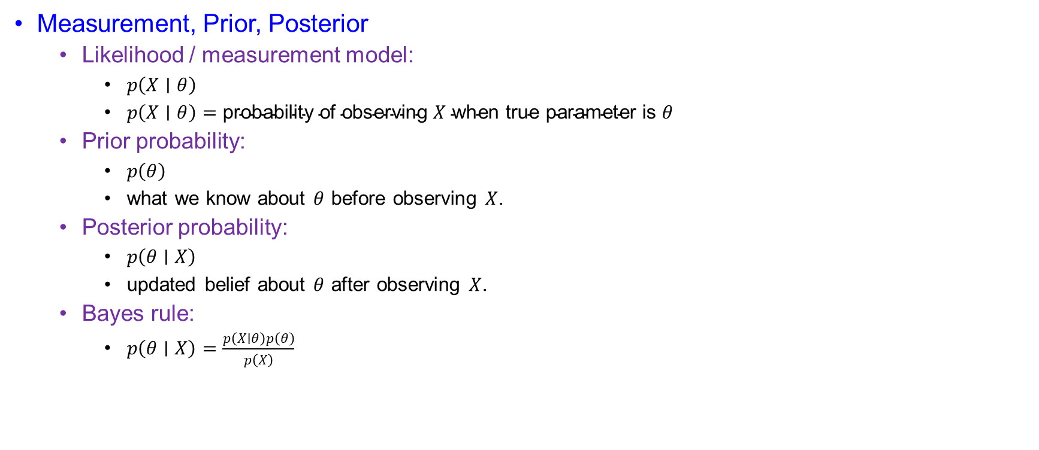
Bayes Rule Updates Prior Belief with Measurements
Measurement, Prior, Posterior
  Likelihood / measurement model:
    $p\left(X∣θ\right)$
    $p\left(X∣θ\right)=\text{probability} \text{of} \text{observing} X \text{when} \text{true} \text{parameter} \text{is} θ$
  Prior probability:
    $p\left(θ\right)$
    what we know about $θ$ before observing $X$.
  Posterior probability:
    $p\left(θ∣X\right)$
    updated belief about $θ$ after observing $X$.
  Bayes rule:
    $p\left(θ∣X\right)=\frac{p\left(X∣θ\right)p\left(θ\right)}{p\left(X\right)}$

Slide 6

Parameter Sensitivity Starts with a Derivative
Why A Derivative Appears
  If the parameter changes slightly:
    $θ→θ+dθ$
  then the likelihood changes:
    $p\left(X∣θ\right)→p\left(X∣θ+dθ\right)$
  So, we check sensitivity:
    $\frac{∂p\left(X∣θ\right)}{∂θ}$
  This tells how sensitive the probability model is to the parameter.

Slide 7

The Score Measures Relative Likelihood Change
Relative Change And Score Function
  Instead of raw change, use relative change:
    $\frac{1}{p\left(X∣θ\right)}\frac{∂p\left(X∣θ\right)}{∂θ}$
  Using log rule:
    $\frac{1}{p\left(X∣θ\right)}\frac{∂p\left(X∣θ\right)}{∂θ}=\frac{∂}{∂θ}\log{p}\left(X∣θ\right)$
  So, the score function is:
    $s(X,θ)=\frac{∂}{∂θ}\log{p}\left(X∣θ\right)$
  $\text{Score} \text{function}\text{ = }\text{relative} \text{slope} \text{of} \text{the} \text{likelihood}$

Slide 8
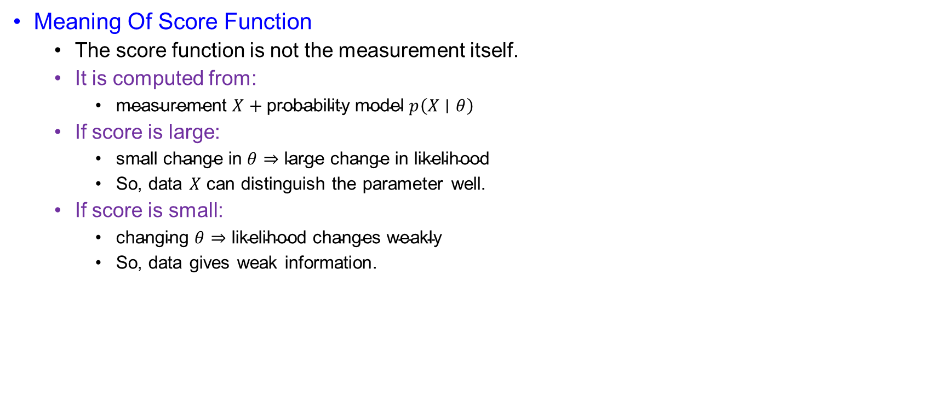
Large Scores Mean More Distinguishable States
Meaning Of Score Function
  The score function is not the measurement itself.
  It is computed from:
    $\text{measurement} X+\text{probability} \text{model} p\left(X∣θ\right)$
  If score is large:
    $\text{small} \text{change} \text{in} θ⇒\text{large} \text{change} \text{in} \text{likelihood}$
    So, data $X$ can distinguish the parameter well.
  If score is small:
    $\text{changing} θ⇒\text{likelihood} \text{changes} \text{weakly}$
    So, data gives weak information.

Slide 9
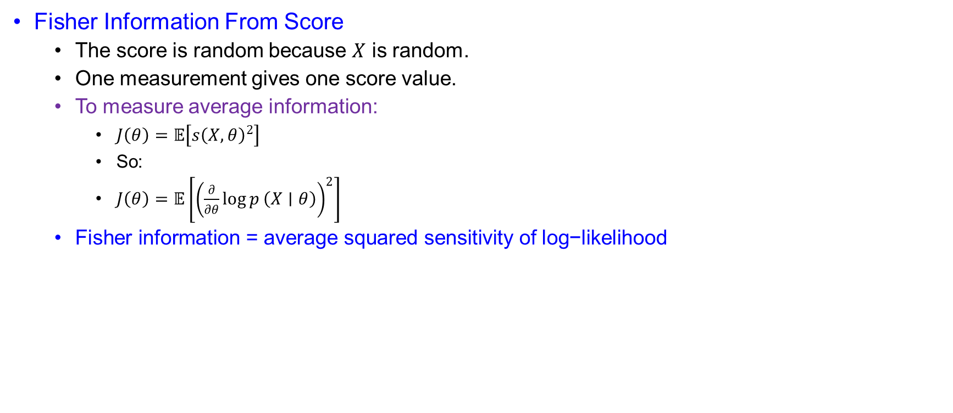
Fisher Information Averages Squared Sensitivity
Fisher Information From Score
  The score is random because $X$ is random.
  One measurement gives one score value.
  To measure average information:
    $J\left(θ\right)=𝔼\left[s{\left(X,θ\right)}^{2}\right]$
    So:
    $J\left(θ\right)=𝔼\left[{\left(\frac{∂}{∂θ}\log{p}\left(X∣θ\right)\right)}^{2}\right]$
  $\text{Fisher} \text{information}\text{ = }\text{average} \text{squared} \text{sensitivity} \text{of} \text{log}\text{−}\text{likelihood}$

Slide 10
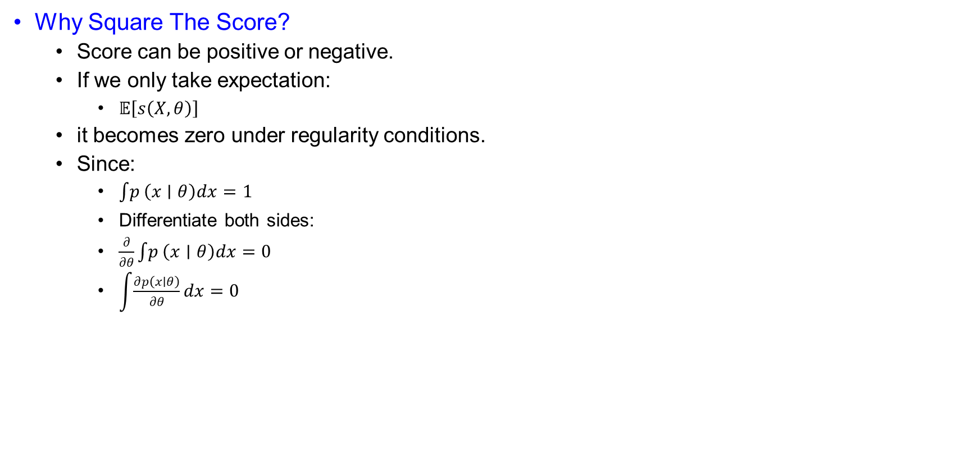
Squaring Keeps Score Contributions from Canceling
Why Square The Score?
  Score can be positive or negative.
  If we only take expectation:
    $𝔼\left[s\left(X,θ\right)\right]$
  it becomes zero under regularity conditions.
  Since:
    $\int{p}\left(x∣θ\right)dx=1$
    Differentiate both sides:
    $\frac{∂}{∂θ}\int{p}\left(x∣θ\right)dx=0$
    $\int{\frac{∂p\left(x∣θ\right)}{∂θ}}dx=0$

Slide 11

The Average Score Vanishes Under Regularity
Average Score Is Zero
  $𝔼\left[s\left(X,θ\right)\right]=\int{\frac{∂\log{p}\left(x∣θ\right)}{∂θ}}p\left(x∣θ\right)dx$
  $=\int{\frac{1}{p\left(x∣θ\right)}}\frac{∂p\left(x∣θ\right)}{∂θ}p\left(x∣θ\right)dx$
  $=\int{\frac{∂p\left(x∣θ\right)}{∂θ}}dx$
  $=0$
  Therefore:
    $𝔼\left[s\left(X,θ\right)\right]=0$
  So, we use:
    $𝔼\left[s^{2}\right]$
  instead of:
    $𝔼\left[s\right]$

Slide 12
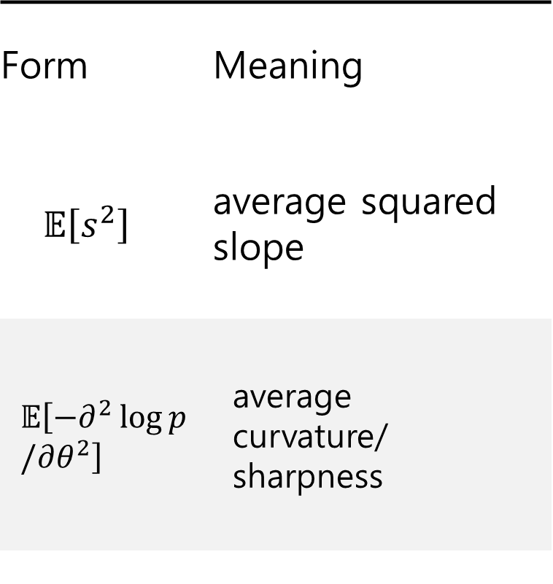
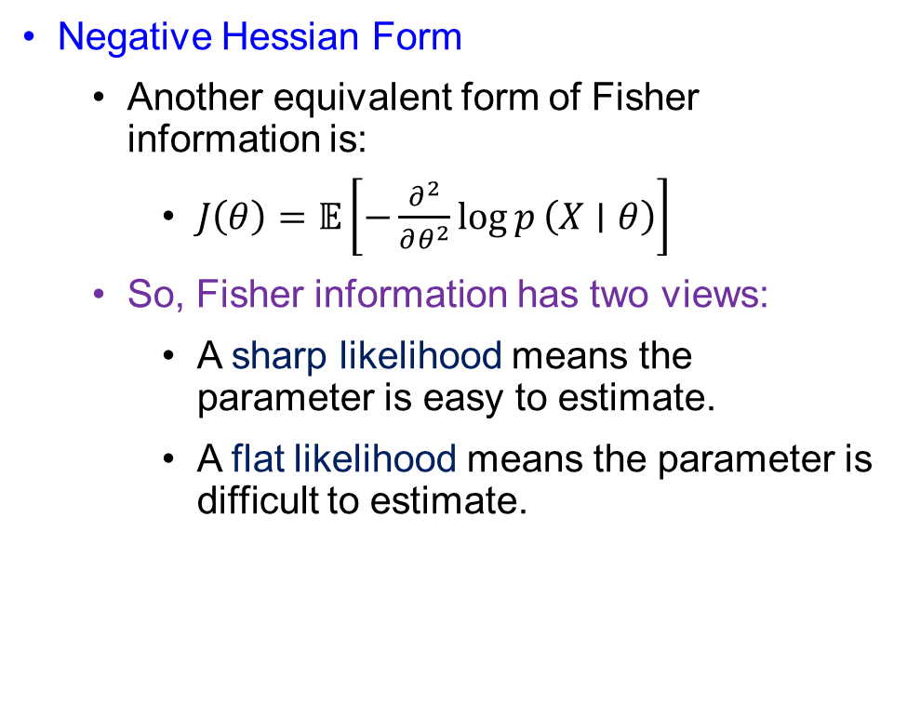
Curvature Gives the Same Information Measure
Negative Hessian Form
  Another equivalent form of Fisher information is:
    $J\left(θ\right)=𝔼\left[−\frac{∂^{2}}{∂θ^{2}}\log{p}\left(X∣θ\right)\right]$
  So, Fisher information has two views:
    A sharp likelihood means the parameter is easy to estimate.
    A flat likelihood means the parameter is difficult to estimate.
Form | Meaning
$$𝔼\left[s^{2}\right]$$ | average squared slope
$$𝔼\left[−∂^{2}\log{p}/∂θ^{2}\right]$$ | average curvature/ sharpness

Slide 13

Vector States Require an Information Matrix
Vector Fisher Information
  For random parameter vector:
    $Θ={\left[Θ_{1},Θ_{2},……,Θ_{r}\right]}^{T}$
  Score component:
    $s_{i}(X,Θ)=\frac{∂}{∂Θ_{i}}\log{p_{X,Θ}}\left(X,Θ\right)$
    $=\frac{1}{p_{X,Θ}\left(X,Θ\right)}\frac{∂p_{X,Θ}\left(X,Θ\right)}{∂Θ_{i}}$
  Fisher information matrix:
    $J_{ij}=𝔼\left[s_{i}\left(X,Θ\right)s_{j}\left(X,Θ\right)\right]$
    $J_{ij}=𝔼\left[\frac{∂\log{p_{X,Θ}}\left(X,Θ\right)}{∂Θ_{i}}\frac{∂\log{p_{X,Θ}}\left(X,Θ\right)}{∂Θ_{j}}\right]$

Slide 14

Log-Density Derivatives Lead to the Hessian Identity
Negative Hessian Derivation
  Let:
    $p=p_{X,Θ}\left(X,Θ\right)$
  First derivative:
    $\frac{∂\log{p}}{∂Θ_{i}}=\frac{1}{p}\frac{∂p}{∂Θ_{i}}$
  Second derivative:
    $\frac{∂^{2}\log{p}}{∂Θ_{i}∂Θ_{j}}=\frac{1}{p}\frac{∂^{2}p}{∂Θ_{i}∂Θ_{j}}−\frac{1}{p^{2}}\frac{∂p}{∂Θ_{i}}\frac{∂p}{∂Θ_{j}}$
  Taking expectation:
    $𝔼\left[\frac{∂^{2}\log{p}}{∂Θ_{i}∂Θ_{j}}\right]=\iint{\frac{∂^{2}p}{∂Θ_{i}∂Θ_{j}}}dXdΘ−\iint{\frac{1}{p}}\frac{∂p}{∂Θ_{i}}\frac{∂p}{∂Θ_{j}}dXdΘ$

Slide 15

Boundary Conditions Remove the Extra Hessian Term
Why First Term Becomes Zero
  First term:
    $T_{1}=\iint{\frac{∂^{2}p}{∂Θ_{i}∂Θ_{j}}}dXdΘ$
  Write:
    $\frac{∂^{2}p}{∂Θ_{i}∂Θ_{j}}=\frac{∂}{∂Θ_{j}}\left(\frac{∂p}{∂Θ_{i}}\right)$
  Integrate over $Θ_{j}$:
    $\int_{−∞}^{∞}{\frac{∂}{∂Θ_{j}}}\left(\frac{∂p}{∂Θ_{i}}\right)dΘ_{j}={\left[\frac{∂p}{∂Θ_{i}}\right]}_{−∞}^{∞}$
  Under regularity condition:
    $\frac{∂p}{∂Θ_{i}}→0 \text{at} \text{boundary}$
  Therefore:
    $T_{1}=0$

Slide 16

Score and Hessian Views Become Equivalent
Final Fisher Information Identity
  Since the first term is zero:
    $𝔼\left[\frac{∂^{2}\log{p}}{∂Θ_{i}∂Θ_{j}}\right]=−\iint{\frac{1}{p}}\frac{∂p}{∂Θ_{i}}\frac{∂p}{∂Θ_{j}}dXdΘ$
  But:
    $\frac{∂\log{p}}{∂Θ_{i}}=\frac{1}{p}\frac{∂p}{∂Θ_{i}}$
  So:
    $𝔼\left[−\frac{∂^{2}\log{p}}{∂Θ_{i}∂Θ_{j}}\right]=𝔼\left[\frac{∂\log{p}}{∂Θ_{i}}\frac{∂\log{p}}{∂Θ_{j}}\right]$
  This proves:
    $\text{Negative} \text{Hessian} \text{form}=\text{Score} \text{outer}\text{−}\text{product} \text{form}$

Slide 17

Posterior Information Splits into Data and Prior Terms
Posterior Information Decomposition
  For PCRB, $Θ$ is random.
  So, we use joint density:
    $p\left(X,Θ\right)$
  Bayes factorization:
    $p\left(X,Θ\right)=p\left(X∣Θ\right)p\left(Θ\right)$
  Taking log:
    $\log{p}\left(X,Θ\right)=\log{p}\left(X∣Θ\right)+\log{p}\left(Θ\right)$
  Therefore:
    $J=J_{D}+J_{P}$
  where:
    $J_{D}=𝔼\left[−Δ_{Θ}^{Θ}\log{p}\left(X∣Θ\right)\right]$
    $J_{P}=𝔼\left[−Δ_{Θ}^{Θ}\log{p}\left(Θ\right)\right]$

Slide 18

More Information Means a Smaller PCRB
Meaning Of $J_{D}$, $J_{P}$, And $J$
  $J_{D}=\text{information} \text{from} \text{measurements}$
  $J_{P}=\text{information} \text{from} \text{prior}$
  $J=\text{total} \text{posterior} \text{information}$
  Better measurements:
    $J_{D}↑$
  Stronger prior knowledge:
    $J_{P}↑$
  Larger posterior information:
    $J↑$
  Smaller PCRB:
    $J^{−1}↓$
  So:
    $PCRB=J^{−1}$

Slide 19
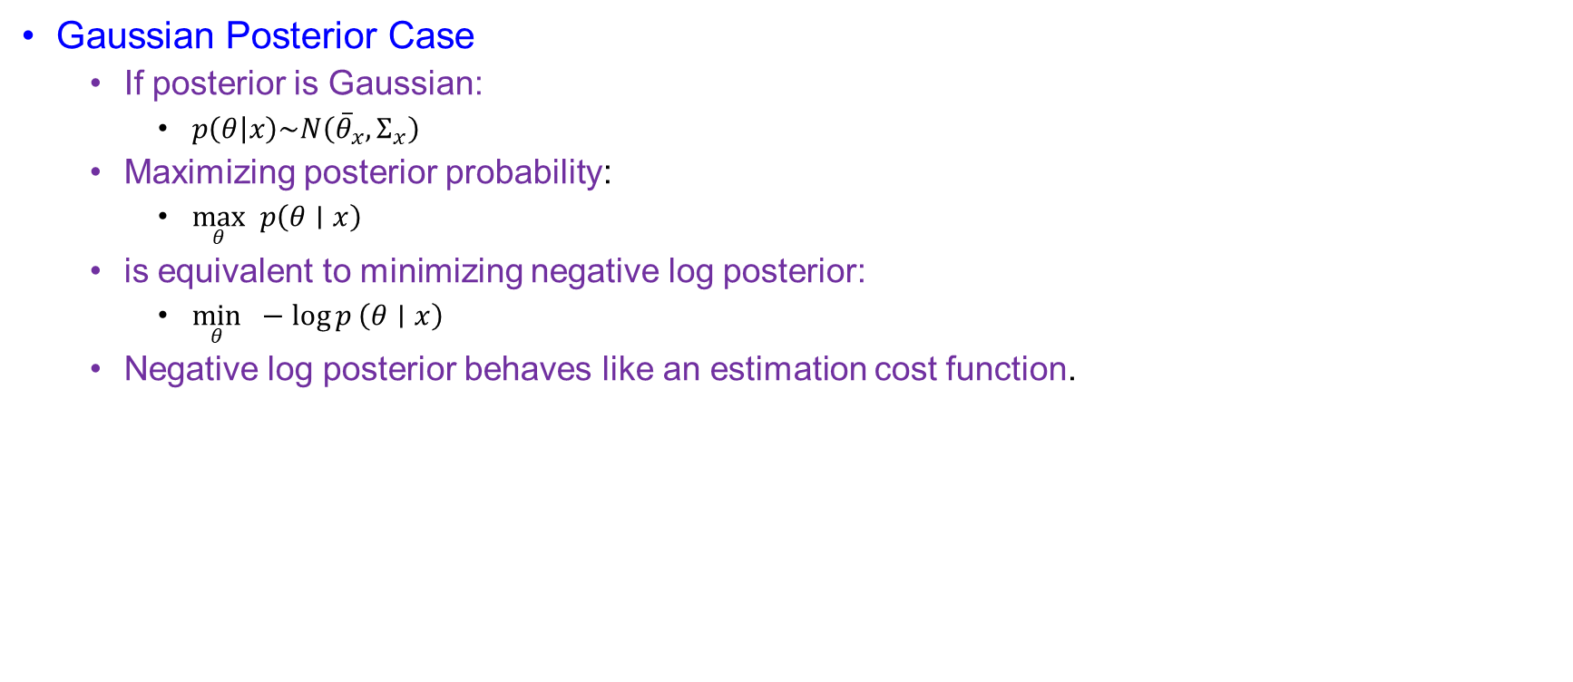
Gaussian Posteriors Become Quadratic Costs
Gaussian Posterior Case
  If posterior is Gaussian:
    $p\left(θ | x\right)\sim N\left({\overline{θ}}_{x},Σ_{x}\right)$
  Maximizing posterior probability:
    $\max_{θ} p\left(θ∣x\right)$
  is equivalent to minimizing negative log posterior:
    $\min_{θ} −\log{p}\left(θ∣x\right)$
  Negative log posterior behaves like an estimation cost function.

Slide 20
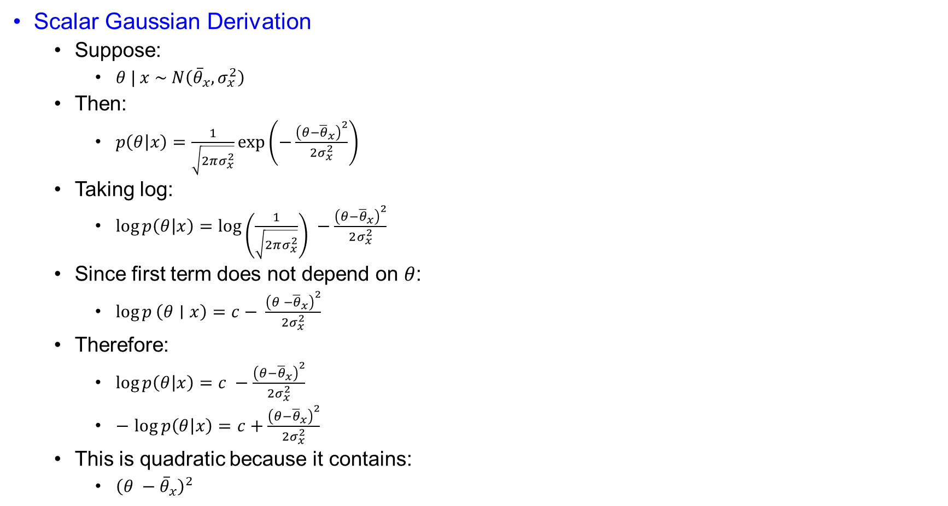
Scalar Gaussian Curvature Equals Inverse Variance
Scalar Gaussian Derivation
  Suppose:
    $θ | x \sim N\left({\overline{θ}}_{x},σ_{x}^{2}\right)$
  Then:
    $p\left(θ | x\right)=\frac{1}{\sqrt{2πσ_{x}^{2}}}\exp\left(−\frac{{\left(θ−{\overline{θ}}_{x}\right)}^{2}}{2σ_{x}^{2}}\right)$
  Taking log:
    $\log{p\left(θ | x\right)}=\log\left(\frac{1}{\sqrt{2πσ_{x}^{2}}}\right) −\frac{{\left(θ−{\overline{θ}}_{x}\right)}^{2}}{2σ_{x}^{2}}$
  Since first term does not depend on $θ$:
    $\log{p}\left(θ∣x\right)=c− \frac{{\left(θ −{\overline{θ}}_{x}\right)}^{2}}{2σ_{x}^{2}}$
  Therefore:
    $\log{p\left(θ | x\right)}=c −\frac{{\left(θ−{\overline{θ}}_{x}\right)}^{2}}{2σ_{x}^{2}}$
    $−$ $\log{p\left(θ | x\right)}=c+\frac{{\left(θ−{\overline{θ}}_{x}\right)}^{2}}{2σ_{x}^{2}}$
  This is quadratic because it contains:
    ${\left(θ −{\overline{θ}}_{x}\right)}^{2}$

Slide 21
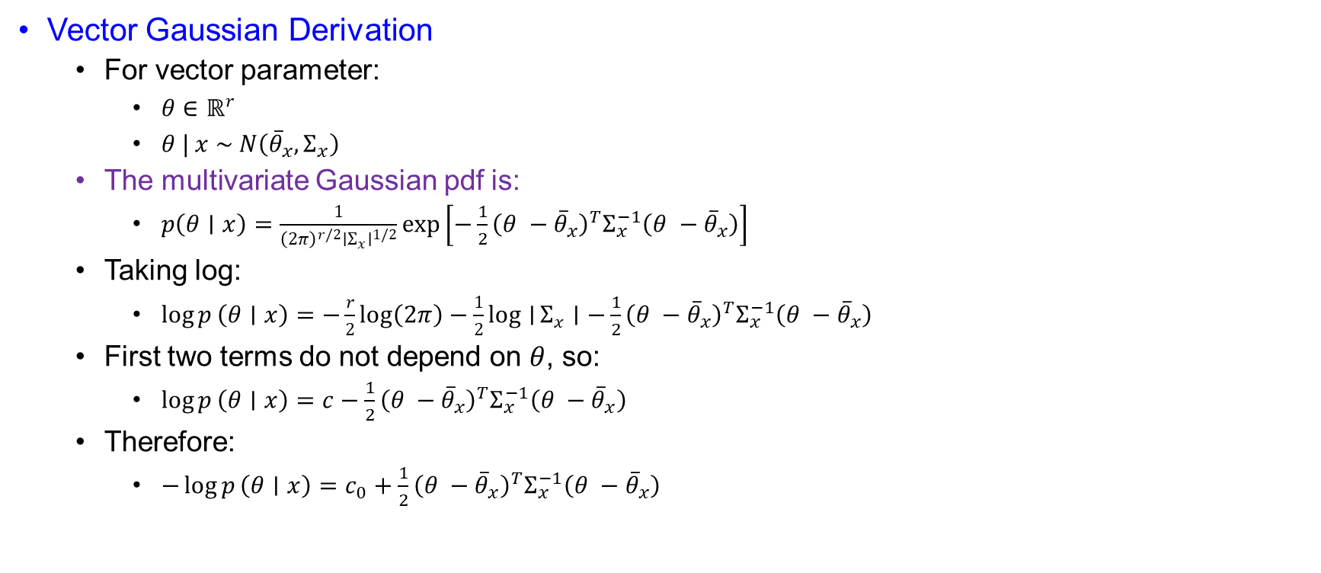
Vector Gaussian Cost Is Weighted by Precision
Vector Gaussian Derivation
  For vector parameter:
    $θ∈ℝ^{r}$
    $θ | x \sim N\left({\overline{θ}}_{x},Σ_{x}\right)$
  The multivariate Gaussian pdf is:
    $p\left(θ∣x\right)=\frac{1}{{\left(2π\right)}^{r/2}∣Σ_{x}∣^{1/2}}\exp\left[−\frac{1}{2}{\left(θ −{\overline{θ}}_{x}\right)}^{T}Σ_{x}^{−1}\left(θ −{\overline{θ}}_{x}\right)\right]$
  Taking log:
    $\log{p}\left(θ∣x\right)=−\frac{r}{2}log⁡\left(2π\right)−\frac{1}{2}\log{∣}Σ_{x}∣−\frac{1}{2}{\left(θ −{\overline{θ}}_{x}\right)}^{T}Σ_{x}^{−1}\left(θ −{\overline{θ}}_{x}\right)$
  First two terms do not depend on $θ$, so:
    $\log{p}\left(θ∣x\right)=c−\frac{1}{2}{\left(θ −{\overline{θ}}_{x}\right)}^{T}Σ_{x}^{−1}\left(θ −{\overline{θ}}_{x}\right)$
  Therefore:
    $−\log{p}\left(θ∣x\right)=c_{0}+\frac{1}{2}{\left(θ −{\overline{θ}}_{x}\right)}^{T}Σ_{x}^{−1}\left(θ −{\overline{θ}}_{x}\right)$

Slide 22

Gaussian Posterior Information Equals Precision
Fisher Information For Gaussian Posterior
  For Gaussian posterior:
    $−\log{p}\left(θ∣x\right)=c_{0}+\frac{1}{2}{\left(θ −{\overline{θ}}_{x}\right)}^{T}Σ_{x}^{−1}\left(θ −{\overline{θ}}_{x}\right)$
  First derivative:
    $∇_{θ}\left[−\log{p}\left(θ∣x\right)\right]=Σ_{x}^{−1}\left(θ −{\overline{θ}}_{x}\right)$
  Second derivative:
    $Δ_{θ}^{θ}\left[−\log{p}\left(θ∣x\right)\right]=Σ_{x}^{−1}$
  Therefore:
    $−Δ_{θ}^{θ}\log{p}\left(θ∣x\right)=Σ_{x}^{−1}$
  So:
    $J=𝔼\left\{Σ_{x}^{−1}\right\}$

Slide 23
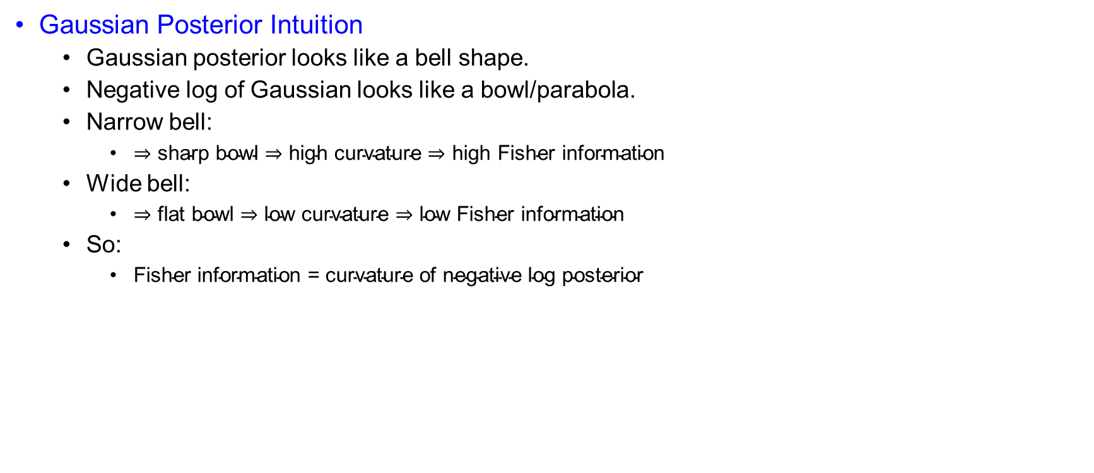
A Narrower Posterior Means More Information
Gaussian Posterior Intuition
  Gaussian posterior looks like a bell shape.
  Negative log of Gaussian looks like a bowl/parabola.
  Narrow bell:
    $⇒\text{sharp} \text{bowl}⇒\text{high} \text{curvature}⇒\text{high} \text{Fisher} \text{information}$
  Wide bell:
    $⇒\text{flat} \text{bowl}⇒\text{low} \text{curvature}⇒\text{low} \text{Fisher} \text{information}$
  So:
    $\text{Fisher} \text{information}\text{ = }\text{curvature} \text{of} \text{negative} \text{log} \text{posterior}$

Slide 24
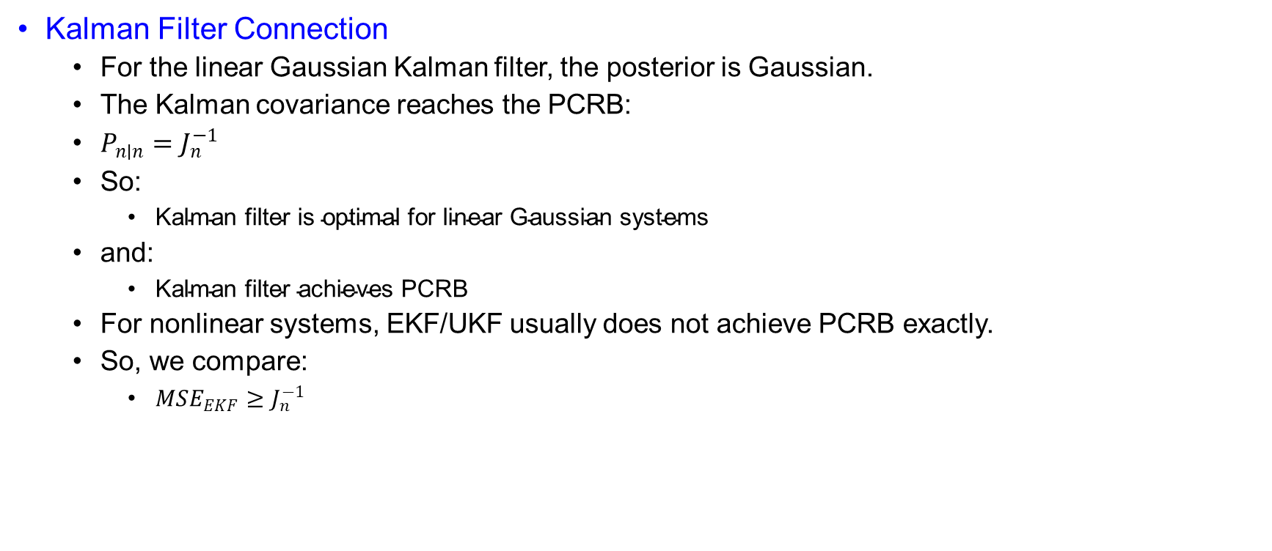
Kalman Achieves the Bound in the Linear Gaussian Case
Kalman Filter Connection
  For the linear Gaussian Kalman filter, the posterior is Gaussian.
  The Kalman covariance reaches the PCRB:
  $P_{n∣n}=J_{n}^{−1}$
  So:
    $\text{Kalman} \text{filter} \text{is} \text{optimal} \text{for} \text{linear} \text{Gaussian} \text{systems}$
  and:
    $\text{Kalman} \text{filter} \text{achieves} \text{PCRB}$
  For nonlinear systems, EKF/UKF usually does not achieve PCRB exactly.
  So, we compare:
    $MSE_{EKF}≥J_{n}^{−1}$

Slide 25
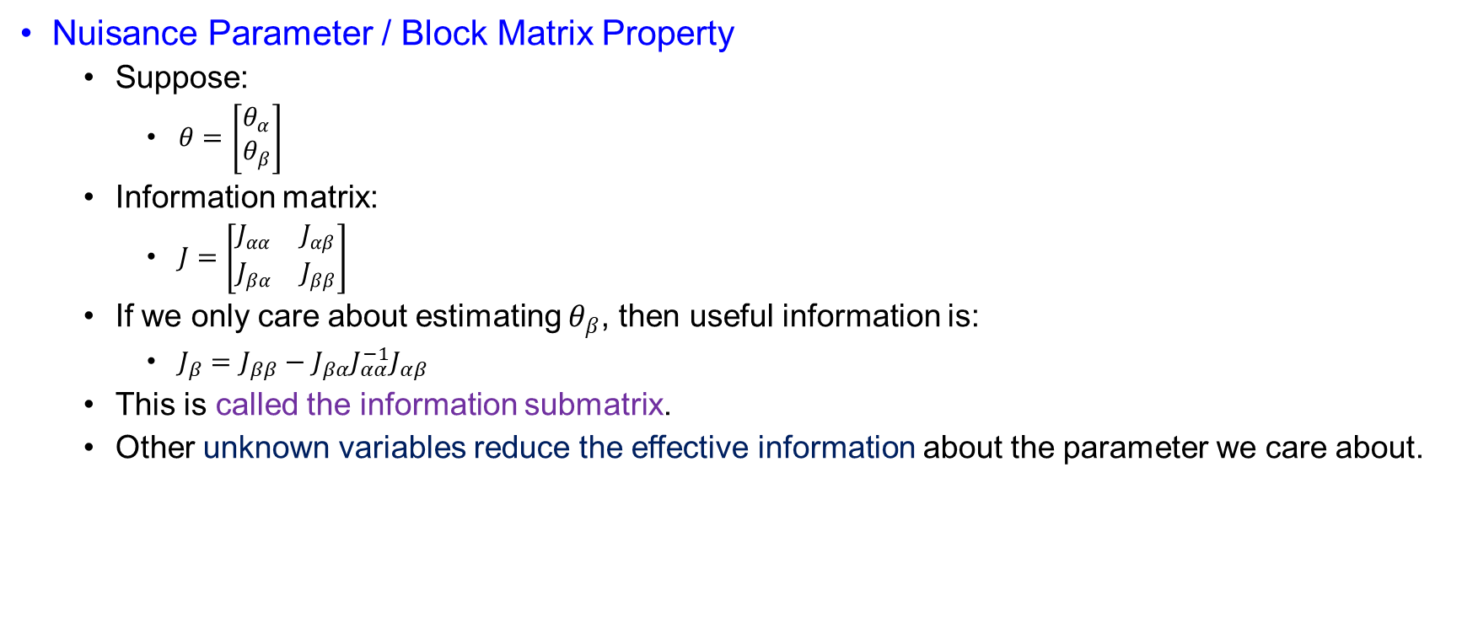
Nuisance States Reduce Usable Information
Nuisance Parameter / Block Matrix Property
  Suppose:
    $θ=\left[\begin{matrix}θ_{α} \\ θ_{β}\end{matrix}\right]$
  Information matrix:
    $J=\left[\begin{matrix}J_{αα} & J_{αβ} \\ J_{βα} & J_{ββ}\end{matrix}\right]$
  If we only care about estimating $θ_{β}$, then useful information is:
    $J_{β}=J_{ββ}−J_{βα}J_{αα}^{−1}J_{αβ}$
  This is called the information submatrix.
  Other unknown variables reduce the effective information about the parameter we care about.

Slide 26
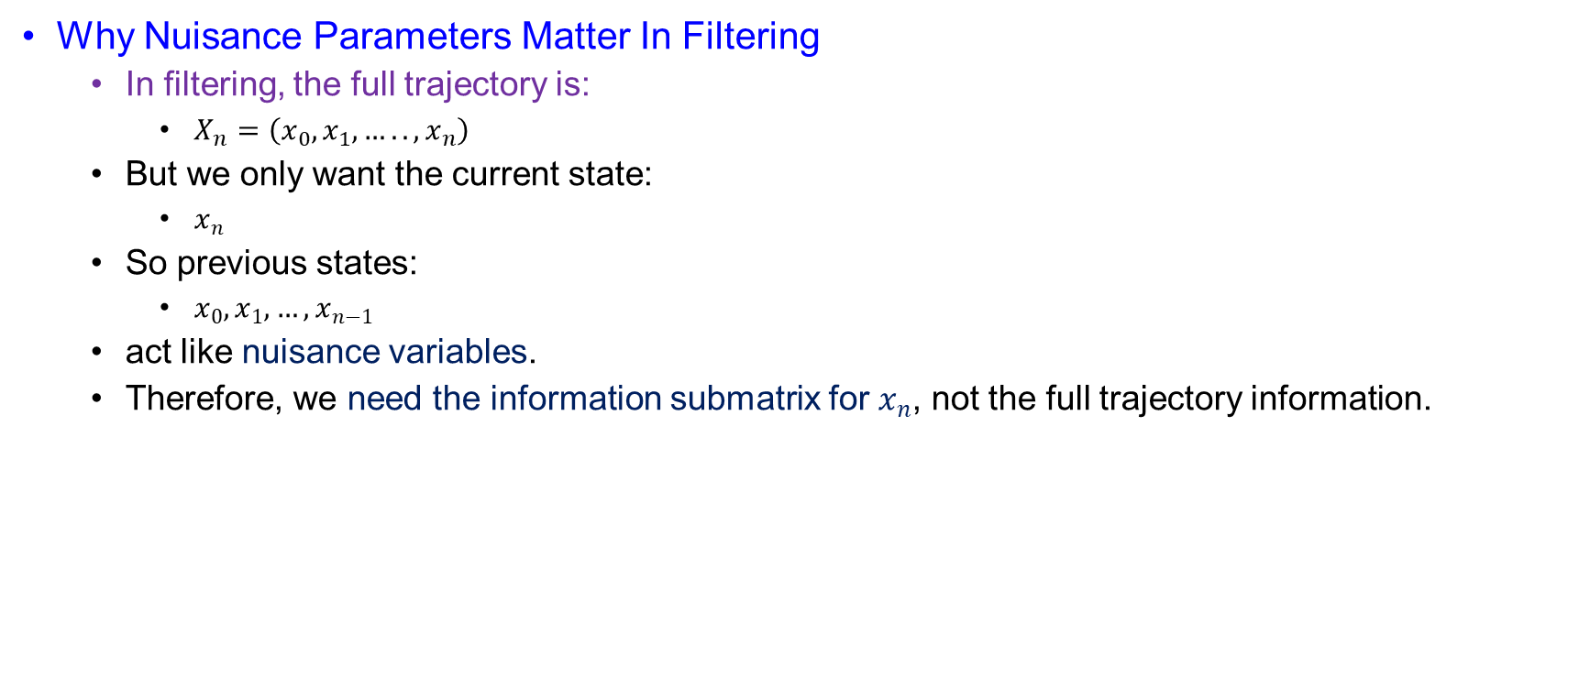
Filtering Must Separate Current State from History
Why Nuisance Parameters Matter In Filtering
  In filtering, the full trajectory is:
    $X_{n}=\left(x_{0},x_{1},…..,x_{n}\right)$
  But we only want the current state:
    $x_{n}$
  So previous states:
    $x_{0},x_{1},…,x_{n−1}$
  act like nuisance variables.
  Therefore, we need the information submatrix for $x_{n}$, not the full trajectory information.

Slide 27
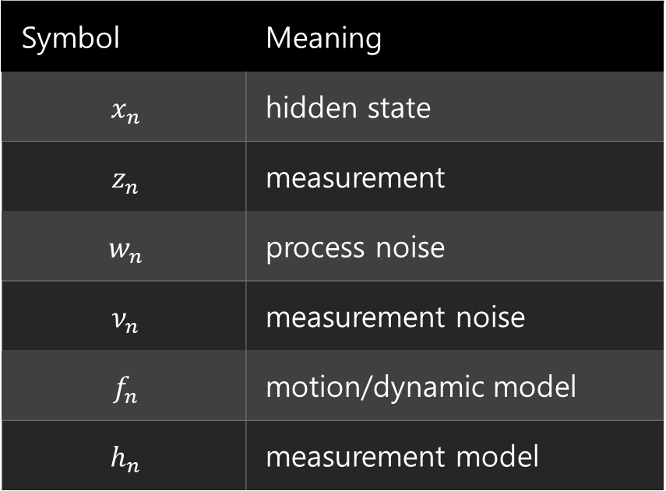
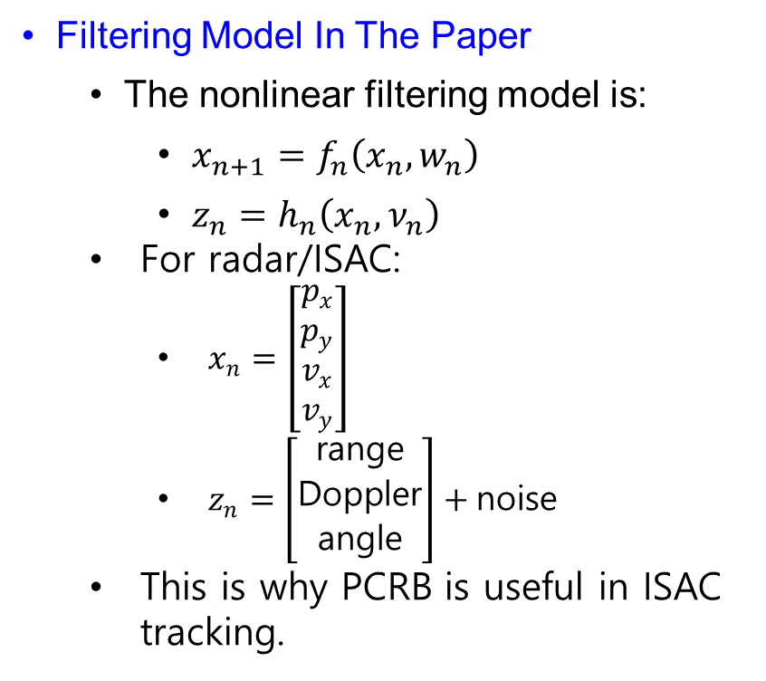
Nonlinear Tracking Models Motivate PCRB Analysis
Filtering Model In The Paper
  The nonlinear filtering model is:
    $x_{n+1}=f_{n}\left(x_{n},w_{n}\right)$
    $z_{n}=h_{n}\left(x_{n},ν_{n}\right)$
  For radar/ISAC:
    $x_{n}=\left[\begin{matrix}p_{x} \\ p_{y} \\ v_{x} \\ v_{y}\end{matrix}\right]$
    $z_{n}=\left[\begin{matrix}\text{range} \\ \text{Doppler} \\ \text{angle}\end{matrix}\right]+\text{noise}$
  This is why PCRB is useful in ISAC tracking.
Symbol | Meaning
$$x_{n}$$ | hidden state
$$z_{n}$$ | measurement
$$w_{n}$$ | process noise
$$ν_{n}$$ | measurement noise
$$f_{n}$$ | motion/dynamic model
$$h_{n}$$ | measurement model

Slide 28

Recursive PCRB Avoids Full-Trajectory Matrices
Recursive PCRB
  Recursive PCRB means:
    $\text{compute} J_{n} \text{time}\text{−}\text{step} \text{by} \text{time}\text{−}\text{step}$
    instead of building one huge information matrix for the whole trajectory.
  The key recursion is:
    $J_{n+1}=D_{n}^{22}−D_{n}^{21}{\left(J_{n}+D_{n}^{11}\right)}^{−1}D_{n}^{12}$
  This gives the posterior Fisher information for the next state.

Slide 29

Filtering Bounds the Current State, Not the Whole Path
State And Measurement Sequences
  State trajectory:
    $X_{n}=\left(x_{0},x_{1},….,x_{n}\right)$
  Measurement sequence:
    $Z_{n} =\left(z_{1},z_{2},….,z_{n}\right)$
  Goal:
    $\text{Find} \text{information} \text{about} x_{n}$
  not the whole trajectory:
    $X_{n}$
  So PCRB uses information submatrix ideas.

Slide 30
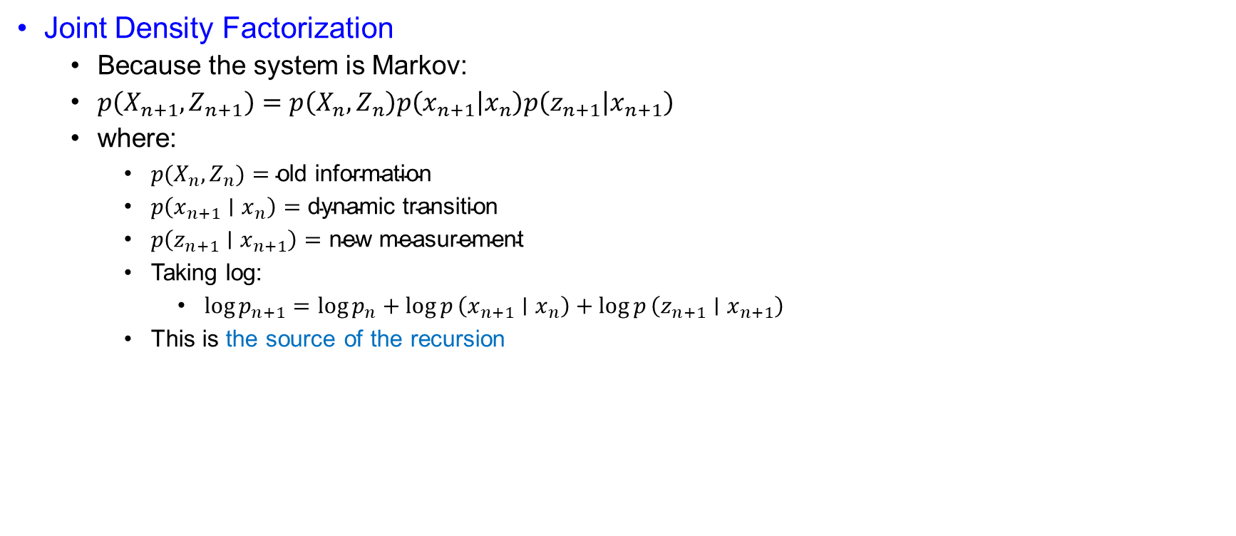
Markov Factorization Creates a One-Step Recursion
Joint Density Factorization
  Because the system is Markov:
  $p\left(X_{n+1},Z_{n+1}\right)=p\left(X_{n},Z_{n}\right)p\left(x_{n+1} | x_{n}\right)p\left(z_{n+1} | x_{n+1}\right)$
  where:
    $p(X_{n},Z_{n})=\text{old} \text{information}$
    $p\left(x_{n+1}∣x_{n}\right)=\text{dynamic} \text{transition}$
    $p\left(z_{n+1}∣x_{n+1}\right)=\text{new} \text{measurement}$
    Taking log:
      $\log{p_{n+1}}=\log{p_{n}}+\log{p}\left(x_{n+1}∣x_{n}\right)+\log{p}\left(z_{n+1}∣x_{n+1}\right)$
    This is the source of the recursion

Slide 31
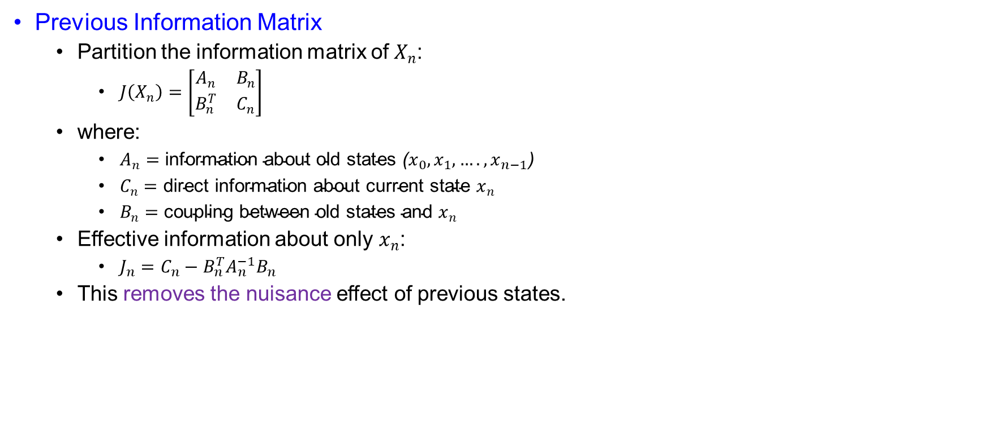
Schur Complement Removes Old-State Nuisance
Previous Information Matrix
  Partition the information matrix of $X_{n}$:
    $J\left(X_{n}\right)=\left[\begin{matrix}A_{n} & B_{n} \\ B_{n}^{T} & C_{n}\end{matrix}\right]$
  where:
    $A_{n}=\text{information} \text{about} \text{old} \text{states} \text{(}x_{0},x_{1},….,x_{n−1}\text{)}$
    $C_{n}=\text{direct} \text{information} \text{about} \text{current} \text{state} x_{n}$
    $B_{n}=\text{coupling} \text{between} \text{old} \text{states} \text{and} x_{n}$
  Effective information about only $x_{n}$:
    $J_{n}=C_{n}−B_{n}^{T}A_{n}^{−1}B_{n}$
  This removes the nuisance effect of previous states.

Slide 32
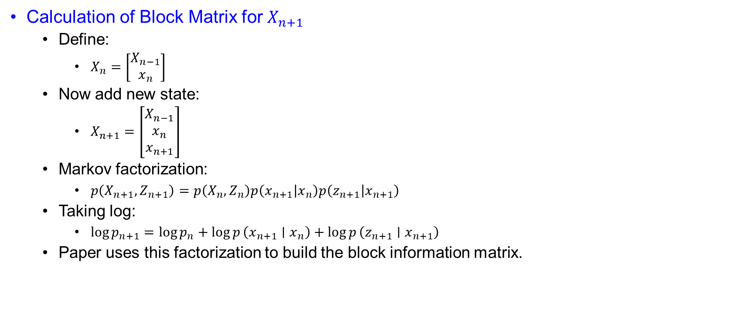
Adding the Next State Expands the Information Blocks
Calculation of Block Matrix for $X_{n+1}$
  Define:
    $X_{n}=\left[\begin{matrix}X_{n−1} \\ x_{n}\end{matrix}\right]$
  Now add new state:
    $X_{n+1}=\left[\begin{matrix}X_{n−1} \\ x_{n} \\ x_{n+1}\end{matrix}\right]$
  Markov factorization:
    $p\left(X_{n+1},Z_{n+1}\right)=p\left(X_{n},Z_{n}\right)p\left(x_{n+1} | x_{n}\right)p\left(z_{n+1} | x_{n+1}\right)$
  Taking log:
    $\log{p_{n+1}}=\log{p_{n}}+\log{p}\left(x_{n+1}∣x_{n}\right)+\log{p}\left(z_{n+1}∣x_{n+1}\right)$
  Paper uses this factorization to build the block information matrix.

Slide 33

Each Density Term Adds a Hessian Contribution
Negative Hessian Contributions
  Posterior information matrix:
    $J\left(X_{n+1}\right)=𝔼\left[−Δ_{X_{n+1}}^{X_{n+1}}\log{p_{n+1}}\right]$
  Since:
    $X_{n+1}=\left[\begin{matrix}X_{n−1} \\ x_{n} \\ x_{n+1}\end{matrix}\right]$
  we take second derivatives with respect to these three blocks

Slide 34

Old Density Does Not Directly Inform the Next State
Contribution From Old Density
    $\log{p_{n}}=\log{p}\left(X_{n},Z_{n}\right)$
  It depends only on:
    $X_{n−1},x_{n}$
  not on:
    $x_{n+1}$
  So:
    $−Δ\log{p_{n}}=\left[\begin{matrix}A_{n} & B_{n} & 0 \\ B_{n}^{T} & C_{n} & 0 \\ 0 & 0 & 0\end{matrix}\right]$

Slide 35

Dynamics Couple Current and Next-State Information
Contribution From Transition Density
  $\log{p}\left(x_{n+1}∣x_{n}\right)$
  This depends on:
    $x_{n},x_{n+1}$
  not directly on:
    $X_{n−1}$
  So:
    $−Δ\log{p}\left(x_{n+1}∣x_{n}\right)=\left[\begin{matrix}0 & 0 & 0 \\ 0 & D_{n}^{11} & D_{n}^{12} \\ 0 & D_{n}^{21} & D_{n,\text{trans}}^{22}\end{matrix}\right]$
  where:
    $D_{n}^{11}=𝔼\left[−Δ_{x_{n}}^{x_{n}}\log{p}\left(x_{n+1}∣x_{n}\right)\right]$
    $D_{n}^{12}=𝔼\left[−Δ_{x_{n}}^{x_{n+1}}\log{p}\left(x_{n+1}∣x_{n}\right)\right]$
    $D_{n}^{21}={\left(D_{n}^{12}\right)}^{T}$

Slide 36

New Measurements Inform Only the Next-State Block
Contribution From Measurement Density
  $\log{p}\left(z_{n+1}∣x_{n+1}\right)$
  This depends only on:
    $x_{n+1}$
  So:
    $−Δ\log{p}\left(z_{n+1}∣x_{n+1}\right)=\left[\begin{matrix}0 & 0 & 0 \\ 0 & 0 & 0 \\ 0 & 0 & D_{n,\text{meas}}^{22}\end{matrix}\right]$

Slide 37

Transition and Measurement Terms Form the Final Block
Final Block Matrix
  Adding all three contributions:
  $J\left(X_{n+1}\right)=\left[\begin{matrix}A_{n} & B_{n} & 0 \\ B_{n}^{T} & C_{n}+D_{n}^{11} & D_{n}^{12} \\ 0 & D_{n}^{21} & D_{n}^{22}\end{matrix}\right]$
  where:
  $D_{n}^{22}=D_{n,\text{trans}}^{22}+D_{n,\text{meas}}^{22}$
  So:
  $D_{n}^{22}=𝔼\left[−Δ_{x_{n+1}}^{x_{n+1}}\log{p}\left(x_{n+1}∣x_{n}\right)\right]+𝔼\left[−Δ_{x_{n+1}}^{x_{n+1}}\log{p}\left(z_{n+1}∣x_{n+1}\right)\right]$

Slide 38

Markov Structure Makes the Corner Block Zero
Why Corner Block Is Zero
  Corner block:
    $\left(1,3\right)=0$
    because old states $X_{n−1}$and new state $x_{n+1}$are not directly connected.
  Markov relation:
    $X_{n−1}→x_{n}→x_{n+1}$
  So:
    $\frac{∂^{2}\log{p_{n+1}}}{∂X_{n−1}∂x_{n+1}}=0$
  $\text{Old} \text{states} \text{affect} x_{n+1} \text{only} \text{through} x_{n}$

Slide 39

D Matrices Capture Model Curvature
Definition Of $D$ Terms
  $D_{n}^{11}=𝔼\left[−Δ_{x_{n}}^{x_{n}}\log{p}\left(x_{n+1}∣x_{n}\right)\right]$
  $D_{n}^{12}=𝔼\left[−Δ_{x_{n}}^{x_{n+1}}\log{p}\left(x_{n+1}∣x_{n}\right)\right]$
  $D_{n}^{21}=𝔼\left[−Δ_{x_{n+1}}^{x_{n}}\log{p}\left(x_{n+1}∣x_{n}\right)\right]={\left(D_{n}^{12}\right)}^{T}$
  $D_{n}^{22}=𝔼\left[−Δ_{x_{n+1}}^{x_{n+1}}\log{p}\left(x_{n+1}∣x_{n}\right)\right]+𝔼\left[−Δ_{x_{n+1}}^{x_{n+1}}\log{p}\left(z_{n+1}∣x_{n+1}\right)\right]$

Slide 40

D Terms Separate Direct Information from Coupling
Meaning Of $D$ Terms
  $D_{n}^{11}=\text{curvature} \text{with} \text{respect} \text{to} \text{old} \text{state} x_{n}$
  $D_{n}^{12},D_{n}^{21}=\text{coupling} \text{between} x_{n} \text{and} x_{n+1}$
  $D_{n}^{22}=\text{direct} \text{information} \text{about} x_{n+1}$
  So, the $D$ matrices collect information from:
    $\text{transition} \text{model}+\text{measurement} \text{model}$

Slide 41
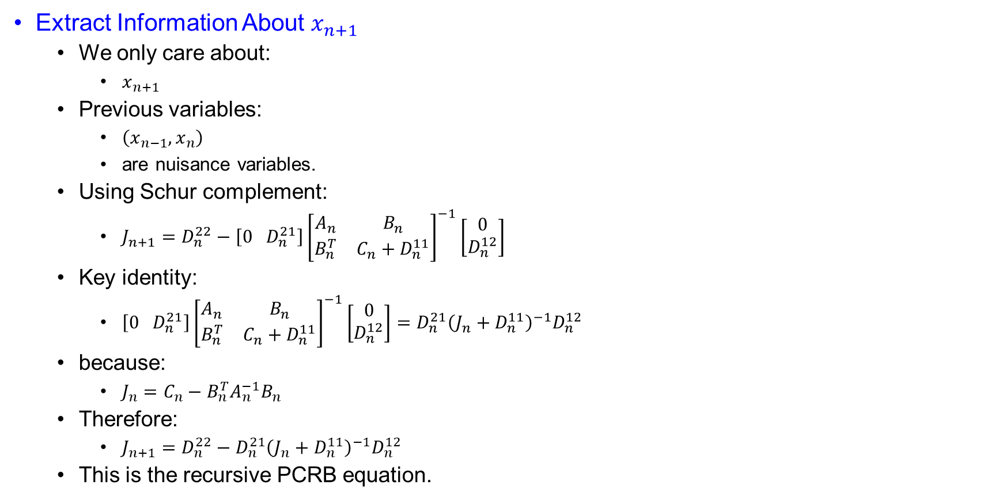
Schur Complement Produces the Recursive PCRB Update
Extract Information About $x_{n+1}$
  We only care about:
    $x_{n+1}$
  Previous variables:
    $\left(x_{n−1},x_{n}\right)$
    are nuisance variables.
  Using Schur complement:
    $J_{n+1}=D_{n}^{22}−\left[0 D_{n}^{21}\right]{\left[\begin{matrix}A_{n} & B_{n} \\ B_{n}^{T} & C_{n}+D_{n}^{11}\end{matrix}\right]}^{−1}\left[\begin{matrix}0 \\ D_{n}^{12}\end{matrix}\right]$
  Key identity:
    $\left[0 D_{n}^{21}\right]{\left[\begin{matrix}A_{n} & B_{n} \\ B_{n}^{T} & C_{n}+D_{n}^{11}\end{matrix}\right]}^{−1}\left[\begin{matrix}0 \\ D_{n}^{12}\end{matrix}\right]=D_{n}^{21}{\left(J_{n}+D_{n}^{11}\right)}^{−1}D_{n}^{12}$
  because:
    $J_{n}=C_{n}−B_{n}^{T}A_{n}^{−1}B_{n}$
  Therefore:
    $J_{n+1}=D_{n}^{22}−D_{n}^{21}{\left(J_{n}+D_{n}^{11}\right)}^{−1}D_{n}^{12}$
  This is the recursive PCRB equation.

Slide 42
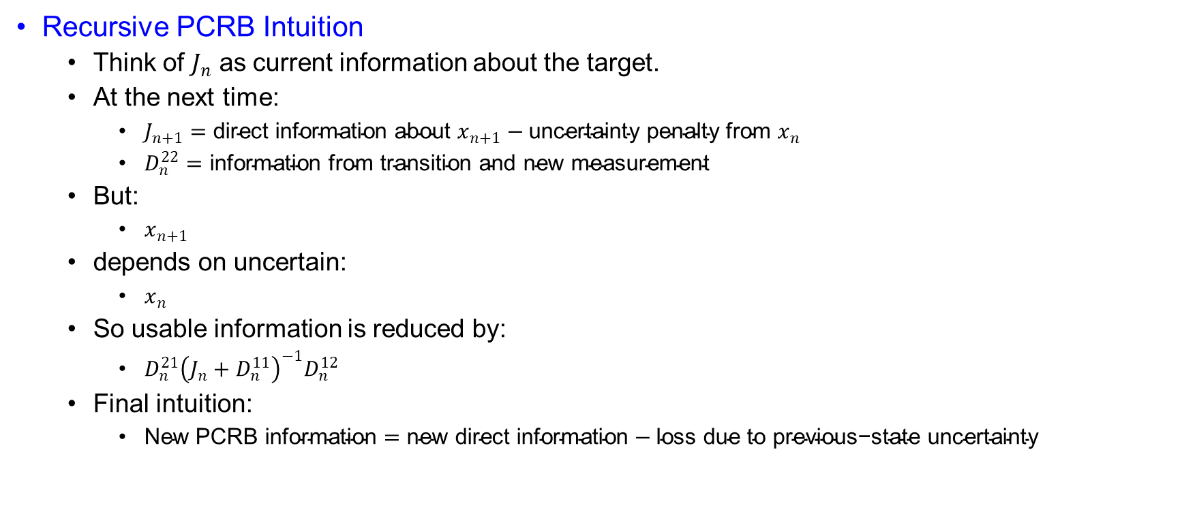
Previous-State Uncertainty Subtracts Usable Information
Recursive PCRB Intuition
  Think of $J_{n}$ as current information about the target.
  At the next time:
    $J_{n+1}=\text{direct} \text{information} \text{about} x_{n+1}−\text{uncertainty} \text{penalty} \text{from} x_{n}$
    $D_{n}^{22}=\text{information} \text{from} \text{transition} \text{and} \text{new} \text{measurement}$
  But:
    $x_{n+1}$
  depends on uncertain:
    $x_{n}$
  So usable information is reduced by:
    $D_{n}^{21}{\left(J_{n}+D_{n}^{11}\right)}^{−1}D_{n}^{12}$
  Final intuition:
    $\text{New} \text{PCRB} \text{information}=\text{new} \text{direct} \text{information}−\text{loss} \text{due} \text{to} \text{previous}\text{−}\text{state} \text{uncertainty}$

Slide 43
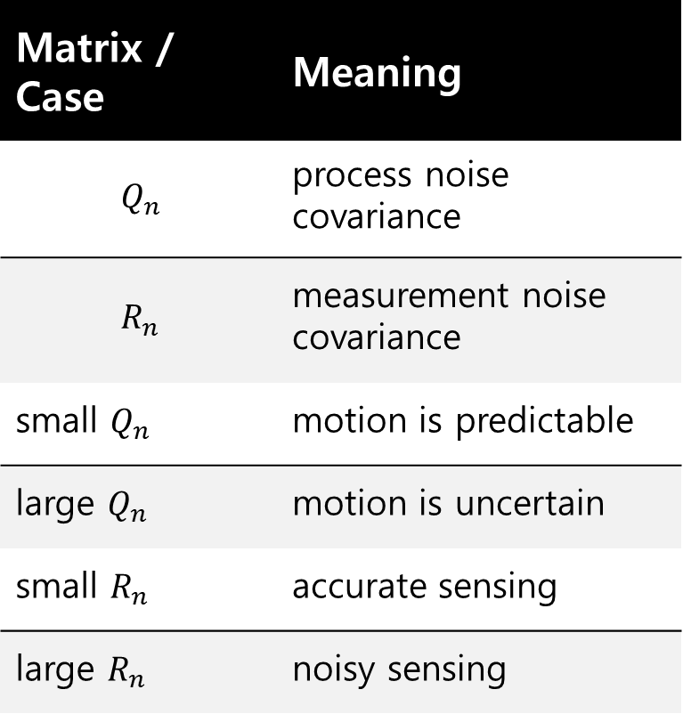

Process and Measurement Noise Control the Bound
Additive Gaussian Noise Case
  If:
    $x_{n+1}=f_{n}\left(x_{n}\right)+w_{n}$
    $z_{n}=h_{n}\left(x_{n}\right)+ν_{n}$
  with:
    $w_{n}\sim N\left(0,Q_{n}\right)$
    $ν_{n}\sim N\left(0,R_{n}\right)$
  then:
    $Q_{n}$
  and:
    $R_{n}$
  control PCRB.
Matrix / Case | Meaning
$$Q_{n}$$ | process noise covariance
$$R_{n}$$ | measurement noise covariance
small $Q_{n}$ | motion is predictable
large $Q_{n}$ | motion is uncertain
small $R_{n}$ | accurate sensing
large $R_{n}$ | noisy sensing

Slide 44
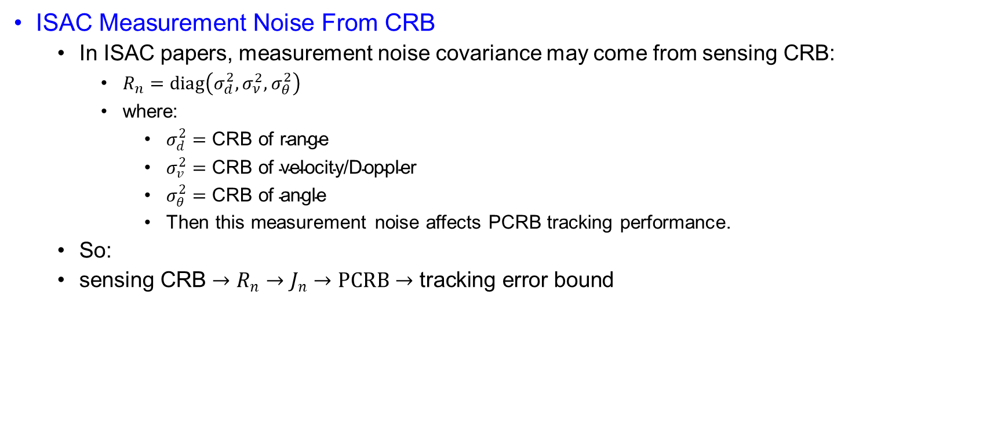
Sensing CRB Becomes Measurement Covariance
ISAC Measurement Noise From CRB
  In ISAC papers, measurement noise covariance may come from sensing CRB:
    $R_{n}=diag\left(σ_{d}^{2},σ_{ν}^{2},σ_{θ}^{2}\right)$
    where:
      $σ_{d}^{2}=\text{CRB} \text{of} \text{range}$
      $σ_{v}^{2}=\text{CRB} \text{of} \text{velocity}\text{/}\text{Doppler}$
      $σ_{θ}^{2}=\text{CRB} \text{of} \text{angle}$
      Then this measurement noise affects PCRB tracking performance.
  So:
  $\text{sensing} \text{CRB}→R_{n}→J_{n}→PCRB→\text{tracking} \text{error} \text{bound}$

Slide 45

Kalman Covariance Reaches PCRB in Linear Models
Connection With Kalman Filter
  For linear Gaussian model:
    $x_{n+1}=F_{n}x_{n}+w_{n}$
    $z_{n}=H_{n}x_{n}+ν_{n}$
  Kalman covariance satisfies:
    $P_{n∣n}=J_{n}^{−1}$
  So PCRB is achieved.
  This means:
    $\text{Kalman} \text{filter} \text{reaches} \text{the} \text{theoretical} \text{lower} \text{bound}$
  for linear Gaussian systems.

Slide 46

EKF Performance Is Judged Against the PCRB
Connection With EKF
  For nonlinear model:
    $x_{n+1}=f_{n}\left(x_{n}\right)+w_{n}$
    $z_{n}=h_{n}\left(x_{n}\right)+ν_{n}$
  EKF approximates using Jacobians:
    $F_{n}=\frac{∂f_{n}}{∂x_{n}}$
    $H_{n}=\frac{∂h_{n}}{∂x_{n}}$
  Then we compare:
    $MSE_{EKF}≥J_{n}^{−1}$
  If EKF MSE is close to PCRB:
    $\text{tracking} \text{is} \text{good}$
  If EKF MSE is far above PCRB:
    $\text{estimator} \text{is} \text{inefficient} \text{or} \text{model} \text{is} \text{difficult}$

Slide 47
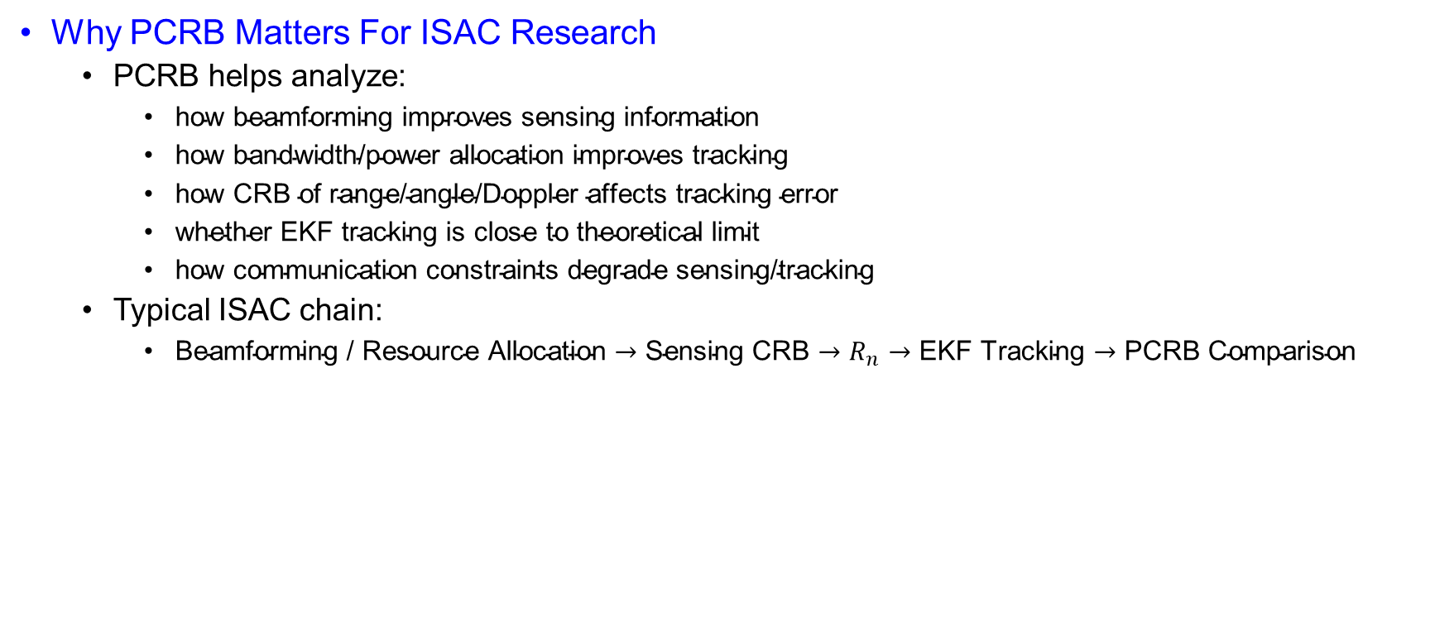
ISAC Resource Choices Propagate into Tracking Accuracy
Why PCRB Matters For ISAC Research
  PCRB helps analyze:
    $\text{how} \text{beamforming} \text{improves} \text{sensing} \text{information}$
    $\text{how} \text{bandwidth}\text{/}\text{power} \text{allocation} \text{improves} \text{tracking}$
    $\text{how} \text{CRB} \text{of} \text{range}\text{/}\text{angle}\text{/}\text{Doppler} \text{affects} \text{tracking} \text{error}$
    $\text{whether} \text{EKF} \text{tracking} \text{is} \text{close} \text{to} \text{theoretical} \text{limit}$
    $\text{how} \text{communication} \text{constraints} \text{degrade} \text{sensing}\text{/}\text{tracking}$
  Typical ISAC chain:
    $\text{Beamforming}\text{ / }\text{Resource} \text{Allocation}→\text{Sensing} \text{CRB}→R_{n}→\text{EKF} \text{Tracking}→\text{PCRB} \text{Comparison}$

Slide 48
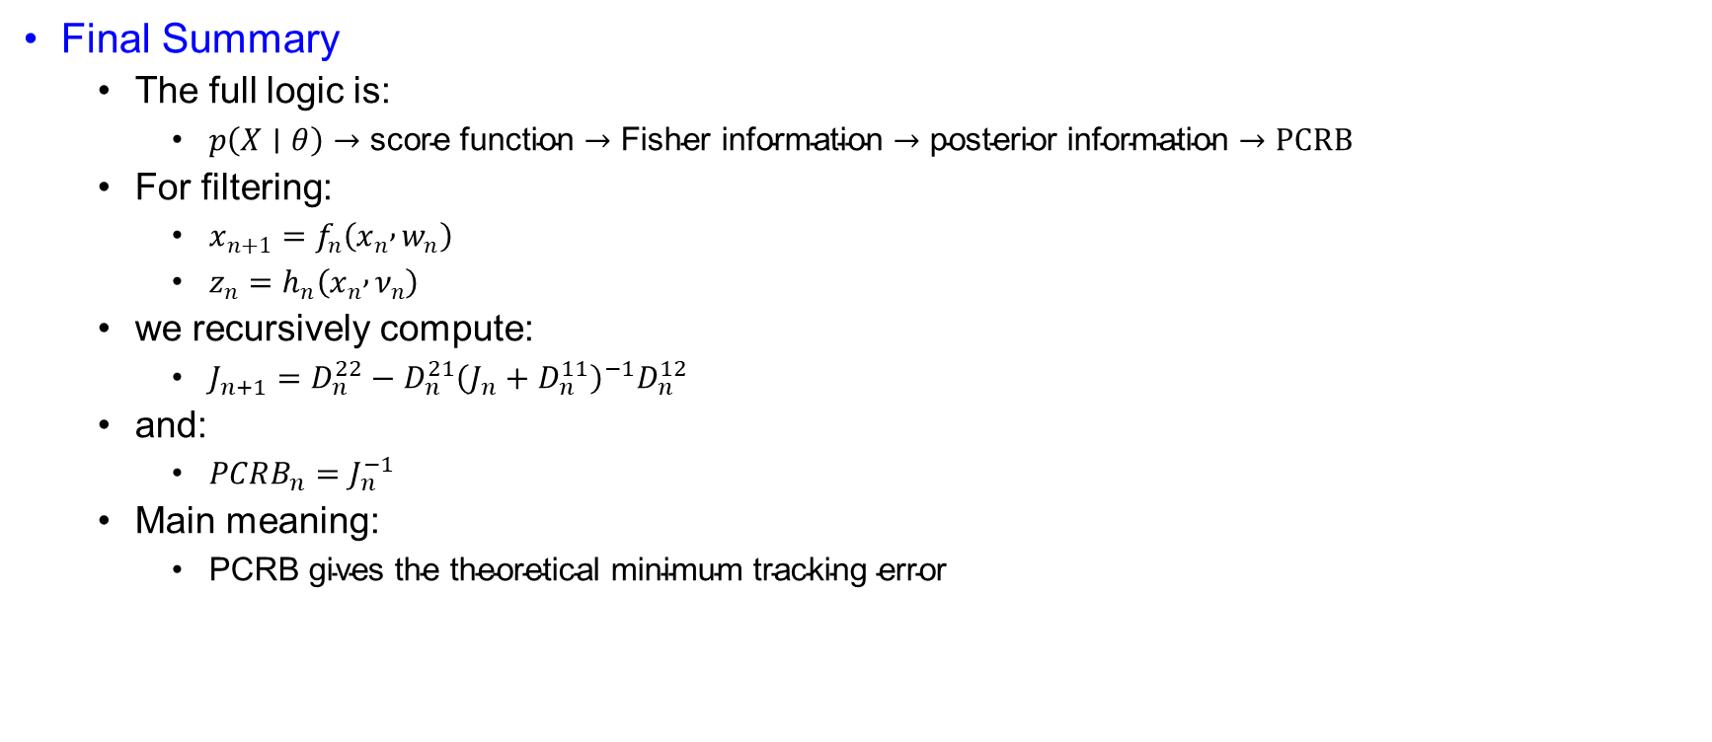
PCRB Sets the Theoretical Floor for Tracking Error
Final Summary
  The full logic is:
    $p\left(X∣θ\right)→\text{score} \text{function}→\text{Fisher} \text{information}→\text{posterior} \text{information}→PCRB$
  For filtering:
    $x_{n+1}=f_{n}\left(x_{n} , w_{n}\right)$
    $z_{n}=h_{n}\left(x_{n} , ν_{n}\right)$
  we recursively compute:
    $J_{n+1}=D_{n}^{22}−D_{n}^{21}{\left(J_{n}+D_{n}^{11}\right)}^{−1}D_{n}^{12}$
  and:
    $PCRB_{n}=J_{n}^{−1}$
  Main meaning:
    $\text{PCRB} \text{gives} \text{the} \text{theoretical} \text{minimum} \text{tracking} \text{error}$

Slide 49
Power and Bandwidth Allocation for Multi-Target Tracking in
Collocated MIMO Radar
AUTHORS
Haowei Zhang | Binfeng Zong | Junwei Xie
PUBLISHER / JOURNAL
IEEE Transactions on Vehicular Technology, Vol. 69, Issue 9, September 2020
Publication date: 16 June 2020

Slide 50
Table of Contents
01
Paper overview
Slides 51-53 | Problem, motivation, resource-allocation objective
04
Recursive BFIM structure
Slides 78-83 | Nuisance states, block matrix, Schur complement
02
Radar and tracking model
Slides 54-65 | Signal, echo, target dynamics, measurement noise
05
Gaussian dynamic prior
Slides 84-88 | Process-noise covariance and closed-form prior information
03
Transmit-aware PCRLB basics
Slides 66-77 | Likelihood, score, Fisher information, posterior split
06
Measurement FIM and final metric
Slides 89-92 | Power/bandwidth-dependent covariance and position PCRLB

Slide 51
Abstract
Paper Focus
  Power and Bandwidth Allocation for Multi-Target Tracking
  Collocated MIMO radar tracks multiple targets.
  Uses simultaneous multi-beam mode.
  Goal: improve target tracking accuracy.
  Key metric: weighted PCRLB.
Main Problem
  Limited Radar Resources
  Radar has limited:
    transmit power,
    bandwidth.
  Multiple targets need to be tracked simultaneously.
  Question: how much power and bandwidth should each target receive?

Slide 52
Abstract
Proposed Method
  Joint Power + Bandwidth Allocation
  Objective: minimize sum of weighted PCRLBs.
  Uses feedback from previous tracking cycle.
  Nonconvex problem is handled by:
    convex relaxation,
    cycle minimizer,
    two-stage convex optimization.
Key Takeaway
  Why This Paper Matters
  Better resource allocation gives better tracking.
  PCRLB links radar resources to tracking accuracy.
  Joint allocation performs better than uniform allocation.
  Useful foundation for dynamic ISAC target tracking.

Slide 53
Introduction
Motivation and Research Gap
  MIMO radar offers path diversity, flexible beam patterns, and multi-function operation.
  Existing radar resource allocation mainly focuses on power allocation.
  Most prior works consider static targets.
  For practical tracking, target motion must be considered.
  Bandwidth is also a critical but often ignored resource.
Proposed Direction
  This paper studies joint power and bandwidth allocation.
  Objective: minimize the sum of weighted PCRLBs.
  Uses feedback from the tracking cycle.
  Develops a closed-loop tracking/resource allocation framework.
  Solves the problem using convex relaxation + cyclical minimizer.

Slide 54
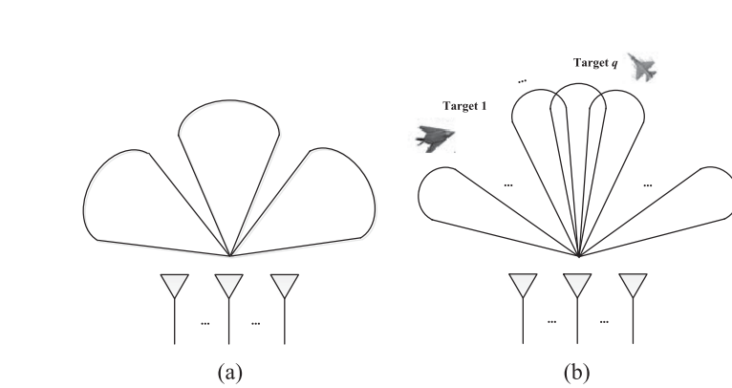
System Model
Figure 1. Illustration of multi-target tracking by simultaneous multi-beam mode. (a) Transmit beam pattern. (b) Receive beam pattern.

Slide 55
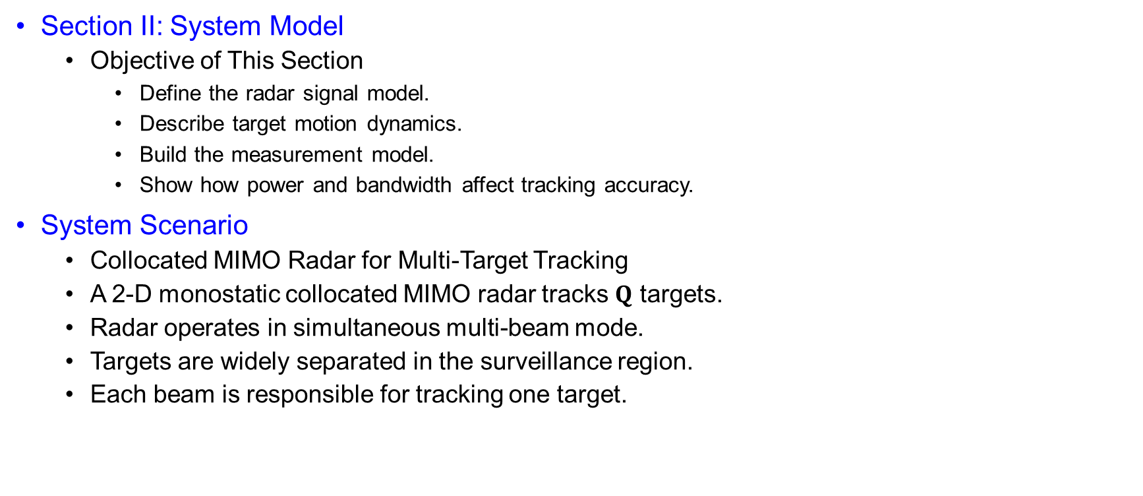
System Model
Section II: System Model
  Objective of This Section
    Define the radar signal model.
    Describe target motion dynamics.
    Build the measurement model.
    Show how power and bandwidth affect tracking accuracy.
System Scenario
  Collocated MIMO Radar for Multi-Target Tracking
  A 2-D monostatic collocated MIMO radar tracks $Q$ targets.
  Radar operates in simultaneous multi-beam mode.
  Targets are widely separated in the surveillance region.
  Each beam is responsible for tracking one target.

Slide 56


System Model
Transmit Signal Model
  For the $q$-th target at the $k$-th interval:
    $s_{t,k}^{q}\left(t\right)=\sqrt{P_{k}^{q}}{\tilde{s}}_{k}^{q}\left(t\right)exp⁡\left(−j2πf_{c}t\right)$
    $P_{k}^{q}$: allocated transmit power.
    ${\tilde{s}}_{k}^{q}\left(t\right)$: complex envelope.
    $f_{c}$: carrier frequency.
    $P_{k}^{q}→\text{affects} \text{received} \text{echo} \text{strength}$
Symbol | Meaning
Superscript $q$ | $q−th$ target, $q∈\left\{1,..,Q\right\}$
Subscript $k$ | $k−$th sample/tracking interval
$$q$$ | $q$-th target
$$k$$ | $k$-th tracking/sample interval
$$x_{k}^{q}$$ | Target state vector
$$P_{k}^{q}$$ | Allocated power
$$β_{k}^{q}$$ | Allocated bandwidth
$$τ_{k}^{q}$$ | Time delay
$$ν_{k}^{q}$$ | Doppler shift
$$z_{k}^{q}$$ | Measurement vector

Slide 57

System Model
Effective Bandwidth
  $∣β_{k}^{q}∣^{2}=\frac{\int{f^{2}}∣{\tilde{s}}_{k}^{q}\left(f\right)∣^{2}df}{\int{∣}{\tilde{s}}_{k}^{q}\left(f\right)∣^{2}df}$
    $β_{k}^{q}$ represents effective bandwidth.
    Larger bandwidth improves range estimation accuracy.
    Bandwidth is a key radar resource.
    $\text{Larger} \text{bandwidth}⇒\text{better} \text{range} \text{accuracy}$
Effective Time Duration
  $∣T_{k}^{q}∣^{2}=\frac{\int{t^{2}}∣{\tilde{s}}_{k}^{q}\left(t\right)∣^{2}dt}{\int{∣}{\tilde{s}}_{k}^{q}\left(t\right)∣^{2}dt}$
    $T_{k}^{q}$ represents effective time duration.
    It affects Doppler / radial velocity estimation.
    Longer observation duration improves velocity estimation.
    $\text{Larger} T_{k}^{q}⇒\text{better} \text{velocity} \text{accuracy}$

Slide 58

System Model
Received Signal Model
  $s_{r,k}^{q}\left(t\right)≈h_{k}^{q}\sqrt{{α_{k}^{q}P}_{t,k}^{q}}{\tilde{s}}_{k}^{q}\left(t−τ_{k}^{q}\right)exp⁡\left(−j2πν_{k}^{q}t\right)+n_{k}^{q}\left(t\right)$
    $h_{k}^{q}$: target reflection coefficient.
    $α_{k}^{q}$: path-loss attenuation.
    $τ_{k}^{q}$: time delay → range information.
    $ν_{k}^{q}$: Doppler shift → velocity information.
    $n_{k}^{q}\left(t\right)$: complex Gaussian noise.

Slide 59

System Model
Information Extracted from Echo
  The received echo contains:
    Radar echo → range, velocity, angle information
Echo Parameter | Physical Meaning
Time delay $τ_{k}^{q}$ | Target range
Doppler shift $ν_{k}^{q}$ | Radial velocity
Reflection coefficient $h_{k}^{q}$ | Target reflectivity
Received power | Measurement quality

Slide 60

System Model
Target State Model
  The target follows a constant acceleration model:
    $x_{k}^{q}=F^{q}x_{k−1}^{q}+w_{k −1}^{q}$
  State vector:
    $x_{k}^{q}={\left[x_{k},y_{k},{\dot{x}}_{k},{\dot{y}}_{k},{\ddot{x}}_{k},{\ddot{y}}_{k}\right]}^{T}$
  The state includes:
    Position
    Velocity
    Acceleration
  State Transition Matrix
    $F^{q}=\left[\begin{matrix}1 & T_{s} & \frac{T_{s}^{2}}{2} \\ 0 & 1 & T_{s} \\ 0 & 0 & 1\end{matrix}\right] ⨂{I_{2}}$
    $T_{s}:sample interval.$
    $I_{2} :2−D motion in x−and y−coordinates$
    $⨂{:} Kronecker product$
  $F^{q}→predicts next target state$

Slide 61

System Model
Process Noise Model
  $w_{k−1}^{q}\sim N\left(0,Q^{q}\right)$
  $Q^{q}=k^{q}\left[\begin{matrix}\frac{T_{s}^{5}}{20} & \frac{T_{s}^{4}}{8} & \frac{T_{s}^{3}}{6} \\ \frac{T_{s}^{4}}{8} & \frac{T_{s}^{3}}{3} & \frac{T_{s}^{2}}{2} \\ \frac{T_{s}^{3}}{6} & \frac{T_{s}^{2}}{2} & T_{s}\end{matrix}\right]⨂{I_{2}}$
  Process noise represents motion uncertainty
  $k^{q}$ controls the process noise intensity
  Larger $k^{q}$ means target motion is harder to predict

Slide 62

System Model
Measurement Model
  $z_{k}^{q}=h\left(x_{k}^{q}\right)+ν_{k}^{q}$
  Where:
    $h\left(x_{k}^{q}\right)={\left[r_{k},{\dot{r}}_{k},θ_{k}\right]}^{T}$
  Radar measures
    $r_{k}:$ range
    $\dot{r_{k}}$ : radial velocity
    $θ_{k}:$ azimuth angel

Slide 63

System Model
Nonlinear Measurement Function
  $r_{k}= \sqrt{x_{k}^{2}+y_{k}^{2}}$
  $\dot{r_{k}}= \frac{{\dot{x}}_{k}x_{k}+{\dot{y}}_{k}y_{k}}{r_{k}}$
  $θ_{k}=\arctan\left(\frac{y_{k}}{x_{k}}\right)$
  The measurement function is nonlinear.
  Therefore, tracking usually requires nonlinear filtering methods such as:
    EKF
    UKF
    SCKF

Slide 64

System Model
Measurement Noise Covariance
  $ν_{k}^{q}\sim N\left(0,R_{k}^{q}\right)$
  $R_{k}^{q}=diag\left(σ_{r_{k}^{q}}^{2},σ_{{\dot{r}}_{k}^{q}}^{2},σ_{θ_{k}^{q}}^{2}\right)$
  Measurements uncertainty is represented by:
    Range error covariance
    Radial velocity error variance
    Angle error variance
CRLB of Measurement Accuracy
  $σ_{r_{k}^{q}}^{2}∝{\left(α_{k}^{q}P_{k}^{q}{\left|h_{k}^{q}\right|}^{2}{\left|β_{k}^{q}\right|}^{2}\right)}^{−1}$
  $σ_{{\dot{r}}_{k}^{q}}^{2}∝{\left(α_{k}^{q}P_{k}^{q}{\left|h_{k}^{q}\right|}^{2}{\left|T_{k}^{q}\right|}^{2}\right)}^{−1}$
  $σ_{θ_{k}^{q}}^{2}∝{\left(\frac{α_{k}^{q}P_{k}^{q}{\left|h_{k}^{q}\right|}^{2}}{B_{w}}\right)}^{−1}$

Slide 65

System Model
$\text{Key} \text{Interpretation}$
  $\text{Power} \text{effect}$
    $P_{k}^{q}↑⇒\text{measurement} \text{error} \text{decreases}$
  $\text{Bandwidth} \text{effect}$
    $β_{k}^{q}↑⇒\text{range} \text{error} \text{decreases}$
  $\text{Time} \text{duration} \text{effect}$
    $T_{k}^{q}↑⇒\text{velocity} \text{error} \text{decreases}$
  $\text{Target} \text{reflection} \text{effect}$
    $∣h_{k}^{q}∣^{2}↑⇒\text{measurement} \text{quality} \text{improves}$
This section builds the chain:
  Power + Bandwidth + Measurement Noise $→$ CRLB$→$PCRLB$→$Tracking Accuracy

Slide 66

Relationship Between Transmit Parameters and Predicted PCRLB
Transmit-Parameter-Aware Predicted PCRLB for Multi-Target Tracking
  Likelihood / measurement model:
    $p\left(z_{k}^{q} | x_{k}^{q}\right)$
    Probability of observing $z_{k}^{q}$ when true target is $x_{k}^{q}$.
  Prior probability
    $p\left(x_{k}^{q}\right)$
  Posterior probability
    $p\left(x_{k}^{q} | z_{k}^{q}\right)$
  Updated belief about $x_{k}^{q}$ after observing $z_{k}^{q}$
  Bayes rule:
    $p\left(x_{k}^{q} | z_{k}^{q}\right)= \frac{p\left(z_{k}^{q} | x_{k}^{q}\right)p\left(x_{k}^{q}\right)}{p\left(z_{k}^{q}\right)}$

Slide 67

Relationship Between Transmit Parameters and Predicted PCRLB
Transmit-Parameter-Aware Predicted PCRLB for Multi-Target Tracking
  Why A Derivative Appears
    If the parameter changes slightly:
      $x_{k}^{q}+dx_{k}^{q}$
    Then the likelihood changes:
      $p\left(z_{k}^{q} | x_{k}^{q}\right)→p\left(z_{k}^{q} | x_{k}^{q}+dx_{k}^{q}\right)$
    So, we check the sensitivity:
      $\frac{∂p\left(z_{k}^{q} | x_{k}^{q}\right)}{∂x_{k}^{q}}$
    This tells how sensitive the probability model is to the parameter.

Slide 68

Relationship Between Transmit Parameters and Predicted PCRLB
Transmit-Parameter-Aware Predicted PCRLB for Multi-Target Tracking
  Relative Change and Score Function
    Instead of raw change, use relative change:
      $\frac{1}{p\left(z_{k}^{q} | x_{k}^{q}\right)}\frac{∂p\left(z_{k}^{q} | x_{k}^{q}\right)}{∂x_{k}^{q}}$
    Using log rule:
      $\frac{1}{p\left(z_{k}^{q} | x_{k}^{q}\right)}\frac{∂p\left(z_{k}^{q} | x_{k}^{q}\right)}{∂x_{k}^{q}}=\frac{∂}{∂x_{k}^{q}}\log{p\left(z_{k}^{q} | x_{k}^{q}\right)}$
    Score function = relative slope of the likelihood

Slide 69

Relationship Between Transmit Parameters and Predicted PCRLB
Transmit-Parameter-Aware Predicted PCRLB for Multi-Target Tracking
  Fisher Information From Score
    The score is random because $x_{k}^{q}$ is random.
    One measurement gives one score value.
    To measure average information:
      $J\left(θ\right)= 𝔼\left[s\left(z_{k}^{q},x_{k}^{q}\right)\right]$
      So,
        $J\left(θ\right)=𝔼\left[\left(\frac{∂}{∂x_{k}^{q}}\log{p\left(z_{k}^{q} | x_{k}^{q}\right)}\right)\right]$
    Fisher information = average squared sensitivity of log-likelihood

Slide 70

Relationship Between Transmit Parameters and Predicted PCRLB
Transmit-Parameter-Aware Predicted PCRLB for Multi-Target Tracking
  Why Square the score?
    Score can be positive or negative
    If we only take expectation:
      $𝔼\left[s\left(z_{k}^{q},x_{k}^{q}\right)\right]$
    It becomes zero under regularity conditions.
    Since:
      $\int{p\left(z_{k}^{q} | x_{k}^{q}\right) dz_{k}^{q}=1}$
      Differentiate both sides:
        $\frac{∂}{∂x_{k}^{q}}\int{p\left(z_{k}^{q} | x_{k}^{q}\right)dz_{k}^{q}=0}$
        $\int{\frac{∂p\left(z_{k}^{q} | x_{k}^{q}\right)}{∂x_{k}^{q}}=0}$

Slide 71

Relationship Between Transmit Parameters and Predicted PCRLB
Transmit-Parameter-Aware Predicted PCRLB for Multi-Target Tracking
  Average Score Is Zero
    $𝔼\left[s\left(z_{k}^{q},x_{k}^{q}\right)\right]= \int{\frac{∂p\left(z_{k}^{q} | x_{k}^{q}\right)}{∂x_{k}^{q}}}p\left(z_{k}^{q} | x_{k}^{q}\right)dz_{k}^{q}$
    $=\int{\frac{∂p\left(z_{k}^{q} | x_{k}^{q}\right)}{∂x_{k}^{q}}dz_{k}^{q}}$
    $=0$
    Therefore:
      $𝔼\left[s\left(z_{k}^{q},x_{k}^{q}\right)\right]=0$
    So, we use:
      $𝔼\left[s^{2}\right]=0$
    Instead of:
      $𝔼 \left[s\right]=0$

Slide 72

Relationship Between Transmit Parameters and Predicted PCRLB
Transmit-Parameter-Aware Predicted PCRLB for Multi-Target Tracking
  Another equivalent form of Fisher information is:
    $J\left(θ\right)=𝔼\left[−\frac{∂^{2}}{∂{\left(x_{k}^{q}\right)}^{2}}\log{p\left(z_{k}^{q} | x_{k}^{q}\right)}\right]$
    Where:
      $𝔼 \left[s^{2}\right]=average squared slope$
      $𝔼\left[−\frac{∂}{∂{\left(x_{k}^{q}\right)}^{2}}\log{p\left(z_{k}^{q} | x_{k}^{q}\right)}\right]=average curvature/sharpness$
      So, Fisher information has two views:
        A sharp likelihood means the target is easy to estimate.
        A flat likelihood means the target is difficult to estimate.

Slide 73

Relationship Between Transmit Parameters and Predicted PCRLB
Transmit-Parameter-Aware Predicted PCRLB for Multi-Target Tracking
  Score vector and Fisher information matrix
    For random target vector:
      $x_{k}^{q}={\left[x_{k,1}^{q},x_{k,2}^{q},…..,x_{k,n_{x}}^{q}\right]}^{T}$
    Score component:
      $s_{i}\left(z_{k}^{q},x_{k}^{q}\right)=\frac{∂}{∂x_{k,i}^{q}}\log{p_{z_{k}^{q},x_{k}^{q}}\left(z_{k}^{q},x_{k}^{q}\right)}$
      $=\frac{1}{p_{z_{k}^{q},x_{k}^{q}}\left(z_{k}^{q},x_{k}^{q}\right)}\frac{∂p_{z_{k}^{q},x_{k}^{q}}\left(z_{k}^{q},x_{k}^{q}\right)}{∂x_{k,i}^{q}}$
    Fisher information matrix:
      $J_{ij}=𝔼\left[s_{i}\left(z_{k}^{q},x_{k}^{q}\right)s_{j}\left(z_{k}^{q},x_{k}^{q}\right)\right]$
      $J_{ij}=𝔼\left[\frac{∂\log{p_{z_{k}^{q},x_{k}^{q}}\left(z_{k}^{q},x_{k}^{q}\right)}}{∂x_{k,i}^{q}}\frac{∂\log{p_{z_{k}^{q},x_{k}^{q}}\left(z_{k}^{q},x_{k}^{q}\right)}}{∂x_{k,j}^{q}}\right]$

Slide 74

Relationship Between Transmit Parameters and Predicted PCRLB
Transmit-Parameter-Aware Predicted PCRLB for Multi-Target Tracking
  Score vector and Fisher information matrix
  Negative Hessian derivation
    Let :
      $p= p_{z_{k}^{q},x_{k}^{q}}\left(z_{k}^{q},x_{k}^{q}\right)$
    First derivative:
      $\frac{∂\log{p}}{∂x_{k,i}^{q}}=\frac{1}{p}\frac{∂p}{∂x_{k,i}}$
    Second derivative:
      $\frac{∂^{2}\log{p}}{∂x_{k,i}^{q}∂x_{k,j}^{q}}=\frac{1}{p} \frac{∂^{2}p}{∂x_{k,i}^{q}∂x_{k,j}^{q}} −\frac{1}{p^{2}} \frac{∂p}{∂x_{k,i}^{q}}\frac{∂p}{∂x_{k,j}^{q}}$
    Taking expectation:
      $𝔼 \left[\frac{∂^{2}\log{p}}{∂x_{k,i}^{q}∂x_{k,j}^{q}}\right]= \iint{\frac{∂^{2}p}{∂x_{k,i}^{q}∂x_{k,j}^{q}}dz_{k}^{q}dx_{k}^{q} − \iint{\frac{1}{p}}}$ $\frac{∂p}{∂x_{k,i}^{q}}\frac{∂p}{∂x_{k,j}^{q}}dz_{k}^{q}dx_{k}^{q}$

Slide 75

Relationship Between Transmit Parameters and Predicted PCRLB
Transmit-Parameter-Aware Predicted PCRLB for Multi-Target Tracking
  Score vector and Fisher information matrix
  Negative Hessian derivation
    Why first term becomes zero
      First term:
        $T_{1}= \iint{\frac{∂^{2}p}{∂x_{k,i}^{q}∂x_{k,j}^{q}}dz_{k}^{q}dx_{k}^{q}}$
        $\frac{∂^{2}p}{∂x_{k,i}^{q}∂x_{k,j}^{q}}=\frac{∂}{∂x_{k,j}^{q}}\left(\frac{∂p}{x_{k,i}^{q}}\right)$
        Integrate over $∂x_{k,j}$:
          $\int_{−∞}^{∞}{\frac{∂}{∂x_{k,j}^{q}}\left(\frac{∂p}{x_{k,i}^{q}}\right)dx_{k,j}={\left[\frac{∂p}{x_{k,i}^{q}}\right]}_{−∞}^{∞}}$
        Under regularity condition:
          $\frac{∂p}{∂x_{k,i}^{q}} →0$ at boundary
        Therefore, $T_{1} =0$

Slide 76

Relationship Between Transmit Parameters and Predicted PCRLB
Transmit-Parameter-Aware Predicted PCRLB for Multi-Target Tracking
  Score vector and Fisher information matrix
  Negative Hessian derivation
    Final Fisher information identity
      Since the first term is zero
        $𝔼 \left[\frac{∂^{2}\log{p}}{∂x_{k,i}^{q}∂x_{k,j}^{q}}\right]=−\iint{\frac{1}{p} \frac{∂p}{∂x_{k,i}^{q}}\frac{∂p}{∂x_{k,j}^{q}}dz_{k}^{q}dx_{k}^{q}}$
      But:
        $\frac{∂\log{p}}{∂x_{k,i}^{q}}=\frac{1}{p}\frac{∂p}{∂x_{k,i}^{q}}$
      So:
        $𝔼 \left[−\frac{∂^{2}\log{p_{z_{k}^{q},x_{k}^{q}}\left(z_{k}^{q},x_{k}^{q}\right)}}{∂x_{k,i}^{q}∂x_{k,j}^{q}}\right]=𝔼\left[\frac{∂\log{p_{z_{k}^{q},x_{k}^{q}}\left(z_{k}^{q},x_{k}^{q}\right)}}{∂x_{k,i}^{q}}\frac{∂\log{p_{z_{k}^{q},x_{k}^{q}}\left(z_{k}^{q},x_{k}^{q}\right)}}{∂x_{k,j}^{q}}\right]$
    This proves:
      Negative Hessian = Score outer - product

Slide 77

Relationship Between Transmit Parameters and Predicted PCRLB
Transmit-Parameter-Aware Predicted PCRLB for Multi-Target Tracking
  Posterior information decomposition
    For PCRB, $x_{k}^{q}$ is random
    So, we use joint density:
      $p\left(z_{k}^{q},x_{k}^{q}\right)$
    Bayes factorization:
      $p\left(z_{k}^{q},x_{k}^{q}\right)=p\left(z_{k}^{q} | x_{k}^{q}\right)p\left(x_{k}^{q}\right)$
    Taking log:
      $\log{p\left(z_{k}^{q},x_{k}^{q}\right)=\log\left(p\left(z_{k}^{q} | x_{k}^{q}\right)\right)+\log\left(p\left(x_{k}^{q}\right)\right)}$
    Therefore,
      $J\left(x_{k}^{q}\right)=J_{P}\left(x_{k}^{q}\right)+J_{D}\left(x_{k}^{q}\right)$
    Where:
      $J_{D}\left(x_{k}^{q}\right)=𝔼_{x_{k}^{q},z_{k}^{q}} \left[{−∆}_{x_{k}^{q}}^{x_{k}^{q}}\log{p\left(z_{k}^{q} | x_{k}^{q}\right)}\right]$
      $J_{P}\left(x_{k}^{q}\right)=𝔼_{x_{k}^{q}}\left[−∆_{x_{k}^{q}}^{x_{k}^{q}}\log\left(p\left(x_{k}^{q}\right)\right) \right]$
  $PCRLB=J^{−1}$

Slide 78

Relationship Between Transmit Parameters and Predicted PCRLB
Transmit-Parameter-Aware Predicted PCRLB for Multi-Target Tracking
  Posterior information decomposition
    Block matrix view of recursive PCRLB
      Suppose:
        $x_{k}^{q}=\left[\begin{matrix}{\left(x_{k}^{q}\right)}_{α} \\ {\left(x_{k}^{q}\right)}_{β}\end{matrix}\right]$
      Information matrix:
        $J =\left[\begin{matrix}J_{αα} & J_{αβ} \\ J_{βα} & J_{ββ}\end{matrix}\right]$
      If we only care about estimating ${\left(x_{k}^{q}\right)}_{β}$, then useful information is :
        $J_{β}^{eff}=J_{ββ} −J_{βα} J_{αα}^{−1} J_{αβ}$
      This is called the information submatrix.
      Other unknown variables reduce the effective information about the parameter we care about.

Slide 79

Relationship Between Transmit Parameters and Predicted PCRLB
Transmit-Parameter-Aware Predicted PCRLB for Multi-Target Tracking
  Posterior information decomposition
    Block matrix view of recursive PCRLB
      In filtering, the full trajectory is:
        $x_{0:k}^{q}={\left[{\left({\left(x_{0}^{q}\right)}^{T},{\left(x_{1}^{q}\right)}^{T},…..,{\left(x_{k}^{q}\right)}^{T}\right)}^{T}\right]}^{T}$
      But we only want the current state:
        $x_{k}^{q}$
      So previous states:
        $x_{0}^{q},x_{1}^{q},……,x_{k−1}^{q}$
      Act like nuisance variables
      Therefore, we need the information submatrix for $x_{k}^{q}$, not the full trajectory information.

Slide 80

Relationship Between Transmit Parameters and Predicted PCRLB
Transmit-Parameter-Aware Predicted PCRLB for Multi-Target Tracking
  Posterior information decomposition
    Block matrix view of recursive PCRLB
      The non-linear filtering model is :
        $x_{k}^{q}=F_{q}x_{k−1}^{q}+w_{k−1}^{q}$
        $z_{k}^{q}=h\left(x_{k}^{q}\right)+ν_{k}^{q}$
      Recursive PCRB
        Compute $J_{n}$ time-step by time-step
        Instead of building one huge information matrix for the whole trajectory
        The key recursion is :
          $J_{n+1} =D_{n}^{22} −D_{n}^{21}{\left(J_{n}+D_{n}^{11}\right)}^{−1} D_{n}^{12}$
        This gives the posterior Fisher information for the next state.

Slide 81

Relationship Between Transmit Parameters and Predicted PCRLB
Transmit-Parameter-Aware Predicted PCRLB for Multi-Target Tracking
  Posterior information decomposition
    Block matrix view of recursive PCRLB
      Joint density Factorization
        Because the system is Markov:
          $p\left(x_{0:k}^{q},z_{1:k}^{q}\right)=p\left(x_{0}^{q}\right)\prod_{i=1}^{k}{p\left(x_{i}^{q} | x_{i−1}^{q}\right)\prod_{i=1}^{k}{p\left(z_{i}^{q} | x_{i}^{q}\right)}}$
          For one step recursion:
            $p\left(x_{0:k}^{q},z_{1:k}^{q}\right)=p\left(x_{0:k−1}^{q},z_{1:k−1}^{q}\right)p\left(x_{k}^{q} | x_{k−1}^{q}\right)p\left(z_{k}^{q} | x_{k}^{q}\right)$
            $\log\left(p_{k}\right)=\log{p_{k−1}+\log{p\left(x_{k}^{q} | x_{k−1}^{q}\right)+\log{p(z_{k}^{q}|x_{k}^{q})}}}$
            $old information+dynamic transition model+new measurement$

Slide 82

Relationship Between Transmit Parameters and Predicted PCRLB
Transmit-Parameter-Aware Predicted PCRLB for Multi-Target Tracking
  Posterior information decomposition
    From factorization to information matrix
      The BFIM is obtained from the negative Hessian:
        $J\left(x_{k}^{q}\right)=−𝔼\left[∇_{x_{k}^{q}}∇_{x_{k}^{q}}^{T}\log{p_{k}}\right]$
      Using block-matrix elimination of previous states
      The prior information for the current state is :
        $J_{p}\left(x_{k}^{q}\right)=D_{22}^{k−1} −D_{21}^{k−1}{\left[J\left(x_{k−1}^{q}\right)+D_{11}^{k−1}\right]}^{−1} D_{12}^{k−1}$
        This is the recursive PCRLB result from Schur complement
        It gives the predicted information before using the current measurement.

Slide 83

Relationship Between Transmit Parameters and Predicted PCRLB
Transmit-Parameter-Aware Predicted PCRLB for Multi-Target Tracking
  Posterior information decomposition
    From factorization to information matrix
    Definition of $D$ matrices
      $p\left(x_{k}^{q} | x_{k−1}^{q}\right)$
      $D_{11}^{k−1}=−𝔼\left[∇_{x_{k−1}^{q}}∇_{x_{k−1}^{q}}^{T}\log{p\left(x_{k}^{q} | x_{k−1}^{q}\right)}\right]$
      $D_{12}^{k−1}=−𝔼\left[∇_{x_{k−1}^{q}}∇_{x_{k}^{q}}^{T}\log\left(x_{k}^{q} | x_{k−1}^{q}\right)\right]$
      $D_{22}^{k−1}=−𝔼\left[∇_{x_{k}^{q}}∇_{x_{k}^{q}}^{T}\log\left(x_{k}^{q} | x_{k−1}^{q}\right)\right]$

Slide 84

Relationship Between Transmit Parameters and Predicted PCRLB
Transmit-Parameter-Aware Predicted PCRLB for Multi-Target Tracking
  Posterior information decomposition
    From factorization to information matrix
      Gaussian dynamic model
        Target dynamics are:
          $x_{k}^{q}=F^{q}x_{k−1}^{q}+w_{k−1}^{q}$
          Where:
            Process noise is gaussian:
              $w_{k−1}^{q}\sim N(0,Q^{p})$
          So conditioned on the previous state $x_{k−1}^{q}$
          The current state also gaussian:
            $x_{k}^{q}|x_{k−1}^{q}\sim N\left(F^{q}x_{k−1}^{q},Q^{p}\right)$
            Here $F^{q}x_{k−1}^{q}$ is predicted mean and $Q^{p}$ is process noise covariance

Slide 85

Relationship Between Transmit Parameters and Predicted PCRLB
Transmit-Parameter-Aware Predicted PCRLB for Multi-Target Tracking
  Posterior information decomposition
    From factorization to information matrix
      Gaussian dynamic model
        The conditional PDF is:
          $p\left(x_{k}^{q} | x_{k−1}^{q}\right)=\frac{1}{{\left(2π\right)}^{n_{x}/2}{\left|Q^{q}\right|}^{1/2}}\exp\left[−\frac{1}{2}\left(x_{k}^{q} −F^{q}x_{k−1}^{q}\right){\left(Q^{q}\right)}^{−1}\left(x_{k}^{q}−F^{q}x_{k−1}^{q}\right)\right]$
          Prediction error
            $e_{k}^{q}= x_{k}^{q} −F^{q}x_{k−1}^{q}$
          $p\left(x_{k}^{q} | x_{k−1}^{q}\right)=\frac{1}{{\left(2π\right)}^{n_{x}/2}{\left|Q^{q}\right|}^{1/2}}\exp\left[−\frac{1}{2}{\left(e_{k}^{q}\right)}^{T}{\left(Q^{q}\right)}^{−1}e_{k}^{q}\right]$
          $\log\left(p\left(x_{k}^{q} | x_{k−1}^{q}\right)\right)=\log\left(\frac{1}{{\left(2π\right)}^{\frac{n_{x}}{2}}{\left|Q^{q}\right|}^{\frac{1}{2}}}\right) − \frac{1}{2}{\left(e_{k}^{q}\right)}^{T}{\left(Q^{q}\right)}^{−1}e_{k}^{q}$
          Since the first term does not depend on the state variables:
          $\log\left(p\left(x_{k}^{q} | x_{k−1}^{q}\right)\right)=c − \frac{1}{2}{\left(e_{k}^{q}\right)}^{T}{\left(Q^{q}\right)}^{−1}e_{k}^{q}$

Slide 86

Relationship Between Transmit Parameters and Predicted PCRLB
Transmit-Parameter-Aware Predicted PCRLB for Multi-Target Tracking
  Posterior information decomposition
    From factorization to information matrix
      Gaussian dynamic model
        This is quadratic because it contains
          $\left(x_{k}^{q} −F^{q}x_{k−1}^{q}\right){\left(Q^{q}\right)}^{−1}\left(x_{k}^{q}−F^{q}x_{k−1}^{q}\right)$
          The Gaussian dynamic model penalizes prediction error quadratically
          Smaller $Q^{q}⇒$more confidence in the motion model
          Larger $Q^{q}⇒$ more uncertainty in the target model

Slide 87

Relationship Between Transmit Parameters and Predicted PCRLB
Transmit-Parameter-Aware Predicted PCRLB for Multi-Target Tracking
  Posterior information decomposition
    From factorization to information matrix
    Calculate $D−$matrices
      From the negative Hessian of the Gaussian transition density:
        $D_{11}^{k−1}={\left(F^{q}\right)}^{T}{\left(Q^{q}\right)}^{−1}F^{q}$
        $D_{12}^{k−1}=−{\left(F^{q}\right)}^{T}{\left(Q^{q}\right)}^{−1}$
        $D_{22}^{k−1}={\left(Q^{q}\right)}^{−1}$
        These terms depend only on target dynamics and process noise

Slide 88

Relationship Between Transmit Parameters and Predicted PCRLB
Transmit-Parameter-Aware Predicted PCRLB for Multi-Target Tracking
  Posterior information decomposition
    Prior information closed form
      Substitute the $D$-Matrices into:
        $J_{P}\left(x_{k}^{q}\right)=D_{22}^{k−1} −D_{21}^{k−1}{\left[J\left(x_{k−1}^{q}\right)+D_{11}^{k−1}\right]}^{−1} D_{12}^{k−1}$
        $J_{P}\left(x_{k}^{q}\right)={\left(Q^{q}\right)}^{−1}−{\left(Q^{q}\right)}^{−1}F^{q}{\left[J\left(x_{k−1}^{q}\right)+{\left(F^{q}\right)}^{T}{\left(Q^{p}\right)}^{−1}F^{q}\right]}^{−1}{\left(F^{q}\right)}^{T}{\left(Q^{q}\right)}^{−1}$
      Using the matrix inverse lemma:
        $J_{P}\left(x_{k}^{q}\right)={\left[Q^{q}+F^{q}J^{−1}\left(x_{k}^{q}\right){\left(F^{q}\right)}^{T}\right]}^{−1}$

Slide 89

Relationship Between Transmit Parameters and Predicted PCRLB
Transmit-Parameter-Aware Predicted PCRLB for Multi-Target Tracking
  Posterior information decomposition
    Measurement model:
      $z_{k}^{q}=h\left(x_{k}^{q}\right)+ν_{k}^{q}$
      $ν_{k}^{q}\sim N(0,R_{k}^{q})$
    The data information is:
      $J_{D}\left(x_{k}^{q}\right)=𝔼_{x_{k}^{q}}\left[{\left(H_{k}^{q}\right)}^{T}{\left(R_{k}^{q}\right)}^{−1}H_{k}^{q}\right]$
      Where:
        $H_{k}^{q}= \frac{∂h\left(x_{k}^{q}\right)}{∂x_{k}^{q}}$

Slide 90

Relationship Between Transmit Parameters and Predicted PCRLB
Transmit-Parameter-Aware Predicted PCRLB for Multi-Target Tracking
  Posterior information decomposition
    Predicted data FIM approximation
      $J_{D}\left(x_{k}^{q}\right)=𝔼_{x_{k}^{q}}\left[{\left(H_{k}^{q}\right)}^{T}{\left(R_{k}^{q}\right)}^{−1}H_{k}^{q}\right]$
      To reduce complexity, evaluate at the predicted state:
        $x_{k}^{q}={\hat{x}}_{k|k−1 }^{q}$
        So, $J_{D}\left(x_{k}^{q}\right) ≈{\left({\hat{H}}_{k}^{q}\right)}^{T}{\left({\hat{R}}_{k}^{q}\right)}^{−1}{\hat{H}}_{k}^{q}$
    Final predicted BFIM
      The BFIM is the sum of prior and data information
        $J\left(x_{k}^{q}\right)=J_{P}\left(x_{k}^{q}\right)+J_{D}\left(x_{k}^{q}\right)$
      Therefore,
        $J_{D}\left(x_{k}^{q}\right)={\left[Q^{q}+F^{q}J^{−1}\left(x_{k}^{q}\right){\left(F^{q}\right)}^{T}\right]}^{−1}+{\left({\hat{H}}_{k}^{q}\right)}^{T}{\left({\hat{R}}_{k}^{q}\right)}^{−1}{\hat{H}}_{k}^{q}$

Slide 91

Relationship Between Transmit Parameters and Predicted PCRLB
Transmit-Parameter-Aware Predicted PCRLB for Multi-Target Tracking
  Posterior information decomposition
    In this paper, measurement covariance depends on allocated transmit parameters:
      ${\hat{R}}_{k}^{q}= {\hat{R}}_{k}^{q}\left(P_{k}^{q},β_{k}^{q}\right)$
      $J\left(x_{k}^{q},P_{k}^{q},β_{k}^{q}\right)={\left[Q^{q}+F^{q}J^{−1}\left(x_{k−1}^{q}\right){\left(F^{q}\right)}^{T}\right]}^{−1}+{\left({\hat{H}}_{k}^{q}\right)}^{T}{\left[{\hat{R}}_{k}^{q}\left(P_{k}^{q},β_{k}^{q}\right)\right]}^{−1}{\hat{H}}_{k}^{q}$
    PCRLB Calculation
      PCRLB is the inverse of BFIM:
        $PCRLB\left(x_{k}^{q},P_{k}^{q},β_{k}^{q}\right)=J^{−1}\left(x_{k}^{q},P_{k}^{q},β_{k}^{q}\right)$
      So:
        $PCRLB={\left[Q^{q}+F^{q}J^{−1}\left(x_{k}^{q}\right){\left(F^{q}\right)}^{T}\right]}^{−1}+{\left({\hat{H}}_{k}^{q}\right)}^{T}{\left[{\hat{R}}_{k}^{q}\left(P_{k}^{q},β_{k}^{q}\right)\right]}^{−1}{\hat{H}}_{k}^{q}$

Slide 92

Relationship Between Transmit Parameters and Predicted PCRLB
Transmit-Parameter-Aware Predicted PCRLB for Multi-Target Tracking
  Posterior information decomposition
    Since position error dominates tracking performance, extract the position submatrix.
      Let $S_{p}$ select the position components
      Then:
      $PCRLB_{p}=S_{p}J^{−1}\left(x_{k}^{q},P_{k}^{q},β_{k}^{q}\right)S_{p}^{T}$
    The final metric is:
      $G\left(P_{k}^{q},β_{k}^{q}\right)=tr\left[S_{p}J^{−1}\left(x_{k}^{q},P_{k}^{q},β_{k}^{q}\right)S_{p}^{T}\right]$

