Slide 1
Sensing as a Service in 6G Perceptive Networks: A Unified Framework for ISAC Resource Allocation
Authors: Fuwang Dong, Fan Liu, Yuanhao Cui, Wei Wang, Kaifeng Han, and Zhiqin Wang
Published in: IEEE Transactions on Wireless Communications
Date of Publication: 10 November 2022

Slide 2
Table of Contents
Abstract
Background and motivation
Sensing QoS metrics
ISAC resource allocation framework
Optimization and numerical analysis

Slide 3
Abstract
Background: Sensing as a Service in 6G
  5G-Advanced / 6G: communication + sensing
  Network functions: detect, localize, track
  Perceptive network: sensing + communication
  Enabling technology: ISAC

Slide 4
Abstract
Sensing QoS Metrics for Different Applications
  Detection: probability of detection / false alarm
  Localization: CRB-based accuracy
  Tracking: PCRB-based state estimation
  Key idea: task-specific sensing QoS
Sensing Task | QoS Metric
Target Detection | Probability of Detection
Target Localization | Cramer-Rao Bound (CRB)
Target Tracking | Posterior Cramer-Rao Bound (PCRB)

Slide 5
Abstract
Unified ISAC Resource Allocation Framework
  Resources
    Power
    Bandwidth
  Optimization criteria
    Fairness
    Comprehensiveness
  Output: sensing-communication trade-off analysis

Slide 6
Introduction
Motivation
  Traditional focus: communication QoS
  6G requirement: environment-aware services
  Example applications
    Connected vehicles
    Drone monitoring
    Smart manufacturing
  Current limitation:
    device-based, low-resolution sensing

Slide 7
Introduction
Perceptive Network and ISAC
  Perceptive network services
    Wireless communication
    Networked sensing
  ISAC role:
    Shared cellular infrastructure
  Sensing functions:
    Detect, Localize, Track
ISAC Concept
User
User
BS
Target
Target
Communication links + Sensing links

Slide 8
Introduction
Main Gains of ISAC
  Integration gain
    Shared spectrum
    Shared energy
    Shared hardware platforms
  Coordination gain
    Mutual assistance between sensing and communication
  Open issue:
    Sensing QoS is less mature

Slide 9
Introduction
Localization QoS
  Target parameters
    Time delay
    Angle of arrival
    Range
  Metric:
    CRB
Tracking QoS
  Metric:
    PCRB
Localization Concept
Target
BS
Position from range / angle

Slide 10
Introduction
Different Sensing QoS Requirements
  High sensing QoS
    Pedestrians
    Fast-moving vehicles
    Safety-critical targets
  Lower sensing QoS
    Static objects
    Low-risk objects
  Allocation principle:
    User-specific S&C needs

Slide 11
Introduction
Need for Resource Allocation
  More resources:
    Better QoS
  Practical constraint:
    Limited resources
  Key resources:
    Transmit power
    Bandwidth
  Result:
    Service trade-offs
Resource Allocation Concept
Power
Sensing
Allocator
Bandwidth
Comm.
Split scarce resources by QoS priority

Slide 12
Introduction
Communication Resource Allocation
  Communication rate:
    Power + Bandwidth
  Existing communication RA domains
    OFDM
    LTE-Advanced D2D
    5G network slicing
    NOMA
    Achievable rate
    Spectral efficiency
    Energy efficiency
    Reliability
Sensing Resource Allocation
  Less explored than communication RA
  Also strongly affected by power and bandwidth

Slide 13
Introduction
ISAC Resource Allocation Gap
  Existing ISAC RA studies
    Radar / information-signal power allocation
    OFDM-ISAC power allocation
  Main limitations
    Scenario-specific formulations
    Power-only focus
  Gap:
    Network-level power + bandwidth allocation
    Existing works do not fully address the trade-off between communication QoS and different sensing QoS metrics.

Slide 14
Introduction
Motivation of This Work
  Conventional RA trade-offs
    Among communication users
    Among radar / sensing targets
  New ISAC trade-off
    Sensing service vs. communication service
  Challenge:
    Same resource has different value for each service

Slide 15
Introduction
Considered System Model
  Scenario:
    Single-cell ISAC system
  Base station:
    MIMO BS
  Provided services:
    Communication service
    Device-free sensing service
  Allocation variables:
    Transmit power and bandwidth
  Future work:
    Cooperative multi-cell sensing

Slide 16
Introduction
Contribution 1: Unified ISAC RA Framework
  General RA framework for 6G perceptive networks
  Service trade-off
    Communication service
    Sensing service
  Supported sensing services
    Target detection
    Target localization
    Target tracking
  User-specific QoS requirements

Slide 17
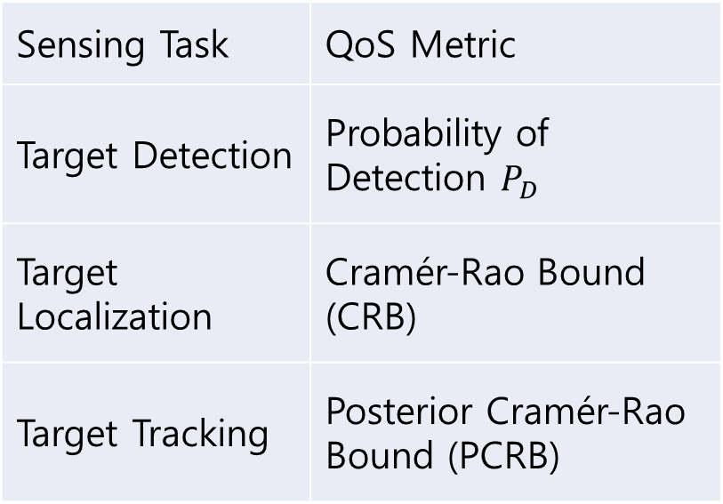
Introduction
Contribution 2 : Sensing QoS Definition
  Task-specific sensing QoS
  Detection
    Probability of detection
    Probability of false alarm
  Localization
    CRB
  Tracking
    PCRB
Sensing Task | QoS Metric
Target Detection | Probability of Detection $P_{D}$
Target Localization | Cramér-Rao Bound (CRB)
Target Tracking | Posterior Cramér-Rao Bound (PCRB)

Slide 18
Introduction
Tracking QoS
  Metric:
    PCRB
  Target states
    Range
    Angle
    Velocity
    Position
  Closed-loop tracking:
    EKF(Extended Kalman Filter)
Moving-object tracking concept
predicted
current
EKF
Estimate target state over time

Slide 19
Introduction
Contribution 3: Optimization Approach
  Optimization criteria
    Fairness: balance QoS
    Comprehensiveness: maximize overall performance
  Problem transformation
    Original formulation to convex form
  Solver: Alternative Optimization (AO)

Slide 20
Introduction
Alternative Optimization Method
  Coupled variables
    Power allocation
    Bandwidth allocation
  AO procedure
    Fix bandwidth to optimize power
    Fix power to optimize bandwidth
    Repeat until convergence

Slide 21
Introduction
Contribution 4 : Numerical Trade-off Analysis
  Simulation focus
    Sensing vs. communication services
    Trade-offs among users
    Impact of allocation schemes
  Main insight
    Limited power and bandwidth must follow QoS priorities

