Slide 1
Sensing as a Service in 6G Perceptive Networks: A Unified Framework for ISAC Resource Allocation
Authors: Fuwang Dong, Fan Liu, Yuanhao Cui, Wei Wang, Kaifeng Han, and Zhiqin Wang
Published in: IEEE Transactions on Wireless Communications
Date of Publication: 10 November 2022

Slide 2
Table of Contents
Abstract
Introduction

Slide 3
Abstract
Background Sensing as a Service in 6G
  Future 5G-Advanced and 6G networks are expected to provide not only communication services but also sensing services.
  This new concept is known as Sensing as a Service, where the network can detect, localize, and track targets.
  A perceptive network is introduced as a new paradigm that jointly supports:
    Sensing
    Communication
  This joint technology is commonly referred to as Integrated Sensing and Communications (ISAC).

Slide 4
Abstract
Sensing QoS Metrics for Different Applications
  The paper introduces the concept of sensing Quality of Service (QoS) for different sensing tasks.
  Different sensing applications require different performance metrics:
    These metrics allow the network to evaluate sensing performance in a more application-specific way.
Sensing Task | QoS Metric
Target Detection | Probability of Detection
Target Localization | Cramer-Rao Bound (CRB)
Target Tracking | Posterior Cramer-Rao Bound (PCRB)

Slide 5
Abstract
Unified ISAC Resource Allocation Framework
  The paper proposes a unified resource allocation framework for ISAC networks.
  The framework allocates limited network resources such as:
    Power
    Bandwidth
  Two optimization criteria are considered:
    Fairness optimization: balances performance among different sensing and communication services.
    Comprehensiveness optimization: improves the overall performance of sensing and communication.
  Simulation results show the trade-off between sensing and communication services under different resource allocation schemes.

Slide 6
Introduction
Motivation
  Traditionally, wireless cellular networks focused mainly on communication QoS.
  In 5G-Advanced and 6G, sensing services will become highly important.
  Future networks must support environment-aware applications.
  Examples:
    Connected vehicles
    Drone monitoring
    Smart manufacturing
Limitations of Current Cellular Sensing
  Current cellular networks can provide limited sensing functions such as localization.
  However, two major limitations exist:
    Low sensing accuracy and resolution
    Mostly device-based localization
  Device-based sensing requires the target to carry a signaling device.
  Future networks need to sense device-free objects.

Slide 7
Introduction
Perceptive Network and ISAC
  A perceptive network provides both:
    Wireless communication
    Networked sensing
  This is enabled by Integrated Sensing and Communication (ISAC).
  ISAC allows the cellular infrastructure to detect, localize, and track objects.
  It supports emerging 6G applications requiring both connectivity and sensing
Evolution of ISAC
  ISAC was initially motivated by the need for additional spectrum resources.
  It enables shared use of frequency bands between radar and communication systems.
  Research has evolved through:
    Radar-communication spectral coexistence
    Radar-communication cooperation
    Dual-functional radar-communication design

Slide 8
Introduction
Main Gains of ISAC
  ISAC provides two major gains:
  1. Integration Gain
    Shared use of limited resources:
      Spectrum
      Energy
      Hardware platforms
  2. Coordination Gain
    Sensing and communication can mutually assist each other.
    This can improve the overall performance of both services.
Sensing QoS Concept
  Communication QoS is already well studied.
  Common communication QoS metrics include:
    Spectral efficiency
    Energy efficiency
    Bit error rate
    Symbol error rate
  However, sensing QoS is still relatively unexplored.
  This paper defines sensing QoS for different sensing applications.

Slide 9
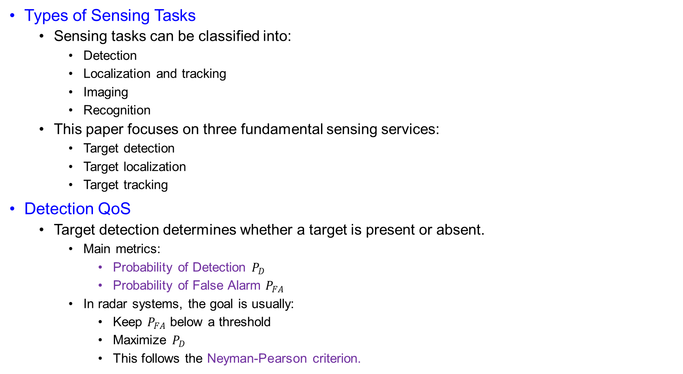
Introduction
Types of Sensing Tasks
  Sensing tasks can be classified into:
    Detection
    Localization and tracking
    Imaging
    Recognition
  This paper focuses on three fundamental sensing services:
    Target detection
    Target localization
    Target tracking
Detection QoS
  Target detection determines whether a target is present or absent.
    Main metrics:
      Probability of Detection $P_{D}$
      Probability of False Alarm $P_{FA}$
    In radar systems, the goal is usually:
      Keep $P_{FA}$ below a threshold
      Maximize $P_{D}$
      This follows the Neyman-Pearson criterion.

Slide 10
Introduction
Localization QoS
  Localization estimates the position or parameters of a static target.
  Important parameters include:
    Time delay
    Angle of arrival
    Range
  The direct metric is MSE, but it is often difficult to characterize.
  Therefore, the paper uses Cramer-Rao Bound (CRB).
  Lower CRB means better localization accuracy.
Tracking QoS
  Target tracking estimates the state variation of a moving target.
  Target states may include:
    Range
    Angle
    Velocity
    Position
  Tracking is important in high-mobility scenarios such as V2X.
  The paper uses Posterior CRB (PCRB) for tracking QoS.
  PCRB uses both measurement data and prior state information.

Slide 11
Introduction
Different Sensing QoS Requirements
  Different users or targets may require different sensing QoS.
  High sensing QoS is required for:
    Pedestrians
    Fast-moving vehicles
    Sensitive or safety-critical targets
  Lower sensing QoS may be acceptable for:
    Static objects
    Inanimate objects
  The base station should allocate resources according to different S&C needs.

Slide 12
Introduction
Need for Resource Allocation
  More transmit resources usually improve sensing and communication QoS.
  However, practical resources are limited.
  Important limited resources include:
    Transmit power
    Bandwidth
  Limited resources create performance trade-offs among users.
  Efficient resource allocation is necessary to optimize QoS performance.

Slide 13
Introduction
Communication Resource Allocation
  Communication achievable rate depends on power and bandwidth.
  This follows Shannon’s theorem.
    Resource allocation has been widely studied in:
      OFDM systems
      LTE-Advanced D2D communication
      5G network slicing
      NOMA systems
    In OFDM, water-filling can optimally allocate power among subcarriers.
Sensing Resource Allocation
  Compared with communication, sensing resource allocation is less explored.
  Existing sensing RA studies include:
    Multibeam and power allocation for tracking
    Dwell time allocation in phased-array radar
    Power and bandwidth allocation to minimize PCRB
  These works show that sensing performance also depends strongly on resource allocation.

Slide 14
Introduction
ISAC Resource Allocation Gap
  Some ISAC resource allocation works already exist.
  Examples include:
    Power allocation between radar waveform and information signal
    OFDM-ISAC power allocation using mutual information
  However, previous works mainly focus on specific scenarios.
  Most works focus only on power allocation.
  A general network-level joint allocation of power and bandwidth for ISAC remains underexplored.
Main Research Gap
  Communication RA is well developed.
  Sensing RA is still limited.
  ISAC RA is not yet fully generalized.
  Joint allocation of different resources, such as power and bandwidth, is still an open problem.
  This motivates a unified ISAC resource allocation framework considering both sensing QoS and communication QoS.

Slide 15
Introduction
Motivation of This Work
  Conventional resource allocation schemes mainly focus on:
    Performance trade-off among communication users
    Performance trade-off among radar/sensing targets
  However, in a perceptive network, another important trade-off must be considered:
    Sensing service vs. Communication service
    Different users may require different sensing and communication QoS levels.
    Therefore, resource allocation should be designed according to user-specific QoS demands.
Unique Challenge in ISAC Resource Allocation
  The same resource may have different importance for sensing and communication services.
    For communication:
      More power can improve SINR and achievable rate.
      More bandwidth can improve data transmission rate.
    For sensing:
      More power can improve detection and estimation accuracy.
      More bandwidth can improve sensing resolution and localization/tracking accuracy.
  Therefore, ISAC resource allocation creates new challenges and opportunities for 6G network design.

Slide 16
Introduction
Considered System Model
  This paper considers a single-cell ISAC system.
  A MIMO base station (BS) provides:
    Communication service
    Device-free sensing service
  The BS simultaneously serves communication users and senses objects/targets.
  The paper focuses on joint allocation of:
    Transmit power
    Bandwidth
  Cooperative sensing in multi-cell ISAC systems is left for future work.

Slide 17
Introduction
Contribution 1: Unified ISAC RA Framework
  The paper establishes a general resource allocation framework for 6G perceptive networks.
  The framework considers the trade-off between:
    Communication service
    Sensing service
  Different sensing services are considered, including:
    Target detection
    Target localization
    Target tracking
  The BS can provide communication and device-free sensing services according to user-specific QoS requirements.

Slide 18
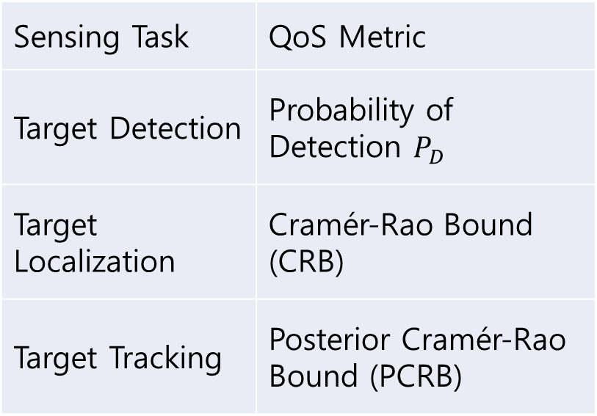
Introduction
Contribution 2 : Sensing QoS Definition
  The paper defines sensing QoS for different sensing tasks.
  Different metrics are used for different sensing services:
    These metrics allow sensing performance to be evaluated in an application-specific manner.
Sensing Task | QoS Metric
Target Detection | Probability of Detection $P_{D}$
Target Localization | Cramér-Rao Bound (CRB)
Target Tracking | Posterior Cramér-Rao Bound (PCRB)

Slide 19
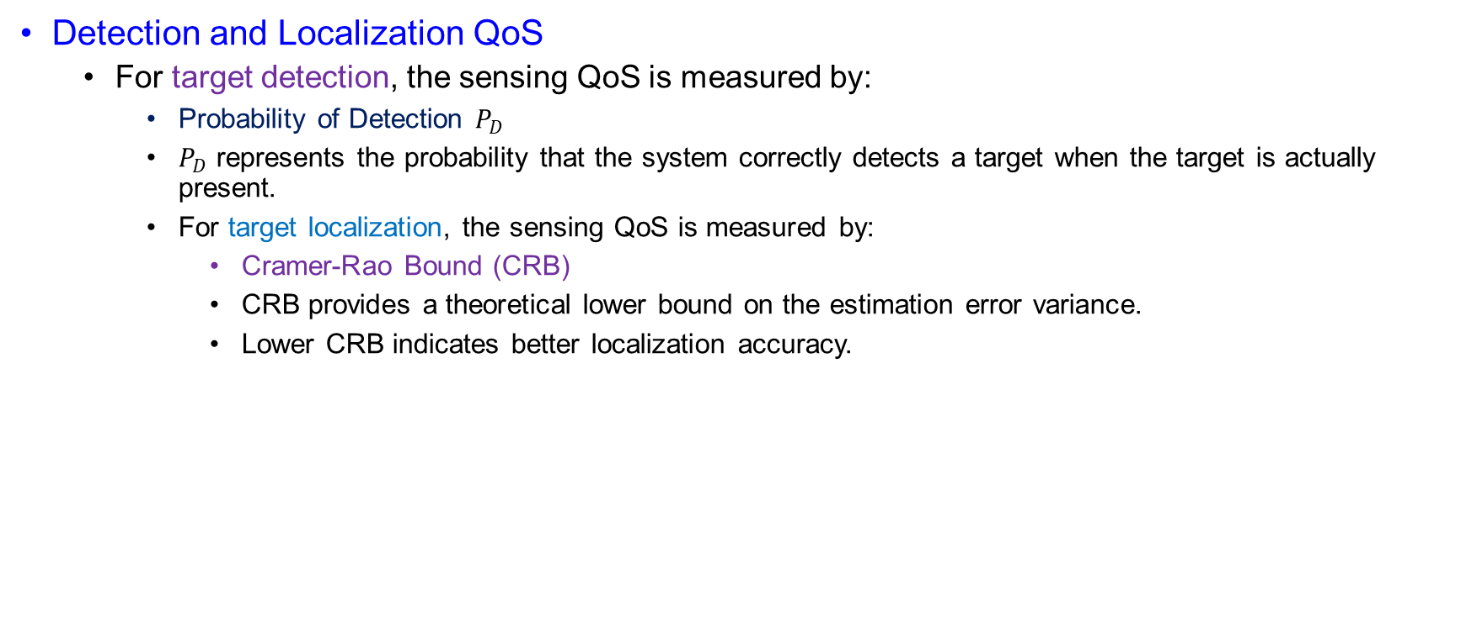
Introduction
Detection and Localization QoS
  For target detection, the sensing QoS is measured by:
    Probability of Detection $P_{D}$
    $P_{D}$ represents the probability that the system correctly detects a target when the target is actually present.
    For target localization, the sensing QoS is measured by:
      Cramer-Rao Bound (CRB)
      CRB provides a theoretical lower bound on the estimation error variance.
      Lower CRB indicates better localization accuracy.

Slide 20
Introduction
Tracking QoS
  For target tracking, the paper uses:
    Posterior Cramer-Rao Bound (PCRB)
    Tracking is used to estimate the state variation of moving targets.
    Target states may include:
      Range
      Angle
      Velocity
      Position
    The paper establishes:
      State model
      Measurement model
      PCRB expression
    An Extended Kalman Filtering (EKF) scheme is adopted to construct a closed tracking loop.

Slide 21
Introduction
Contribution 3: Optimization Approach
  The paper proposes effective approaches to solve the ISAC resource allocation problems.
  Two optimization criteria are considered for each sensing task:
    1. Fairness Criterion
      Balances QoS among different users or services.
    2. Comprehensiveness Criterion
      Improves the overall sensing and communication performance.
    The original optimization problems are transformed into convex forms.
    Then, an Alternative Optimization (AO) method is adopted.

Slide 22
Introduction
Alternative Optimization Method
  The resource allocation problem involves coupled variables:
    Power allocation
    Bandwidth allocation
  Directly solving the joint problem can be difficult.
  The AO method decouples the variables and optimizes them alternatively.
  Basic idea:
    Fix bandwidth and optimize power
    Fix power and optimize bandwidth
    Repeat until convergence
  This makes the problem easier to solve efficiently.

Slide 23
Introduction
Contribution 4 : Numerical Trade-off Analysis
  The paper analyzes the performance trade-off through numerical simulations.
  The simulations study:
    Trade-off between sensing and communication services
    Trade-off among different users
    Impact of different resource allocation schemes
  The results show how limited power and bandwidth should be allocated to satisfy both sensing and communication QoS.

