Slide 1

Car Sales: A Data-Driven Journey Through 2023
As we closed out 2023, the auto industry showed remarkable resilience. Our comprehensive dashboard reveals how the year unfolded across regions, brands, and models.
This analysis offers clear insights into sales performance, customer preferences, and market dynamics.

Slide 2

Year in Review: Numbers That Drive the Story
$371.2M
$28K
YTD Total Sales
Average Sale Price
23.59% growth from previous year
Slight dip of 0.79%
13.3K
Total Units Sold
19.73% increase year-over-year

Slide 3








Understanding Market Trends: Who's Buying What
SUVs
Market leader
Sedans
Strong second position
Passenger Cars
Solid mid-market presence
Hatchbacks & Hardtops
Smaller market share

Slide 4
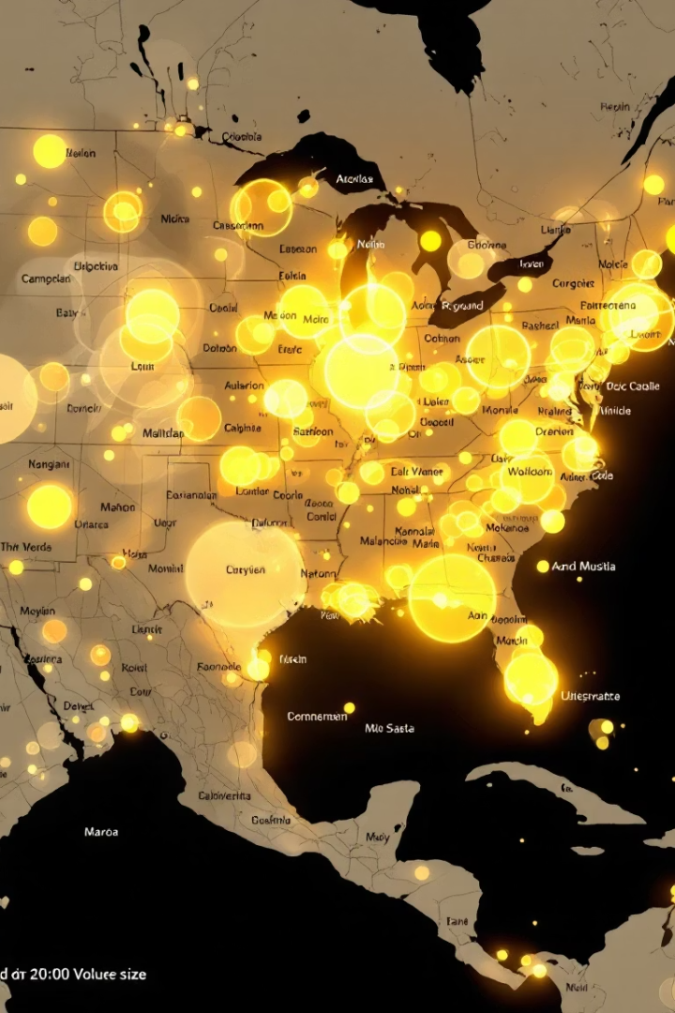
Geographical Insights: Where the Sales Happened
Top Performers
Strong Contenders
Janesville and Pasco led regional sales. These cities showed exceptional dealer network strength.
Greenville and Austin demonstrated consistent performance. Their market presence continued to grow.
Rising Stars
Middletown showed promising growth. New dealership strategies yielded positive results.

Slide 5
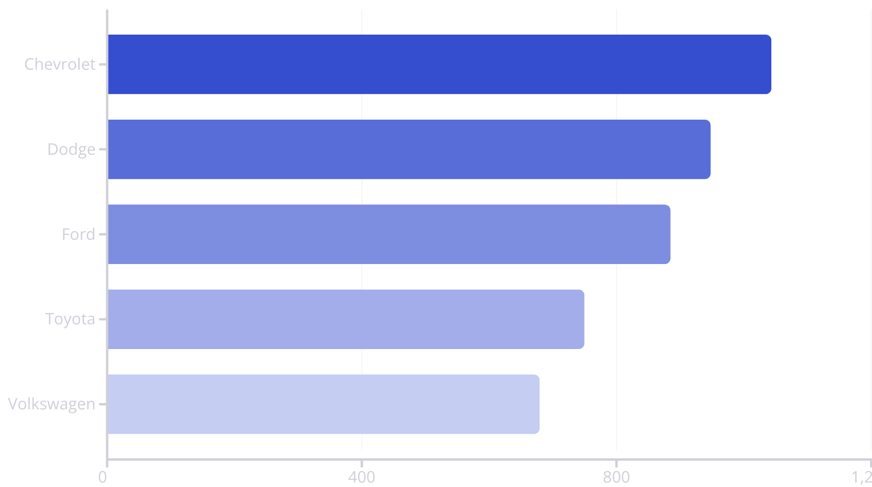
Top Performing Brands: The Leaders of the Pack

Slide 6
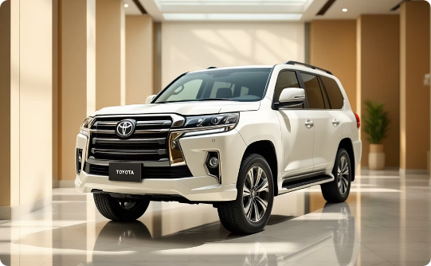
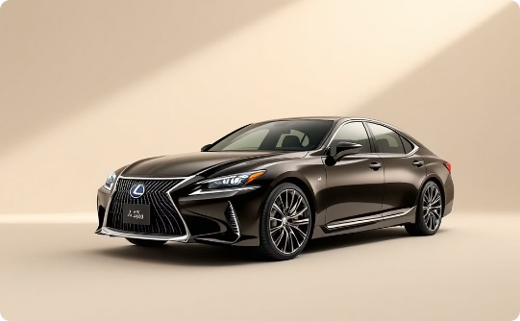
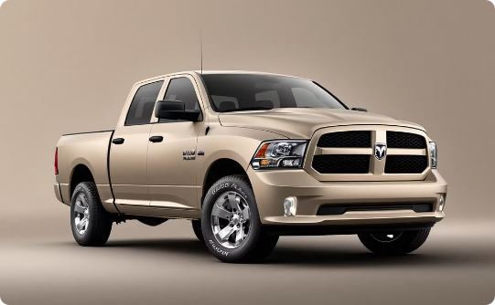
A Closer Look: Customer-Level Insights
Premium Segment
Luxury Sedans
High-End Utility
Toyota's Land Cruiser reached $210K. This luxury vehicle topped our individual sales.
Lexus LS400 at $69K demonstrated continued luxury sedan appeal.
Dodge's Ram Pickup hit $45.5K. Utility vehicles maintained strong pricing.

Slide 7





Key Takeaways
Strong Growth
Over $70 million added in YTD sales.
Clear Preferences
SUVs and neutral colors dominated consumer choices.
Brand Leaders
Chevrolet emerged as top performer in units and revenue.
Regional Impact
Specific dealer regions drove critical sales volume.

