Slide 1
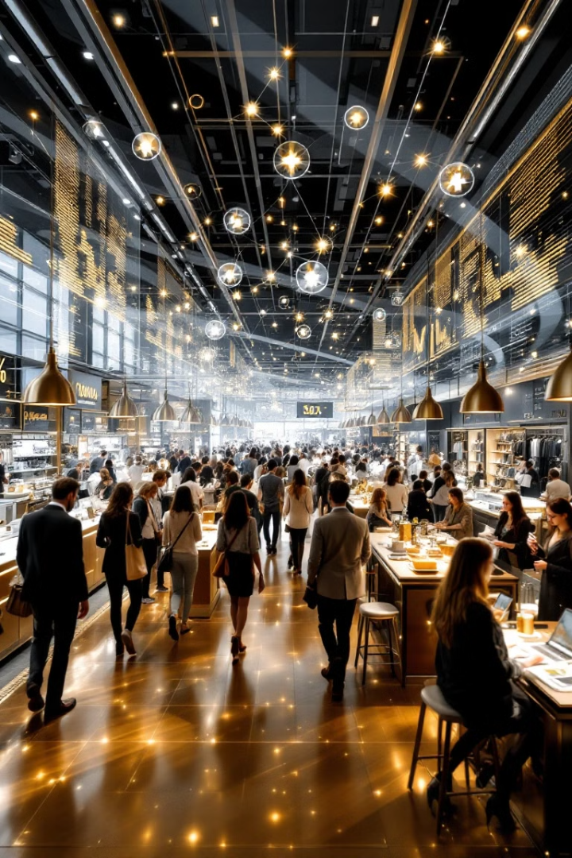

Unlocking Customer Insights: K-means Clustering for Retail Analytics
In the complex world of retail, understanding customer behavior is crucial for business success. This presentation explores how K-means clustering can transform raw purchase data into actionable customer insights.
We'll journey through the process of applying this powerful machine learning technique to segment retail customers based on their spending patterns and income levels, revealing hidden patterns that can drive targeted marketing strategies and personalized customer experiences.
by Aiyede Sunday

Slide 2

Setting the Foundation: Data Preparation
200
4
0
Customer Records
Key Features
Missing Values
Total dataset size analyzed
Gender, Age, Income, Spending Score
Clean dataset with complete records
The analysis began with importing essential Python libraries—pandas for data manipulation, numpy for numerical operations, matplotlib for visualization, and sklearn for implementing the K-means algorithm. Our dataset, Mall_Customers.csv, contained comprehensive information about 200 retail shoppers.
Initial data exploration confirmed the quality of our dataset with no missing values, providing a solid foundation for our clustering analysis. The clean, structured nature of the data allowed us to move directly into feature selection and algorithm application.

Slide 3
Feature Selection: Finding the Right Variables
Annual Income (k$)
Spending Score (1-100)
Represents the customer's purchasing power and economic status. This variable helps identify potential high-value customers and those with budget constraints.
Measures actual purchasing behavior regardless of income level. This proprietary metric combines frequency, monetary value, and recency of purchases.
Reveals customer loyalty and engagement, identifying both frugal shoppers and impulsive buyers across different income segments.
Range varies from low-income to high-income brackets, allowing for meaningful segmentation across economic classes.
These two variables were selected as the primary features for our clustering analysis because they capture both the potential and actual spending behavior of customers. Together, they create a powerful framework for understanding the relationship between economic capacity and shopping preferences.

Slide 4








The Elbow Method: Determining Optimal Clusters
Calculate WCSS
Plot Results
Compute Within-Cluster Sum of Squares for different k values
Create visualization of WCSS vs. number of clusters
Select Optimal k
Identify "Elbow"
Choose the number of clusters at the bend point
Find the point where adding more clusters yields diminishing returns
The Elbow Method provides a systematic approach to determining the optimal number of clusters by plotting the Within-Cluster Sum of Squares (WCSS) against various cluster counts. As we add more clusters, the WCSS naturally decreases, but the rate of improvement slows at a certain point.
Our analysis revealed a distinct "elbow" at k=5, indicating that five clusters would efficiently capture the natural groupings in our data without overfitting. This scientific approach ensures we're applying the algorithm with the right parameters for meaningful results.

Slide 5




Applying K-means: The Clustering Process
Initialize Centroids
Randomly place k=5 centroids in the feature space
Assign Customers
Group each customer to the nearest centroid based on Euclidean distance
Recalculate Centroids
Update centroid positions to the mean of all points in each cluster
Iterate Until Convergence
Repeat assignment and recalculation until centroids stabilize
With our optimal number of clusters determined, we applied the K-means algorithm to our customer data. The process began with initializing five centroids in the feature space defined by Annual Income and Spending Score.
Through multiple iterations, customers were assigned to the nearest centroid, and centroids were recalculated until convergence was achieved. This iterative process ensured that each customer was placed in the most appropriate segment based on their purchasing characteristics.

Slide 6



Cluster Visualization: Bringing Insights to Life
Cluster 1: High Income, Low Spending (Red)
Cluster 2: Moderate Income, High Spending (Blue)
Cluster 3: Low Income, Low Spending (Green)
Affluent customers who despite their economic capacity, maintain conservative spending habits. Potential for targeted luxury marketing that emphasizes value and exclusivity.
Budget-conscious customers with matching spending patterns. Perfect targets for value offerings, promotions, and budget-friendly product lines.
Aspirational shoppers who prioritize retail experiences despite income constraints. Ideal for loyalty programs and premium product lines with flexible payment options.
The visual representation of our clusters transforms abstract data into actionable insights. Each cluster is marked with a distinct color, while yellow centroids represent the average characteristics of each group. This visualization makes complex patterns immediately apparent and accessible to business stakeholders.

Slide 7

More Customer Segments: Completing the Picture
Cluster 4: Low Income, High Spending (Cyan)
Cluster 5: Moderate Income, Moderate Spending (Magenta)
Strategic Opportunities
Each cluster represents unique marketing opportunities:
These customers prioritize shopping experiences despite financial limitations. They may be:
The balanced middle segment represents practical shoppers who are:
Tailored communication strategies
Careful in their purchasing decisions
Personalized product recommendations
Young professionals building their lifestyle
Responsive to value propositions
Customized promotions and incentives
Trend-focused shoppers who save elsewhere
Consistent but not impulsive buyers
Occasional splurge shoppers seeking experiences
Understanding these additional segments completes our customer portrait, revealing the full spectrum of shopping behaviors across income levels. Each cluster represents a unique opportunity for tailored marketing approaches and personalized customer experiences.

Slide 8





From Insights to Action: Strategic Applications
Strategic Decision Making
Data-driven business planning
Targeted Marketing
Personalized campaigns for each segment
Store Layout Optimization
Physical space designed for cluster preferences
Product Assortment Planning
Inventory tailored to cluster demands
Staff Training & Deployment
Service approach customized to each group
The true value of customer clustering emerges when insights translate into action. Retailers can now develop targeted strategies for each customer segment, from personalized marketing messages to customized product offerings that resonate with specific cluster preferences.
By understanding the unique characteristics of each customer group, businesses can optimize resource allocation, enhance customer experiences, and build stronger relationships. This data-driven approach transforms customer understanding from an abstract concept into a concrete competitive advantage in today's retail landscape.

