Slide 1

Security and Network Vulnerabilities
Dave Goodell, Nasko Oskov, Chris Clausen

Slide 2
What is Security?
Restricting information from parties who should not have access to it.
Maintaining control of resources, like computers and networks, such that malicious users cannot exploit them.

Slide 3
Good Passwords
Good passwords are the starting point for lots of systems. Poor password choice leaves you open to simple guessing and potential dictionary attacks.
Good passwords should have non-alphanumeric characters as well as a mix of uppercase and lowercase letters and numbers. Passwords should also be as long as is feasible and allowed by the system (8 characters on most UNIX systems).

Slide 4
File Permissions
Essential to system security... Imagine if someone was allowed to change your password file, or alter network configurations.
Implemented differently on different operating systems.

Slide 5

Permissions - UNIX
Model has been around since UNIX was created over 30 years ago, has a few weaknesses.
Four groups (special, user, group, and other) of three bits (read, write, and execute for the last three groups).

Slide 6
Permissions - ACLs
Access Control Lists give you more flexibility than the UNIX approach.
ACL lists users (or groups of users) and the permissions they have (read, write, execute, etc).
Different filesystems provide varying levels of granularity. Some only allow ACLs on directories, others allows files too.

Slide 7
Permissions - Windows
Uses a very customizable ACL system.
Pre-set permissions: read, write, read & execute, modify, full control
Custom ACLs can be setup using ‘cacls’ or ‘xcacls’

Slide 8
Keeping Up to Date
Windows Update
RedHat Network / up2date
Debian ‘apt-get update’
Mac OS X System Updater

Slide 9
Networking Review
IP addresses (Internet Protocol)
TCP/UDP ports
Ethernet + MAC addresses
switched vs repeated networks

Slide 10
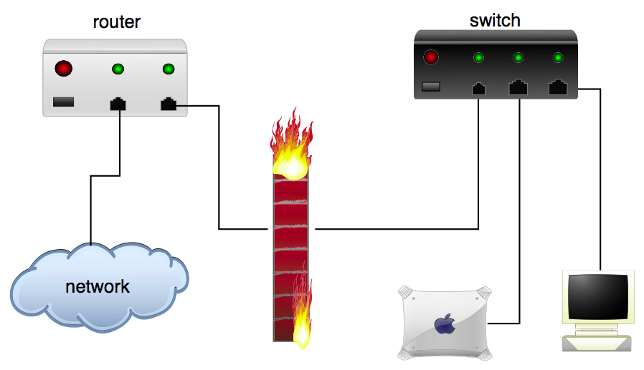

Slide 11
Switched Networks... Truly Safe?
At first glance, switched networks seem to solve the problems associated with repeated (hubbed) networks.
ARP poisoning allows you to sniff packets that switching would normally prevent you from seeing.

Slide 12
Encryption is the Key
Encryption is essential for security in modern systems. Using ssh instead of telnet, pgp instead of unsigned/unencrypted email, etc...
HOWEVER, encryption is no substitute for good security practices. SSH won’t matter a whole lot if your password is sitting on a post-it note on your monitor.

Slide 13
Tunneled Services
Tons of services can be tunneled over encrypted channels.
SSH tunneling can encrypt arbitrary network connections, SSL (Secure Socket Layer) allows for secure email and web access (among other things).

Slide 14
Firewalls
Provide control over the network connections into and out of a network or machine.
Firewalls are not the magic beans of security... just as with any other technology discussed, good security practices in general are needed too.

Slide 15
Firewalls on Various Platforms
ipfw/ipfilter/pf on *BSD
ipfw on Mac OS X
iptables/ipchains/ipfwadm on linux
checkpoint on Solaris
Zone Alarm, builtin (XP & 2003) on Windows

Slide 16
Network Address Translation (NAT)
Allows multiple devices to use one IP address.
Available in most home routers.
Great “poor man’s security” tool.
Not perfect, some things need a globally routable address.

Slide 17
Wi-Fi Networking
Wireless access points are becoming more and more prevalent today.
Unlike a wired system, where you can keep someone from getting direct access to your network through physical security, someone can sit outside your room/area and listen to the radio signals being broadcast.

Slide 18
WEP is One Option
Wired Equivalent Privacy attempts to increase your security in the data link layer.
One of the major flaws is that the RC4 implementation used in most access points is weak.
Still useful because it substantially complicates an attacker’s life.

Slide 19
MAC Addresses and Other Options
Most wi-fi access points allow you to restrict access to a set of MAC addresses.
Basically security through obscurity, because an attacker can always set his MAC address to be whatever he wants.
VPN, Radius authentication, 802.1x are more expert options.

Slide 20
Questions?

