Slide 1
Git
…for the rest of us
David Turner
Senior Developer
Christ’s Church of the Valley
Email: DavidTurner@ccvonline.com

Slide 2
History
git
N Brit slang
1. a contemptible person, often a fool
2. a bastard
“I'm an egotistical bastard, and I name all my projects after myself. First ‘Linux’, now ‘git’.”
- Linus Torvalds

Slide 3
Benefits
Distributed Repository
Open Source
Fast
Easy Branching/Merging

Slide 4
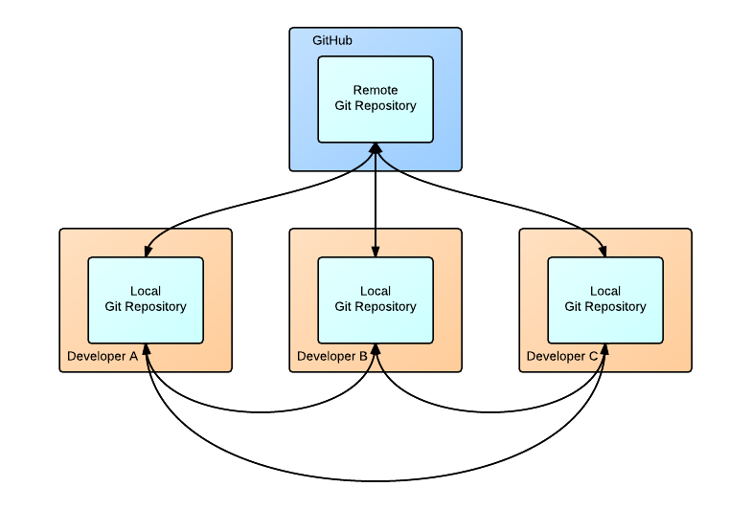
Distributed

Slide 5
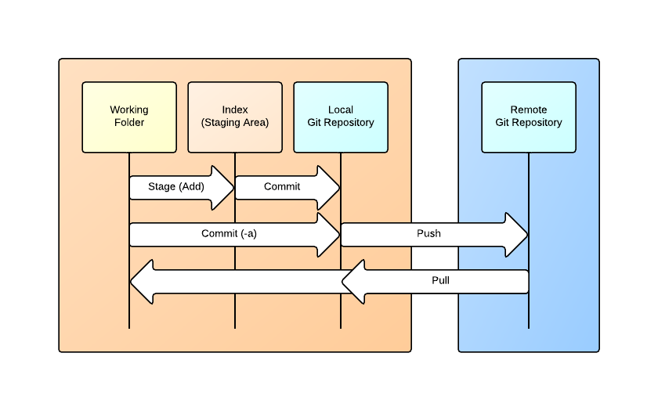
Work Flow
Notes:
.Index and Repository are stored in the .git folder of your working folder area

Slide 6
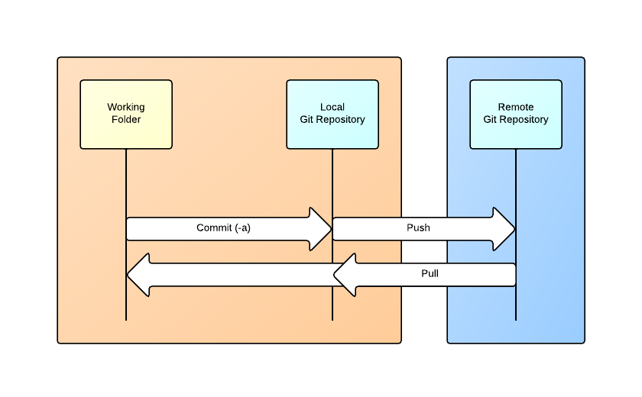
Normal Work Flow

Slide 7
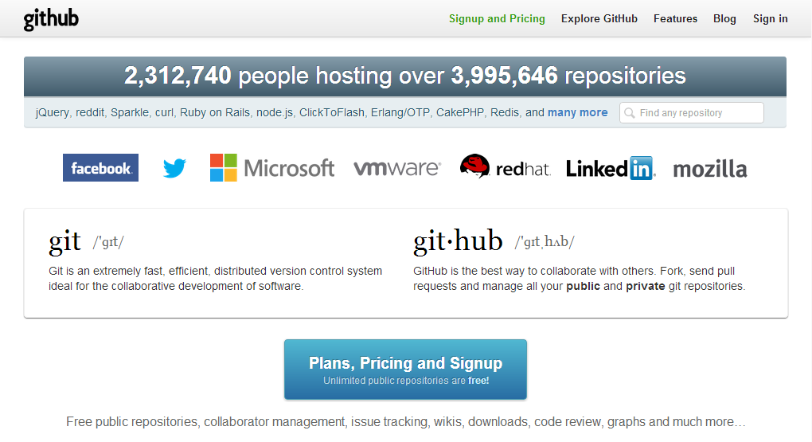
github
https://github.com/

Slide 8
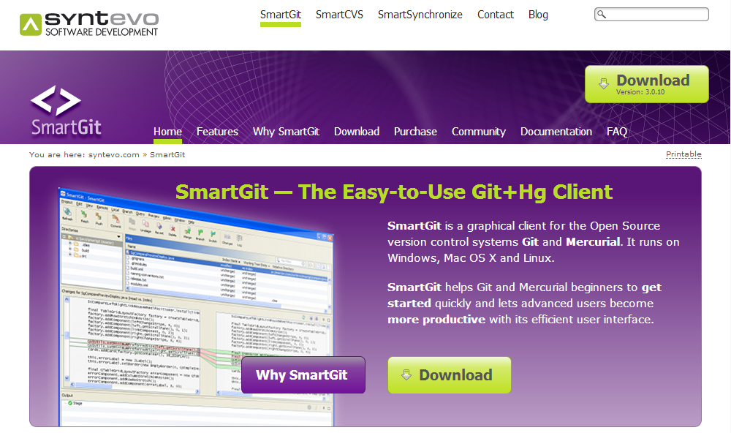
SmartGit
http://www.syntevo.com/smartgit/index.html

Slide 9
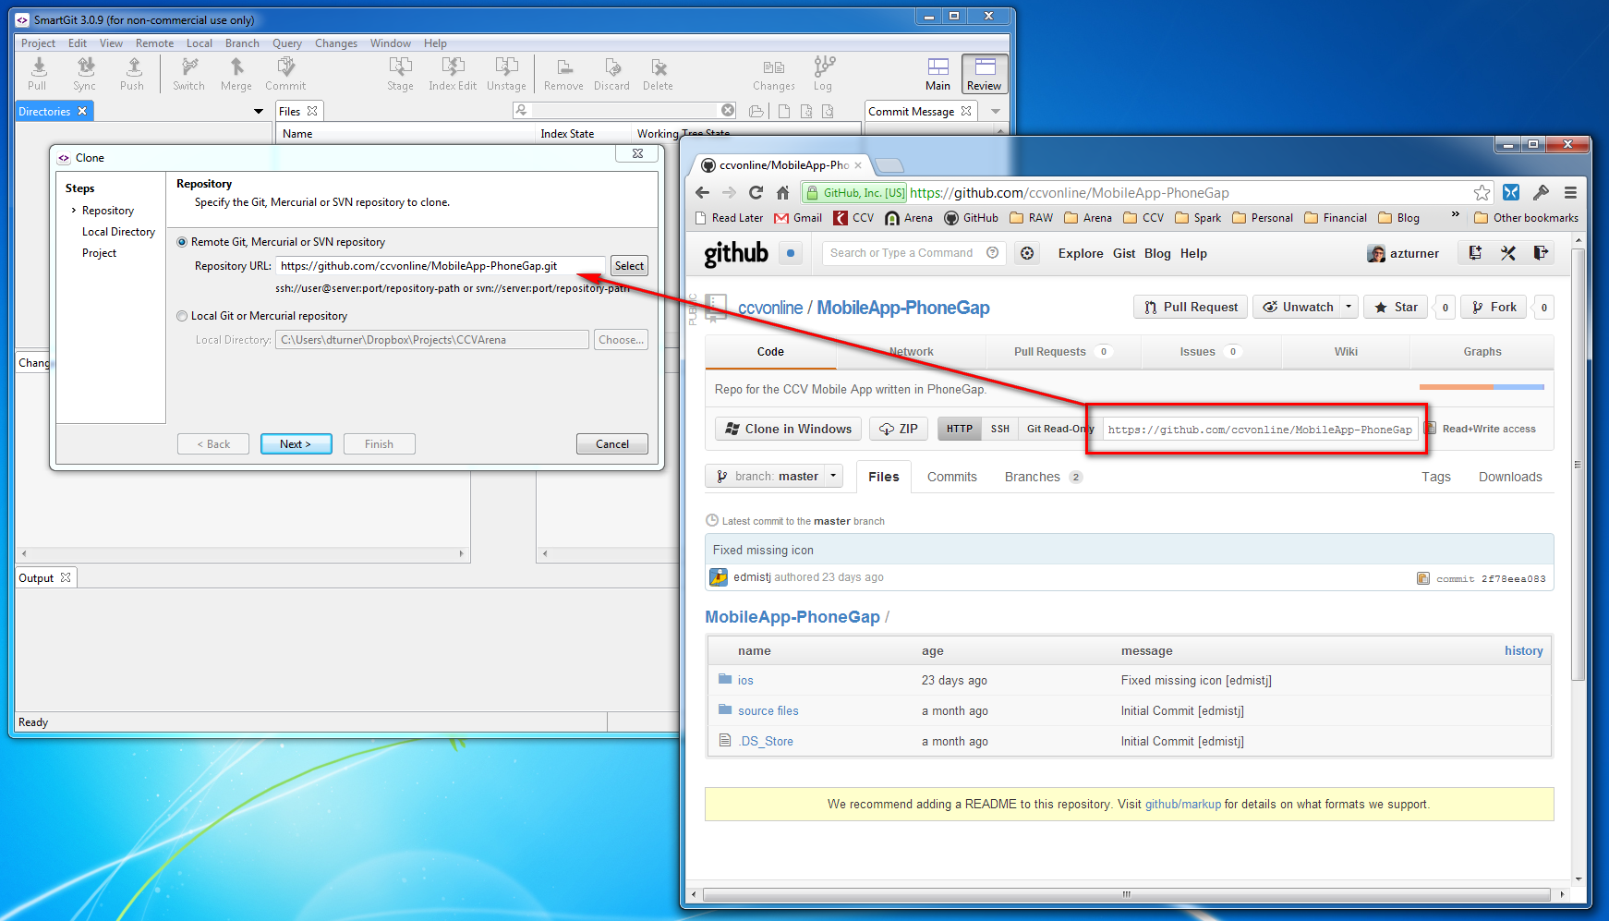
Clone

Slide 10
Demo…
Pull
Edit
Commit
Pull
Push
Branch
Switching Branches
Merge
Delete Branch

Slide 11
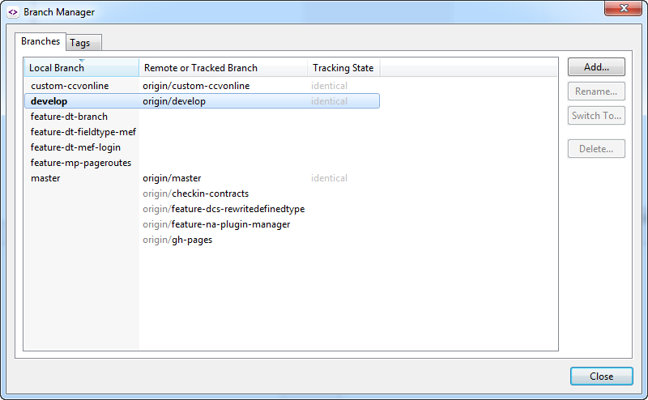
Branch Manager

Slide 12
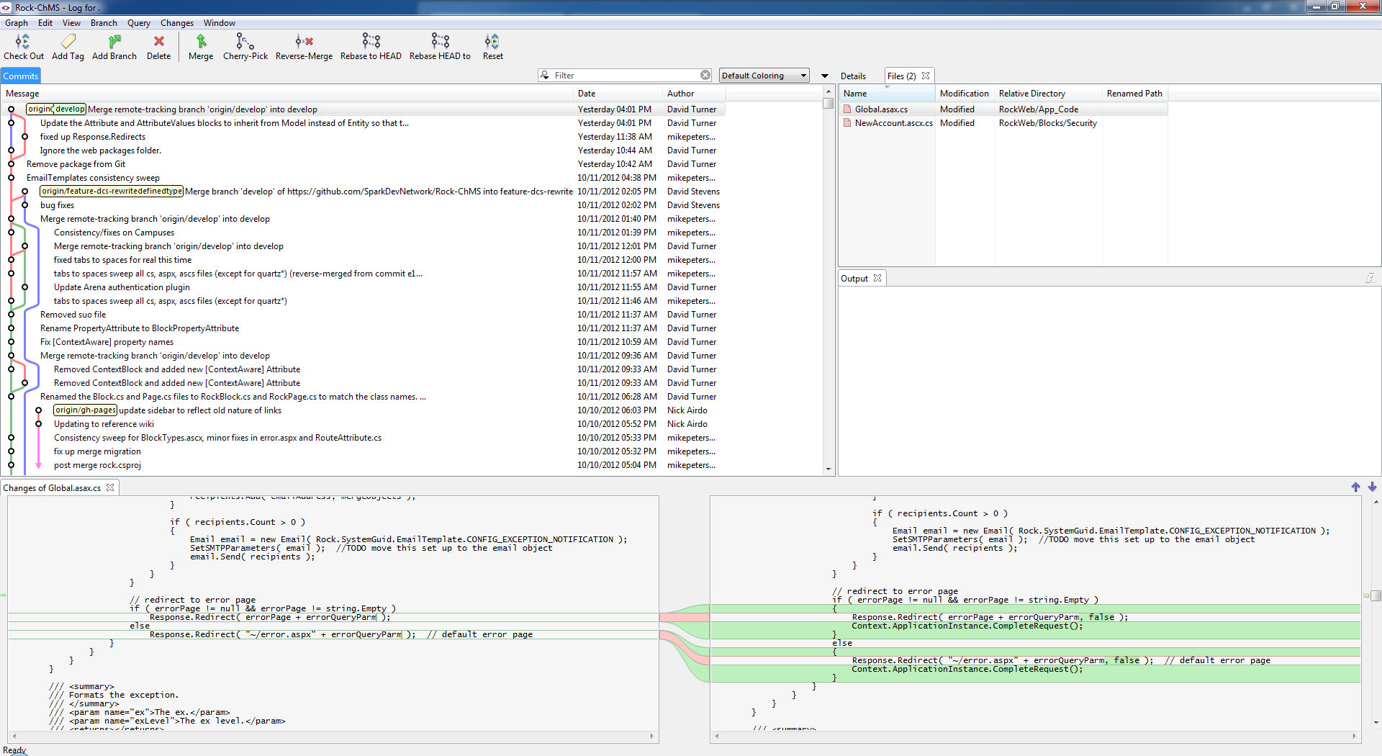
Log
Notes:
Show branch selection
Diffs
Branch coloring

Slide 13
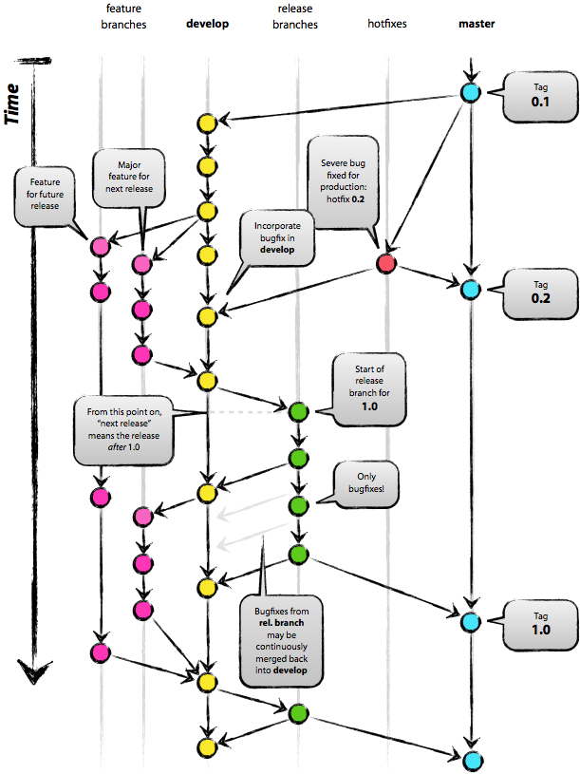
Branching Strategy
http://nvie.com/posts/a-successful-git-branching-model/

