Slide 1
.NET Migrations
Entity Framework Code-First Migrations
David Turner
Senior Developer
Christ’s Church of the Valley
Email: DavidTurner@ccvonline.com

Slide 2
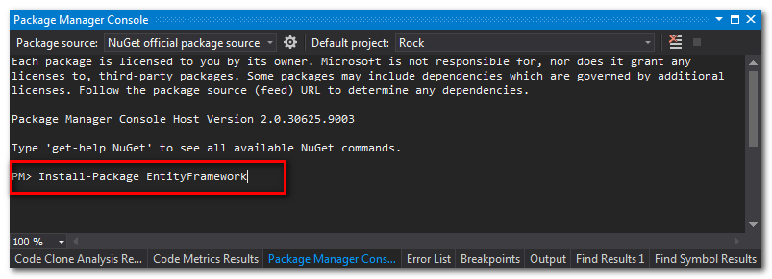
Entity Framework
Tools > Library Package Manager > Package Manager Console

Slide 3
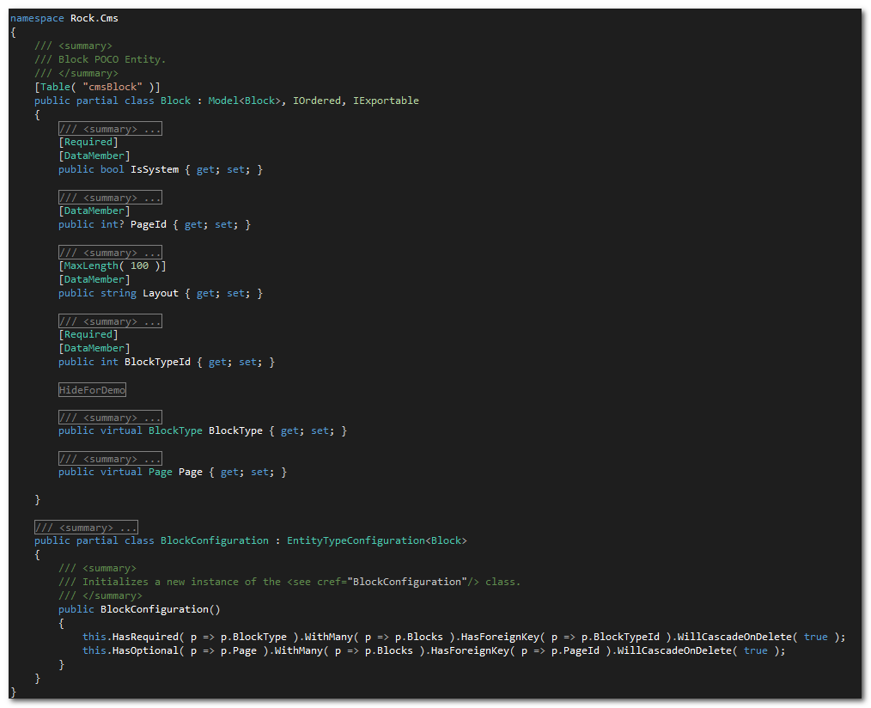
Code-First Model (POCO)

Slide 4
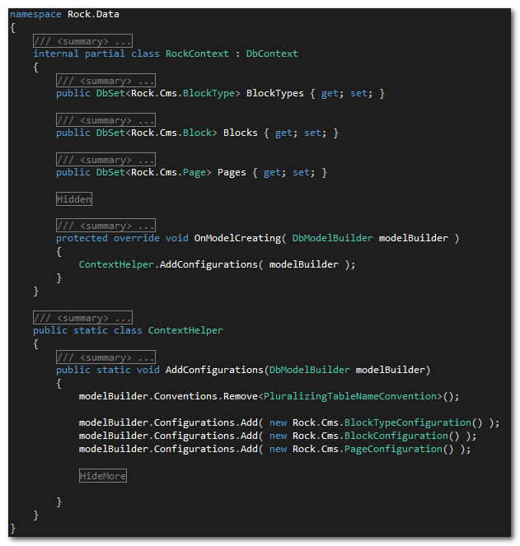
dbContext

Slide 5
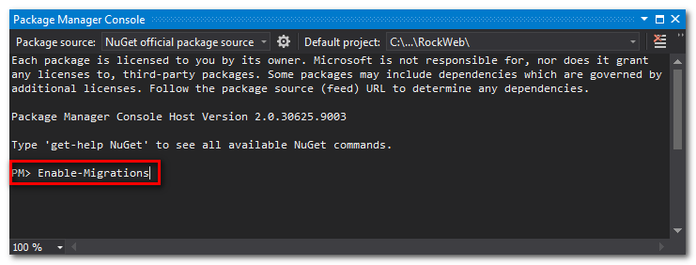
Enabling

Slide 6
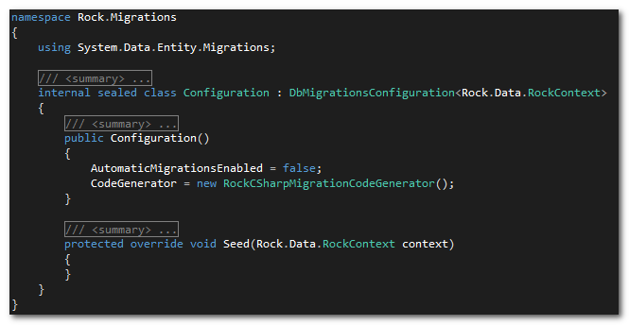
Configuration
Notes:
Enabling, creates migrations folder with two files, configuration and an initial create migration

Slide 7
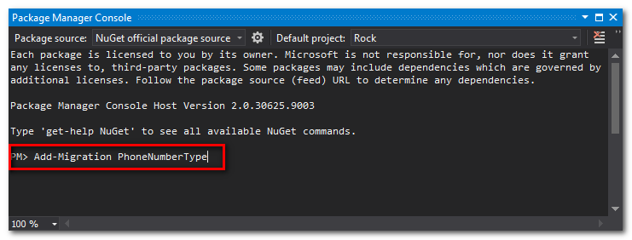
Add Migration

Slide 8
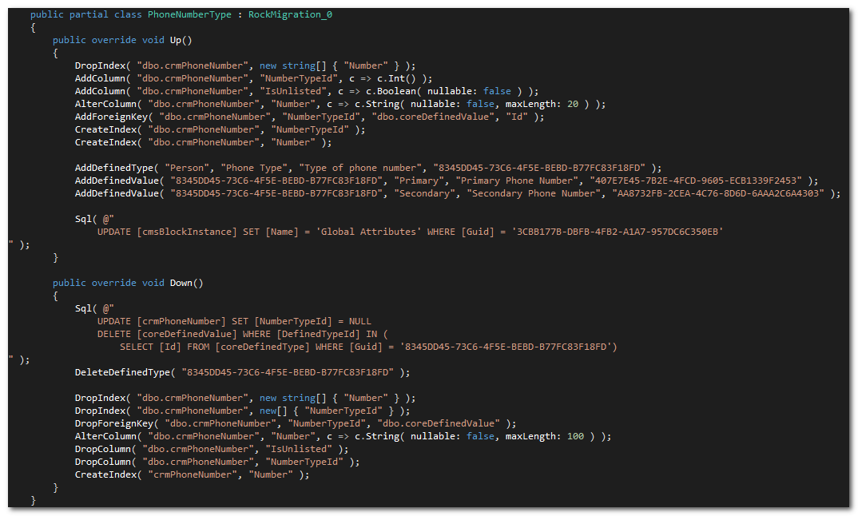
Customizing

Slide 9
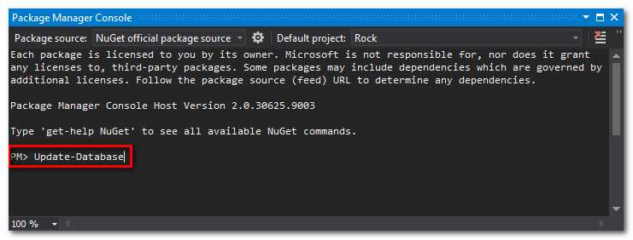
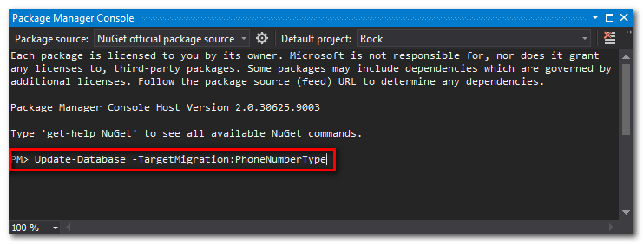
Run Migration

Slide 10
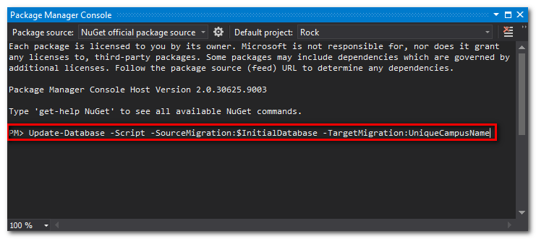
SQL Script

Slide 11
Reference
http://msdn.microsoft.com/en-us/data/jj591621

