Slide 1
HackNight

Slide 2
HackNight Brainstorming
Problem: Describe the problem or need.
Abstract: In a sentence or two, briefly describe what the module supposed to do.
Design Details: tell us as much detail about the design as possible. I.e., is it a single module on a page, or several modules on several pages or something else. Describe how each part is supposed to work.

Slide 3
Idea: ________________________
Problem: __________________________________ _______________________________________ _______________________________________
Abstract: __________________________________ _______________________________________ _______________________________________
Design: ___________________________________ _______________________________________ _______________________________________

Slide 4
Afterwards
We’ll review everyone’s ideas
Then assemble into teams

Slide 5
HackNight Coordinators ™
Someone on the team becomes the coordinator
They ask the idea creator if clarity is needed
They help the team break the idea into component parts and then into tasks
They help the team to work through tasks

Slide 6
Arena Projects
By Bill Wood, Arena HackNight Idea Creator ™

Slide 7
New Arena Poll Module
Problem: Arena’s poll module is useful but needs adjustment. It does not store if a person has taken part in a poll. If they wanted to change their answer, they would have to submit one point for every other answer and then an additional one for the correct answer they choose.
Abstract: Store which person choose which answer on which poll. This is only useful for logged in users.
Design Details: Table that will store person_id, poll_id, and poll_answer_id. When they see the poll their answer is auto selected from the previous time they polled. Also should have a override button for admins if they want to continue to use the same poll_id and have it seem like it’s a brand new poll.

Slide 8
Benevolence Module
Problem: No free way to track baby item donations to our Value Life Ministry
Abstract: A module that will allow a (non-monetary) donation to be recorded within Arena. The donation will have attributes to store who donated the item as well as whom the item was given to. Each item will have some attribute that will show what the item was donated for.
Design Details: Two new tables in the database will be created. One for recording the time, and the other for recording maybe the ministry it was donated to (or just a category). Two module will be required, one to list, sort, and filter the donations. The other would allow you to create/update a new donation. Potentially a framework would be nice so people could reach the donations in what ever custom modules they make in the future for this.

Slide 9
Drag & Drop Modules
Problem: Adding child pages and modules is tedious
Abstract: Module will act as a Module toolbox in Arena that allows an administrator to drag and drop a new module or new child page into the current page’s content section. The Module will operate similar to Visual Studio’s toolbox.
Design Details: Module sits on every page. When a user wants to load the toolbox, they click a toolbox link located in the administration section of the left side navigation. This act will populate a new toolbox menu that overlaps the navigation module with registered Arena modules. The toolbox will be organized in a parent > child expand/collapse list fashion and will only require the user to drag a selected module onto the page to be redirected to that modules custom information. The toolbox is not populated with modules until the administrator clicks “toolbox” to not slow down Arena. The toolbox could be an absolute positioned “DIV”. The drag-n-drop functionality is already built out in jQuery-UI but we can make it from scratch is we would like to.

Slide 10
Public Exception Handler Module
Problem: If an error is found on a live web-facing arena page, an arena administrator will need to route individuals to an alternate “in construction page” while they make the fix.
Abstract: Create a redirect module that bases view permission based on exceptions instead of top-down permissions. This allows a staff member to see what an arena administrator can not.
Detail: Create a redirect module with a text module setting that accepts either a role id, or a user id. Potentially sending over “construction” text from a text setting module so you can always route to the same page.

Slide 11
Available “Seats” Module
Problem: Registrants can’t see how many “seats” are still available for an Arena event registration.
Abstract: Module would show how many seats remain for the event.
Design Details: Module sits on event details or event registration page 1 (or any page that uses the “event” parameter and eventID value in the querystring). A single module grabs the event ID from the querystring and loads the event to see if there is a registration limit and if so, subtracts the number of currently registered (active, excludes inactive members) from the registration limit and displays the value in a DIV.

Slide 12
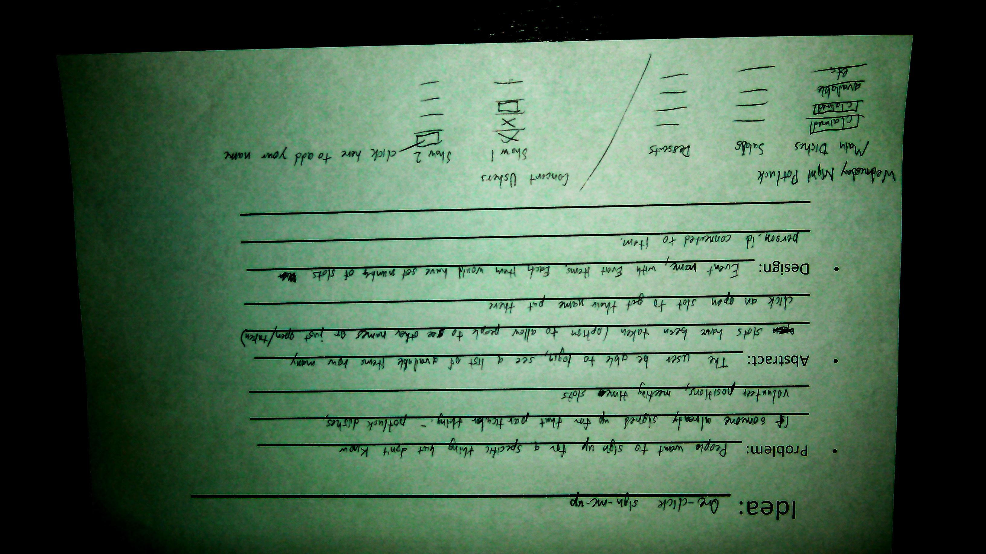

Slide 13
One Time Donation
Problem: Users have to log in to make a one time donation, this adds an extra step and is a bit of a hurdle for donations
Abstract: This should be an adjustment to the existing recurring donations module, however this module will not allow recurring donations, but will create a new person (which will later be merged), and then process a donation against that new person.
Design Details: see this: Front Page Giving.pdf.

Slide 14
MinistryPlatform Projects
By Chris Kehayias, MinistryPlatform HackNight Idea Creator ™

Slide 15
Rock Chms Projects
By TBD, RockChMS HackNight Idea Creator ™

Slide 16
Vuurr
Seo and analytics

Slide 17
Must Haves
Perfectly formatted
Name
Address
Phone number
Title tags
Descriptive
Meta description *mention this re: Arena templates
Use H1 tags

Slide 18
Off-site SEO
Links from other sites (beware of the Penguin update)
Yoast plugin for Wordpress (not as good as all-in-one)

Slide 19
Campuses: Locations Page
A page with Name, Address, Phone for each campus

Slide 20
URL formatting
Uses dashes, keywords, keep them short
Google Keyword Tool
Re-targetting

Slide 21
Micro-formats
Rating system
Authorship
Add this into our sermons page
“Google Rich Web Snippets Tester”

