Slide 1
CentralAZ Demo

Slide 2
Some Small Little Things
Mobile phone check-in
Member Portal
Profile Owner Changer
Import People to Tag
Inject into Head
Live Check-in Map
Simple Hit Counter
Up Team Book
My Subscribed Profiles
Portal

Slide 4
My Subscribed Profiles
With subtotals of radio-button custom fields

Slide 5
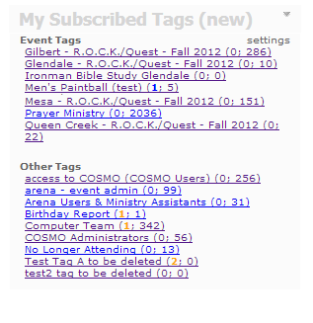

Slide 6
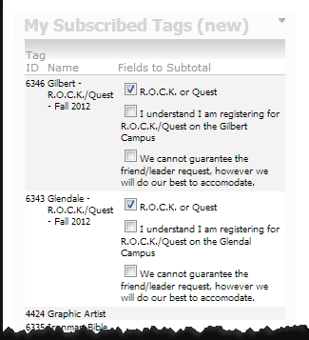


Slide 7
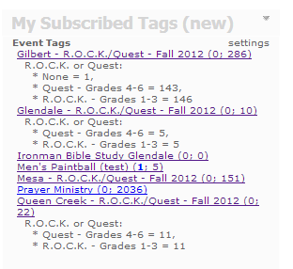

Slide 8
Up Team Book
Derek Mangrum’s

Slide 9
Member Portal
http://www.centralaz.com/Arena/default.aspx?page=5445

Slide 10
Profile Owner Changer
http://arena/Arena/default.aspx?page=5564

Slide 11
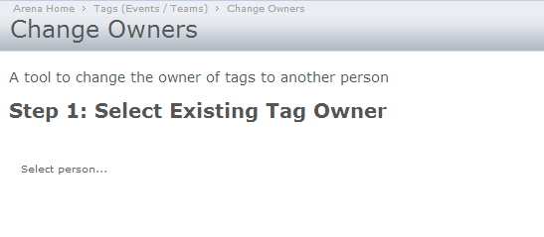
Step 1

Slide 12
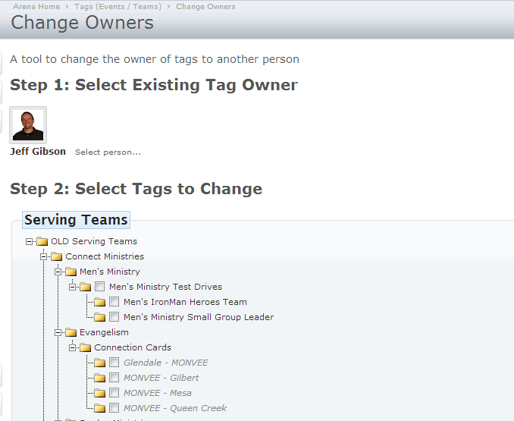
Step 2

Slide 13
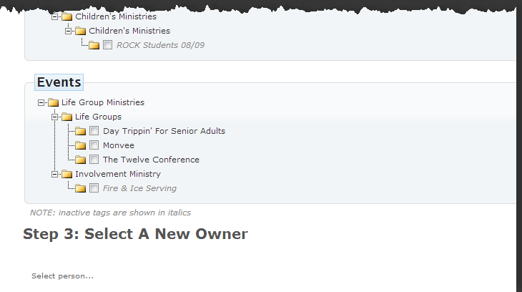
Step 3

Slide 14
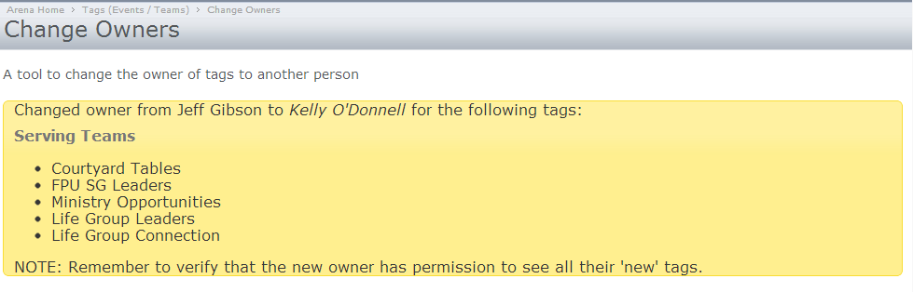
Finish

Slide 15
Simple Hit Counter
SimpleHitCounter.ascx http://redmine.refreshcache.com/projects/cccev-web-collection/repository/show/trunk/Arena/UserControls/Custom/Cccev/WebUtils

Slide 16
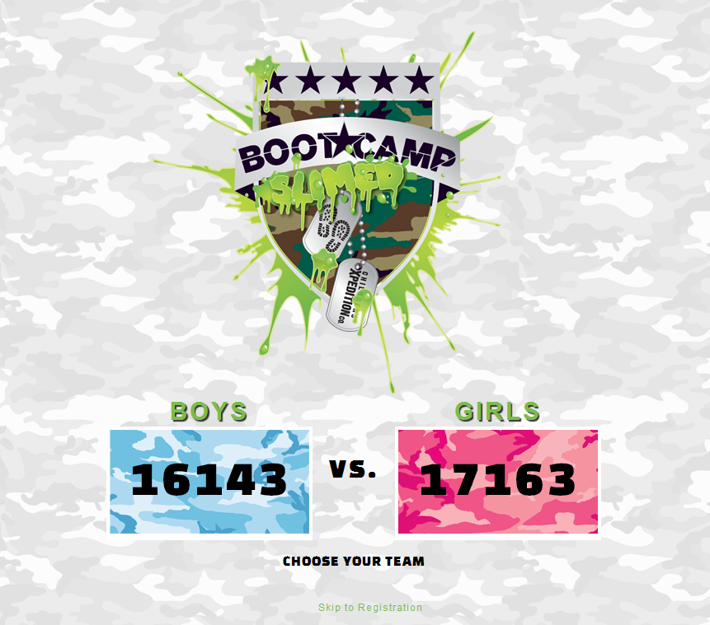

Slide 18
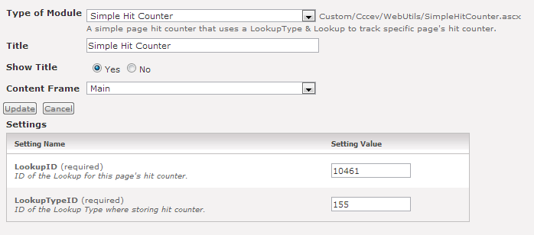
Boys Page Counter

Slide 19
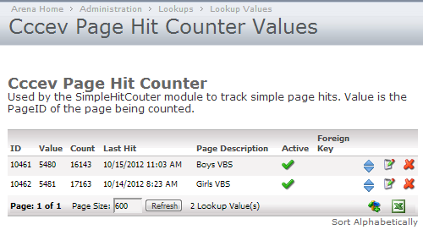
LookupType

Slide 21
Live Checkin Map
http://www.centralaz.com/Arena/default.aspx?page=5530

Slide 22
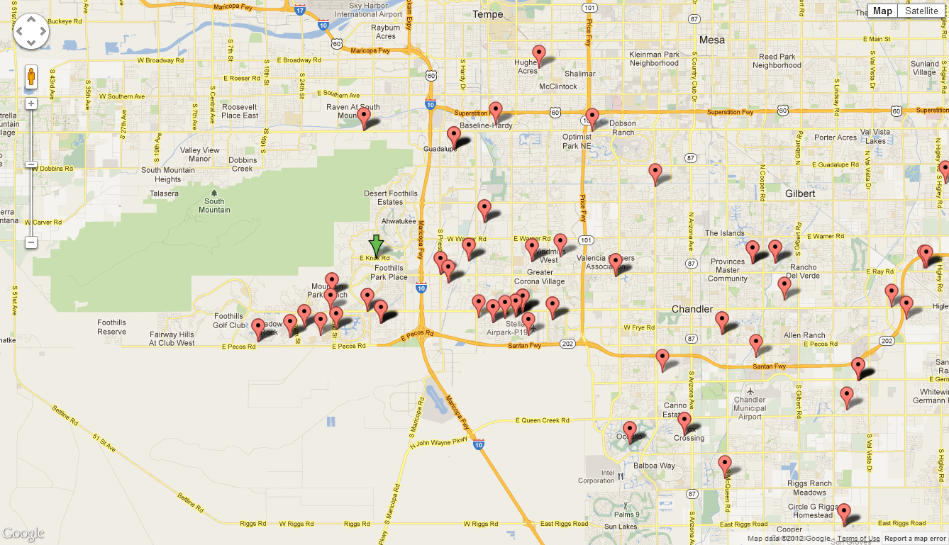
Live Check-in Map

