Slide 1

CI - Daily Builds
w/Jenkins – an Open Source Continuous Integration Server
Nick Airdo
Community Developer Advocate
Central Christian Church AZ (cccev)
Nick.Airdo@CentralAZ.com
@airdo

Slide 2
What are daily builds?
Automatic building of your software to ensure that all dependencies are present and your software compiles.
Smoke Test. When possible, runs your automated tests to ensure that they still “pass”.

Slide 3
Jenkins vs CruiseControl
Both are popular
I just happened to pick Jenkins (seemed to be a little more popular or easier)
“If you're only going to have a few builds I think Hudson is the clear winner. If you're going to have lots -- and don't mind the xml -- then I think CruiseControl's xml configuration tricks become a real strength.”
http://stackoverflow.com/questions/604385/what-is-the-difference-between-hudson-and-cruisecontrol-for-java-projects
Notes:
CruiseControl, CruiseControl.NET, CruiseControl.rb

Slide 4
Continuous Integration
Instead of running 1 or 2 daily, hooks into the source control system allow for continuous integration.

Slide 5
Why CI or Daily Builds?

Slide 6

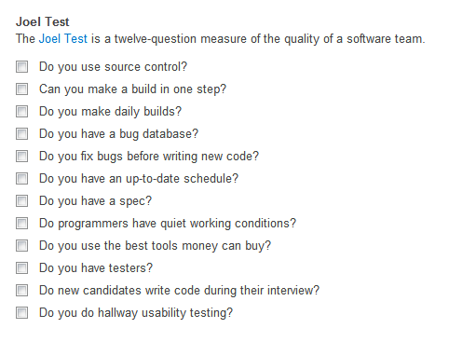
It’s #3 on the Joel Test
From http://careers.stackoverflow.com/jobs/post

Slide 7

So?
Solves the “works on my machine” syndrome
Notes:
Basically a requirement when you’re working in a multi-person environment

Slide 8
The Bus Scenario
The build is automated 100% so that nothing is "documented" in one person's head.

Slide 9
Consistency
Everything should be done by the daily build script:
Fetching code
Compiling
Packaging
Publishing

Slide 10
Notification
It’s recommended to use the max warning level
To complain if the slightest thing is not perfect
Notify the team when the build is broken
The person who “breaks the build” then becomes the babysitter until someone else breaks the build.

Slide 11
When to Build?
If team in one time zone, around lunch
Else 1-2 hours before each team’s quitting time

Slide 12
What Is Jenkins?
Formerly called Hudson, it’s “an application that monitors execution of repeated jobs, such as building a software project”
Continuously builds and tests your software/package, as well as distribution of the build, among other things.
Notes:
* If you have tests written, your build script would run those tests.

Slide 13
Installs on Windows
Requires a Java JRE
Grab the native package http://jenkins-ci.org/
Installing Jenkins is the easy part…

Slide 14
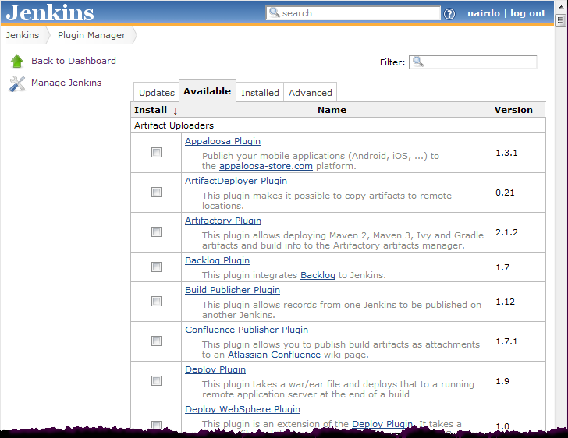
It’s All About the Plugins
This is the power of Jenkins
There are over 200 300+ plugins that lets it do just about anything you can think of

Slide 15
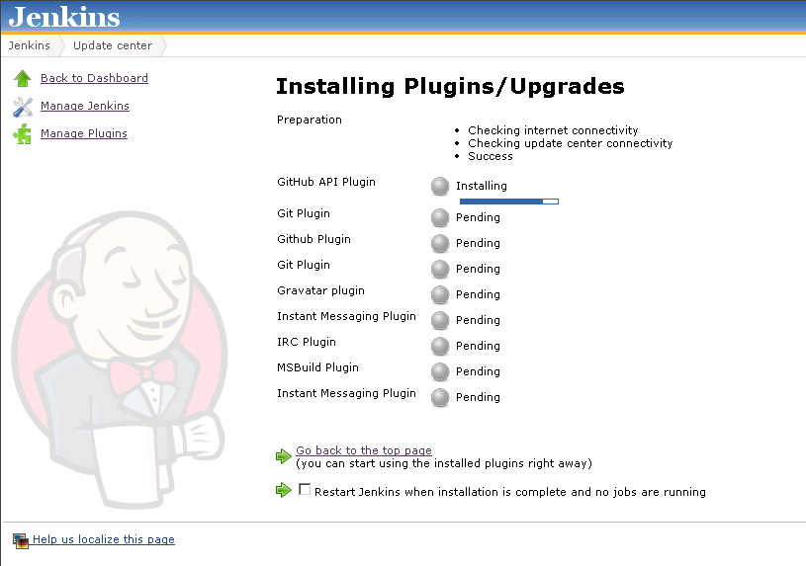
Install Some Plugins
Notes:
Recommend: MSBuild, Git, GitHub, Gravatar, and the Role-based Authorization Strategy

Slide 16
Uh….

Slide 17
…now the hard part
//or maybe the “messy” part

Slide 18
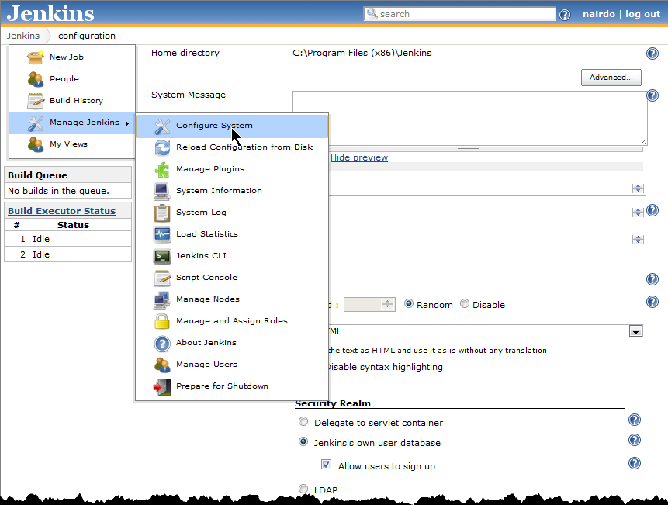
Configure Plugins
All plugins are seemingly configured under Configure System

Slide 19
Git.exe
Also needed Git.exe so I installed msysgit here
http://code.google.com/p/msysgit/downloads/list

Slide 20
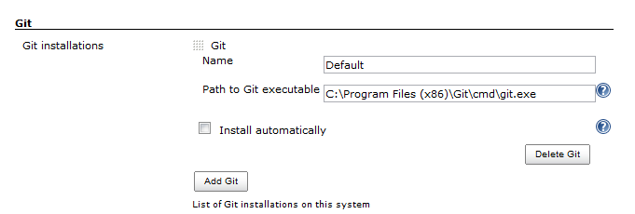
Oh SSHhhhh
Want to fetch your code from a Git repo?
Need to do some SSH setup
http://computercamp.cdwilson.us/jenkins-git-clone-via-ssh-on-windows-7-x64
** my path was different than the one in the blog and I’m using git.exe NOT git.cmd

Slide 21
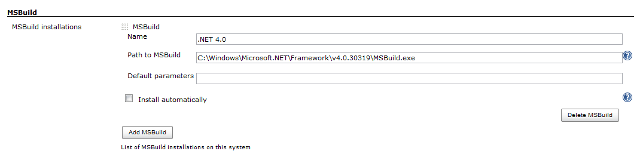
MSBuild

Slide 22
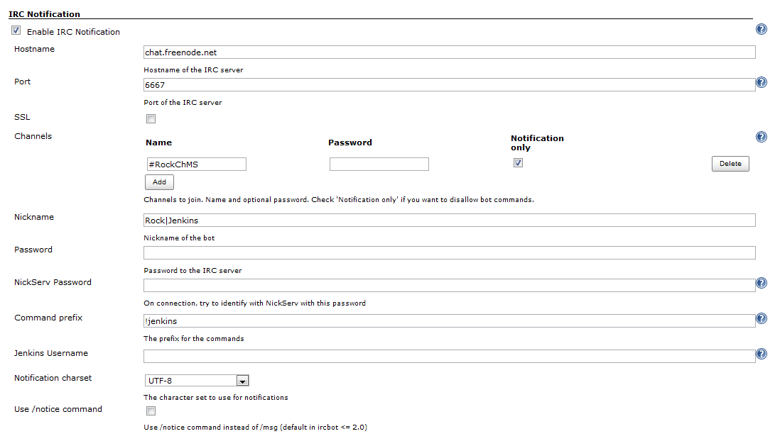
IRC Notification

Slide 23
Ok, now we’re ready…

Slide 24
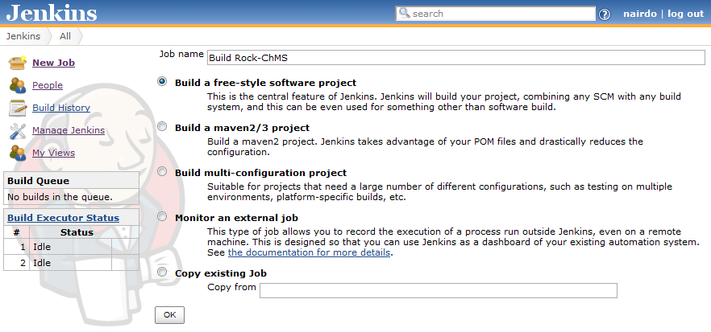
New Job

Slide 25
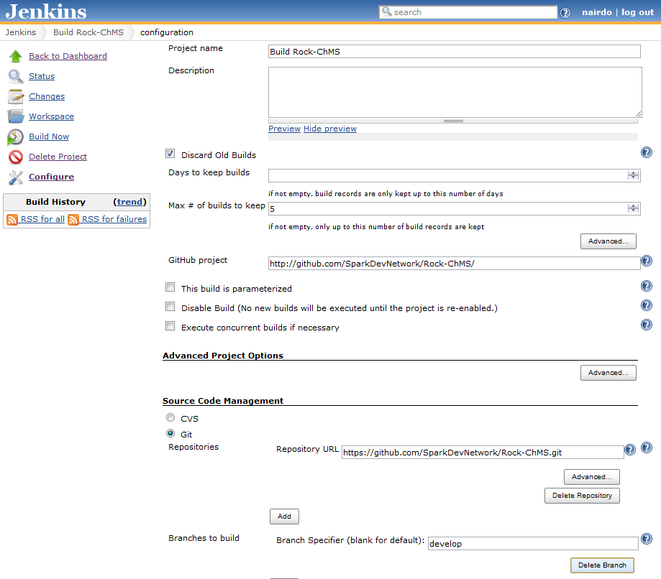

Slide 26
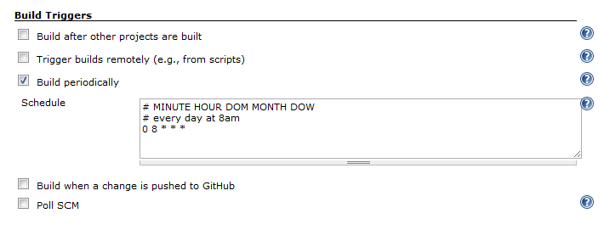
Schedule Builds

Slide 27
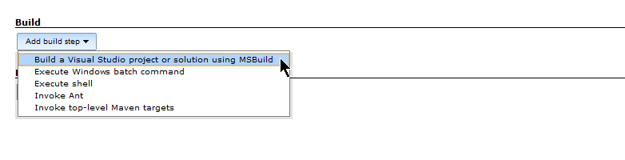
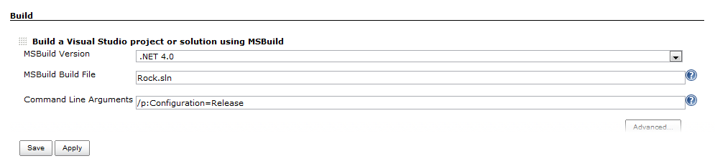
Add build step

Slide 28
Later, at 8am…

Slide 29
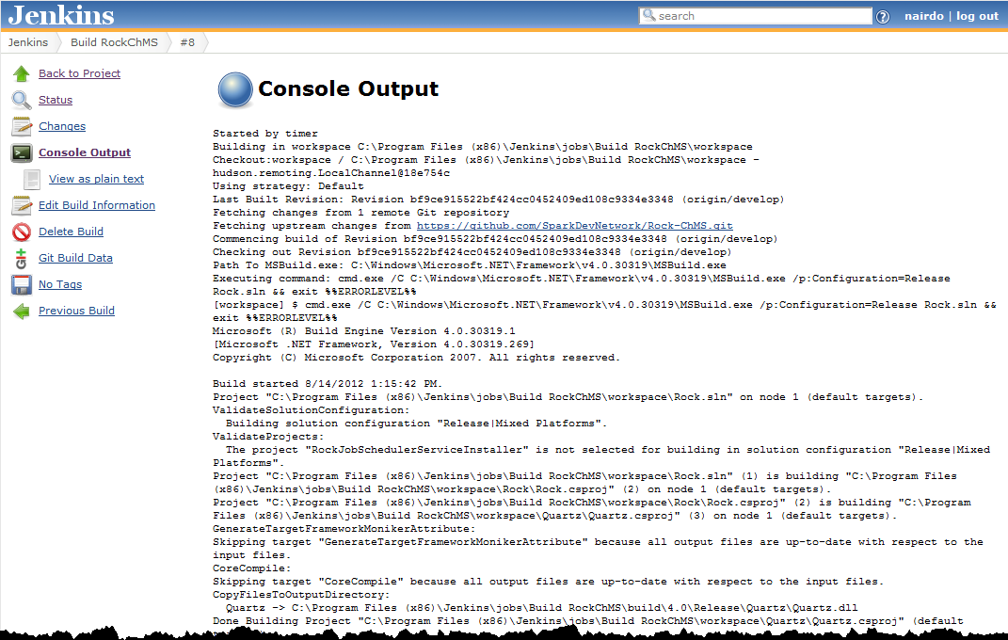

Slide 30
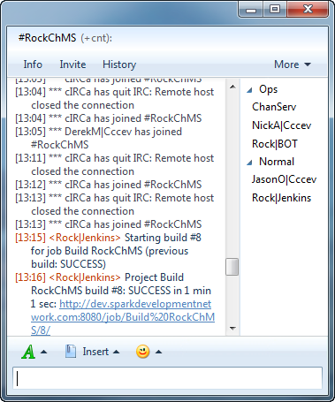
Also via IRC

Slide 31
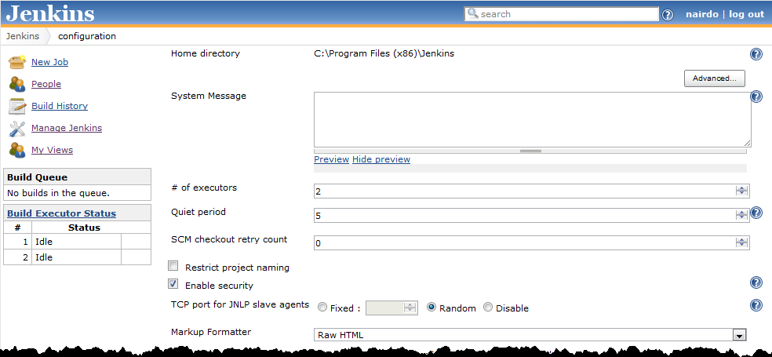
Security?
Seemingly none without a plugin
Check that

Slide 32
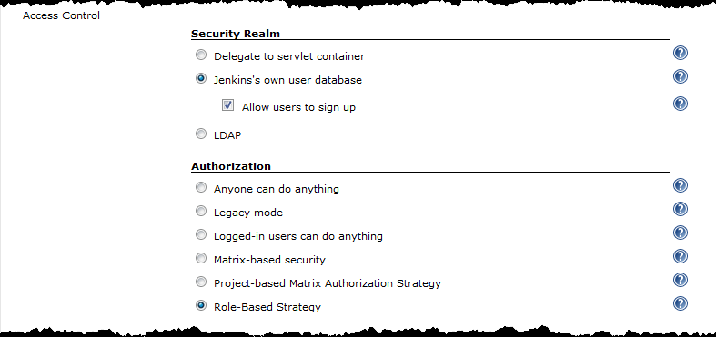
Authorization
And set these:

Slide 33
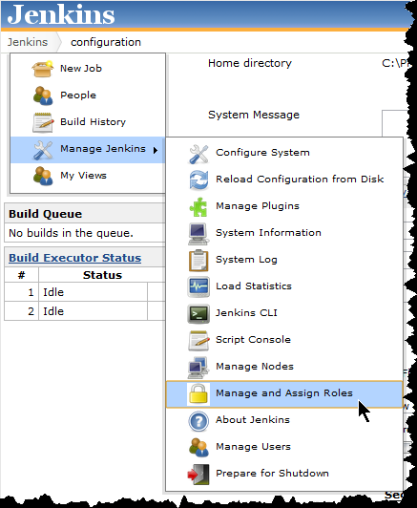
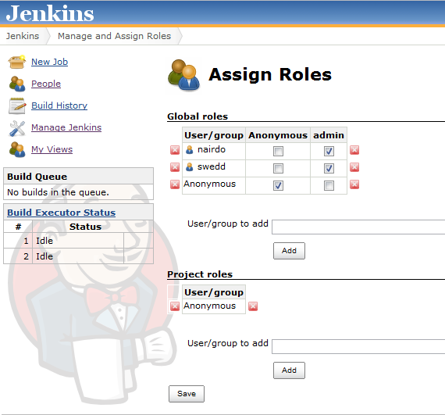
Roles & Users

Slide 34
Basic Usage / Levels
Level 1 – schedule daily builds
Notify people when build fails
Level 2- builds triggered by repo change
Level 3 – make it run your tests
Level 4 >= fetch, package, publish

Slide 35
References
http://blog.bobcravens.com/2010/03/getting-started-with-ci-using-hudson-for-your-net-projects/
http://game-linchpin.com/2012/04/installing-jenkins-as-continuous-integration-builder-on-windows.html
http://computercamp.cdwilson.us/jenkins-git-clone-via-ssh-on-windows-7-x64
https://wiki.jenkins-ci.org/display/JENKINS/Git+Plugin

Slide 36
References (cont)
http://www.joelonsoftware.com/articles/fog0000000023.html
http://www.joelonsoftware.com/articles/fog0000000043.html

