Slide 1
Github Backed Wikis
A few tips about Github’s wiki
Nick Airdo
Señior Developer
Central Christian Church AZ (Cccev)
Email: Nick.Airdo@CentralAZ.com
Twitter: @airdo

Slide 2
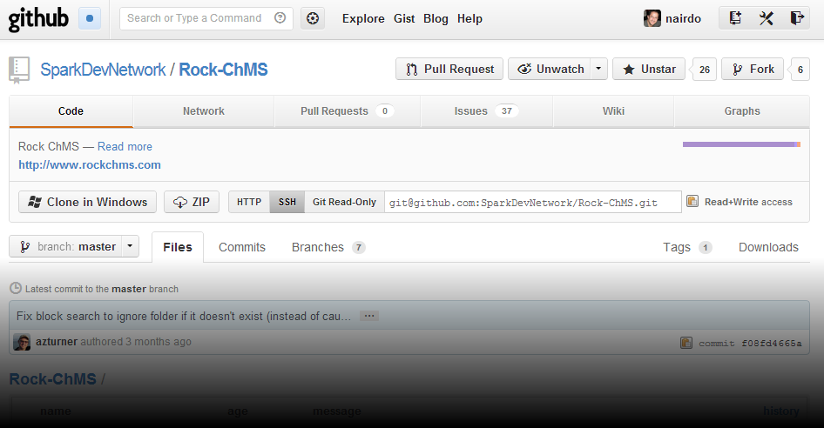

Slide 3
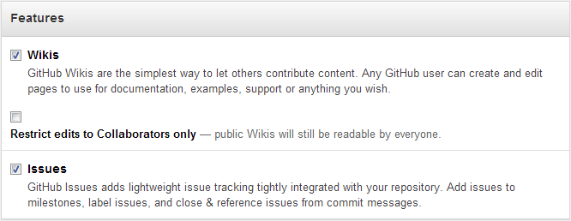
Open or Not Open
You decide…
Notes:
Setting is found under the Admin panel for your repo.

Slide 4
Built on Golumn
Gollum – A wiki built on top of Git
Supports
Sidebar files: _Sidebar.ext
Header files: _Header.ext
Footer files: _Footer.ext
HTML Sanitized ☹
Supposed to be a good thing, but means no custom CSS ☹

Slide 5
They’re just another Repo
Every Github project has a Wiki repo
git@github.com:<Org>/<Proj>.wiki.git
Example: git@github.com:SparkDevNetwork/Rock-ChMS.wiki.git
Each page is a file in a directory.
Each change is a commit.

Slide 6
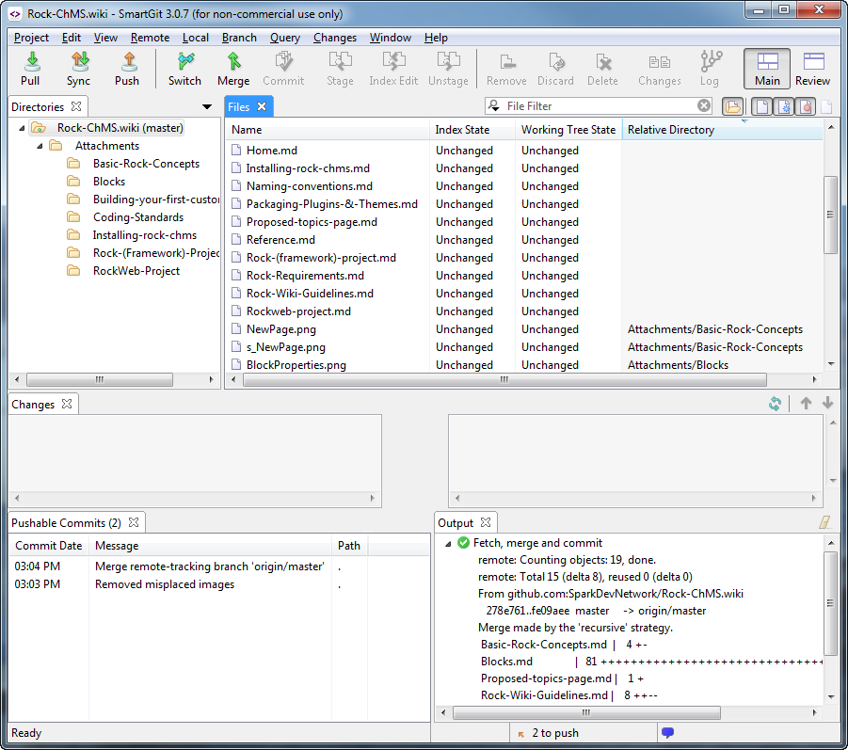

Slide 7
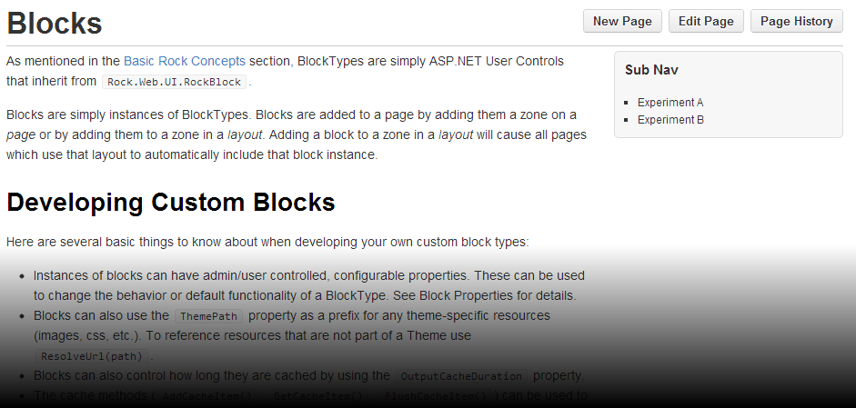
Page History

Slide 8
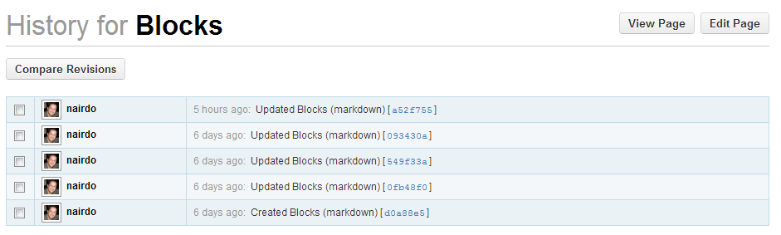
Compare!

Slide 9
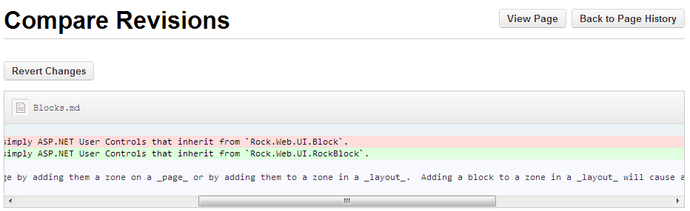
Nice

Slide 10
Markup … Markdown!
Actually, they support 8 markup flavors:
.markdown, .mdown, .md
.textile
.rdoc
.org
.creole
.mediawiki
.rst
.asciidoc
.pod

Slide 11
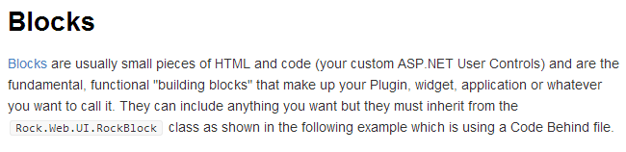
Huh?
# Blocks
[[Blocks]] are usually small pieces of HTML and code (your custom ASP.NET User Controls) and are the fundamental, functional "building blocks" that make up your Plugin, widget, application or whatever you want to call it. They can include anything you want but they must inherit from the `Rock.Web.UI.RockBlock` class as shown in the following example which is using a Code Behind file.
becomes…

Slide 12
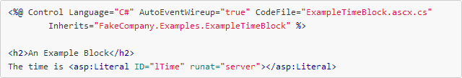
Trivial Syntax Highlighting
becomes…
```aspx-cs
<%@ Control Language="C#" AutoEventWireup="true" CodeFile="ExampleTimeBlock.ascx.cs"
Inherits="FakeCompany.Examples.ExampleTimeBlock" %>
<h2>An Example Block</h2>
The time is <asp:Literal ID="lTime" runat="server"></asp:Literal>
```
Notes:
Due to being integrated with the Pygments syntax highlighting engine.

Slide 13
Supported Lexers
It’s built-in via Pygments: http://pygments.org/
Supports more than 200 lexers
Xml, xslt, C#, css, php, ruby, etc.
List of “short names” are here: http://pygments.org/docs/lexers/
Notes:
You can almost just guess the “short name” and it will probably work.

Slide 14
Images?
We’re getting closer to easy - but not there yet.
Still, a little better for devs.
By convention, put them under an Attachments folder and under a topic folder

Slide 15
Refer to them like this:
[Attachments/Blocks/ BlockProperties.png]]

Slide 16
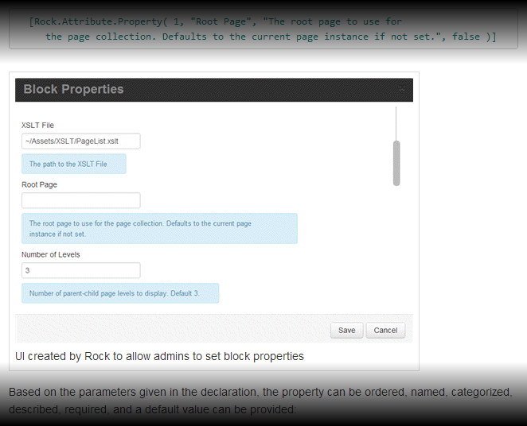
…Or get fancy
[[Attachments/Blocks/BlockProperties.png|frame|alt=UI created by Rock to allow admins to set block properties]]

Slide 17

Sequence Diagrams!

Slide 18
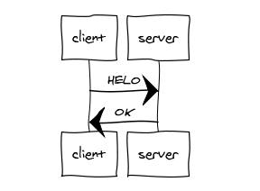
Ok, I’m a nerd
{{{napkin
client->server: HELO
server->client: OK
}}}
renders as…

Slide 19
But Seriously
It’s that kind of stuff that makes me think this Wiki is a winner in the long run.

Slide 20
References
https://github.com/blog/774-git-powered-wikis-improved
https://github.com/blog/699-making-github-more-open-git-backed-wikis
https://github.com/github/gollum
http://pygments.org/faq/
http://daringfireball.net/projects/markdown/basics

