Slide 1
Rock ChMS Dev Workshop 101
Setting up your dev environment
Nick Airdo
Señior Developer
Central Christian Church AZ (Cccev)
Email: Nick.Airdo@CentralAZ.com
Twitter: @airdo

Slide 2
From scratch
Setting up your dev environment…

Slide 3
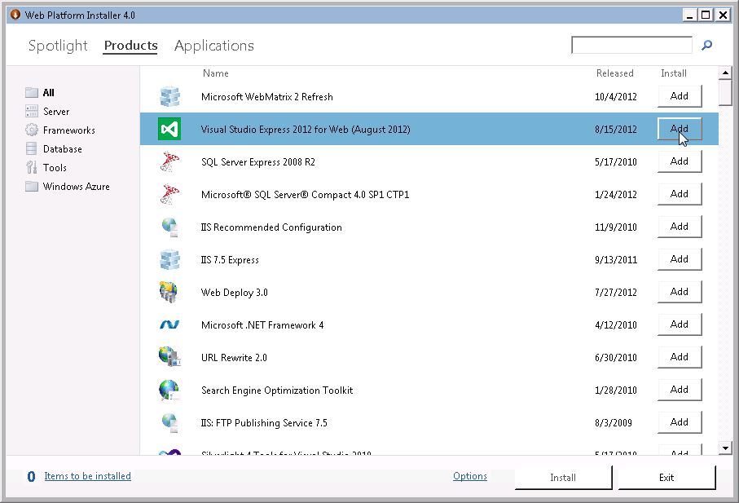
http://bit.ly/WebPI4
Use Web PI 4.0
Add “Visual Studio Express 2012 for Web”
Not “F# Tools for Visual Studio Express 2012 for Web”
It comes with SQL Express LocalDB Edition
Then, Install
You’ll get it all…but it will take a LONG time.
Notes:
When it installs SQL Server Express leave the default “Mixed Mode Authentication” and select a good SA password (don’t forget it).

Slide 4
Side Note: SQL Express 2012 LocalDB
Small installer. The 32-bit version has 28.2 MB and the 64-bit version has 33.7 .
Simplified Installation. It does do not require configuration or administration.
Run as a low privileged user.
Offers the same T-SQL language as SQL Server Express. It supports stored procedures, geometry and geography data types, triggers, views.
LocalDB uses the same sqlservr.exe as other editions of SQL Server and the same client-side providers.
LocalDB doesn't create any database services; LocalDB processes are started and stopped automatically when needed.
LocalDB connections support AttachDbFileName property, which allows developers to specify a database file location (if desired)
One LocalDB installation for all users on a computer.
Familiar to developers using SQL Server Compact.
It works with ASP.NET
It supports XML (XQuery, XPath) and BLOB.
It supports ADO .NET Sync Framework
It supports LINQ.
It supports distributed transactions.
Unlimited local connections.
From http://blogs.msdn.com/b/sqlexpress/archive/2011/07/12/introducing-localdb-a-better-sql-express.aspx and http://sqlcoffee.com/SQLServer2012_0004.htm

Slide 5
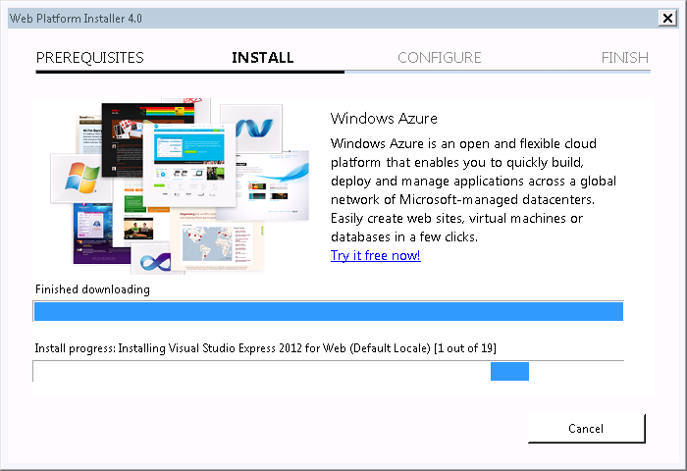
…waiting…

Slide 6
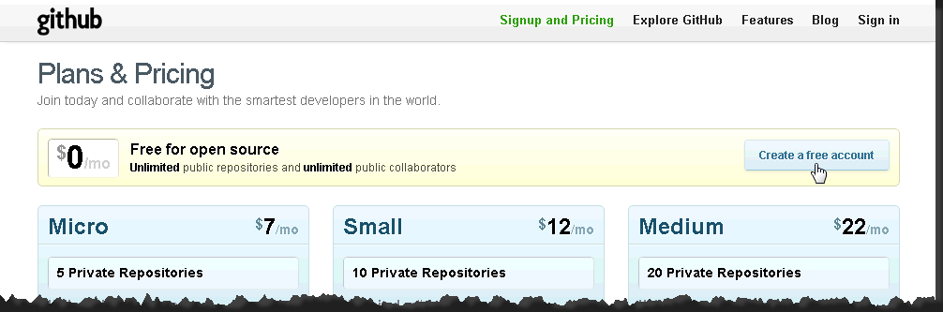
GitHub
Create a free GitHub account* if you don’t have one yet
You’ll use it in a little bit…
* Don’t forget your password.

Slide 7
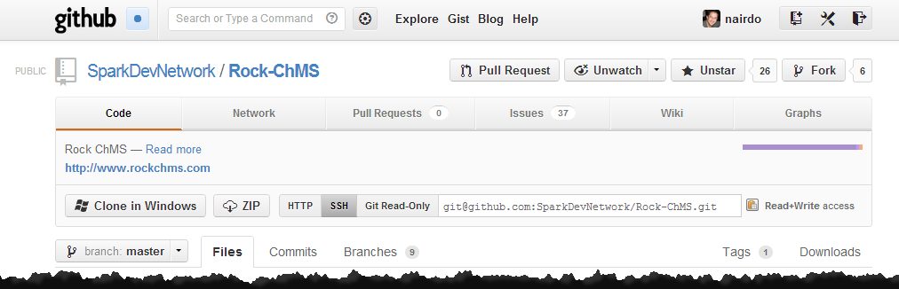
Go Fork Rock-ChMS
Seriously, it’s not as bad as it might sound
Go to https://github.com/SparkDevNetwork/Rock-ChMS
Click Fork

Slide 8
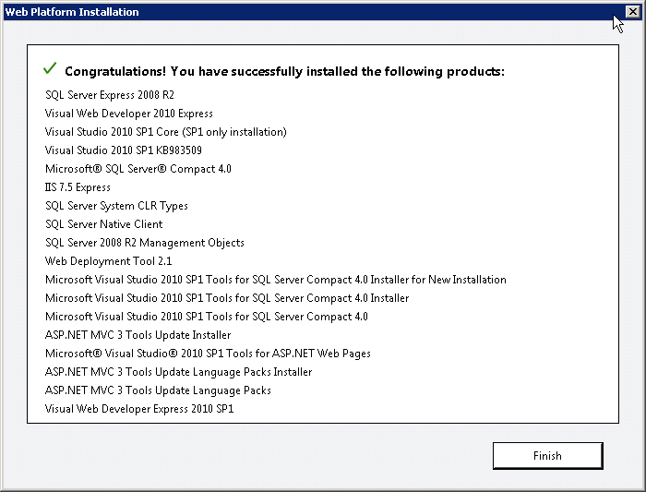
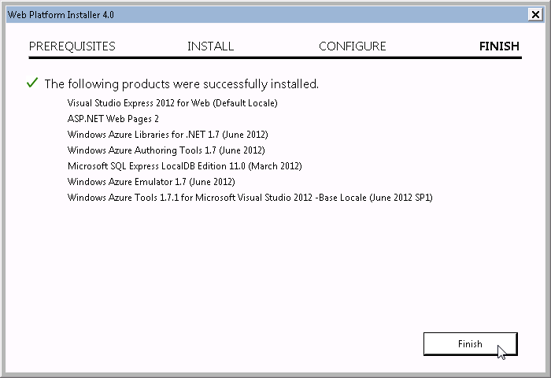
One click install!
Finish
Then Exit.

Slide 9
Installing Git Tools
Source control is your friend.

Slide 10
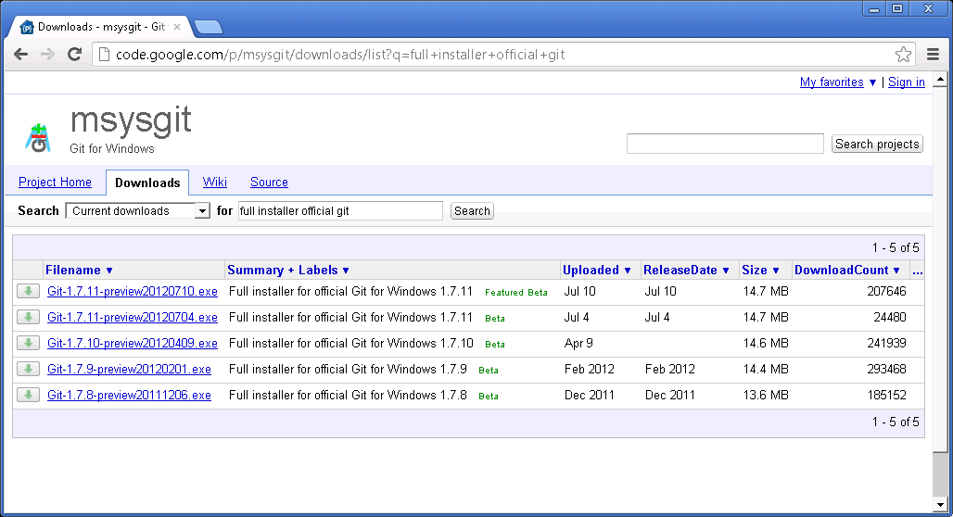
Download msysgit
http://bit.ly/DownloadMsysGit
Will be used by SmartGit

Slide 11
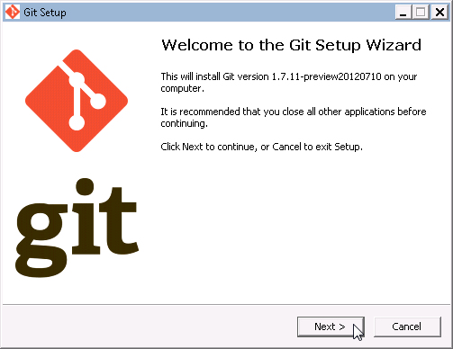
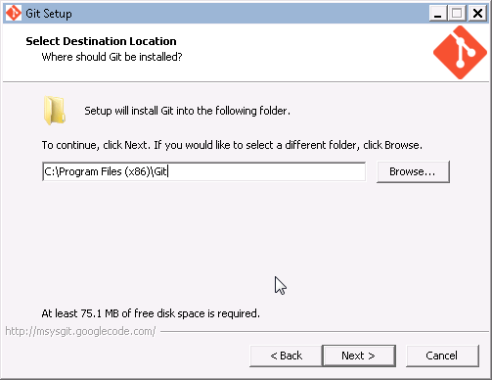
Install msysgit
Run the installer
Use the defaults

Slide 12

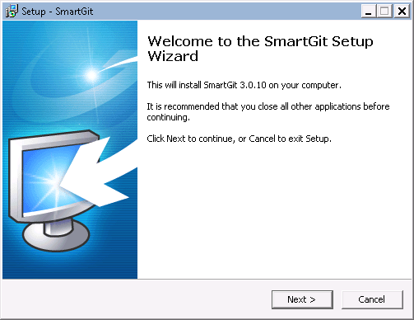
Download SmartGit
An easy-to-use, free* GUI for Git
* For non-commercial use license

Slide 13
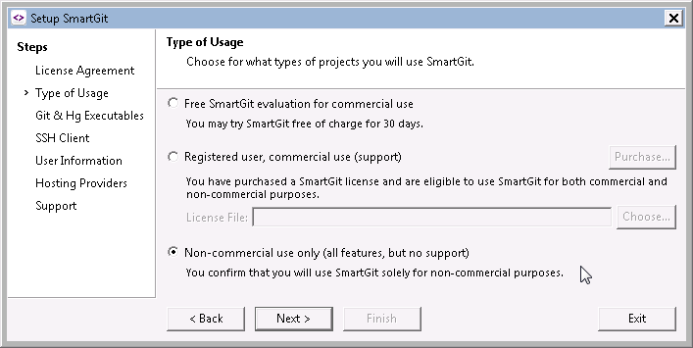
Setup SmartGit
License Agreement
Next
Type of Usage
Choose “Non-commercial use only”
Next

Slide 14
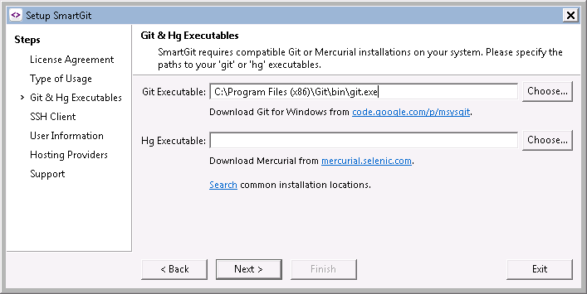
Git Executable
If you installed msysgit, it should pre-fill this line
Next

Slide 15
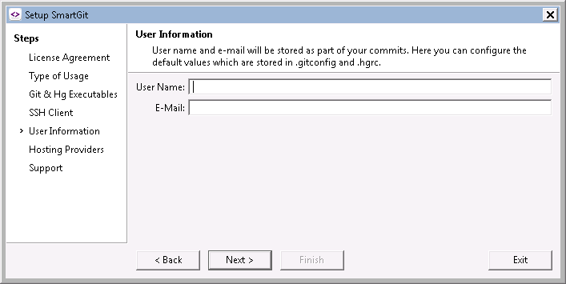
User Information
Recommend using your GitHub account information…
…but your real GitHub account goes on the next screen…

Slide 16
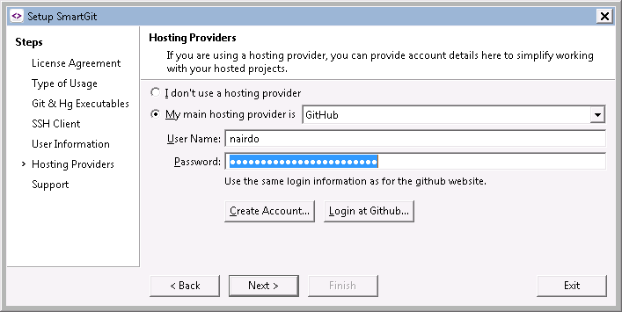
Hosting Provider
…right over there.

Slide 17
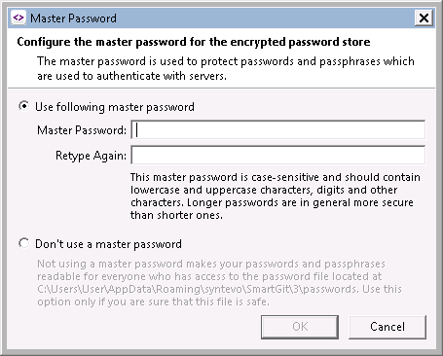
Master Password
Read
Do

Slide 18
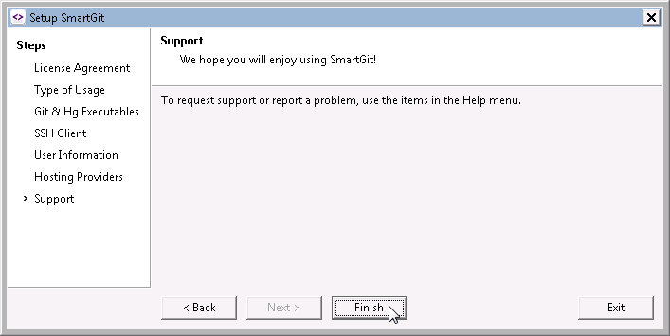
SmartGit Installed
Finish

Slide 19
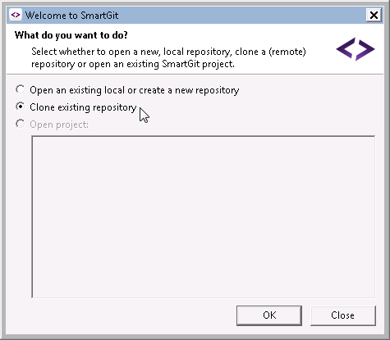
Cloning is not Illegal
You’re making a duplicate copy of your Forked Rock repository (origin) to your local system
Ok

Slide 20
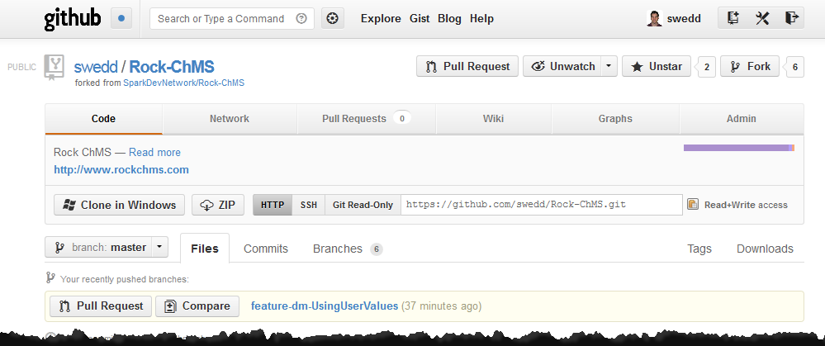
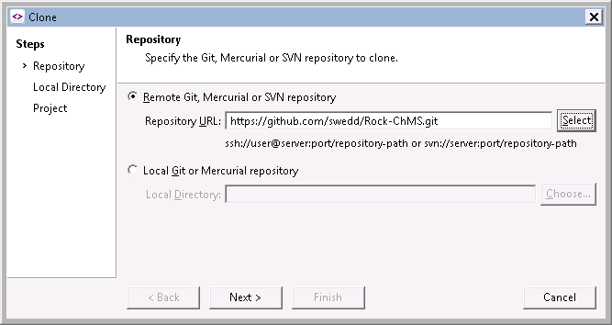
Your Rock-ChMS Git

Slide 21
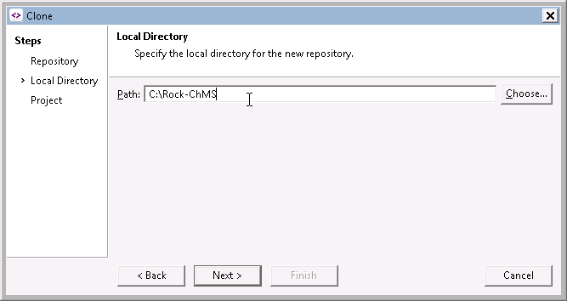
Local Directory
C:\Rock-ChMS
or whatever you prefer
Next, then Finish
Then wait while the data is pulled from the origin repo…

Slide 22
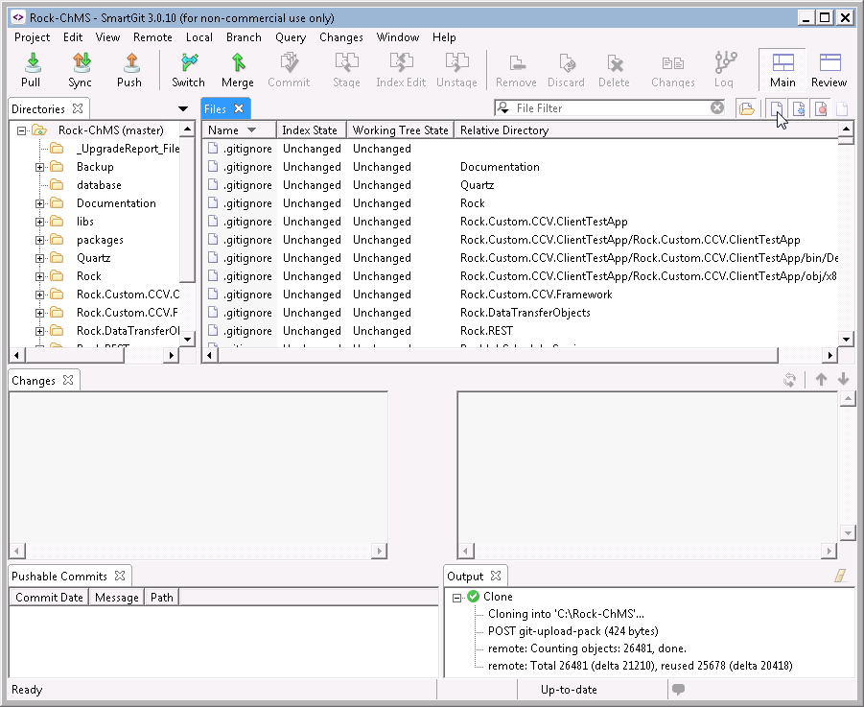
SmartGit Config
Recommend you unselect this one
If selected, unchanged files will be shown

Slide 23
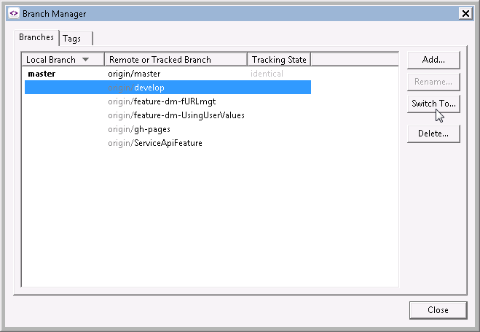
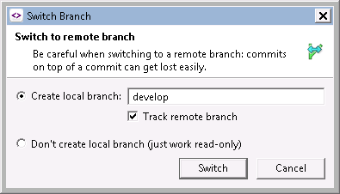
Change Branch
Following the gitflow* model, we’re developing in the “develop” branch
Branch->Branch Manager
Select origin/develop
Switch To…
* http://nvie.com/posts/a-successful-git-branching-model/

Slide 24
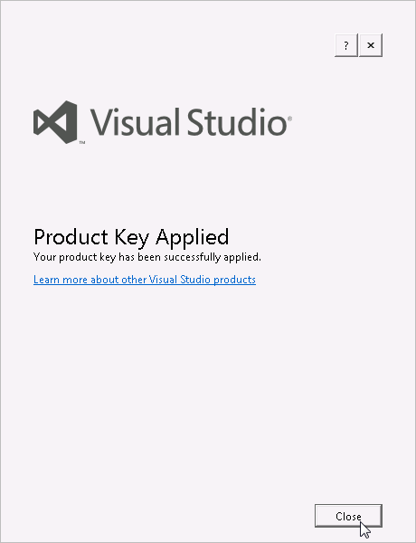
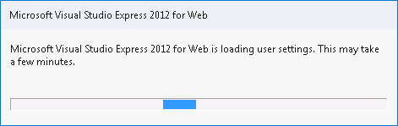
Almost There…
Open your C:\Rock-ChMS\Rock.sln
Go fetch a VS Product key ☹

Slide 25
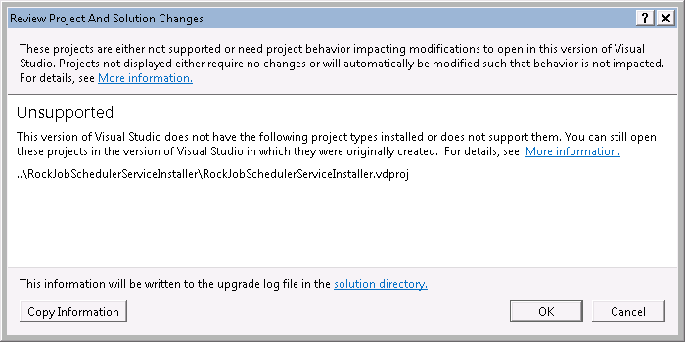
Don’t Worry*
If you see this… just press OK
* You won’t be monkeying with the Rock Scheduler Service anyhow.

Slide 26
Rock Development 101
Develop on a Rock foundation

Slide 27
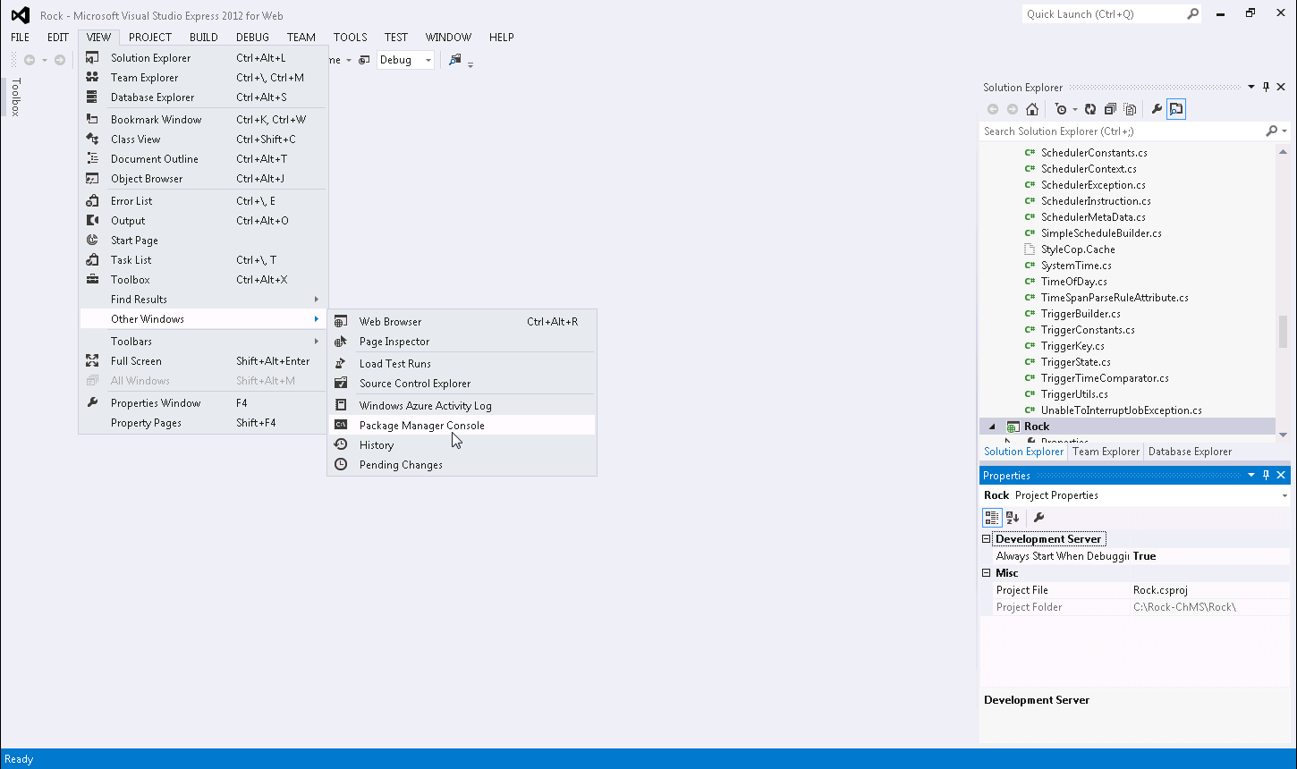
Turn on your Package Manager Console
Notes:
Open the Package Manager Console

Slide 28
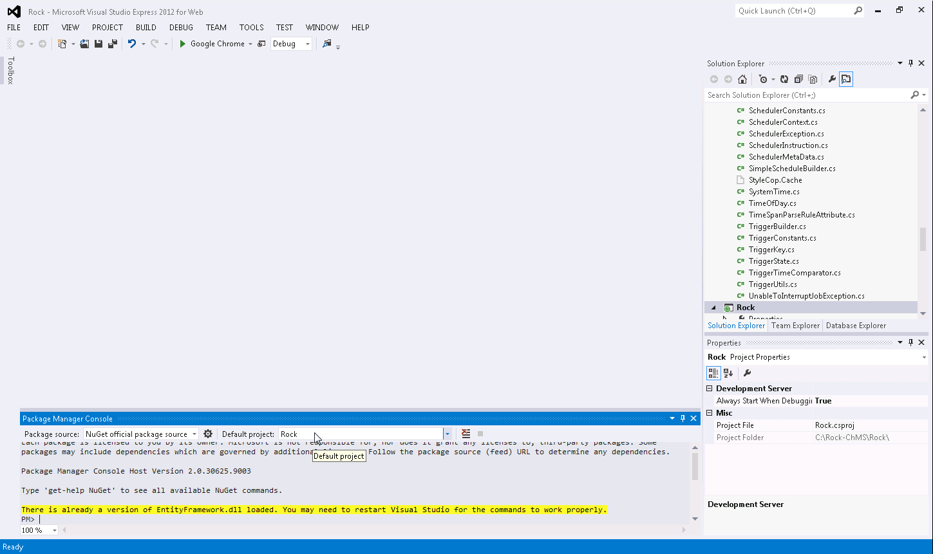
Make sure your Default project is “Rock”
Notes:
Make sure the Default project is set to “Rock”

Slide 29
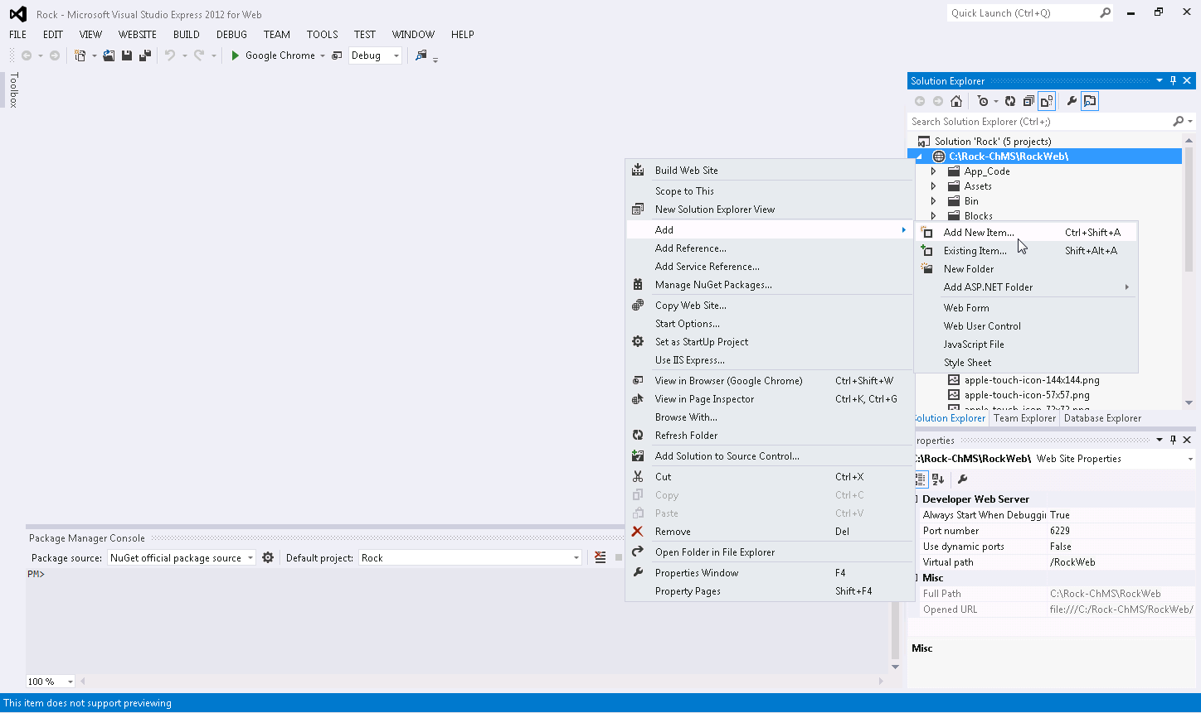
Add a web.connectionStrings.config
to your RockWeb project
Notes:
Add New Item under your RockWeb project

Slide 30
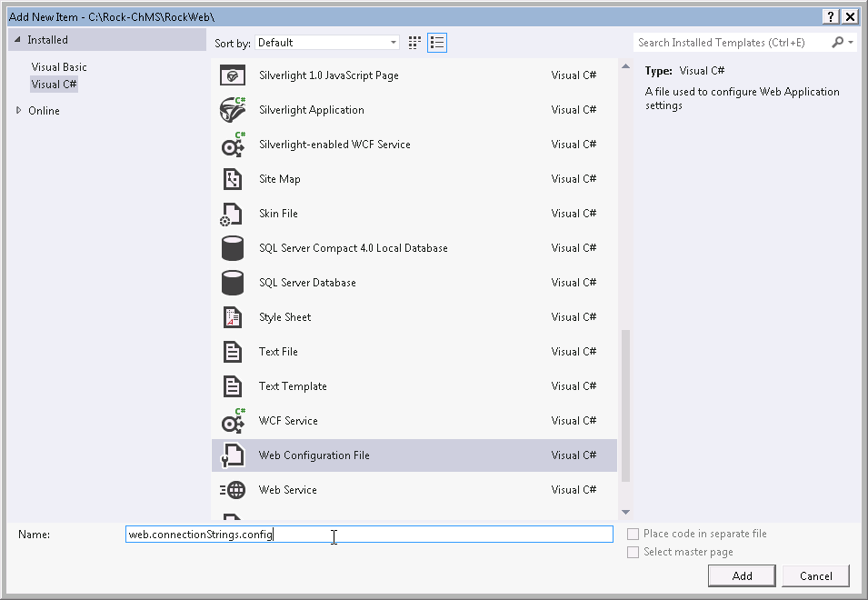
web.connectionStrings.config

Slide 31
The Password Is…
For SQL Express LocalDB put this into the web.connectionStrings.config
If using other SQL, then use:

Slide 32
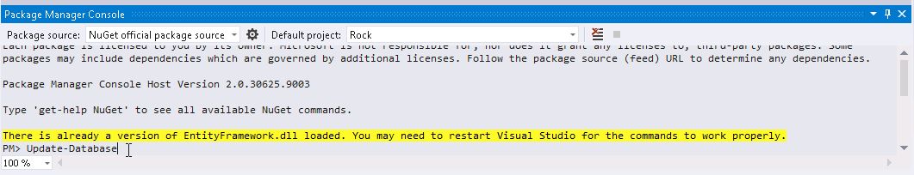
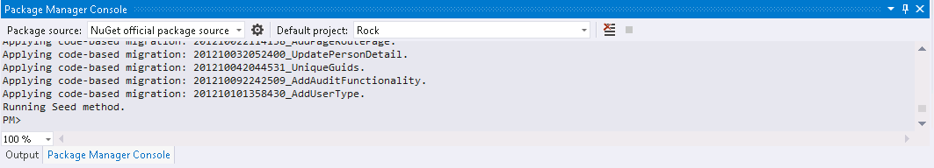
Update-Database
In the PMC, run “Update-Database”

Slide 33

F5

Slide 34

If…

Slide 35
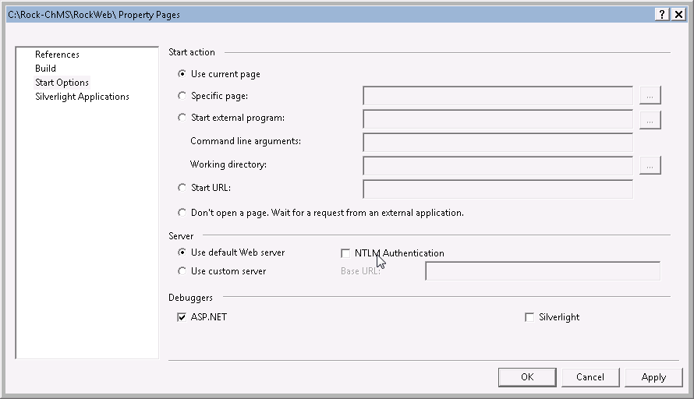
…Then
Uncheck this if you get authentication popup when you F5
Right-click RockWeb ->Property Pages

Slide 36
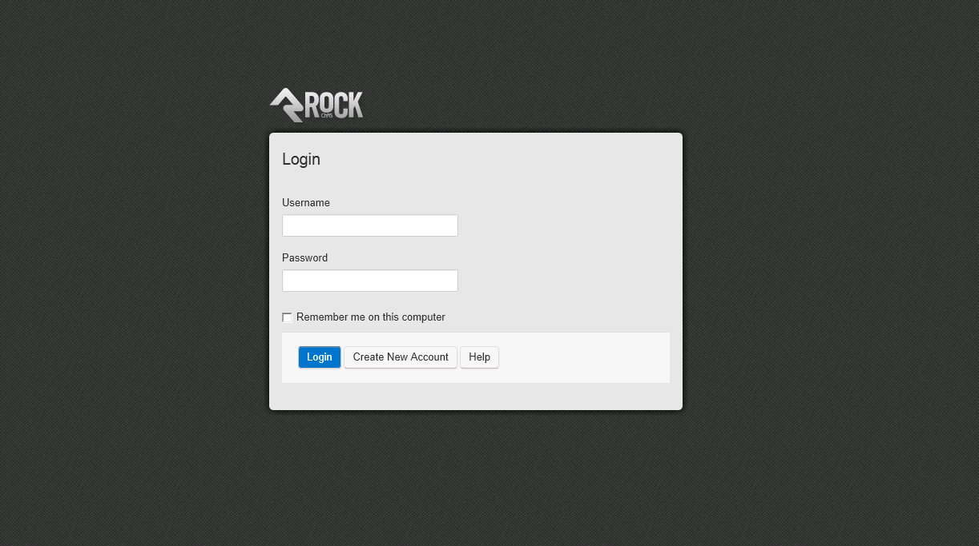
Success!

Slide 37
More? Go to the Wiki
Warning: We’re currently moving from gh-pages (Word/PDFs) to a GitHub-backed-Wiki
Warning: Rock has undergone frequent refactoring
Developer Starting Point
http://sparkdevnetwork.github.com/Rock-ChMS
Rock Wiki
https://github.com/SparkDevNetwork/Rock-ChMS/wiki

Slide 38
Git Basics
A few things to get you going:
Pull
Merge
Push
You’ll learn more about Git during an RC session this week
Pull Requests (in GitHub) – a way to submit your valuable, cool code to the core team

Slide 39
References
SQL Server 2012 Express LocalDB
http://msdn.microsoft.com/en-us/library/hh510202.aspx
Git Book http://git-scm.com/book
Rock-ChMS Developer Starting Point http://sparkdevnetwork.github.com/Rock-ChMS/

