Slide 1
One Database to Rule Them All
Chris Kehayias
Calvary Chapel Melbourne

Slide 2
History
2 years we deployed MinistryPlatform
4 “other” databases were decommissioned within 4 months
The beginning of a dream

Slide 3

Challenges to ONE Database
My Precious

Slide 4
ONE Database
Not ONE application
Keep the data in ONE location
Get our Congregation to ONE Username / Password
Goal of ONE reporting context on people

Slide 5

Journey Not Event

Slide 6
Vision / Inspiration
Vision: something seen in a dream or trance a supernatural appearance that conveys a revelation
Inspiration: the quality or state of being inspired
Information versus Insight

Slide 7
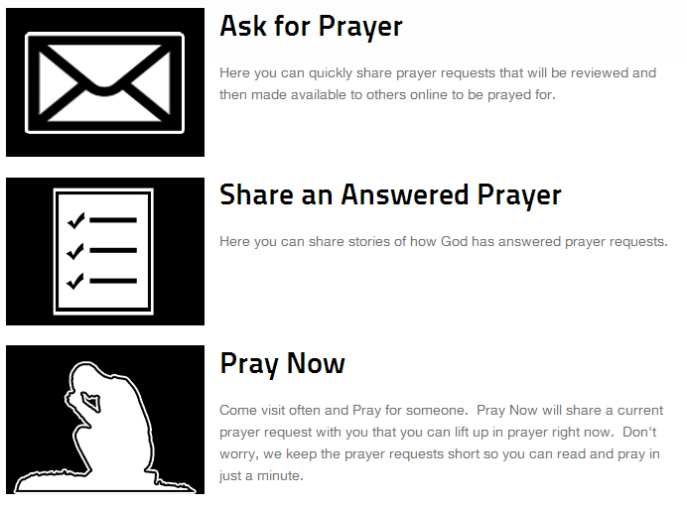
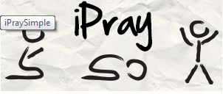
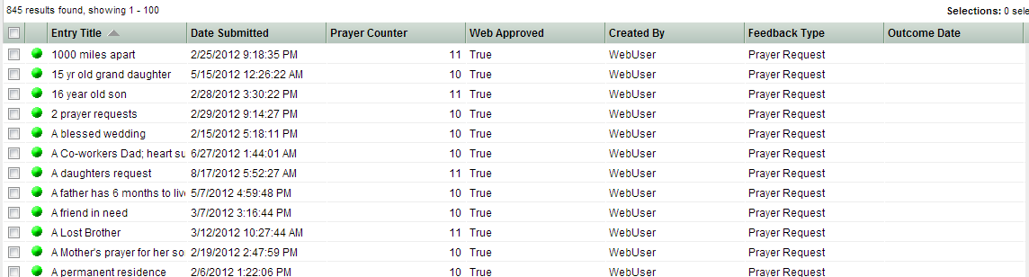
iPray

Slide 8
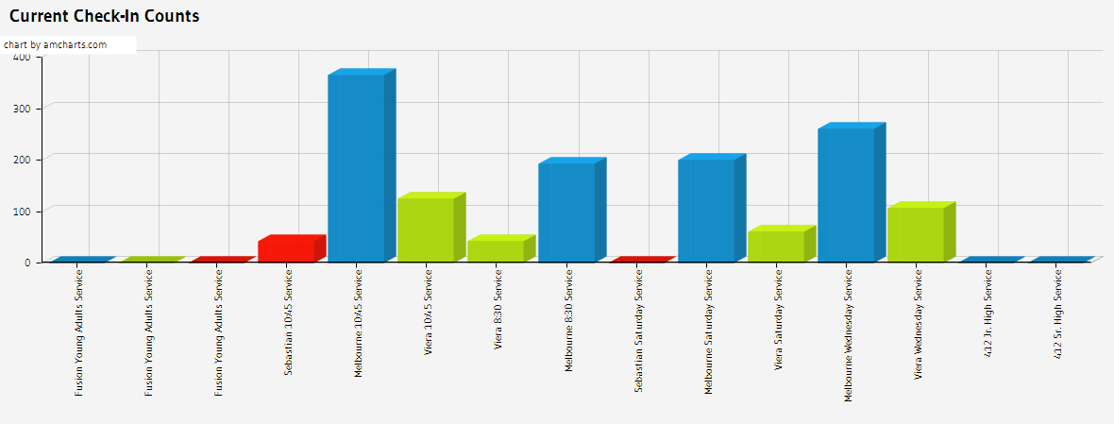
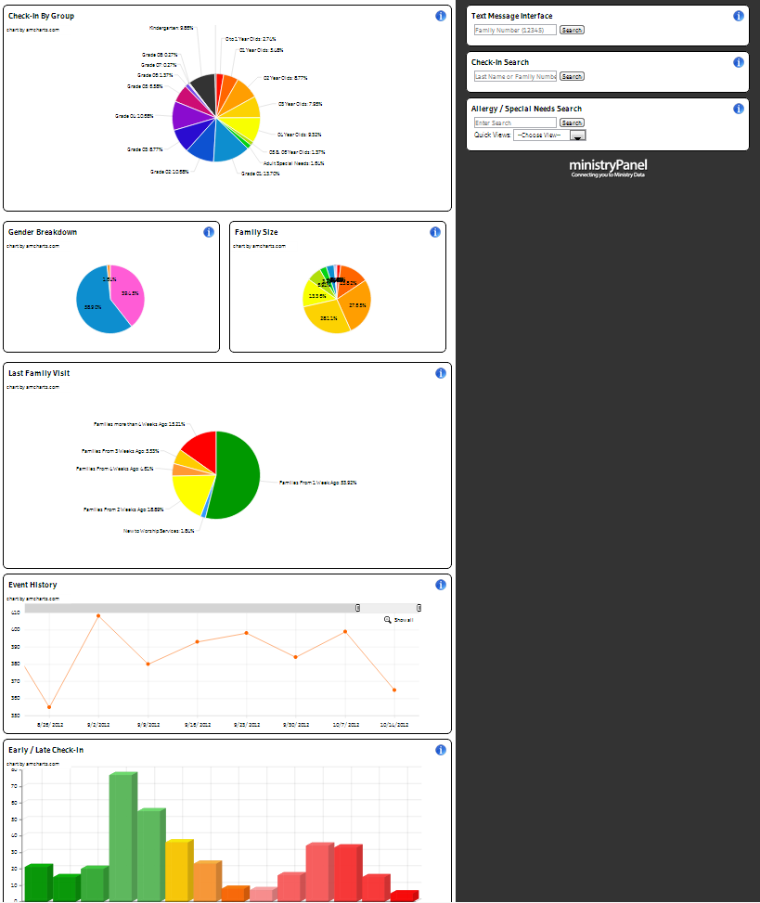
ministryPanel

Slide 9
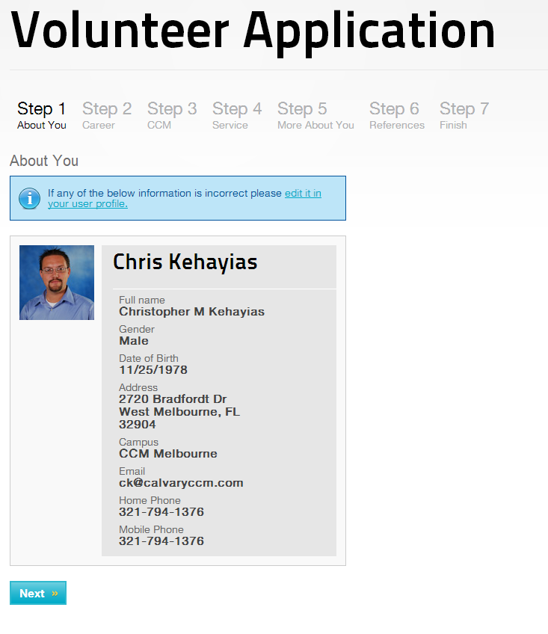
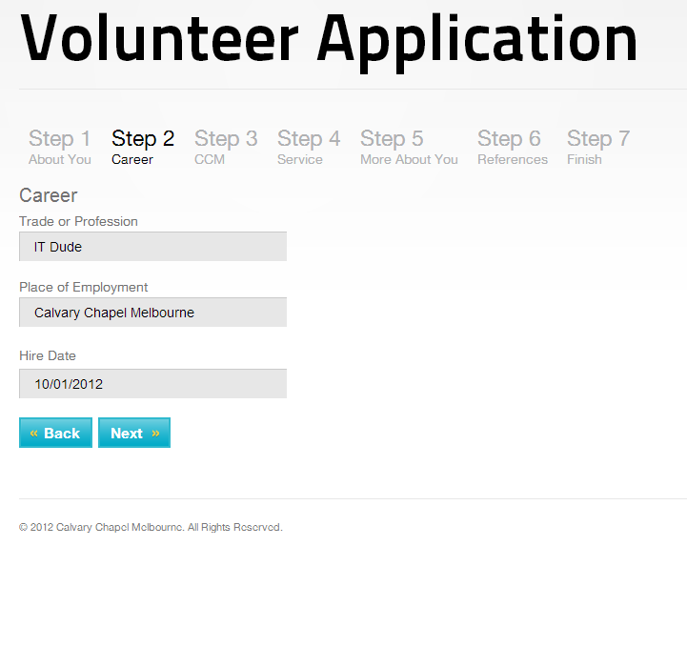
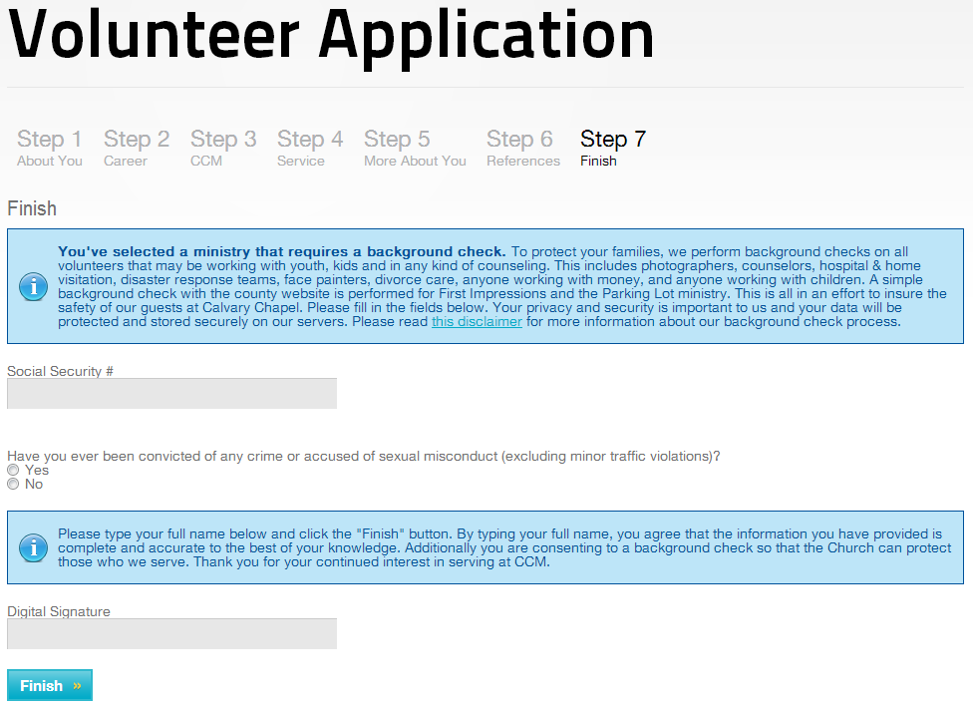
Volunteer Application

Slide 10
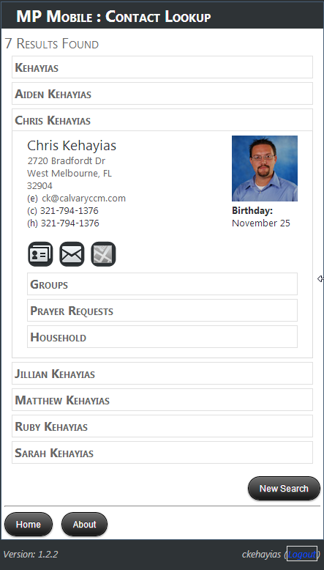
MPMobile
Community / Free
Mobile Access

Slide 11






