Slide 1
State of the Union
Oct 2011 – Oct 2012
Nick Airdo
Señior Developer
Central Christian Church AZ (Cccev)
Email: Nick.Airdo@CentralAZ.com
Twitter: @airdo

Slide 2
Where Were We?
Some modules on Arena Community Server
80 shared modules
108 shared reports
Redmine.RefreshCache.com
32+ projects (modules)
A cumbersome module market/store
IRC channel with decent participation

Slide 3

Where Are We Now?
Community Server
100 shared modules
132 shared reports
Redmine.RefreshCache.com
44+ projects (modules)
3-4 Partner ChMS Platforms
Several of which you can contribute directly to.

Slide 4
Where Are We?
Open source sw & project mgmt tool (Redmine)
Github usage
But still no manageable marketplace/store

Slide 5
Where Are We?
Greater participation in IRC #ArenaChMS channel
RC conference initially contracted after the-Great-ChMS-Shakeup-of-2011™ but then back up to about 40

Slide 6

















Good Participation

Slide 7
Where Are We Going?
RC 2010
A few of us are looking at some open source CMS as a possible future ChMS foundation
If we go down that path we would initially begin spending our personal time working on the initiative
And later, possibly our normal work hours (pending approval of leadership, etc.)

Slide 8
Where Are We Going?
RC 2011
Announced the Spark Development Network & our intentions to start building Rock ChMS

Slide 9
Three Four ChMS
We’re not just for a single #ChMS vendor anymore!

Slide 10


New RC Partner

Slide 11


Open Source ChMS Options
http://bvcms.codeplex.com/
http://github.com/SparkDevNetwork/Rock-ChMS

Slide 12
Quote
“The idea of open source is all about community. Doesn’t the church represent what community should be all about? Who better than the church to embrace open source?”
- David Carroll

Slide 13
Where Are We Going?
CITRT / Church IT Network?
ICCM?
* These quotes are from last year’s RefreshCache

Slide 14
Where Are We Going?
Simple, easy to use plugin/package distribution system
Discussion?

Slide 15
Future RC Invites
What other ChMS or “Tool” communities should we invite to RC?
Criteria
Must be active
Must be awesome (or at least not mediocre)
I prefer free or open source solutions, but am open minded.
Possibilities:
OneBody (Ruby on Rails)
Sheepology (Django, DOA?)
Fellowship One
PCO

Slide 16
Where are others going?
Thou shall not judge…

Slide 17
DotNetNuke v6
Released 8/29/2011
501,016 downloads
As of today: ???

Slide 18
Umbraco CMS v4.7
Released 9/26/2011
311,226 downloads
As of today: ???

Slide 19
Orchard CMS v0.1 - 1.5

Slide 20
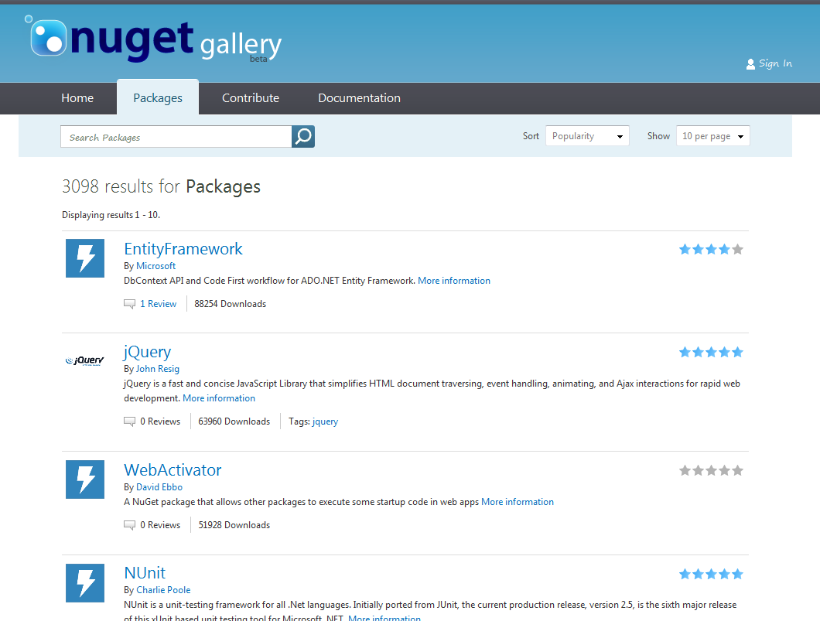
NuGet Gallery - Oct 2011

Slide 21
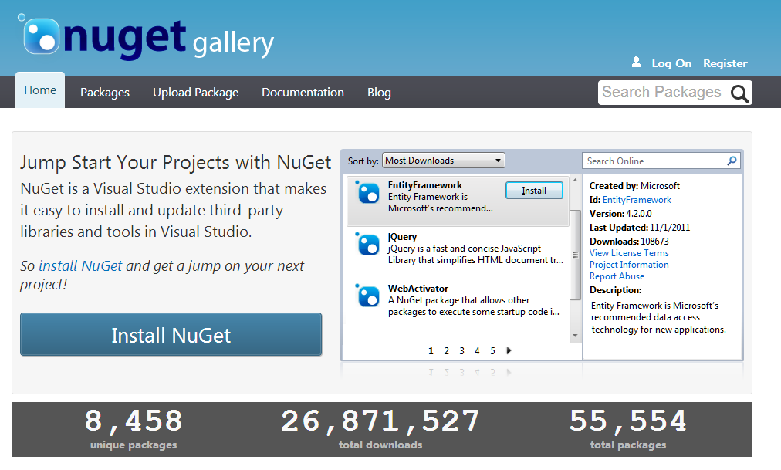
NuGet Gallery – Oct 2012

Slide 22
jQuery via NuGet
jQuery downloaded 930,079 times

Slide 23
Ok, what about us

Slide 24
But…
The RefreshCache group will continue to use/support all three four ChMS systems.
Notes:
The less important parts are still pretty important if you’re driving your website
I’m tired of using DNN and Wordpress as my open source *web application framework*
PHP is OK, but I really love .NET

Slide 25
Where Are We Going?
Wherever you decide we’re going?
fin
Notes:
Doug Drinka, CCV, ShadeTree, SoChurch?

