Slide 1
Web Stuff Making It Work
Jason Ake
Marketing Director
Central Christian Church AZ (Cccev)
Email: Jason.Ake@CentralAZ.com

Slide 2
Don’t Ask the Vendor

Slide 3
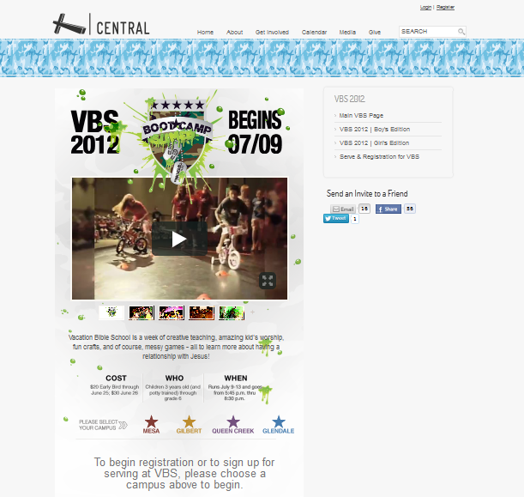
Back to the Basics
iframeing
Simple jquery sliders
Allows for simple ministry pages without a lot of development time
Notes:
When it installs SQL Server Express leave the default “Mixed Mode Authentication” and select a good SA password (don’t forget it).

Slide 4
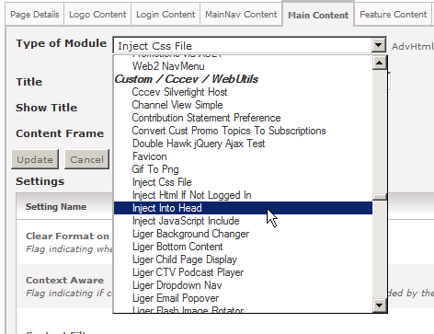
Page Modifying Modules
Basic web functions that allow a web admin to modify a single page without effecting the site
Notes:
When it installs SQL Server Express leave the default “Mixed Mode Authentication” and select a good SA password (don’t forget it).

Slide 5
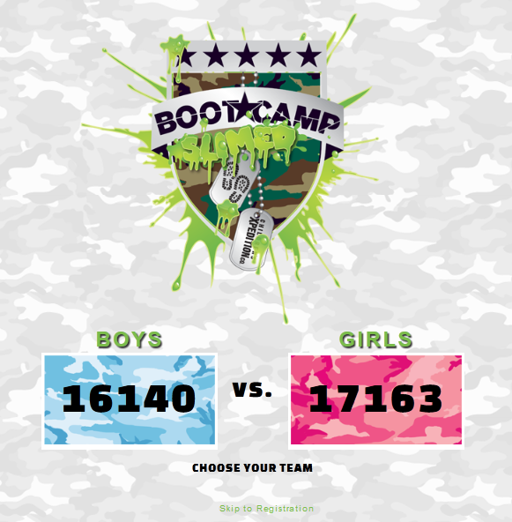
Don’t Be Afraid to Ask
Web Admin should Partner with Development Team
Notes:
When it installs SQL Server Express leave the default “Mixed Mode Authentication” and select a good SA password (don’t forget it).

Slide 6

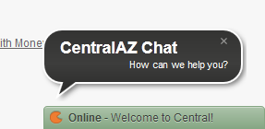
Don’t Be Afraid to Fail
Try New Things
Use Available Services
Notes:
When it installs SQL Server Express leave the default “Mixed Mode Authentication” and select a good SA password (don’t forget it).

Slide 7
Questions

